Slide 1

Budweiser Marketing Campaign
Team: Data Dynamos
July 1, 2020

Slide 2
Questions Asked
Provide Details on the Beer Market Data Set and any associated issues.
Describe the Beer Characteristics within the overall market.
Show Points of Interest within the Data.
Tell us about the Alcohol content between beers.
Tell us about the relationship between alcohol and bitterness.
What can we do with this data?

Slide 3

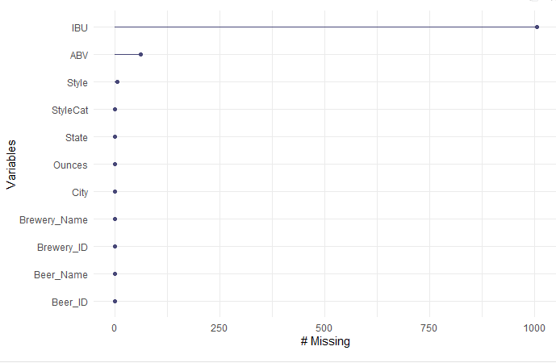
Data Facts
Eight Separate Fields
2,692 Distinct Beers
558 Distinct Breweries
99 Distinct Styles Listed
However, Not All Data Is Provided!
Missing Values For:
IBU: | 1,005
ABV: | 62
STYLE: | 5

Slide 4
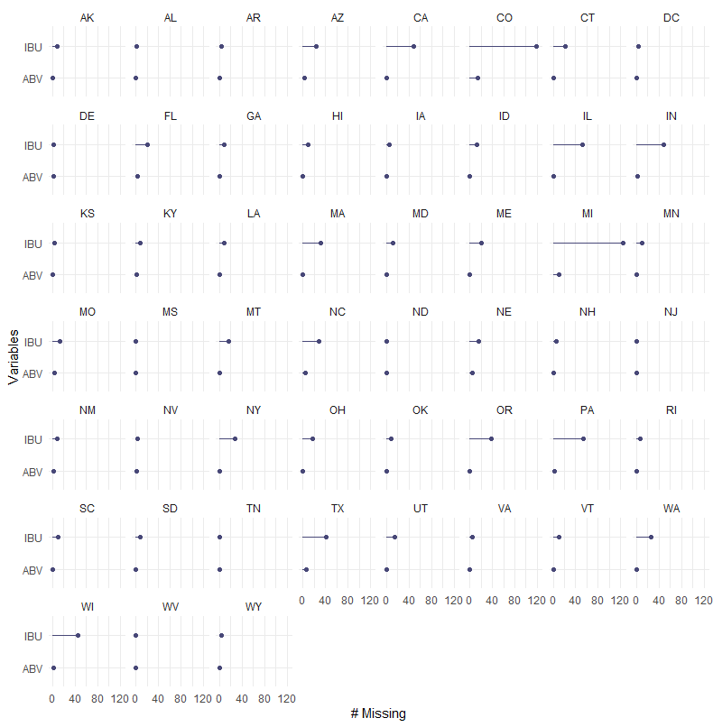
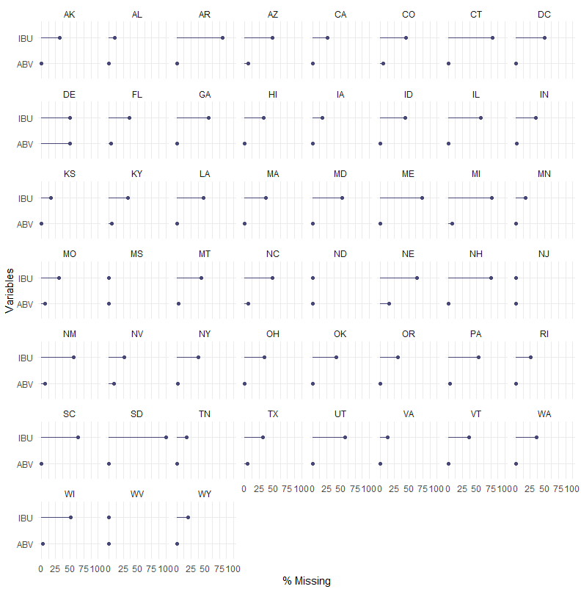
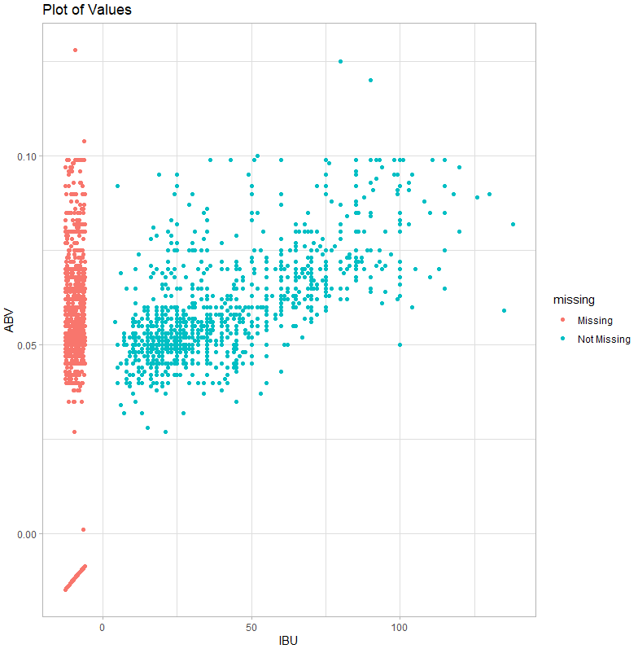
Focusing on the Values in IBU and ABV
First Chart shows missing values by state count and percent.
Second Chart shows distribution of the missing values.

Slide 5
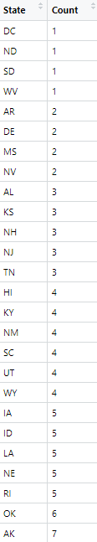
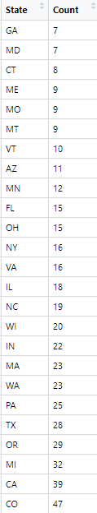
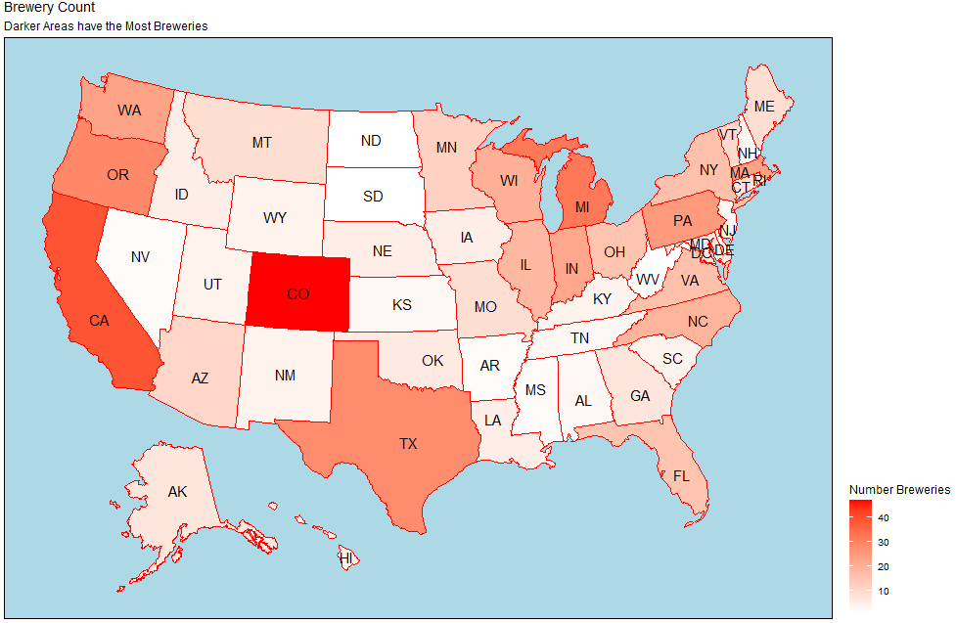
How Many Breweries Are In Each State?

Slide 6
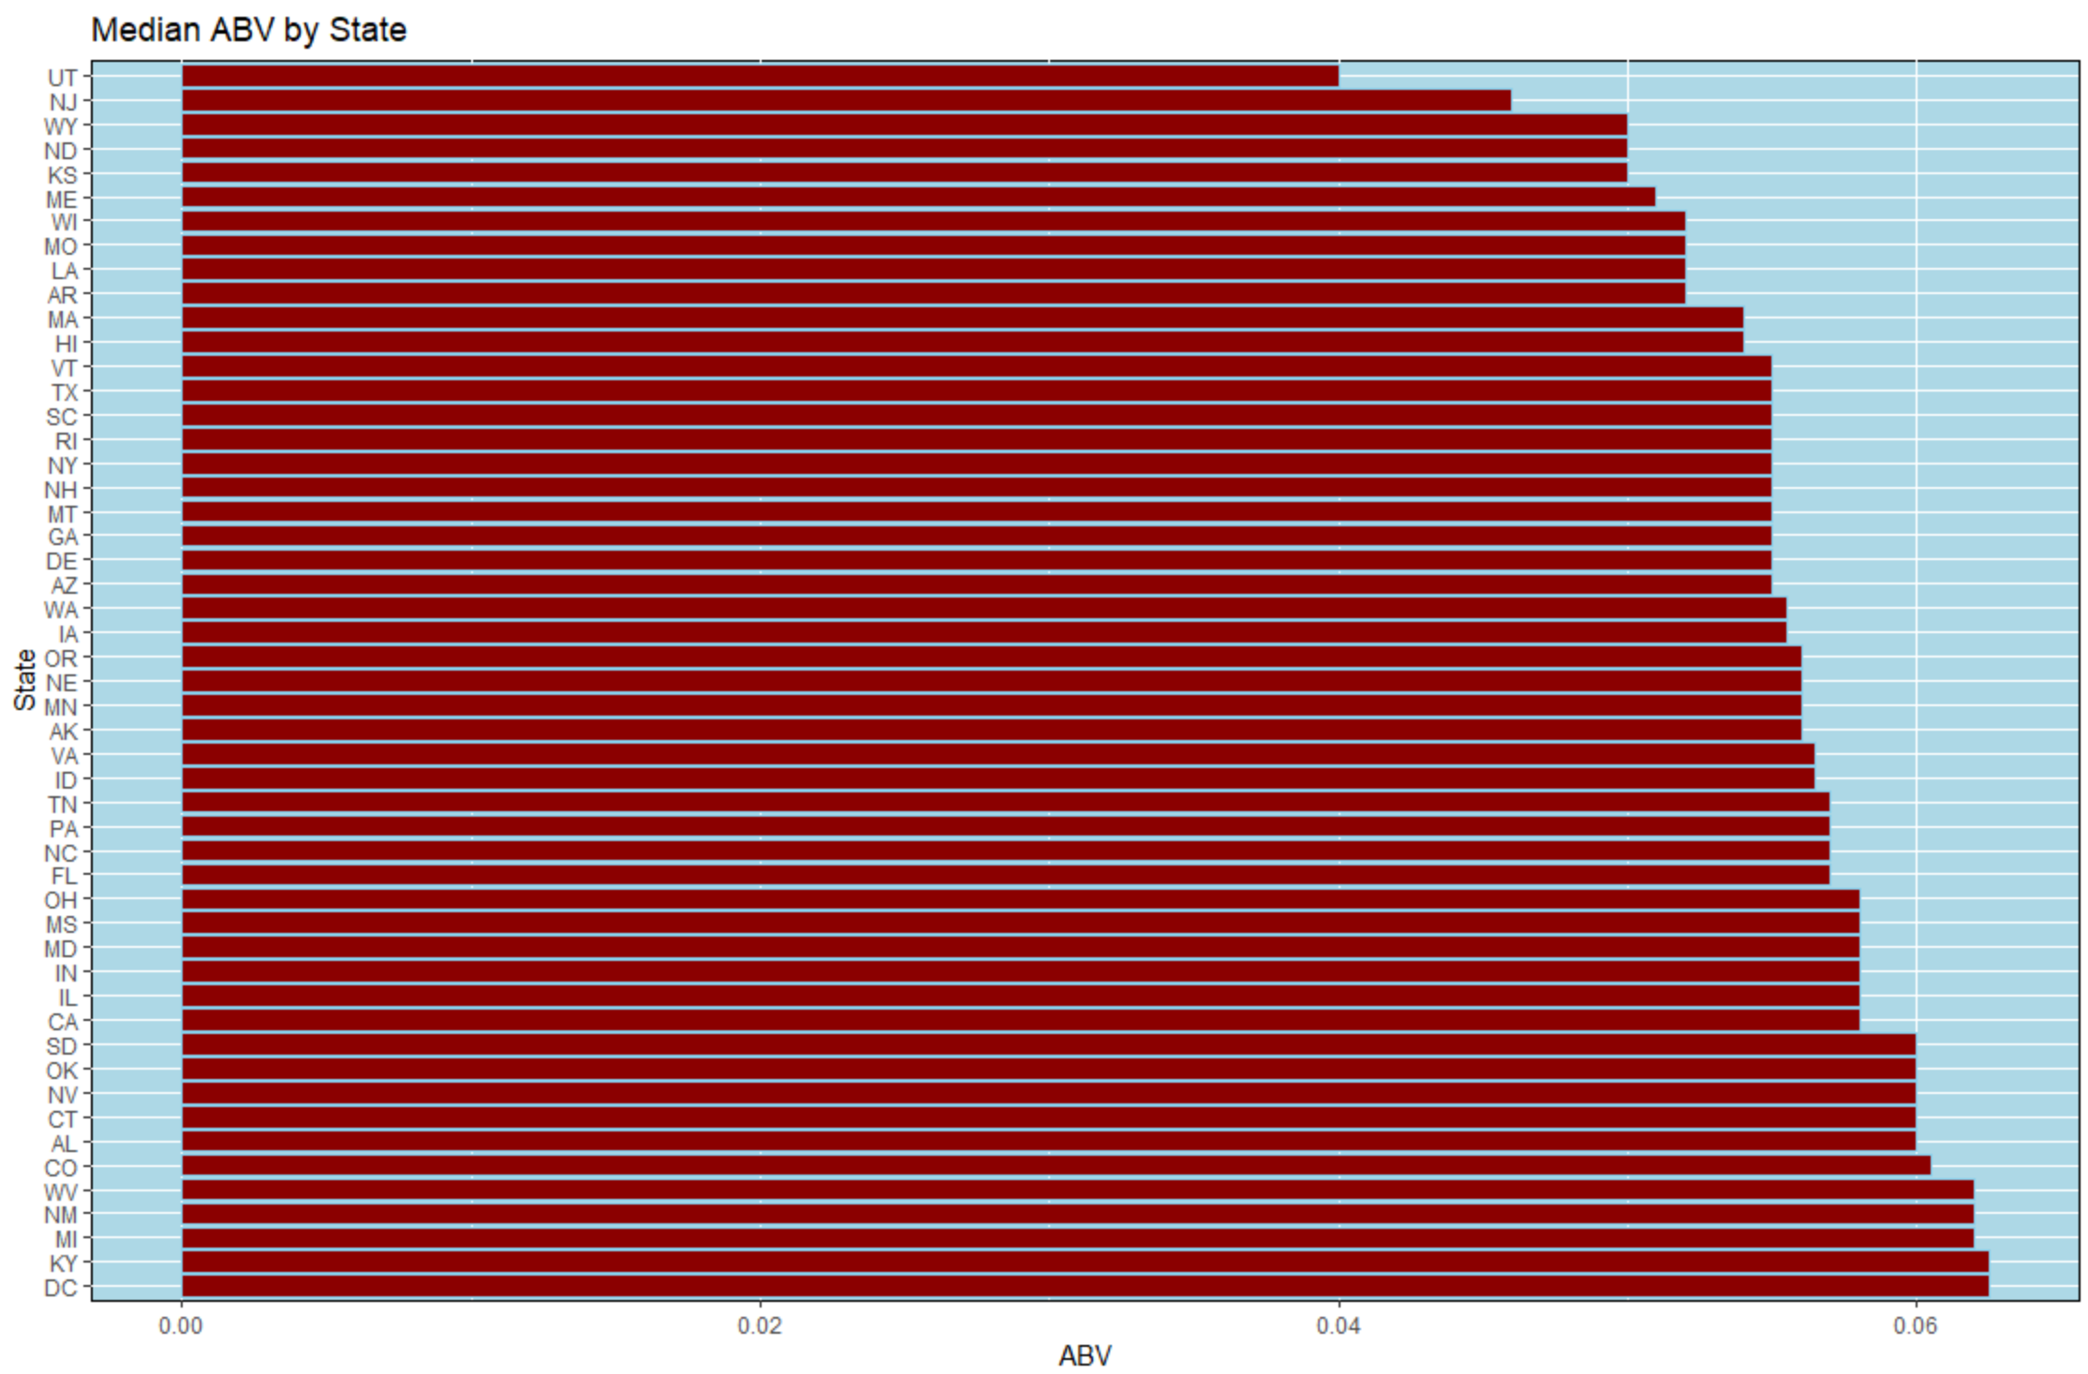
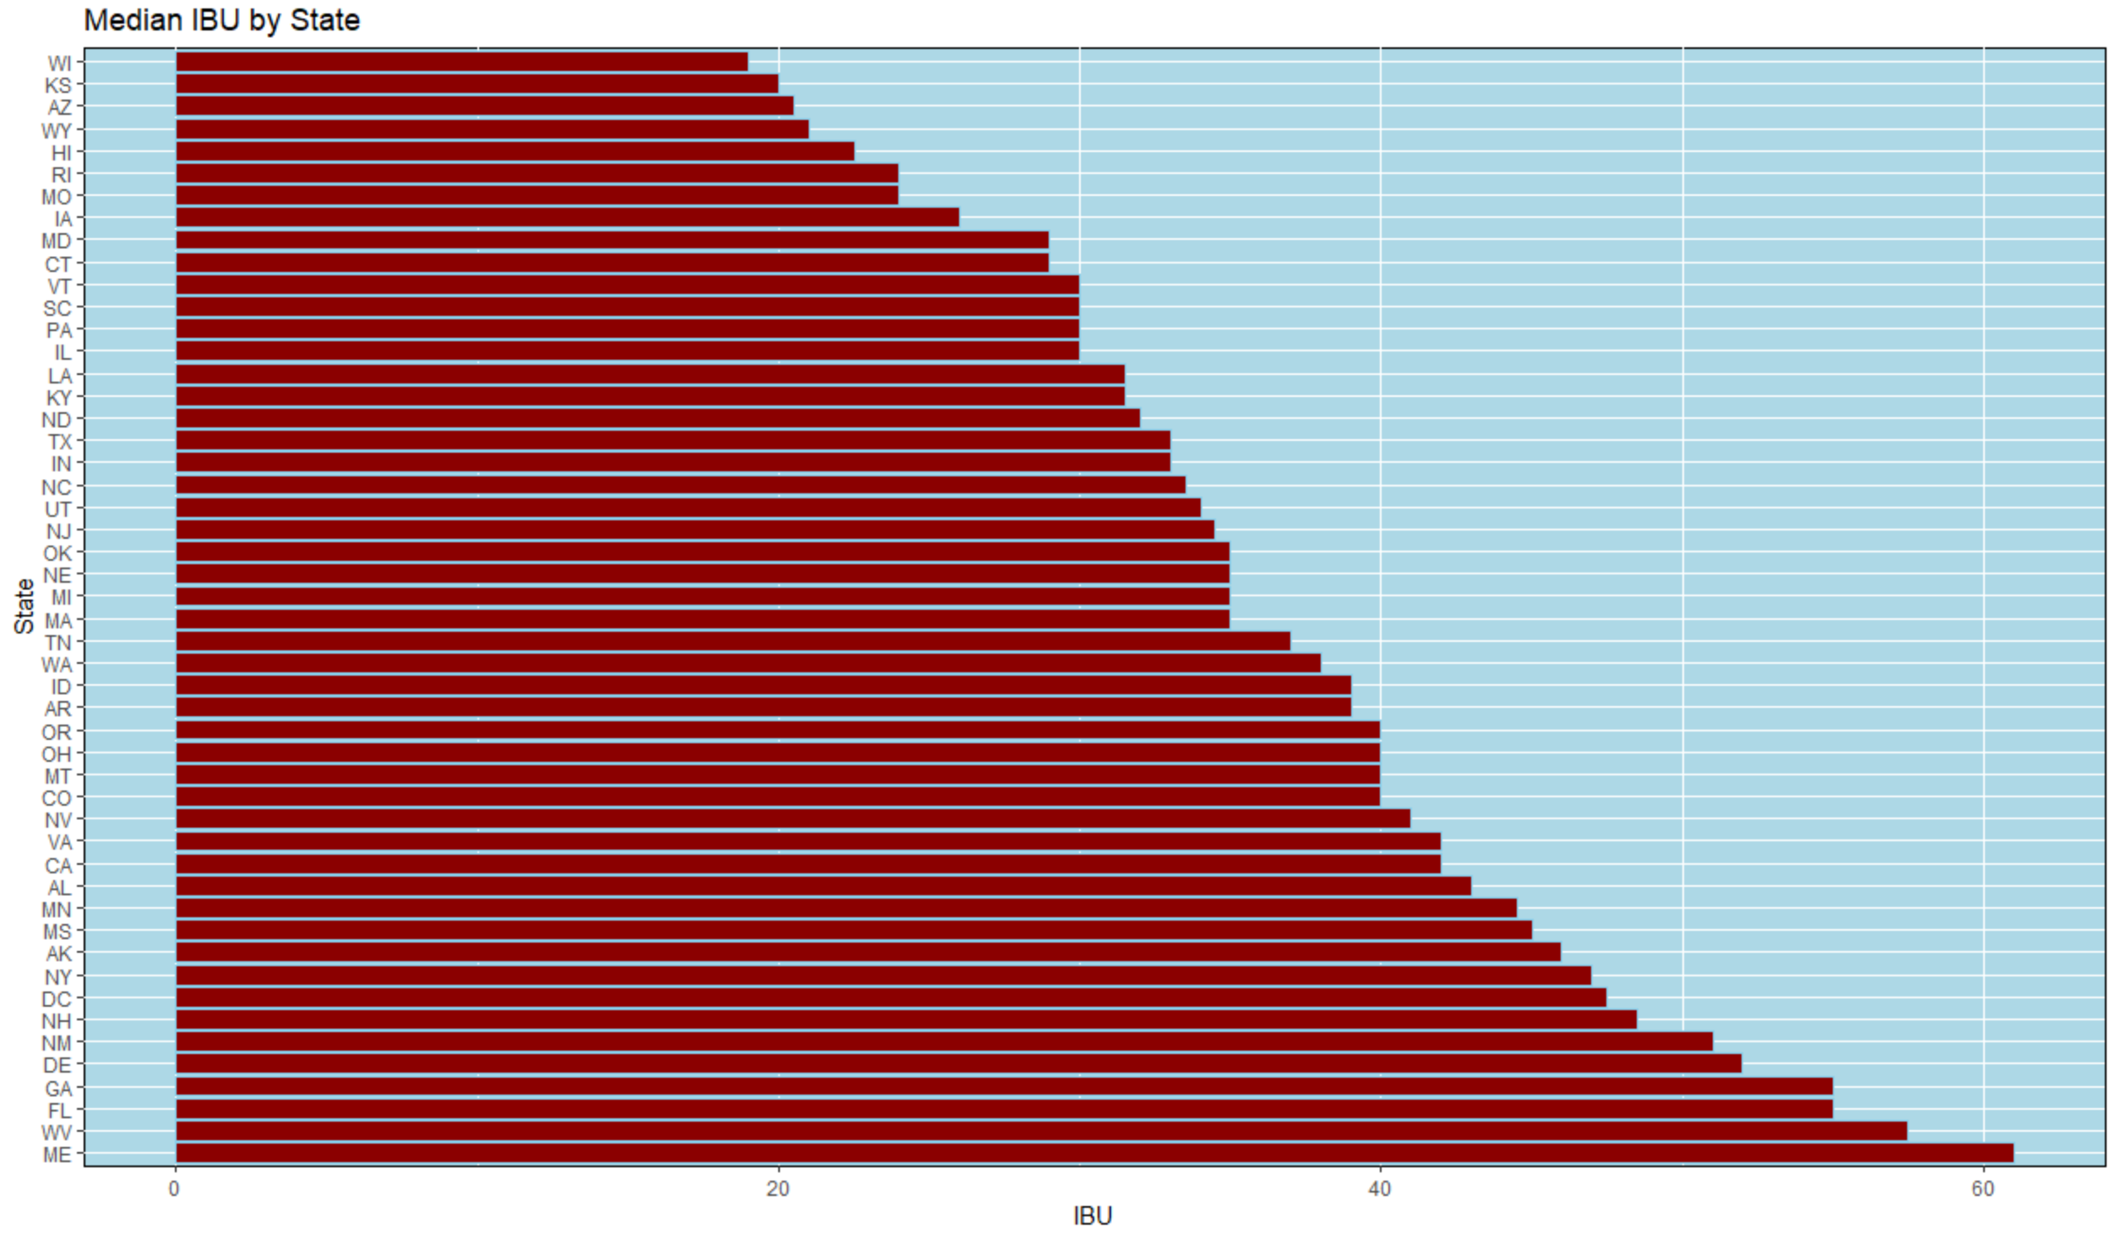
Comparing the Median ABV and IBU by State
When looking at the Median for ABV and IBU, the ABV looks somewhat uniform and IBU seems to have more variation.
Min ABV: Scotty K NA from CA with ABV of 1% | Min: 3 versions of Summer Solstice from CA with IBU of 4
Max ABV: Lee Hill Series Vol. 5 - Belgian Style Quadruple Ale from CO with ABV of 12.8% | Max: Bitter Bitch Imperial IPA from OR with IBU of 138

Slide 7
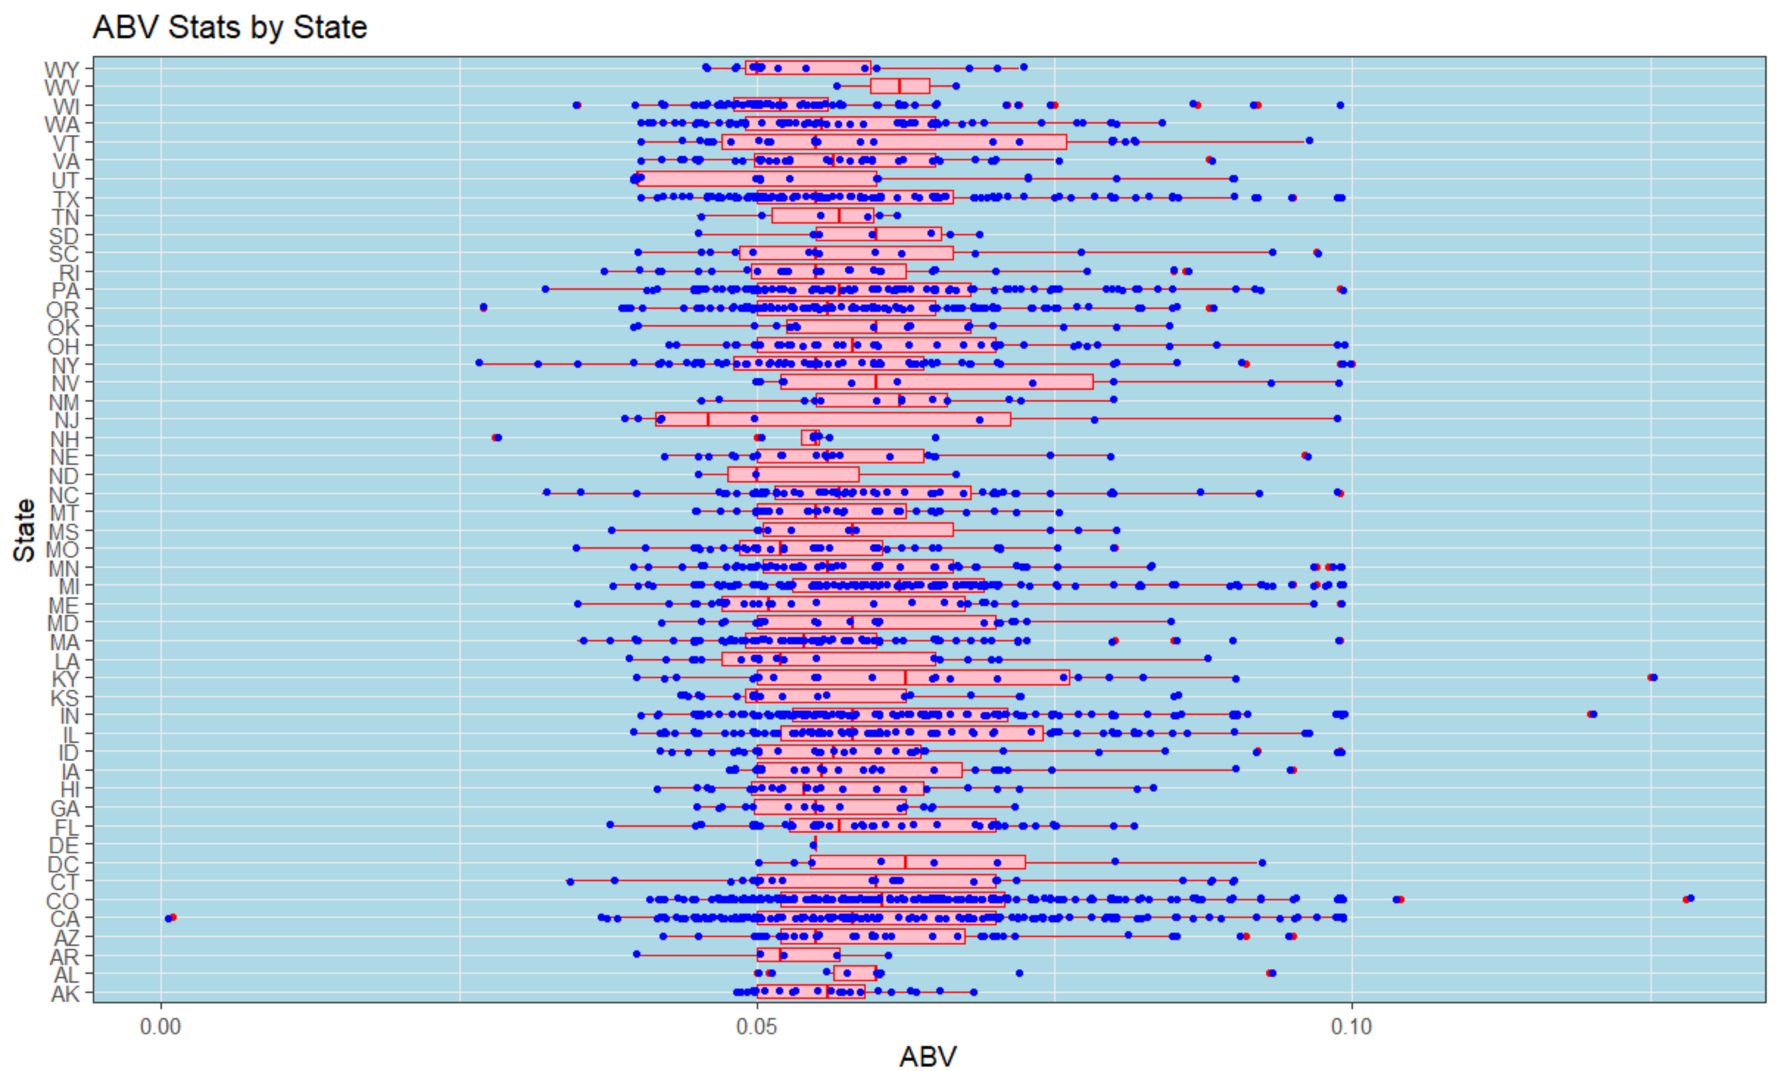
ABV Compared by State
Quite a bit a variation, even within the states
Consumers are demanding niche and craft beers

Slide 8
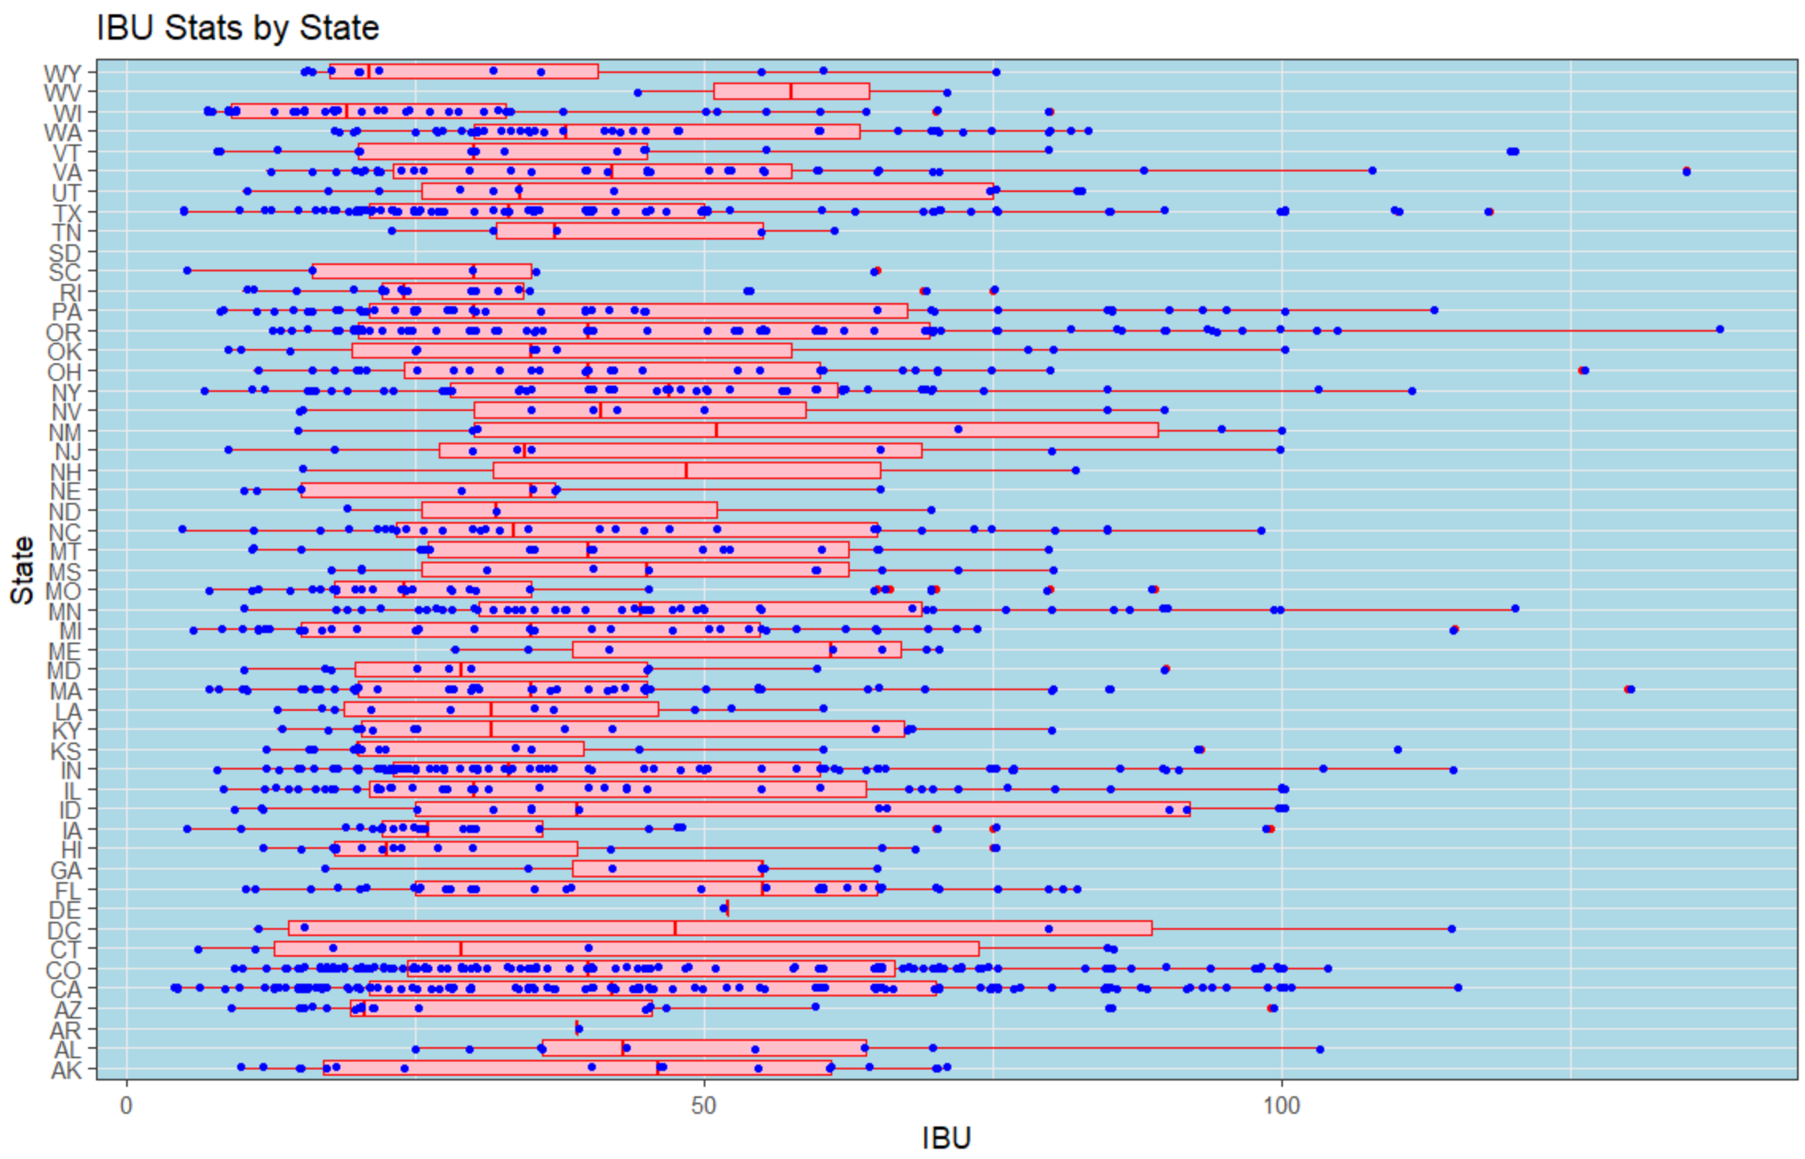
IBU Compared by State
Less variation as compared to ABV
Amount of variation is likely the same as ABV as seen from Scatter Plot
Data Quality is important

Slide 9
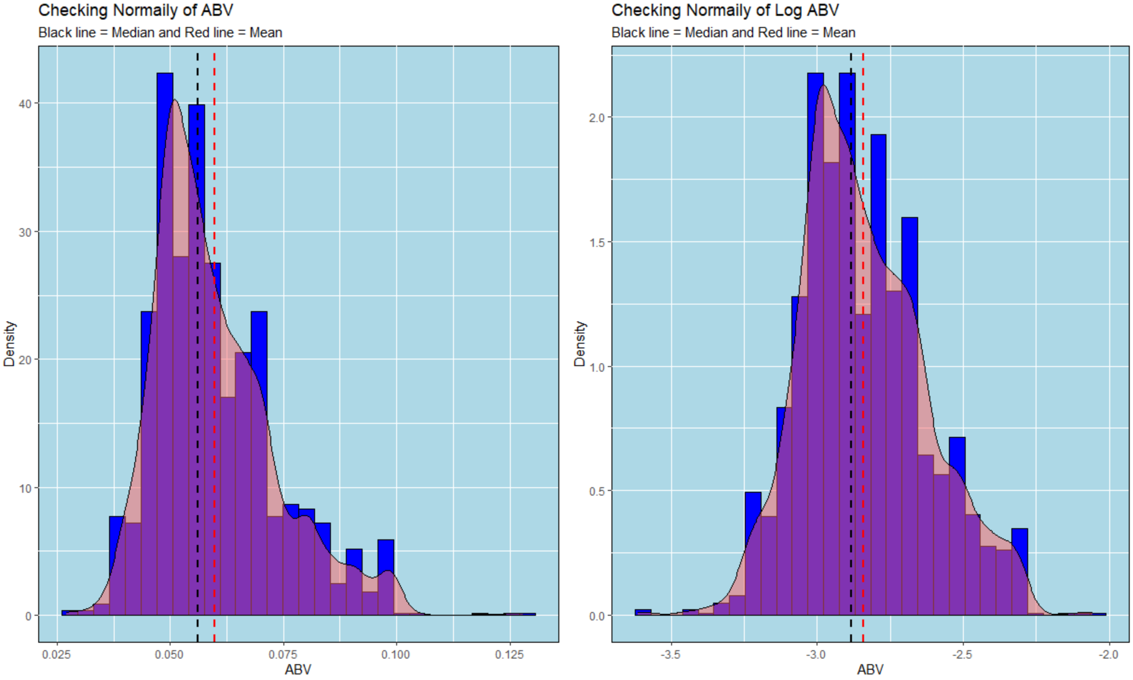
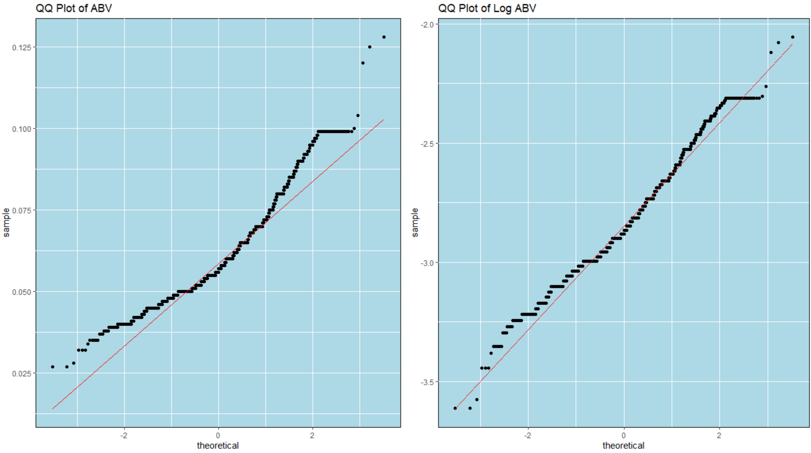
Distribution of the ABV Variable
The 1 Non-Alcoholic Beer is skewing data (see min value) so it was dropped.
ABV looks fairly normal, but is improved with a log transformation
Min.: 0.00100
1st Qu.: 0.05000
Median: 0.05600
Mean: 0.05977
3rd Qu.: 0.06700
Max.: 0.12800

Slide 10
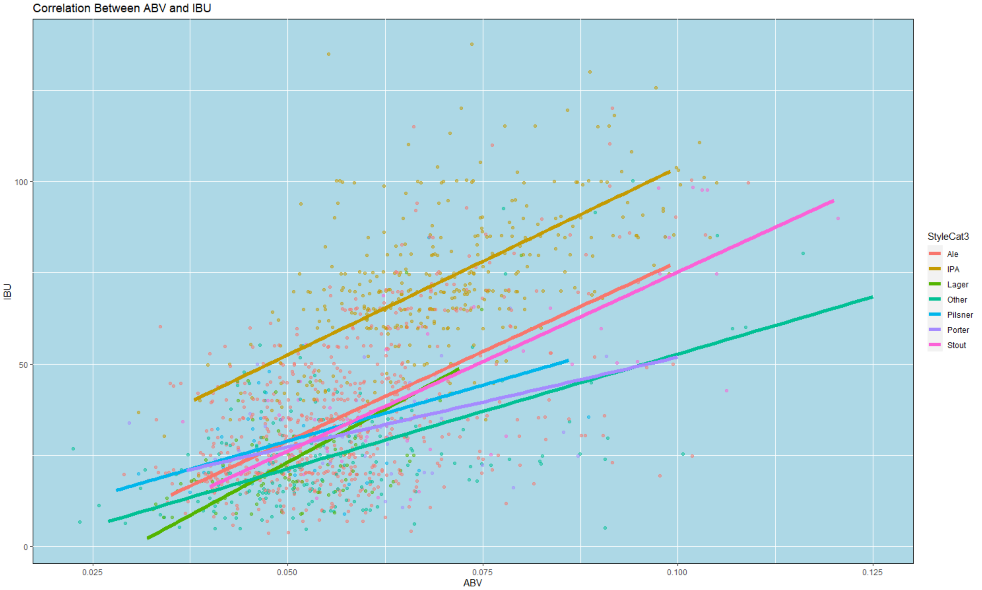
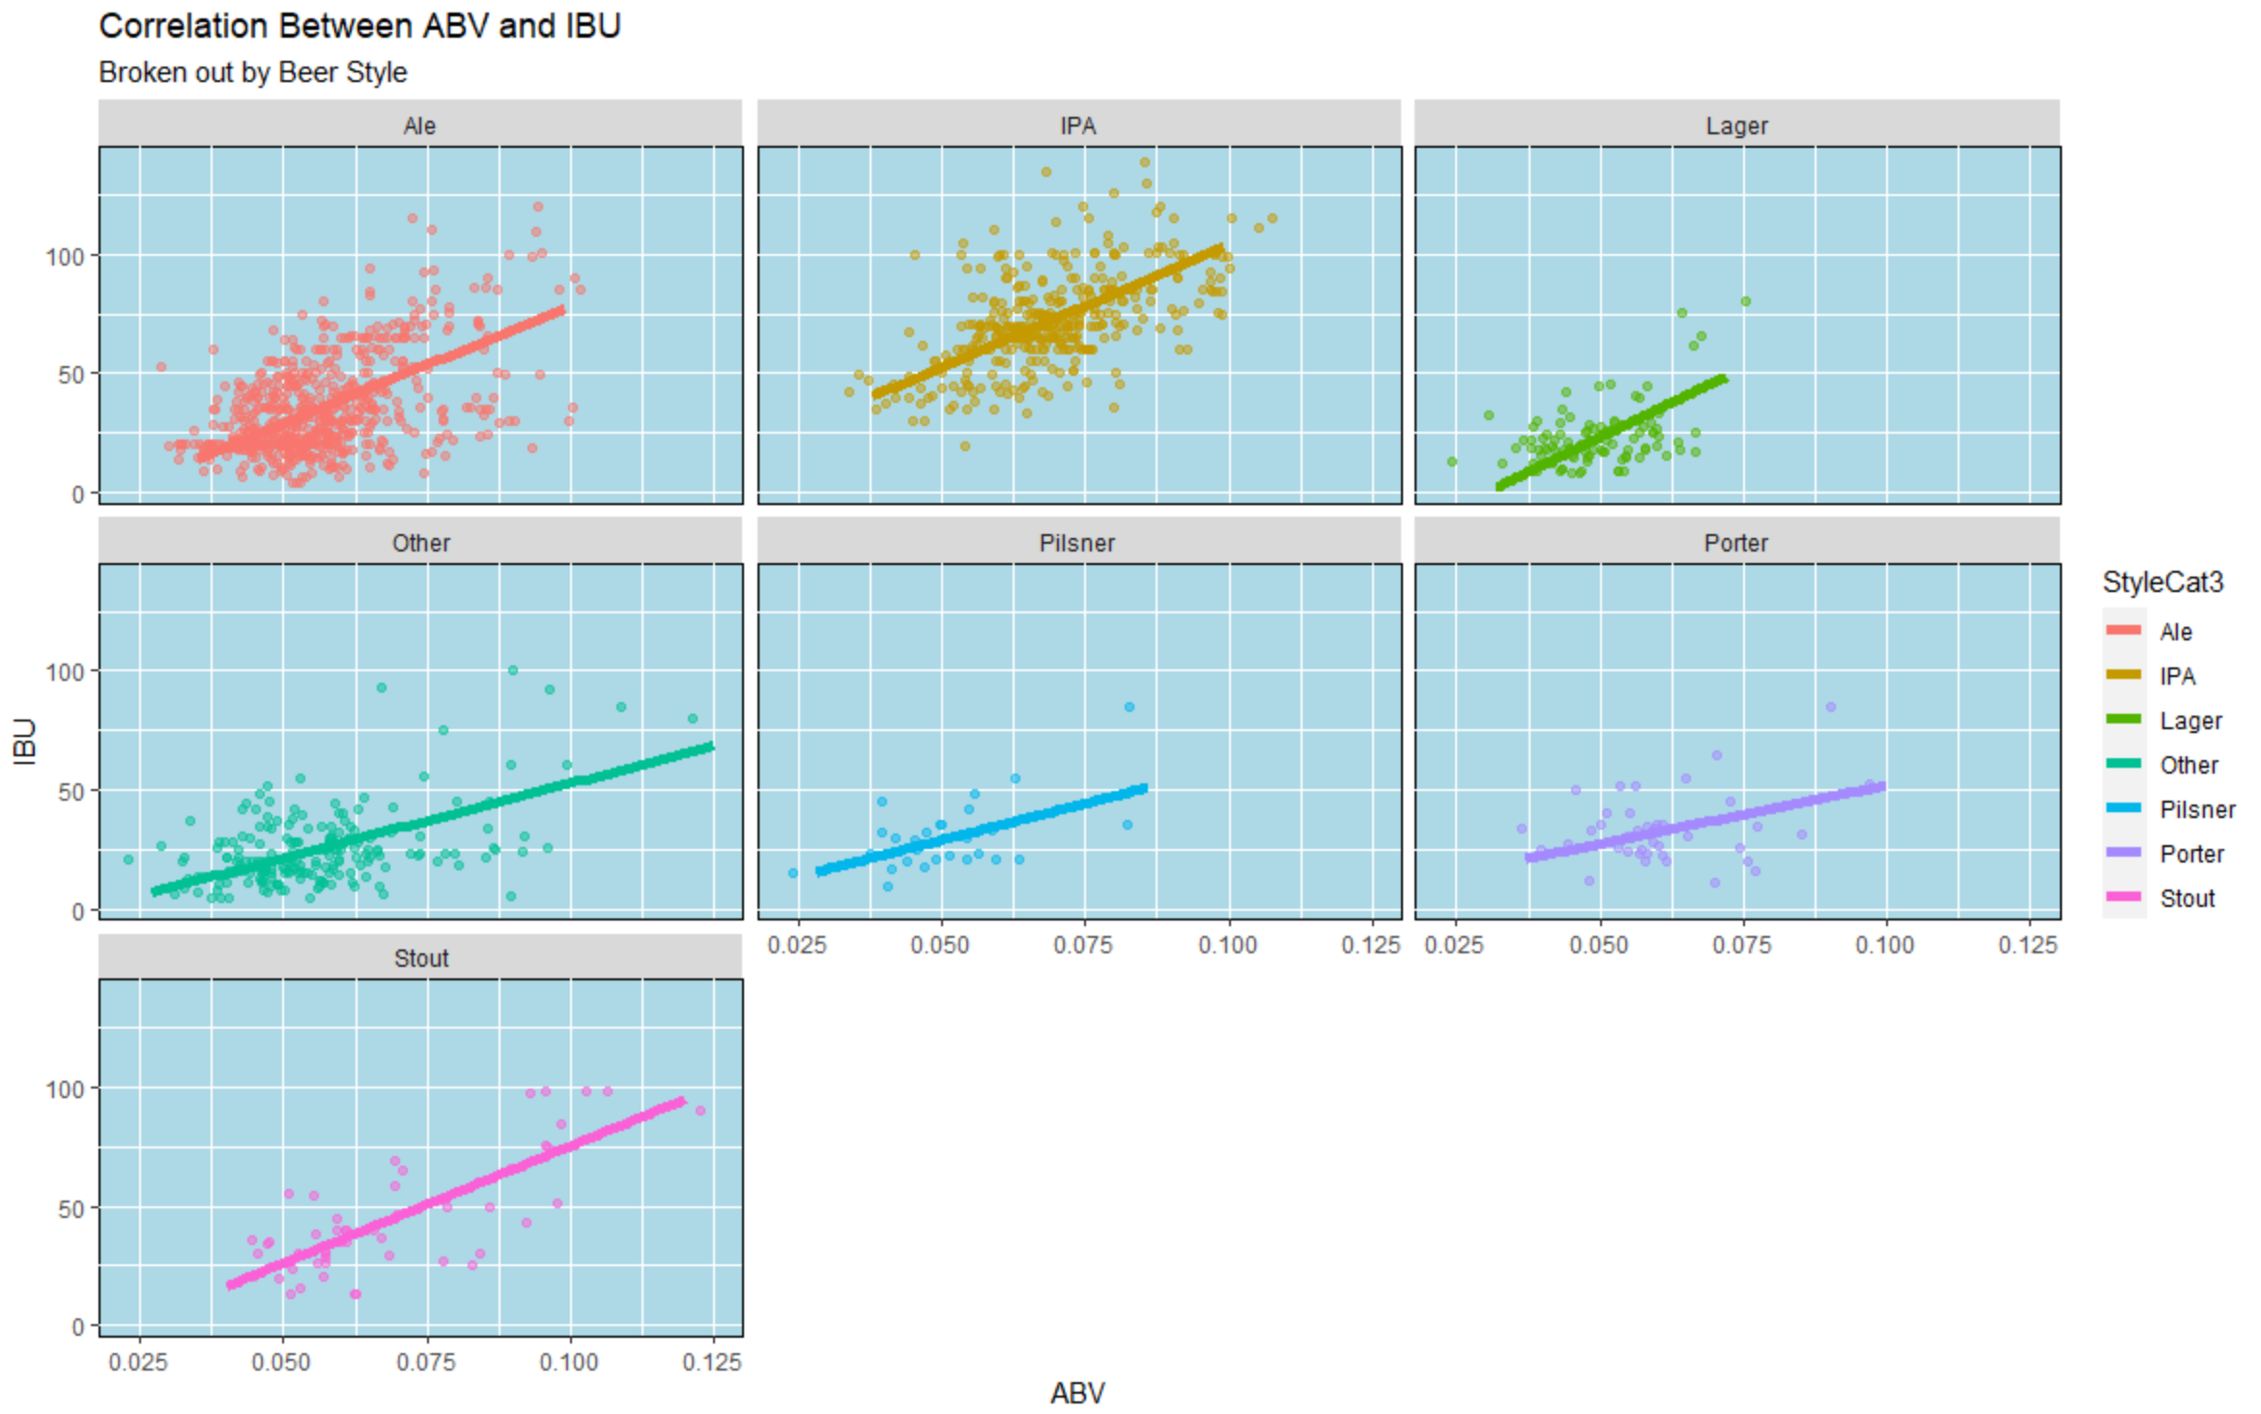
Relationship Between Beer Bitterness and Alcohol Content
There is a moderate positive correlation between ABV and IBU. The upward slope is evidence of a positive relationship.
At the same level of alcoholic content, IPA type of beer is more bitter than an Ale, Lager or Stout
When looked at individually, Lager is the most positively corelated, as seen by steepest slope of line.

Slide 11
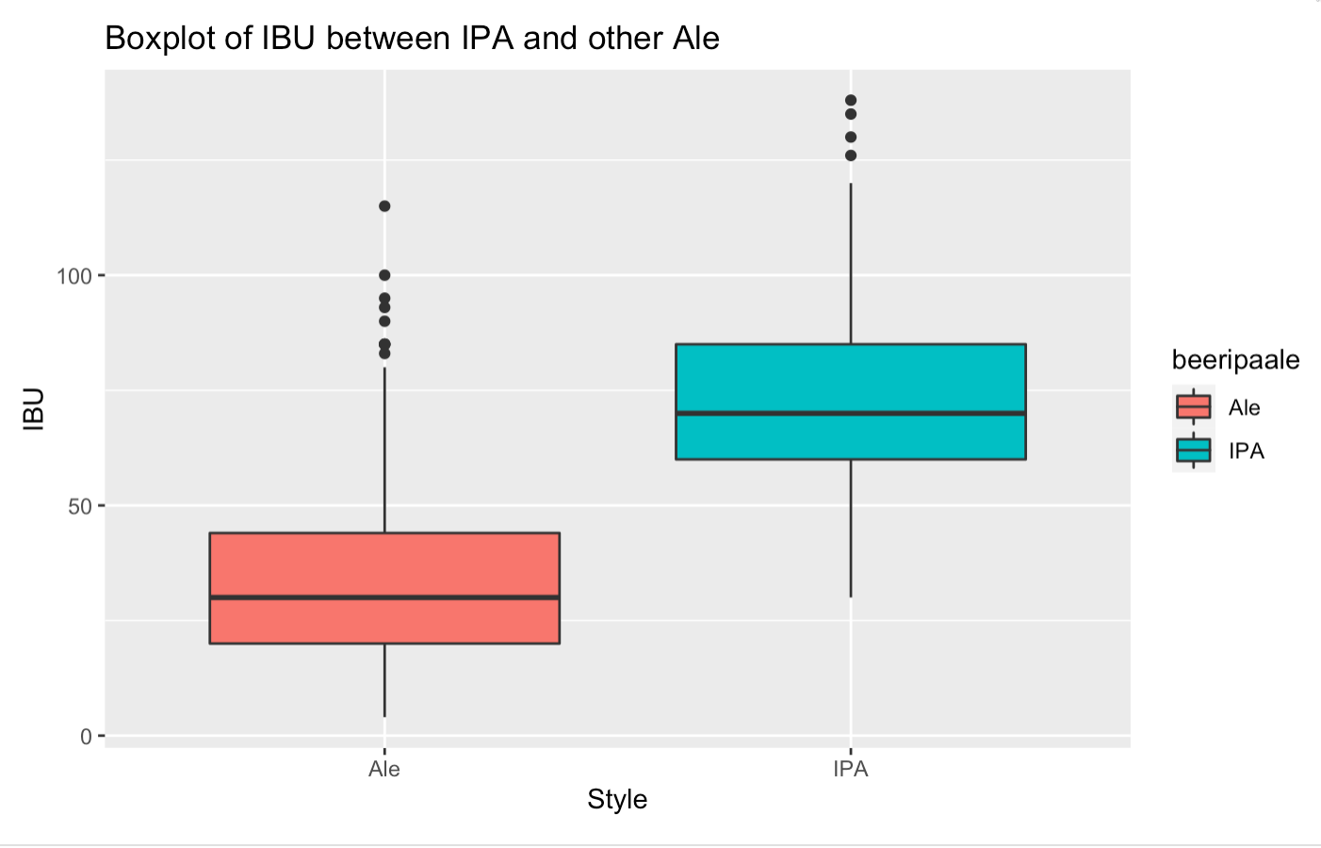
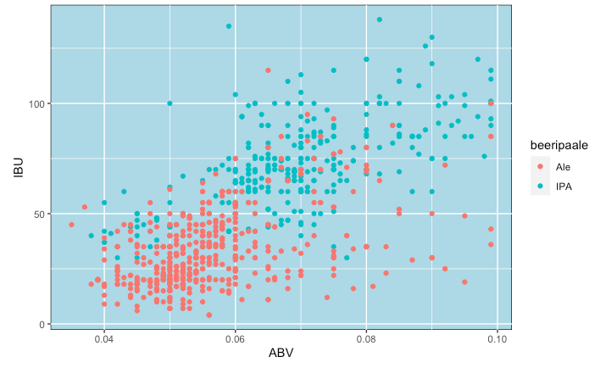
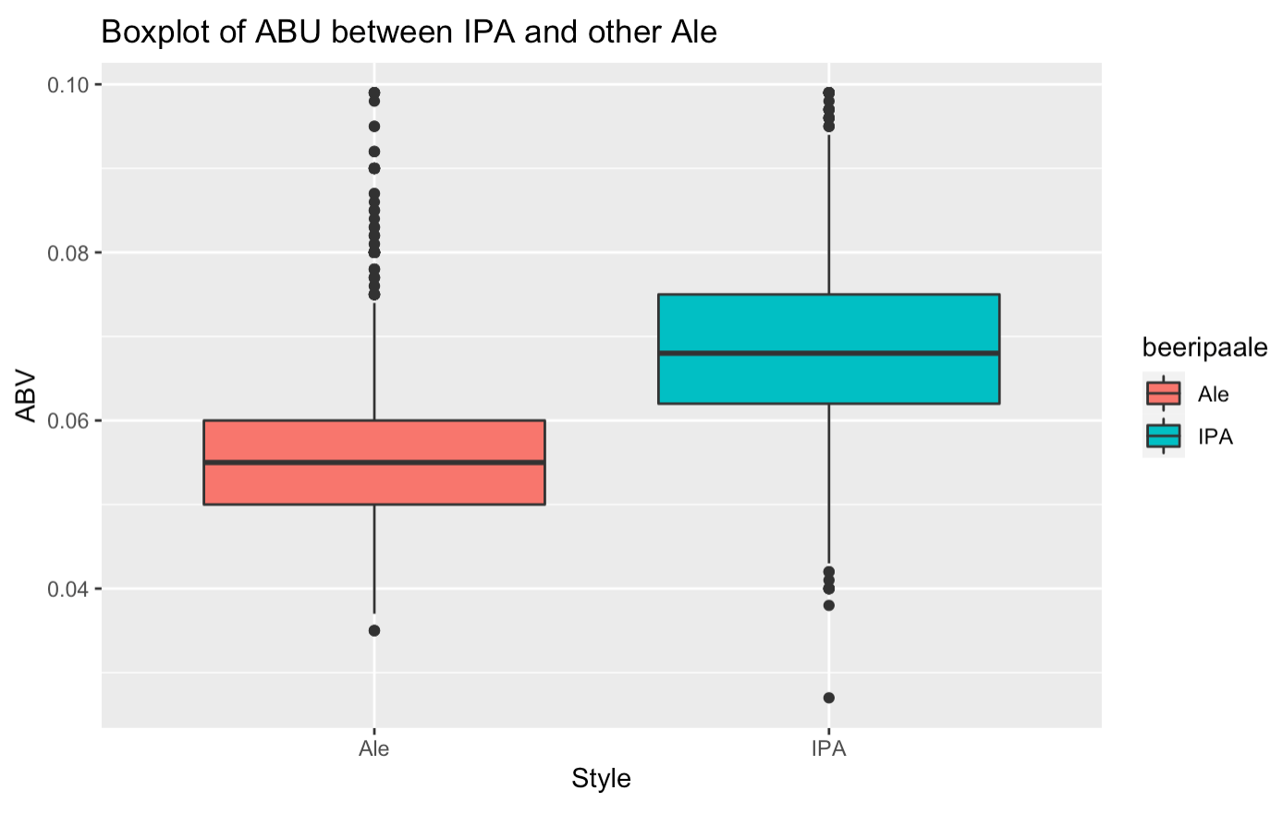
Differences Between Beer IPA and Ale
From the boxplot, Ale type of beers have higher IBU than IPA.
Ale type of beers have higher ABV than IPA.
At the same level of ABV, IPA has higher IBU than Ale

Slide 12
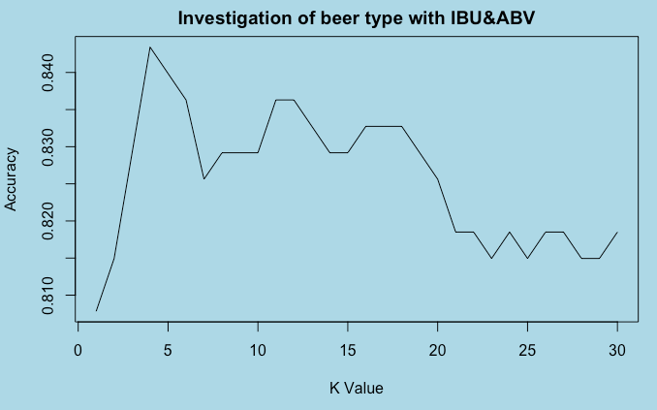
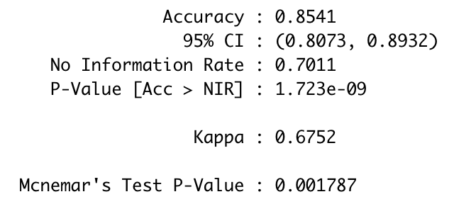
Use KNN to Investigate the beer type with IBU and ABV
Use ABV and IBU to get beer type
The best mean accuracy is 0.859395, best K value is 5.

Slide 13
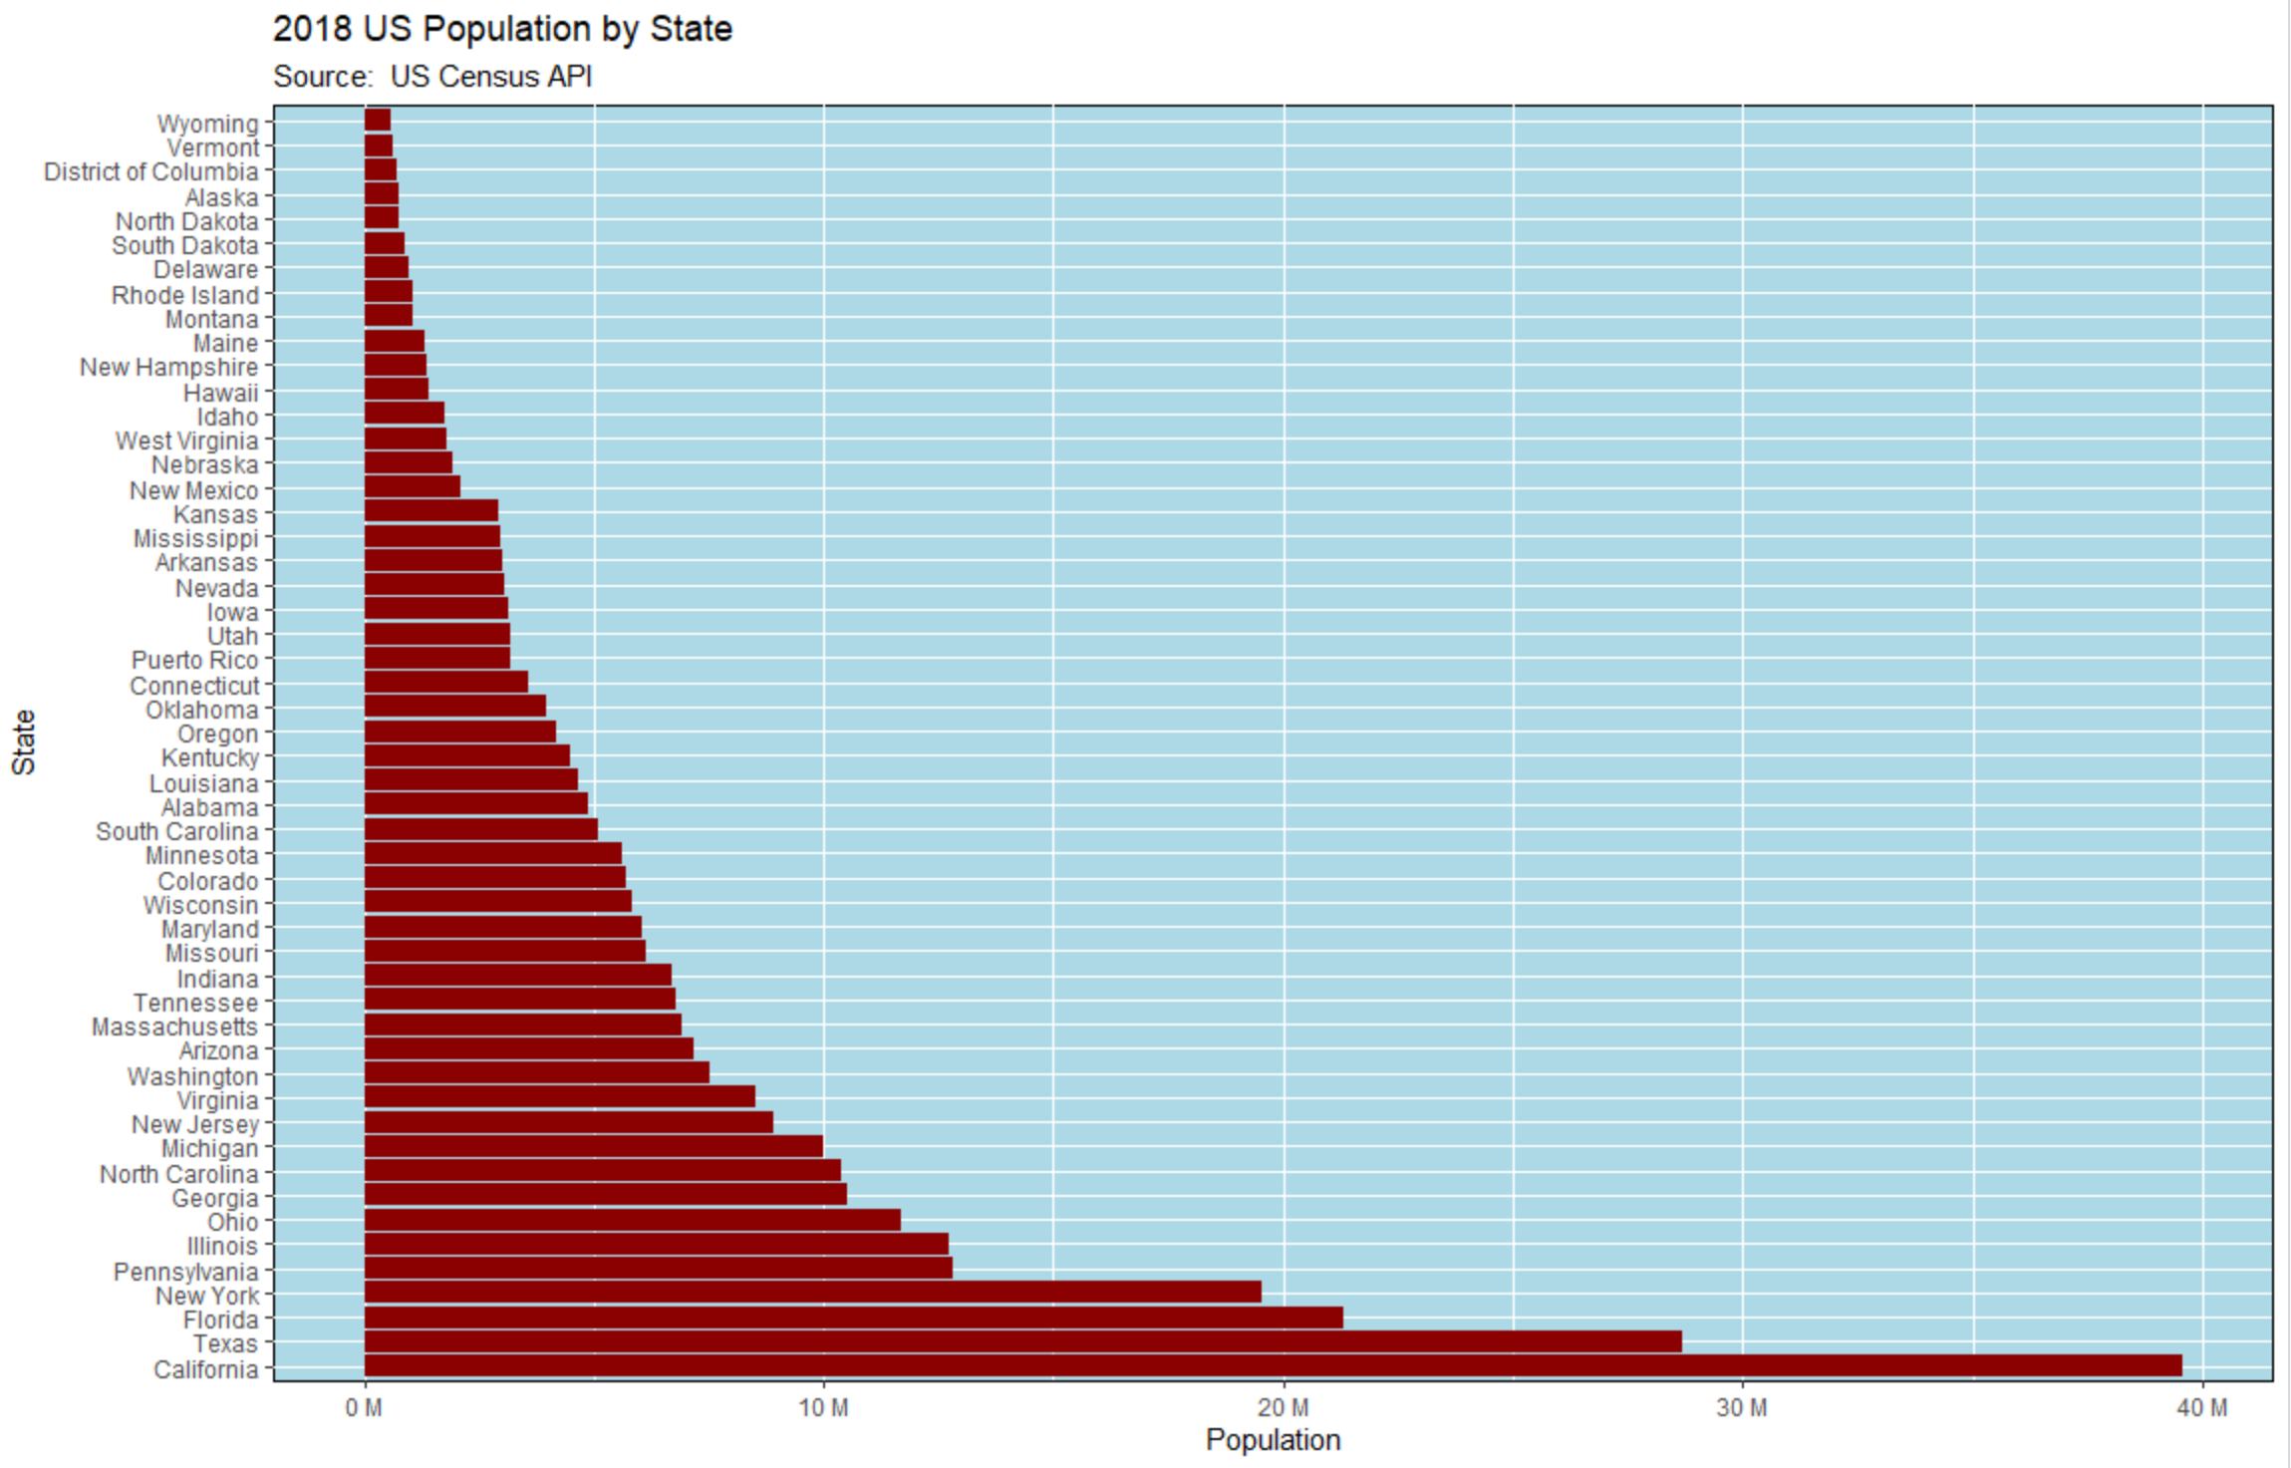
Identifing New Market Opportunities
Comparing the existing market as seen earlier with the population of the US may yields some interesting facts.

Slide 14
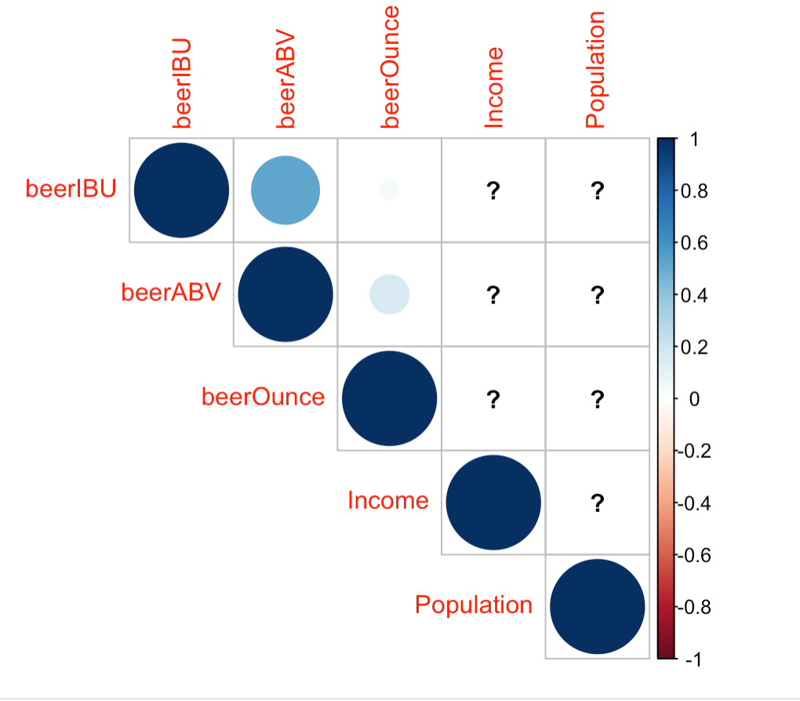
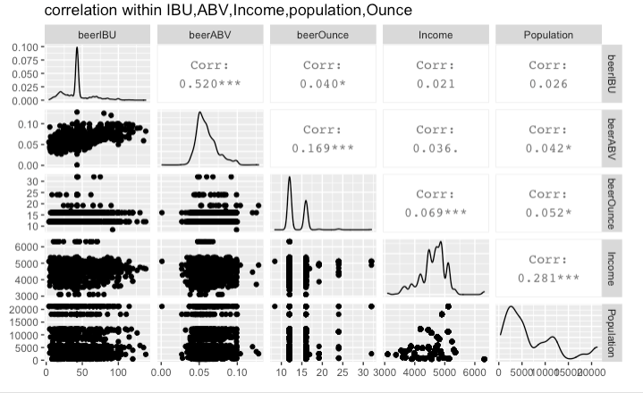
Investigate the relationship with different variables
In order to find the opportunities from this data, first we checked these relationships winthin different variables. We would like to predict if there are some relathinship within Income, Population, beer type.

Slide 15
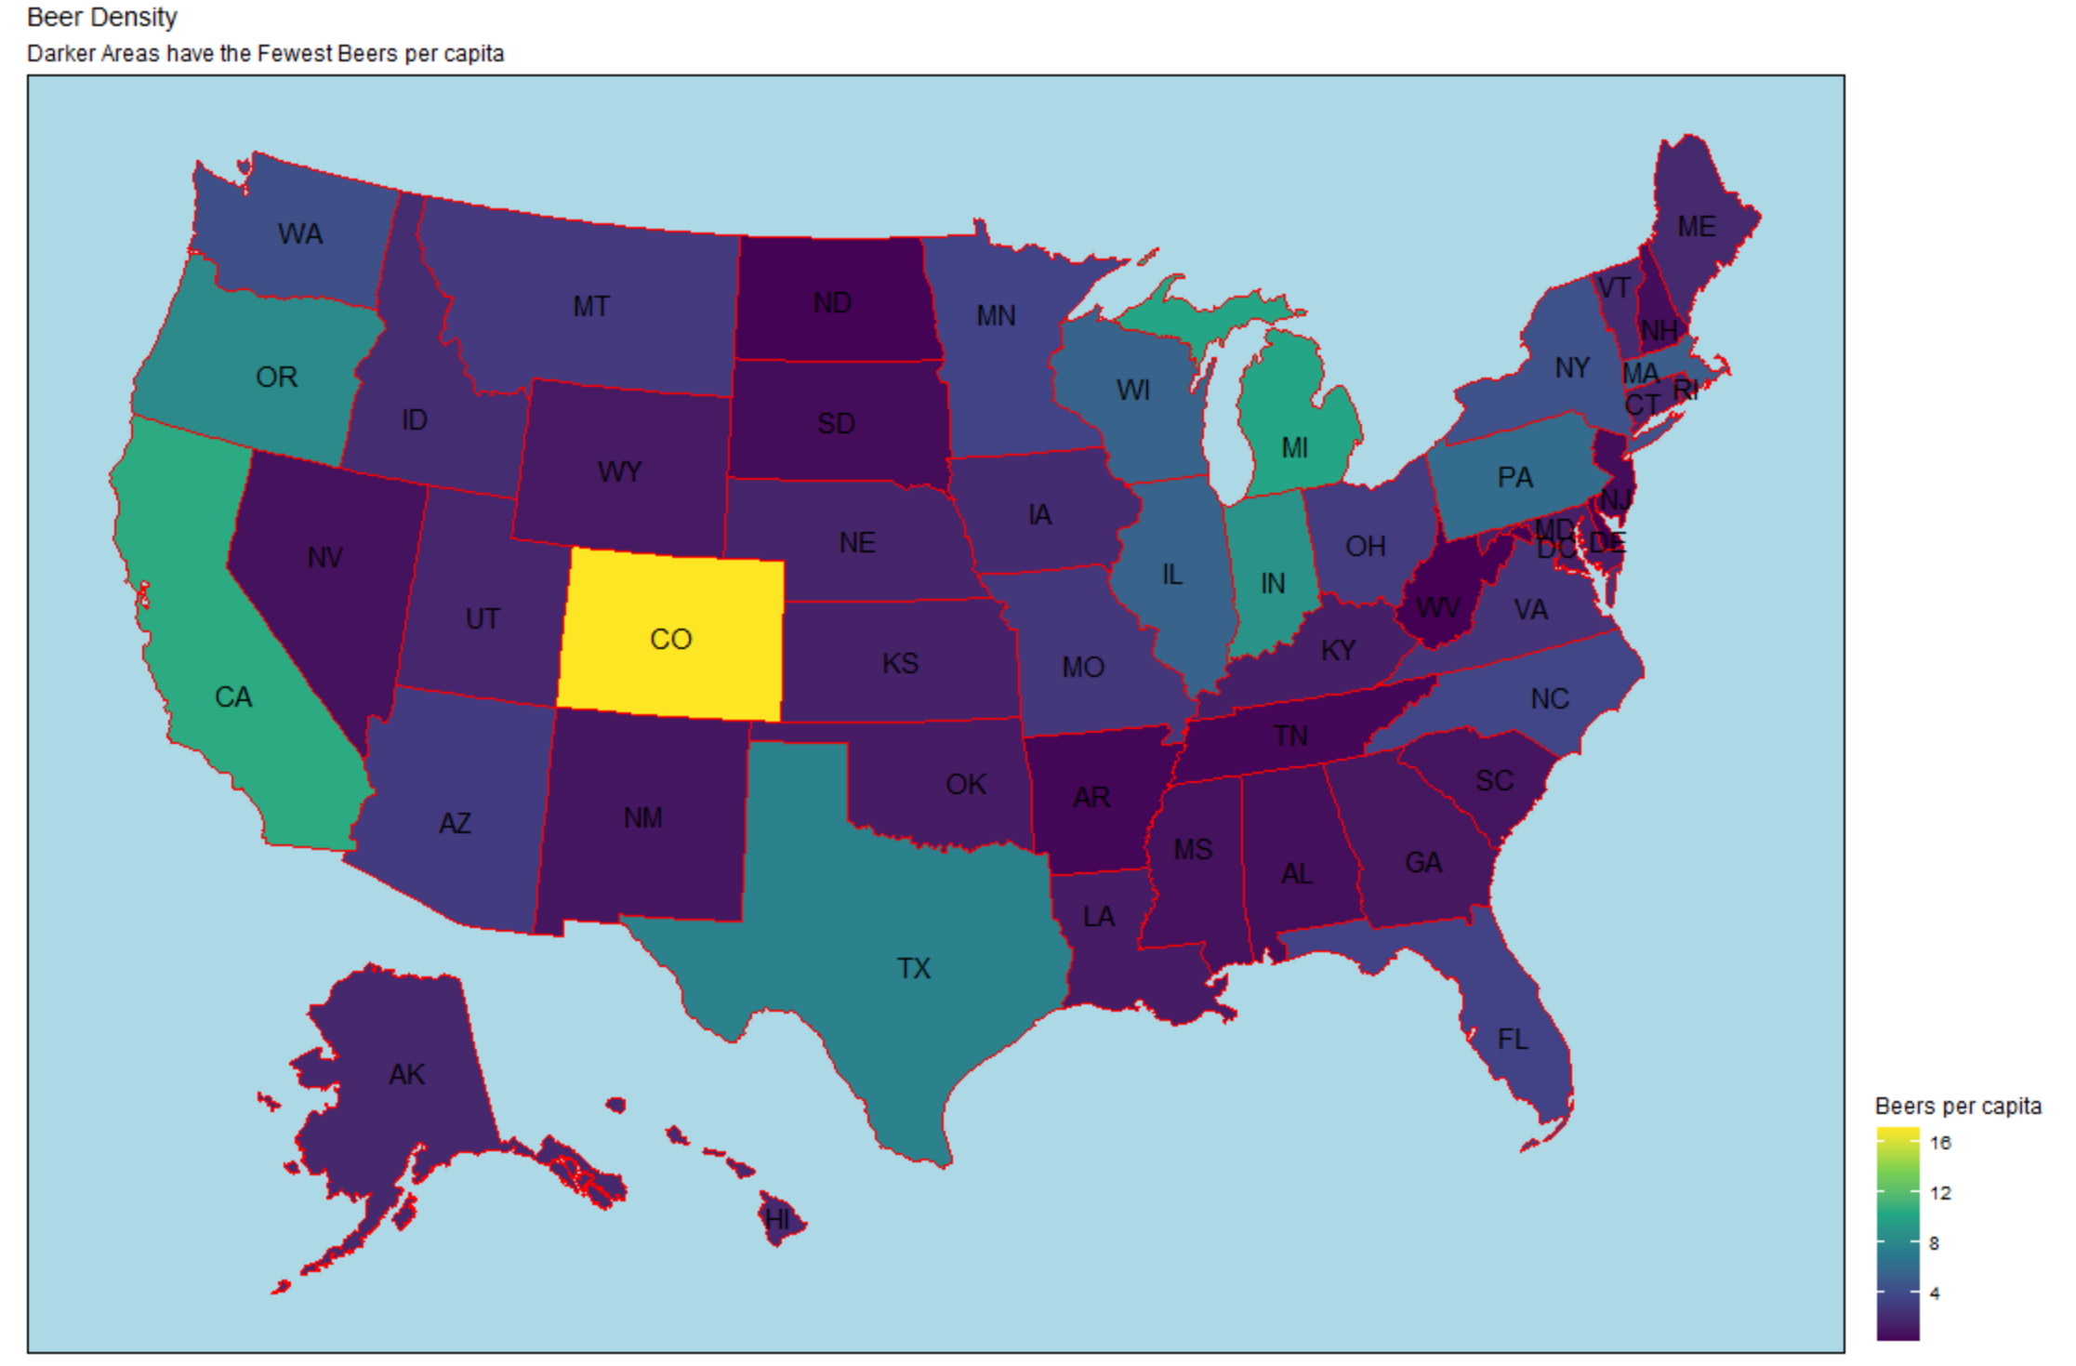
Using the Data to Focus on a Region
Using US Census data along with our Market data, we created a factor showing Beers per Population.
Plotting this factor on a map shows a region that is underserved relative to the rest of the country.

Slide 16
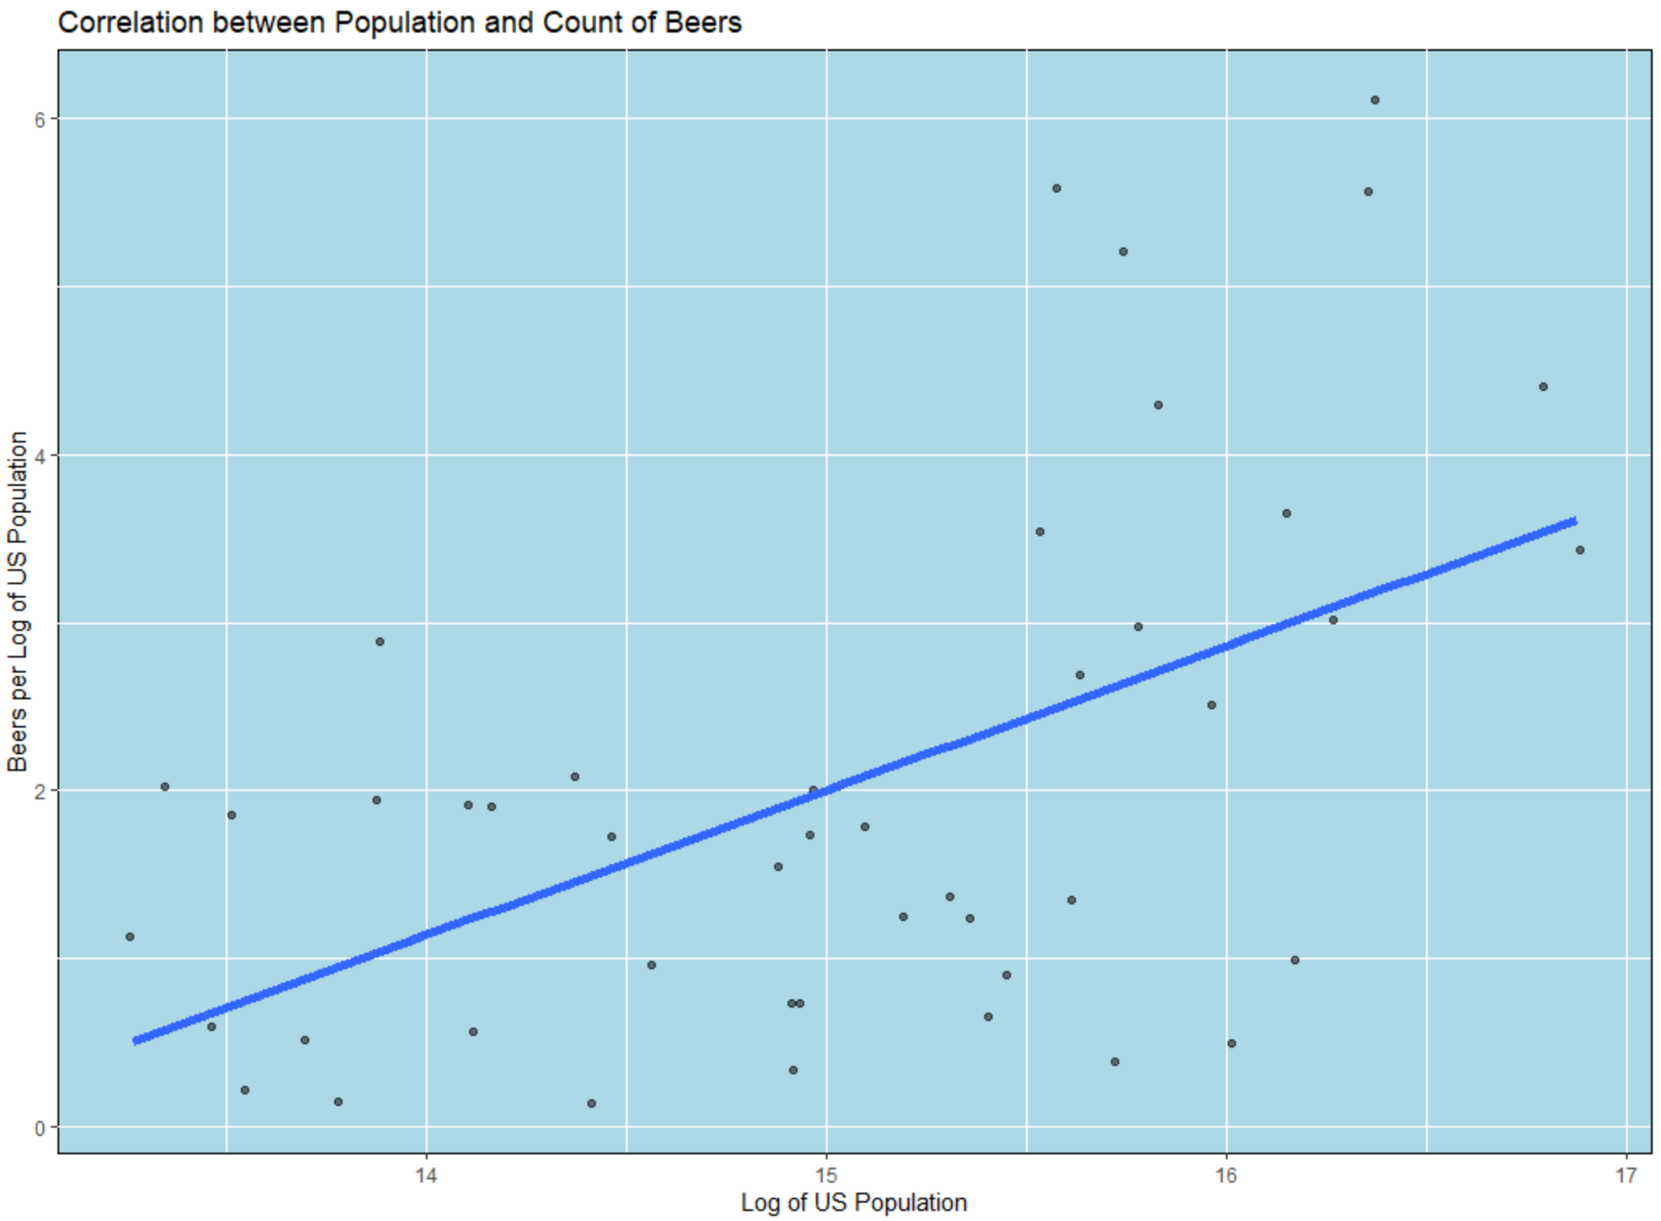
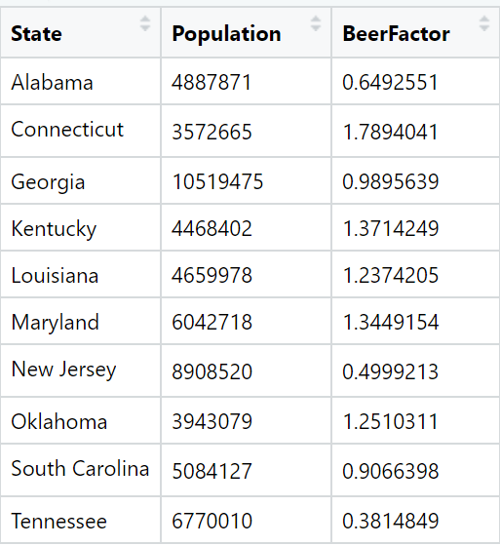
What is the Data Telling US?
We are looking to target higher population areas which appear to be below what we would expect to see in Total Beers being sold.
When we target these areas showing below the regression line, we see many of our states highlighted in the previous map.

Slide 17
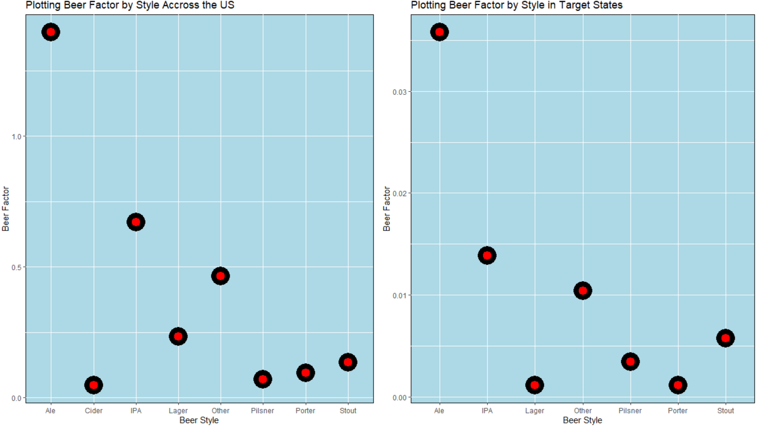
What do we Sell to the Underserved States?
The plots to the right show a lower Beer Factor for each style
However, the most notable exception is Cider, which is not present in any of the target states.
If we target Cider distribution in this cluster of states, we can expect an increase in sales to an underserved market.

Slide 18
Next Steps
Create budget forecasts around expected costs and revenues from Cider sales in this area.
Perform additional research to on how and where to distribute Cider from.
Market research for Branding of Cider to distribute to this area.
Questions?

