Slide 1
Algorithmics and Applications of Tree and Graph Searching
Dennis Shasha, shasha@cs.nyu.edu
Courant Institute, NYU
Joint work with
Jason Wang and Rosalba Giugno

Slide 2
Outline of the Talk
Introduction:
  Application examples
  Framework for tree and graph matching techniques
Algorithms :
  Tree Searching
  Graph Searching
Conclusion and future vision

Slide 3
Usefulness
Trees and graphs represent data in many domains in linguistics, vision, chemistry, web. (Even sociology.)
Tree and graphs searching algorithms are used to retrieve information from the data.

Slide 4
Tree Inclusion
Book
Book
Chapter
Editor
Editor
Chapter
Chapter
Title
?
Name
Title
Author
Title
Author
XML
John
XML
Mary
OLAP
Jack
(a)
(b)

Slide 5
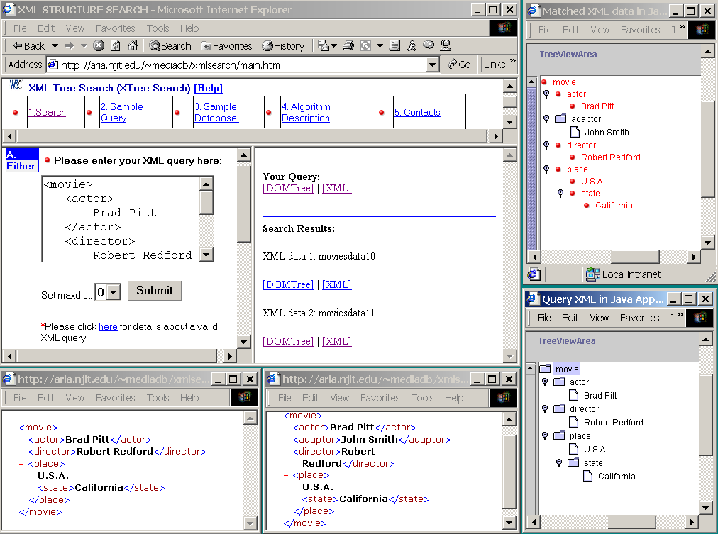

Slide 6
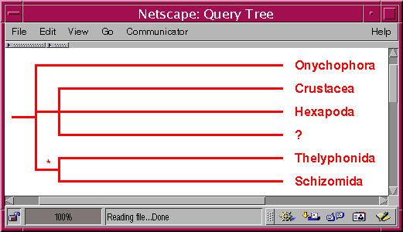
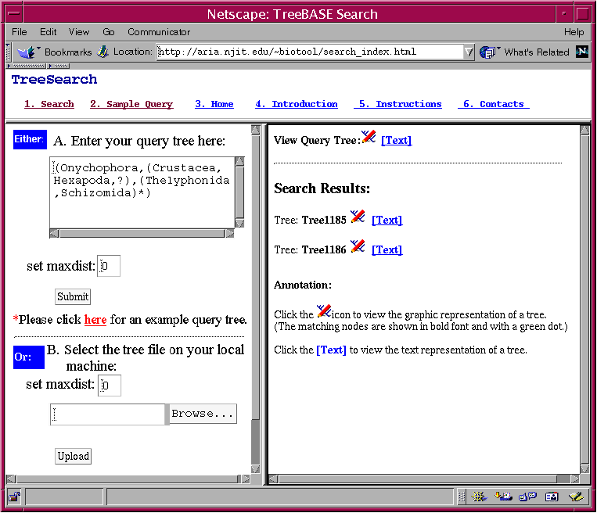
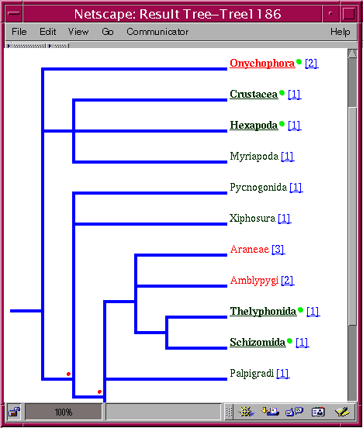
TreeBASE Search Engine

Slide 7


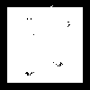
Vision Application: Handwriting Characters Representation
From pixels to a small attributed graph
l₁
l₃
e₂
e₃
e₁
l₂
e₅
e₄
l₄
l₅
D.Geiger, R.Giugno, D.Shasha,
Ongoing work at New York University

Slide 8

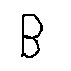
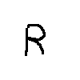
Vision Application: Handwriting Characters Recognition
QUERY
l₄
l₂
e₃
e₃
l₃
e₄
e₅
l₁
l₅
D
A
T
A
B
A
S
E
Best
Match
l₁
l₃
l₂
e₇
l₂
e₆
e₂
l₅
l₅
e₁
e₃
e₂
e₃
e₅
e₃
e₅
l₂
l₃
e₂
l₃
e₅
e₄
e₁
e₄
l₄
e₁
e₄
e₆
l₄
l₄
l₅
l₁
l₁

Slide 9

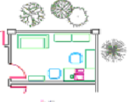
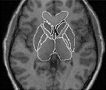
Vision Application: Region Adjacent Graphs
J. Lladós and E. Martí and J.J. Villanueva, Symbol Recognition by Error-Tolerant Subgraph Matching between Region Adjacency Graphs, IEEE Transactions on Pattern Analysis and Machine Intelligence, 23-10,1137—1143, 2001.

Slide 10
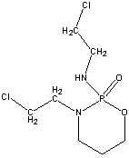
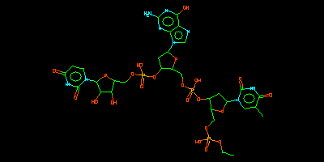
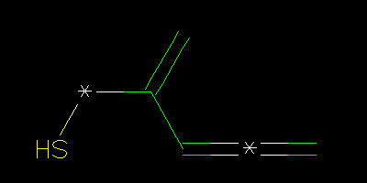
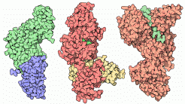
Chemistry Application
Protein Structure Search. http://sss.berkeley.edu/
Daylight (www.daylight.com),
MDL http://www.mdli.com/
BCI (www.bci1.demon.co.uk/)

Slide 11
Algorithmic Questions
Question: why can’t I search for trees or graphs at the speed of keyword searches? (Proper data structure)
Why can’t I compare trees (or graphs) as easily as I can compare strings?

Slide 12
Tree Searching
Given a small tree t is it present in a bigger tree T?
t
T

Slide 13
Present but not identical
"Happy families are all alike; every unhappy family is unhappy in its own way” Anna Karenina by Leo Tolstoy
Preserving sibling order or not
Preserving ancestor order or not
Distinguishing between parent and ancestor
Allowing mismatches or not

Slide 14
Sibling Order
Order of children of a node:
A
A
?
=
B
C
C
B

Slide 15
Ancestor Order
Order between children and parent.
C
A
?
=
A
B
C
B

Slide 16
Ancestor Distance
Can children become grandchildren:
A
A
?
=
B
B
X
C
C

Slide 17
Mismatches
Can there be relabellings, inserts, and deletes? If so, how many?
A
A
how
far?
B
X
C
C

Slide 18
Bottom Line
There is no one definition of inexact or subtree matching (Tolstoy problem). You must ask the question that is appropriate to your application.

Slide 19
TreeSearch Query Language
Query language is simply a tree decorated with single length don’t cares (?) and variable length don’t cares (*).
A
>= 0, on
each side
?
=1
*
B
C
D

Slide 20
Exact Match
Query matches exactly if contained regardless of sibling order or other nodes
X
A
Y
A
X
Q
?
=
W
B
*
Z
D
B
C
D
U
C

Slide 21
Inexact Match
Inexact match if missing or differing node labels. Higher differences cost more.
X
A
Y
A
X
Q
?
Differ
by 1
W
*
B
Z
E
B
C
D
U
C

Slide 22
Treesearch
Conceptual Algorithm
Take all paths in query tree.
Filter using subpaths.
Find out where each real path is in the data tree. Distance = number of paths that differ. Higher nodes are more important.
Implementation: hashing and suffix array. A few seconds on several thousand trees.

Slide 23
Treesearch
Data Preparation
Take nodes and parent-child pairs and hash them in the data tree. This is used for filtering.
Take all paths in data trees and place in a suffix array. (In worst case O(num of nodes * num of nodes) space but usually less).

Slide 24
Treesearch Processing
Take nodes and parent-child pairs and hash them in the query tree. Accept data trees that have a supermultiset of both. (If mismatches are allowed, then liberalize.)
Match query tree against data trees that survive filter.
Do one path at a time and then intersect to find matches.

Slide 25
Tree == Set of “Paths”
Paths:
A
0
0
A
0
A
0
A
0
A
A
1
C
2
C
3
1
A
1
A
2
C
3
C
B
4
C
5
E
6
4
B
5
C
6
E
Parent-Child Pairs:
AA={(0,1)}
AB={(1,4)}
AC ={(0,2),(0,3),(1,5)}
CE={(2,6)}

Slide 26
Parent-Child Pairs of 3 Data Trees
D
0
B
0
A
0
A
1
A
1
A
1
C
2
C
3
C
2
C
3
E
4
D
2
A
3
C
4
E
5
B
4
C
5
E
6
G
B
E
C
C
5
6
6
7
8
Tree t₁
Tree t₂
Tree t₃
Key
t₁
t₂
t₃
h(AA)
1
0
1
h(AB)
1
0
0
h(AC)
3
2
2
……

Slide 27
Patterns in a Query
Paths:
0
A
0
A
0
A
A
0
1
A
1
A
2
C
A
1
C
2
C
B
3
4
C
3
B
4
Parent-Child Pairs:
AA={(0,1)}
AB={(1,4)}
AC ={(0,2),(1,3)}

Slide 28
Filter the Database
(Max distance = 1)
Key
Query
Key
t₁
t₂
t₃
h(AA)
1
h(AA)
1
0
1
h(AB)
1
h(AB)
1
0
0
h(AC)
3
2
2
h(AC)
2
A
0
……
A
1
C
2
C
3
A
0
B
4
C
5
E
6
D
0
Tree t₁
A
1
C
2
A
1
B
0
C
3
B
4
C
2
C
3
E
4
A
1
Discarded
B
Query
G
5
6
Tree t₂
D
2
A
3
C
4
E
5
E
6
C
7
C
8
Tree t₃

Slide 29
Path Matching
(Max distance = 1)
B
0
A
0
A
CAA
BAA
CA
1
A
1
C
2
B
2
A
3
C
4
E
5
C
3
B
4
E
6
C
7
C
8
Query
Tree t₃
Select the set of paths in t₃ matching the paths of the query (maybe not root/leaf)
CAA={(7,3,1)}
BAA= Ø
CA = {(4,1), (7,3)}
Count all paths when labels correspond to identical starting roots
|Node(1)|=2
|Node(3)|=1
Remove roots if they do not satisfy the Max distance restriction
Node(1) matches query tree within distance 1

Slide 30
Matching Query with Wildcards
A
0
Partition into
subtrees
A
0
C
0
*
1
?
2
B
1
E
2
C
3
B
4
E
5
Find matching candidate subtrees
Glue the subtrees based on the matching semantics of wildcards.

Slide 31
Complexity: Building the database
M is number of trees and N is the number of nodes of biggest tree.
The space/time complexity is O(MN²).
This is for trees that are narrow at top and bushy at the bottom. In practice much better.

Slide 32
Complexity: Tree Search
Current implementation: Linear in the number of the trees in the database that survive filter, because we have one suffix array for each tree. Could have one larger suffix array, but filtering is very effective in practice.
The time complexity for searching for a path of length L is O(L log S) where S is the size of the suffix array.

Slide 33
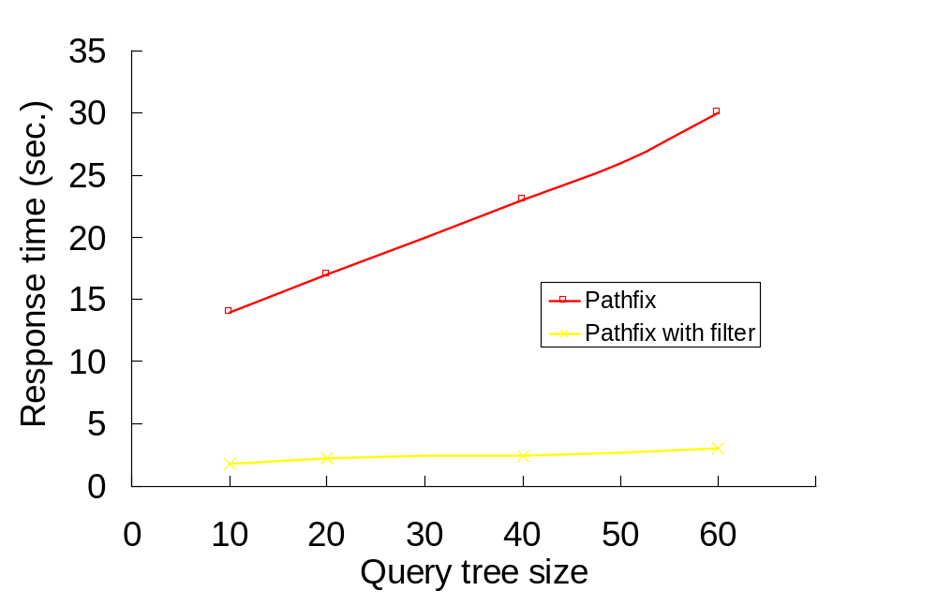
Filtering on 1528 trees

Slide 34
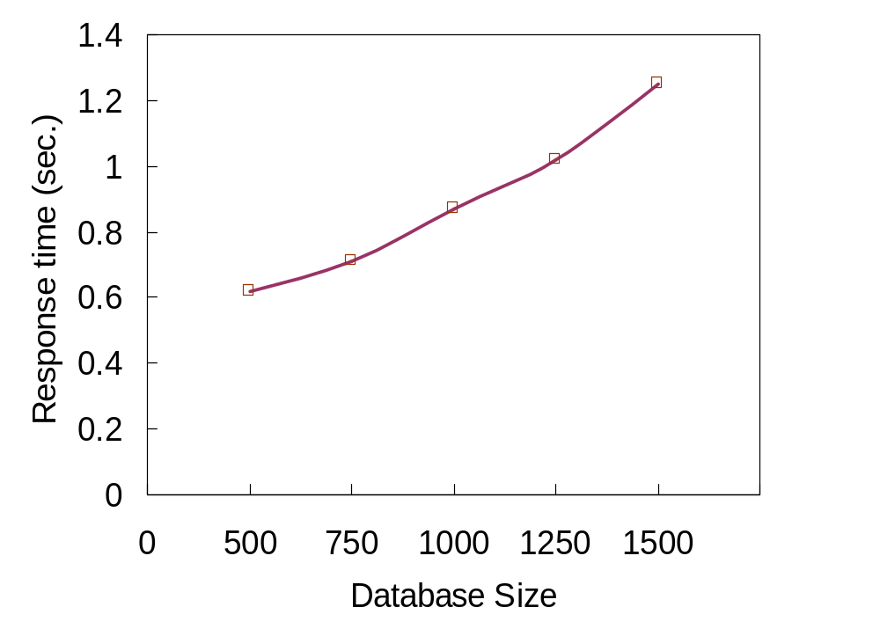
Scalability

Slide 35
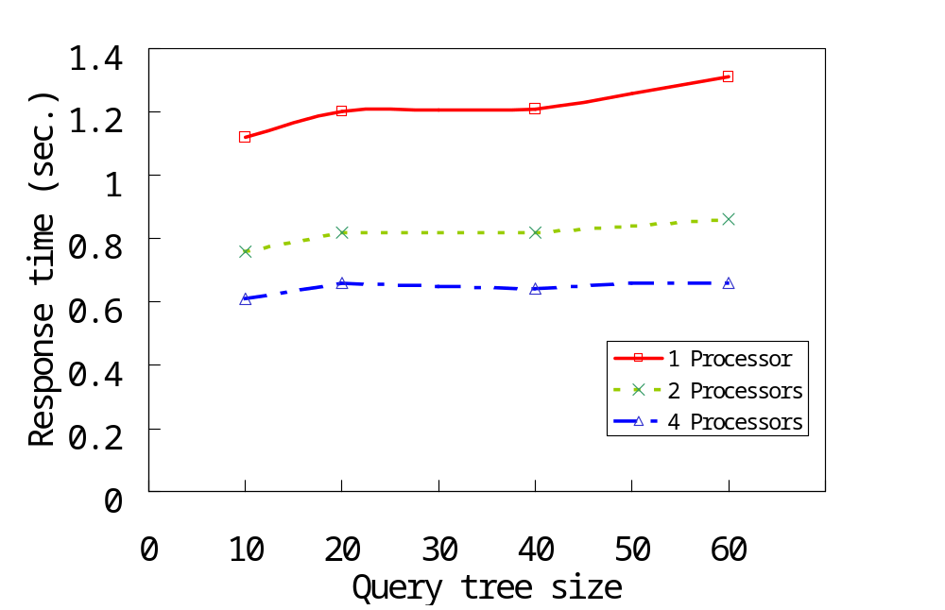
Parallel Processing
1000 trees were used

Slide 36
Treesearch Review
Ancestor order matters.
Sibling order doesn’t.
Don’t cares: * and ?
Distance metric is based on numbers of path differences.
System available; please see our web site.

Slide 37
Related Work
S. Amer-Yahia, S. Cho, L.V.S. Lakshmanan, and D. Srivastava. Minimization of tree pattern queries. SIGMOD, 2001.
Z. Chen, H. V. Jagadish, F. Korn, N. Koudas, S. Muthukrishnan, R. T. Ng, and D. Srivastava. Counting twig matches in a tree. ICDE, 2001.
J. Cracraft and M. Donoghue. Assembling the tree of life: Research needs in phylogenetics and phyloinformatics. NSF Workshop Report, Yale University, 2000.

Slide 38
Tree Edit
Order of children matters
A'
A
A A'
del(B)
ins(B)
B
C
B
C

Slide 39
Tree Edit in General
Operations are relabel A->A', delete (X), insert (B).
A'
A
A A'
del(X)
ins(B)
X
C
B
C
C
C

Slide 40
Review of Tree Edit
Generalizes string editing distance (with *) for trees. O(|T1| |T2| depth(T1) depth(T2))
The basis for XMLdiff from IBM alphaworks.
“Approximate Tree Pattern Matching” in Pattern Matching in Strings, Trees, and Arrays, A. Apostolico and Z. Galil (eds.) pp. 341-371. Oxford University Press.

Slide 41
Graph Matching Algorithms: Brute Force
1
7
2
3
6
5
4
root
G_{a}
G_{b}
(1,4)
(1,5)
(1,6)
(1,7)
(2,5)
(2,6)
(2,7)
(2,4)
(2,6)
(2,7)
(3,6)
(3,7)
(3,5)
(3,7)
(3,5)
(3,6)
(3,6)
(3,7)
(3,4)
(3,7)
(3,4)
(3,6)

Slide 42
Graph Matching Algorithms
Exact Matching
Inexact Matching
1
Ullmann’s Alg.
Nilsson’s Alg.
2
3
root
root
G_{a}
7
(1,4)
(1,5)
(1,4)
6
5
4
(1,5)
(1,6)
(1,7)
(1,_)
G_{b}
Delete
(2,4)
(2,6)
(2,4)
(2,6)
(2,7)
(2,_)
Bad connectivity
(3,4)
(3,7)
(3,4)
(3,7)
(2,_)

Slide 43
Complexity of Graph Matching Algorithms
Matching graph of the same size:
  Difficulty, time consuming, but it is not proved to be NP-Complete
Matching a small graph in a big graph
  NP-Complete

Slide 44
Steps in Graph Searching
STEP 1
Filter the search space.
We need indexing techniques to
    Find the most relevant graphs
    Then the most relevant subgraphs
Filtering finds the answer in a fast way:
  How similar the query is to a database graph?
  Could a database graph “G” contain the query?

Slide 45
Steps in Graph Searching
STEP 2
Formulate query
  Use wildcards
  Decompose query into simple structures
    Set of paths, set of labels
Matching
  Traditional (sub)graph-to-graph matching techniques
  Combine set of paths (from step 2)
  Application specific techniques
STEP 3

Slide 46
Filtering Techniques
STEP 1
  Content Based: Bit Vector of Features Application dependent, use it when feature set is rich, e.g. the graph contains 5 benzene rings.
  Structural (representation of the data) Based:
    Subgraph relations
    Take tracks of the paths (all-some) in the database graphs
      Dataguide, 1-index, XISS , ATreeGrep, GraphGrep, Daylight Fingerprint, Dictionary Fingerprints (BCI).

Slide 47
Daylight Fingerprint
STEP 1
Fixed-size bit vector;
For each graph in the database:
  Find all the paths in a graph of length one and up to a limit length ;
  Each path is used as a seed to compute a random number r which is ORed in.
  fingerprint := fingerprint | r
  [Daylight (www.daylight.com)]
  [BCI (www.bci1.demon.co.uk/) ]

Slide 48
Daylight Fingerprint –Similarity-
STEP 1
The similarity of two graphs is computed by comparing their fingerprints. Some similarity measures are:
  Tanamoto Coefficient (the number of bits in common divided by the total number);
  Euclidean distance (geometric distance);

Slide 49
T-Index (Milo/Suciu ICDT 99)
STEP 1
Non-deterministic automaton (right graph) whose states represent the equivalence classes (left graph) produced by the Rabin-Scott algorithm (Aho) and whose transitions correspond to edges between objects in those classes.
Book
1
Book
Editor
Chapter
1
Chapter
Editor
Chapter
2
3
4
Keyword
Title
Author
Name
Author
2
keyword
3,4
Author
Title
Name
Title
5
9
Title
6
7
8
Author
John
XML
Mary
Jack
OLAP
5
6
7,8
9

Slide 50
LORE
Nodes: V-index, T-index, L-index (node labels, incoming labels, outgoing labels)
Data Guide for root to leaf.
Book
1
Book
Editor
Chapter
1
Chapter
Editor
Chapter
2
3
4
Keyword
Title
Author
Name
Author
2
3,4
Author
Title
Name
Keyword
9
Title
5
6
7
8
Author
John
XML
Mary
Jack
OLAP
5
9
6, 9
7,8
http://www-db.stanford.edu/lore/

Slide 51
SUBDUE
STEP 3
Find similar repetitive subgraphs in a single-graph database.
  An improvement over the inexact graph matching method proposed by Nilsson
  Minimum description length of subgraphs
  Domain-Dependent Knowledge
Application in : protein databases, image databases, Chinese character databases,
  CAD circuit data and software source code.
  An extension of SUBDUE (WebSUBDUE ) has been applied in hypertext data.
It uses:
http://cygnus.uta.edu/subdue/

Slide 52
GraphGrep
Glide: an interface to represent graphs
inspired by SMILES and XPATH
Fingerprinting: to filter the database
A subgraph matching algorithm
STEP 2
STEP 1
STEP 3
D. Weininger, SMILES. Introduction and Encoding Rules, Journal Chemical Information in Computer Science,28-31,1998.
J. Clark and S. DeRose, Xml Path Language (Xpath), http://www.w3.org/TR/xpath, 1999

Slide 53
Glide:query graph language
Node a/
Edge a/b/
Path a/b/c/f/
Branches a/(h/c/)b/
a
a
b
a
b
c
f
a
b
h
c

Slide 54
Glide: query graph language
c
Cycle
c%1/ f/ i%1/
Cycles (c returns to a and starts its own cycle)
a%1/h/c%1%2/d/i%2/
f
i
a
c
d
i
h

Slide 55
Glide: wildcards
. a/./c/
* a/*/c/
? a/?/c/
+ a/+/c/
c
a
a
c
a
c
a
c

Slide 56
Query Graphs in Glide
a%1/( ./*/ b/) ?/c/d%1/
a%1/(m/o/o/b/)n/c/ d%1/
a
c
d
b
n
a
c
m
o
d
o
b

Slide 57
Concept
Use small components of the query graph and of the database graphs to filter the database and to do the matching

Slide 58
Graph == Sets of “Paths”
B
0
3
C
lp = 4
A={(1)}
AB={(1, 0), (1,2)}
AC ={(1, 3)}
ABC={(1,0,3), (1,2,3)}
ACB={(1, 3, 0), (1,3,2)}
ABCA={(1 ,0 ,3 ,1),(1, 2, 3, 1)}
ABCB ={(1 ,2,3 ,0),(1, 0, 3, 2)}
B={(0),(2)}
BA={(0,1),(2,1)}
BC={(0,3), (2, 3)}
….…….
A
1
2
B
1
A
1
A
1
A
1
A
lp = 2
0
B
2
B
3
C
3
C
lp = 3
3
C
3
C
B
B
0
2
lp = 4
2
B
0
B
1
A
1
A

Slide 59
Fingerprint
D
1
B
0
B
0
3
C
B
2
3
C
C
4
B
C
B
E
A
1
2
B
A
4
5
6
A
1
2
3
Graph g1
Graph g2
Graph g3
Key | g₁ | g₂ | g₃
h(CA) | 1 | 0 | 1
……
h(ABCB) | 2 | 2 | 0

Slide 60
Patterns in a Query
lp = 4
A B C A
C B
1
A
B
C
2
0
B
3
2
3
C
A
B
0
B
lp = 3
A B C C B
C A
1
A%1/B/C%1/B/

Slide 61
Filter the Database
Key | Query
h(CA) | 1
……
h(ABCB) | 1
Key | g₁ | g₂ | g₃
h(CA) | 1 | 0 | 1
……
h(ABCB) | 2 | 2 | 0
B
0
3
C
A
1
2
B
Graph g1
1
C
D
1
B
0
2
3
B
2
3
C
A
B
B
E
A
4
5
6
B
0
Query
Discarded
Graph g2
C
4
B
C
A
1
2
3
Discarded
Graph g3

Slide 62
Subgraph Matching
A B C A
C B
1
C
B
0
3
C
B
0
2
3
A
1
2
B
A
B
Query
Graph g1
Select the set of paths in g1 matching
the patterns of the query
ABCA = {(1, 0, 3, 1),(1, 2, 3, 1)}
CB = {(3,0),(3,2)}
Combine any list from ABCA with any list of CB when labels correspond to identical nodes (possible exponential)
ABCACB = {((1, 0, 3, 1),(3, 0)),
((1, 0, 3, 1),(3, 2)),((1, 2, 3, 1),(3, 0)),
((1, 2, 3, 1),(3, 2))}
ABCACB ={removed,
((1, 0, 3, 1),(3, 2)),((1, 2, 3, 1),(3, 0)),
removed}
Remove lists if they contains identical nodes when they should not

Slide 63
Matching Query with Wildcards
D
2
A/ B / (./) */ D/
AB
D
0
1
3
A
B
Find matching candidate subgraphs
Search in the graphs for ‘. ‘ and ‘*’ using transitive closure.

Slide 64
Complexity: Building the database
Linear in the size of the database |D|
Linear in the number of the nodes in the graphs, n
Polynomial in the valence of the nodes, m
Exponential in the value of lp (small constant!)
O(|D| n m^{lp})

Slide 65
Complexity: Subgraph Matching
Linear in the size of the database |D| and data graph size n.
Exponential in p and lp, where p is number of query patterns, (n m^{lp}) is number of paths of size lp in a data graph of size n and valence m. Any combination of matches possible. In practice: bigger lp is good.
O(|D| (n m^{lp})^{p})

Slide 66
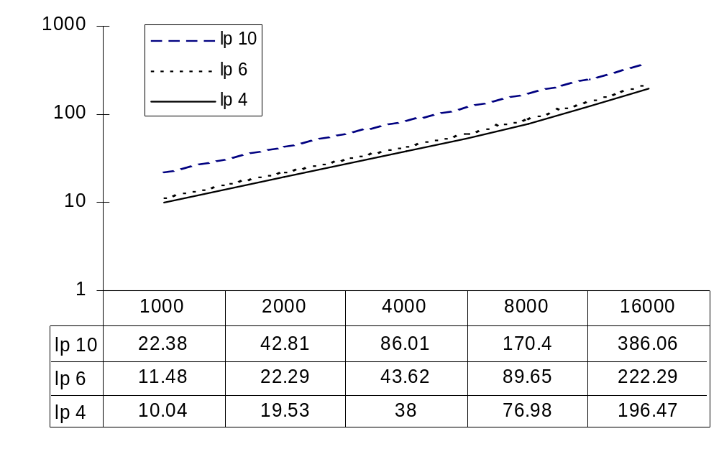
Setup on NCI database 20-270 nodes graphs (time in seconds)

Slide 67
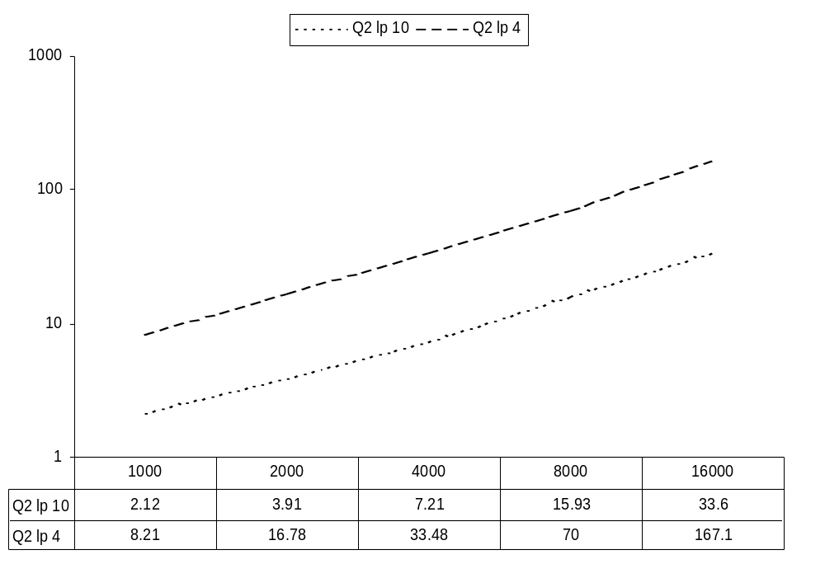
Results (better when database has longer paths; time in seconds)
Query Q2:
Nodes: 189
Un-Edges: 210
Filtering
Discard 99%
e.g.
|D|=16,000
|D_{f}|=612 for Q2

Slide 68
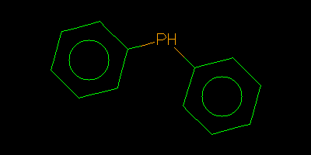
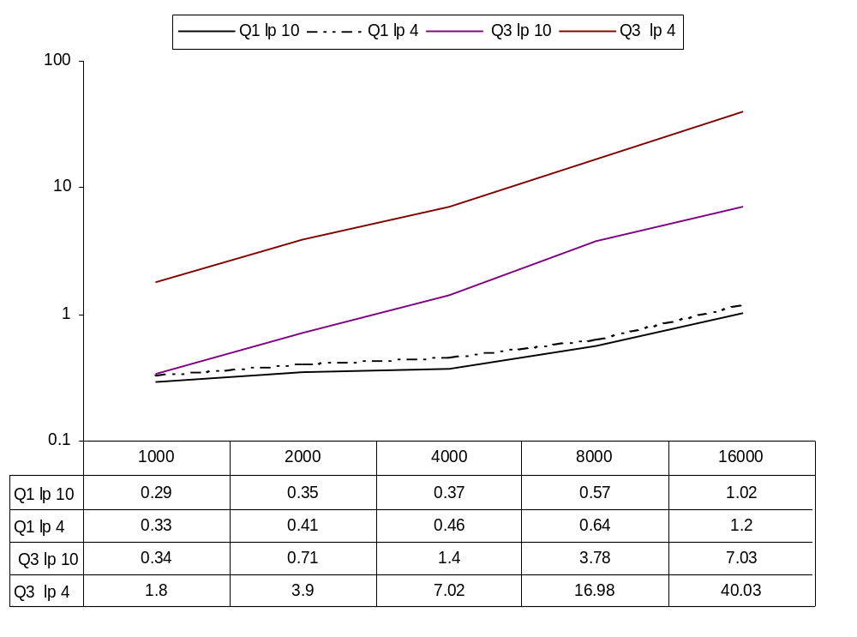
Results (longer is better again)
Database size

Slide 69
URLs for Tools
http://www.cs.nyu.edu/shasha/papers/graphgrep
http://cs.nyu.edu/cs/faculty/shasha/papers/treesearch.html
http://web.njit.edu/~wangj/sigmod.html

Slide 70
Conclusion and Future Vision
Approaches to date combine paths by intersection. The intersection step can be slow. Can this be improved?
Develop a framework for turning searching to pattern discovery in trees (e.g. Zaki’s TreeMiner) and graphs, possibly unified with Subdue.

