Slide 1
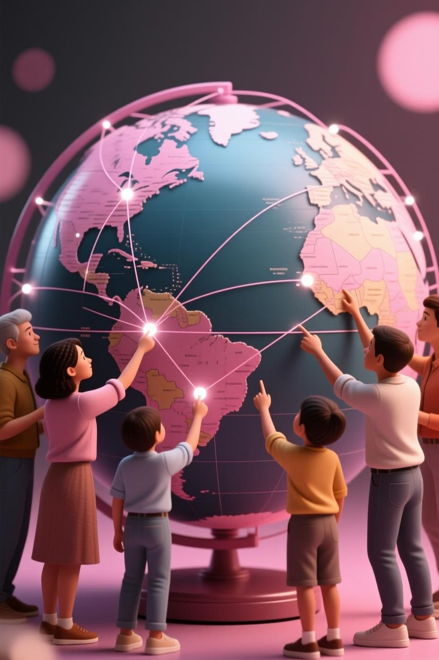

International StudieS: UnderStanding a World That TalkS
Have you ever wondered how something that happens in one country can affect people all over the world? Imagine the world as a giant group chat. Every country is sending messages 4 sometimes friendly, sometimes confusing, and sometimes in all caps. Yet everything they do still affects everyone else.

Slide 2

The Ripple Effect: Global Connections
A drought in one country can raise food prices in another. A political decision on one continent can shake economies on another. Even a trend started by one teenager can spread globally overnight.
This is exactly what International Studies tries to understand 4 how countries communicate, argue, cooperate, and shape the world we live in.

Slide 3

What is International Studies?
InterdiSciplinary Approach
International Studies is an interdisciplinary major, combining politics, economics, history, culture, and communication. We study them together because the world doesn9t operate in separate boxes.
Connected World
A political decision can affect an economy. A cultural misunderstanding can affect diplomacy. A historical conflict can influence relationships even today.

Slide 4

The Global ClaSSroom Analogy
To make it simple, think of the world as a huge classroom and each country as a student with a different background, language, and personality.
Some students are quiet, some are loud, some love teamwork, and some prefer independence. The <teacher,= which we might imagine as the United Nations, tries to keep peace and help everyone work together.
Understanding this global classroom helps us make sense of international behavior and global challenges.

Slide 5



Examining Real-World ISSueS
In our major, we examine real-world issues 4 but not as isolated events. We look at how they connect and influence each other.
Conflict OriginS
Why do conflicts start?
Peace NegotiationS
How is peace negotiated?
Culture'S Role
How does culture shape communication?

Slide 6

The Snack Trade: A MicrocoSm of Global MiSunderStanding
Imagine two kids trading snacks. One says, <I9ll give you my cookies for your chips,= but the other refuses because in their culture, sharing is about friendship, not trading.
A tiny misunderstanding like that, on the global level, can grow into a diplomatic issue. That9s why we study cultural signals, global power dynamics, and critical decision-making between nations.

Slide 7

ESSential SkillS for a Global Future
Studying International Studies equips us with vital skills for navigating our interconnected world.
Critical Thinking
Analyzing complex global events.
Problem-Solving
Finding solutions to international challenges.
Intercultural Communication
Bridging cultural divides.
Multiple PerSpectiveS
Understanding diverse viewpoints.

Slide 8
DiverSe Career PathS
One of the strongest reasons to study International Studies is its wide range of opportunities.
Diplomacy & NGOS
Embassies, UN, international organizations, human rights, education, development.
Global BuSineSS
Multinational companies, global trade, tourism.
Information & AnalySiS
Journalism, research, policy analysis, education.

Slide 9
Making the World Run More Smoothly
If the world were a machine, International Studies graduates are the people who understand how all the parts connect and how to make it run more smoothly.
We9re the ones who grow up to help countries cooperate, communicate, and avoid turning the whole world into a playground fight.

Slide 10

Beyond FlagS: A Connected SyStem
International Studies is not about memorizing flags or learning random facts about countries. It9s about understanding how the world actually works 4 how economies depend on each other, how cultures shape decisions, and how cooperation can solve global problems.
This major teaches us to think globally, communicate wisely, and imagine a world where cooperation is stronger than conflict.

