Slide 1
ACV Final Project
學號：111318096
姓名：巫伯銘

Slide 2
Contents
Flow Chart
Methods
Results
Reference

Slide 3
Flow Chart

Slide 4
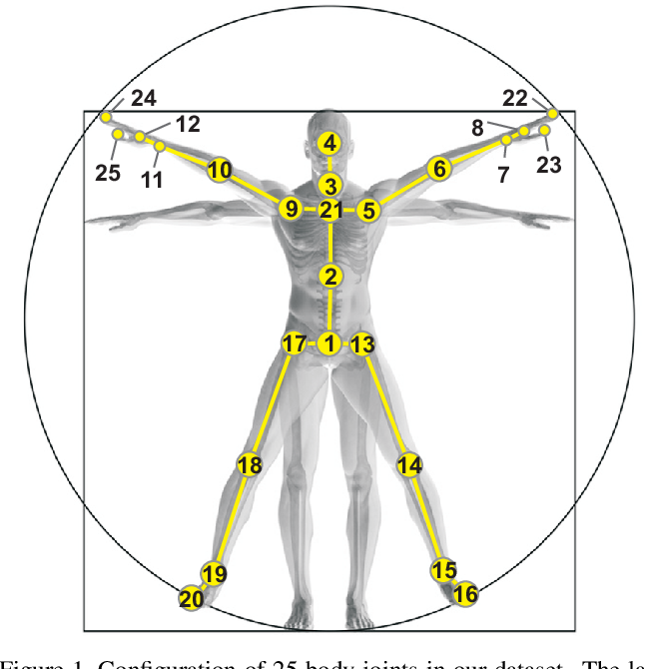
Methods
https://www.semanticscholar.org/paper/NTU-RGB%2BD%3A-A-Large-Scale-Dataset-for-3D-Human-Shahroudy-Liu/091e4d3c85dc0a8212afea875cd3b162d273d46b

Slide 5
Results
 | Level 1 | Level 2 | Level 3 | Ratio
Accurate videos in testing data | 4 | 4 | - | 8/8
Time (sec.) | 0.037496 | 0.029310 | - | -
Accurate videos in 1/12 data | 4 | 8 | - | 9/12

Slide 6
Results
Confusion matrix in 1/12 data
predict
 | Hand waving | Kicking something | Sit down | Stand up
Hand waving | 3 | 0 | 0 | 0
Kicking something | 0 | 1 | 2 | 0
Sit down | 0 | 0 | 2 | 1
Stand up | 0 | 0 | 0 | 3
true

Slide 7
Reference
Amir Shahroudy, Jun Liu, Tian-Tsong Ng, Gang Wang: NTU RGB+D: A Large Scale Dataset for 3D Human Activity Analysis, Proceedings of the IEEE Conference on Computer Vision and Pattern Recognition (CVPR), 2016, pp. 1010-1019

