Slide 1
DocCraft: Streamlining Document Intelligence
A Python Package for Unified Document Parsing & Benchmarking
Simon Wu, Sustainable Computational Engineering, 2025

Slide 2

THE BEGINNING
Restaurant owners struggling to track supplier costs
More issues:
Where to find suppliers?
How to negotiate?
How to compare prices?
What are your prices?
I’ll tell you when you buy
Opaque prices leave pricing power in the hands of the supplier

Slide 3
THE DIAGNOSIS
Why are restaurant owners struggling to track supplier costs?
You have an information deficiency problem!
Simon, help!
You need DATA!

Slide 4

THE SOLUTION
Create a Database
Help us create a database
Okay!

Slide 5


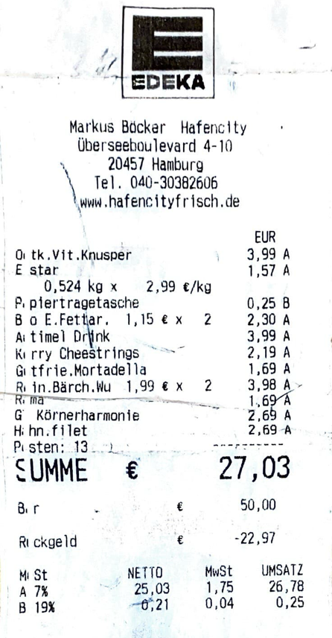
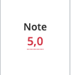
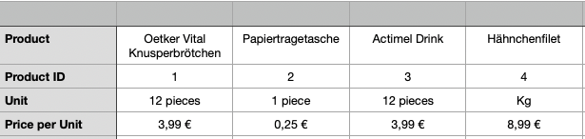
THE CHALLENGE
Processing Data into a Database can be hard!
How to go from here:
Definitely not here!
Manual Invoice processing is error-prone and time-consuming!
To here:
Image credit: freepik.com

Slide 6
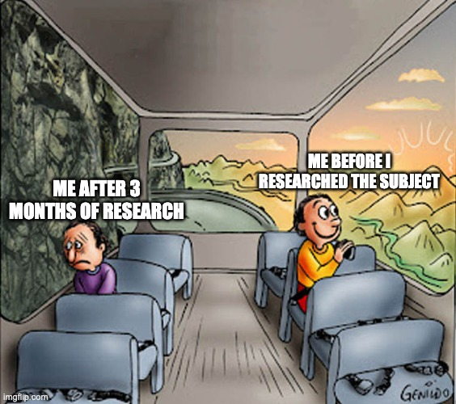
THE SIMPLE (?) SOLUTION
Use intelligent document parsing
It’s 2025, I’m sure there are very good intelligent document parsing solutions out there!

Slide 7
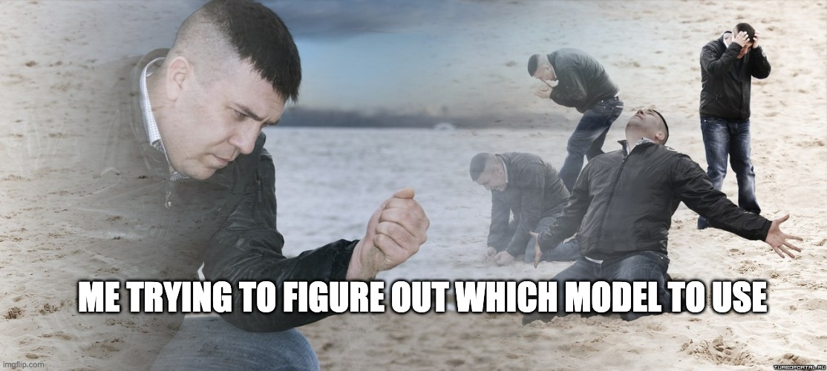
REACHING PEAK DESPAIR
Intelligent document parsing is a fractured and jumbled field
PDF
HEIC
OCR
LayoutLM
Indexify
Multimodal LLMs
Tesseract
…. and lots more!

Slide 8
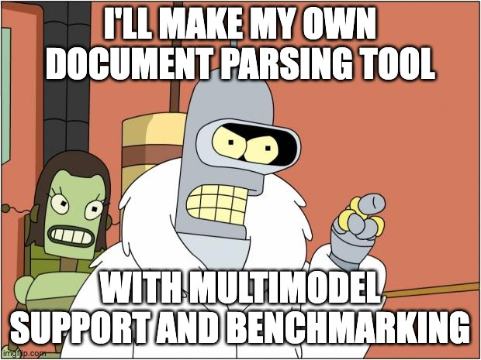
THE (ACTUAL) SOLUTION
“One Package to parse them all”
DocCraft (intended) features
Unified interface for OCR and AI processing
Customizable pipelines
Benchmarking for different models
Document
DocCraft
Structured Data + Performance metrics

Slide 9
THE END (FOR NOW)
I just gave a presentation at RWTH Aachen University, AMA

