Slide 1
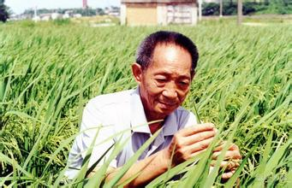
Yuan Long Ping
People

