Slide 1
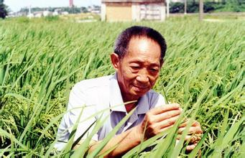
Yuan Long Ping
Devote
Perseverance
Innovate
GOD
OF
RICE

