Slide 1
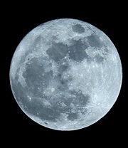

witter Sentiment
COSC 592
William Gillespie
Greg Moldovan
Watson Tong

Slide 2
Project Motivation
How is it different from the assignment we’ve already done in class?
Emoji
Full Moon

Slide 3
Emoji
Twitter has a 140 character limit [1].
Emoji are the perfect way to convey a range of emotions in a small amount of space.

Slide 4
Research Questions
Do Emoji give additional information about the sentiment of tweets compared to words?
How similar are the sentiments expressed in words and Emoji?

Slide 5
Our Emoji Dictionary
emoji_dict = {'😌': 1, '😤': -2, '😍': 2, '😚': 2, '😭': -2, '😔': -1, '🙈': -1, '😓': -1, '😃': 2, '😋': 2, '😻': 2, '😘': 2, '☺️': 2, '💔': -2, '💗': 1, '💖': 1, '❤️': 1, '💕': 1, '✨': 1, '🌟': 1, '😊': 1, '😁': -2, '😜': 1, '😒': -1, '🎉': 2, '😹': 1, '👏': 1, '🙉': -1, '😆': 1, '🙀': -1, '💝': 1, '💋': 1, '👊': -1, '😋': 1, '😎': 2, '😈': -1, '🎈': 1, '💞': 1, '💀': -3, '😩': -2, '😢': -2, '💓': 1, '💍': 1, '👼': 1, '😕': -1, '😟': -1, '👍': 1, '👌': 1, '💛': 1, '😐': -1, '💚': 1, '🔥': -2, '👑': 1, '😣': -1, '🙏': 1, '😾': -2, '😳': -1, '✌️': 2, '☺️': 1, '😷': -3, '😨': -1, '🍫': 1, '😮': -1, '😱': -1, '🍕': 1, '😼': -1, '💎': 1, '☀️': 1, '😏': 1, '🙊': -1, '💙': 1, '🐱': 1, '💣': -2, '🏆': 1, '😡': -2, '💟': 1, '😶': -1, '💓': 1, '🌹': 1, '😰': -1, '😖': -2, '😝': -1, '😙': 2, '🎂': 1, '🎁': 1, '🎊': 1, '😛': 1, '😠': -1, '💰': 1}

Slide 6
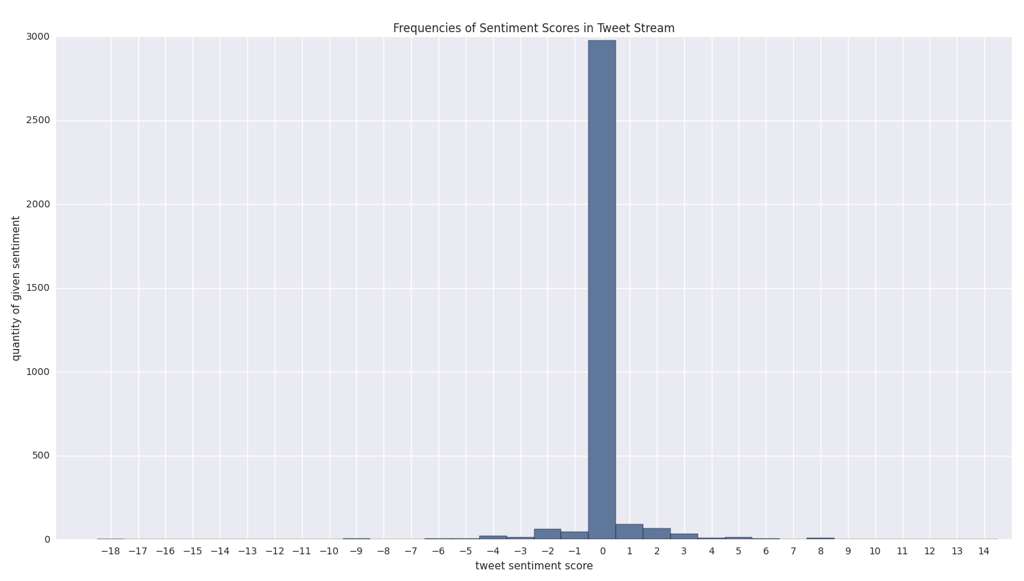
Frequencies of Emoji Sentiment Scores
Tweet Count: 3359, Sentiment Frequency: 396, mean: 0.043, Standard Deviation: 1.169

Slide 7
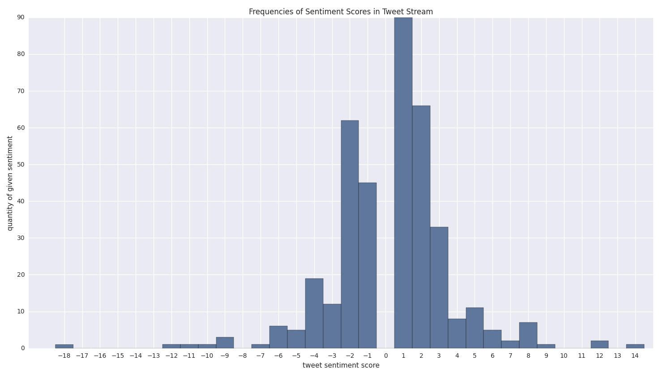
Emoji Sentiment Frequency (no zeros)

Slide 8
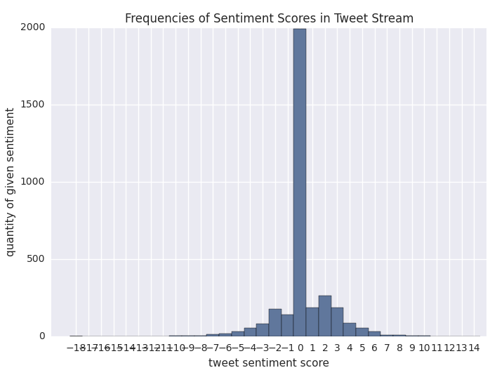
Word Sentiment Frequency
Tweet Count: 3359, Sentiment Frequency: 1415, mean: 0.244, Standard Deviation: 2.137

Slide 9
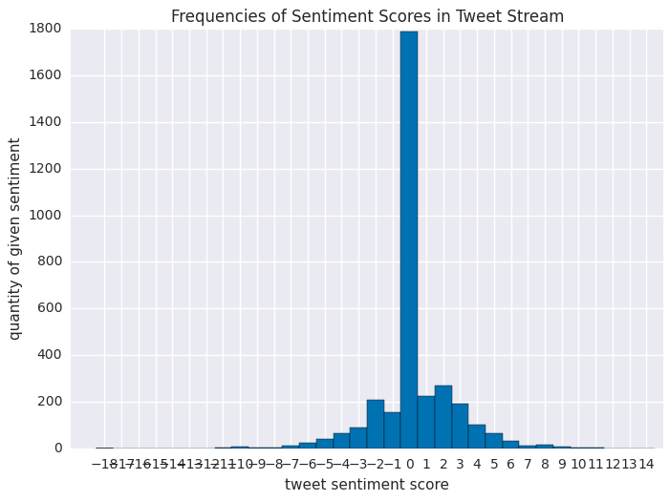
Word and Emoji Combined Sentiment
Tweet Count: 3359, Sentiment Frequency: 1632, mean: 0.286, Standard Deviation: 2.518

Slide 10
So, what have we learned?
49% of tweets have sentiment from words or Emoji.
42% from words alone.
12% from Emoji alone
(there is some overlap)
So, Emoji do add sentiment, but not as much as the words.
But do they give the same information?

Slide 11
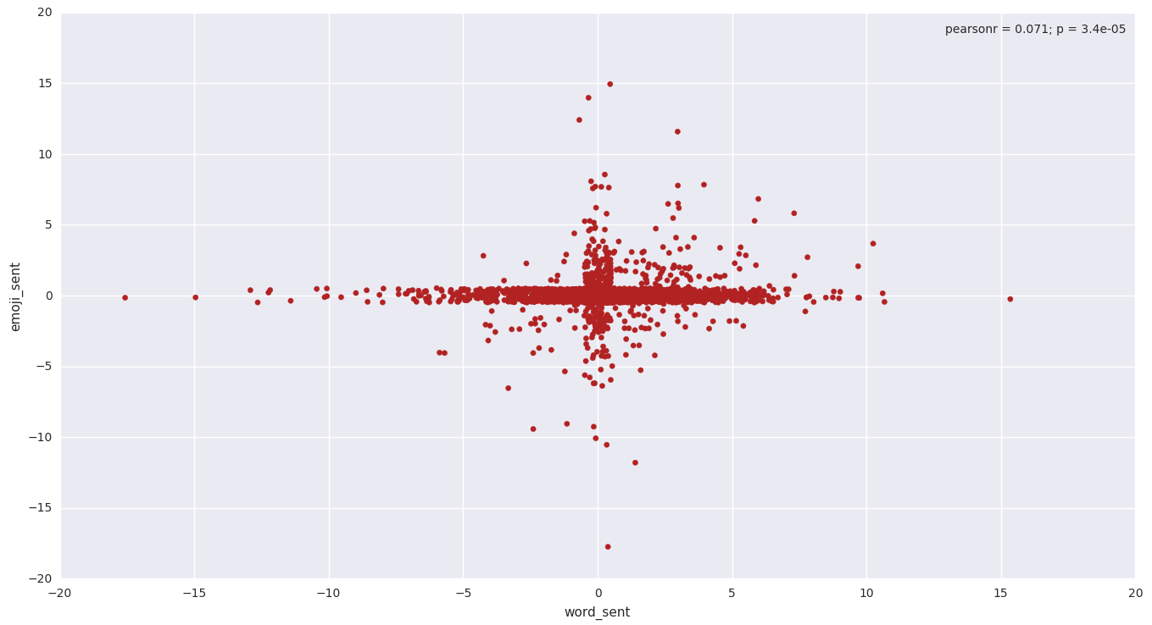
Scatter plot of Emoji by word sentiment
Emoji_mean: 0.04, stdev: 1.17
word_mean: 0.24, stdev: 2.14,
t-statistic: 4.96, p-value: 7.42e-07
File 1

Slide 12
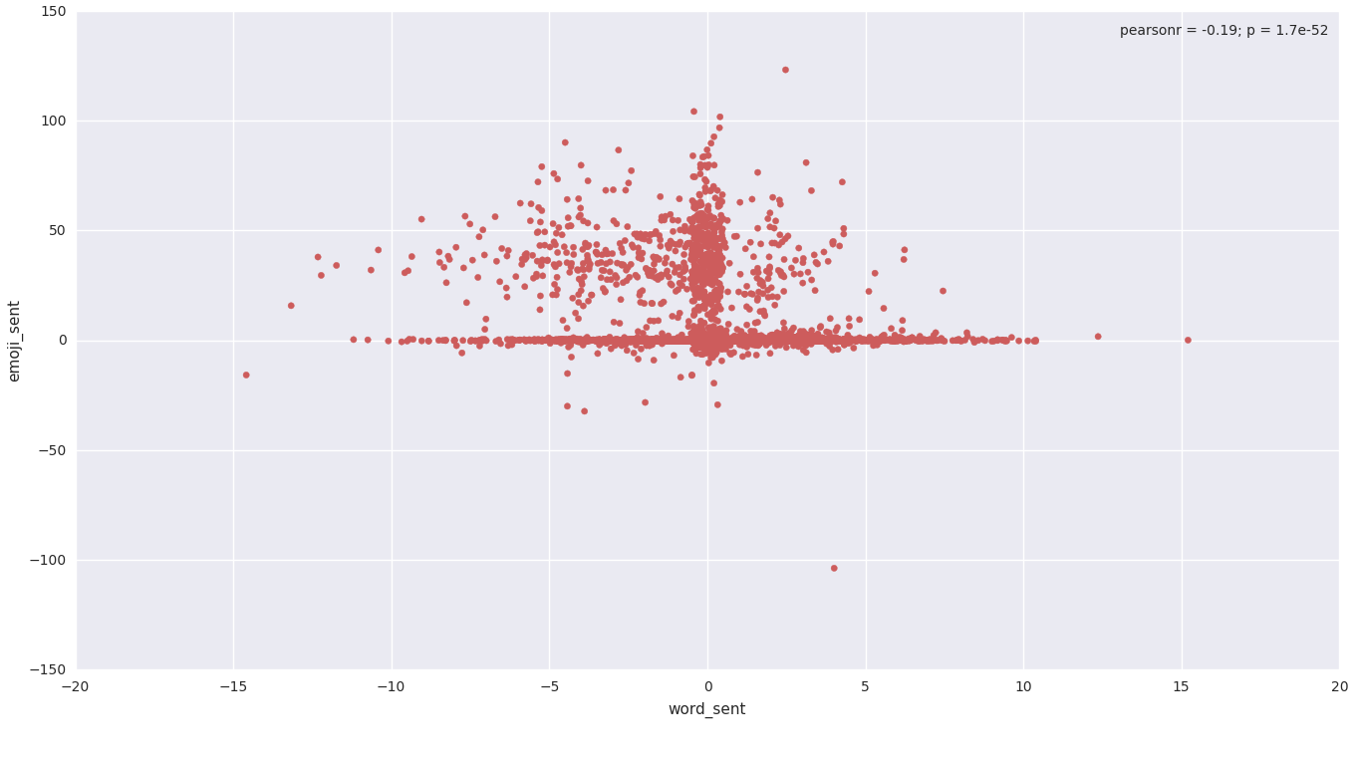
Scatter plot of Emoji by word sentiment
Emoji_mean: 5.0, stdev: 14.4
word_mean: 0.26, stdev: 2.29,
t-statistic: -24.8, p-value: 1.86e-129
File 8

Slide 13
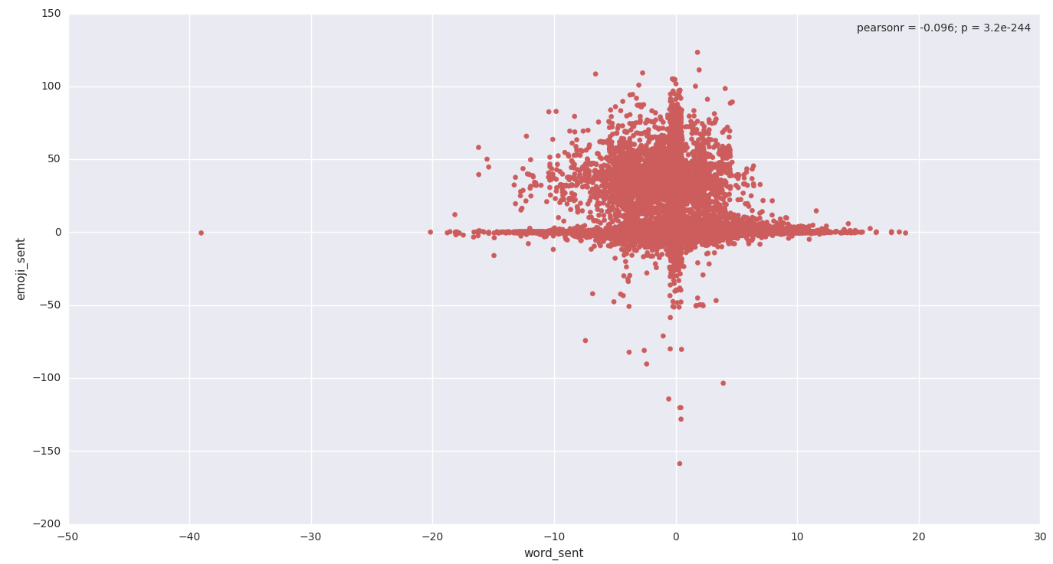
Scatter plot of Emoji by word sentiment
All Files collected: 120,898 tweets

Slide 14
Conclusions
Emoji can give us a different perspective on the sentiment of a tweet, especially when the sentiments of words and Emoji are different.
In 2 data sets, sentiment scores of Emoji were significantly different than word scores.

Slide 15
Full Moon
It’s been thought that it affects the behavior of animals and humans.
Keywords:
mood, feel, music

Slide 16
Normal Sentiment
tweet_count: 115822
sent_freq: 58357
mean_level: 0.48
stdev_level: 3.18
mean_magnitude: 0.43
stdev_magnitude: 2.33
total_sentiment_level: 55535
total_sentiment_magnitude: 49646

Slide 17
Blood Moon Sentiment
tweet_count: 120898
sent_freq: 64446
mean_level: 2.17
stdev_level: 9.19
mean_magnitude: 2.23
stdev_magnitude: 9.17
total_sentiment_level: 261924
total_sentiment_magnitude: 269316

Slide 18
The two files have a similar tweet count; therefore, I’m looking at this data as if in relatively equal sets. The sentiment frequency is how many tweets have a sentiment.
The mean sentiment level is 2.17 for the blood moon and 0.48 for the normal day; that’s 4.5 times higher than a normal Saturday! This means the tweets were much more positive on the blood moon.

Slide 19
The standard deviation is 9.2 for the blood moon and 3.2 for the normal day; that’s almost 3 times higher. This means people were much more sporadic in their tweets on the blood moon.
The mean for the magnitude is 2.23 for the blood moon and 0.43 for the normal day. Also, the standard deviation for the magnitude is 9.2 for the blood moon and 2.33 for the normal day. Since this is slightly larger than the mean for the blood moon (and same for the standard deviation) and less than the normal day mean (a whole level less for the standard deviation) , the normal day had less extreme tweets.

Slide 20
The total sentiment level (all sentiments added up) for the blood moon is 261924 and for the normal day is 55535. The blood moon sentiment is 4.7 times that of the normal Saturday! I was expecting the outcome to be the same, but to find the magnitude significant. Instead, the tweets are obviously much more positive on the eclipse.
The total sentiment magnitude for the blood moon is 269316; comparing that to its sentiment of 261924, there’s not many large negative tweets. The total sentiment magnitude for the normal day is 69646; comparing that to its sentiment of 55535, there’s also not many large negative tweets. Dividing the levels by the magnitudes, 0.97 for the blood moon and 0.8 for normal day, we see that the magnitude is most different for the normal day. Meaning, if anything, there’s more extreme negative tweets on the normal day and much more positive tweets on the blood moon!

Slide 21
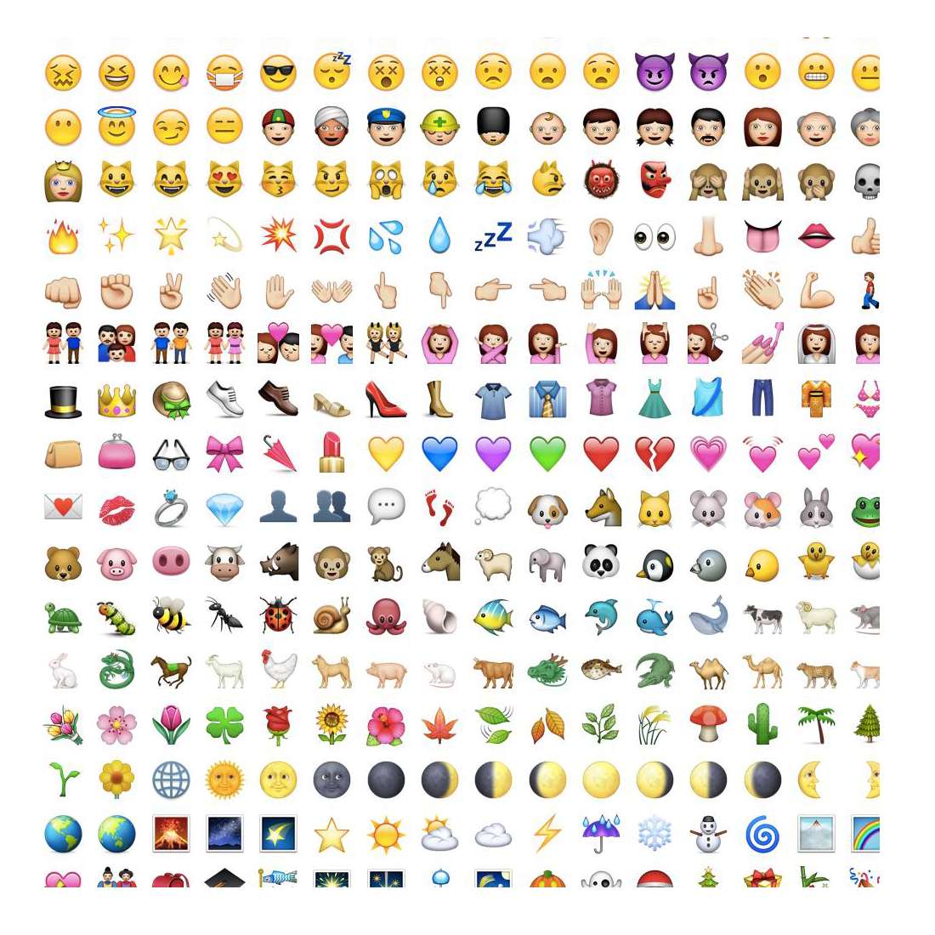
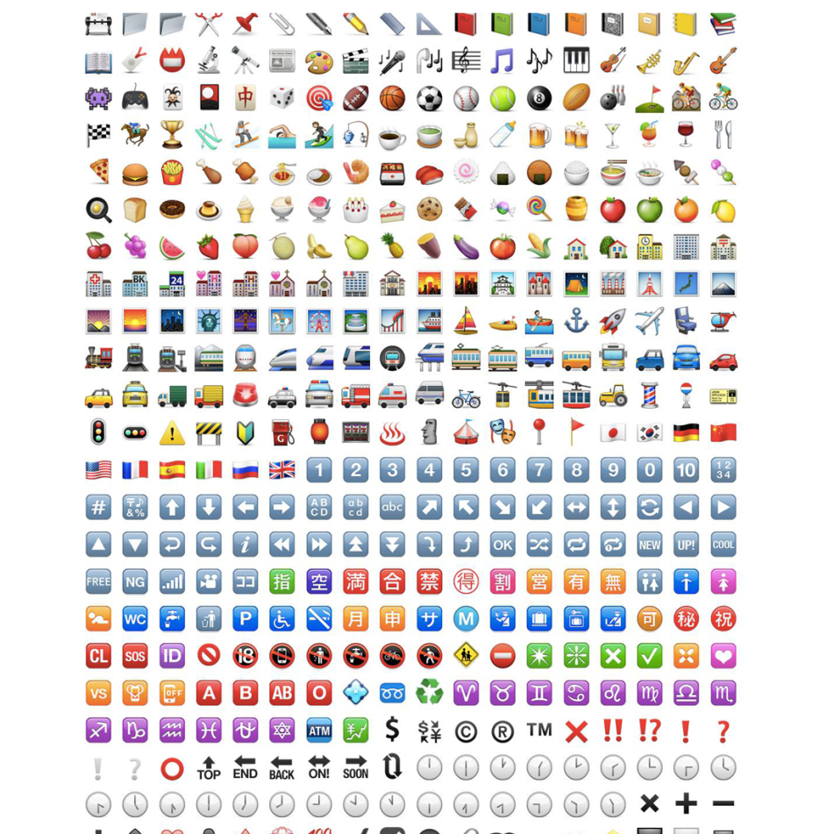
There are a lot of emojis

Slide 22
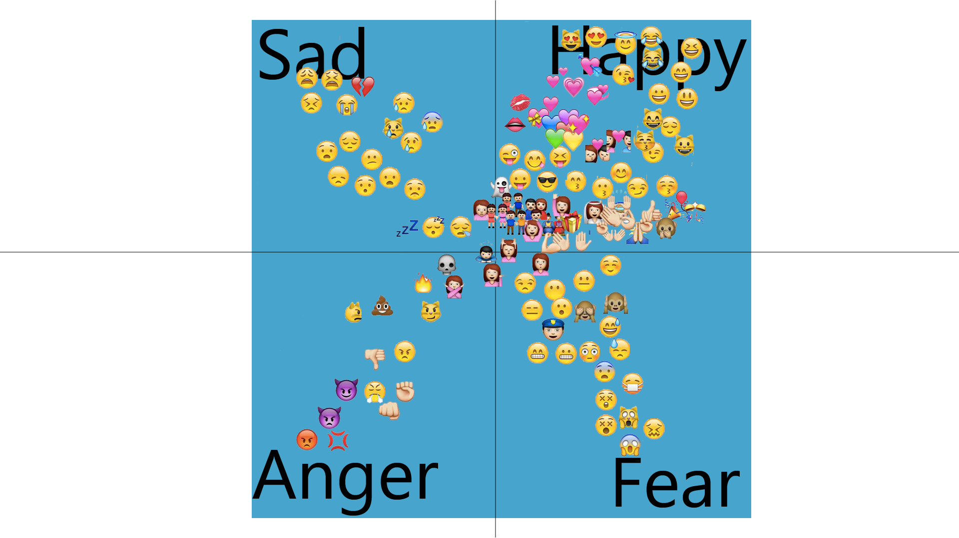

Slide 23
Mood Dictionaries
sad_dict = {'😭': -2, '😔': -1, '💔': -2, '😩': -2, '😢': -2, '😕': -1, '😟': -1, '😰': -1, '😝': -1, '😣': -1, '😪': -1, '💤': -1} anger_dict = {'😤': -2, '😡': -2, '😠': -1, '😈': -1, '💀': -3, '👊': -1, '🔥': -2, '😾': -2, '💣': -2, '😼': -1} fear_dict = {'😌': 1, '🙈': -1, '😓': -1, '😁': -2, '😖': -2, '😮': -1, '😱': -1, '😒': -1, '😐': -1, '🙉': -1, '🙀': -1, '😶': -1, '😨': -1, '😳': -1, '😷': -3, '🙊': -1}

Slide 24
Sample 1 (early in morning)
Distribution on count
Distribution on Score

Slide 25
Sample 8 (in the evening)
Distribution on count
Distribution on Score

Slide 26
Sample on full day
Distribution on count
Distribution on Score

Slide 27
Overwhelmingly happy
Why?
1) Happy focus
2) Culture of Twitter
Jokes or anything else to
“spammy” amounts of emoji

Slide 28
Data was skewed, was this additional data useful?
Certainly. Another layer to see how the twittersphere currently feels.
Emoji are universal.

Slide 29
Sources
[1]
https://dev.twitter.com/overview/api/counting-characters
[2]
http://en.wikipedia.org/wiki/Emoji#Apple_encoding
[3]
http://www.fileformat.info/info/emoji/list.htm
[4]
http://en.wikipedia.org/wiki/Lunar_effect#Human_behavior
[5]
http://faculty.washington.edu/chudler/moon.html
[6]

