Slide 1
Rough-fuzzy rule interpolation
Chengyuan Chen ª , Neil Mac Parthaláin ^{b} , Chris Price ^{b} , Qiang Shen ^{b , ∗}
^{Information Sciences}

Slide 2
1. Introduction
Rough-fuzzy sets and their representative values
Rough-fuzzy rule interpolation
Application case study
Conclusion

Slide 3
1. Introduction

Slide 4
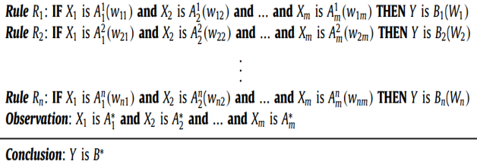
1 Introduction
A sparse/incomplete fuzzy rule base
Fuzzy inference engine
Fuzzy Input
Fuzzy Output
Fig1. A fuzzy rule-based system
Fuzzy rule base:
Notes:
在由稀疏规则库组成的模糊系统中，模糊规则插值对于执行模糊推理来说是一种重要的方法。对于现有的模糊插值方法，都是通过利用模糊集的表达能力来处理和解释基于规则推理的不确定性。在模糊规则插值中,很少有关于处理规则或观察的不确定性的研究，(也就是说模糊集本身的不确定性的研究)，这是因为这些方法采用传统的模糊集理论来实现，这无法解决模糊集本身的不确定性。同时在定义模糊集时，隶属函数也扮演着重要的角色, 但有时很难精确地定义这种隶属函数功能。更普遍来说 ,在模糊规则系统中可能有不同类型的不确定性,这些不确定性需要被捕获或建模：

Slide 5
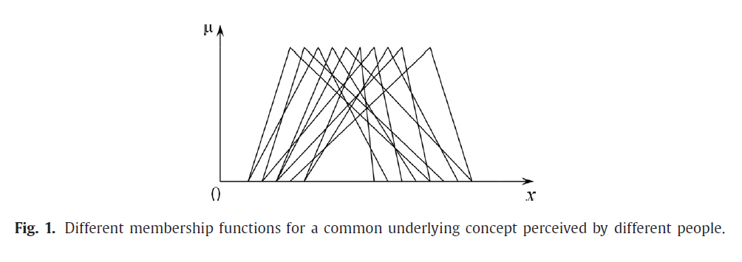
(1) The interpretation of the values of the underlying linguistic variables may be vague, e.g., the same word/concept can mean different things to different people.
(2) An element can belong to a fuzzy set with a given degree, but that degree of belonging may itself be uncertain.
(3) The obtained rules may be inconsistent when individual views are provided from a group of experts.
Notes:
对解释某个潜在语言变量的值可能是模糊的。也就是说，对不同的人来说,同一个词可以意味着不同的意思。

Slide 6
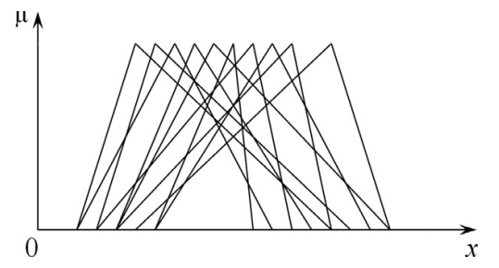
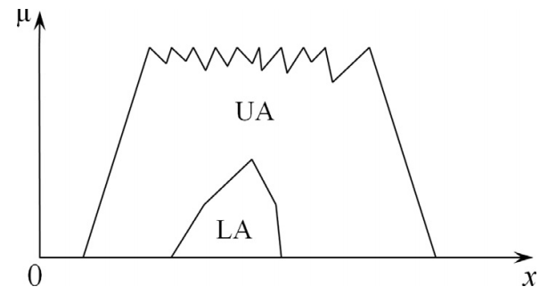
In this paper, a novel rough-fuzzy approach is proposed in an attempt to address such difficulties. The proposed approach allows the representation, handling and utilisation of different levels of uncertainty in knowledge. This allows transformation-based fuzzy rule interpolation techniques to model and harness additional uncertain information in order to implement an effective fuzzy interpolative reasoning system.

Slide 7
2. Rough-fuzzy sets and their representative values

Slide 8

2.1. Rough-fuzzy sets
Let I = (U, A) be an information system, where U is a non-empty set of finite objects and A is a non-empty finite set of attributes such that a : U → V_{a} for every a∈A with V_{a} being the domain that attribute a takes values from. With any P⊆A there is a crisp equivalence relation IND (P)
Let X ⊆U, X be approximated using only the information contained within P by constructing the P-lower and P-upper approximations of X :

Slide 9
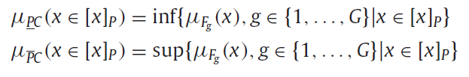
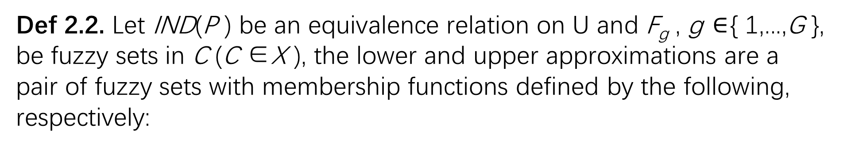
Def 2.1. With any P ⊆A , an alternative equivalence relation IND(P) to the traditional one of Eq. (1) can be defined by
where F_{g} , g ∈ { 1,...,G }, are fuzzy sets that jointly define a particular concept C in X , X ⊆U .
Def 2.2. Let IND(P ) be an equivalence relation on U and F_{g} , g $∈${ 1,...,G }, be fuzzy sets in C (C ∈X ), the lower and upper approximations are a pair of fuzzy sets with membership functions defined by the following, respectively:

Slide 10

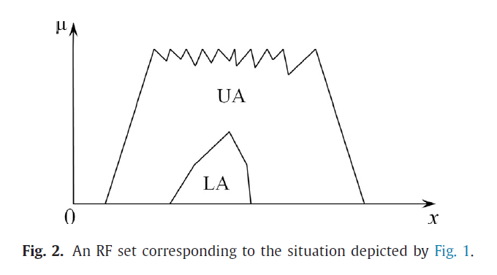
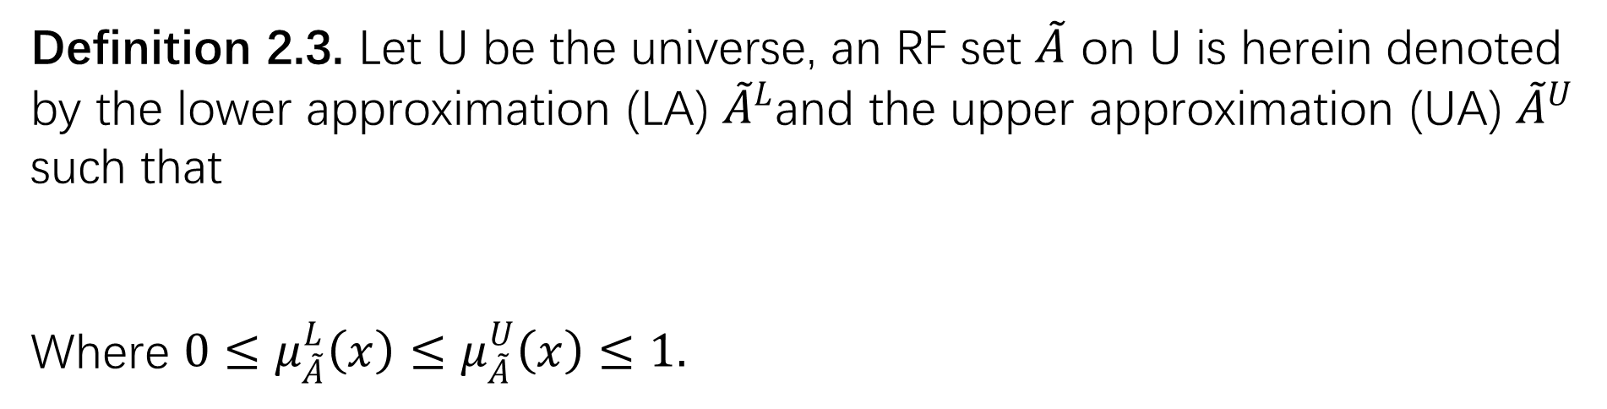
Definition 2.3. Let U be the universe, an RF set $\tilde{A}$ on U is herein denoted by the lower approximation (LA) ${\tilde{A}}^{L}$and the upper approximation (UA) ${\tilde{A}}^{U}$ such that
Where ${0≤μ}_{\tilde{A}}^{L}\left(x\right)≤μ_{\tilde{A}}^{U}\left(x\right)≤1.$

Slide 11

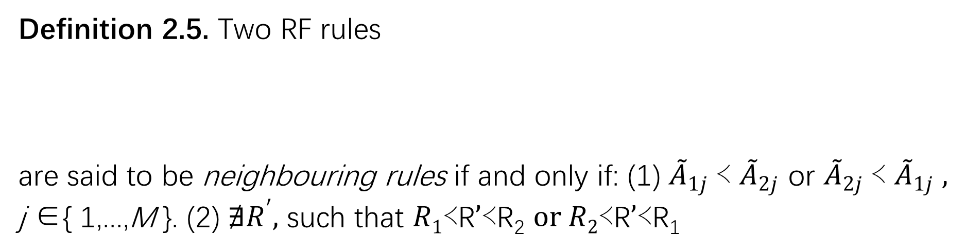
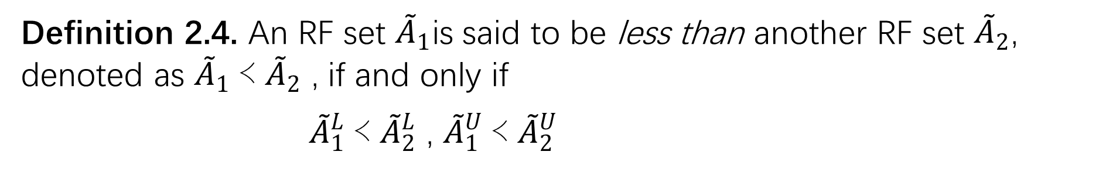
2.2. Basic notions
A₁ ≺A₂ : if ∀ α∈ (0,1] , the following conditions hold :
inf { A_{1α}} < inf { A_{2α}} , sup { A_{1α}} < sup { A_{2α}}
Definition 2.4. An RF set ${\tilde{A}}_{1}$is said to be less than another RF set ${\tilde{A}}_{2}$, denoted as ${\tilde{A}}_{1}$≺ ${\tilde{A}}_{2}$ , if and only if
${\tilde{A}}_{1}^{L}$≺ ${\tilde{A}}_{2}^{L}$ , ${\tilde{A}}_{1}^{U}$≺ ${\tilde{A}}_{2}^{U}$
Definition 2.5. Two RF rules
are said to be neighbouring rules if and only if: (1) ${\tilde{A}}_{1j}$≺ ${\tilde{A}}_{2j}$ or ${\tilde{A}}_{2j}$≺ ${\tilde{A}}_{1j} ,$ j ∈{ 1,...,M }. (2) $∄R^{′},$ such that $R1\text{≺}\text{R}’\text{≺}\text{R}\text{2} or R2\text{≺}\text{R}’\text{≺}\text{R}\text{1}$

Slide 12
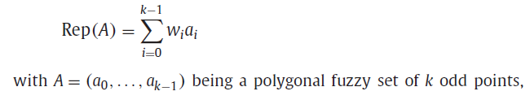
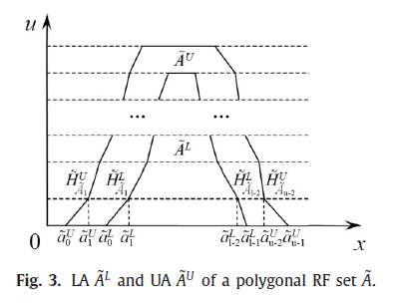
2.3. Representative values

Slide 13
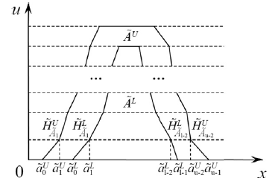
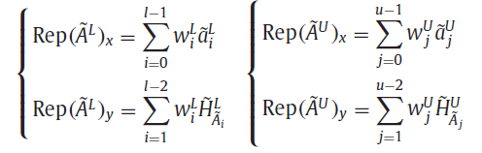
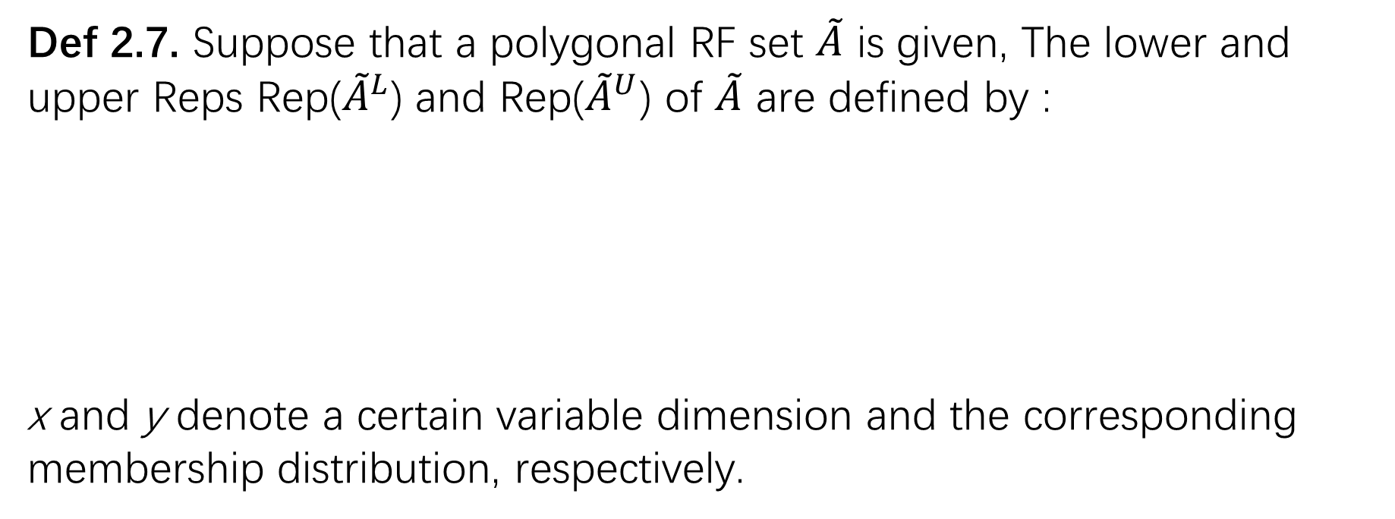
Def 2.7. Suppose that a polygonal RF set $\tilde{A}$ is given, The lower and upper Reps Rep(${\tilde{A}}^{L}$) and Rep(${\tilde{A}}^{U}$) of $\tilde{A}$ are defined by :
x and y denote a certain variable dimension and the corresponding membership distribution, respectively.

Slide 14
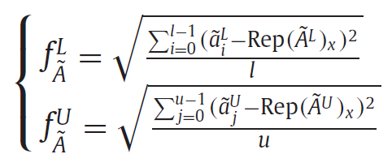
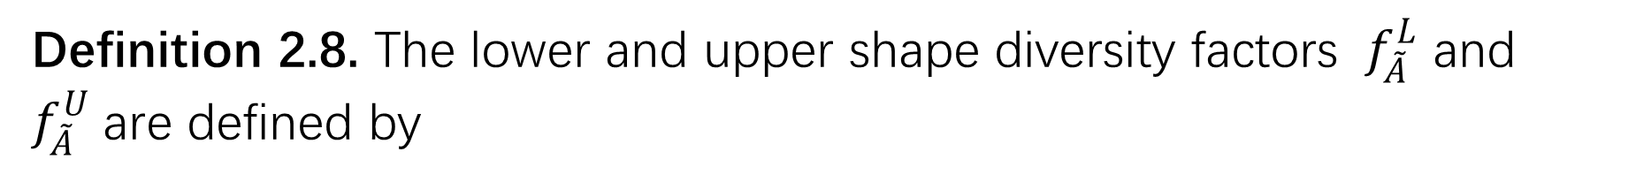
Definition 2.8. The lower and upper shape diversity factors ${ f}_{\tilde{A}}^{L}$ and $f_{\tilde{A}}^{U}$are defined by

Slide 15

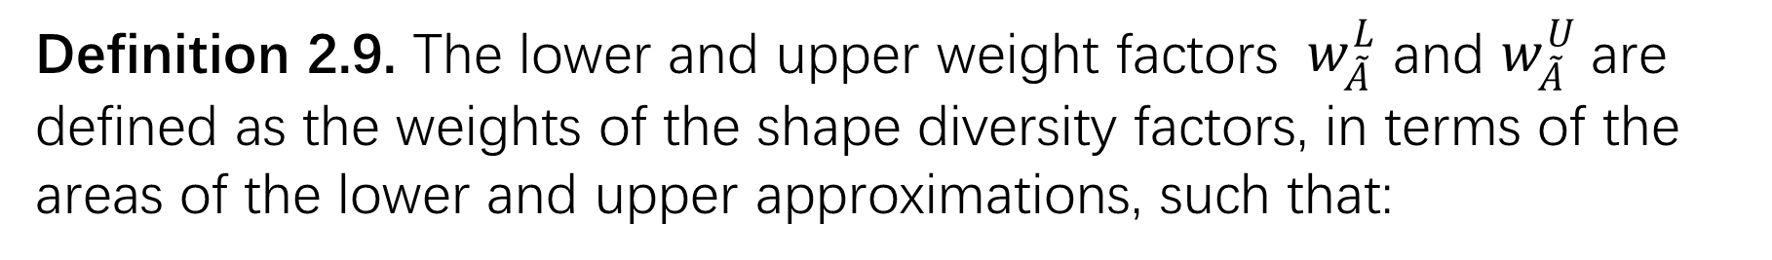
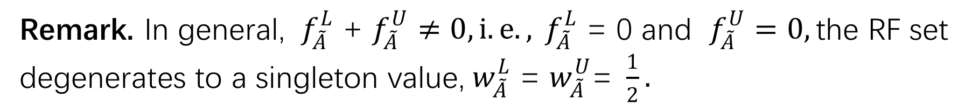
Definition 2.9. The lower and upper weight factors ${ w}_{\tilde{A}}^{L}$ and $w_{\tilde{A}}^{U}$are defined as the weights of the shape diversity factors, in terms of the areas of the lower and upper approximations, such that:
Remark. In general, ${ f}_{\tilde{A}}^{L}$ + $f_{\tilde{A}}^{U}≠0,i.e.,{ f}_{\tilde{A}}^{L} \text{= 0 }\text{and} f_{\tilde{A}}^{U}=0,\text{the} \text{RF} \text{set} \text{degenerates} \text{to} \text{a} \text{singleton} \text{value}\text{,}{ w}_{\tilde{A}}^{L} \text{=} w_{\tilde{A}}^{U}\text{= }\frac{1}{2}.$

Slide 16
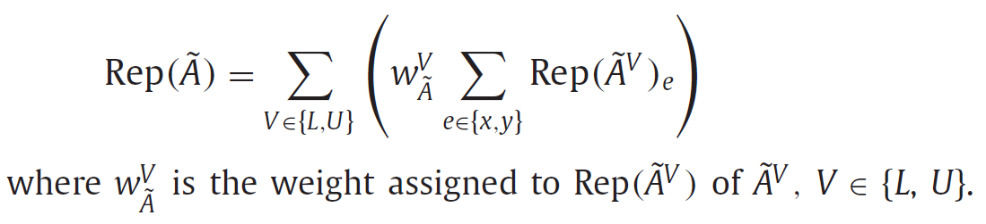
Definition 2.10. The overall Rep of a given RF set $\tilde{A}$ is defined by

Slide 17
3. Rough-fuzzy rule interpolation

Slide 18
Sparse Rule Base
Observation：O*
Step1: Selection of closest N rules
Step2: Construction of intermediate rule ( r’)
Step3: Scale ,Move and Height Transformations ( S_{q} , M_{r} , h₀ )
N closest rules
r’
Interpolated
Consequent

Slide 19
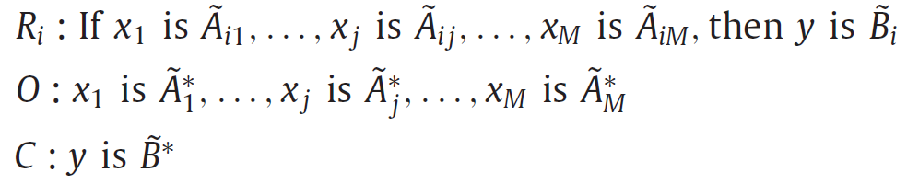
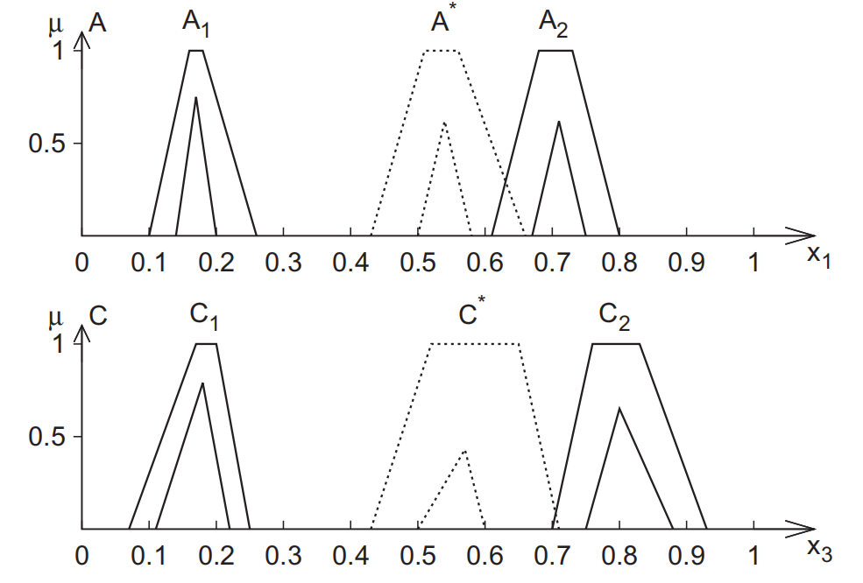
Step1. Selection of closest N rules

Slide 20

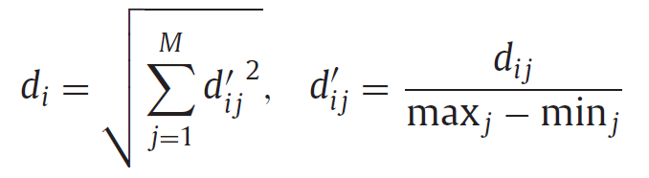
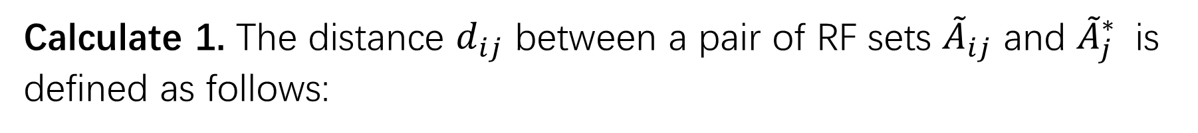

Calculate 1. The distance $d_{ij}$ between a pair of RF sets ${\tilde{A}}_{ij}$ and ${\tilde{A}}_{j}^{∗}$ is defined as follows:
Calculate 2. The distance $d_{i}$ between the rule $R_{i}$ and the observation O
where $\max_{j}$ and $\min_{j}$ are the maximum and minimum value in the domain of the variable $x_{j}$, j ∈ { 1 , . . . , M } .

Slide 21
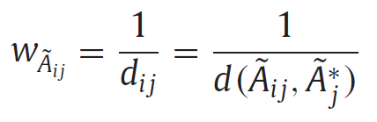
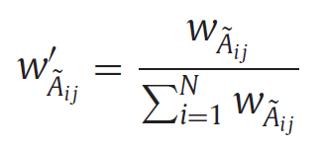
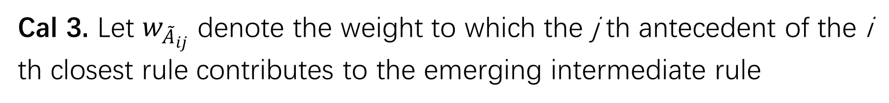
Step2. Construction of intermediate rule
Cal 3. Let $w_{{\tilde{A}}_{ij}}$ denote the weight to which the j th antecedent of the i th closest rule contributes to the emerging intermediate rule

Slide 22
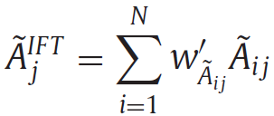
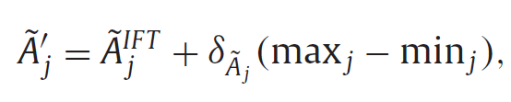
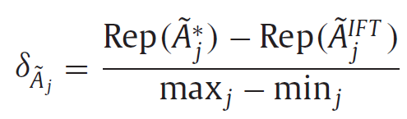
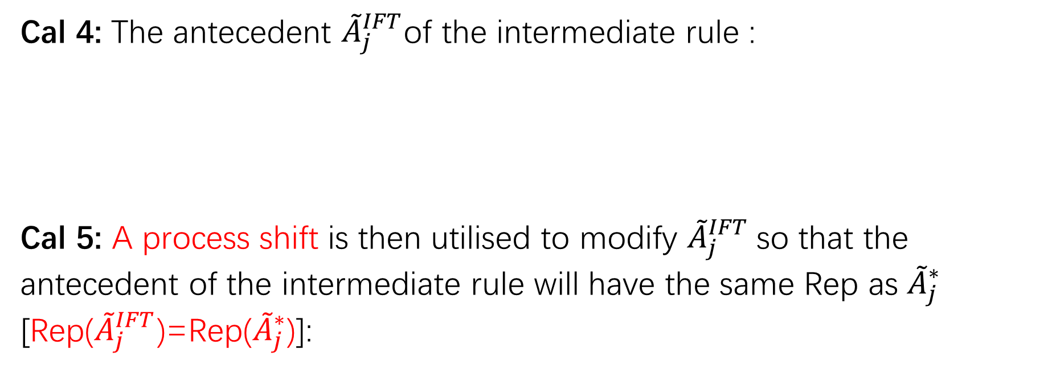
Cal 4: The antecedent ${\tilde{A}}_{j}^{IFT}$of the intermediate rule :
Cal 5: A process shift is then utilised to modify ${\tilde{A}}_{j}^{IFT}$so that the antecedent of the intermediate rule will have the same Rep as ${\tilde{A}}_{j}^{∗}$ [Rep(${\tilde{A}}_{j}^{IFT}$)=Rep(${\tilde{A}}_{j}^{∗}$)]:

Slide 23
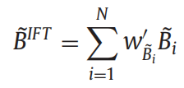

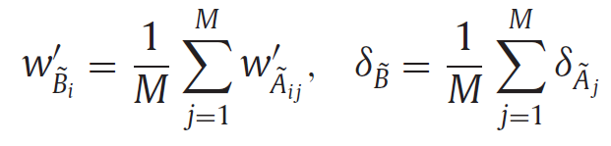

The consequence of the intermediate rule $\tilde{B′}$ is calculated by analogy to the computation of the antecedent, such that:

Slide 24
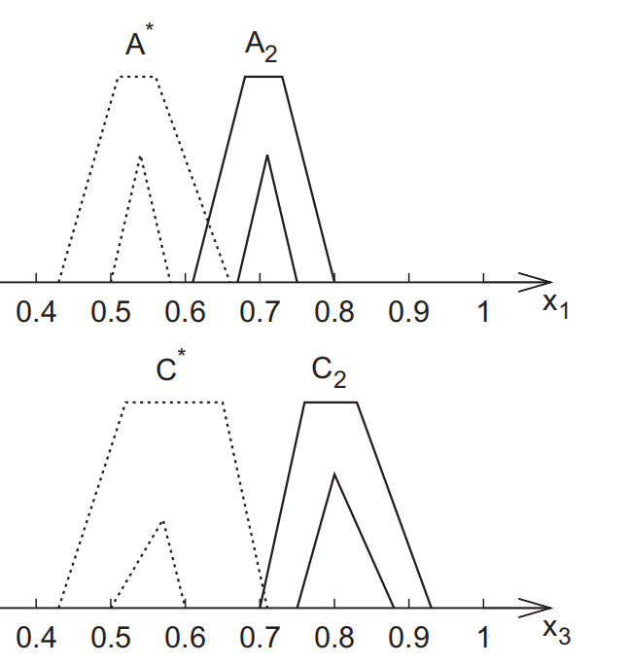
Notes:
在构造中间规则后，在这个中间规则和观察值之间的前件部分就存在着某种相似度，同理，他们的结果部分也需要保持这种相似性度量。也就是说，对于中间规则和观察值，中间规则结果C2与插值结果C*的形状类似于前件部分的形状组合。为了确保这种性质，下面设计了三种变换:

Slide 25
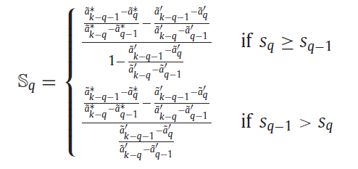

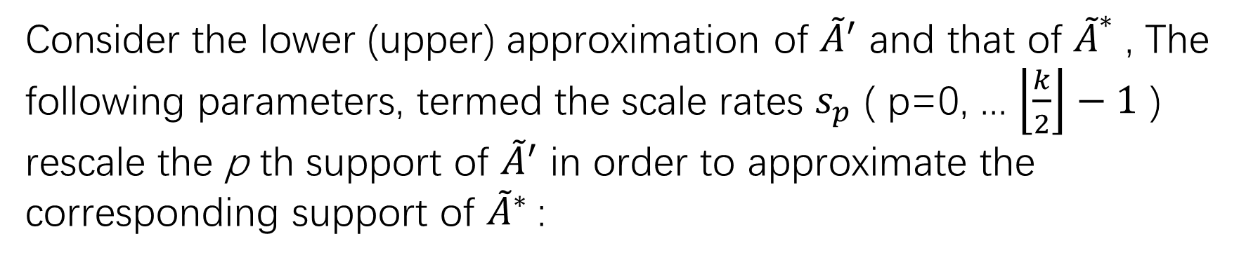
Step3: Scale , Move and Height Transformations ( S_{q} , M_{r} , h₀ )
3.3.1. Scale transformation
Consider the lower (upper) approximation of ${\tilde{A}}^{′}$ and that of ${\tilde{A}}^{∗}$ , The following parameters, termed the scale rates $s_{p}$ ( p=0, ... $\left\lfloor \frac{k}{2}\right\rfloor −1$ ) rescale the p th support of ${\tilde{A}}^{′}$ in order to approximate the corresponding support of ${\tilde{A}}^{∗}$:

Slide 26
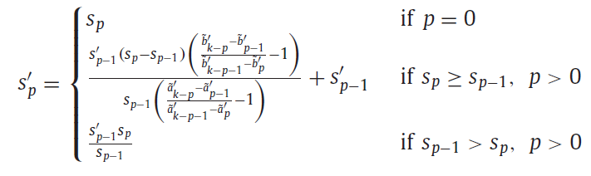
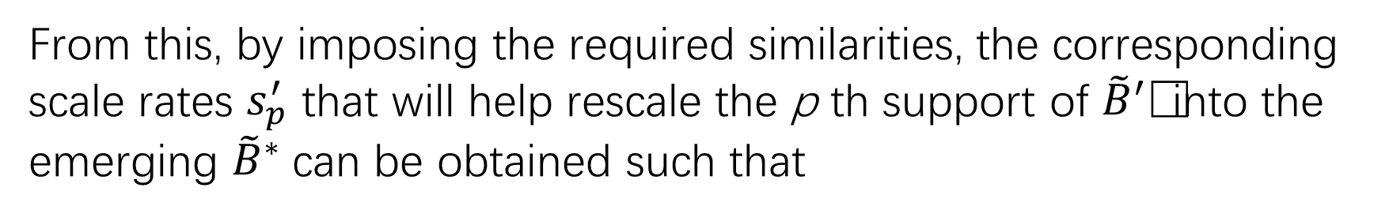
From this, by imposing the required similarities, the corresponding scale rates $s_{p}^{′}$ that will help rescale the p th support of ${\tilde{B}}^{′}$ into the emerging ${\tilde{B}}^{∗}$can be obtained such that

Slide 27
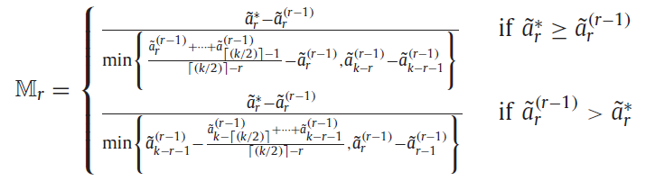
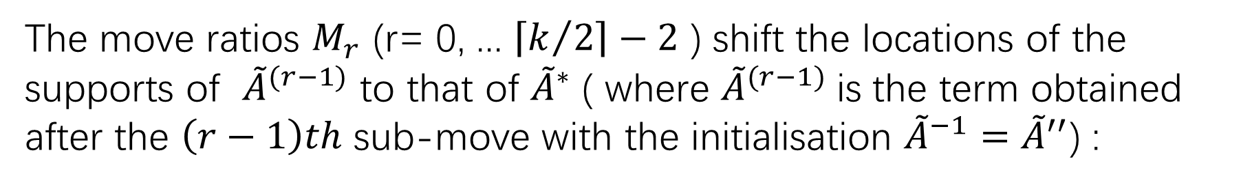
3.3.2. Move transformation
The move ratios $M_{r}$ (r= 0, ... $\left\lceil k/2\right\rceil −2$ ) shift the locations of the supports of ${\tilde{A}}^{(r−1)}$ to that of ${\tilde{A}}^{∗}$ ( where ${\tilde{A}}^{(r−1)}$is the term obtained after the $\left(r−1\right)th$ sub-move with the initialisation ${\tilde{A}}^{−1}={\tilde{A}}^{′′}$) :

Slide 28
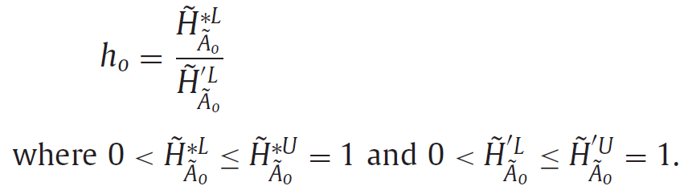
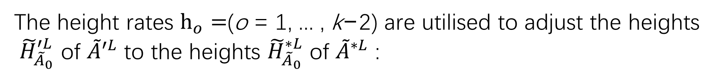
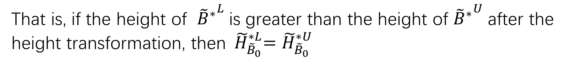
3.3.3. Height transformation
The height rates $h_{o}=$(o = 1, ... , k−2) are utilised to adjust the heights ${\tilde{H}}_{{\tilde{A}}_{0}}^{′L}$ of ${\tilde{A}}^{′L}$ to the heights ${\tilde{H}}_{{\tilde{A}}_{0}}^{∗L}$ of ${\tilde{A}}^{∗L}$ :
That is, if the height of ${{\tilde{B}}^{∗}}^{L}$is greater than the height of ${{\tilde{B}}^{∗}}^{U}$after the height transformation, then${ \tilde{H}}_{{\tilde{B}}_{0}}^{∗L}=$ ${\tilde{H}}_{{\tilde{B}}_{0}}^{∗U}$

Slide 29
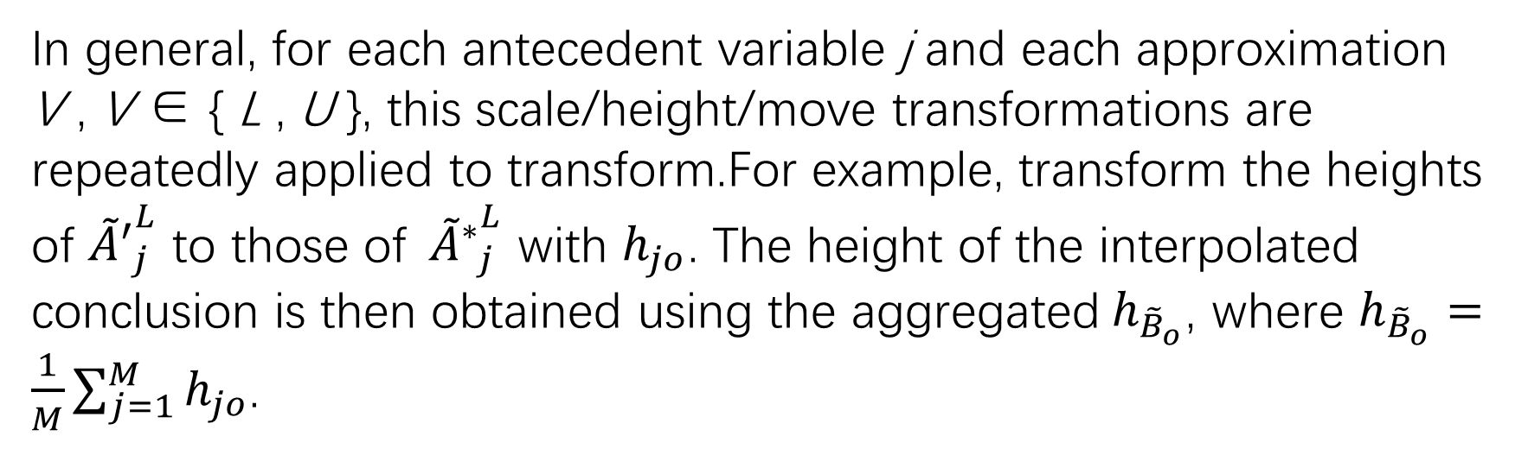
In general, for each antecedent variable j and each approximation V , V ∈ { L , U }, this scale/height/move transformations are repeatedly applied to transform.For example, transform the heights of ${{\tilde{A}}^{′}}_{j}^{L}$ to those of${{ \tilde{A}}^{∗}}_{j}^{L}$ with $h_{jo}$. The height of the interpolated conclusion is then obtained using the aggregated${ h}_{{\tilde{B}}_{o}}$, where $h_{{\tilde{B}}_{o}}=\frac{1}{M}\sum_{j=1}^{M}{h_{jo}}$.

Slide 30
4. Application case study

Slide 31
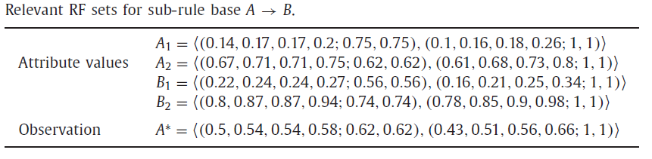
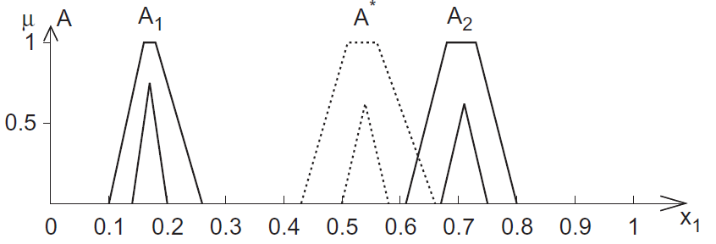
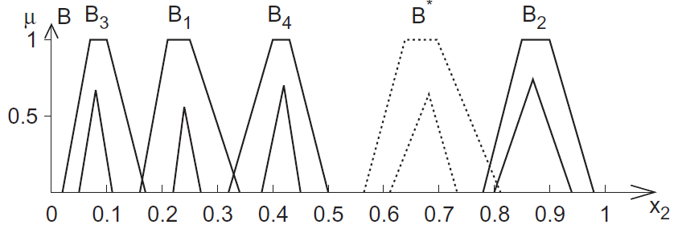
Interpolation
Table 1

Slide 32
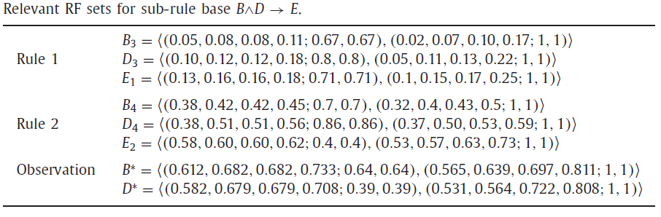
Extrapolation
Table 2

Slide 33
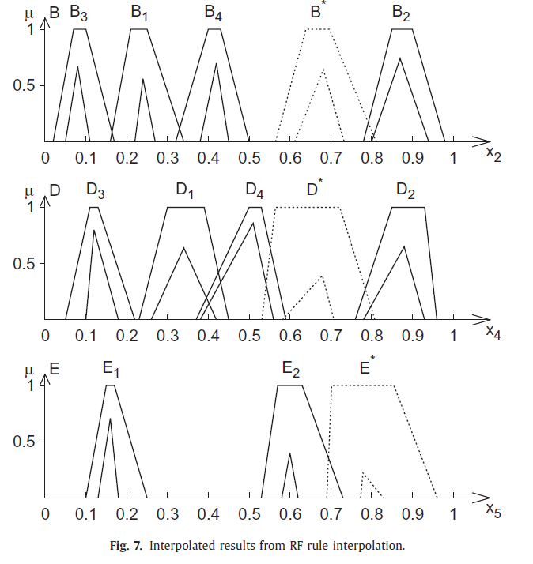

Slide 34

Singletoan-valued interpolation

Slide 35

Degenerated interpolation

Slide 36
5. Conclusion and Future work
This paper has proposed a novel approach for both representing the knowledge involving higher order uncertainty and facilitating rule interpolation with such knowledge.
1. Ordered weighted averaging (OWA) operators may be applied to enhance the ability of this approach.
2. A weighting scheme should therefore be assigned to the rules in order to express the belief of usefulness related to each rule.
3. It would be interesting to investigate the performance of the approach by learning the weights from the constructed rule bases.

