Slide 1
OMNIFALL · TRANSITION-CONDITIONING
Fallen or Just Lying Down?
Exploiting Causal Action Transitions to Fix a Blind Spot in Fall Detection
FALLEN
FALL
LYING
Real-time webcam demo · VideoMAE-K400 + Rule-Based & Learnable Conditioning · OF-ItW benchmark

Slide 2
THE PROBLEM
One benchmark class is silently dangerous
Fall-detection systems must tell apart two states that look almost identical to a per-frame classifier, but mean completely different things to a caregiver:
!
FALLEN
A person on the floor after a fall — an emergency
A person lying on a bed or sofa to rest — completely normal
Pixel-wise, a static body on the ground looks the same either way
Standard per-segment classifiers ignore what just happened before — they judge each clip in isolation
Needs emergency help — follows a “fall” action
z
LYING
Resting normally — follows a “lie_down” action
2

Slide 3
KEY INSIGHT
Static states inherit meaning from what came before
OmniFall's own taxonomy already encodes the causal link — a transient action always precedes its static state. We just have to make the model use it.
fall
fallen
probability boosted, decays over ~10s
transient action
static state (boosted)
lie_down
lying
probability boosted, decays over ~10s
transient action
static state (boosted)
Core idea: condition the prediction for a static segment on the transient action that most recently preceded it — instead of classifying every segment independently.
3

Slide 4
METHOD
Two conditioners, built on top of a trusted baseline
Video segment
VideoMAE-K400
baseline
Conditioner
Final label
16-frame windows, 7.5 fps
official omnifall-experiments
FeatureTransformer
Rule-Based OR Hybrid v8
(this project's contribution)
one of 10 classes,
fallen highlighted
Rule-Based Conditioner
Hybrid v8 (Learnable)
Exponential-decay boost
No learned parameters — a transparent, auditable baseline conditioner.
2 subtle bugs found & fixed (self-overwrite at t=0; wrongly re-boosting a 2nd consecutive “fall” segment).
Self-attention over time + KL-anchor
Learns how to weight past segments instead of a fixed decay curve; anchored to the rule-based prior for stability.
Checkpoint selected on Fall∪Fallen F1 (not Fallen-F1 alone) to avoid trading away Fall accuracy.
4

Slide 5
EXPERIMENTAL SETUP
Trusted baseline, real staged + synthetic + in-the-wild data
Train (St + Sy)
GMDCSA24 (staged)
Le2i (staged)
CAUCAFall (staged)
OF-Synthetic (12,000 synthetic clips)
Why the baseline can be trusted
Official omnifall-experiments repo (not a custom reimplementation)
VideoMAE-K400 features: 7.5 fps, 16 frames/window, stride 2/15s — matches the paper's Table 12
FeatureTransformer baseline, 2-layer, trained to convergence (checkpoint-7000)
Conditioners applied strictly post-hoc on top of these frozen baseline logits
Test — OF-ItW (in-the-wild)
OOPS accident videos — real, uncontrolled footage
2,804 test segments across 572 videos
10-class OmniFall taxonomy (extended classes merged into “other”)
5

Slide 6
RESULTS
Hybrid v8 wins on every metric that matters
Method | Fallen-F1 (%) | Fall-F1 (%) | Fall∪Fallen F1 (%)
Baseline (St+Sy) | 26.6 | 45.3 | 55.5
Rule-Based Conditioner | 30.0 | 45.3 | 55.6
Hybrid v8 (ours) | 34.3 ± 0.6 | 44.6 ± 0.9 | 57.1 ± 0.8
+4.3
points Fallen-F1
vs. rule-based
+1.5 pts on Fall∪Fallen
(the clinically decisive metric)
mean ± std over 3 seeds (42 / 43 / 44) · OF-ItW test, n = 2,804 segments
Baseline and rule-based are deterministic (0 variance) — Hybrid v8's spread reflects 3 independently trained seeds, not measurement noise.
6

Slide 7
STATISTICAL VALIDATION
Is the improvement real, or noise?
Video-level bootstrap (10,000 resamples) — Hybrid v8 vs. Rule-Based, Fall∪Fallen F1
Seed 42
Seed 43
Seed 44
+2.35 pp
+1.57 pp
+0.86 pp
95% CI [+0.90, +3.82]
95% CI [+0.15, +2.96]
95% CI [−0.64, +2.35]
p = 0.0017
p = 0.0148
p = 0.1283
SIGNIFICANT
SIGNIFICANT
CI INCLUDES 0
Triangulation: McNemar's test on union-accuracy is significant for all 3 seeds (p < 0.0001) — Hybrid v8 flips roughly 2× more segments correct than it breaks, every time. The F1-bootstrap result is more conservative (2/3 seeds), which we report honestly rather than rounding up.
7

Slide 8
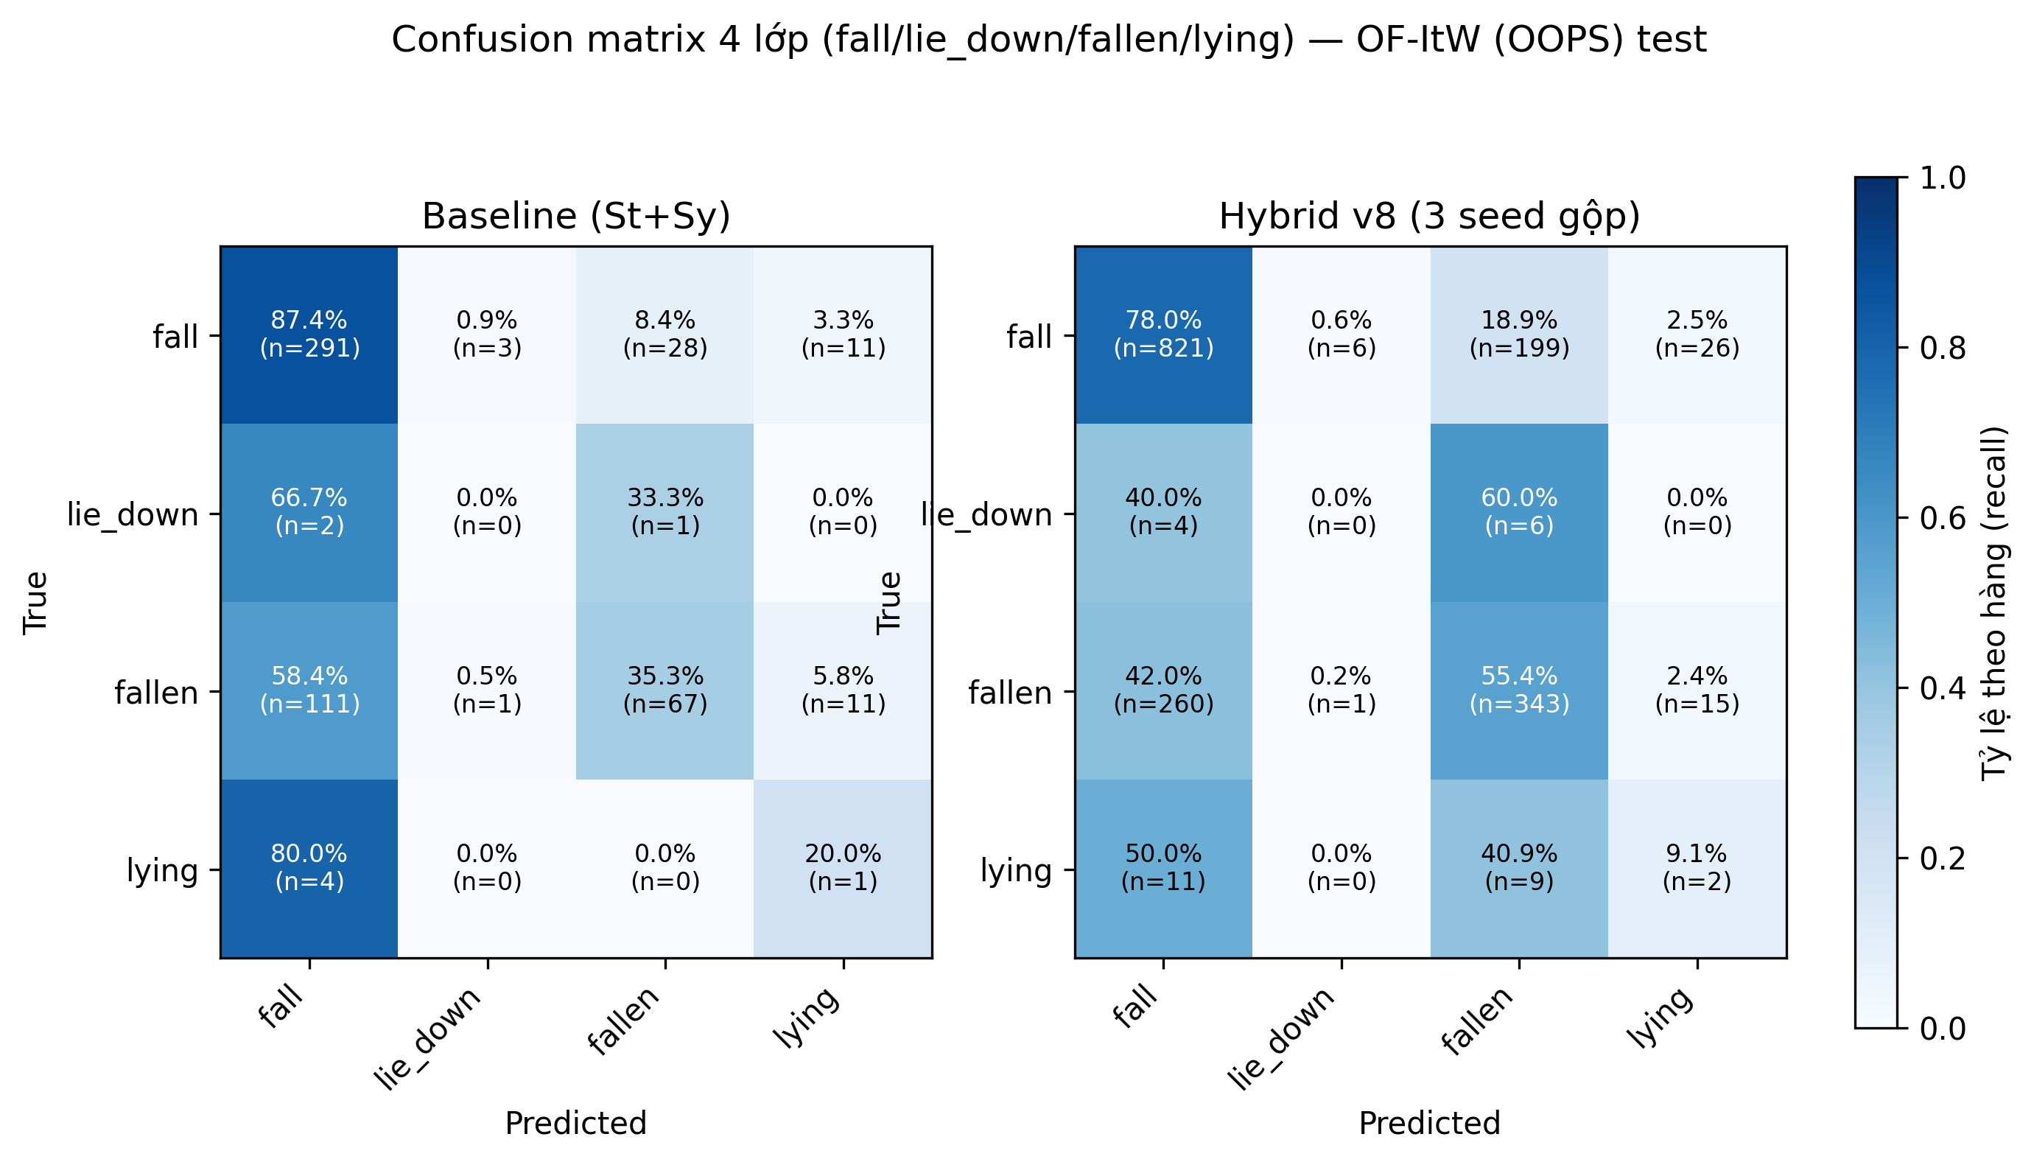
ERROR ANALYSIS
Where the confusion actually goes away
Row-normalized confusion matrix (fall / lie_down / fallen / lying), Baseline vs. Hybrid v8, pooled across 3 seeds — OF-ItW test set.
8

Slide 9
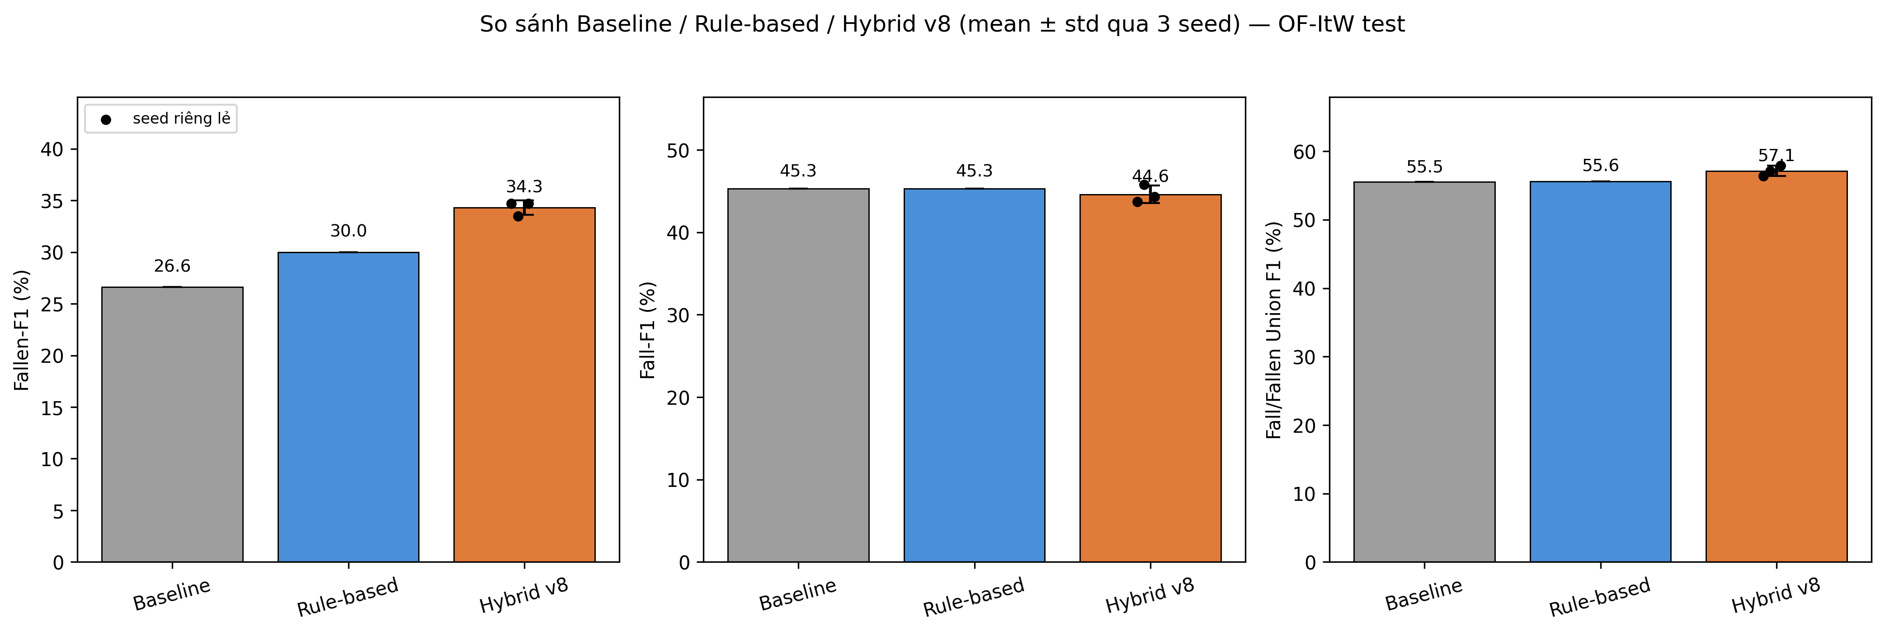
ERROR ANALYSIS
Consistent gains across all three metrics
Individual seed results overlaid as points — the spread is genuine training variance, not a display artifact.
9

Slide 10
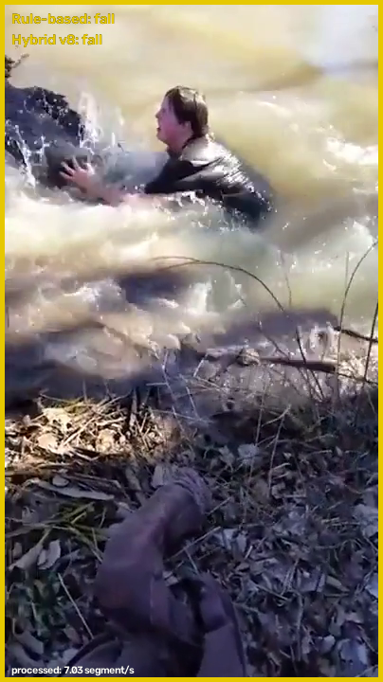

WORKING SYSTEM — REAL FOOTAGE
Tested live on a real OOPS accident video
Ground truth for this clip: fall 18.5–20.2s → fallen 20.2–22.4s.
Both conditioners correctly sequence fall → fallen within ~2s of the true onset.
Honest miss: the alert persists intermittently for up to ~8s after the person has already stood back up — the same decay window that helps recall also causes this lag.
~6.5–11.9 seg/s · ~87–155 ms/update on a single RTX 3070 (real video, both modes)
Every fallen event is timestamped to fallen_events_log.csv for later review
t ≈ 22.0s — “fall” (yellow)
t ≈ 23.5s — “fallen” (red alert)
Unedited overlay output — scripts/realtime_demo.py --mode both, run directly on OOPS test footage.
10

Slide 11
HONEST ASSESSMENT
What this result does not claim
Single backbone
Everything is validated on VideoMAE-K400 only. I3D/DINOv2 extraction code isn't shipped in the official repo, and re-acquiring raw video for a second backbone is a real, unresolved cost.
Sparse lying evidence
OF-ItW test set has only 17 lying / 11 lie_down segments out of 2,804. In a real clip we tested, “lying” meant a person on a gym bench mid-exercise — the model called it “other” rather than “fallen,” which is safe but shows the lying class is domain-narrow.
Per-seed variance
1 of 3 seeds does not clear the 95% bootstrap CI on F1 (though all 3 do on McNemar accuracy) — reported as “consistent, not unanimous.”
Reporting the gaps precisely is what makes the positive results credible.
11

Slide 12
CONCLUSION
Context turns a blind spot into a strength
Causal structure already in the taxonomy (fall→fallen, lie_down→lying) is a free, powerful signal — most classifiers throw it away
A simple, transparent rule-based conditioner already helps; a learnable, self-attention conditioner does significantly better, with statistical proof
The result ships as a real, runnable system — not just a table in a paper
Thank you — questions welcome
scripts/realtime_demo.py · results_final.md · OmniFall benchmark (Schneider et al.)
12

