Slide 1

AngularJS
client structural framework for dynamic web applications
HTML as template and extend HTML's syntax to express application's components
data binding and dependency injection
<script src="http://ajax.googleapis.com/ajax/libs/angularjs/1.4.8/angular.min.js"></script>
ng-app ng-model ng-bind ng-init ng-controller
<div ng-app=""> <p>Name: <input type="text" ng-model="name"></p> <p ng-bind="name"></p> </div>
<div ng-app="myApp" ng-controller="myCtrl"> First Name: <input type="text" ng-model="firstName"><br> Last Name: <input type="text" ng-model="lastName"><br> <br> Full Name: {{firstName + " " + lastName}} </div> <script> var app = angular.module('myApp', []); app.controller('myCtrl', function($scope) { $scope.firstName= "John"; $scope.lastName= "Doe"; }); </script>
<div ng-app ng-init="qty=1;cost=2">
<b>Invoice:</b>
<div>
Quantity: <input type="number" min="0" ng-model="qty">
</div>
<div>
Costs: <input type="number" min="0" ng-model="cost">
</div>
<div>
<b>Total:</b> {{qty * cost | currency}}
</div>
</div>

Slide 2
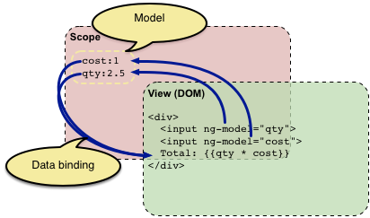
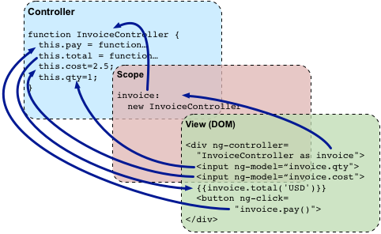
AngularJS – Conceptual Overview

Slide 3
AngularJS – Best Practices & Folder Structure
adapted to MVC structure
Modularized by functions
app/
----- controllers/
---------- mainController.js
---------- otherController.js
----- directives/
---------- mainDirective.js
---------- otherDirective.js
----- services/
---------- userService.js
---------- itemService.js
----- js/
---------- bootstrap.js
---------- jquery.js
----- app.js
views/
----- mainView.html
----- otherView.html
----- index.html
app/
----- shared/ // acts as reusable components or partials of our site
---------- article/
--------------- articleDirective.js
--------------- articleView.html
----- components/ // each component is treated as a mini Angular app
---------- home/
--------------- homeController.js
--------------- homeService.js
--------------- homeView.html
---------- blog/
--------------- blogController.js
--------------- blogService.js
--------------- blogView.html
----- app.module.js
----- app.routes.js
assets/
----- img/ // Images and icons for your app
----- css/ // All styles and style related files (SCSS or LESS files)
----- js/ // JavaScript files written for your app that are not for angular
----- libs/ // Third-party libraries such as jQuery, Moment, Underscore, etc.
index.html

Slide 4
AngularJS – Best Practices & Folder Structure

