Slide 1
PROJECT PROGRESS UPDATE — WORK IN PROGRESS
Koa-AI
A local-first AI companion with a real-time 3D avatar, voice in and voice out.
Runs fully offline
Streaming voice + chat
3D VRM avatar
Group Software Project WIP Review 1 of 2 · 06 Jun 2026 → Final Review · 20 Jul 2026

Slide 2
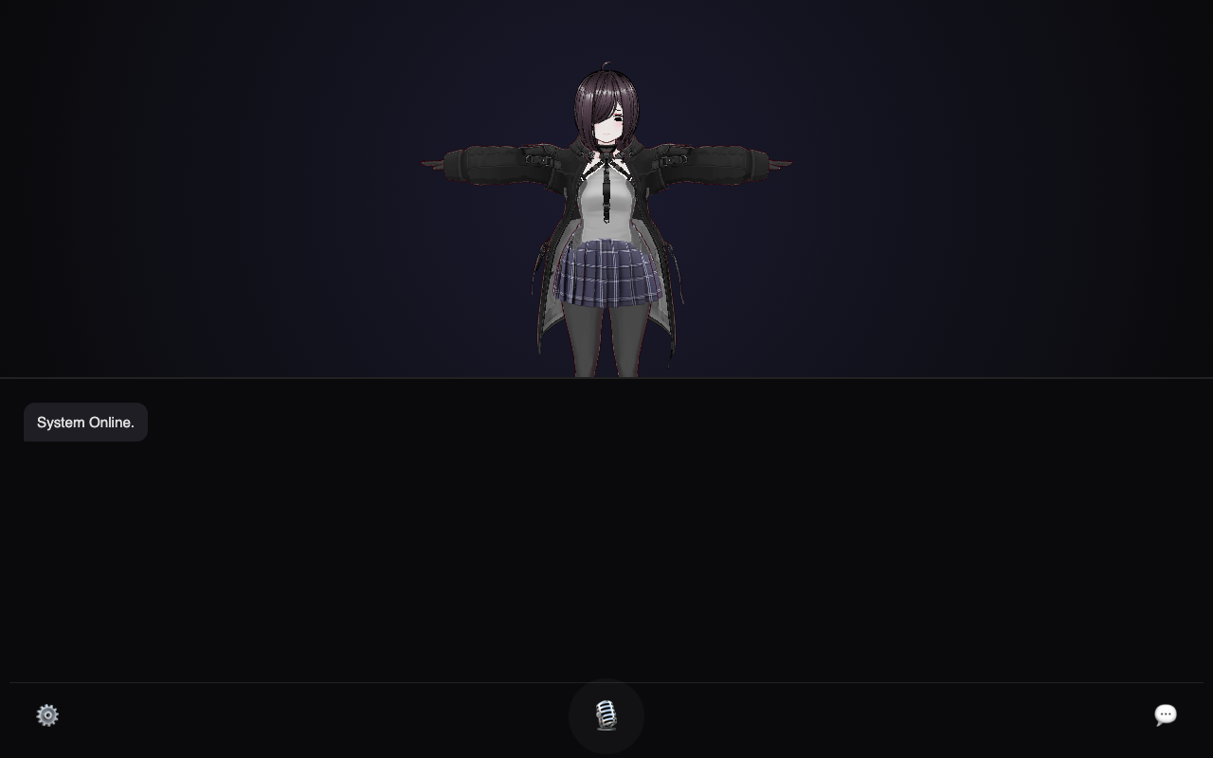



THE CONCEPT
KOA-AI
What we're building
An AI you talk to — that talks back, in its own voice, through an expressive 3D character — and runs entirely on your own machine.
Private by design
LLM, speech-to-text and text-to-speech all run locally — no cloud, no API keys.
Natural voice loop
Current build — the avatar rendered in-browser with the chat console below.
Speak to it; it transcribes, thinks, and replies out loud as the answer streams.
Embodied presence
A 3D VRM avatar gives the assistant a face and (eventually) expression.
Koa-AI · Work-in-Progress Review · 06 Jun 2026
2

Slide 3






SYSTEM ARCHITECTURE
KOA-AI
How it fits together
LLM · llama.cpp
Llama 3.2 3B · OpenAI-style API
Frontend
FastAPI
Backend
Browser · Three.js
@pixiv/three-vrm avatar
Chat + mic controls
Streams tokens & audio
Speech-to-Text · Whisper
Service layer:
chat · voice · memory
Streaming endpoints
Serves the frontend
Transcribes microphone audio
Text-to-Speech · Piper
Speaks replies, sentence by sentence
Everything runs on one machine. No external services, no data leaves the device.
Memory · SQLite
Stores conversation history
Koa-AI · Work-in-Progress Review · 06 Jun 2026
3

Slide 4

MILESTONES REACHED
KOA-AI
What's working so far
Modular backend stood up
3D avatar renders in-browser
FastAPI app with clean LLM / audio / memory / animation services.
VRM character loads with Three.js; animation assets (Idle, Taunt) wired in.
Live streaming chat
Persistent memory
Replies stream token-by-token from a local Llama 3.2 model.
Conversations saved to a SQLite store across sessions.
End-to-end voice loop
Running locally on macOS
Whisper transcribes speech; Piper speaks replies sentence-by-sentence as they generate.
Model wired up and chat verified end-to-end during this review.
Koa-AI · Work-in-Progress Review · 06 Jun 2026
4

Slide 5
WHERE WE ARE TODAY
KOA-AI
Current state of the build
100%
local — zero cloud calls
3B
param Llama model, on-device
4
services integrated (LLM·STT·TTS·DB)
Live local build — avatar + chat console (avatar shown in default T-pose: the animation layer is still being wired in).
Koa-AI · Work-in-Progress Review · 06 Jun 2026
5

Slide 6

CHALLENGES — STILL WIP
KOA-AI
Open problems we're working through
Cross-platform packaging
Original build is Windows-only (.exe launchers for the LLM, Whisper & Piper). Porting the runtime to macOS / Linux is in progress.
Memory isn't context-aware yet
History is saved to SQLite but not yet fed back into the prompt — so the AI doesn't truly 'remember' within a chat.
Avatar is static
Animation service is currently a stub; idle motion, lip-sync and emotion-driven gestures are not hooked up.
Reproducible setup
No dependency manifest or model bundling yet — getting it running takes manual steps.
Audio robustness
Whisper assumes a clean 16 kHz mono input; real mic audio needs a conversion step (e.g. ffmpeg).
Koa-AI · Work-in-Progress Review · 06 Jun 2026
6

Slide 7
ROADMAP TO FINAL REVIEW
KOA-AI
Where we go from here
NOW
THEN
20 JUL
WIP Review 1
Context memory
Final Review
Core loop running
locally
Feed history back
into the prompt
Polished, demo-
ready companion
NEXT
THEN
Cross-platform
Living avatar
Mac/Linux runtime
+ easy setup
Idle motion, lip-sync
& expressions
Goal for 20 Jul: from 'core loop works' to a polished, expressive companion that remembers you.

