Slide 1

Human Activity Recognition
WU XIANLONG
MAT: 2038500
Notes:
1

Slide 2

Structure
HAR introduction
Inspection and preprocessing
Lower dimensional representation of the data
Models for multiclass classification
Regularization
Conclusion

Slide 3
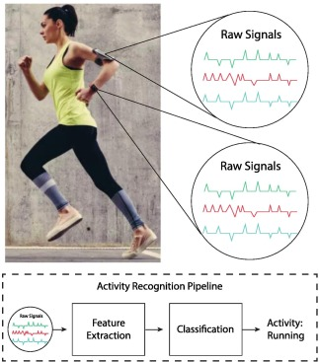
Human Activity Recognition (HAR)
Collection via devices attached to the body
Gyroscope and accelerometer
Body or gravity acceleration and angular velocity
Sampling in time domain (50Hz)
Time domain and Frequency domain data

Slide 4
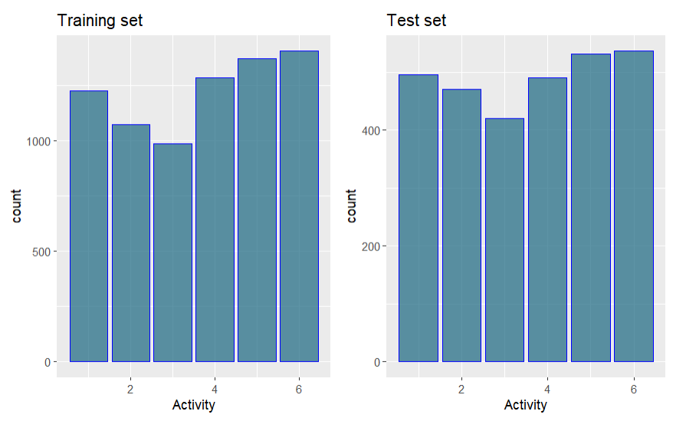
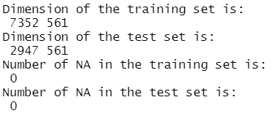
Inspection of data set
Multi-class classfication: Laying, Standing, Sitting, Walking, Walking-Upstairs, Walking-Downstairs.
70% Training , 30% Test split
No missing values
Unbalanced labels : Walking-Upstairs and Walking-Downstairs

Slide 5
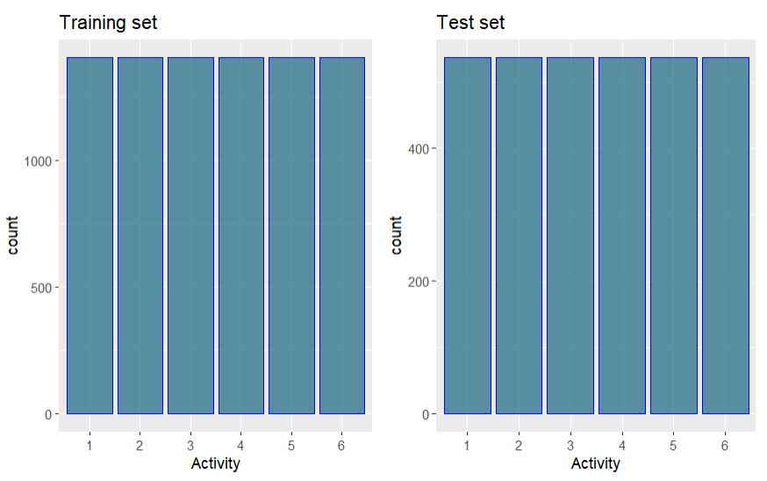
Oversampling
Generate synthesis from the minority classes to match that of the majority class
Labels from 1 to 5 match the label 6
New number of samples: 8442 and 3222 for training and test set

Slide 6
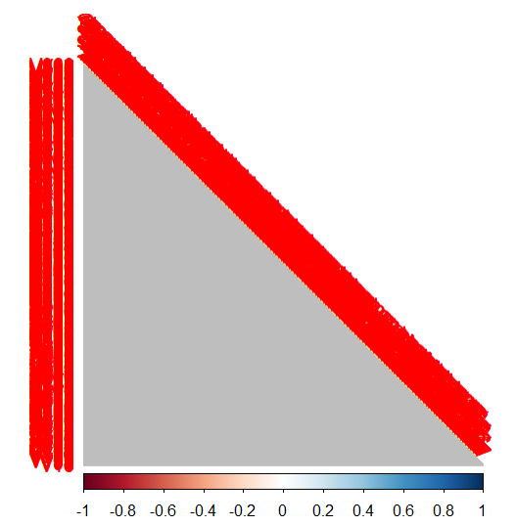
Lower dimensional representation
Too many features , hard to visualize
No correlation between features
Over 1600 unique values in term of absolute values
Really high correlations: Close to 1

Slide 7
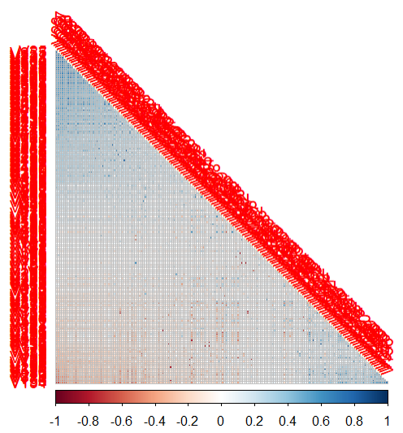
Removal of highly correlated features
Way more interpretable matrix
Most of the features are highly correlated as numbers of features left with a threshold value of 0.8: From 561 to 173.
Other representation: PCA
How good is this representation?
Test different models over different data set selected by different methods

Slide 8
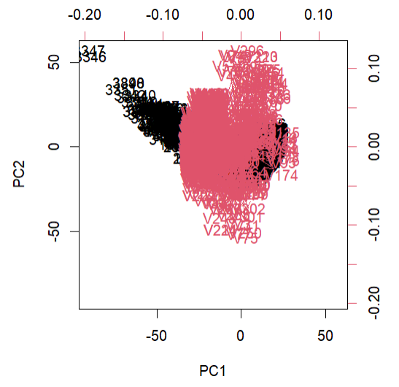
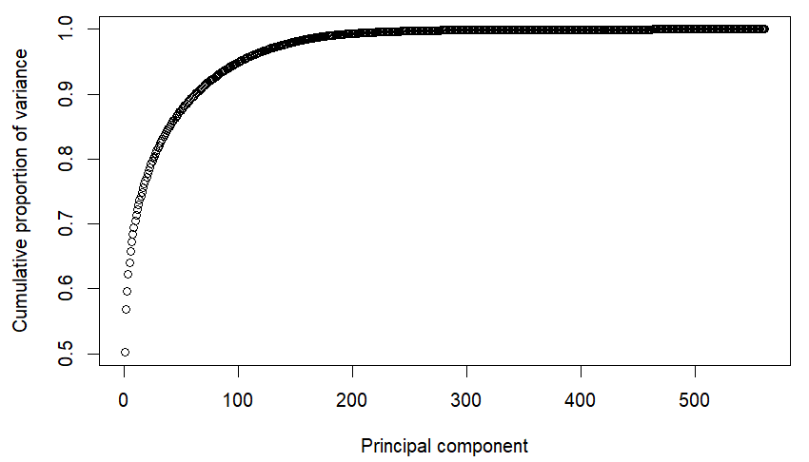
Principle Component Analysis (PCA)
Project onto a lower dimension such that the maximum variance is preserved
Sensitive to variance, thus dataset must be normalized
With the first 180 principle components almost all the variance can be preserved

Slide 9
Multinomial models and evaluation
Models:
KNN (K Nearest Neighbors)
Logistic Regression
LDA (Linear Discriminant Analysis)
QDA (Quadratic Discriminant Analysis)
Evaluation:
Mean error
Confusion Matrix

Slide 10
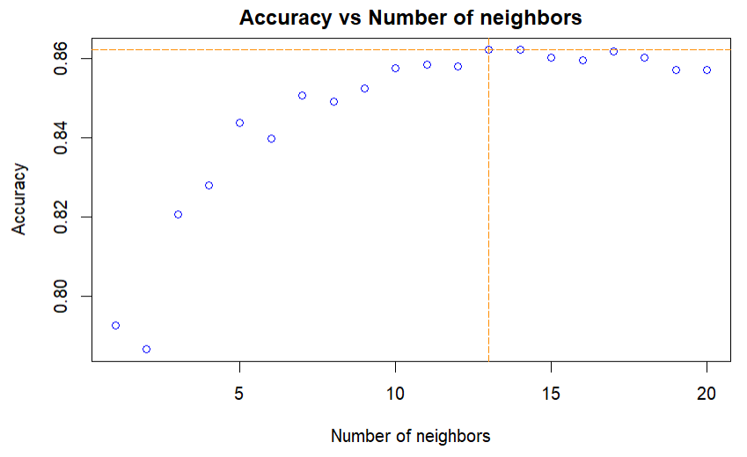
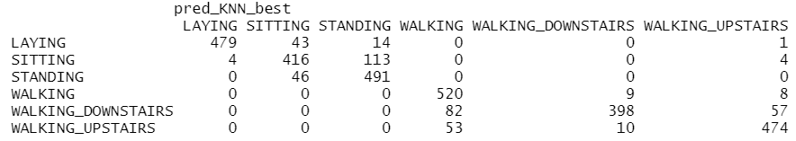
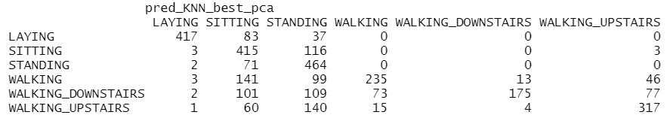
KNN
Label based on the K nearest neighbor
Unsupervised learning, K is needed
Removed: 13 neighbors, accuracy: 0.86
PCA: 5 neighbors, accuracy: 0.63
Separation between WALKING and NON-WALKING
With PCA, poor performance labeling WALKING block

Slide 11
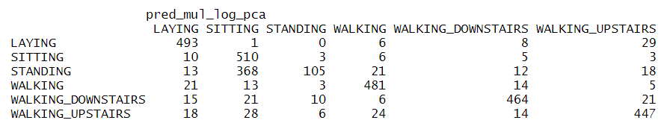
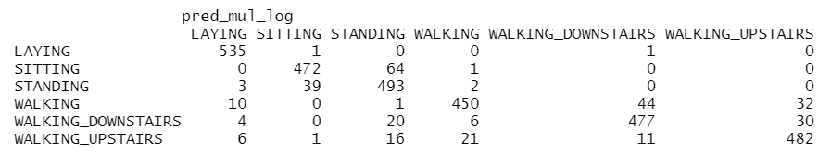
(Multinomial) Logistic Regression
Extension of logistic regression
Use MLE to classify the labels
PCA accuracy 0.77
Convergence after 470 iterations
Fail to label ‘SITTING’
Removed accuracy: 0.90
Failed to converge after 1000 iteration, but the drop of loss is small

Slide 12
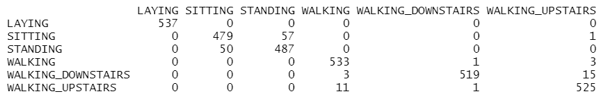
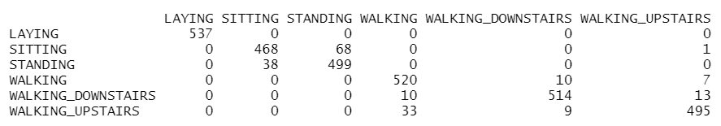
LDA
Linear combination of features is considered
Fail when colinearity exists
PCA accuracy: 0.95
Separation between blocks
Removed accuracy: 0.94
Separation between blocks

Slide 13
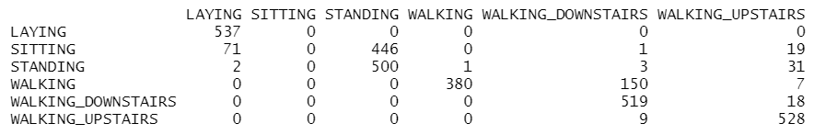
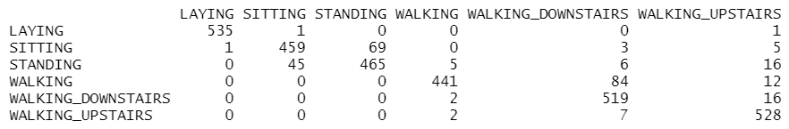
QDA
PCA accuracy: 0.76
Fail to label activity ‘SITTING’
Removed accuracy: 0.91
Separation between blocks

Slide 14
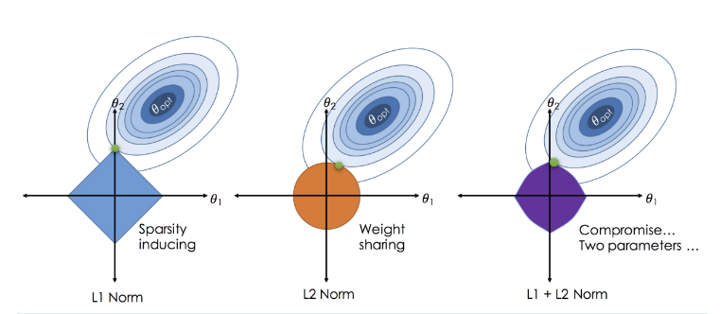
Regularization
Improve model stability
Feature selection ie. LASSO
L1 penalty LASSO: force sparsity
L2 penalty Ridge Regression: force the coefficients to be close to zero
Elastic-net: Mixture between LASSO and Ridge Regression
Hyper parameter (alpha, lambda) needed and they can be found with Cross-validataion
Model dependent, use only Logistic regression as it is can be implemented easily with glmnet

Slide 15
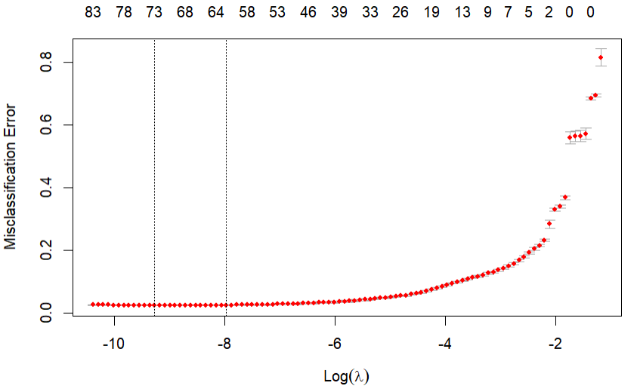
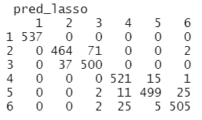
LASSO
Accuracy: almost 0.94
Number of features selected:
73 for lambda_min and 61 for lambda_1se
Almost perfect separability
Lambda: 9.4e^-5
Search path for the best lambda
Top two features: tBodyAcc-correlation()-X,Y and
fBodyAcc-meanFreq()-X

Slide 16
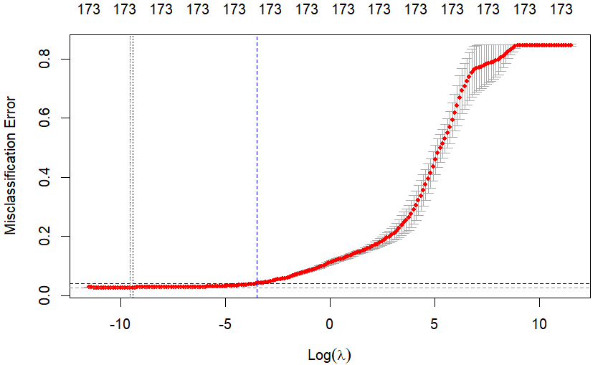
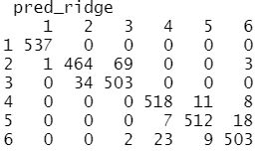
Ridge Regression
With default grid, the best lambda is close to the border and the trend of dropping in error is still strong
No feature discarded as Ridge forces them to be close to zero
Accuracy: over 0.94
Most relavent features: tBodyAcc-mean()-Y,
tBodyGyroJerk-arCoeff()-Y,2
Search path for the best lambda (with defined grid)
Greed: with defined grid. Blue: with default grid

Slide 17
Elastic Net
Hyper parameter alpha needed
Cross validation with a defined grid
Best alpha = 1 which means LASSO regression
Same result as LASSO if provided the same search grid (lambda) as LASSO

Slide 18
Summary
 |  | KNN | Log | LDA | QDA | LASSO | Ridge | Enet
ACC. | PCA | 0,63 | 0,77 | 0,95 | 0,76 | - | - | -
 | Reml | 0,86 | 0,90 | 0,94 | 0,91 | 0,94- | 0,94+ | 0,94-
Fail | PCA | YES | YES | NO | YES | - | - | -
 | Reml | NO | NO | NO | NO | NO | NO | NO
Sep. | PCA | NO | YES- | YES | YES | - | - | -
 | Reml | YES | YES | YES | YES | YES | YES | YES
Feature removal appears to be better in overall performance and all have good separability of the blocks
With PCA, sometimes model fails to label one or two classes
All regularization works well

Slide 19
Conclusion
Data Representation: Removing highly correlated features appears to be a better strategy to get a lower dimensional representation of the data than PCA as all the models perform well on it. PCA is better only when the LDA is implemented and if the separability is needed, then PCA + LDA is a good combination to perform such a task. However, with PCA, there is a high risk we the model fails to label one or two classes.
Model Selection: As for the single model selection, LDA is the most favorable one as no matter which representation of the data is implemented, it can always gives the best performance and since it is also easy to implement, hence, for this problem the best option will be LDA.
Regularization: All the regularization gives good result on generalization, furthermore, LASSO and Elastic-net appear to be the same in this case. The Ridge Regression gives the best stability but considering also the feature selection ability of LASSO/Elastic-net. LASSO appears to be a better solution as it is more efficient in terms of computation and memory.

