Slide 1
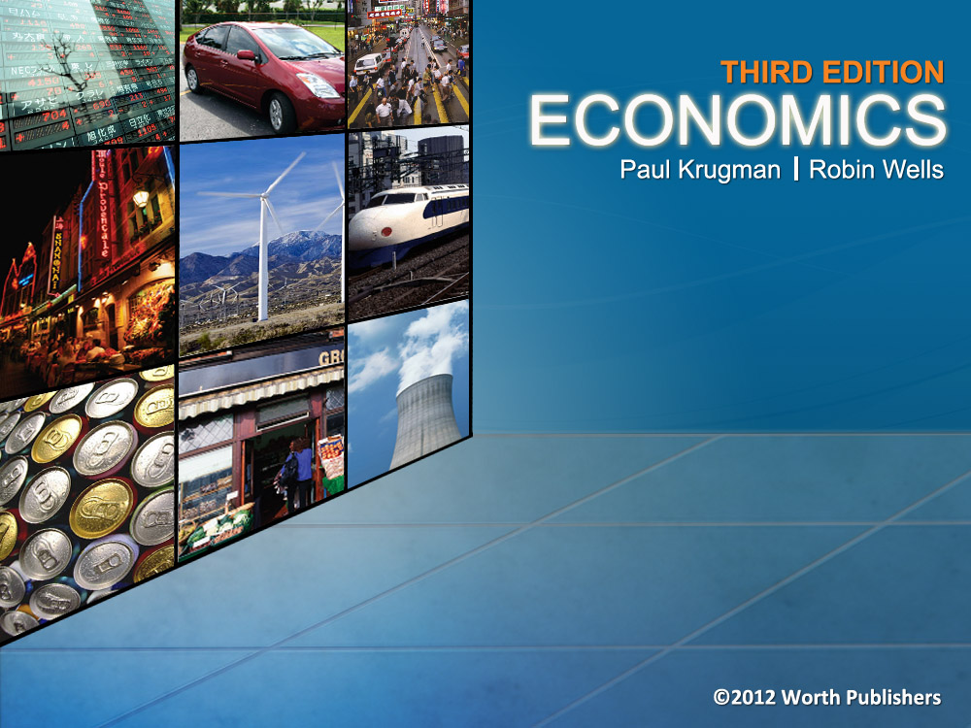
Chapter 16
THIRD EDITION
ECONOMICS
and
MICROECONOMICS Paul Krugman | Robin Wells
Externalities

Slide 2

What externalities are and why they can lead to inefficiency and government intervention in a market
The difference between negative, positive, and network externalities
The importance of the Coase theorem, which explains how private individuals can sometimes solve externalities
Why some government policies to deal with externalities—such as emissions taxes, tradable permits, or Pigouvian subsidies—are efficient, but others—like environmental standards—are inefficient
WHAT YOU
WILL LEARN
IN THIS CHAPTER

Slide 3

Externalities
Externalities (or spillovers) are the impacts on third parties of an action
Negative externality: If an action imposes costs on others, it is an external cost
Positive externality: If the third party benefits, it is an external benefit
When there are externalities, the free-market equilibrium is not socially optimal
There is a Market Failure: the market outcome is not efficient

Slide 4
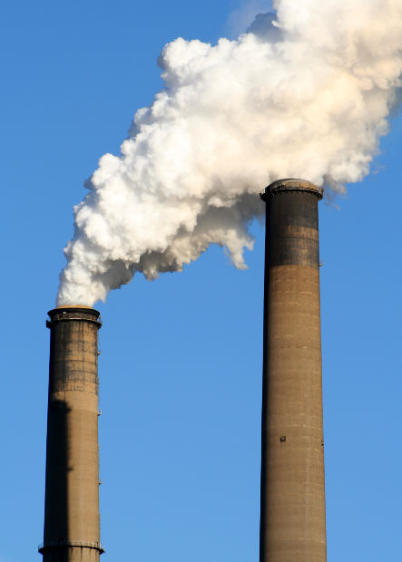


Positive and Negative Externalities
Examples of situations with external costs:
Air and water pollution
Texting on phone while driving
Depletion of fish in the ocean due to overfishing
Examples of situations with external benefits:
Education
Beehives next to fruit orchards
Vaccination against infectious diseases

Slide 5
Production, Consumption, and Externalities
The social cost of a good or activity is equal to the cost of production, plus its external cost.
When there are external costs (e.g. pollution), the marginal social cost exceeds a firm’s marginal cost of production
In the absence of government intervention, the industry typically produces too much of the good.
The socially optimal quantity can be achieved by an optimal Pigouvian tax, in order to internalize the externality
The optimal Pigouvian tax is set equal to the marginal external cost
Notes:
4

Slide 6
Negative Externalities and Meat Production
Price, marginal social cost of livestock
(a) Negative Externality
(b) Optimal Pigouvian Tax
Price of livestock
Marginal external cost
MSC of livestock
S_{TAX}
Price to consumers after tax
P_{MSC}
S
Tax
S
P_{OPT}
Optimal Pigouvian Tax
P_{MKT}
E_{MKT}
E_{MKT}
D
Price to producers after tax
D
Q_{OPT}
Q_{MKT}
Quantity of livestock
Q_{OPT}
Q_{MKT}
Quantity of livestock
Notes:
Figure Caption: Figure 16-5: Negative Externalities and Production
Livestock production generates external costs, so the marginal social cost curve, MSC, of livestock, corresponds to the supply curve, S, shifted upward by the marginal external cost. Panel (a) shows that without government action, the market produces the quantity QMKT. It is greater than the socially optimal quantity of livestock production, QOPT, the quantity at which MSC crosses the demand curve, D. At QMKT, the market price, PMKT, is less than PMSC, the true marginal cost to society of livestock production. Panel (b) shows how an optimal Pigouvian tax on livestock production, equal to its marginal external cost, moves the production to QOPT, resulting in lower output and a higher price to consumers.

Slide 7

Private, External, and Social Benefits
The marginal social benefit of a good or activity is equal to the marginal benefit that accrues to consumers, plus its marginal external benefit.
A technology spillover when new knowledge spreads among firms
Vaccination prevents disease from spreading through the population
A Pigouvian subsidy is a payment designed to encourage activities that yield external benefits.
The socially optimal quantity can be achieved by an optimal Pigouvian subsidy equal to the marginal external benefit
Notes:
6

Slide 8
Positive Externalities and Consumption
(a) Positive Externality
(b) Optimal Pigouvian Subsidy
Price, marginal social benefit of measles vaccine
Price of measles vaccine
Marginal external benefit
S
S
Price to producers after subsidy
P_{MSB}
Subsidy
Opt
Opt
P_{OPT}
Optimal Pigouvian subsidy
P_{MKT}
E_{MKT}
E_{MKT}
MSB of measles vaccine
D with
subsidy
Price to consumers after subsidy
D
D
Q_{MKT}
Q_{OPT}
Quantity of measles vaccines
Q_{MKT}
Q_{OPT}
Quantity of measles vaccines
Notes:
Figure Caption: Figure 16-4: Positive Externalities and Consumption
Consumption of flu shots generates external benefits, so the marginal social benefit curve, MSB, of flu shots, corresponds to the demand curve, D, shifted upward by the marginal external benefit. Panel (a) shows that without government action, the market produces QMKT. It is lower than the socially optimal quantity of consumption, QOPT, the quantity at which MSB crosses the supply curve, S. At QMKT, the marginal social benefit of another flu shot, PMSB, is greater than the marginal benefit to consumers of another flu shot, PMKT. Panel (b) shows how an optimal Pigouvian subsidy to consumers, equal to the marginal external benefit, moves consumption to QOPT by lowering the price paid by consumers.

Slide 9
Network Externalities
A good is subject to a network externality when the value of the good to an individual is greater when a large number of other people also use the good.
Network externalities increases the value of a good or service when more people use the good or service.
Examples:
Computer operating systems like Microsoft Windows
Chat apps like QQ
Online social networks like Facebook
Traditional communication systems: telephones, telegraphs, railway systems
Notes:
8

Slide 10

Network Externalities
Any way in which other people’s consumption of a good increases your own marginal benefit from consumption of that good can give rise to network effects.
Windows is used widely so it attracts more attention from software developers.
As a result, there are more programs that run on Windows than on any other operating system.
There is positive feedback when success breeds greater success and failure breeds failure.
Notes:
9

Slide 11


Active Learning Practice
The extra enjoyment you might have because other people in the area have purchased flowers for their gardens is an example with?
private cost
external cost
private benefit
external benefit
When you bring bulky baggage on the MTR and make it difficult for others to get in or out of the train, there is:
private cost
external cost
private benefit
external benefit

Slide 12

Case Study: The Economics of Pollution
Pollution is a side effect of economic activities that provide us with good things (transportation, fertilizer, electric power)
Producers can reduce pollution by using (expensive) pollution mitigation technologies
However, An unregulated firm has no incentive to reduce pollution
Producers do not pay for the pollution they cause − it is a negative externality
Notes:
11

Slide 13
Costs and Benefits of Pollution
Pollution is bad, but the optimal quantity isn’t zero.
How much pollution should a society have?
What are the costs and benefits of pollution?
The marginal social cost of pollution is the additional cost imposed on society as a whole by an additional unit of pollution.
The marginal social benefit of pollution is the additional gain to society (including cheaper production costs) from an additional unit of pollution.
The socially optimal quantity of pollution is the quantity of pollution that society would choose if all the costs and benefits of pollution were fully accounted for.
Notes:
12

Slide 14
The Socially Optimal Quantity of Pollution
Marginal social cost, marginal social benefit
Marginal social cost, MSC of pollution
Socially optimal point
O
$200
Marginal social benefit,
(incl cheaper production)
MSB of pollution
0
Q
OPT
Quantity of pollution
Socially optimal quantity of pollution
emissions (tons)
Notes:
Figure Caption: Figure 16-1: The Socially Optimal Quantity of Pollution
Pollution yields both costs and benefits. Here the curve MSC shows how the marginal cost to society as a whole from emitting one more ton of pollution emissions depends on the quantity of emissions. The curve MSB shows how the marginal benefit to society as a whole of emitting an additional ton of pollution emissions depends on the quantity of pollution emissions. The socially optimal quantity of pollution is QOPT; at that quantity, the marginal social benefit of pollution is equal to the marginal social cost, corresponding to $200.

Slide 15
How do we measure Costs and Benefits?
How do we measure the marginal social cost of pollution?
It’s the sum of the harm done to members of society from an extra unit of pollution.
Health costs, psychological costs
Sometimes estimated from public opinion surveys
It is hard to estimate, and is often underestimated
How do we measure the marginal social benefit of pollution?
It’s the willingness to pay (of polluters) for the right to emit a unit of pollution.
Can be measured by emissions trading schemes
Notes:
14

Slide 16
A Market Economy Produces Too Much Pollution
Marginal social cost, marginal social benefit
Marginal social cost at Q_{MKT}
MSC of pollution
$400
300
The market outcome is inefficient: marginal social cost of pollution exceeds marginal social benefit
Optimal Pigouvian tax on pollution
O
200
100
Marginal social benefit at Q_{MKT}
MSB of pollution
0
Q
OPT
Q
H
Q
M
K
T
Quantity of pollution
emissions (tons)
Socially optimal quantity
Market-determined quantity
Notes:
Figure Caption: Figure 16-2: Why a Market Economy Produces Too Much Pollution
In the absence of government intervention, the quantity of pollution will be QMKT, the level at which the marginal social benefit of pollution is zero. This is an inefficiently high quantity of pollution: the marginal social cost, $400, greatly exceeds the marginal social benefit, $0. An optimal Pigouvian tax of $200, the value of the marginal social cost of pollution when it equals the marginal social benefit of pollution, can move the market to the socially optimal quantity of pollution, QOPT.

Slide 17
Environmental Policies To Control Pollution
Environmental standards are rules that protect the environment by specifying actions by producers and consumers. Generally such standards are inefficient because they are inflexible.
An emissions tax is a tax that depends on the amount of pollution a firm produces.
A Pollution Tax is an example of a Pigouvian tax.
Tradable emissions permits are licenses to emit limited quantities of pollutants, which can be bought and sold.
The effect is similar to a tax, except they do not generate revenue for the government
If permits are auctioned, they are exactly like a tax
Notes:
16

Slide 18

Environmental Standards versus Emissions Taxes
(a) Environmental Standard
(b) Emissions Taxes
Marginal benefit to individual polluter
Marginal benefit to individual polluter
An emissions tax is more efficient. It allows firms to flexibly respond according to their costs of reducing pollution
$600
MB
$600
MB
B
B
MB
A
S
B
MB
A
300
T
A
T
B
S
200
150
A
Emissions
tax
0
300
600
Quantity of pollution emissions (tons)
0
200
400
600
Quantity of pollution emissions (tons)
Environmental standards forces both plants to cut emission by half
Without government action, each plant emits 600 tons
Plant A has a lower marginal benefit of pollution and reduces emissions by 400 tons
Plant B has a higher marginal benefit of pollution and reduces emissions by only 200 tons
Notes:
Figure Caption: Figure 16-3: Environmental Standards Versus Emissions Taxes
In both panels, MBA shows the marginal benefit of pollution to plant A and MBB shows the marginal benefit of pollution to plant B. In the absence of government intervention, each plant would emit 600 tons. However, the cost of reducing emissions is lower for plant A, as shown by the fact that MBA lies below MBB. Panel (a) shows the result of an environmental standard that requires both plants to cut emissions in half; this is inefficient, because it leaves the marginal benefit of pollution higher for plant B than for plant A. Panel (b) shows that an emissions tax achieves the same quantity of overall pollution efficiently: faced with an emissions tax of $200 per ton, both plants reduce pollution to the point where its marginal benefit is $200.

Slide 19
Tradable Emissions Permits
If the government issues a limited number of tradable pollution permits:
The government limits the total amount of pollution, and creates a market for the right to pollute
Firms that can easily and at low cost reduce their pollution will reduce pollution beyond what they need to, and sell their extra tradable pollution permits
Firms that find it difficult and costly to reduce their pollution will buy additional tradable pollution permits
If the government were to sell the tradable pollution permits, instead of issuing them to firms:
The effect would be the same as imposing a tax on pollution

Slide 20
Private Solutions to Externalities
The economist Ronald Coase pointed out that, ideally, the private sector could indeed deal with externalities.
According to the Coase theorem, even in the presence of externalities, an economy can reach an efficient solution provided that the transaction costs—the costs to individuals of making a deal—are low.
The implication of Coase’s analysis is that externalities need not lead to inefficiency because individuals have an incentive to find a way to make mutually beneficial deals that lead them to take externalities into account.
Notes:
19

Slide 21

The Coase Theorem: An Example
Dick owns a dog named Spot
Negative externality: Spot’s barking disturbs Jane, Dick’s neighbor
The socially efficient outcome maximizes Dick’s & Jane’s well-being
If Dick values having Spot more than Jane values peace & quiet, the dog should stay
If Jane values peace & quiet more, than Dick values the dog, the dog should go
Coase theorem: The private market can reach the efficient outcome on its own…
Hear Spot bark.
Notes:
20

Slide 22
The Coase Theorem: An Example
CASE 1a: Dick has the right to keep Spot.
Benefit to Dick of having Spot = $500
Cost to Jane of Spot’s barking = $800
Jane pays Dick $600 to get rid of Spot, both Jane and Dick are better off.
CASE 1b: Dick has the right to keep Spot.
Benefit to Dick of having Spot = $1200
Cost to Jane of Spot’s barking = $800
Jane cannot pay Dick enough, Spot stays.
Notes:
21
Both Jane and Dick are better off. (What about Spot? Doesn’t anyone care about Spot???)

Slide 23
The Coase Theorem: An Example
CASE 2a: Jane has the legal right to peace & quiet.
Benefit to Dick of having Spot = $500
Cost to Jane of Spot’s barking = $800
Spot is kicked out
CASE 2b: Jane has the legal right to peace & quiet.
Benefit to Dick of having Spot = $1200
Cost to Jane of Spot’s barking = $800
Dick pays Jane $600 to not sue, Spot stays.
The private market achieves the efficient outcome regardless of the initial distribution of rights.
Notes:
22
Both Jane and Dick are better off. (What about Spot? Doesn’t anyone care about Spot???)

Slide 24

Private Solutions to Externalities
Coase-type solutions to externalities are distinguished by side payments between individuals. Examples include:
A family gets their next-door neighbor to stop playing loud music during their child’s naptime, in exchange they cook lunch for the neighbor.
In order to improve their air quality, a town agrees to pay for the installation of water scrubbers in a nearby electricity generation plant.
Owners of fruit orchards pay beekeepers to house their bee colonies nearby to provide pollination services.
Notes:
23

Slide 25
Private Solutions to Externalities
When individuals do take externalities into account, economists say that they internalize the externality.
However, most externalities are not internalized.
Transaction costs prevent individuals from making efficient deals. Examples of transaction costs include:
Costs of communication among the interested parties —costs may be very high if many people are involved
The costs of making legally binding agreements may be high, especially if it requires expensive legal services
Costly bargaining—even if there is a potentially beneficial deal, both sides may hold out to try to extract more favorable terms, leading to increased costs
Notes:
24

Slide 26
Summary
When pollution can be directly observed and controlled, government policies should be geared directly to producing the socially optimal quantity of pollution, the quantity at which the marginal social cost of pollution is equal to the marginal social benefit of pollution.
The costs to society of pollution are an example of an external cost; in some cases, however, economic activities yield external benefits. External costs and benefits are jointly known as externalities, with external costs called negative externalities and external benefits called positive externalities.

Slide 27
Summary
According to the Coase theorem, individuals can find a way to internalize the externality, making government intervention unnecessary, as long as transaction costs—the costs of making a deal—are sufficiently low.
Governments often deal with pollution by imposing environmental standards, a method, economists argue, that is usually an inefficient way to reduce pollution. Two efficient (cost-minimizing) methods for reducing pollution are emissions taxes, a form of Pigouvian tax, and tradable emissions permits. The optimal Pigouvian tax on pollution is equal to its marginal social cost at the socially optimal quantity of pollution.

Slide 28
Summary
When a good or activity yields external benefits, such as technology spillovers, the marginal social benefit of the good or activity is equal to the marginal benefit accruing to consumers plus its marginal external benefit. Without government intervention, the market produces too little of the good or activity. An optimal Pigouvian subsidy to producers, equal to the marginal external benefit, moves the market to the socially optimal quantity of production. This yields higher output and a higher price to producers. It is a form of industrial policy, a policy to support industries that are believed to generate positive externalities.

Slide 29
Summary
When only the original good or activity can be controlled, government policies are geared to influencing how much of it is produced. When there are external costs from production, the marginal social cost of a good or activity exceeds its marginal cost to producers, the difference being the marginal external cost. Without government action, the market produces too much of the good or activity. The optimal Pigouvian tax on production of the good or activity is equal to its marginal external cost, yielding lower output and a higher price to consumers. A system of tradable production permits for the right to produce the good or activity can also achieve efficiency at minimum cost.

Slide 30
Summary
Communications, transportation, and high-technology goods are frequently subject to network externalities, which arise when the value of the good to an individual is greater when a large number of people use the good. Such goods are likely to be subject to positive feedback: if large numbers of people buy the good, other people are more likely to buy it, too. Producers have an incentive to take aggressive action in the early stages of the market to increase the size of their network. Markets with network externalities tend to be monopolies.

Slide 31
Key Terms
Marginal social cost of pollution
Marginal social benefit of pollution
Socially optimal quantity of pollution
External cost
External benefit
Externalities
Negative externalities
Positive externalities
Coase theorem
Transaction costs
Internalize the externality
Environmental standards
Emissions tax
Pigouvian tax
Tradable emissions permits
Pigouvian subsidy
Technology spillover
Positive feedback

