Slide 1
THIRD EDITION
MICROECONOMICS Paul Krugman | Robin Wells
>>
Chapter 6 Elasticity
Notes:
1

Slide 2
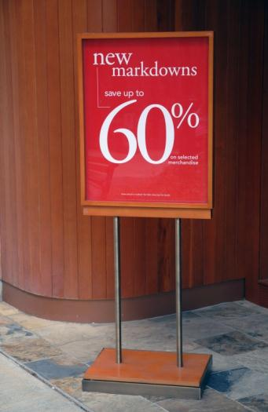

Price Elasticity of Demand
There is an inverse relationship between price and quantity demanded.
But how much does quantity demanded change when price changes?
A demand curve is elastic when an increase in price reduces the quantity demanded a lot (and vice versa).
When the same increase in price reduces quantity demanded just a little, then the demand curve is inelastic.
D
Notes:
2

Slide 3
What is the definition of elasticity?
Why economists use elasticity to measure responsiveness to changes in prices or incomes
What is the meaning and importance of:
price elasticity of demand?
income elasticity of demand?
price elasticity of supply?
What factors influence the size of these various elasticities?
How the cross-price elasticity of demand measures the responsiveness of demand for one good to changes in the price of another good
WHAT YOU
WILL LEARN
IN THIS CHAPTER
Notes:
3

Slide 4


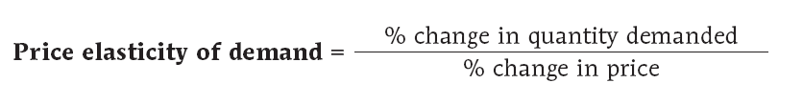
The Price Elasticity of Demand
The price elasticity of demand is the ratio of the percent change in the quantity demanded to the percent change in the price as we move along the demand curve (dropping the minus sign).
Notes:
4

Slide 5
Demand for Vaccination
Price of vaccination
When price rises to $21 per vaccination, world quantity demanded falls to 9.9 million vaccinations per year (point B).
B
$21
A
20
D
0
9.9
10.0
Quantity of vaccinations (millions)
Notes:
Figure Caption:
Figure 6-1: Demand for Vaccinations
At a price of $20 per vaccination, the quantity of vaccinations demanded is 10 million per year (point A). When price rises to $21 per vaccination, the quantity demanded falls to 9.9 million vaccinations per year (point B).

Slide 6

Calculating the Price Elasticity of Demand
Notes:
6

Slide 7
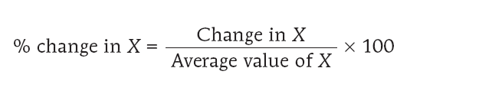
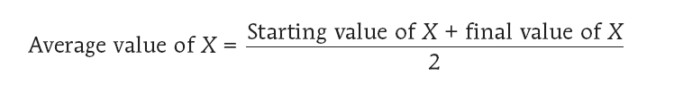
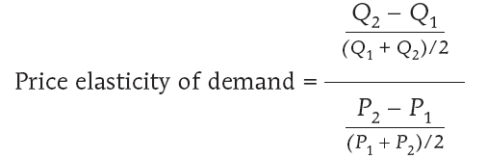
Using the Midpoint Method
The midpoint method is a technique for calculating the percent change. In this approach, we calculate changes in a variable compared with the average, or midpoint, of the starting and final values.
Notes:
7

Slide 8
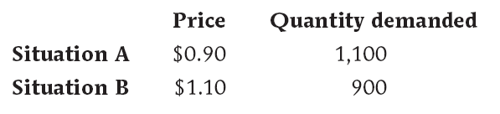

Using the Midpoint Method
Notes:
8

Slide 9
Some Estimated Price Elasticities of Demand
Good Price Elasticity
Inelastic demand
Eggs 0.1
Beef 0.4
Stationery 0.5
Gasoline 0.5
Elastic demand
Housing 1.2
Restaurant meals 2.3
Airline travel 2.4
Foreign travel 4.1
Price elasticity of demand < 1
Price elasticity of demand > 1
Notes:
9

Slide 10
Interpreting the Price Elasticity of Demand
Two Extreme Cases of Price Elasticity of Demand
Demand is perfectly inelastic when the quantity demanded does not respond at all to changes in the price. When demand is perfectly inelastic, the demand curve is a vertical line.
Demand is perfectly elastic when any price increase will cause the quantity demanded to drop to zero. When demand is perfectly elastic, the demand curve is a horizontal line.
Notes:
10

Slide 11
Two Extreme Cases of Price Elasticity of Demand
(a)
Perfectly Inelastic Demand:
Price Elasticity of Demand = 0
Price of shoelaces
(per pair)
D
1
$3
An increase in price…
$2
… leaves the quantity demanded unchanged.
0
1
Quantity of shoelaces (billions of pairs per year)
Notes:
Figure Caption:
Figure 6-2: Two Extreme Cases of Price Elasticity of Demand
Panel (a) shows a perfectly inelastic demand curve, which is a vertical line. The quantity of shoelaces demanded is always 1 billion pairs, regardless of price. As a result, the price elasticity of demand is zero—the quantity demanded is unaffected by the price.

Slide 12
Two Extreme Cases of Price Elasticity of Demand
(b)
Price Elastic Demand: Price Elasticity of Demand = ∞
Price of pink tennis balls
(per dozen)
At exactly $5, consumers will buy any quantity
At any price above $5, quantity demanded is zero
$5
D
2
At any price below $5, quantity demanded is infinite
0
Quantity of tennis balls (dozens per year)
Notes:
Figure Caption:
Figure 6-2: Two Extreme Cases of Price Elasticity of Demand
Panel (b) shows a perfectly elastic demand curve, which is a horizontal line. At a price of $5, consumers will buy any quantity of pink tennis balls, but will buy none at a price above $5. If the price falls below $5, they will buy an extremely large number of pink tennis balls and none of any other color.

Slide 13
Elastic Demand
Elastic Demand: Price Elasticity of Demand = 2
Price of bridge crossing
A 20% increase in the price ...
B
$1.10
A
0.90
D
3
0
800
1,200
Quantity of bridge crossings (per day)
… generates a 40% decrease in the quantity of crossings demanded.
Demand is elastic if the price elasticity of demand is greater than 1
Notes:
Figure Caption:
Figure 6-3: Unit-Elastic Demand, Inelastic Demand, and Elastic Demand
A case of elastic demand is shown in Panel (c): a 20% increase in price causes a 40% decline in quantity demanded, implying a price elasticity of demand of 2. All percentages are calculated using the midpoint method.

Slide 14
Unit Elasticity of Demand
Unit-Elastic Demand: Price Elasticity of Demand = 1
Price of bridge crossing
A 20% increase in the price ...
B
$1.10
A
0.90
D
1
0
900
1,100
Quantity of bridge crossings (per day)
. . . generates a 20% decrease in the quantity of crossings demanded.
Demand is unit-elastic if the price elasticity of demand is equal to 1
Notes:
Figure Caption:
Figure 6-3: Unit-Elastic Demand, Inelastic Demand, and Elastic Demand
Panel (a) shows a case of unit-elastic demand: a 20% increase in price generates a 20% decline in quantity demanded, implying a price elasticity of demand of 1.

Slide 15
Inelastic Demand
Inelastic Demand: Price Elasticity of Demand = 0.5
Price of bridge crossing
A 20% increase in the price ...
B
$1.10
A
0.90
D
2
0
950
1,050
Quantity of bridge crossings (per day)
. . . generates a 10% decrease in the quantity of crossings demanded.
Demand is inelastic if the price elasticity of demand is less than 1
Notes:
Figure Caption:
Figure 6-3: Unit-Elastic Demand, Inelastic Demand, and Elastic Demand
Panel (b) shows a case of inelastic demand: a 20% increase in price generates a 10% decline in quantity demanded, implying a price elasticity of demand of 0.5.

Slide 16
Unit-Elastic, Inelastic, or Elastic?
Why Does It Matter Whether Demand is Unit-Elastic, Inelastic, or Elastic?:
Because this classification predicts how changes in the price of a good will affect the total revenue earned by producers from the sale of that good.
The total revenue is defined as the total value of sales of a good or service:
Total Revenue = Price × Quantity Sold
Notes:
16

Slide 17
Total Revenue by Area
Price of bridge crossing
$0.90
Total revenue = price x quantity = $990
P
D
0
1,100
Quantity of bridge crossings (per day)
Q
Notes:
Figure Caption:
Figure 6-4 (a):
The green rectangle represents total revenue generated from 1,100 drivers who each pay a toll of $0.90.
17

Slide 18
Elasticity and Total Revenue
When a seller raises the price of a good, there are two countervailing effects in action (except in the rare case of a good with perfectly elastic or perfectly inelastic demand):
A price effect: After a price increase, each unit sold sells at a higher price, which tends to raise revenue.
A quantity effect: After a price increase, fewer units are sold, which tends to lower revenue.
Notes:
18

Slide 19
Effect of a Price Increase on Total Revenue
Price of bridge crossing
Price effect of price increase: higher price for each unit sold
Quantity effect of price increase: fewer units sold
$1.10
C
0.90
B
A
D
0
900
1,100
Quantity of bridge crossings (per day)
Notes:
Figure Caption:
Figure 6-4 (b):
The graph above shows how total revenue is affected when the price increases from $0.90 to $1.10. Due to the quantity effect, total revenue falls by area A. Due to the price effect, total revenue increases by the area C. In general, the overall effect can go either way, depending on the price elasticity of demand.
19

Slide 20
Elasticity and Total Revenue
If demand for a good is elastic (the price elasticity of demand is greater than 1), an increase in price reduces total revenue.
In this case, the quantity effect is stronger than the price effect.
If demand for a good is inelastic (the price elasticity of demand is less than 1), a higher price increases total revenue.
In this case, the price effect is stronger than the quantity effect.
Notes:
20

Slide 21
How Total Revenue Changes When Price Changes
The case of inelastic demand
The case of elastic demand
Price
Price
$5
$5
A
A
4
4
B
Demand
B
Demand
0
90
100
Quantity
0
70
100
Quantity
In the case of inelastic demand, an increase in the price leads to a decrease in quantity demanded that is proportionately smaller, so total revenue increases. Here an increase in the price from $4 to $5 causes the quantity demanded to fall from 100 to 90. Total revenue rises from $400 to $450.
In the case of elastic demand, an increase in the price leads to a decrease in quantity demanded that is proportionately larger, so total revenue decreases. Here an increase in the price from $4 to $5 causes the quantity demanded to fall from 100 to 70. Total revenue falls from $400 to $350.

Slide 22
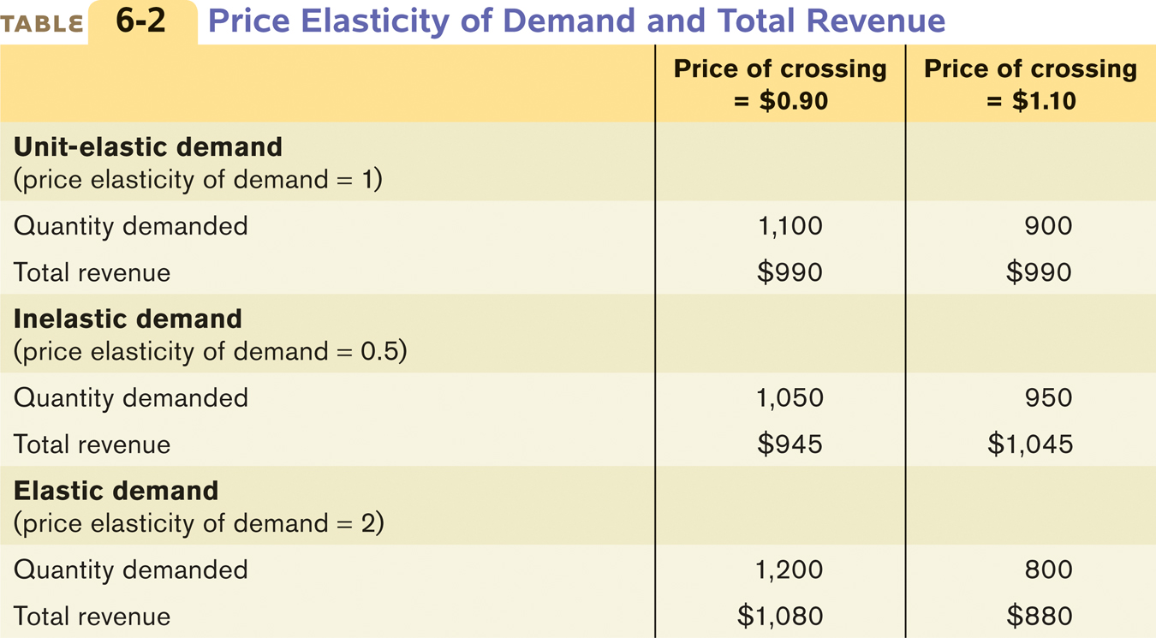
Elasticity and Total Revenue
If demand is unit-elastic (the price elasticity of demand is 1), an increase in price does not change total revenue.
The sales effect and the price effect exactly offset each other
Notes:
22

Slide 23
Demand Schedule and Total Revenue
Price
$10
Elastic
9
Unit-elastic
8
7
6
Inelastic
Demand Schedule and Total Revenue
for a Linear Demand Curve
5
4
3
Price
Quantity demanded
Total Revenue
2
1
D
0
1
2
3
4
5
6
7
8
9
10
$0
10
$0
Quantity
1
9
9
Total revenue
2
8
16
3
7
21
4
6
24
5
5
25
$25
6
4
24
24
7
3
21
21
8
2
16
16
9
1
9
10
0
0
9
The price elasticity of demand changes along the demand curve
0
0
1
2
3
4
5
6
7
8
9
10
Quantity
Demand is elastic: a higher price reduces total revenue
Demand is inelastic: a higher price increases total revenue
Notes:
Figure Caption:
Figure 6-5: The Price Elasticity of Demand Changes Along the Demand Curve
The upper panel shows a demand curve corresponding to the demand schedule in the table. The lower panel shows how total revenue changes along that demand curve: at each price and quantity combination, the height of the bar represents the total revenue generated. You can see that at a low price, raising the price increases total revenue. So demand is inelastic at low prices. At a high price, however, a rise in price reduces total revenue. So demand is elastic at high prices.
23

Slide 24

What Factors Determine the Price Elasticity of Demand?
Price elasticity of demand is determined by:
Whether close substitutes are available
more elastic
Whether the good is a necessity or a luxury
neccesity is less elastic
Share of income spent on the good
more elastic
Time to adjust
More elastic
Vacations in Bali
Have many substitutes
Are not a necessity
Very expensive
Take a long time to plan
– Very Price Elastic
Notes:
24

Slide 25
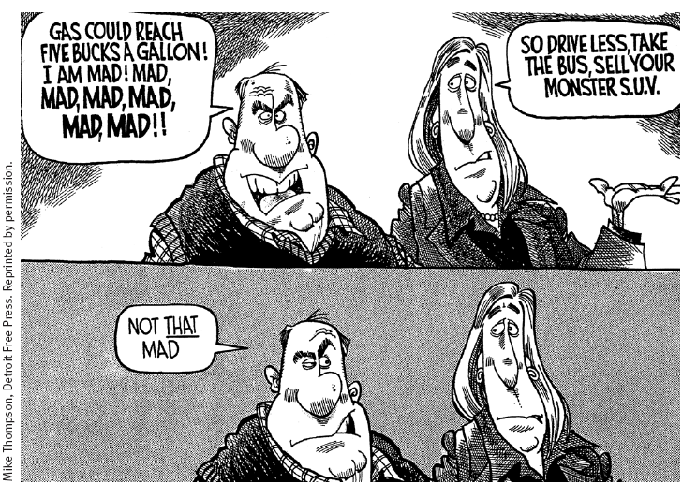
How Mad?

Slide 26

Other Demand Elasticities: Cross-Price Elasticity
The cross-price elasticity of demand between two goods measures the effect of the change in one good’s price on the quantity demanded of the other good.
It is equal to the percent change in the quantity demanded of one good divided by the percent change in the other good’s price.
The Cross-Price Elasticity of Demand
between Goods A and B
Notes:
26

Slide 27


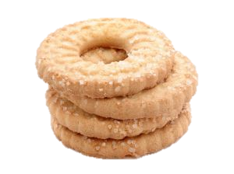
Cross-Price Elasticity
Goods are substitutes when the cross-price elasticity of demand is positive.
An increase in the price of one brand of cookies will increase the demand for other brands.
$
$
$
$
Goods are complements when the cross-price elasticity of demand is negative.
An increase in the price of milk causes a decrease in demand for cookies.
Notes:
27

Slide 28
The Income Elasticity of Demand
The income elasticity of demand is the percent change in the quantity of a good demanded when a consumer’s income changes divided by the percent change in the consumer’s income.
When the income elasticity of demand is positive, the good is a normal good; that is, the quantity demanded at any given price increases as income increases.
When the income elasticity of demand is negative, the good is an inferior good; that is, the quantity demanded at any given price decreases as income increases.
Notes:
28

Slide 29
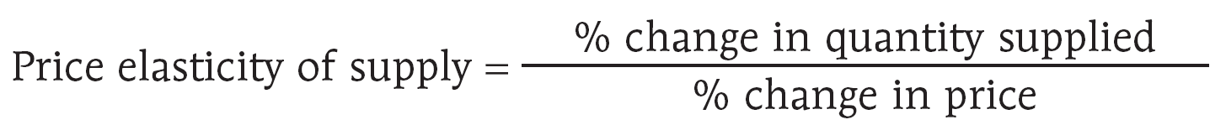
Measuring the Price Elasticity of Supply
The price elasticity of supply is a measure of the responsiveness of the quantity of a good supplied to the price of that good.
It is the ratio of the percent change in the quantity supplied to the percent change in the price as we move along the supply curve.
Notes:
29

Slide 30
The Price Elasticity of Supply
Unit Elastic Supply: Elasticity Equals 1
Price
1. A 22%
increase
in price…
Supply
$5
4
2. … leads to
a 22% increase
in quantity
supplied
0
100
125
Quantity
The price elasticity of supply determines whether the supply curve is steep or flat.
In this example, all percentage changes are calculated using the midpoint method.

Slide 31

Two Extreme Cases of Price Elasticity of Supply
(a)
Perfectly Inelastic Supply: Price Elasticity of Supply = 0
Price of cell phone frequency
S
The supply of land is fixed
1
$3,000
An increase in price…
2,000
… leaves the quantity supplied unchanged
0
100
Quantity of cell phone frequencies
Notes:
Figure Caption:
Figure 6-6:
Panel (a) shows a perfectly inelastic supply curve, which is a vertical line. The price elasticity of supply is zero: the quantity supplied is always the same, regardless of price.
Panel (b) shows a perfectly elastic supply curve, which is a horizontal line. At a price of $12, producers will supply any quantity, but they will supply none at a price below $12. If price rises above $12, they will supply an extremely large quantity.
31

Slide 32

Two Extreme Cases of Price Elasticity of Supply
(b)
Perfectly Elastic Supply: Price Elasticity of Supply = ∞
Price of pizza
At any price above $12, quantity supplied is infinite
At exactly $12, producers will produce any quantity
The supply of copies of
MP3 song files is limitless
$12
S
2
At any price below $12, quantity supplied is zero
0
Quantity of pizzas
Notes:
Figure Caption:
Figure 6-6:
Panel (a) shows a perfectly inelastic supply curve, which is a vertical line. The price elasticity of supply is zero: the quantity supplied is always the same, regardless of price.
Panel (b) shows a perfectly elastic supply curve, which is a horizontal line. At a price of $12, producers will supply any quantity, but they will supply none at a price below $12. If price rises above $12, they will supply an extremely large quantity.
32

Slide 33
Two Extreme Cases of Price Elasticity of Supply
There is perfectly inelastic supply when the price elasticity of supply is zero, so that changes in the price of the good have no effect on the quantity supplied. A perfectly inelastic supply curve is a vertical line.
There is perfectly elastic supply when even a tiny increase or reduction in the price will lead to very large changes in the quantity supplied, so that the price elasticity of supply is infinite. A perfectly elastic supply curve is a horizontal line.
Notes:
33

Slide 34
What Factors Determine the Price Elasticity of Supply?
The Availability of Inputs: The price elasticity of supply tends to be large when inputs are readily available and can be shifted into and out of production at a relatively low cost. It tends to be small when inputs are difficult to obtain.
Time: The price elasticity of supply tends to grow larger as producers have more time to respond to a price change. This means that the long-run price elasticity of supply is often higher than the short-run elasticity.
Notes:
34

Slide 35
How the Price Elasticity of Supply Can Vary
Price
Elasticity is small
(less than 1)
Supply
$15
12
Elasticity is large
(greater than 1)
4
3
0
100
200
500
525
Quantity
Firms often have a maximum capacity for production. The elasticity of supply may be high at low levels of production and very low at high levels of production.
As firms reach their limit of production, it become much harder to increase production, and there is correspondingly little increase in production in response to price increases.

Slide 36
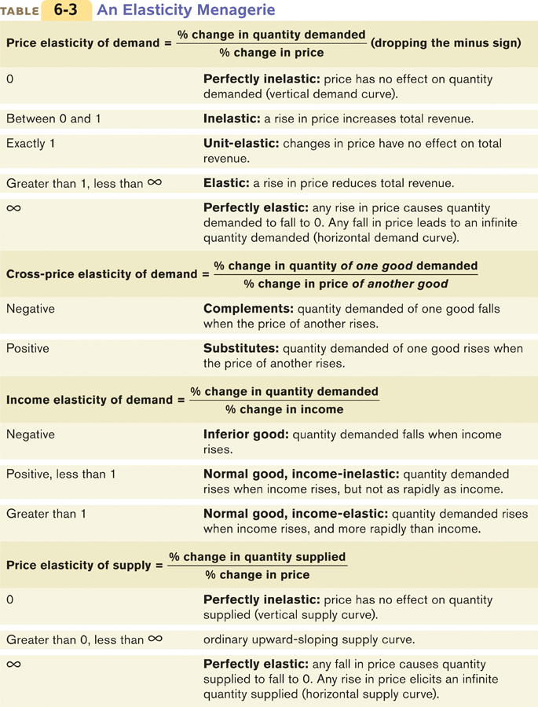
An Elasticity Menagerie
Notes:
36

Slide 37
An Elasticity Menagerie
Notes:
37

Slide 38
SUMMARY
Elasticity is a general measure of responsiveness that can be used to answer such questions.
The price elasticity of demand—the percent change in the quantity demanded divided by the percent change in the price (dropping the minus sign)—is a measure of the responsiveness of the quantity demanded to changes in the price.

Slide 39
SUMMARY
The responsiveness of the quantity demanded to price can range from perfectly inelastic demand, where the quantity demanded is unaffected by the price, to perfectly elastic demand, where there is a unique price at which consumers will buy as much or as little as they are offered. When demand is perfectly inelastic, the demand curve is a vertical line; when it is perfectly elastic, the demand curve is a horizontal line.

Slide 40
SUMMARY
The price elasticity of demand is classified according to whether it is more or less than 1. If it is greater than 1, demand is elastic; if it is less than 1, demand is inelastic; if it is exactly 1, demand is unit-elastic. This classification determines how total revenue, the total value of sales, changes when the price changes.
The price elasticity of demand depends on whether there are close substitutes for the good, whether the good is a necessity or a luxury, the share of income spent on the good, and the length of time that has elapsed since the price change.

Slide 41
SUMMARY
The cross-price elasticity of demand measures the effect of a change in one good’s price on the quantity of another good demanded.
The income elasticity of demand is the percent change in the quantity of a good demanded when a consumer’s income changes divided by the percent change in income. If the income elasticity is greater than 1, a good is income elastic; if it is positive and less than 1, the good is income-inelastic.

Slide 42
SUMMARY
The price elasticity of supply is the percent change in the quantity of a good supplied divided by the percent change in the price. If the quantity supplied does not change at all, we have an instance of perfectly inelastic supply; the supply curve is a vertical line. If the quantity supplied is zero below some price but infinite above that price, we have an instance of perfectly elastic supply; the supply curve is a horizontal line.
The price elasticity of supply depends on (1) the availability of resources to expand production, and (2) time. It is higher when inputs are available at relatively low cost and the longer it has been since the price change.

Slide 43
KEY TERMS
Price elasticity of demand
Midpoint method
Perfectly inelastic demand
Perfectly elastic demand
Elastic demand
Inelastic demand
Unit-elastic demand
Total revenue
Cross-price elasticity of demand
Income elasticity of demand
Income-elastic demand
Income-inelastic demand
Price elasticity of supply
Perfectly inelastic supply
Perfectly elastic supply

