Slide 1
Chapter 7 Taxes
THIRD EDITION
MICROECONOMICS Paul Krugman | Robin Wells
>>
Notes:
0

Slide 2
The effects of taxes on supply and demand in a competitive market
What determines who really bears the burden of a tax
The costs and benefits of taxes, and why taxes impose a cost that is larger than the tax revenue they raise
The difference between progressive and regressive taxes and the trade-off between tax equity and tax efficiency
WHAT YOU
WILL LEARN
IN THIS CHAPTER
Notes:
1

Slide 3
The Economics of Taxes: A Preliminary View
An excise tax is a tax on sales of a good or service.
Examples:
An excise tax levied on sales of hotel accommodation (paid by the hotel guest).
An excise tax levied on sales of alcohol (paid by the retail shop).
Taxes drive a wedge between the price buyers pay and the price sellers receive.
Buyers will have to pay more.
Seller will receive less.
The tax incidence is a measure of who bears the burden for a tax (who really pays for the tax).

Slide 4
The Supply and Demand for Hotel Rooms
Price of hotel room
$140
Q_{Demand} if price was $100
120
A
S
100
Equilibrium price
E
80
B
60
D
40
20
0
5,000
10,000
15,000
Quantity of hotel rooms
Q_{Supply} if price was $60
Equilibrium quantity
Notes:
Figure Caption: Figure 7-1: The Supply and Demand for Hotel Rooms in Potterville
In the absence of taxes, the equilibrium price of hotel rooms is $80 a night, and the equilibrium number of rooms rented is 10,000 per night, as shown by point E. The supply curve, S, shows the quantity supplied at any given price, pre-tax. At a price of $60 a night, hotel owners are willing to supply 5,000 rooms, point B. But post-tax, hotel owners are willing to supply the same quantity only at a price of $100: $60 for themselves plus $40 paid to the city as tax.

Slide 5
An Excise Tax Imposed on Hotel Owners
The $40 excise tax is shared between buyers and sellers.
Price
The equilibrium price of hotel rooms rises to $100 a night.
$140
Supply curve shifts upward by the amount of the tax.
S₂
Hotel guests bear some of the burden as price RISES from $80 to $100.
120
A
S₁
100
Excise tax = $40 per room
E
80
Hotel owners also bear some of the burden as their price (net of the tax paid) FALLS from $80 to $60.
60
B
D
40
20
0
5,000
10,000
15,000
Quantity of hotel rooms
And the quantity falls to 5,000

Slide 6
An Excise Tax Imposed on Hotel Guests
The incidence of an excise tax doesn’t depend on who officially pays the tax.
Price
The equilibrium price of hotel rooms falls to $60 a night.
$140
Hotel guests also bear some of the burden as price RISES from $80 to $100 (after taxes are paid).
Demand curve shifts downward by the amount of the tax.
120
A
S
100
E
Excise tax = $40 per room
80
Hotel owners bear some of the burden as their price FALLS from $80 to $60.
60
D
B
1
40
20
D
2
0
5,000
10,000
15,000
And the quantity falls to 5,000.
Quantity of hotel rooms

Slide 7
Active Learning Practice
If A is the buyer price and B the seller price, how large is the per-unit tax imposed on the graph?
$5
$10
$15
$50
$1,000
Price
$35
30
A
S
25
E
20
15
D₁
B
10
5
0
100
200
300
Quantity

Slide 8
Tax Incidence
The incidence of a tax is a measure of who really pays it.
Who really bears the tax burden (in the form of higher prices to consumers and lower prices to sellers) does not depend on who officially pays the tax. Depending on the shapes of supply and demand curves, the incidence of an excise tax may be divided differently.
The wedge between the demand price and supply price becomes the government’s tax revenue.

Slide 9

An Excise Tax Paid Mainly By Consumers
When the price elasticity of demand is low and the price elasticity of supply is high, the burden of an excise tax falls mainly on consumers.
Price of gasoline (per gallon)
$2.95
Tax burden falls mainly on consumers
Excise tax = $1 per gallon
2.00
S
1.95
D
0
Quantity of gasoline (gallons)
Notes:
Figure Caption: Figure 7-4: An Excise Tax Paid Mainly By Consumers
The relatively steep demand curve here reflects a low price elasticity of demand for gasoline. The relatively flat supply curve reflects a high price elasticity of supply. The pre-tax price of a gallon of gasoline is $2.00, and a tax of $1.00 per gallon is imposed. The price paid by consumers rises by $0.95 to $2.95, reflecting the fact that most of the burden of the tax falls on consumers. Only a small portion of the tax is borne by producers: the price they receive falls by only $0.05 to $1.95.

Slide 10

An Excise Tax Paid Mainly by Producers
When the price elasticity of demand is high and the price elasticity of supply is low, the burden of an excise tax falls mainly on producers.
Price of parking space
S
$6.50
6.00
D
Excise tax = $5
per parking
space
Tax burden falls mainly on producers
1.50
0
Quantity of parking spaces
Notes:
Figure Caption: Figure 7-5: An Excise Tax Paid Mainly by Producers
The relatively flat demand curve here reflects a high price elasticity of demand for downtown parking, and the relatively steep supply curve results from a low price elasticity of supply. The pre-tax price of a daily parking space is $6.00 and a tax of $5.00 is imposed. The price received by producers falls a lot, to $1.50, reflecting the fact that they bear most of the tax burden. The price paid by consumers rises a small amount, $0.50, to $6.50, so they bear very little of the burden.

Slide 11
Tax Incidence – Putting It Together
When the price elasticity of demand is higher than the price elasticity of supply, an excise tax falls mainly on producers.
When the price elasticity of supply is higher than the price elasticity of demand, an excise tax falls mainly on consumers.
So elasticity—not who officially pays the tax—determines the incidence of an excise tax.

Slide 12
The Revenue from an Excise Tax
Price of hotel room
The tax revenue collected is:
Tax revenue = $40 per room × 5,000 rooms = $200,000
The area of the shaded rectangle is:
Area = Height × Width = $40 per room × 5,000 rooms = $200,000
$140
120
A
S
100
E
Excise tax = $40 per room
80
Area = tax revenue
60
D
B
40
20
0
6
5,000
10,000
15,000
Quantity of hotel rooms
Notes:
Figure Caption: Figure 7-6: The Revenue from an Excise Tax
The revenue from a $40 excise tax on hotel rooms is $200,000, equal to the tax rate, $40—the size of the wedge that the tax drives between the supply price and the demand price—multiplied by the number of rooms rented, 5,000. This is equal to the area of the shaded rectangle.

Slide 13
Tax Rates and Revenue
The revenue collected by an excise tax:
Equal to the area of the rectangle formed by the tax wedge between supply and demand, and the quantity transacted under the tax.
A tax rate is the amount of tax people are required to pay per unit of whatever is being taxed.
In general, doubling the excise tax rate on a good or service won’t double the amount of revenue collected, because the tax increase will reduce the quantity of the good or service transacted.
In some cases, raising the tax rate may actually reduce the amount of revenue the government collects.

Slide 14
Tax Rates and Revenue
Price of hotel room
(a) An excise tax of $20
Price of hotel room
(b) An excise tax of $60
$140
$140
120
120
110
S
S
Excise tax = $20 per room
90
E
Excise tax = $60 per room
E
80
Area = tax revenue
80
Area = tax revenue
70
D
D
50
40
40
20
20
0
6
,000
7,500
10,000
15,000
0
2,500
5,000
10,000
15,000
Quantity of hotel rooms
Quantity of hotel rooms
Notes:
Figure Caption: Figure 7-7: Tax Rates and Revenue
In general, doubling the excise tax rate on a good or service won’t double the amount of revenue collected, because the tax increase will reduce the quantity of the good or service bought and sold. And the relationship between the level of the tax and the amount of revenue collected may not even be positive. Panel (a) shows the revenue raised by a tax rate of $20 per room, only half the tax rate in Figure 7-6. The tax revenue raised, equal to the area of the shaded rectangle, is $150,000, three-quarters as much as the revenue raised by a $40 tax rate. Panel (b) shows that the revenue raised by a $60 tax rate is also $150,000. So raising the tax rate from $40 to $60 actually reduces tax revenue.

Slide 15
A Tax Reduces Consumer and Producer Surplus
A fall in the price of a good generates a gain in consumer surplus.
Similarly, a price increase causes a loss to consumers.
So it’s not surprising that in the case of an excise tax, the rise in the price paid by consumers causes a loss.
Meanwhile, the fall in the price received by producers leads to a fall in producer surplus.
A tax reduces both the consumer surplus and
the producer surplus.

Slide 16
A Tax Reduces Consumer and Producer Surplus
P
r
i
c
e
Fall in consumer surplus due to tax
S
P
C
A
B
Excise tax
= T
P
E
E
C
F
P
P
Fall in producer surplus due to tax
D
Q
Q
Quantity
T
E
Notes:
Figure Caption: Figure 7-8: A Tax Reduces Consumer and Producer Surplus
Before the tax, the equilibrium price and quantity are PE and QE, respectively. After an excise tax of T per unit is imposed, the price to consumers rises to PC and consumer surplus falls by the sum of the dark blue rectangle, labeled A, and the light blue triangle, labeled B. The tax also causes the price to producers to fall to PP; producer surplus falls by the sum of the dark red rectangle, labeled C, and the light red triangle, labeled F. The government receives revenue from the tax, QT× T, which is given by the sum of the areas A and C. Areas B and F represent the losses to consumer and producer surplus that are not collected by the government as revenue; they are the deadweight loss to society of the tax.

Slide 17
The effects of taxes on supply and demand in a competitive market
What determines who really bears the burden of a tax
The costs and benefits of taxes, and why taxes impose a cost that is larger than the tax revenue they raise
The difference between progressive and regressive taxes and the trade-off between tax equity and tax efficiency
WHAT YOU
WILL LEARN
IN THIS CHAPTER
Notes:
16

Slide 18
The Deadweight Loss of a Tax
Although consumers and producers are hurt by the tax, the government gains revenue. The revenue the government collects is equal to the tax per unit sold, T, multiplied by the quantity sold, Q_{T}.
But a portion of the loss to producers and consumers from the tax is not offset by a gain to the government.
The deadweight loss caused by the tax represents the total surplus lost to society because of the tax—that is, the amount of surplus that would have been generated by transactions that now do not take place because of the tax.

Slide 19
The Welfare Effects of a Tax
A Tax generates revenue and creates a deadweight loss.
Price
Consumer surplus— consumers get this.
Deadweight loss—no one gets this.
Supply
Price buyer pays = $2.65
Tax Revenue
= $500
tax = $1
Tax
Price seller receives = $1.65
Tax revenue—the government gets this.
Demand
Producer surplus—producers get this.
Quantity
500 = Q_{T}
700 = Q_{E}
Notes:
Figure Caption: Figure 7-9: The Deadweight Loss of a Tax
A tax leads to a deadweight loss because it creates inefficiency: some mutually beneficial transactions never take place because of the tax, namely the transactions QE−QT. The yellow area here represents the value of the deadweight loss: it is the total surplus that would have been gained from the QE− QT transactions. If the tax had not discouraged transactions—had the number of transactions remained at QE—no deadweight loss would have been incurred.

Slide 20
The Deadweight Loss of a Tax
Using a triangle to measure deadweight loss is a technique used in many economic applications. For example, triangles are used to measure the deadweight loss produced by types of taxes other than excise taxes.
They are also used to measure the deadweight loss produced by monopoly, another kind of market distortion.
Deadweight-loss triangles are often used to evaluate the benefits and costs of public policies besides taxation—such as whether to impose stricter safety standards on a product.

Slide 21
Deadweight Loss, Tax Revenue and Tax Size
(a) Small tax
(c) Large tax
Price
Deadweight loss
Price
Deadweight loss
Supply
P_{B}
Supply
P_{B}
Tax
revenue
P_{S}
(b) Medium tax
Tax revenue
Demand
Price
Demand
Deadweight loss
P_{S}
0
Q₂
Q₁
Supply
P_{B}
0
Q₂
Q₁
Quantity
Tax
revenue
Quantity
P_{S}
Demand
0
Q₂
Q₁
Quantity

Slide 22
Deadweight Loss, Tax Revenue and Tax Size
Deadweight loss
Tax Revenue
Laffer curve
0
Tax size
0
Tax size
As the size of a tax grows larger, the deadweight loss grows larger.
As the size of a tax grows larger, tax revenue first rises and then falls. This relationship is sometimes called the Laffer curve.

Slide 23
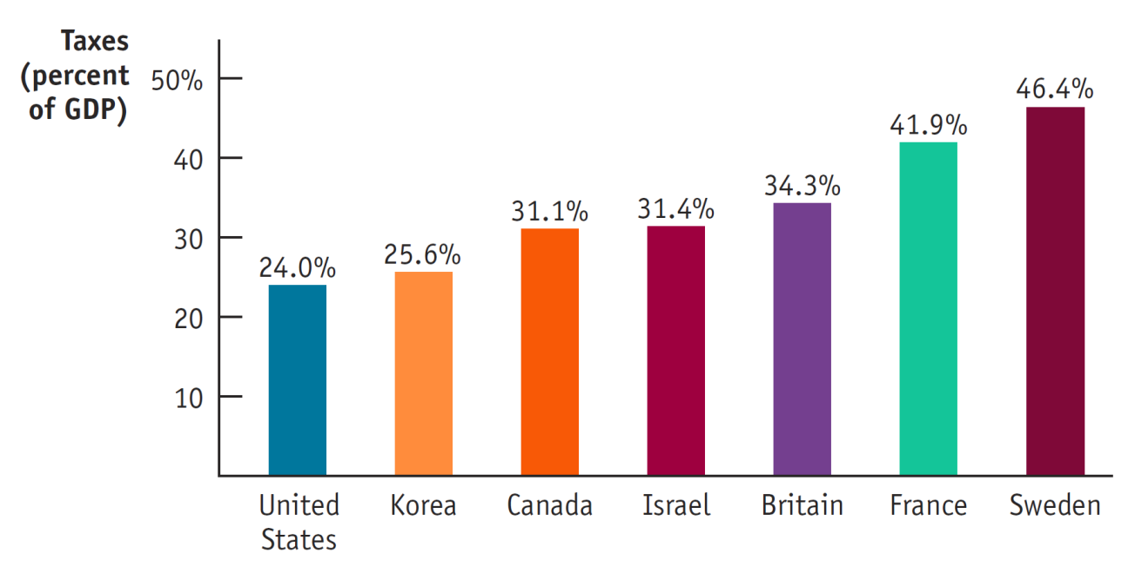
Tax Collection Around the World
OECD, 2009

Slide 24
Cost of Collecting Taxes
The administrative costs of a tax are the resources used by government to collect the tax, and by taxpayers to pay it, over and above the amount of the tax. It also includes steps taken (both legal and illegal) to evade the tax.
Accounting costs
Shell companies to hide profits
The total inefficiency caused by a tax is the sum of its deadweight loss plus its administrative costs. The general rule for economic policy is that, other things equal, a tax system should be designed to minimize the total inefficiency it imposes on society.

Slide 25
Deadweight Loss and Elasticities
To minimize the efficiency costs of taxation, one should choose to tax only those goods for which demand or supply, or both, is relatively inelastic.
For such goods, a tax has little effect on behavior because behavior is relatively unresponsive to changes in the price.

Slide 26
Deadweight Loss and Elasticities
(a) Elastic Demand
Price
S
Deadweight loss is larger when demand is elastic
P
C
P
E
E
Excise tax = T
D
P
P
Q
T
Q
E
Quantity
Notes:
Figure Caption: Figure 7-10: Deadweight Loss and Elasticities
Demand is elastic in panel (a) and inelastic in panel (b), but the supply curves are the same. Supply is elastic in panel (c) and inelastic in panel (d), but the demand curves are the same. The deadweight losses are larger in panels (a) and (c) than in panels (b) and (d) because the greater the price elasticity of demand or supply, the greater the tax-induced fall in the quantity transacted. In contrast, the lower the price elasticity of demand or supply, the smaller the tax-induced fall in the quantity transacted and the smaller the deadweight loss.

Slide 27
Deadweight Loss and Elasticities
(b)
Inelastic Demand
Price
S
P
C
Excise tax = T
P
E
Deadweight loss is smaller when demand is inelastic
E
P
P
D
Q
T
Q
E
Quantity
Notes:
Figure Caption: Figure 7-10: Deadweight Loss and Elasticities
Demand is elastic in panel (a) and inelastic in panel (b), but the supply curves are the same. Supply is elastic in panel (c) and inelastic in panel (d), but the demand curves are the same. The deadweight losses are larger in panels (a) and (c) than in panels (b) and (d) because the greater the price elasticity of demand or supply, the greater the tax-induced fall in the quantity transacted. In contrast, the lower the price elasticity of demand or supply, the smaller the tax-induced fall in the quantity transacted and the smaller the deadweight loss.

Slide 28
Deadweight Loss and Elasticities
(c) Elastic Supply
Price
Deadweight loss is larger when supply is elastic
P
C
S
Excise tax = T
P
E
E
P
P
D
Q
Q
Quantity
T
E
Notes:
Figure Caption: Figure 7-10: Deadweight Loss and Elasticities
Demand is elastic in panel (a) and inelastic in panel (b), but the supply curves are the same. Supply is elastic in panel (c) and inelastic in panel (d), but the demand curves are the same. The deadweight losses are larger in panels (a) and (c) than in panels (b) and (d) because the greater the price elasticity of demand or supply, the greater the tax-induced fall in the quantity transacted. In contrast, the lower the price elasticity of demand or supply, the smaller the tax-induced fall in the quantity transacted and the smaller the deadweight loss.

Slide 29
Deadweight Loss and Elasticities
(d)
Inelastic Supply
Price
S
P
C
P
E
Deadweight loss is smaller when supply is inelastic
Excise tax = T
E
P
P
D
Q
Q
Quantity
T
E
Notes:
Figure Caption: Figure 7-10: Deadweight Loss and Elasticities
Demand is elastic in panel (a) and inelastic in panel (b), but the supply curves are the same. Supply is elastic in panel (c) and inelastic in panel (d), but the demand curves are the same. The deadweight losses are larger in panels (a) and (c) than in panels (b) and (d) because the greater the price elasticity of demand or supply, the greater the tax-induced fall in the quantity transacted. In contrast, the lower the price elasticity of demand or supply, the smaller the tax-induced fall in the quantity transacted and the smaller the deadweight loss.

Slide 30
Deadweight Loss and Elasticities
In the extreme case in which demand is perfectly inelastic (a vertical demand curve), the quantity demanded is unchanged by the imposition of the tax. As a result, the tax imposes no deadweight loss.
Similarly, if supply is perfectly inelastic (a vertical supply curve), the quantity supplied is unchanged by the tax and there is also no deadweight loss.
If the goal in choosing whom to tax is to minimize deadweight loss, then taxes should be imposed on goods and services that have the most inelastic response—that is, goods and services for which consumers or producers will change their behavior the least in response to the tax.

Slide 31
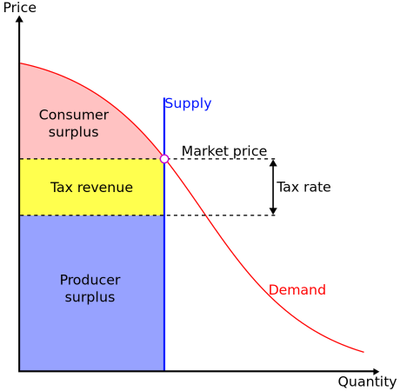
Land Value Taxes – An Efficient Tax
Economists since Adam Smith have noted that the supply of land is almost perfectly inelastic (the quantity of land cannot be easily changed).
A tax on land value (that disregards the value of buildings, infrastructure and other improvements) is an extremely efficient tax.
The tax burden of a tax on land value will fall entirely on the owners of land.
If paid by the rentier, market rents will fall by the amount of the tax.
The market value of land will fall correspondingly, reducing the wealth of land owners.

Slide 32
Tax Fairness and Tax Efficiency
Two principles of tax fairness:
According to the benefits principle of tax fairness, those who benefit from public spending should bear the burden of the tax that pays for that spending.
Those who own the most property likely benefit the most from government (police, public infrastructure, etc.)
According to the ability-to-pay principle, those with greater ability to pay, should pay more tax.
A lump-sum tax is the same for everyone, regardless of any actions people take.
It is the most efficient, as it is easiest to collect and distorts incentives the least, but it is also the least fair.

Slide 33
Tax Fairness and Tax Efficiency
The fairest taxes, in terms of the ability-to-pay principle, taxes most those who earn the most (who may also be the hardest working)
These progressive taxes distort incentives the most and perform badly on efficiency grounds.
In a well-designed tax system, there is a trade-off between equity and efficiency: the system can be made more efficient only by making it less fair, and vice versa.
Tax systems are often badly designed, and so it is often possible to both increase equity and efficiency

Slide 34
Understanding the Tax System
The tax base is the measure or value, such as income or property value, that determines how much tax an individual or firm pays.
Some important taxes and their tax bases are:
Income tax: a tax that depends on the income of an individual or a family from wages and investments
Payroll tax: a tax that depends on the wages an employer pays to an employee
Sales tax: a tax that depends on the value of goods sold, also known as an excise tax or a value-added tax (VAT)
Profits tax: a tax that depends on a firm’s profits
Property tax: a tax that depends on the value of property, such as the value of real estate or land
Wealth tax: a tax that depends on an individual’s wealth

Slide 35
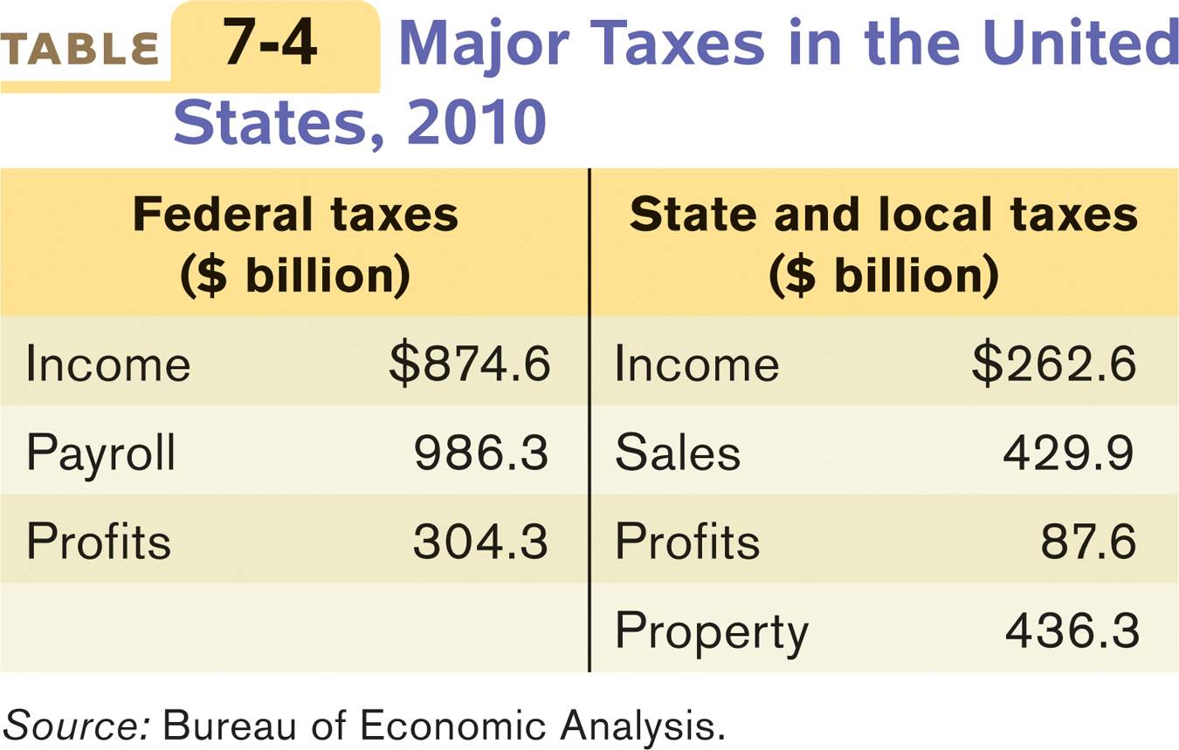
Understanding the Tax System

Slide 36
Understanding the Tax System
Once the tax base has been defined, the next question is how the tax depends on the base. The tax structure specifies how the tax depends on the tax base.
The simplest tax structure is a proportional tax, also sometimes called a flat tax, which is the same percentage of the base regardless of the taxpayer’s income or wealth.
A progressive tax takes a larger share of the income of high-income taxpayers than of low-income taxpayers.
A regressive tax takes a smaller share of the income of high-income taxpayers than of low-income taxpayers.
The marginal tax rate is the percentage of an increase in income that is taxed away.

Slide 37
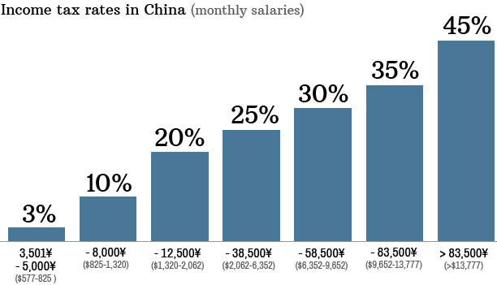
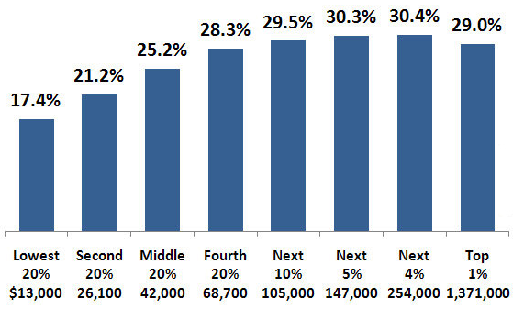
Income Tax Rates: China and US
China’s income tax rates are highly progressive. But tax evasion at the top makes it effectively regressive for high incomes.
US has a complex system of taxation including sales tax, payroll tax, income tax, profits tax, at both the Federal level and the State level. In total, it is progressive at lower levels but regressive at higher levels of income.
Notes:
36

Slide 38
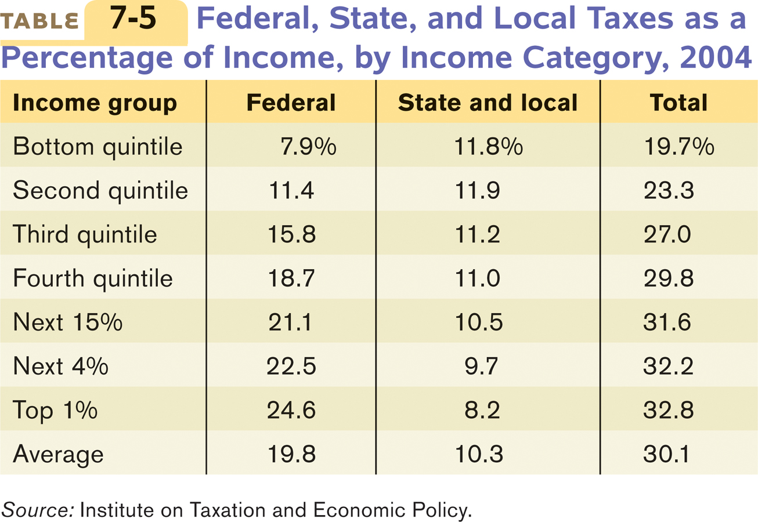
U.S. Taxation is Mildly Progressive by Income
Notes:
37

Slide 39
SUMMARY
Excise taxes — taxes on the purchase or sale of a good—raise the price paid by consumers and reduce the price received by producers, driving a wedge between the two. The incidence of the tax—how the burden of the tax is divided between consumers and producers—does not depend on who officially pays the tax.
The incidence of an excise tax depends on the price elasticities of supply and demand. If the price elasticity of demand is higher than the price elasticity of supply, the tax falls mainly on producers; if the price elasticity of supply is higher than the price elasticity of demand, the tax falls mainly on consumers.

Slide 40
SUMMARY
The tax revenue generated by a tax depends on the tax rate and on the number of units transacted with the tax. Excise taxes cause inefficiency in the form of deadweight loss because they discourage some mutually beneficial transactions. Taxes also impose administrative costs —resources used to collect the tax.

Slide 41
SUMMARY
An excise tax generates revenue for the government, but lowers total surplus. The loss in total surplus exceeds the tax revenue, resulting in a deadweight loss to society. This deadweight loss is represented by a triangle, the area of which equals the value of the transactions discouraged by the tax. The greater the elasticity of demand or supply, or both, the larger the deadweight loss from a tax. If either demand or supply is perfectly inelastic, there is no deadweight loss from a tax.

Slide 42
SUMMARY
An efficient tax minimizes both the sum of the deadweight loss due to distorted incentives and the administrative costs of the tax. However, tax fairness, or tax equity, is also a goal of tax policy.
There are two major principles of tax fairness, the benefits principle and the ability-to-pay principle. The most efficient tax, a lump-sum tax, does not distort incentives but performs badly in terms of fairness. The fairest taxes in terms of the ability-to-pay principle, however, distort incentives the most and perform badly on efficiency grounds. So, in a well-designed tax system, there is a trade-off between equity and efficiency.

Slide 43
SUMMARY
Every tax consists of a tax base, which defines what is taxed, and a tax structure, which specifies how the tax depends on the tax base. Different tax bases give rise to different taxes—the income tax, payroll tax , sales tax, profits tax , property tax, and wealth tax..

Slide 44
SUMMARY
A tax is progressive if higher-income people pay a higher percentage of their income in taxes than lower-income people and regressive if they pay a lower percentage. Progressive taxes are often justified by the ability-to-pay principle. However, a highly progressive tax system significantly distorts incentives because it leads to a high marginal tax rate, the percentage of an increase in income that is taxed away, on high earners. The U.S. tax system is progressive overall, although it contains a mixture of progressive and regressive taxes.

Slide 45
KEY TERMS
Excise tax
Incidence
Tax rate
Administrative costs
Benefits principle
Ability-to-pay principle
Lump-sum tax
Trade-off between equity and efficiency
Tax base
Tax structure
Income tax
Payroll tax
Sales tax
Profits tax
Property tax
Wealth tax
Proportional tax
Progressive tax
Regressive tax
Marginal tax rate

