Slide 1
META-X VU BETA TEST

Slide 2
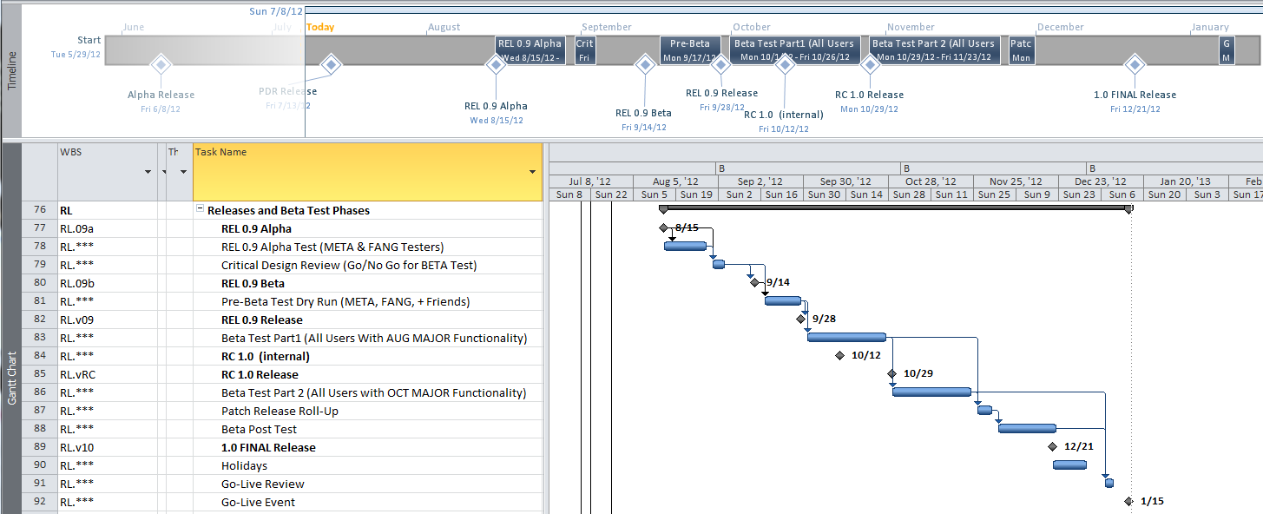
Release / Beta Testing Plan
Dev Release
Go Live Rev
Trial BETA
BETA 1
Dev Release
BETA 2
August Development = Release 0.9, October Release = 1.0

Slide 3
BETA 1 Development Schedule
Date | Milestone
Aug 1st | Primary feature lockdown + Language feature definition
Aug 7th | BETA 1 Language Lockdown
Aug 15th | Primary Feature Lockdown
Aug 28th | DARPA Readiness Review
Aug 31st | BETA 1 Feature Lockdown
Sept 10th | Trial BETA 1 Release
Sept 28th | BETA 1 Release

Slide 4
BETA 2 Development Schedule
Date | Milestone
Sept 31st | Primary feature lockdown + Language feature definition
Sept 7th | BETA 1 Language Lockdown
Sept 14th | Primary Feature Lockdown
Sept 28st | BETA 2 Feature Lockdown
Oct 12th | Trial BETA 2 Release
Oct 29th | BETA 2 Release (a.k.a v1.0 RC)

Slide 5
META-X CyPhy Vignettes KEY: [Green] = AUG Tool, Sept Tutorial [Yellow] = Aug/Sept w. Dependency
Start a Team and Project
Creation of Accounts/Team and Projects , Plus
Acquisition of Tools and Seed Designs
Design & Analysis
Modify Design By Component Addition & Evaluate
Change Design Structure, Evaluate Metrics/Score- AUG
Full System Evaluation – AUG
Assembling CAD, Check Physical Properties - OCT
Compute PCC on Design - OCT
Explore/Optimize Parameters - OCT
Add Detail to 3D Structures - OCT
Finite Element Analysis for Hidden Interactions - OCT
Collaboration
Design Reviews and Team Design – ElectroTank
Split / Merge Team for Parallel Design – OCT/DEC

Slide 6
Documentation Schedule
 | Date | META Delivery | Vignette | VF Doc (html) | Video | pdf
Drop 1 | 9/15/2012 | Beta-1 (9/28/12) | Start A Project, Build a Team, Prepare Tools and Initial Design | X | X | X
 |  | 0.9 RELEASE | Modify System Design By Adding A New Component, Evaluate Changes Impact on KPPs | X | X | X
 |  |  | Modify System Design By Adding Subsystem or Change Architecture, Evaluate Changes | X | X | X
 |  |  | Conceptual Component Development Within System Context | X | X | X
 |  |  | Full System Check - Recompute All KPP's, Evaluate Score | X | X | X
 |  |  | Check Physical 3D Design | X | X | X
 |  |  | Compute PCC For Design Point | X | X | X
Drop 2 | 10/15/2012 | Beta-2 (10/29/12) | Check Physical 3D Design (+ NRMM) | X | X | X
 |  | RC 1.0 RELEASE | Detailed Mechanical Design | X | X | X
 |  |  | Explore and Optimize Parameters | X | X | X
 |  |  | Parallel Team Design | X | X | X
 |  |  | Design Review with Project Team | X | X | X
Drop 3 | 12/7/2012 | 1.0 FINAL (12/21/2012) | All | X | X | X
 |  | "Go-live" Release

Slide 7
Dependencies
C2M2L TA1 Models
Phenomena Specification Mechanism
OpenModelica Compatibility
Models and OM are both Moving Targets
Component Feature Usage & Composition
Seed Designs
Serial Dependency on Models
Test Benches
Serial Dependency on Seed Designs
Alignment
Complexity/Execution Time
Environmental Models
OpenModelica Progress

Slide 8
TestBench Schedule - KPPs
Attribute Title | System Level | System Description | Priority | Description | Units | Requirement Type | Drop Date
Troop Capacity | Vehicle | Full Vehicle | KPP | The vehicle shall carry a reinforced rifle squad of combat equipped marines of no less than: | marines | Vehicle Functionality | 15-Aug
NATO Mobility | Vehicle | Full Vehicle | KPP | The vehicle (at GVW) shall achieve the NATO Reference Mobility Model (NRMM) requirements as called out below. |  | Vehicle Functionality | 15-Aug
Level Road Land Speed | Vehicle | Full Vehicle | KPP | On a level, hard surfaced road, the vehicle, at GVW, shall attain a speed of no less than: | kph | Vehicle Functionality | 15-Aug
Minimum Sustained Forward Cruising Speed in up to Sea State 3 | Vehicle | Full Vehicle | KPP | The vehicle at GVW, while operating through a mix of head and following seas with a SWH of up to x m (x inches) shall have a sustained minimum average speed of (T: x knots, O: y knots) | knots | Vehicle Functionality | 15-Aug
Well Deck Water Transportation Compatibility | Vehicle | Full Vehicle | KPP | Compatible with all classes of U.S. Navy amphibious ships that possess a well deck and amphibious landing craft. Compatible Length <370 in Width<146.5 in Height<129.5 in 12 vehicles on LSD- 49 class; 14 on LPD-17 class |  | Vehicle Functionality | 15-Aug

Slide 9
TestBench Schedule High Priority, Near Term
Attribute Title | System Level | System Description | Priority | Description | Units | Requirement Type | Drop Date
Bilge Pump Capacity | Sub System | Bilge System | High | The total bilge pump capacity shall be greater than: |  | Vehicle Functionality | 15-Aug
Sufficient Cooling During Tractive Effort | Sub System | Thermal | High | The vehicle cooling System shall maintain and stabilize component temperatures within manufacturer's specific limits while operating at max ambient temperature for a period of 2 hrs, with the vehicle developing a tractive effort equal to : | TE/GVW | Vehicle Functionality | 15-Aug
Transverse Center of Gravity (TCG) for All Weight Conditions | Vehicle | Full Vehicle | High | The vehicle TCG, from the vehicle Center Line in all weight conditions, shall be no more than (T: 20 cm, O: 10 cm) | cm | Vehicle Functionality | 15-Aug
Troop Capacity | Vehicle | Full Vehicle | KPP | The vehicle shall carry a reinforced rifle squad of combat equipped marines of no less than: | marines | Vehicle Functionality | 15-Aug
Service Brake Performance on Grades | Vehicle | Full Vehicle | High | With the engine running, the service brakes shall hold the vehicle at GVW on a dry hard surface, pointing either uphill or downhill on a grade greater than : | % | Vehicle Functionality | 15-Aug
Stopping Distance & Drift from Maximum Road Speed | Vehicle | Full Vehicle | High | The vehicle, at GVW, shall stop from maximum vehicle forward speed , with drift not exceeding xxm, within a distance of: | m | Vehicle Functionality | 15-Aug
Like For Like Tow Capability | Vehicle | Full Vehicle | High | The vehicle with a full tank of fuel, at GVW shall be capable of towing another like vehicle in its payload category of GVW over flat secondary roads for a distance of: | km | Vehicle Functionality | 15-Aug
Water Towing Speed | Vehicle | Full Vehicle | High | The vehicle at GVW shall be capable of towing a like vehicle at GVW in sea state xx and through the surf zone onto a beach at speed of: | knots | Vehicle Functionality | 15-Aug
Maximum Tractive Effort on Level Ground | Vehicle | Full Vehicle | High | The maximum output torque at the sprocket under ambient conditions defined by NATO AEP-5 at xx m altitude in forward and reverse on a level, hard surface road shall be sufficient to generate a tractive effort equal to : | TE/GVW | Vehicle Functionality | 15-Aug
Vehicle Operations on Side Slope | Vehicle | Full Vehicle | High | The vehicle at GVW shall be capable of slope operations at a grade of more than: | % | Vehicle Functionality | 15-Aug
Speed on 60% Grade | Vehicle | Full Vehicle | High | The vehicle, at GVW shall be able to ascend/descend, in both forward and reverse, a xx% grade at: | kph | Vehicle Functionality | 15-Aug
Stopping & Re-starting on Grades | Vehicle | Full Vehicle | High | The vehicle at GVW shall be capable of stopping on a xx% xx-x grade for not less than xx minute, shut the engine off, restart, and then continue to ascend/descend the xx% grade. |  | Vehicle Functionality | 15-Aug
NATO Mobility | Vehicle | Full Vehicle | KPP | The vehicle (at GVW) shall achieve the NATO Reference Mobility Model (NRMM) requirements as called out below. |  | Vehicle Functionality | 15-Aug
Approach Angle | Vehicle | Full Vehicle | High | The Approach angle shall be : | deg | Vehicle Functionality | 15-Aug
Departure Angle | Vehicle | Full Vehicle | High | The Departure angle, shall be: | deg | Vehicle Functionality | 15-Aug
Land Range on Level Ground | Vehicle | Full Vehicle | High | The vehicle at GVW shall be capable of operating on a level hard surface road on internally carried fuel, at an average speed of xx kph (xx mph) for a minimum distance of: | km | Vehicle Functionality | 15-Aug
0-20 mph Acceleration on Level Ground | Vehicle | Full Vehicle | High | The vehicle at GVW shall accelerate on a level hard surface from 0 to xx kph (xx mph) in: | sec | Vehicle Functionality | 15-Aug
Cross Country Land Speed | Vehicle | Full Vehicle | High | For cross-country movement, with the vehicle at GVW, shall be able to attain land speeds of: | kph | Vehicle Functionality | 15-Aug
Level Road Land Speed | Vehicle | Full Vehicle | KPP | On a level, hard surfaced road, the vehicle, at GVW, shall attain a speed of no less than: | kph | Vehicle Functionality | 15-Aug
Minimum Reverse Land Speed | Vehicle | Full Vehicle | High | The vehicle at GVW shall have a reverse speed of no less than: | kph | Vehicle Functionality | 15-Aug
Minimum Sustained Forward Cruising Speed in up to Sea State 3 | Vehicle | Full Vehicle | KPP | The vehicle at GVW, while operating through a mix of head and following seas with a SWH of up to x m (x inches) shall have a sustained minimum average speed of (T: x knots, O: y knots) | knots | Vehicle Functionality | 15-Aug
Air Transportation Compatibility | Vehicle | Full Vehicle | High | The vehicle shall be air transportable aboard both C-5, C-17 |  | Vehicle Functionality | 15-Aug
Rail Transportation Compatibility | Vehicle | Full Vehicle | High | Shall be compatible with, and transportable on, U.S. railway systems |  | Vehicle Functionality | 15-Aug
Road Transportation Standard | Vehicle | Full Vehicle | High | Transportable By highway, rail, air, and sea. Per MIL-STD-1366D |  | Vehicle Functionality | 15-Aug
Highway Road Transportation Standards | Vehicle | Full Vehicle | High | The vehicle shall not exceed highway weight and dimensional permit limits when carried as cargo by highway transportation assets of the Army, USMC, NATO, or allied countries. |  | Vehicle Functionality | 15-Aug
Well Deck Water Transportation Compatibility | Vehicle | Full Vehicle | KPP | Compatible with all classes of U.S. Navy amphibious ships that possess a well deck and amphibious landing craft. Compatible Length <370 in Width<146.5 in Height<129.5 in 12 vehicles on LSD- 49 class; 14 on LPD-17 class |  | Vehicle Functionality | 15-Aug
MPF Water Transportation Compatibility | Vehicle | Full Vehicle | High | Compatible with all classes MPF ships for MPF shipping with ramps rated to accommodate the weight of the vehicle. Compatible Length <370 in Width<146.5 in Height<129.5 in |  | Vehicle Functionality | 15-Aug

Slide 10
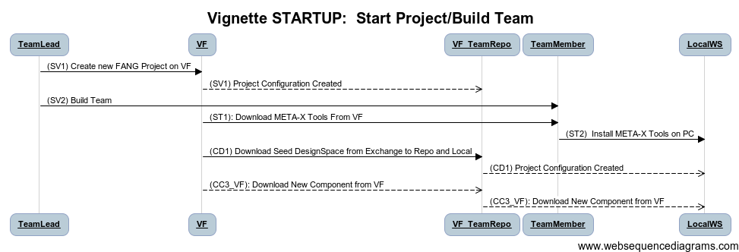
Start A Team & Project
Type: Administrative, Vehicle Forge, Installation, Initialization
Before: Nothing
After:
Team Formed,
Project On VF
Seed design & Components in Project Repo

Slide 11
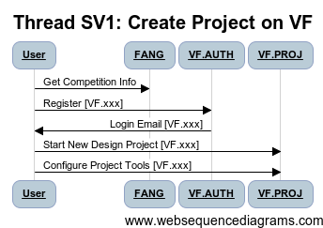
Thread: SV1: Start VF Project
Step ID | Description | Pre | Post | Tool Used | Function | Status
1 | User Registers on VF | None | Request Submitted | VF.xxx | Login | Complete
2 | User Receives Login |  | Account Available | VF.AUTH | Authorize | Complete
3 | User Logs In to VF |  | Login Page | VF.AUTH | Authorize | Complete
4 | User Starts New Design Project |  | Default Project | VF.PROJ | Admin | Complete
5 | Configure Project Tools |  | Project Configured | VF.PROJ | Admin | Complete
AUG

Slide 12
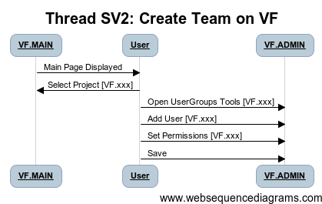
Thread: SV2 Start VF Project
Step ID | Description | Pre | Post | Tool Used | Function | Status
1 | User Logs In to VF | None | Logged In | VF.AUTH | Login | Complete
2 | Navigate to Project |  | Project Open | VF.xxx | Authorize | Complete
3 | Admin Project/UserGroups |  | User Group Editor Open | VF.ADMIN | Authorize | Complete
4 | Add User/Groups |  | User Added to Project | VF.ADMIN | Admin | Complete
5 | Save Config |  | Project Configured | VF.ADMIN | Admin | Complete
AUG

Slide 13
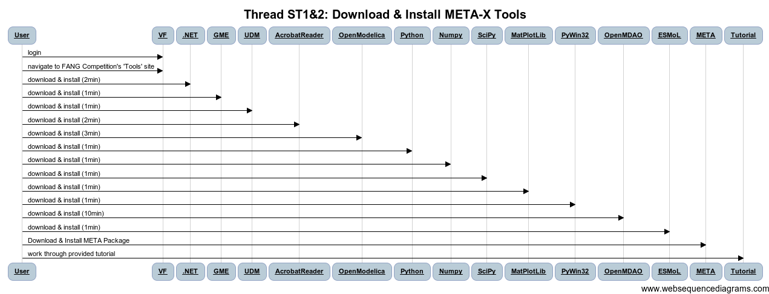
Thread: ST1&2 Download/Install Tools
Step ID | Description | Pre | Post | Tool Used | Function | Status
1 | User Logs into Vehicle Forge | VF Portal in Browser | VF Portal shows Logged in | VF | Login | Complete
2 | User Navigates to FANG Competition's 'Tools' Site |  | Access to Tools/Deps | VF |  | Gap
3 | Install .NET runtime dependencies |  |  |  |  | COTS
4 | Install GME |  |  |  |  | COTS
5 | Install UDM |  |  |  |  | COTS
6 | Install Acrobat Reader |  |  |  |  | COTS
7 | Install OpenModelica |  |  |  |  | COTS
8 | Install Python |  |  |  |  | COTS
9 | Install Numpy python module |  |  |  |  | COTS
10 | Install SciPy |  |  |  |  | COTS
11 | Install MatPlotLib |  |  |  |  | COTS
12 | Install PyWin32 |  |  |  |  | COTS
13 | Install OpenMDAO |  |  |  |  | COTS
14 | Install ESMoL |  |  |  |  | COTS
AUG

Slide 14
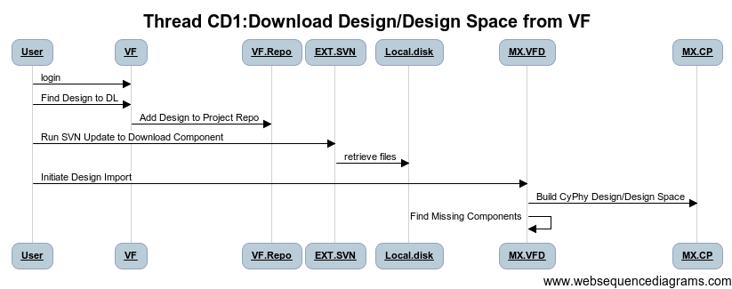
Thread CD1: Download Designs
AUG
Step ID | Description | Pre | Post | Tool Used | Function | Status
1 | User Logs into Vehicle Forge | VF Portal in Browser | VF Portal shows Logged in | VF | Login | Complete
2 | User Locates Desgin Space to Incorporate | VF Portal Design Search Page | Shows a list of Designs Available for Download | VF.CSR | Search | Prototype
3 | Add Design Space To Project Repo (Copy Selected Design, Insert into Repo Directory on VF) | Selected Design on VF | Design Package In Project Repo Design Folder | VF.CDL | Download | In Progress
 | OPT: VF Scans JSON Design File, Locating missing components, add to project
4 | User Refreshes Local Design Folder from Repo | Design Directory without New Design | Design Directory with New Design | EXT.SVN
5 | import Design XME, (JSON L8TR) file into GME CyPhy Tool | Design in Design Directory (JSON fmt) | Design in GME/CyPhy Design Folder | MX.VFD, MX.CPL | Import | Dev - WBS
6 | Scan Design for any Missing Components or Download ALL components | Design in CyPhy | List of Components to Import | MX.VFD | Import | Dev - WBS
7 | Execute CC3 Component Import for all missing components(Thread CC3) | Incomplete CyPhy Design | Complete CyPhy Design | MX.CLM |  | Dev – WBS
W
Work-
around
W

Slide 15
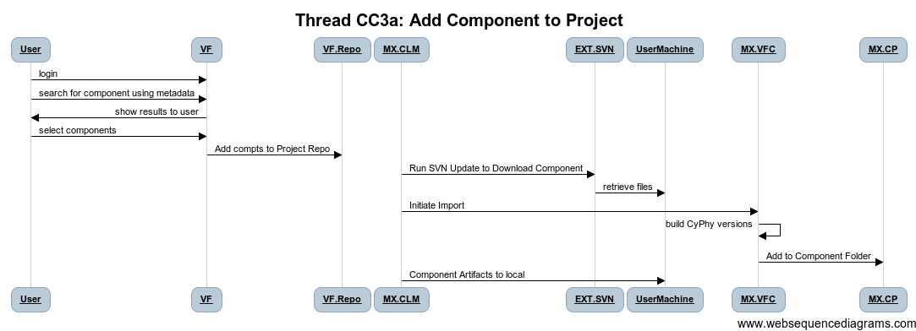
Thread: CC3: Add Components to Project
Step ID | Description | Pre | Post | Tool Used | Function | Status
1 | User Logs into Vehicle Forge | VF Portal in Browser | VF Portal shows Logged in | VF | Login | Complete
2 | User Searches for Component using Meta Data | VF Portal Component Search Page | Shows a list of Components that satisfy query | VF.CSR | Search | Complete
3 | Add Component To Project Repo (Components Directory on VF) | Selected Component from the Search Result Page | Component Package In Project Component Repo | VF.CDL | Download | TBD
4 | User Refreshes Local Component Library from Repo | Component Library without Component X | Component Library with Component X | EXT.SVN |  | COTS
5 | User launches Component Library Manager | Component packages are downloaded | Component Library Manager running | MX.CLM |  | DEV-WBS
6 | User selects downloaded components to import |  |  | MX.CLM |  | DEV-WBS
7 | Component library manager incorporates files into library structure |  |  | MX.CLM | Unpack | DEV-WBS
8 | User Invokes Component Importer Tool in CyPhy | CyPhy Open | Importer Running | MX.TEMP_CLM |  | Prototype
9 | User selects components to add to project, | Importer Pointed to File |  | MX.TEMP_CLM |  | Prototype
10 | Importer Builds CyPhy representations of components from JSON File | JSON File | Component into project component library | MX.VFC | Import | DEV-WBS
11 | Component artifacts are copied into CyPhy Project (modelica/CAD) | Component Artifacts in ZIP | Component Copied into Project | MX.CP |  | Complete
MX.CLM
MX.CLM-2.5

Slide 16
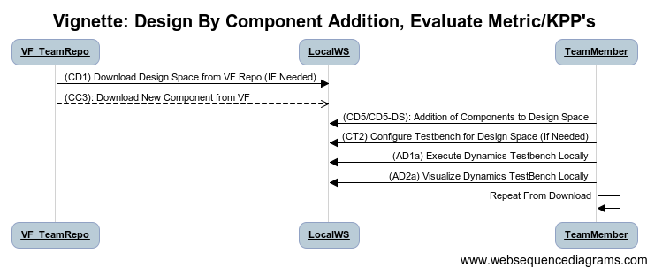
Vignette: Modify Design By Component Addition & Evaluate
Type: Design and Analysis Activity
Before: Project with Initial Design
After:
Project Modified with New Component(s)
New Design Analyzed via Dynamics Testbenches
AUG
OM &Dymola
Dep. On Comp

Slide 17
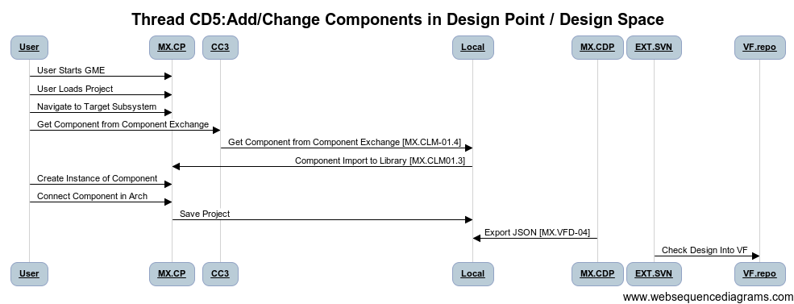
Thread: CD5: Add Components to Design
Step ID | Description | Pre | Post | Tool Used | Function | Status
1 | User Starts GME | Empty Window | META-X CyPhy Loaded | MX.CP |  | Complete
2 | User Loads Project |  | Design in GME/CyPhy Tool | MX.CP | Editor | Complete
3 | Navigate Design Architecture to Target Subsystem |  |  |  | Editor | Complete
4 | Execute CC3: Get New Component | Design in CyPhy | Component In CyPhy Components Folder |  | Editor | Complete
5 | Create Reference of Component in Composite/Alternative |  | Component in Design Space | MX.CP | Editor | Complete
6 | Connect Component (Ports, Properties, Parameters) |  | Component installed into design space | MX.CP | Editor | Complete
7 | Save Model |  |  |  |  | Complete
8 | Export to JSON |  |  |  |  | WBS-DEV
9 | Update Repo SVN |  |  |  |  | COTS
AUG
Fix numbers

Slide 18
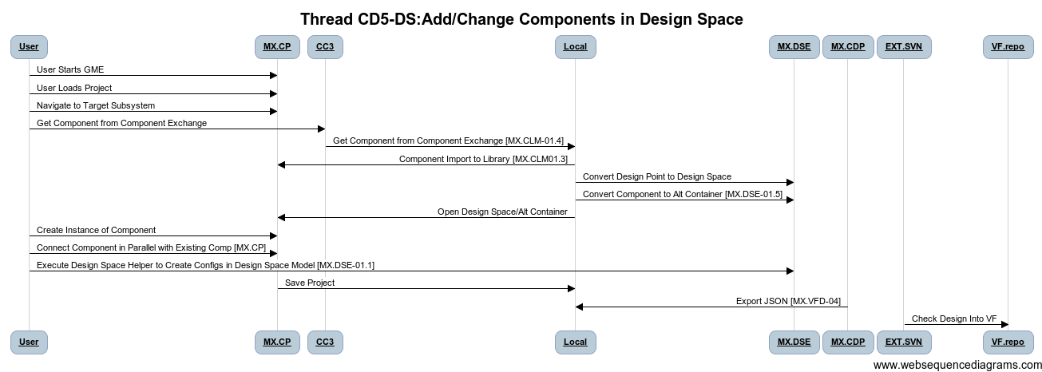
Thread: CD5_DS: Add Components to Design Space
AUG
Step ID | Description | Pre | Post | Tool Used | Function | Status
1 | Convert Design Point to Design Space(If needed) | Simple Point Design | Design Space with 1 config | MX.DSE | Util | Prototype
2 | Convert Component to Alternative Container | Simple Component/Assy | Design Alt Container with 1 Component option | MX.DSE | Util | Prototype
3 | Create Reference of Component in Composite/Alternative | One Alternative | Two Alternatives | MX.CP | Editor | Complete
4 | Connect Component (Ports, Properties, Parameters) | Incomplete Model | Completely Connected Model | MX.CP | Editor | Complete
5 | Execute Design Space Helper to Create Config | Design Space Specified | Design Alternatives Generated | MX.CP | Editor | WBS-DEV
6 | Save Model |  | Component installed into design space | MX.CP | Editor | Complete
7 | Export to JSON |  |  |  |  | Complete
8 | Update Repo SVN |  |  | MX.VFD-04 |  | WBS-DEV

Slide 19
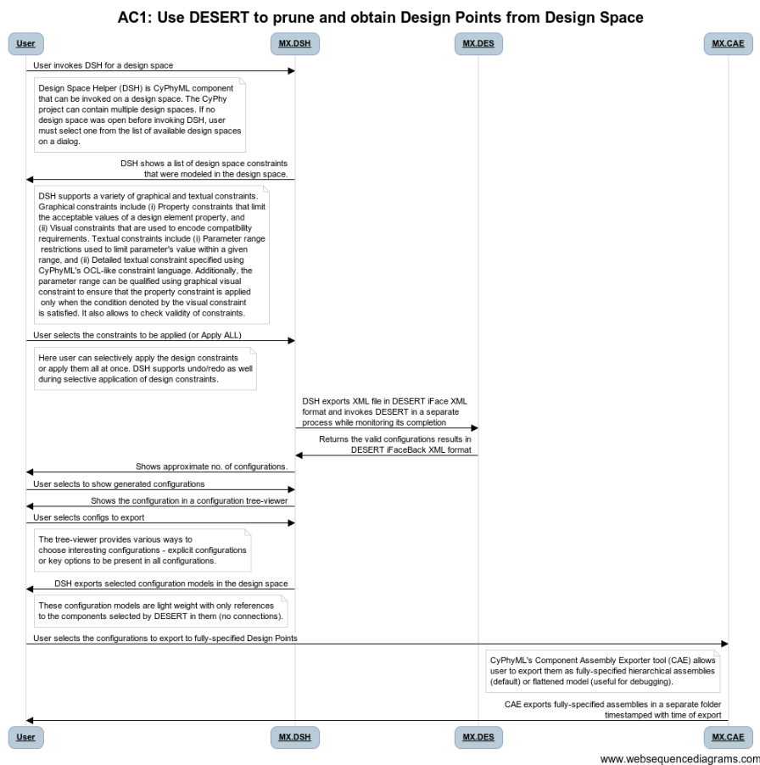
Prune Design Space

Slide 20
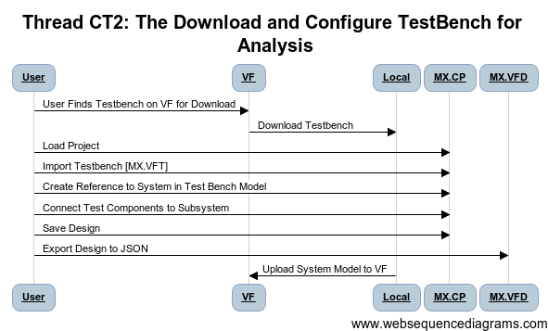
Thread: CT2: Download and Configure Testbench for Dynamic Analysis
AUG
Step ID | Description | Pre | Post | Tool Used | Status
1 | User Finds Testbench on VF/Downloads |  | Empty Testbench model exists in CyPhy GME | MX.CP | Complete
2 | User Opens and Locates Subsystem to Test in Design, Instantiates subsystem in Test Bench Model | Testbench with Test Components and Environment | Testbench with Test Components and Subsystem Under Test | MX.CP | Complete
3 | User Connects Test Components to Subsystem Instance | Testbench with Test Components and Subsystem Under Test | Testbench with Test Components and Subsystem Under Test Connected | MX.CP | Prototype
4 | Save Design | Complete Testbench | Testbench.json, System.json | MX.VFD | WBS-MX.VFD
5 | Upload System Model to VF | Testbench.json, System.json | Testbench.json, System.json in VF Project | VF | Prototype
TestBench Interchange Format TBD.
CyPhyXML Workaround.

Slide 21
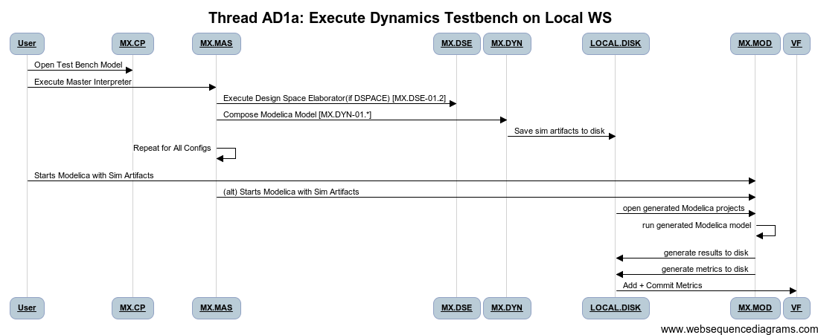
Thread: AD1a: Execute Testbench for Dynamic Analysis
Step ID | Description | Pre | Post | Tool Used | Status | WBS
1 | User Opens TestBench | Testbench model exists in CyPhy GME | Model Open | MX.CP | Complete | MX.MAS.1,2,6
2 | Execute master Interpreter on Testbench | Testbench model open in GME, Dynamics Composer tool available | Testbench directory with a number of .mo files is created fresh on user's local workstation | MX.MAS, MX.DYN | Prototype | MX.MAS.1,2,6, MX.DYN.01.*
3 | User Opens generated Modelica projects OR Composer Auto Executes | Existing package.mo under the testbench directory | Modelica editor opens the package and is able to run the testbench | MX.MOD | Prototype | MX.MOD
4 | Run generated Modelica model | Existing modelica models generated from testbench | Run log from Modelica, Data on Disk(MAT, CSV, PLT). Metrics Generated for DASHBOARD, | MX.MOD | Prototype | MX.MOD
5 | Check Results into VehicleForge (ADD+COMMIT) |  |  |  |  | MX.DYN
C2M2L Model X OM/Dymola Dep

Slide 22
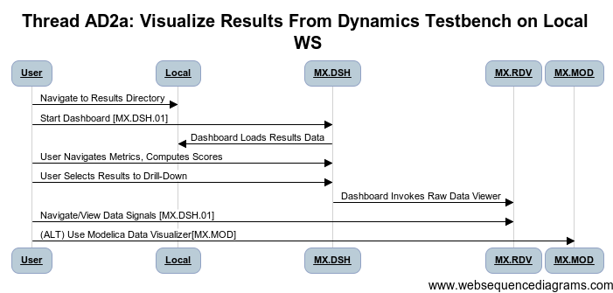
Thread: AD2a: Visualize Results from Dynamics Testbench
Step ID | Description | Pre | Post | Tool Used | Status
1 | User reviews available test bench data, selects an analysis, and launches viz tool | Testbench data on local, index file on local | Viz tool launched on target data | MX.DAS | Prototype
2 | User Browses Available Simulation Data, Selects Variables | Viz Tool Launched on target data | Plots for data appear for interpretation | MX.DAS, MX>RDV | Prototype
3 | Repeat for Other Signals | Viz Tool Launched on target data | Plots Visible | MX.DAS, MX>RDV | Prototype
4 | Potentially Save Plot Plot, Notes | Plots Visible | Plot Image Saved, Link/Spec to Regen | MX.DAS, MX>RDV | COTS
5 | Create Issue Tracking/Wiki/Notification for Team Collaboration | Image/Link | VF Collaboration Action Launched | VF.TIX | Gap
E-Tank or Local (Dev Needed)

Slide 23
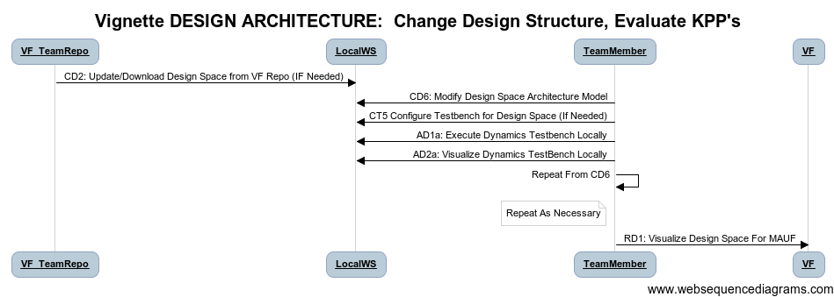
Vignette: Change Design Structure, Evaluate Metrics/Score
Type: Design and Analysis Activity
Before: Project with Initial Design
After:
Project Modified with New Structure
New Design Analyzed via Dynamics Test Benches
AUG
OM &Dymola
Dep. On Comp

Slide 24
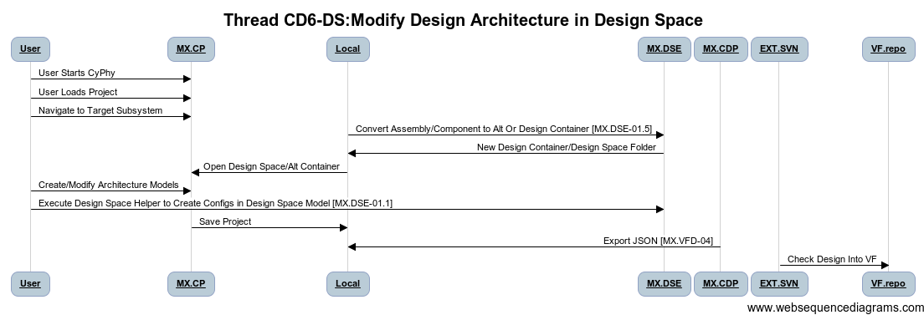
Thread: CD6_DS: Change Structure in Design Space
AUG
Step ID | Description | Pre | Post | Tool Used | Function | Status
1 | Convert Design Point to Design Space(If needed) | Simple Point Design | Design Space with 1 config | MX.DSE | Util | Prototype
2 | Convert Component/Assembly to Design/ Alternative Container | Simple Component/Assy | Design Alt Container with 1 Component option | MX.DSE | Util | Prototype
3 | Change Architecture (Add Components, Assemblies. Alternatives, …) | Simple Design | More Detailed Design | MX.CP | Editor | Complete
4 | Create Constraints, Requirement Links, … |  | Constrained Design, Links to Reqts
5 | Execute Design Space Helper to Create Config | Design Space Specified | Design Alternatives Generated | MX.DSE | Editor | Complete
6 | Save Model |  | Component installed into design space | MX.CP | Editor | Complete
7 | Export to JSON |  |  |  |  | Complete
8 | Update Repo SVN |  |  | MX.VFD-04 |  | WBS-DEV

Slide 25
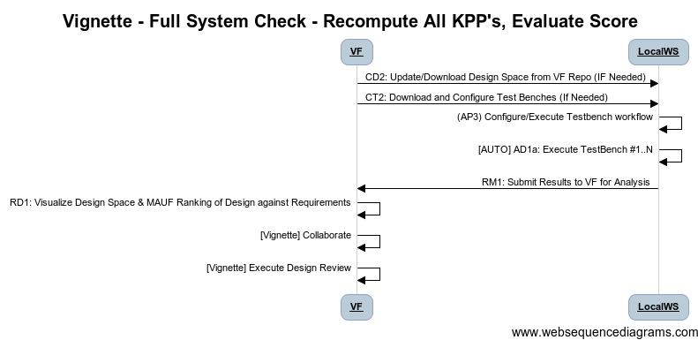
Vignette: Full System Evaluation
Type: Design and Analysis Activity
Before: Project with Partial Design Evaluation
After:
Design Evaluated for Specified Bank of TestBenches
OCT
Run Battery
Of TestBenches

Slide 26
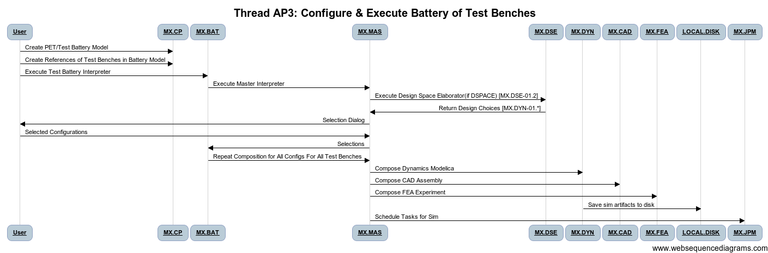
Thread: AP3: Configure & Execute Battery of Tests
Step ID | Description | Pre | Post | Tool Used | Status | WBS
1 | Thread CT2: User Configures Test Benches for Design/Design Space | Test Bench templates and Design Space | Test Benches Configured for Test Bences | MX.CP | Complete
2 | Create PET Model and Reference Configured Test Benches |  | PET - Test Battery Model | MX.CP | In Progress | MX.CP, MX.PET
3 | User Executes Test Battery Interpreter on Model |  | Workflow of Master Interpreter Executes on All Test Benches in Battery | MX.BAT | SEPT | MX.BAT
4 | Initial Master Interpreter Dialog for Design Config Selection |  | Configurations Selected | MX.MAS | Prototype | MX.MAS
5 | Analysis Jobs Created for All Configs x Test Benches |  | Analysis Jobs Ready to Submit |  |  | MX.DYN
6 | Submit Jobs (Local/Remote) |  | Jobs Running | MX.JBM, MX.MAS, MX.MOD | In Design | MX.JBM
OCT

Slide 27
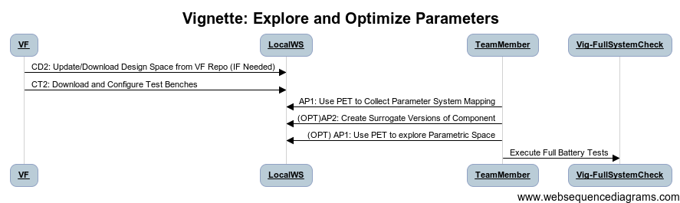
Vignette: Explore/Optimize Parameters
AUG
OpenModelica
DOE & OPT
Type: Design and Analysis Activity
Before: Project with Initial Design
After:
Component Parametric Space Characterized and Understood
Improved Parameter Values Found
OCT
Dymola
DOE & OPT
Surrogate Gen

Slide 28
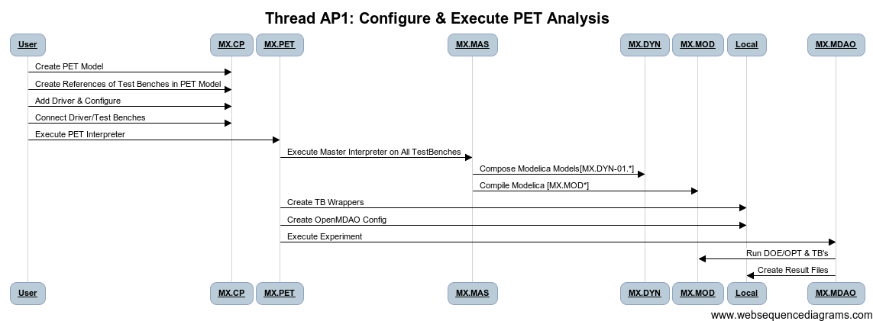
Thread: AP1: Configure & Execute PET
Step ID | Description | Pre | Post | Tool Used | Status | WBS
1 | Create PET Model | Testbench model exists in CyPhy GME | PET Blank Model | MX.CP | Complete
2 | Add Test Bench Refs, Drivers, Specify Topology | PET Blank Model | Configured PET Model | MX.CP | Prototype
3 | Execute PET Model | PET Model | Configured MDAO and Test Bench Executables | MX.PET | Prototype | MX.PET
4 | Execute OpenMDAO Model | Configured OpenMDAO | Run log from Modelica, Data on Disk(MAT, CSV, PLT). Metrics Generated for DASHBOARD, (results.json) | MX.PET, MX.MDAO MX.MOD | Prototype | MX.MOD
5 | Check Results into VehicleForge (ADD+COMMIT) |  |  | MX.MAS,EXT.SVN |  | MX.DYN

Slide 29
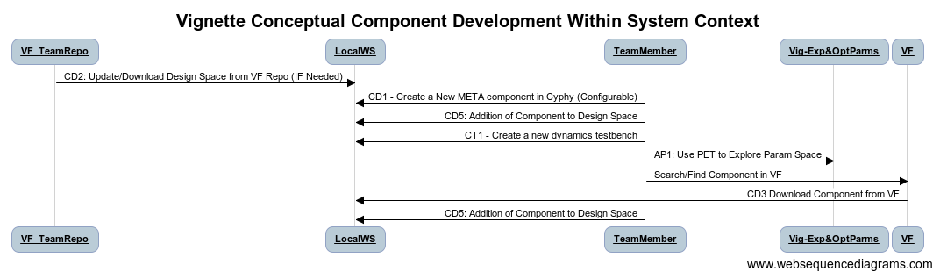
Vignette: Optimize Design, Select Best Component
AUG
OpenModelica
DOE & OPT
Type: Design Activity
Before: Project with Unknown Optimal Design
After:
Placeholder (conceptual) Component Created to Fill Gap in Design
Performance Metric Defined in Custom Test Bench.
Parametric Exploration Experiment Executed to Explore Component Param Interactions
Best Component Properties Identified, Used to Search VF for Appropriate Component.
New component downloaded from VF, Inserted Into Design
OCT
Dymola
DOE & OPT
Surrogate Gen

Slide 30
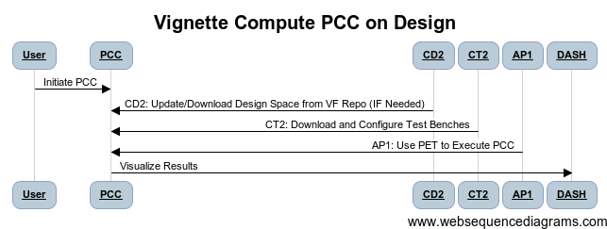
Vignette: Compute PCC on Design
Type: Design and Analysis Activity
Before: Project Meets KPP’s, Sufficient Scoring
After:
Computation of PCC considering component/environment variation
OCT

Slide 31

Thread: AP2: Configure & Execute PCC
 | Description | Pre | Post | Tool Used | Status | WBS
1 | Create PET Model | Testbench model exists in CyPhy GME | PET Blank Model | MX.CP | Complete
2 | Add Test Bench Refs, PCC Drivers, Specify Topology | PET Blank Model | Configured PET Model | MX.CP | Prototype
3 | Execute PET Model | PET Model | Configured PCC in MDAO and Test Bench Executables | MX.PET, MX.PCC | Prototype | MX.PET
4 | Execute OpenMDAO Model | Configured OpenMDAO | PCC Data Computed | MX.PET, MX.MDAO MX.MOD | Prototype | MX.PCC, MX.MDAO, MX.MOD
5 | Check Results into VehicleForge |  |  | MX.MAS,EXT.SVN |  | MX.DYN

Slide 32
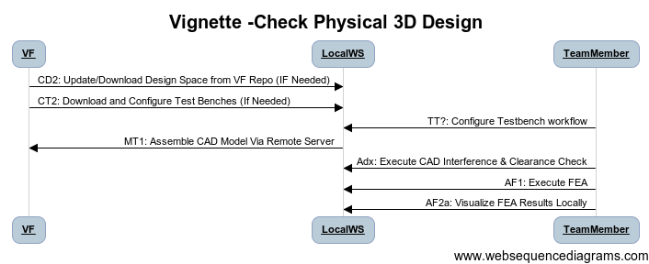
Vignette: Assemble CAD Check Physical Properties of Design
CAD Assy
Remote Assy
Struct.FEA
Type: Analysis Activity
Before: Conceptual Design, Simulation Results Only
After:
Project 3D Models Composed
Assembled Parts Evaluated in 3D Space.
Finite Element Analysis Used for 3D Domain Analysis
AUG
OCT
Interference
Chk

Slide 33
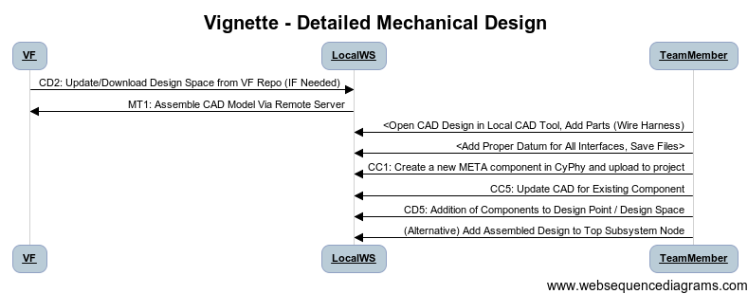
Vignette: Add Detail To Mechanical Design
Type: Design and Analysis Activity
Before: Project with Initial Design
After:
Project Modified with New Component(s)
New Design Analyzed via Dynamics Testbenches
AUG

Slide 34
Design: Flesh Out Details of 3D Design
Type: Design Activity
Before: Core Design Complete, Details Missing
After:
Project 3D Models Composed via Remote Service
CAD (STEP) core design imported to CAD, Brackets/Fasteners Added.
New Parts Curated Into META Tools and Added to Design
AUG

Slide 35
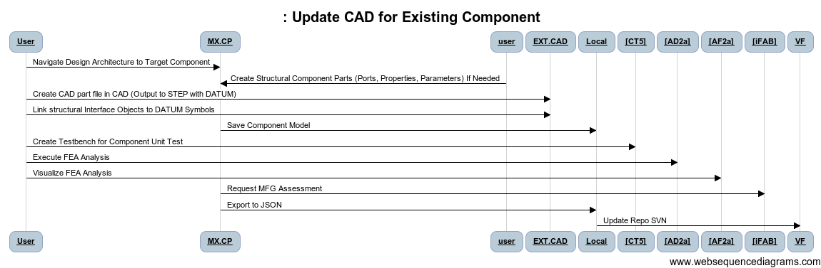
Thread CC5: Add CAD to Existing Component
AUG
Step ID | Description | Pre | Post | Tool Used | Function | Status
1 | Start GME, | Empty Window | META-X CyPhy Loaded | MX.CP
2 | Load Project |  | Design in GME/CyPhy Tool | MX.CP | Editor | Complete
3 | Navigate Design Architecture to Target Component |  |  | MX.CP | Editor | Complete
4 | Create Structural Component Parts (Ports, Properties, Parameters) If Needed |  |  | MX.CP | Editor | Complete
5 | Create CAD part file in CAD (Output to STEP with DATUM) |  |  | MX.CP | Editor | Complete
6 | Link structural Interface Objects to DATUM Symbols |  |  | EXT.MOD | Modelica | Complete
7 | Link Test Interface Points to DATUM Symbols |  |  | MX.CP | Editor | Complete
8 | Save Component Model |  |  | MX.CP | Editor | Complete
9 | (OPT) [CT5] Create Testbench for Component Unit Test |  |  | MX.CP | Editor | WBS-MX.CAD
10 | (OPT) [AD2a] Execute FEA Analysis |  |  | EXT.OMD | OpenMDAO | WBS-MX.FEA
11 | (OPT) [AF2a] Visualize FEA Analysis |  |  |  |  | WBS-MX.FEA
12 | Export to JSON |  |  | MX.CFC |  | WBS-MX.VFD
13 | Update Repo SVN |  |  |  |  | Complete

Slide 36
Design - Point vs. Space
Setup
Design
Space
Options
Retained
Comp
Adds
Design
Point
Arch
Adds
Component
Swap
CDS
Composition
Arch
Mod
TB
Eval
Composition
TB
Eval
Produce
Produce
Single Option,
Manual Edits

Slide 37
Architecture/Task Mapping
MX.CLM
MX.VFD
MX.STD
MX.TIF
MX.CPL
MX.CP
AUG
MX.*VF
AUG
CyPhy Model
Editor
Vehicle
Forge
AVM
Standards
OCT
AUG
MX.DSE
MX.MAS
AUG
DESERT
(CDS Tool)
Master
Interpreter
OCT
OCT
AUG
AUG
AUG
AUG
OCT
OCT
ESMOL
Tools
Cyber
Interp
PET
Interp
PCC
Interp
Dynamics
Interpreter
CAD
Interp
FEA
Interp
Mob.
Interp
MX.CYB
MX.CYB
MX.PET
MX.PCC
MX.DYN
MX.CAD
MX.FEA
MX.MOB
OCT
AUG
AUG
AUG
OCT
OCT
Modelica+TrueTime
OpenMDAO
Modelica
ProE
FEA
D3D
EXT Tool
MX.DYN
OCT
Analysis
Job Mgr
Visualize
Score
Results
MX.DTO
MX.JBM
AUG
AUG

Slide 38
Summary
Key Capabilities Available Now
Need to Be Tested With C2M2L Components/Environ.
Need to Be Tested With Seed Designs
Maturation Needed
Core Capabilities In Aug for Sept/Oct Beta Tests
Modeling, Design Space, Dynamics, CAD, Struct FEA
Extended Capabilities in Sept/Oct for Nov Beta
Small Set Post Nov.
Plan:
Maintain Schedule, Test to Greatest Extent
Flexible Execution

Slide 39
Release / Beta Testing Plan
Dev Release
Go Live Rev
Trial BETA
BETA 1
Dev Release
August Development = Release 0.9, October Release = 1.0

