Slide 1
ModStack
Alizeh Jahan, Kevin Wu
CSE 111
Checkpoint 1

Slide 2

Synopsis
Game Mod Tracker is a database application designed to organize and manage information about video games and their mods. The system helps users find and track mods by storing comprehensive metadata, managing user interactions, and generating insights.
storage
group
bar_chart
Tracked Information
Stores key data points to help users seamlessly find and track mods:
Mod versions & categories
Developers & supported platforms
Download counts
Game version compatibility
Main User Roles
Three key groups interact with the database:
Gamers: Search mods, check compatibility, & leave ratings/reviews
Mod Developers: Manage mod releases & update details
Administrators: Oversee database operations & system info
Reports & Analytics
Allows users to generate valuable insights and reports on:
The most popular mods
Games with the most mods
Commonly used mod categories

Slide 3
Main Use Case
Workflow for mods
01
GAMER
02
GAMER
03
SYSTEM
Gamer searches for a mod by game or category.
Gamer selects a mod to view its details.
System retrieves available mod releases.
04
GAMER
05
SYSTEM
06
GAMER
Gamer selects a game version.
System checks whether the mod release is compatible.
Gamer can view download information and leave a review.

Slide 4
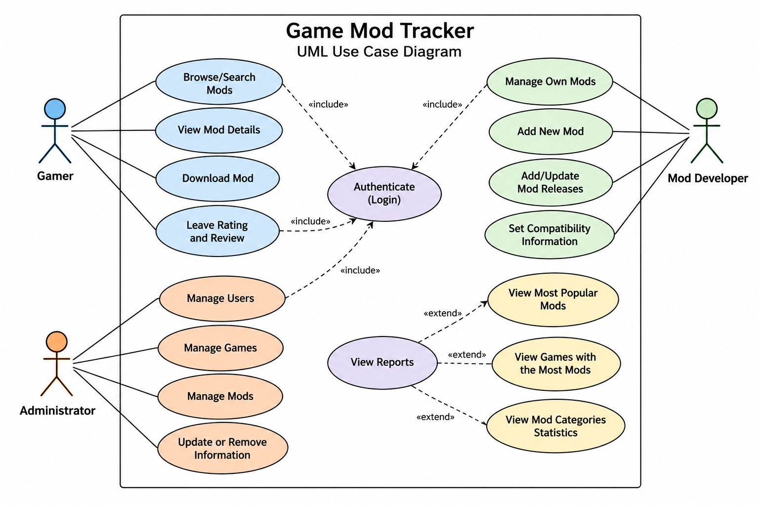
UML Use Case Diagram
Primary Workflow
Search for mods by game or category and verify compatibility across game versions. Access mod details, download links, and user reviews.
Actor Roles & Capabilities
Gamers: Search mods, check compatibility, download & submit ratings.
Developers: Add mods, update details, manage releases & compatibility.
Admins: Manage users, games, versions & maintain database integrity.
Secondary Use Cases
View popular mods, discover games with the most mods, and generate analytical reports across mod categories.

Slide 5
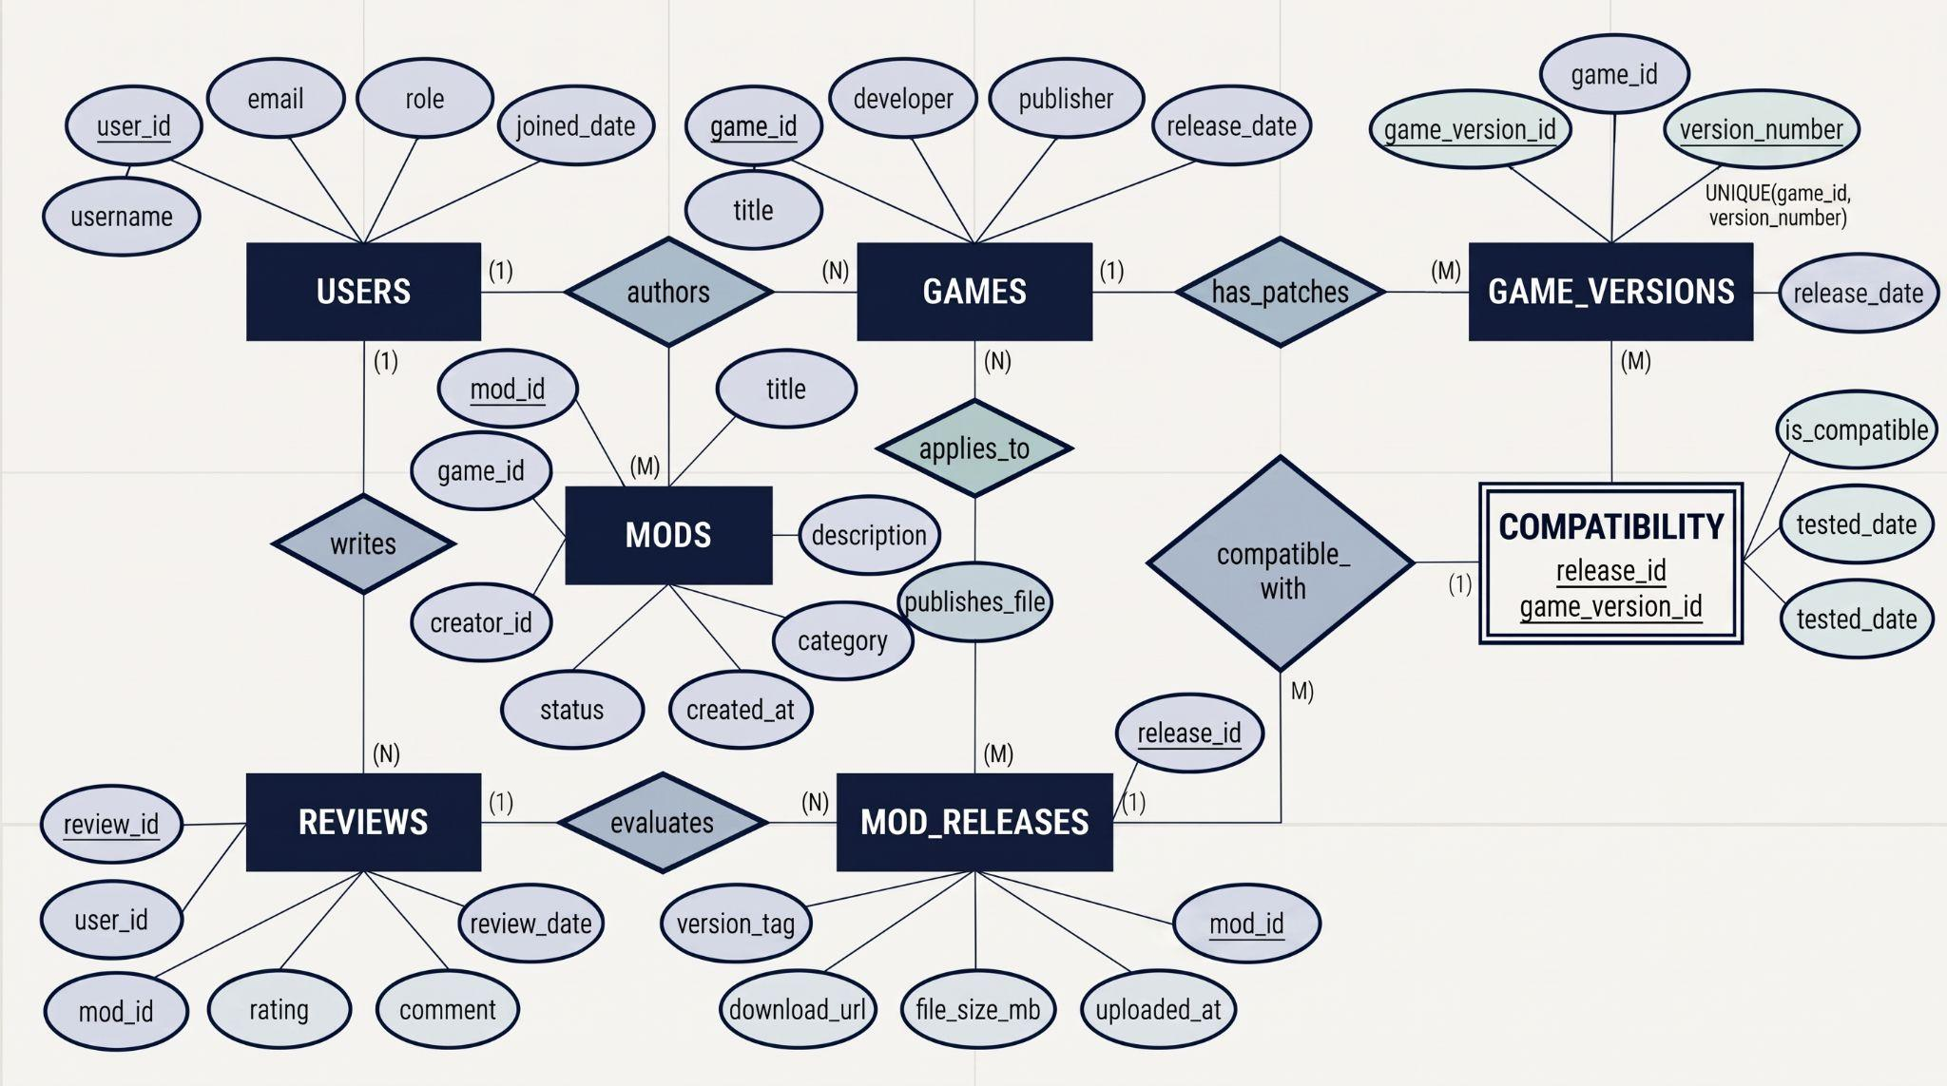
UML Use Case Diagram

Slide 6

Relationship Schema
Entities & Attributes
Relationships
Keys & Constraints
Users: user_id, username, email, role, joined_date
Games: game_id, title, developer, publisher, release_date
Game_Versions: game_version_id, game_id, version_number, release_date
Mods: mod_id, game_id, creator_id, title, description, category, status, created_at
Mod_Releases: release_id, mod_id, version_tag, download_url, file_size_mb, download_count, uploaded_at
Compatibility: release_id, game_version_id, is_compatible, tested_date
Reviews: review_id, user_id, mod_id, rating, comment, review_date
Authors 1:N
Users → Mods
Applies_To 1:N
Games → Mods
Has_Patches 1:N
Games → Game_Versions
Publishes_File 1:N
Mods → Mod_Releases
Compatible_With M:N
Mod_Releases ↔ Game_Versions (via Compatibility)
Evaluates M:N
Users ↔ Mods (via Reviews)
Primary Keys
user_id, game_id, game_version_id, mod_id, release_id, review_id
Composite Primary Key
Compatibility (release_id, game_version_id)
Foreign Keys
Game_Versions → Games
Mods → Games, Users
Mod_Releases → Mods
Compatibility → Mod_Releases, Game_Versions
Reviews → Users

