Slide 1

Deep Learning for Financial Market: Evaluating LSTM, CNN, and RNN Models in Stock Price Analysis and Prediction
Wutyi Kyi Toe (23194286)
MSc in Artificial Intelligence
National College of Ireland

Slide 2
Introduction
Stock price prediction is a fundamental challenge in the financial industry due to volatile market and influence of many factors.
With historical data and current stock market trends, advanced technologies such as machine learning, and deep learning can predict the future stock prices
The main objective is - 1) To analyse the stock data(Nvidia, Micron Technology, Microsoft, Google, Meta and Apple) 2)To compare the performance of LSTM, CNN, and RNN models and determine which is most effective model for each stock(Nvidia and Micron Technology).

Slide 3
Dataset overview
Historical stock data from Yahoo Finance using yfinance
Includes daily prices over a significant period, with key attributes such as Open, High, Low, Close, Adjusted Close, Volume, and Company Name.
Data Range is 1st August 2012 to 1st August 2024 for both analysing, and models training & testing
Preprocessing steps - Only business days (freq=‘B’) - Filling forward, backward for public holidays during weekdays (ffill, bfill) - Scaling the data (fit_transform)

Slide 4
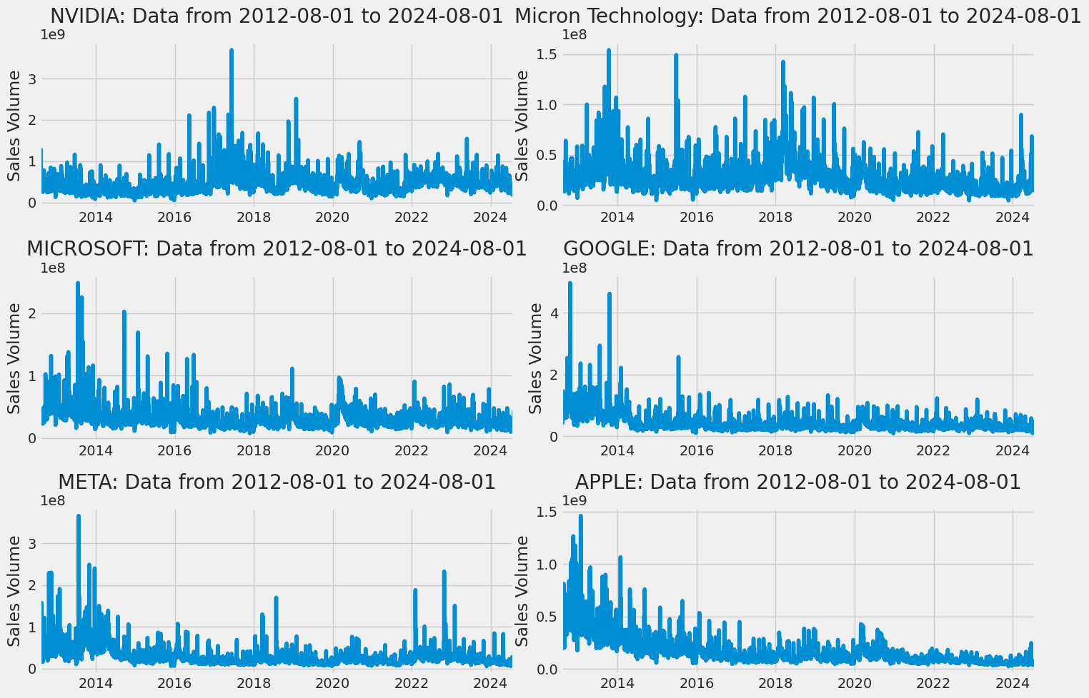
Analysing data – Sales volume

Slide 5
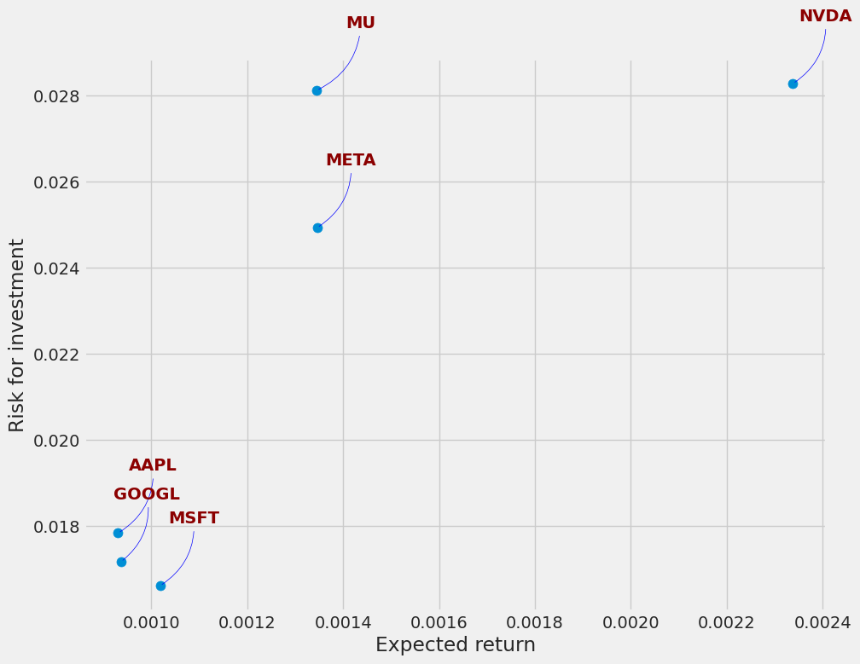
Analysing data – Risk vs return

Slide 6
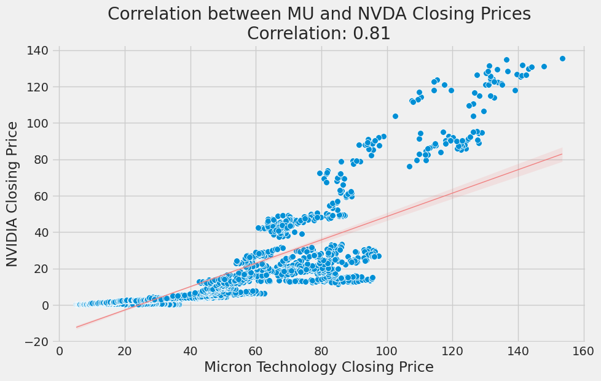
Analysing data – Correlation

Slide 7
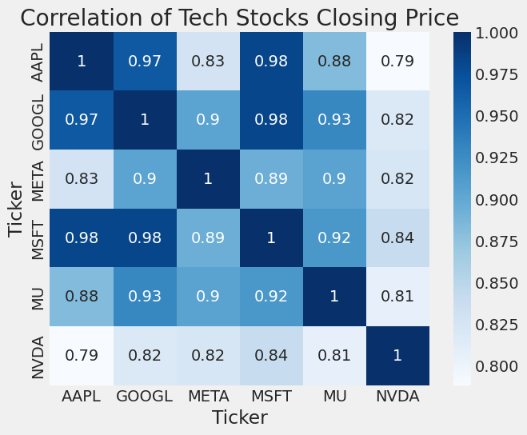
Analysing data – Correlation

Slide 8
Model selection
LSTM, CNN and RNN are chosen due to their individual strengths and purpose for comparing
LSTM model - Ability to capture long-term dependencies, making it popular for time-series forecasting.
CNN model - Originally designed for image data, has been adapted here to recognize local patterns in stock price movements.
RNN model – More traditional but still powerful for capturing sequential dependencies.

Slide 9
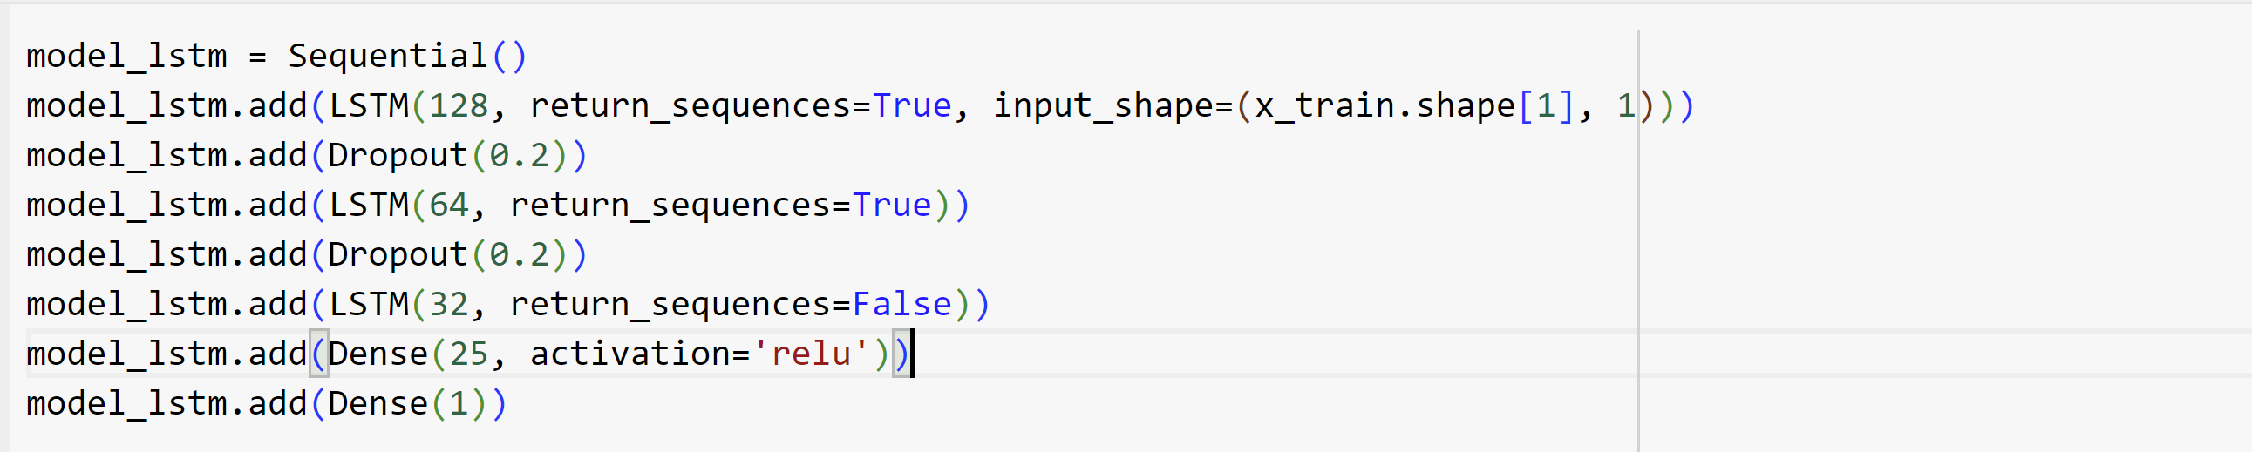
Model architecture - LSTM
LSTM - Three LSTM layers, each followed by dropout layers (to prevent overfitting), and a dense layer to output the final prediction

Slide 10
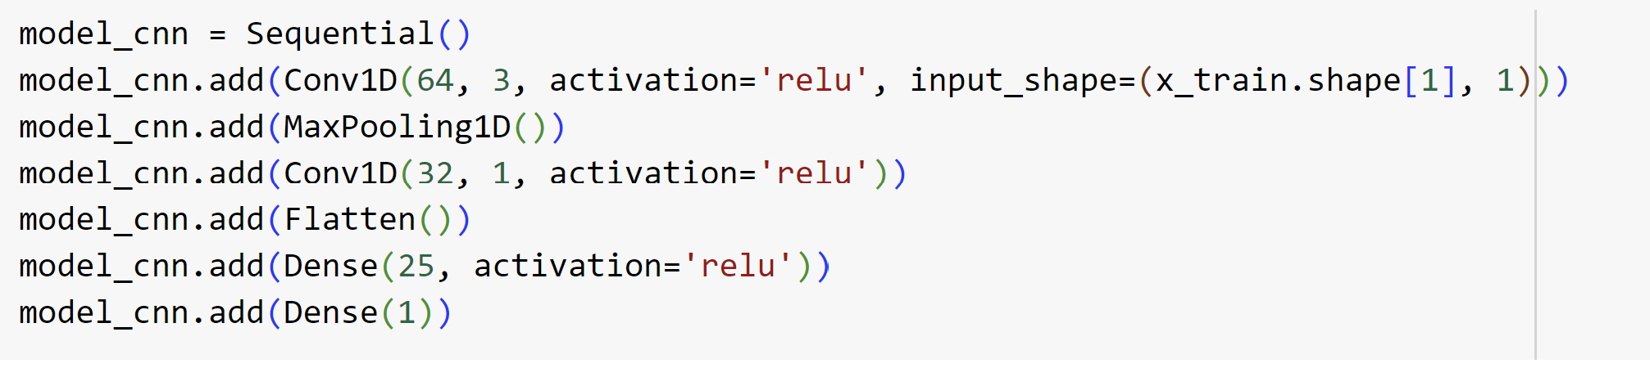
Model architecture - CNN
CNN - Two convolutional layers followed by max-pooling and dense layers to detect the pattern in data.

Slide 11
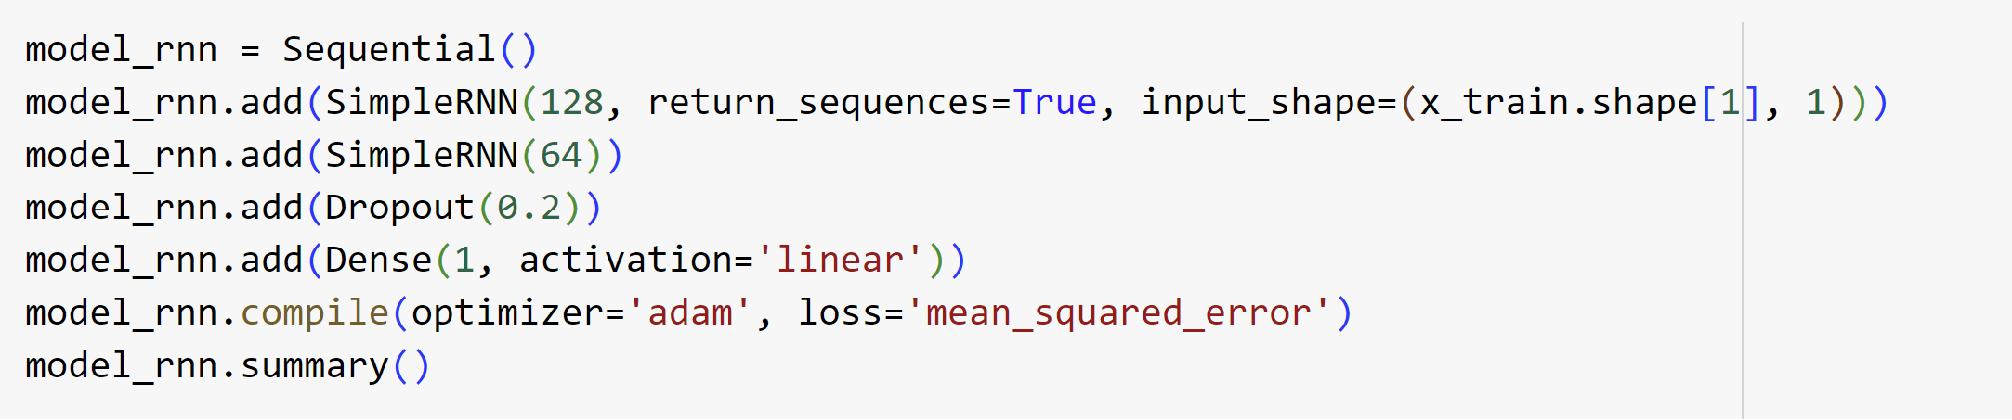
Model architecture - RNN
RNN - Two Simple RNN layers, followed by a dropout layer and a dense output layer to test the ability of model to capture sequential data

Slide 12
training configuration and Evaluation metrics
Epochs – 150, Batch size 10, Optimizer – Adam, Loss function – Mean Squared Error(MSE)
Mean Absolute Error (MAE) and Root Mean Squared Error (RMSE) - Commonly used in regression tasks and provide insight into the model’s prediction accuracy

Slide 13
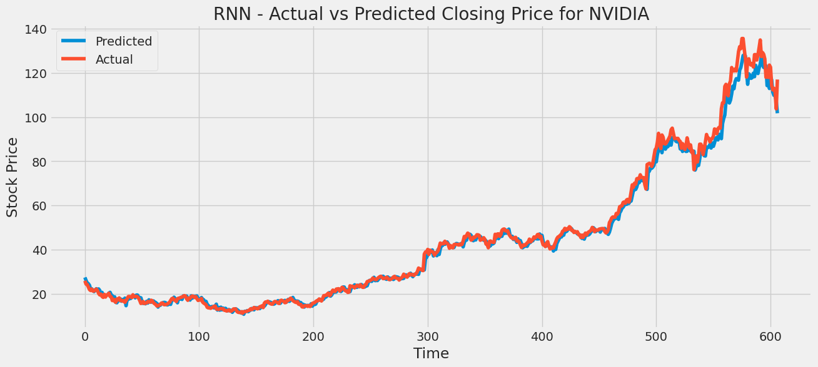
RNN for NVIDIA
MAE - 1.624
RMSE - 2.761

Slide 14
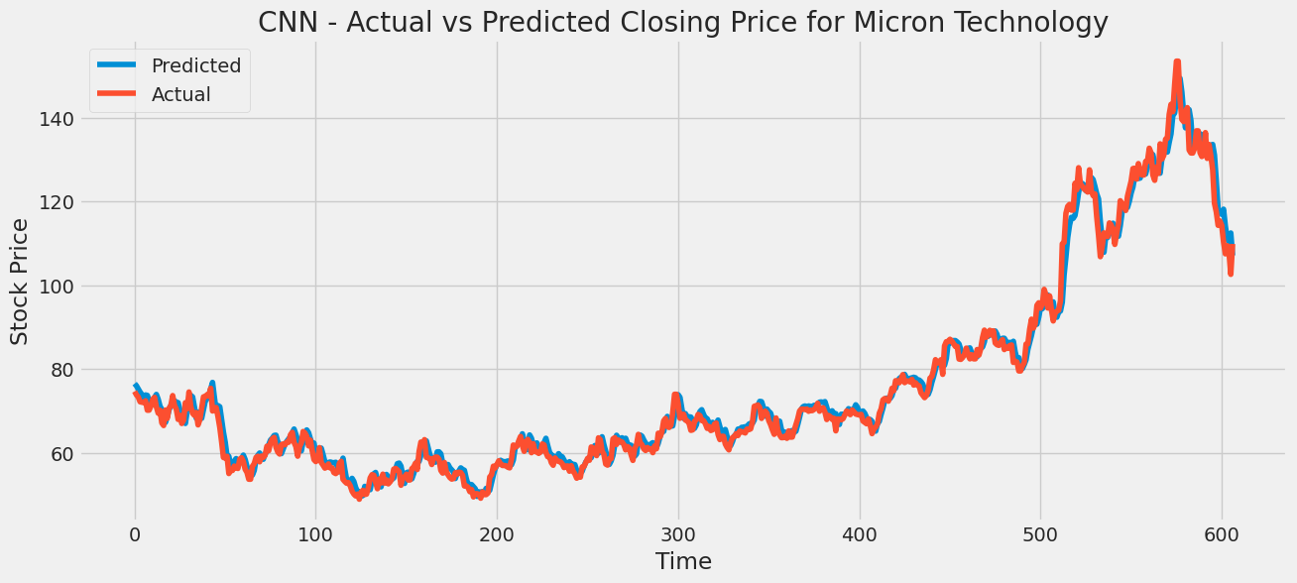
CNN for micron technology
MAE - 1.909
RMSE - 2.601

Slide 15
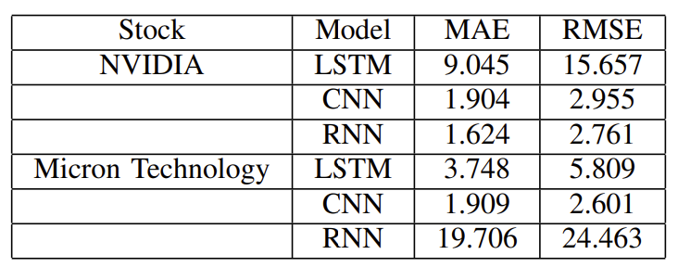
Results and comparisons

Slide 16
Conclusion
CNN model showed strong performance for Micron Technology, while the RNN model excelled with NVIDIA’s stock. The LSTM model, although it is ideal for time-series data, did not perform well in this context
Characteristic of data is also important for models.
This study emphasizes the importance of model selection in financial forecasting and suggests that a tailored approach, rather than relying on one model.
Future work could be fine-tuning and finding the correlation with other commodities. Subsequently, the stock data and related commodities trends will also be trained and evaluated as well as create an application for traders and investors.

Slide 17
Thank you!

