Slide 1
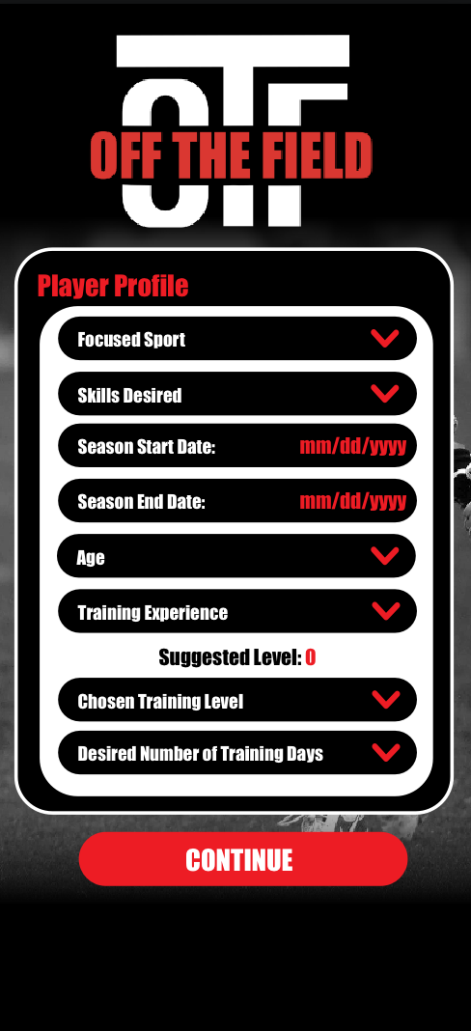
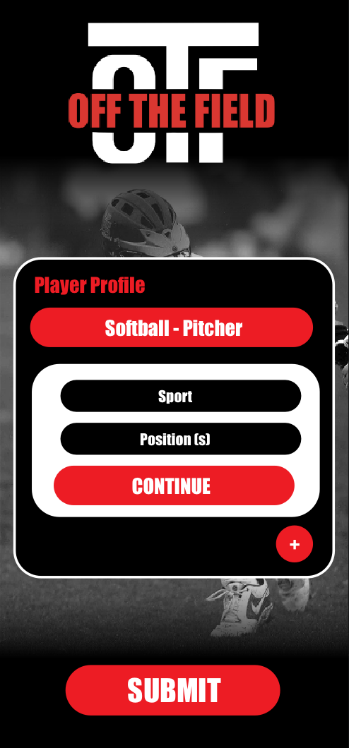
User Inputs Information
Questions:
Sport
Position
Age
Training Experience
Season Start Date
Season End Date
Skills Desired
Chosen training level
Desired number of training days

Slide 2
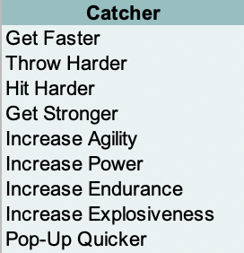
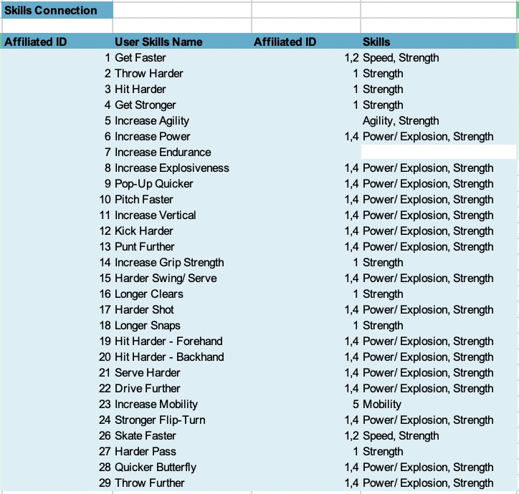
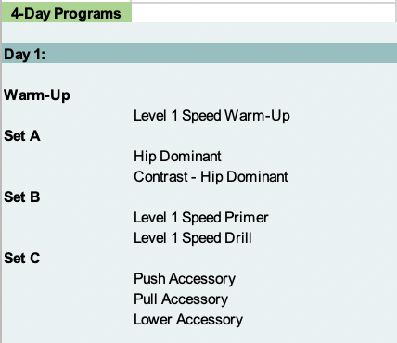
EX. Baseball, Catcher, Level 1 Off-Season
2. Algorithm Creates Program
Skills Associated with Position
+
Level, Number of Training Days & Type of Season
+
Transferable Training to Playing Skills

Slide 3
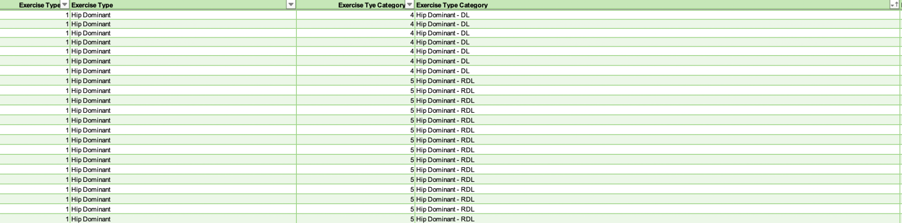
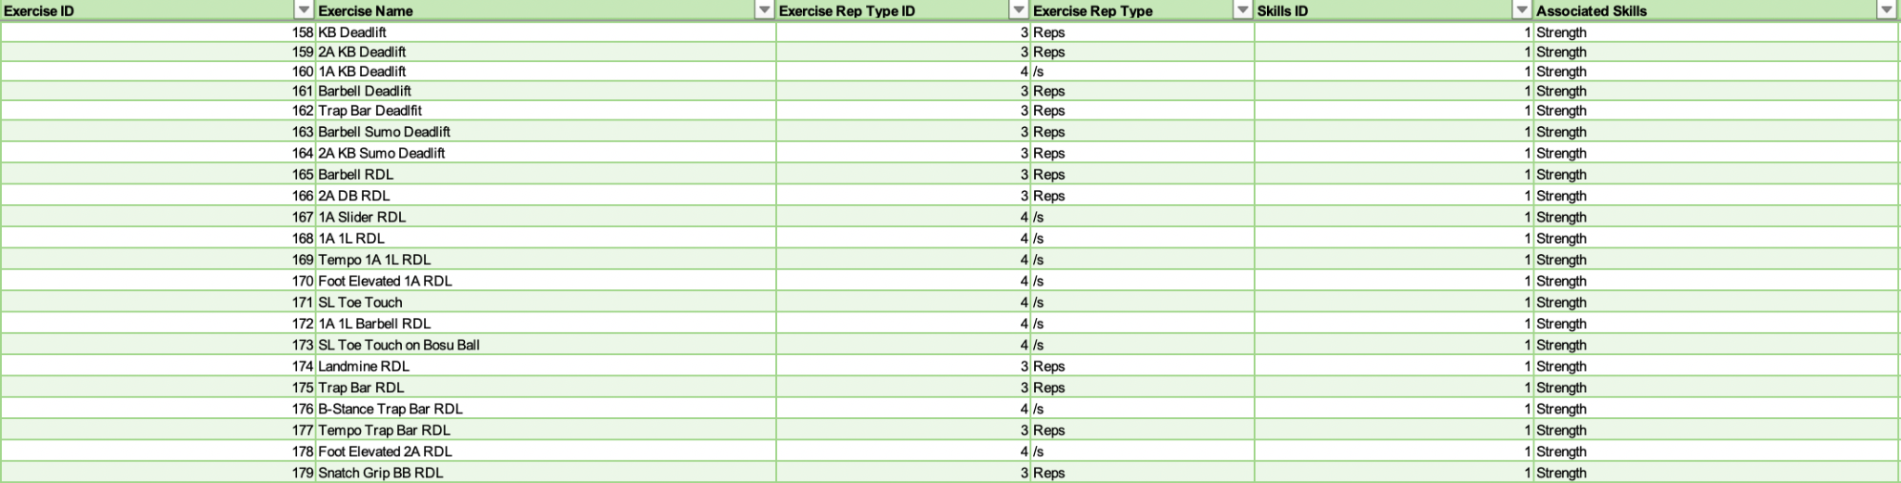
2. Algorithm Creates Program (continued)

Slide 4
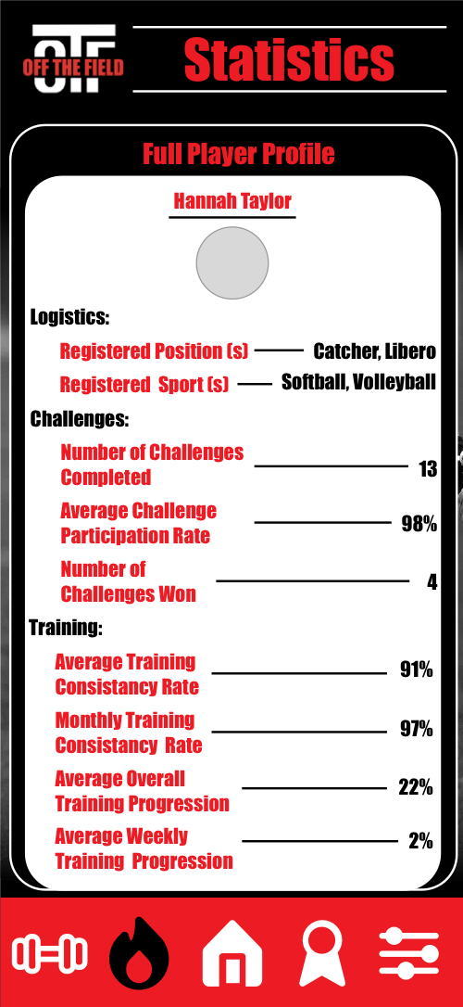
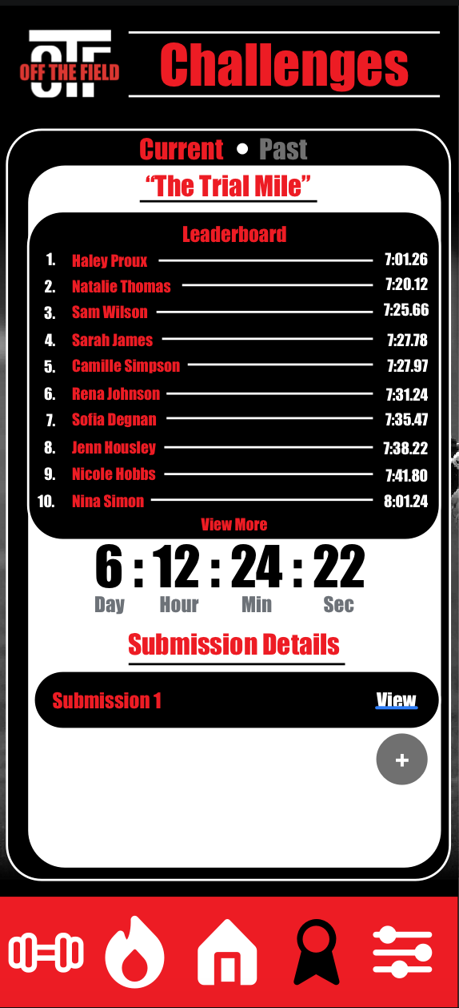
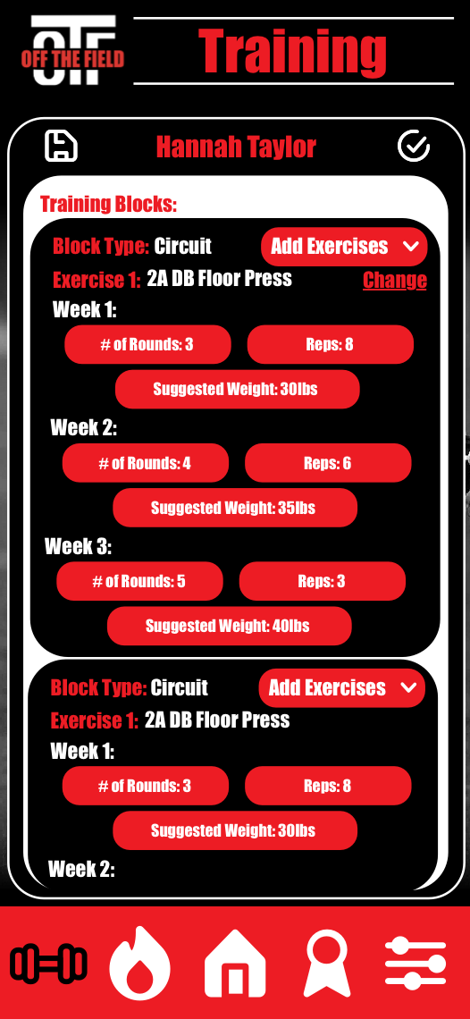
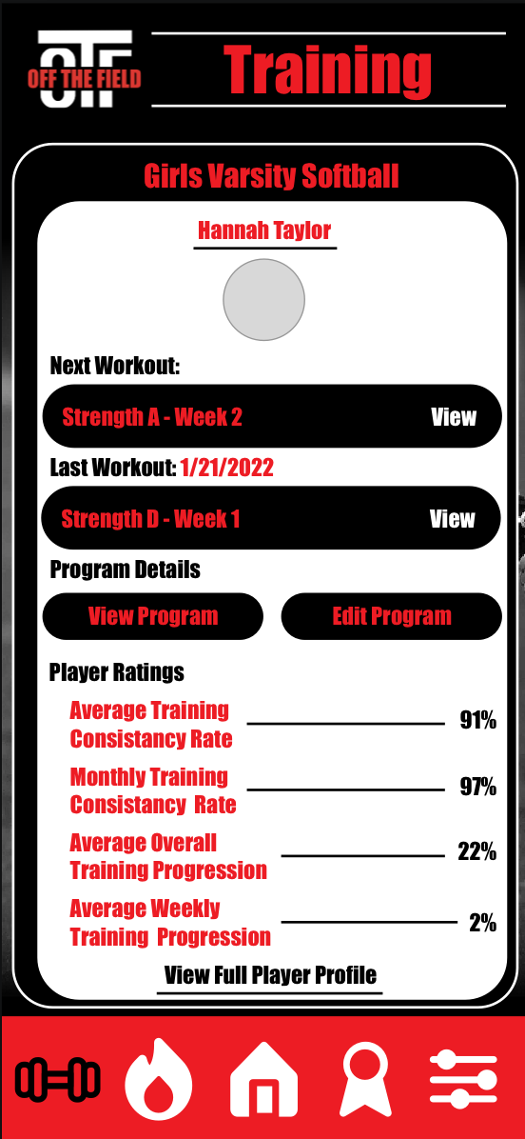
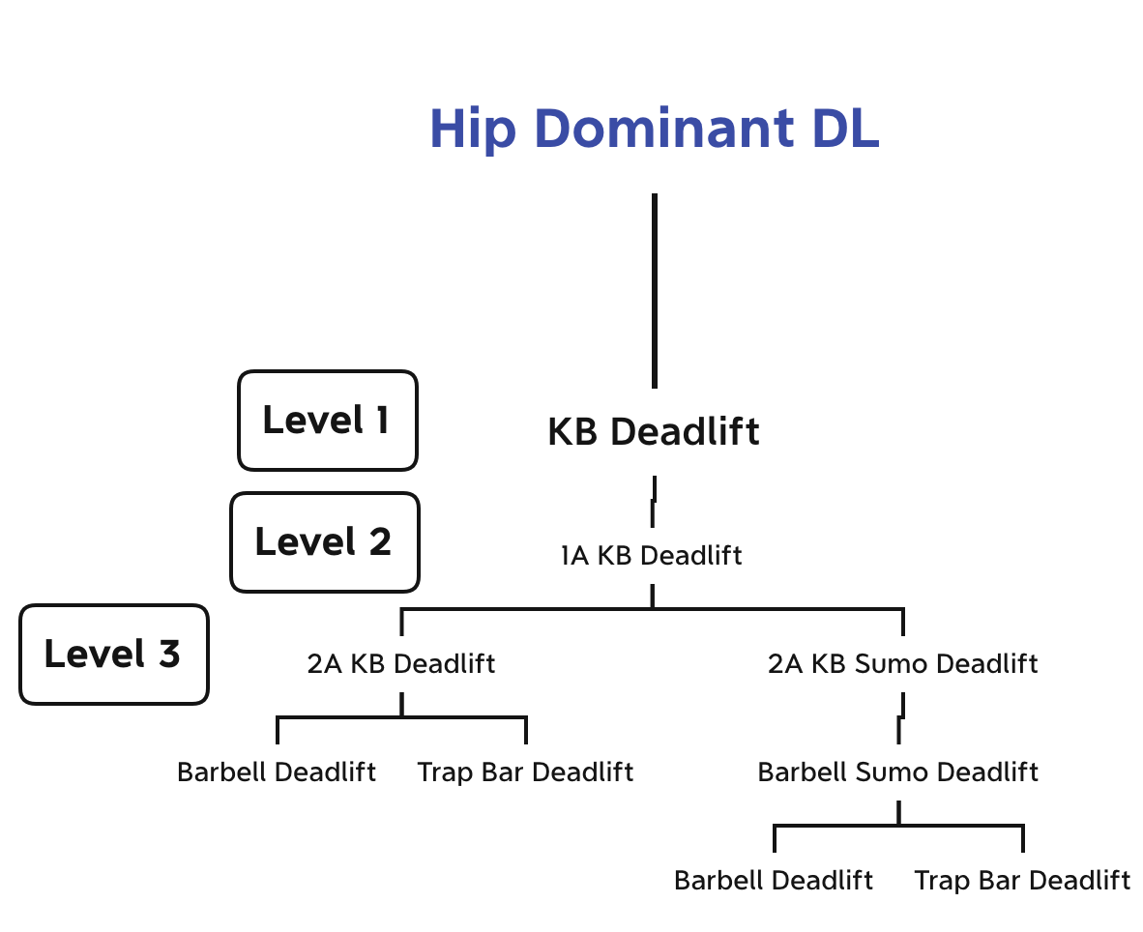
Other Features
Challenges:
Coaches can set challenges for players
Players participate and submit an entry
Teammates can see other entries
Accountability:
Coaches can see player progress and workout log
Coach Programmed Workouts:
Coaches can override the programs given to the players and enter their own
Can use exercises from OTF library or upload their own exercises with a demonstration video and written cues
Exercise Progressions and Regressions:
Players can progress to more difficult exercises and also regress to less challenging ones
Player Strength and Conditioning Evaluations:
Player’s work on the app including their evaluations will be put into a player profile
This can be used in recruitment as a way of showing the work done in the off-season and in-season on their sport in the weightroom

