Slide 1
2024 Spring CSC3150 Project 3
Wuzhou Du
Tianci Hou (Pacific Daylight Time)

Slide 2
Motivation
Play with the kernel
Implement useful system calls (remember your first project?) in xv6 operating system
Modified from MIT6.S081 lab. DO NOT TRY TO COPY 👀
Maybe useful in resume

Slide 3
My Comment
It takes some time to understand
Tens of lines of code to implement

Slide 4
Submission Guide
Submit a zip to BB.
Zip structure: one report pdf and one source folder. The source folder only includes 4 source C files.
A script (gen_submission.sh) for you to generate the zip file.

Slide 5
Introduction-prerequisite
You should learn some background knowledge about xv6, file descriptor, and page tables by reading the prerequisite summary in BB. (Prof. Hsu will also teach most contents in the lecture)

Slide 6
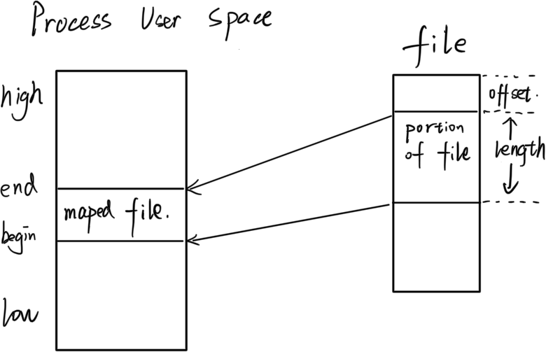
Introduction-What is mmap()?
Map a portion of memory in the kernel space to user space.
Modification will affect both user space and kernel space.

Slide 7
Introduction-Why mmap()?
Large file operations!
Avoid frequent read() and write().

Slide 8
Introduction-How to use it?
addr: the start address of the mapped region; 0 if the user leave it to kernel to then the kernel chooses the page-aligned address (always 0 in this assignment).
length: how many bytes of the file to map.
prot: the desired memory protection of the mapping (and must not conflict with the open mode of the file).
flags: determines whether updates to the mapping are carried through to the underlying file.
fd: the file descriptor
offset: the starting offset in the file

Slide 9
Introduction-Example usage
char *p = mmap(0, PGSIZE*2, PROT_READ, MAP_PRIVATE, fd, 0);
0: kernel will choose the page-aligned address for the user
PROT_READ indicates that the mapped memory should be read-only, i.e., modification is not allowed.
MAP_PRIVATE indicates that if the process modifies the mapped memory, the modification should not be written back to the file (of course, due to PROT_READ, updates are prohibited in this case).

Slide 10
Introduction-How to implement?
To ensure the function of mmap, you should complete the function `sys_mmap` in sysfile.c and the VMA (Virtual Memory Area) struct definition in proc.h

Slide 11
Introduction-What is VMA?
Virtual Memory Area: used by the kernel to track the mapping area.
Each VMA represents a contiguous region of virtual memory that has the same permissions and is backed by the same kind of object. The operating system needs to keep track of these mappings, including where they start, how large they are, what permissions they have, and what file or device they're associated with.

Slide 12
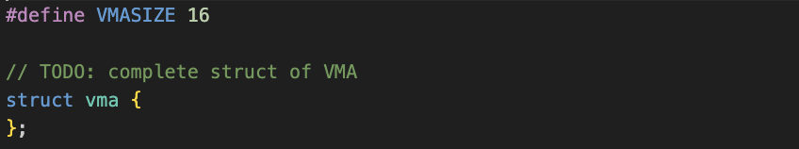
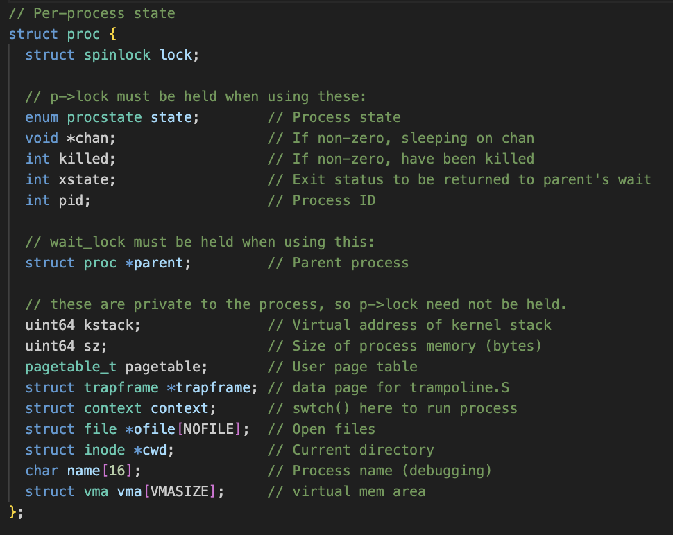
Introduction-What is VMA-Trace the code
kernel/proc.h

Slide 13
Implementation-VMA
Define a structure to record the address, length, permissions, file, etc. for a virtual memory range created by mmap.
Look at the parameters of mmap() to see what should be recorded in the VMA.
You may add other fields to VMA struct if you later find that they are useful.

Slide 14
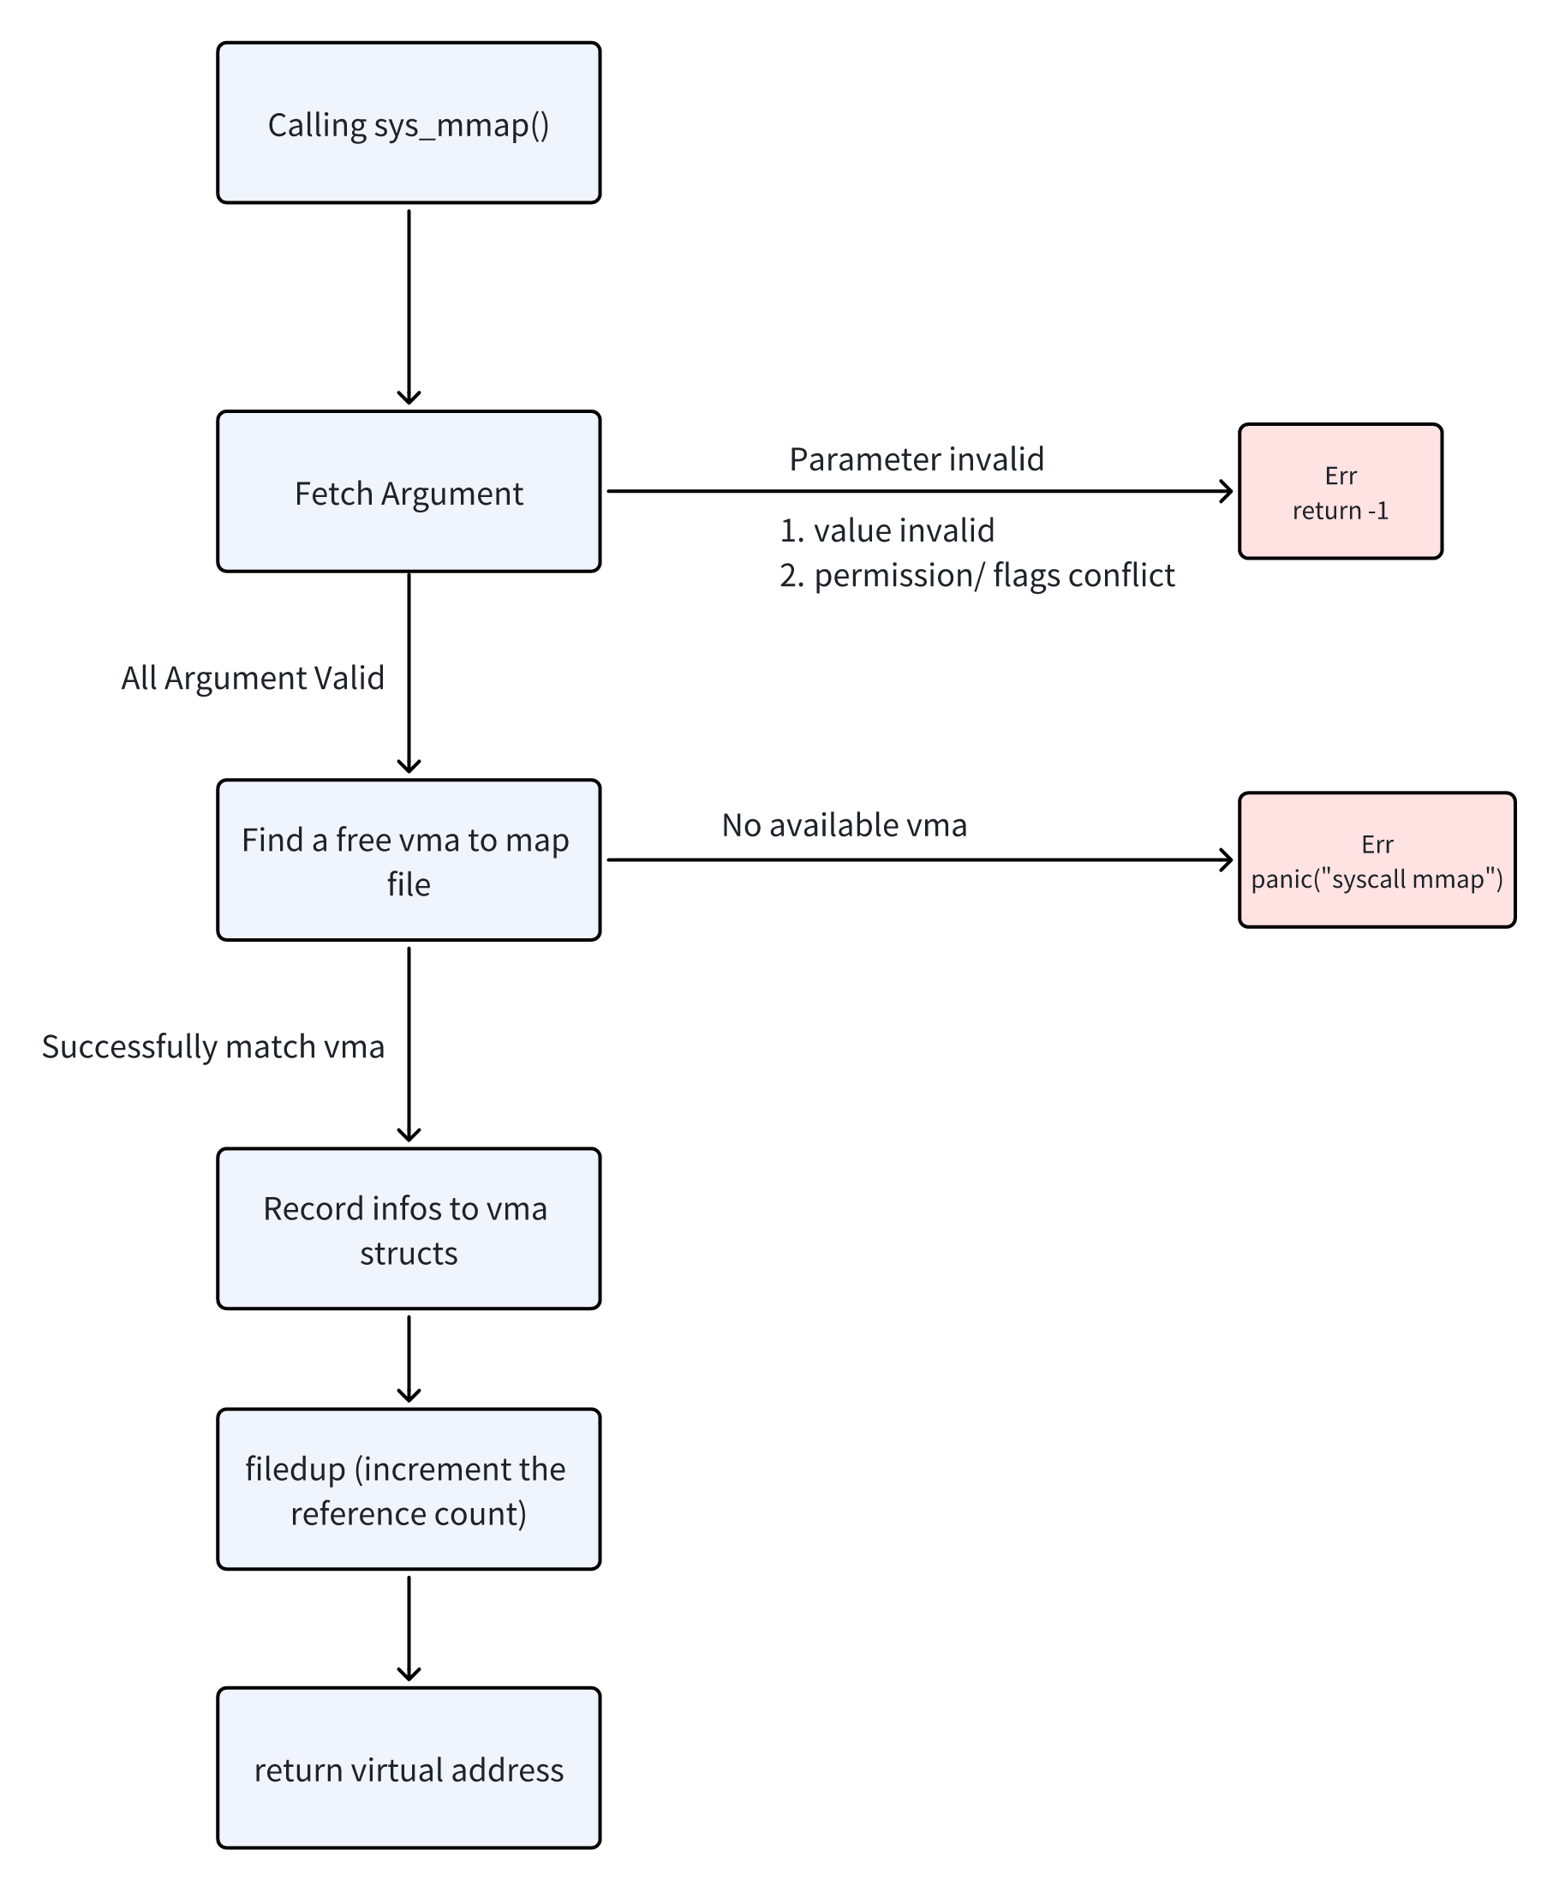
Implementation-sys_mmap
1. Fetch the arguments and check if they are valid from the user call.
2. Search for an available VMA in the current process and record the map information.
3. Increase the file duplicate.

Slide 15
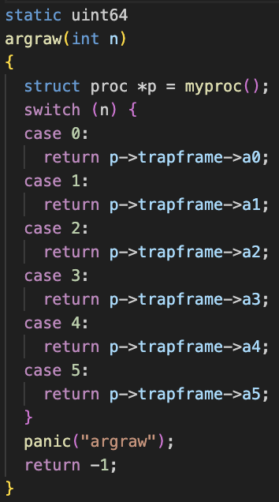
Implementation-sys_mmap
kernel/syscall.c
Q: How to fetch the arguments? There is no argument passed by calling sys_mmap?
A: The trapframe (do not remember? refer to proc struct!) will store the arguments.

Slide 16
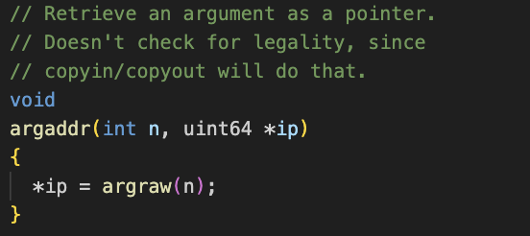
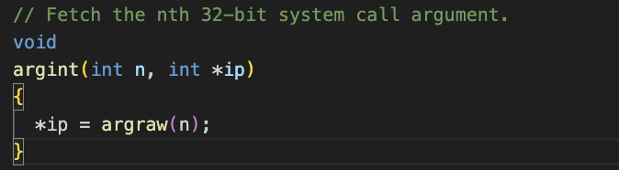
Implementation-sys_mmap
kernel/syscall.c
Q: How to fetch the arguments from the trapframe?
A: use argint/argfd/argxxx……
e.g.
int var;
argint(1, &var);

Slide 17
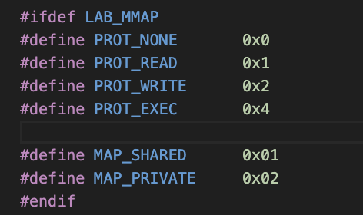
Implementation-sys_mmap
kernel/functl.h
Q: What’s the possible `prot` and `flags` arguments of mmap? How to pass them?
A: check whether the combination of arguments is valid. Arguments are passed in ‘FlagA | FlagB’ form.

Slide 18
Implementation-sys_mmap
Q: what is the return address of the mmap?
A: the start of available memory of the current process. Refer to the proc struct definition.

Slide 19
Implementation-sys_mmap
Finish? No file content in the memory!
It seems that we just record the meta data in the VMA, but there is no actual data in the memory!

Slide 20
Introduction-page fault handle
When the application accesses this memory, the kernel loads the actual data through a page fault exception. This step is also called lazy loading.

Slide 21
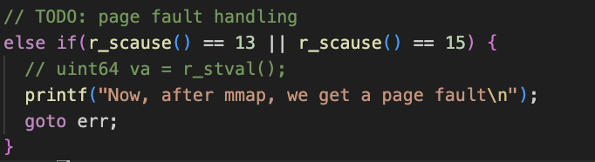
Implementation-page fault handle
kernel/trap.c
1. Find corresponding valid VMA by fault address.
2. Read 4096 bytes (1 PAGESIZE) of the relevant file onto that page, map it into the user address space.
3. Set the permissions correctly on the page.

Slide 22
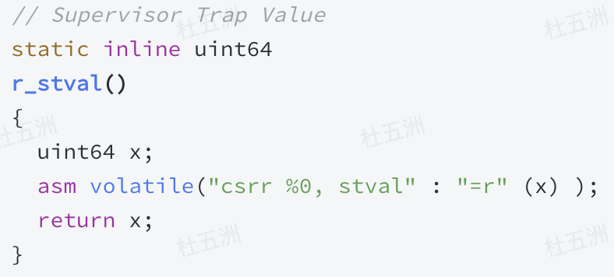
Implementation-page fault handle
Find corresponding VMA by fault address. How? `r_stval` provides the address causing the trap. Use this address to find the VMA.

Slide 23
Implementation-page fault handle
2. Read 4096 bytes (1 PAGESIZE) of the relevant file onto that page, map it into the user address space.
Please trace the code of `mapfile`, `mappages` and `kalloc`.

Slide 24
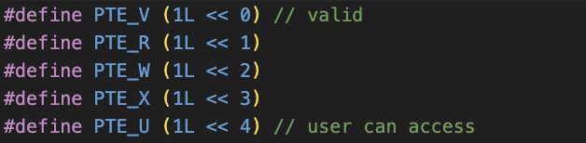
Implementation-page fault handle
3. Set the permissions correctly on the page. According to the VMA flags and prot!

Slide 25
Introduction-munmap
You should cancel the map! And write back to the file when necessary.

Slide 26
Implementation-munmap
Find the VMA for the address range and unmap the specified pages. (use `uvmunmap`)
If munmap removes all pages of a previous mmap, it should decrease the reference count of the corresponding struct file.
If an unmapped page has been modified and the file is mapped MAP_SHARED, write the page back to the file. (use `filewrite`)

Slide 27
Introduction-page align
What? Organize memory in such a way that each page of memory starts at a memory address that is a multiple of the PAGESIZE (4096 bytes in this project).
Why? Efficient Memory Access! Memory access operations are often optimized when memory addresses are aligned with the PAGESIZE.

Slide 28

Implementation-page align
How? Use these two macros!
You have to figure out use which on under different situations.

Slide 29
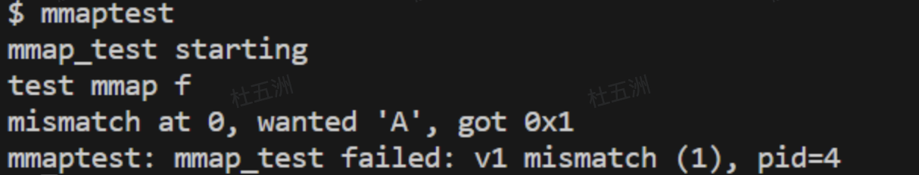
Introduction-How to test?
After `make qemu`, run `mmaptest`
Before your implementation of mmap(), you should fail in the first test. Sample output:

Slide 30
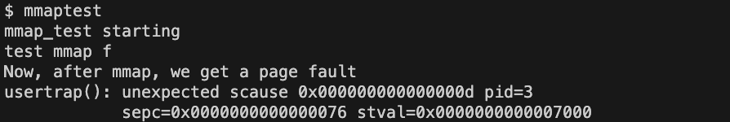
Introduction-How to test?
After your implementation of mmap(), before your implementation of page fault handle, you should encounter a page fault trap. Sample output:

Slide 31
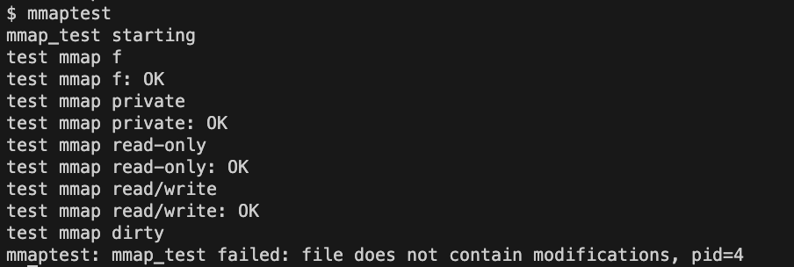
Introduction-How to test?
Afte your implementation of page fault handle, you should pass a few tests. Sample output:

Slide 32
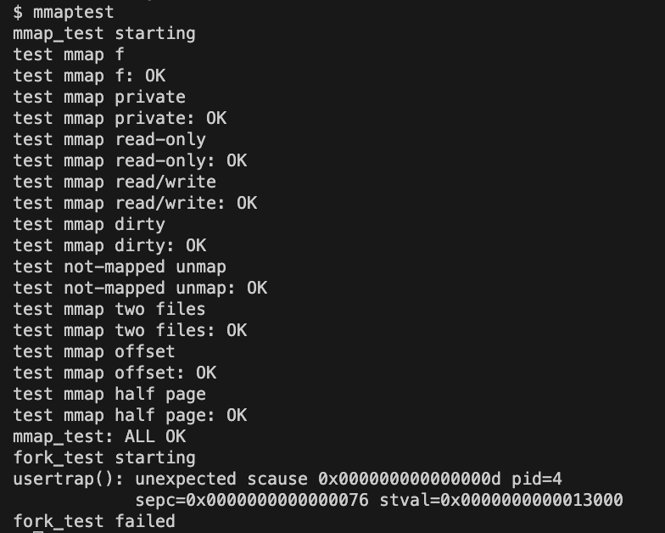
Introduction-How to test?
Afte your implementation of munmap, you should pass all tests except forktest. Sample output:

Slide 33
Final tips
Remember to `make qemu` after any modification of xv6. You are modifying kernel!
To quit the qemu, press `control` and then press `A`, release and then press `X`.
Begin early! It’s hard for you to trace the code and understand the whole system. Ask in Piazza!
Good luck!

