Slide 1
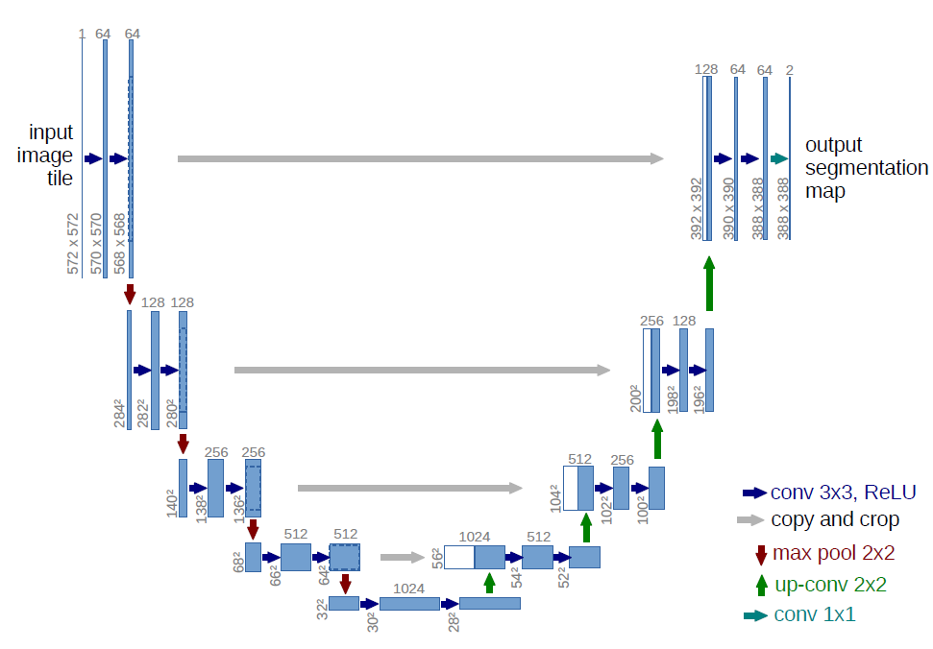
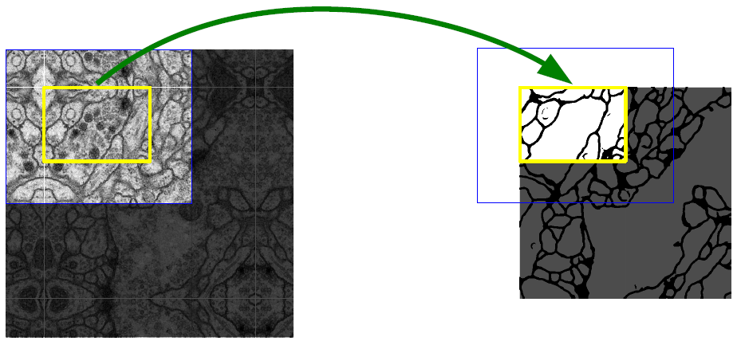
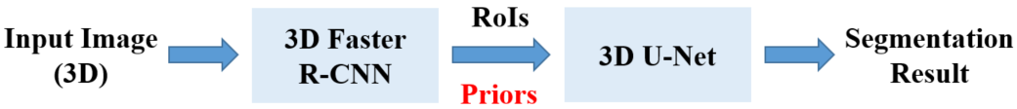
CFUN: Medical Image Segmentation
Previous works all focus on improving U-Net
The overlap-tile strategy in U-Net
Cannot leverage global information
Time and GPU memory-consuming
Our method
First localize the object (Faster R-CNN)
Then segment it (U-Net)
My contributions: most of the experiments
(2021.1.20) arXiv version 22 citations, GitHub repo ~100 stars

