Slide 1
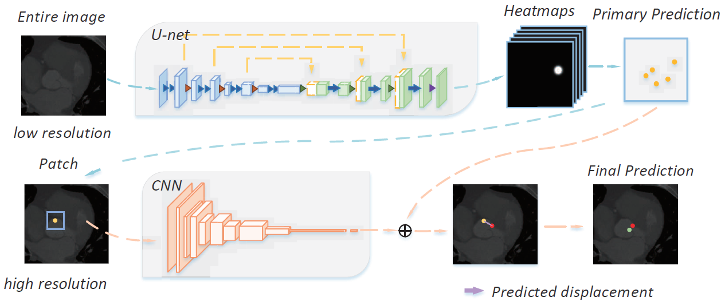
Second Project: Cardiac Landmark Regression
A workshop challenge of MICCAI 2019
Two-stage cascade model, coarse-to-fine
3D U-Net to regress heatmap on low-resolution full images, global information
CNN to refine the results on high-resolution local patches, local context
My contributions: some experiments
Accepted

