Slide 1


Master thesis defense
Resilience of Tor relays on BGP hijacks & BGP monitoring of potential hijacks containing Tor prefixes
28th August, 2020
Master [120] in computer science
Author: William Visée
Supervisors: Ramin Sadre, Florentin Rochet
Reader: Olivier Pereira

Slide 2
Table of contents
Background: Correlation attacks, BGP, BGP hijack resilience, RAPTOR
Goal: Propose new security metrics
Results
Further works

Slide 3
1. Background

Slide 4
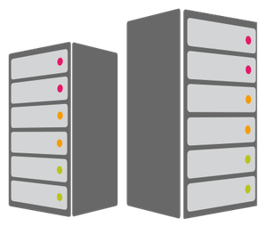

Standard communication with servers
TCP/IP connexion

Slide 5

Standard communication with servers
TCP/IP headers containing source and destination.
No anonymity with direct connexion.

Slide 6

Passing traffic through Tor network
Middle
Guard
Exit

Slide 7
Passing traffic through Tor network
Middle
Guard
Exit

Slide 8
Passing traffic through Tor network
Middle
Guard
Exit

Slide 9
Correlation attacks
Middle
Guard
Exit

Slide 10
BGP: Border Gateway Protocol
1
5
A random example of the representation of the Internet
Each cercle is an Autonomous System
Each AS has a number
Each AS is assigned IP prefix(es), which is a set of IP addresses to assign to devices inside of their network
BGP enables ASes to know the path towards each IP prefix
3
6
4
2
7

Slide 11
BGP: Border Gateway Protocol
If an AS obtains two routes towards the same prefix, it will choose the best one.
There is a preference list.
There are two attributes:
AS relation : An AS will prefer the best financial path
AS path: An AS will prefer the shortest path

Slide 12
Example of BGP prefix announcement
1
5
10.0.0.0/24
Path: 3 1 2
P
10.0.0.0/24
Path: 5 3 1 2
10.0.0.0/24
Path: 1 2
C
Pr
3
P
Pr
Pr
C
Pr
6
Pr
10.0.0.0/24
Path: 6 5 3 1 2
C
4
C
Pr
C
C
2
7
10.0.0.0/24
Path: 2
10.0.0.0/24
Path: 7 6 5 3 1 2
10.0.0.0/24
Path: 4 3 1 2

Slide 13
Example of BGP hijack
Based on AS relation and AS path only
1
5
10.0.0.0/24
Path: 5
10.0.0.0/24
Path: 3 1 2
P
10.0.0.0/24
Path: 1 2
C
Pr
3
P
Pr
Pr
C
Pr
6
10.0.0.0/24
Path: 6 5
Pr
C
4
C
Pr
C
C
2
7
10.0.0.0/24
Path: 2
10.0.0.0/24
Path: 7 6 5
10.0.0.0/24
Path: 4 6 5

Slide 14
Computation of the resilience
Compute the proportion of AS that prefer the path towards the true origin AS during a BGP hijack.
In the example, it is 3/7 = 0,4285714
We will compute all the scenarios with all AS as an attacker.
We will compute the average of these result to get the resilience of the prefix.

Slide 15
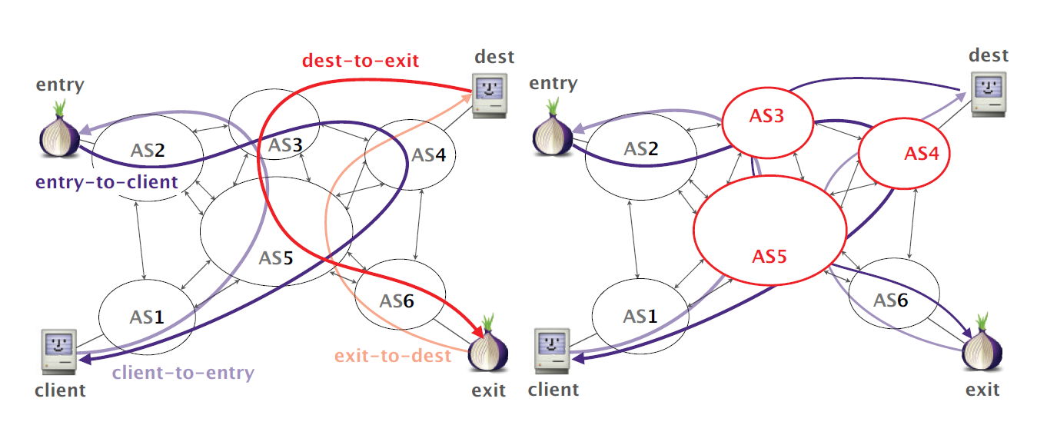
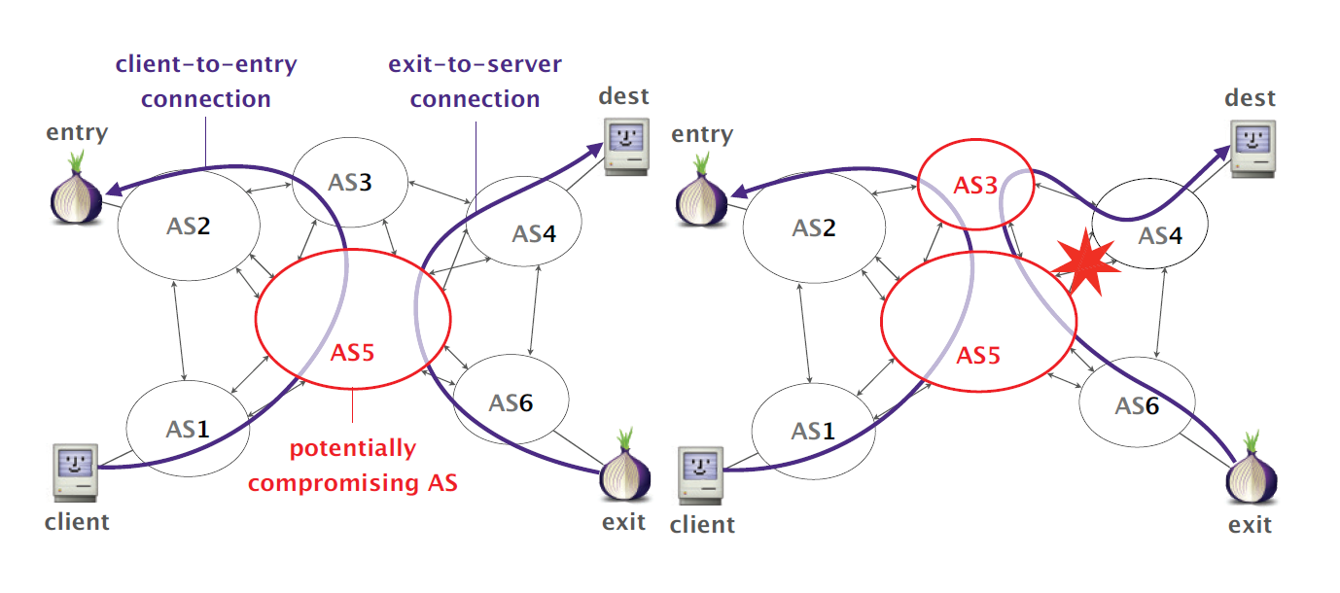
How to observe the two parts of the traffic?
Set of three attacks called RAPTOR : Routing attack on Tor
1. Asymmetric Traffic Analysis
2. Natural Churn

Slide 16
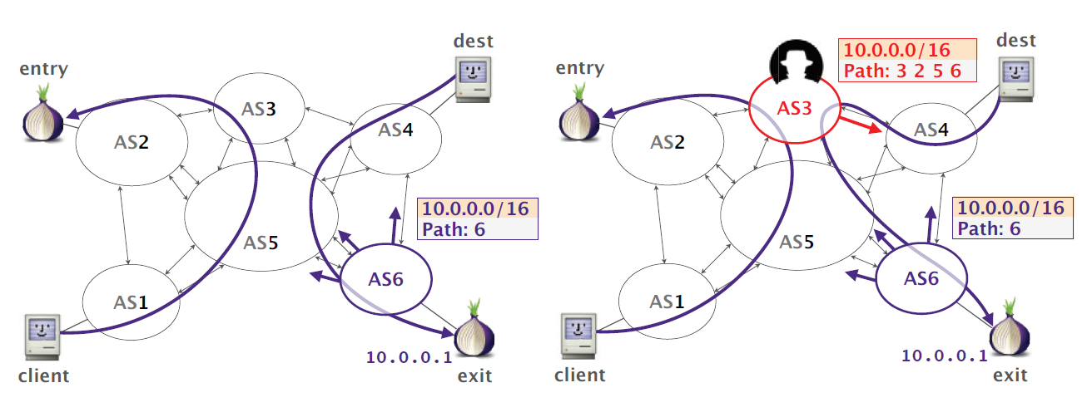
How to observe the two parts of the traffic?
Set of three attacks called RAPTOR : Routing attack on Tor
3. BGP hijacks and interceptions

Slide 17
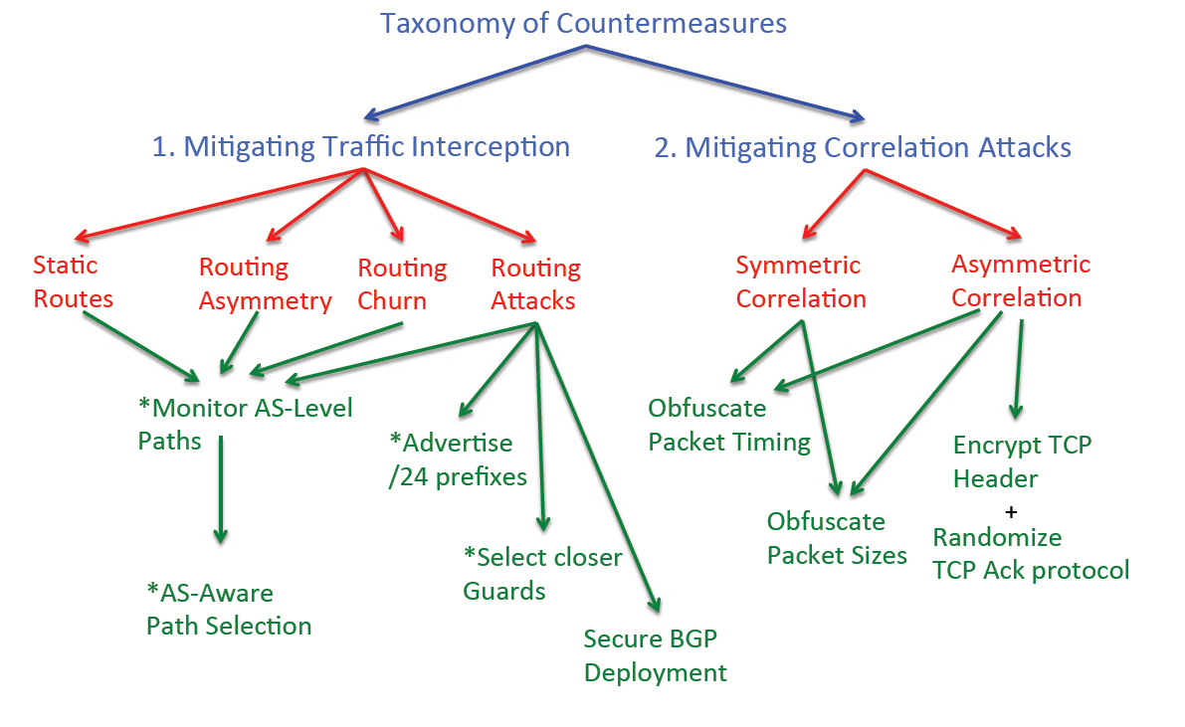
Defenses

Slide 18
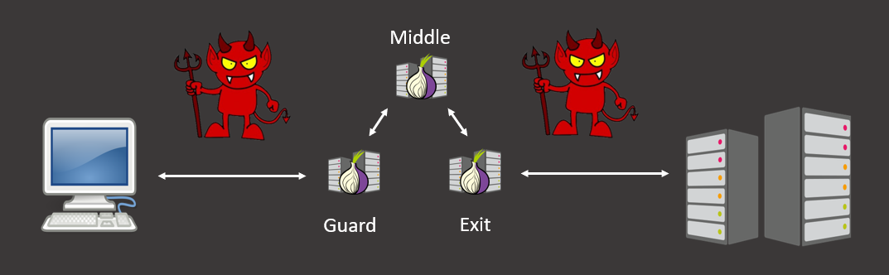
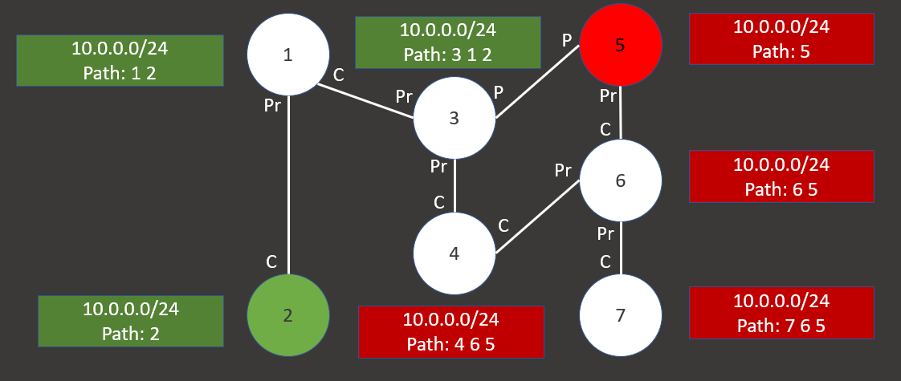
Summary
If an attacker has access to the ingress and egress traffic of a Tor communication, he can launch a correlation attack to delete the anonymity of the communication.
To observe the two parts of the traffic, the attacker can launch BGP hijacks on Guard and Exit prefixes.
We can compute the resilience of a prefix to see the robustnest against a BGP hijack.

Slide 19
2. Goal

Slide 20
Purpose of this master thesis
The defenses proposed to counter BGP hijacks are nowadays not well deployed
Propose security metrics to illustrate the robustness of Tor Network against BGP hijacks
Two metrics proposed:
Resilience of Tor relays on BGP hijacks: The resilience of all prefixes containing a Tor guard or exit relay. Each relay will be given a resilience each first day of the month.
A list of potential BGP hijacks of Tor guard or exit relay prefix(es) sorted chronologically.

Slide 21
Tor relay resilience computation
Each month
Tor consensus
BGP archives
AS relation
IP addresses of Tor guard and exit relays
Extract only BGP path towards Tor prefixes
Creates a virtual network and propagates prefix from true origin AS
Computes resilience of each prefix

Slide 22
2. BGP monitoring
Each hour
Tor consensus
BGP archives
IP to ASN mapping
IP addresses of Tor guard and exit relays
Extract only BGP announcement containing Tor prefixes
Frequency check
Time check
Alert
Origin check

Slide 23
Speed
Resilience: due to optimisation issues, only nine days of data were analysed (1st Novembern 2007 to 1st November, 2015).
BGP Monitoring: Three years of BGP archives have been filtered to catch these potential BGP hijacks.

Slide 24
3. Results

Slide 25
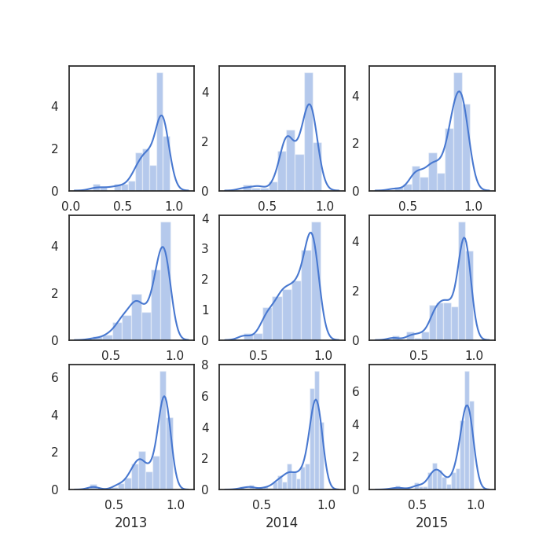
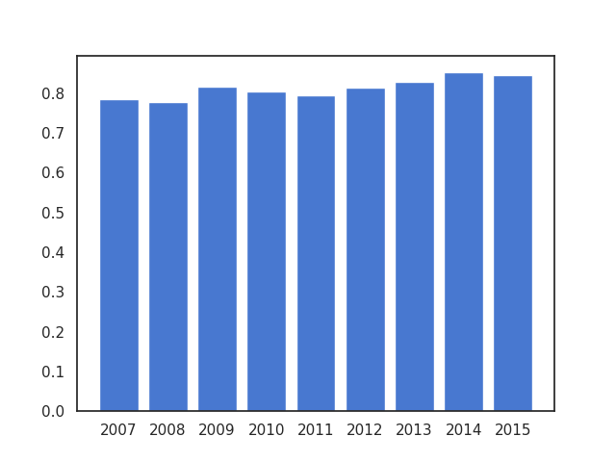
Results of resilience metric
Distribution of resilience by year
Resilience average by year

Slide 26
Results of monitoring metric
5 potential BGP hijacks have been discovered:
2 with frequency analysis
3 with time analysis

Slide 27
4. Further works

Slide 28
Further works
Optimise the programs
Embellish the metrics

Slide 29


Further works

Slide 30
Thank you for listening

