Slide 1
Raptor : Meeting 23/10
1. Countermesure of Raptor
2. Github and Trello

Slide 2
Countermesure of Raptor
New Guard relay selection algorithm. We choose path where entry and exit relay are in resilient AS against BGP hijack or interception.
Monitoring system that advertise tor relay ( that are subscribe to the tool ) of suspicious BGP annoucement.
1. We do a database with the prefix that each AS ( containing entry/exit tor relay) has. If wrong prefix announcement we advertise the relays. (lot's of false positive explained next)
2. Not a lot of BGP update of tor relay prefix.
2.1. If the frequency of an AS originate a prefix is different than normal, suspicious.
2.2. The time an attack maintain is small. we mesure the amount of time each path to a prefix is announce for. If it is small, suspicious.

Slide 3
Why is there false positive in the monitoring countermesure?
There is about 50000 prefix conflict BGP update every month.
There are lot's of duplicate and if we take only unique prefix we get about 100 unique prefix announce in conflict.
Some conflict BGP announce are ok since origin AS accept it.
Ex: 164 unique prefix in conflict from 79 AS in february 2016.
Some of them will also be announce next month and aren't attacks.
We combine these "alert" with frequency analytics and time analytics which use threshold values to delete these false positive.
But perfect thresholds are hard to find.

Slide 4
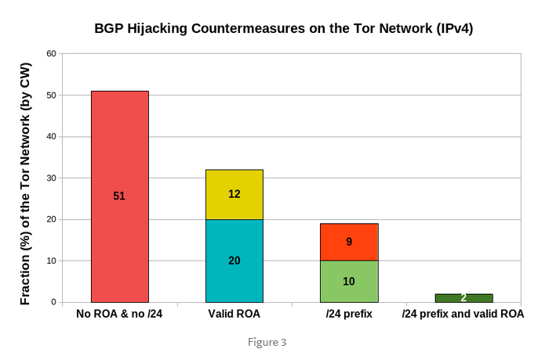
RPKI : Resource Public Key Infrastructure
August 2018
Resource Public Key Infrastructure (RPKI) is a public key infrastructure framework designed to secure the Internet’s routing infrastructure, specifically the Border Gateway Protocol.
ROA (Route Origin Authorization) is an attestation of a BGP route announcement. It attests that the origin AS number is authorized to announce the prefix(es).

Slide 5
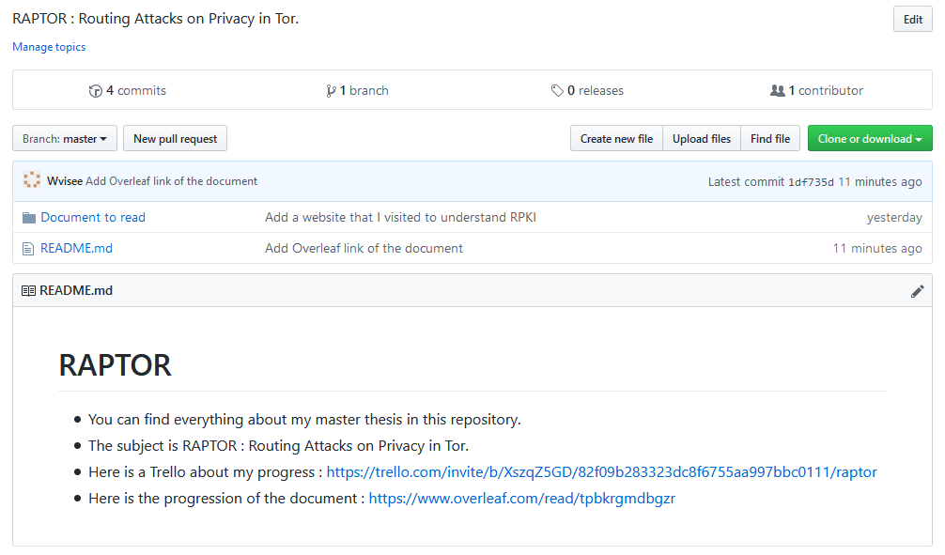
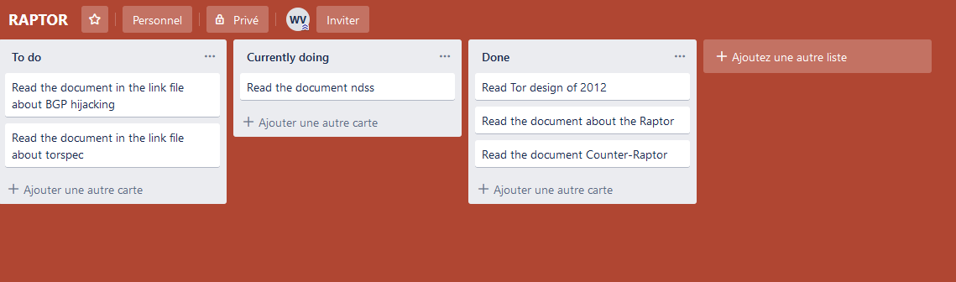
Github & trello

