Slide 1
Credit Risk Project
Introduction & Background
Exploratory Data Analysis
Data Preparation & Feature Engineering
Model Assessment & Insights
Key Findings & Future Directions
Jiapeng Wang

Slide 2

Introduction & Background
1
Problem Statement:
2
Objective:
Small business owners lack credit history, making them risky for banks.
Credit union issues short-term loans (12 months, $10K - $2M) to small businesses.
Sales fluctuations create repayment uncertainty, increasing credit risk.
Assess borrower creditworthiness using PRSM (Performance Ratio at Six Months).
Dataset Overview:
4
Approach:
3
Preprocess data to meet linear regression assumptions
Train regression model to predict PRSM, identify key features.
Use predictions to enhance loan approval decisions and mitigate risk.
Key variables include:
Binary features: WomanOwned
Continuous features: TotalAmtOwed, etc.
Categorical features: NAICS, CorpStructure, etc.
Introduction & Background

Slide 3
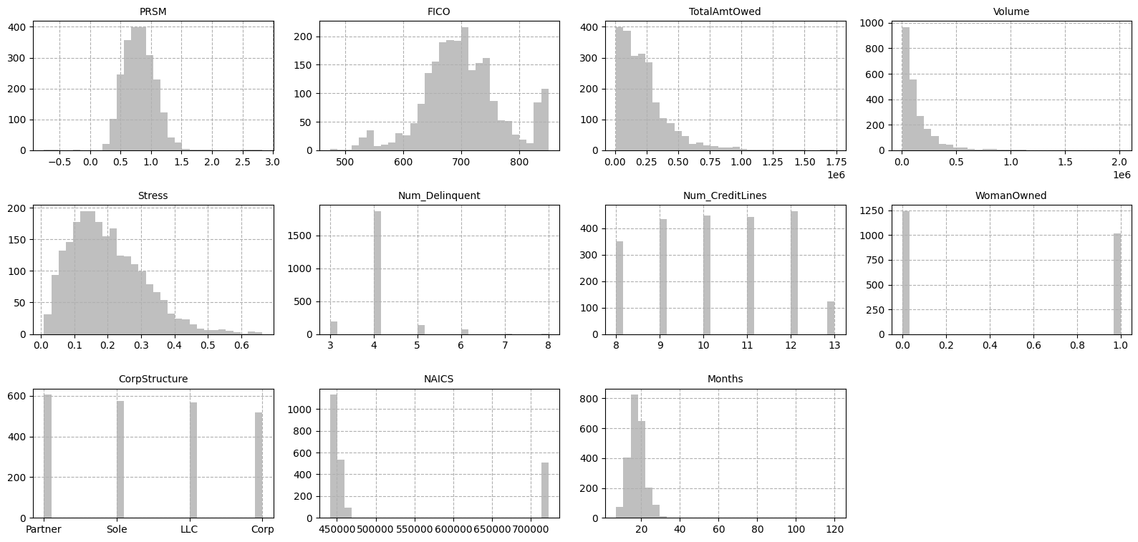
Exploratory Data Analysis
Exploratory Data Analysis

Slide 4
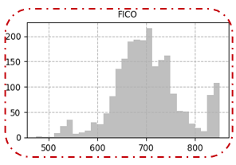
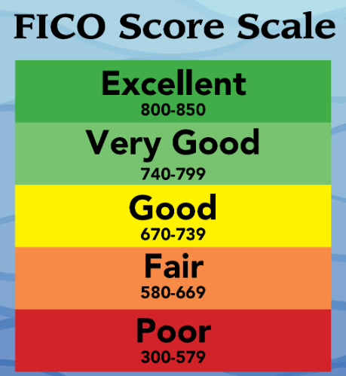
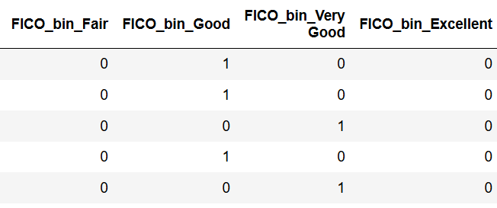
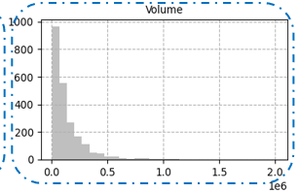
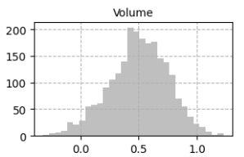
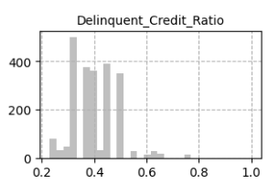
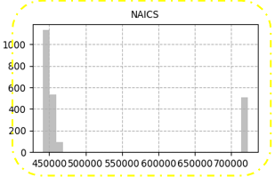
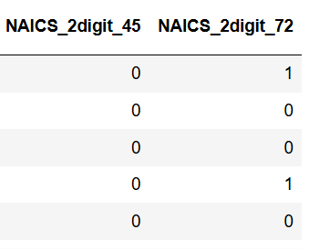
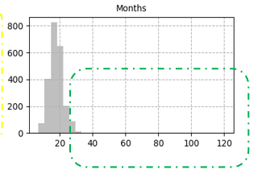
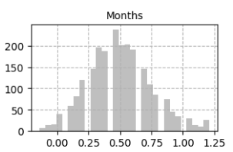
Data Preparation & Feature Engineering
Num_Delinquent
Num_CreditLines
Data Preparation & Feature Engineering

Slide 5
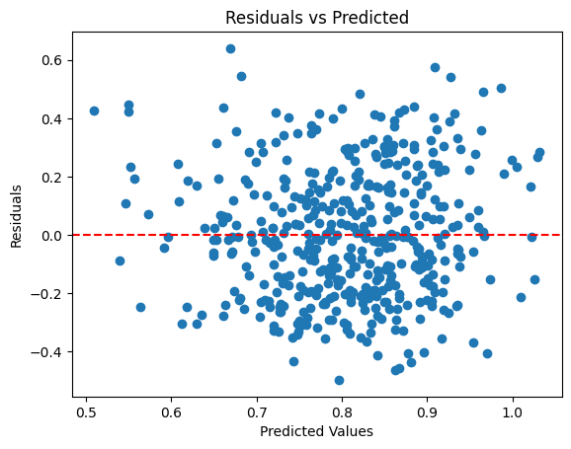

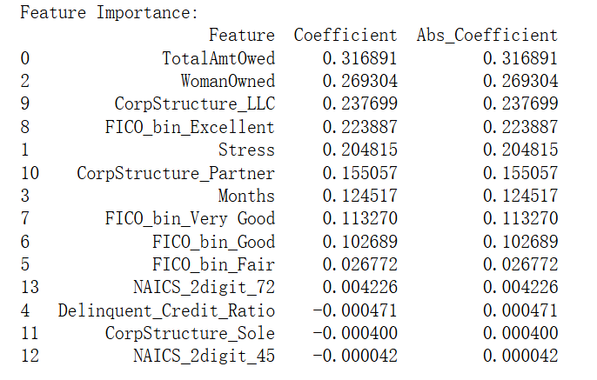
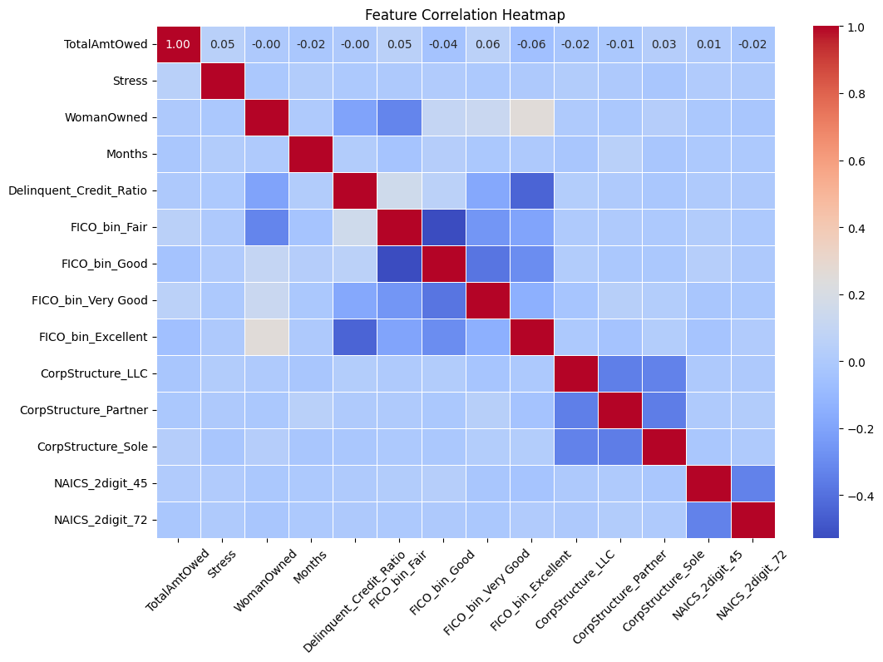
Model Assessment & Insights
Checking Linear Regression Assumptions
Model Performance and Feature Importance
Under 5Fold cross validation:
Model Assessment & Insights

Slide 6
Key Findings & Future Directions
Key Drivers of Credit Risk
Loan Amount: Larger loans link to higher PRSM scores, indicating stronger cash flow.
Women-Owned Businesses: Higher PRSM scores, possibly due to financial management or industry focus.
Business Structure: LLCs and partnerships score higher than sole proprietorships and corporations.
FICO Score: Higher scores ("Excellent" or "Very Good") suggest better repayment performance.
Financial Stress: A higher garnishment-to-volume ratio is associated with lower credit risk.
Months in Business: Longer operation reduces default risk, as shown by a positive coefficient.
Future Work
Improving Data Analysis
Explore feature interactions to uncover hidden patterns.
Test advanced models for better accuracy and interpretability.
Enhance weak features like NAICS for better insights.
Next Steps for Business Impact
Validate the model with real-world testing.
Integrate it into decision-making processes.
Monitor performance and refine based on new data.
Key Findings & Future Directions

Slide 7
Thank you Q&A

Slide 8
Backup

Slide 9
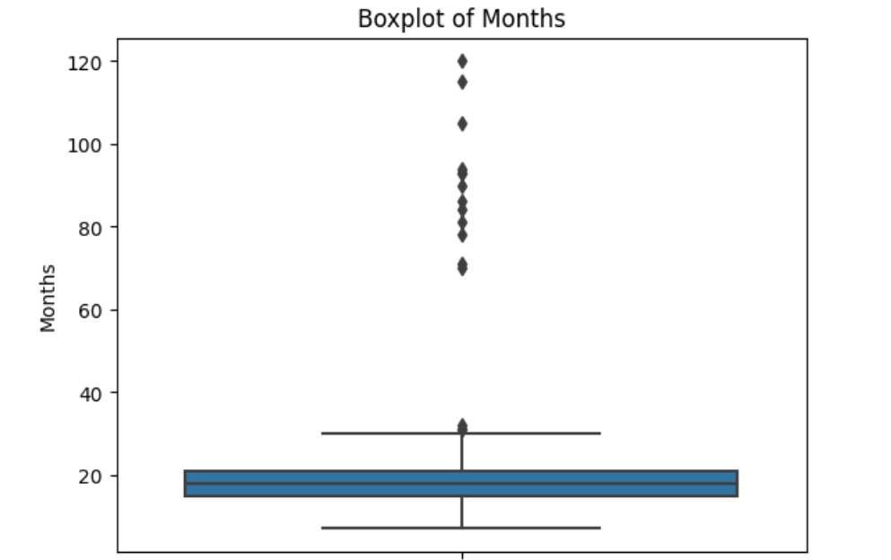

Slide 10
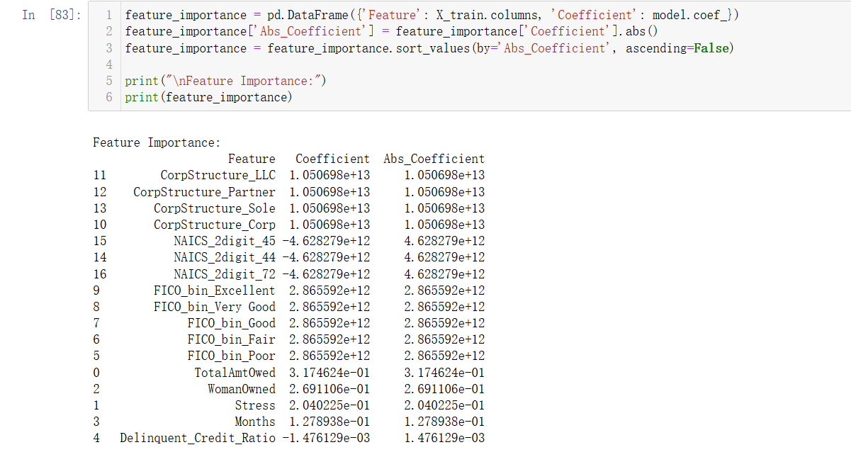

Slide 11
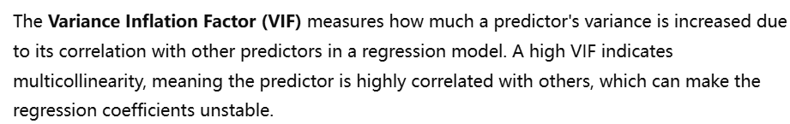
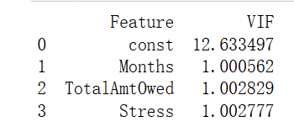
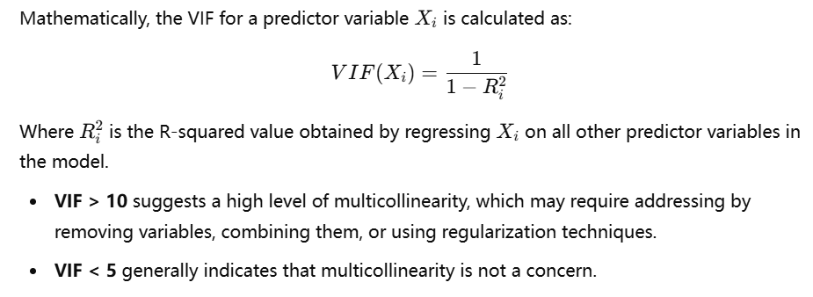
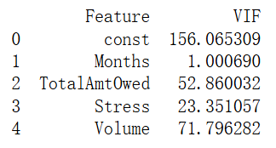
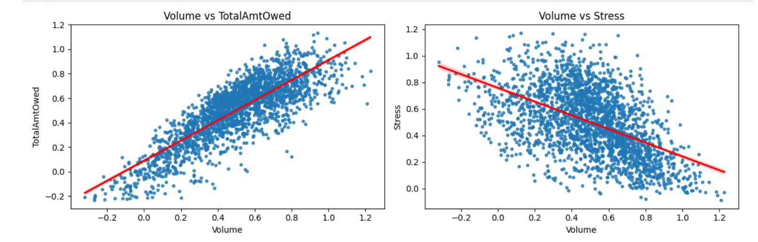

Slide 12
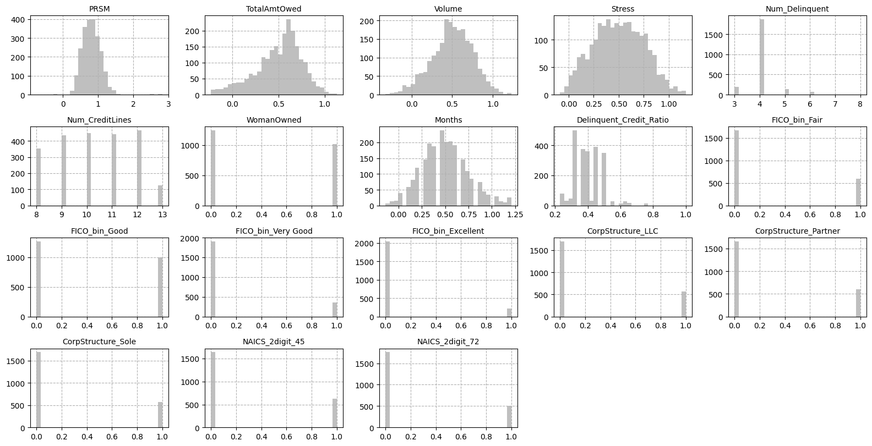

Slide 13
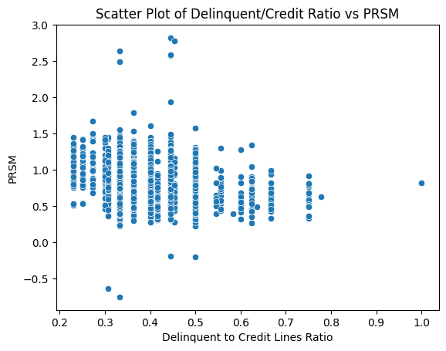

Slide 14






























Note: Only use red icons on white or light gray backgrounds

