Slide 1
Optimal USA Gymnastics Lineup: Simulation for 2024 Olympics
Background
Modeling Approach
Simulation Process
Results & Analysis
Future Outlook
Jiapeng Wang

Slide 2
Background: Project Overview
Objective:
Approach:
Select the optimal USA lineup for the 2024 Women's Gymnastics Olympic Games to maximize the medal performance.
Build a performance prediction model
Predict each gymnast's score distribution based on historical data.
Fix the lineups of 11 other countries
Simulate all possible USA lineups (2000 simulations per lineup)
Run the full team competition and individual events.
Calculate each lineup's average medal count.
Select the optimal lineup
Prioritize gold medals, then silver, then bronze.
Dataset Overview:
Tokyo 2021 Olympic Results
2022-2023 International Competition Results Including 40+ major competitions, such as:
World Championships (2022, 2023)
European Championships (2022, 2023)
Background

Slide 3
Background: Paris 2024 Gymnastics Competition Format
Team Final ("533")
Top 8 teams
3 gymnasts per apparatus
All 3 scores count
Qualification Round ("543")
5 gymnasts per team
4 compete on each apparatus
Top 3 scores count
Goal: Qualify for team, all-around, and apparatus finals
Individual All-Around Final
Top 24 gymnasts (max 2 per country)
Compete on all 4 apparatuses
Total score determines ranking
Apparatus Finals
Top 8 gymnasts per apparatus (max 2 per country)
Score on each apparatus(VT, UB, BB, and FX) determines ranking
Background

Slide 4
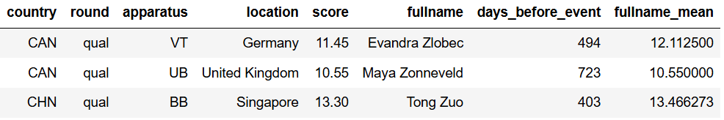
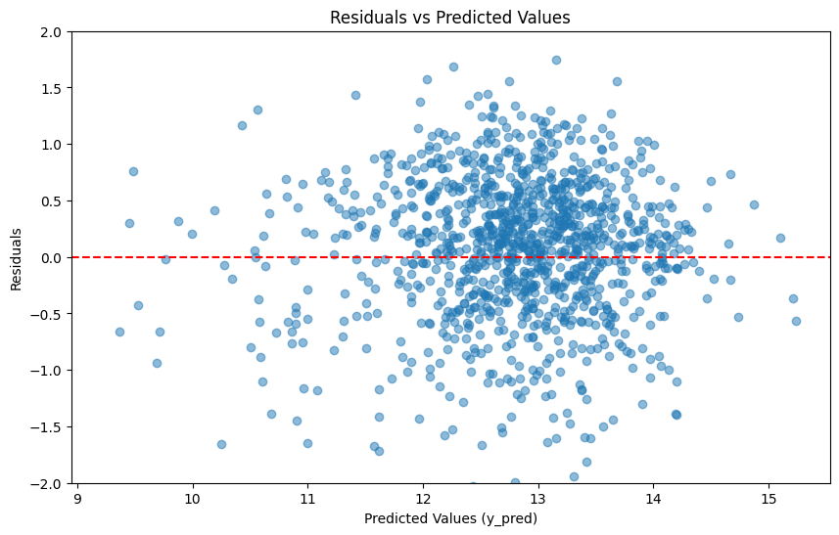
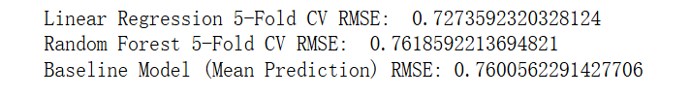
Modeling Approach
Feature Engineering
Target Encoding
One-hot Encoding
Standardization
Models
Linear Regression
Random Forest
Baseline Model
Modeling Approach

Slide 5
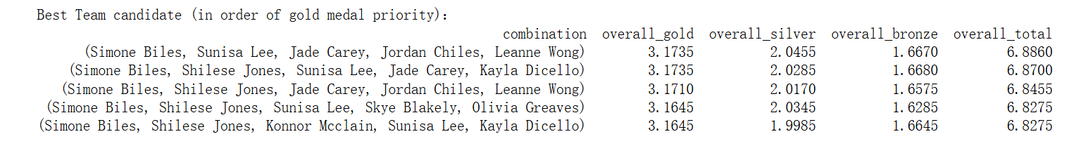
Simulation Process
Step 1: Fix Lineups of 11 Countries
Select top 5 gymnasts from each country based on historical average performance
Fixed lineups: GBR, CAN, BRA, FRA, JPN, NED, ITA, AUS, ROU, KOR, CHN
Step 2: Predict Performance
Predict scores for all U.S. gymnasts
Predict scores for each gymnast in the fixed lineups
Add random noise to mimic real competition uncertainty
Step 3: USA Lineup Simulation
Enumerate all possible USA lineups
Simulate from qualification round (543 rule) to:
Team Final (533 rule)
Individual All-Around Final
Event Finals (VT, UB, BB, and FX)
Run 2000 simulations per lineup
Prioritize gold count
(Use noise-free predicted scores to determine which athletes compete in team events.)
Simulation Result:
USA Lineup for 2024 Paris Olympics: Simone Biles; Sunisa Lee; Jade Carey; Jordan Chiles; Hezly Rivera
Traveling Replacement Alternates: Joscelyn Roberson; Leanne Wong
Simulation Process

Slide 6
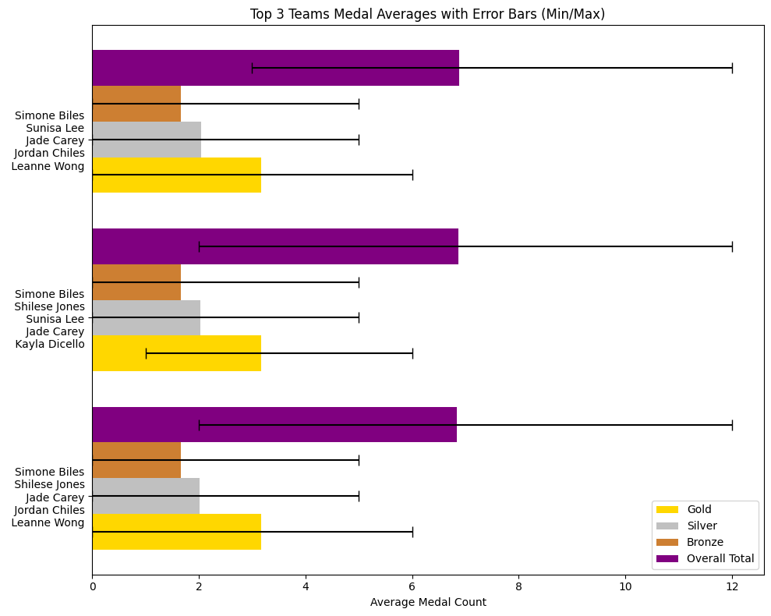
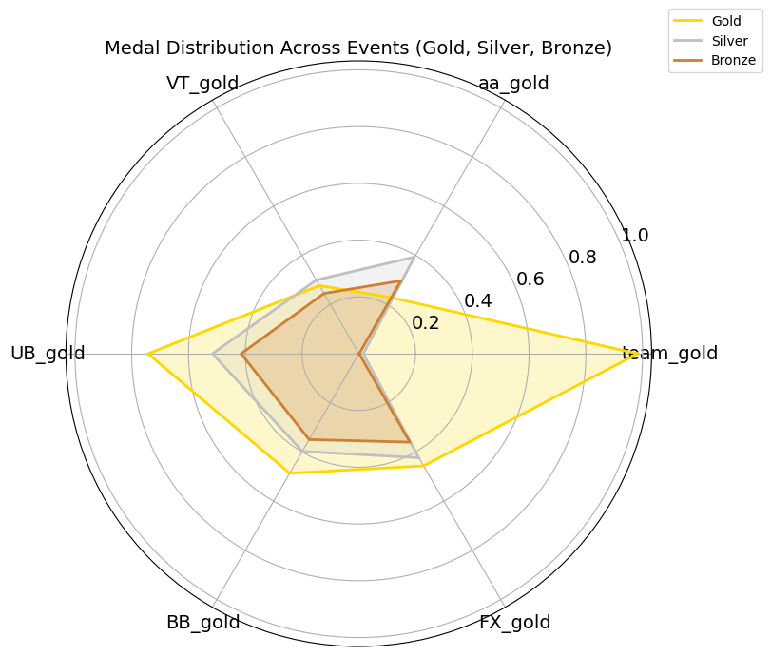
Results & Analysis
Overall Performance
Event-Specific Performance
Results & Analysis

Slide 7
Future Outlook: Potential Improvements & Applications
Potential Improvements
Tokyo 2021 Data Integration
Attempted to merge Tokyo 2021 data with the 2022-2023 dataset. However, this led to decreased model accuracy, requiring further refinement.
Refined Handling of Scores
Consider separating D-score, E-score, and Penalty for more precise analysis.
Data Gaps for Emerging Talents
The dataset only covers up to 2023, missing rising stars for the 2024 Paris Olympics. Additional data collection is needed to improve prediction accuracy.
.
Applications
Broad Predictive Scope
The model can be extended beyond U.S. women's gymnastics at the Paris Olympics to predict performance across different countries, genders, and competitions.
Comprehensive Performance Analysis
Simulates optimal athlete selection for each event and identifies national strengths in specific apparatus. Also projects potential medal outcomes, especially gold medals.
Future Outlook

Slide 8
Thank you Q&A

Slide 9
Backup

Slide 10
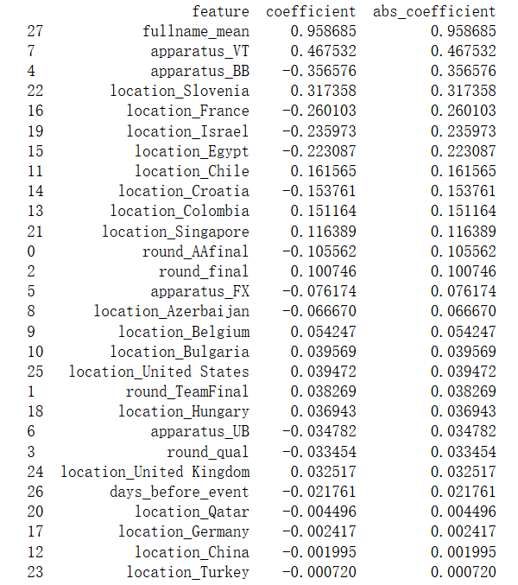

Slide 11






























Note: Only use red icons on white or light gray backgrounds

