Slide 1
Differentiable programming quantum circuits
Quantum circuit simulation and visualization
Weixuan Yuan
27/05/2021

Slide 2
Organization
Definition
Gradient of a function
Gradient of a quantum circuit
Obtaining gradient
Parameter shift rule
Visualization
Use cases
Gradient decent method
Machine learning
References

Slide 3
Organization
Definition
Gradient of a function
Gradient of a quantum circuit
Obtaining gradient
Parameter shift rule
Visualization
Use cases
Gradient decent method
Machine learning
References

Slide 4
Gradient of a function
Definition
Oriented function:
Gradient:

Slide 5
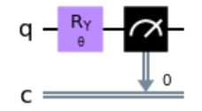


Gradient of a quantum circuit
Definition
Oriented function:
Gradient:

Slide 6
Organization
Definition
Gradient of a function
Gradient of a quantum circuit
Obtaining gradient
Parameter shift rule
Visualization
Use cases
Gradient decent method
Machine learning
References

Slide 7
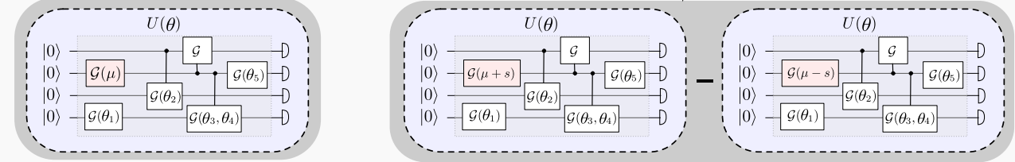
Parameter shift rule
Obtaining gradient
No intermediate quantum state required
In certain cases, r and s are fixed
Figure: Maria Schuld ······

Slide 8
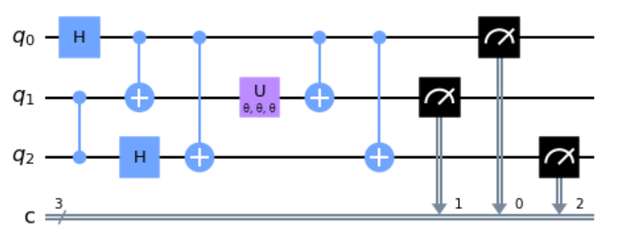
Parameter shift rule
Obtaining gradient
Oriented function:

Slide 9
Parameter shift rule
Obtaining gradient
Remember:

Slide 10
Parameter shift rule
Obtaining gradient
Remember:

Slide 11
Parameter shift rule
Obtaining gradient
Remember:

Slide 12
Parameter shift rule
Obtaining gradient
Remember:

Slide 13
Parameter shift rule
Obtaining gradient
Remember:

Slide 14
Parameter shift rule
Obtaining gradient

Slide 15
Parameter shift rule
Obtaining gradient

Slide 16
Parameter shift rule
Obtaining gradient

Slide 17
Parameter shift rule
Obtaining gradient
Wait!
V S
Finite difference rule
Macroscopic shift VS Microscopic shift
Exact result VS Approximate result

Slide 18
Organization
Definition
Gradient of a function
Gradient of a quantum circuit
Obtaining gradient
Parameter shift rule
Visualization
Use cases
Gradient decent method
Machine learning
References

Slide 19
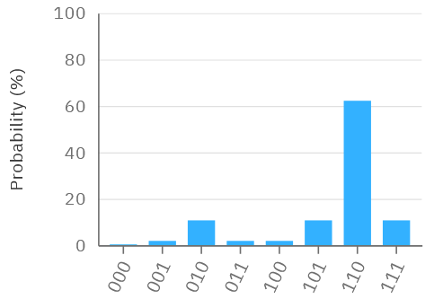
What we need no access!
Obtaining gradient
Visualization!
What we have

Slide 20
Obtaining gradient
Visualization!
Consider it as optimization problem:

Slide 21
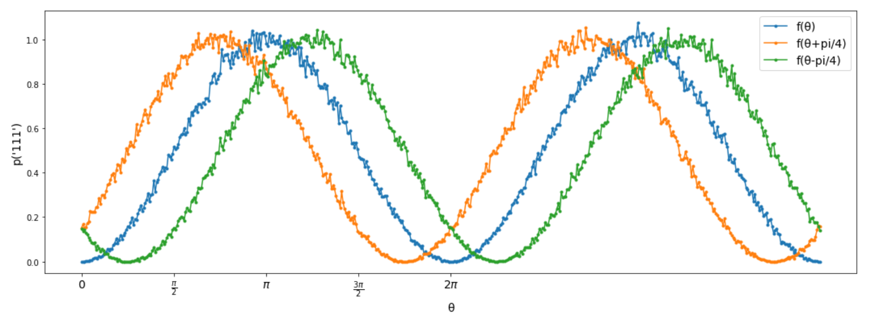
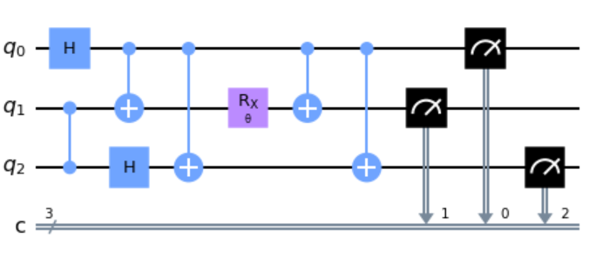
Obtaining gradient
Visualization!

Slide 22
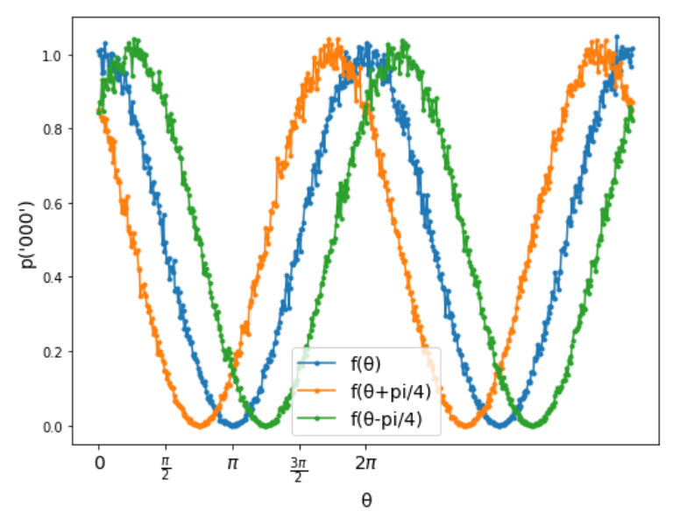
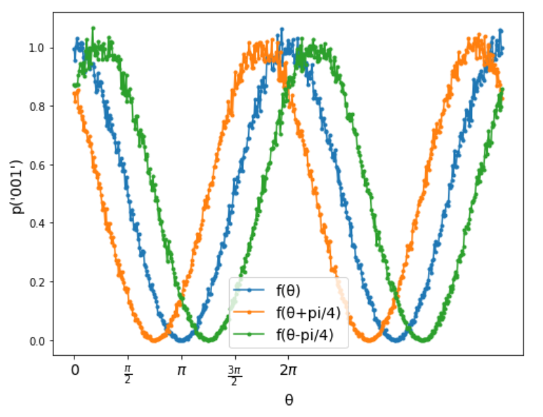
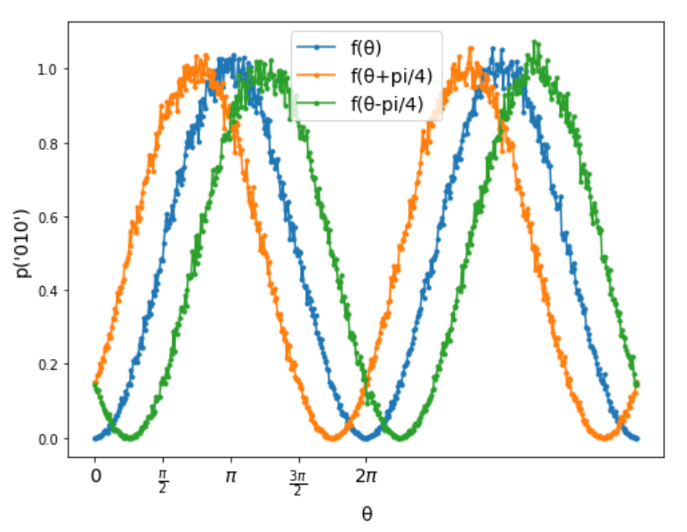
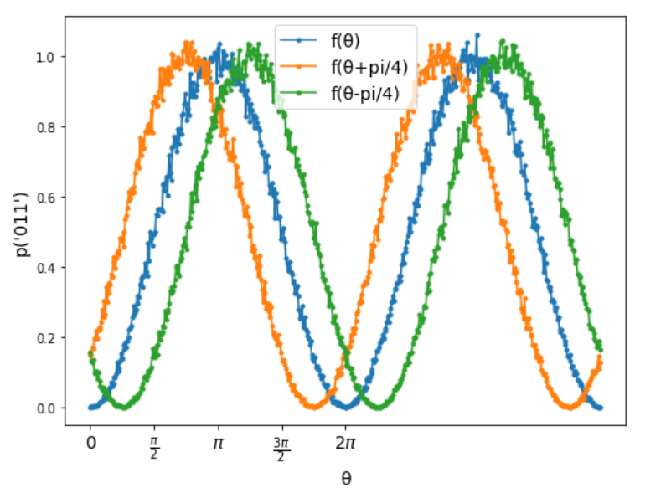
Obtaining gradient
Visualization!

Slide 23
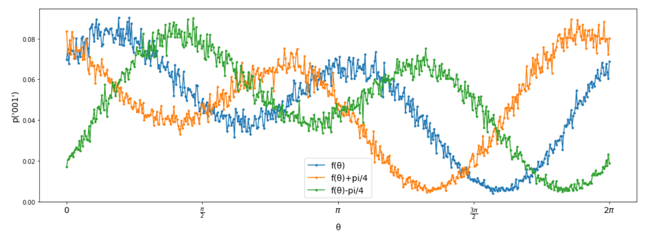
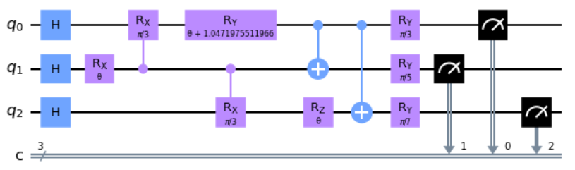
Obtaining gradient
Visualization!

Slide 24
Organization
Definition
Gradient of a function
Gradient of a quantum circuit
Obtaining gradient
Parameter shift rule
Visualization
Use cases
Gradient decent method
Machine learning
References

Slide 25
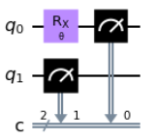
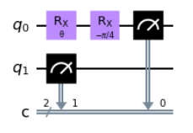
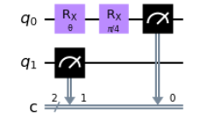
Use cases
Gradient decent method

Slide 26
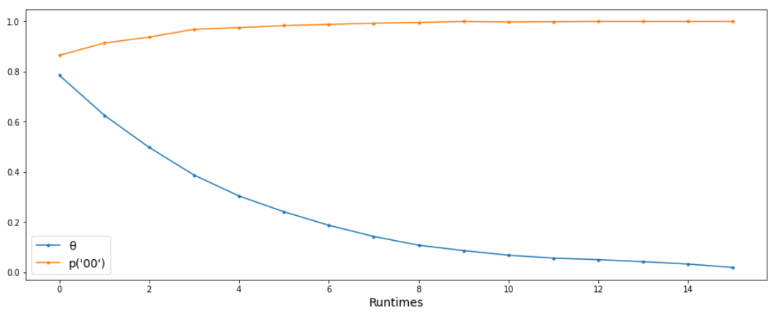
Use cases
Gradient decent method

Slide 27
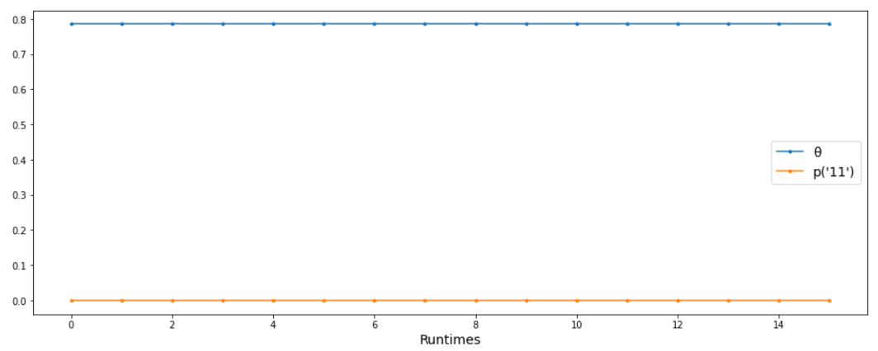
Use cases
Gradient decent method

Slide 28
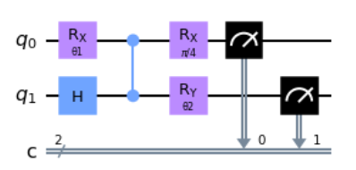
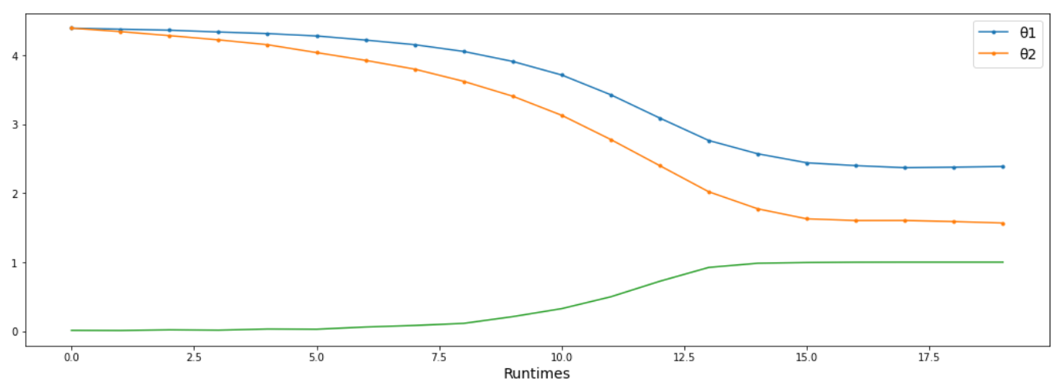
Use cases
Gradient decent method

Slide 29
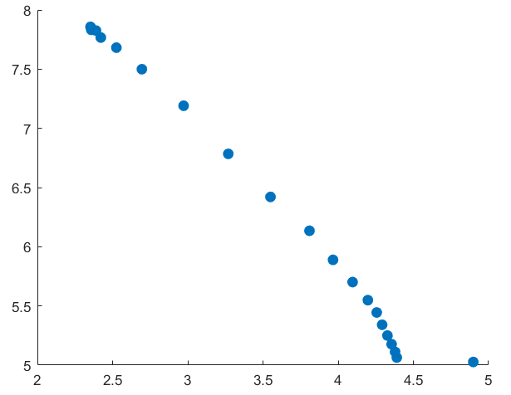
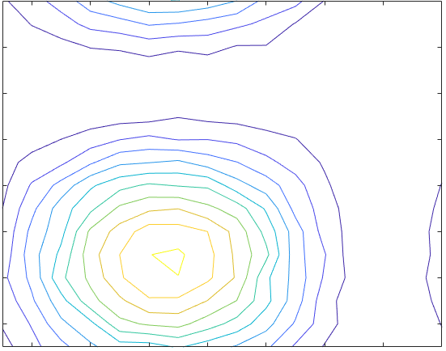
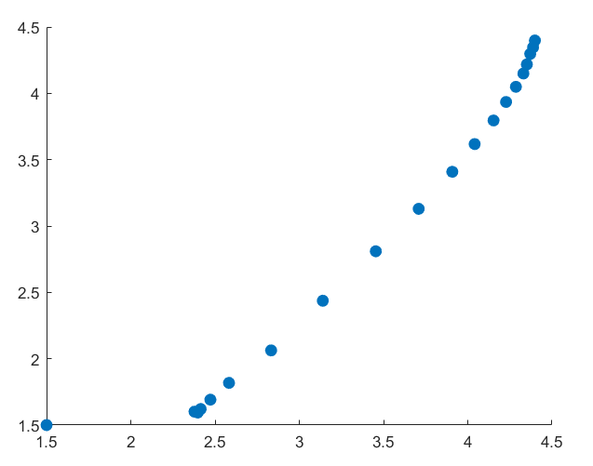
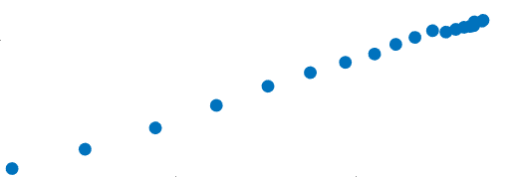
Use cases
Gradient decent method

Slide 30
Organization
Definition
Gradient of a function
Gradient of a quantum circuit
Obtaining gradient
Parameter shift rule
Visualization
Use cases
Gradient decent method
Machine learning
References

Slide 31
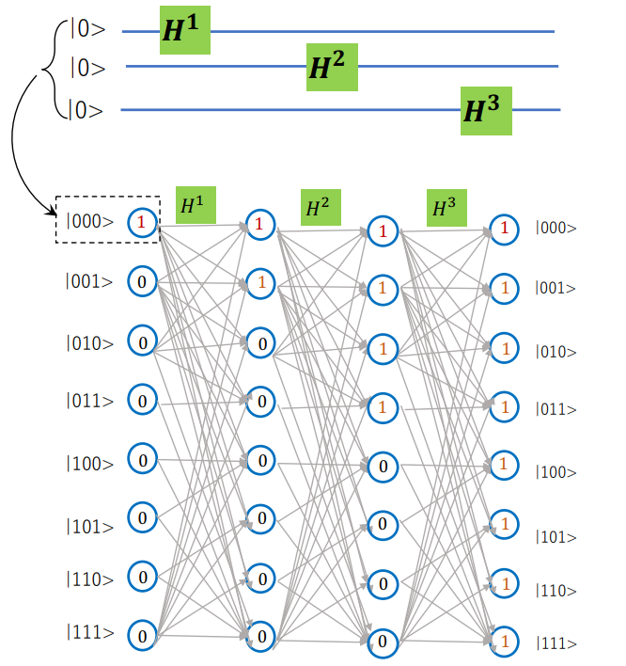
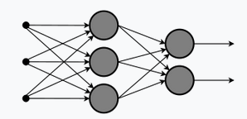
Use cases
Machine learning

Slide 32
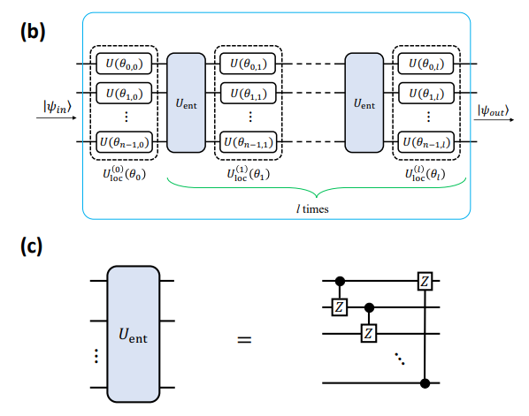
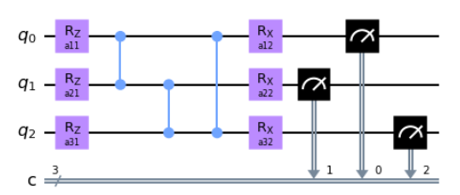
Use cases
Machine learning
Figure: Masaya Watabe ······

Slide 33
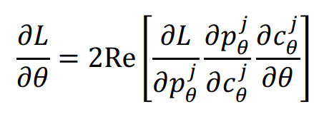
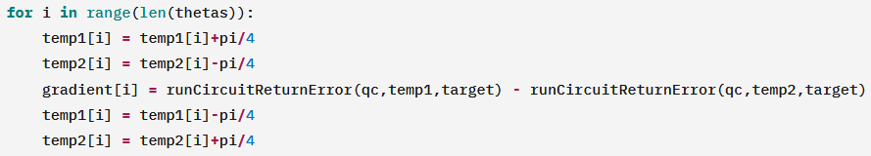
Use cases
Machine learning
Backpropagation
Parameter shift rule

Slide 34
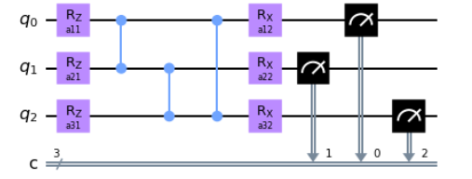
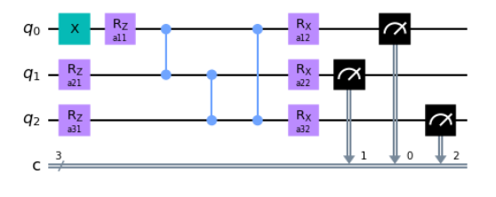
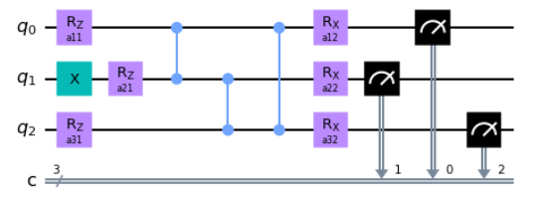
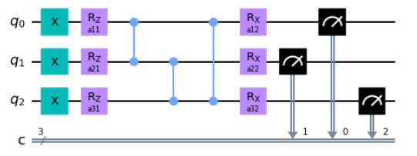
Use cases
Machine learning
…

Slide 35
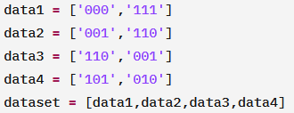
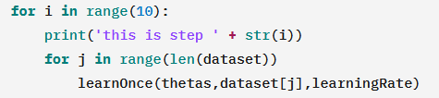
Use cases
Machine learning
Create dataset
Learn!

Slide 36
Use cases
Machine learning

Slide 37
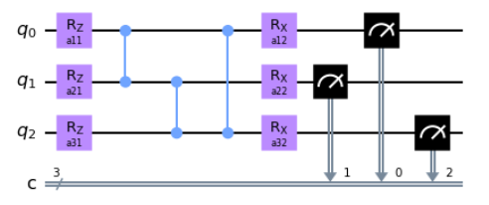
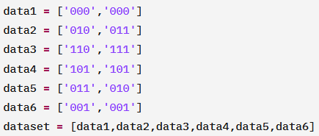
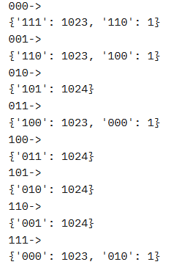
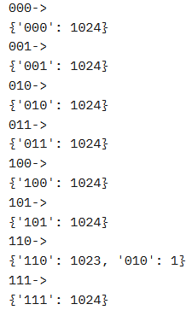
Use cases
Machine learning

Slide 38
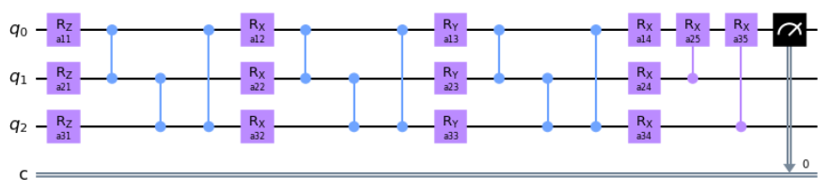
Use cases
Machine learning

Slide 39
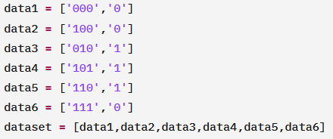
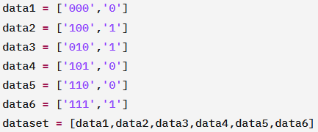
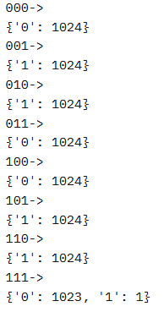
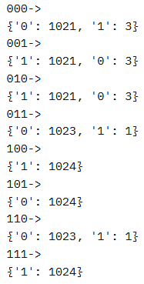
Use cases
Machine learning

Slide 40



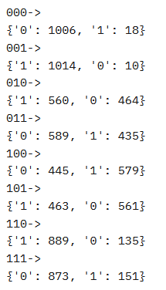
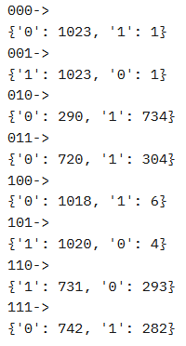
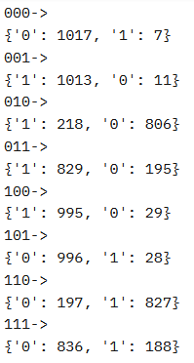
Use cases
Machine learning

Slide 41
Organization
Definition
Gradient of a function
Gradient of a quantum circuit
Obtaining gradient
Parameter shift rule
Visualization
Use cases
Gradient decent method
Machine learning
References

Slide 42
References
https://quantum-computing.ibm.com/
https://de.wikipedia.org/
Maria Schuld,∗ Ville Bergholm, Christian Gogolin, Josh Izaac, and Nathan Killoran Xanadu Inc., 372 Richmond St W, Toronto, M5V 1X6, “Evaluating analytic gradients on quantum hardware,” (2018), arxiv:1811.11184
Masaya Watabe , Kodai Shiba, Masaru Sogabe, Katsuyoshi Sakamoto, Tomah Sogabe, “Quantum Circuit Parameters Learning with Gradient Descent Using Backpropagation,” (2019), arxiv:1910.14266

