Slide 1
Compartmental Models: Deterministic & Bayesian Approaches
Wyatt Madden & Will Rogers

Slide 2
SIR
Simple mathematical model formulated model spread of a disease through a population by tracking change in compartments (Kermack and McKendrick 1927)
S: Susceptible Proportion/Size
I: Infected Proportion/Size
R: Recovered Proportion/Size

Slide 3


Slide 4
SIR
$$\frac{dS}{dt}=−βSI \frac{dI}{dt}=βSI−γI \frac{dR}{dt}=γI$$
$β$: disease transmission rate
$γ$: recovery rate (reciprocal is average recovery rate)
$S+I+R=1$ for all time points.
If $S_{0}<\frac{γ}{β}$, infections decrease monotonically
Basic Reproductive Ratio ($R_{0}$): $\frac{β}{γ}$
For more basic results, see (Bjørnstad 2018)

Slide 5
Simulating
Due to numerical instabilities common in nonlinear ordinary differential equations, often must use numerical solvers such as Euler’s method, or other Runge-Kutta methods.
In practice, many ODE solvers available

Slide 6
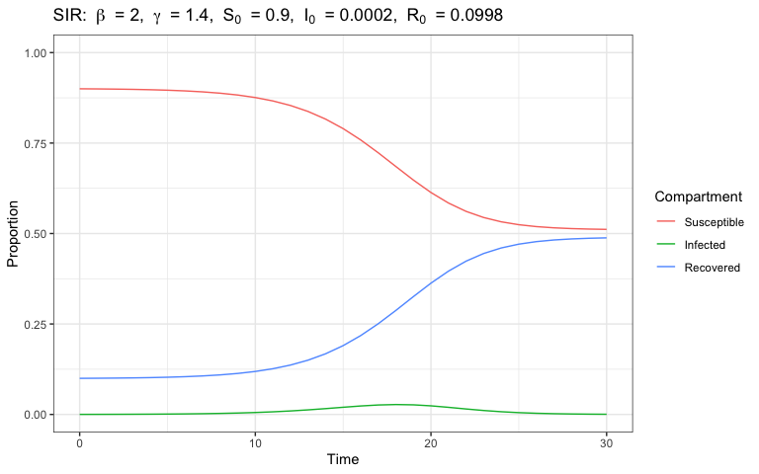
SIR Simulation - Discrete (Bjørnstad 2018)

Slide 7
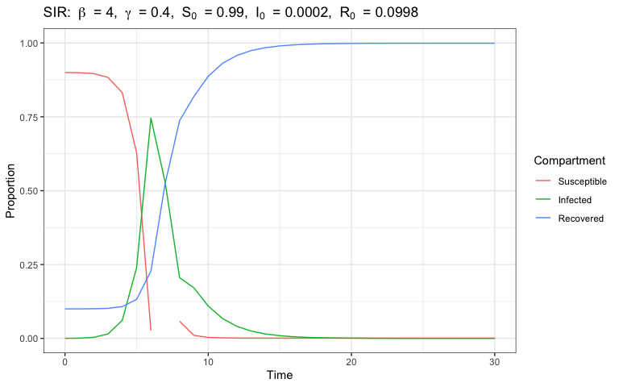
SIR Simulation - Discrete

Slide 8
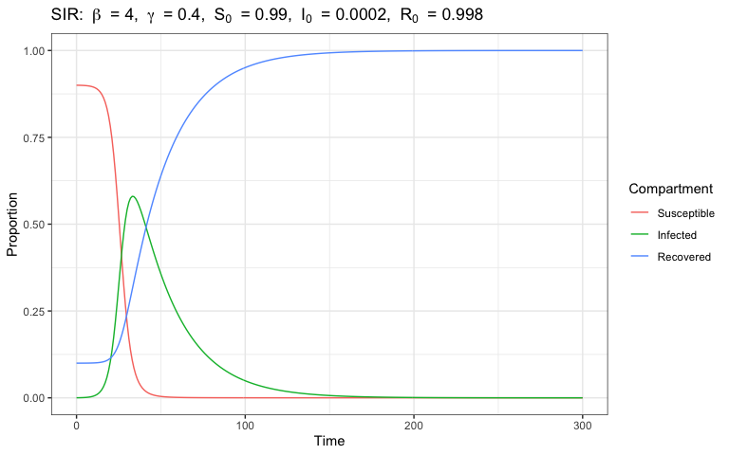
SIR Simulation - Numerical

Slide 9
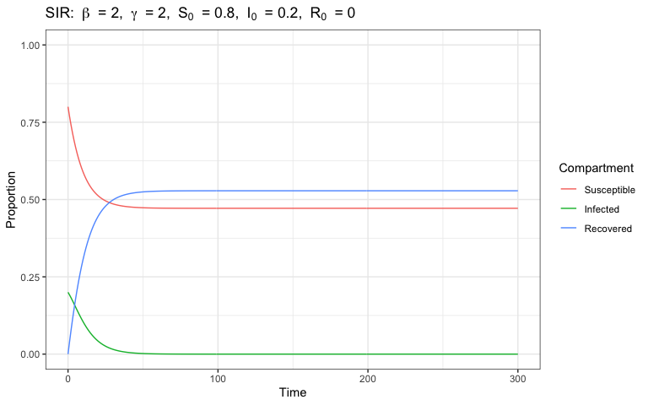
SIR Simulation - Numerical

Slide 10
SIR Variations
Variations include:
SEIR: Exposed compartment (disease onset latency)
SIRS: Temporary immunity
MSIR: Temporary maternal immunity
SILI: Latent non-infectious period (for bats)
Incorporating birth/death rates etc

Slide 11
Epidemics Vs. Seasonal spread
Often goal is predicting spread of epidemics given certain parameters
New strain of Flu
COVID-19
Can also be used to study dynamics of endemic diseases
Measles
Rabies in animal populations

Slide 12
Using Derministic SIR Models in Practice
If estimates of $β$, $γ$ or $R_{0}$ are obtained, models can be use deterministically to propogate uncertainty
There are many methods to estimating these parameters early in an epidemic, some more simple than others, especially when $S_{0}$ can be assumed high. These can provide “reasonable” trajectories.

Slide 13
Bayesian State-Space Approaches
Long tradition of frequentist methods to estimating compartamental models.
With advent of MCMC methods in the last few decades, Bayesian methods have gained more traction

Slide 14
Bayesian Statistics Review
Want to approximate posterior distribution: $p(θ|X)$
$p(θ|X)=\frac{p(X|θ)p(θ)}{p(X)}∝p(X|θ)p(θ)$
$p(X|θ)$: Likelihood
$p(θ)$: Prior, encodes a priori beliefs

Slide 15
State-Space Review (Prado and West 2010)
State-space model can be formulated with evolution and observation equations.
observation: $y_{t}∼p(y_{t}|θ_{t},ϕ)$
evolution: $θ_{t}∼p(θ_{t}|θ_{t−1},ϕ)$
State-Space SIR models typically treat compartment proportions as latent “state” parameters, with observations often being some version of case counts.

Slide 16
(Dukic, Lopes, and Polson 2012)
Use state-space SEIR model to track ILI (influenza-like-illness) from google flu trends.
${\tilde{I}}_{t}$ (observed weekly ILI) treated as noisy approximation of $I_{t}$
work with observed growth rate, $y_{t}=\frac{({\tilde{I}}_{t}−{\tilde{I}}_{1−1})}{{\tilde{I}}_{t−1}}$
observation equation: $y_{t}=g_{t}+ϵ_{t}^{y} ϵ_{t}^{y}∼N(0,σ_{y}^{2})$
evolution equation (growth rate): $g_{t}=−γ+α\frac{E_{t−1}}{I_{t−1}}+ϵ_{t}^{g} ϵ_{t}^{g}∼N(0,σ_{g}^{2})$
evolution equation (other states):
$$\left(\begin{matrix}S_{t} \\ E_{t} \\ R_{t}\end{matrix}\right)=\left(\begin{matrix}S_{t−1} \\ E_{t−1} \\ R_{t−1}\end{matrix}\right)+\left(\begin{matrix}−\frac{βS_{t−1}}{N} & 0 \\ \frac{βS_{t−1}}{N} & α \\ γ & 0\end{matrix}\right)\left(\begin{matrix}I_{t−1} \\ E_{t−1}\end{matrix}\right)$$

Slide 17
(Osthus et al. 2017)
Use Dirichlet-Beta state-space model motivated by SIR model to forecast estimate of influenza prevalence(combination of weekly CDC ILInet data with NREVSS virologic surveillance data)
observation equation: $y_{t}|θ_{t},ϕ∼Beta(λθ_{t}^{I},λ(1−θ_{t}^{I}))$
evolution equation: $θ_{t}|θ_{t−1},ϕ∼Dirichlet(κf(θ_{t−1},β,γ))$
Where $θ_{t}=(θ_{t}^{S},θ_{t}^{I},θ_{t}^{R})$, and $f(θ_{t−1},β,γ)$ is defined as previous SIR differential equations:
$$\frac{dS}{dt}=−βθ^{S}θ^{I} \frac{dI}{dt}=βθ^{S}θ^{I}−γI \frac{dR}{dt}=γθ^{I}$$

Slide 18
(Osthus et al. 2017)
posterior distribution: $p(θ_{1:t′},ϕ|y_{1:t′})∝p(ϕ)p(y_{1:t′},θ_{1:t′}|ϕ)=p(ϕ)\prod_{t=1}^{t′}{p}(y_{t}|θ_{t},ϕ)p(θ_{t}|θ_{t−1},ϕ)$
Where $ϕ=[κ,λ,θ_{0},ρ,β]$, and $ρ=\frac{γ}{β}$
Fitting of this model (in jags) is enabled with a clever introduction of latent variable $z=[PI,PT]$, and specification of informative prior

Slide 19
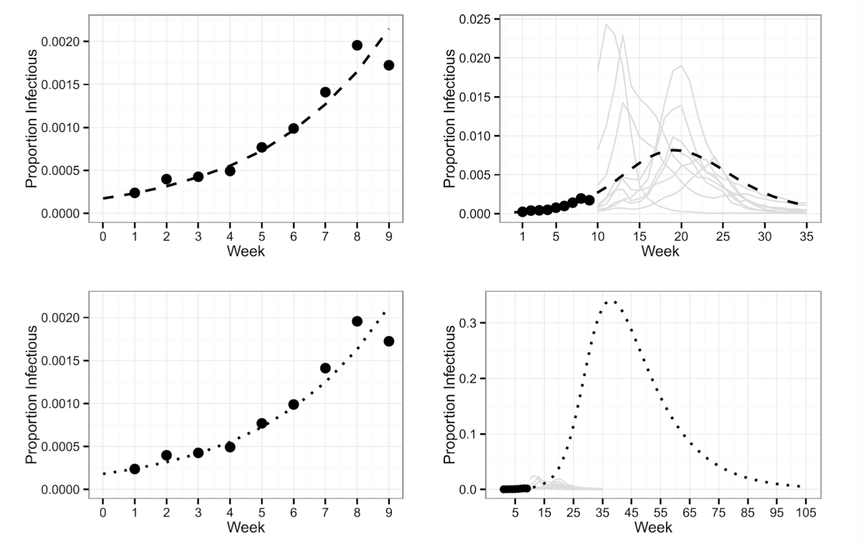
(Osthus et al. 2017)

Slide 20
Informative Priors (Osthus et al. 2017)
Decompose $p(ϕ,z)$ as follows:
$$p(κ,λ,θ_{0},z,ρ,β)=p(κ)p(λ|κ)p(θ_{0}|λ,κ)p(z|θ_{0},λ,κ)p(ρ|z,θ_{0},λ,κ)p(β|ρ,z,θ_{0},λ,κ)$$
$$=p(κ)p(λ)p(θ_{0})p(z|θ_{0})p(ρ|z,θ_{0})p(β|ρ,z,θ_{0})$$
$p(θ_{0}^{S})∼δ(θ_{0}^{S}−0.9) p(θ_{0}^{I})∼Beta(1.62, 7084.1)$ i.e. small but large enough to cause epidemic.
$$p(z|θ_{0})=p(PI,PT)∼TN(μ=(0.0144,17.9) Σ=\left(\begin{matrix}0.000036 & −0.0187 \\ −0.0187 & 16.09\end{matrix}\right),lower=(θ_{0}^{I},1),upper=(1,35))$$
$p(ρ|z,θ_{0})∼δ(ρ−g^{−1}(PI,θ_{0}^{S},θ_{0}^{I})) \text{ where } PI=g(S_{0},I_{0},ρ)=I_{0}+S_{0}−ρ[log(S_{0})+1−log(ρ)]$ i.e. $ρ$ deterministic given initial conditions and $PI$
$p(β|ρ,z,,θ_{0})$ is estimated by simulating SIR curves or a range of reasonable $PT$ values.

Slide 21
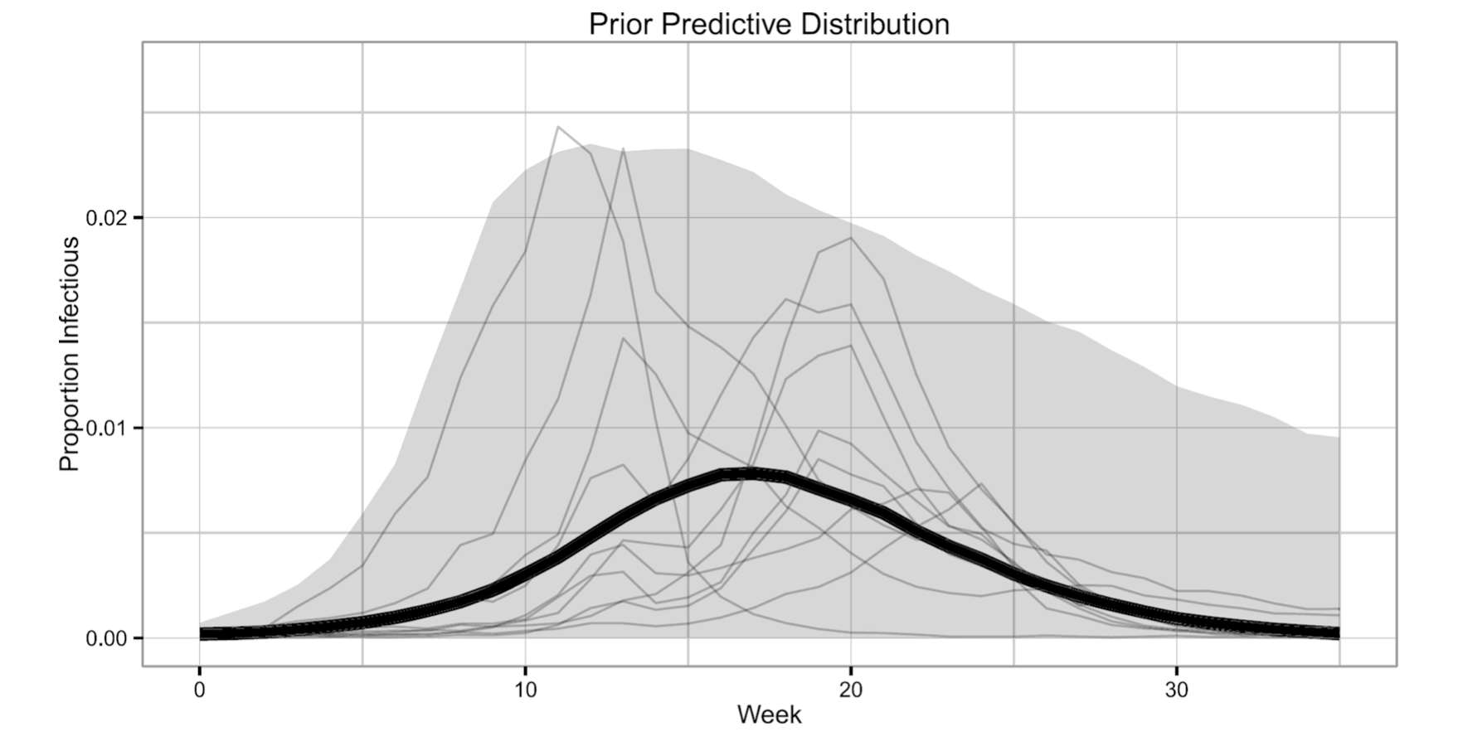
(Osthus et al. 2017)

Slide 22
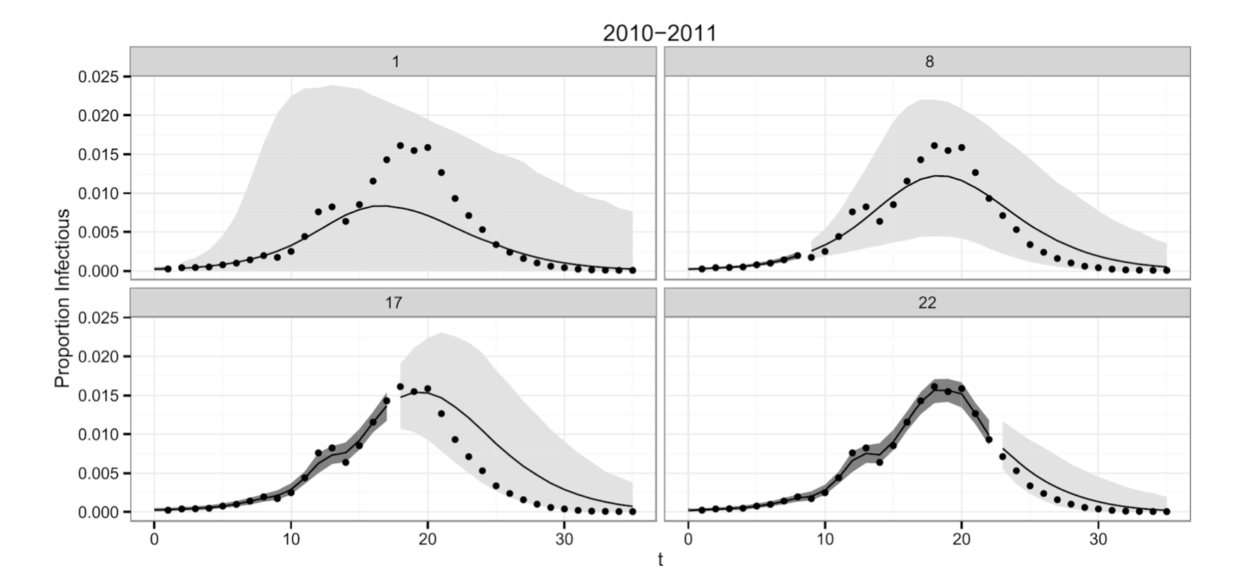
95% Credible Intervals & Prediction Intervals (Osthus et al. 2017)

Slide 23
Extending to COVID-19 (Song et al. 2020)
Song et al. extend Osthus’ state-space formulation to COVID-19 in march 2020, introducing:
SIR model with time varying transmission rate to account for government responses
SIR model with time varying quarantine rate to account for changes in enforced quarantine
SIR with time-varying subset of population immunized with antibody positivity

Slide 24
SIR model with time varying transmission rate (Song et al. 2020)
Introduce $π(t)$ tramsmission parameter to SIR model, where $π(t)∈[0,1]$, such that
$$\frac{θ_{t}^{S}}{dt}=−βπ(t)θ_{t}^{S}θ_{t}^{I} \frac{dθ_{t}^{I}}{dt}=βπ(t)θ_{t}^{S}θ_{t}^{I}−γθ_{t}^{I} \frac{dθ_{t}^{R}}{dt}=γθ_{t}^{I}$$
where,
$$π(t)=\left\{\begin{matrix}1.0 & \text{if} t≤\text{Jan 23} \\ 0.9 & \text{if} t∈\text{(Jan 23, Feb 4) city blockade} \\ 0.5 & \text{if} t∈\text{(Feb 4, Feb 8) enhanced quarantine} \\ 0.1 & \text{if} t∈\text{t > Feb 8 use of new hospitals}\end{matrix}\right.$$

Slide 25
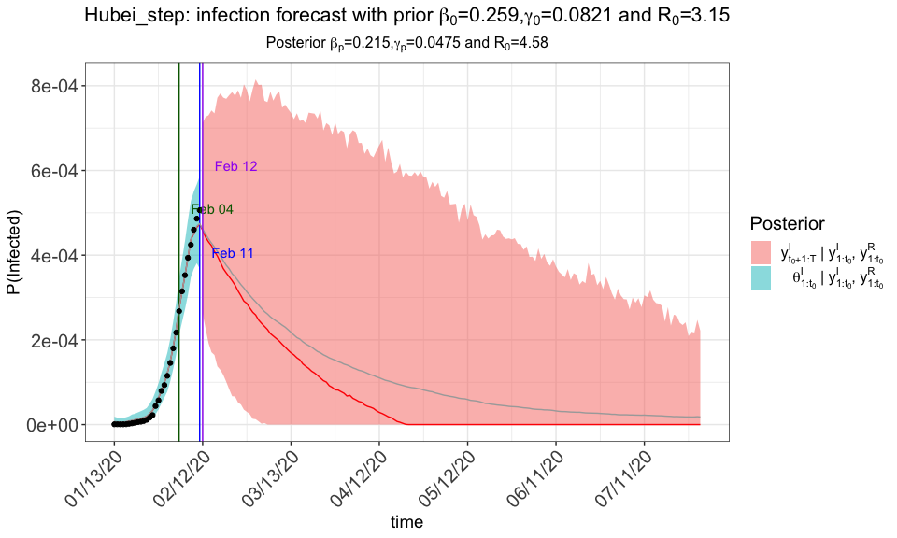
SIR model with time varying transmission rate (Song et al. 2020)

Slide 26
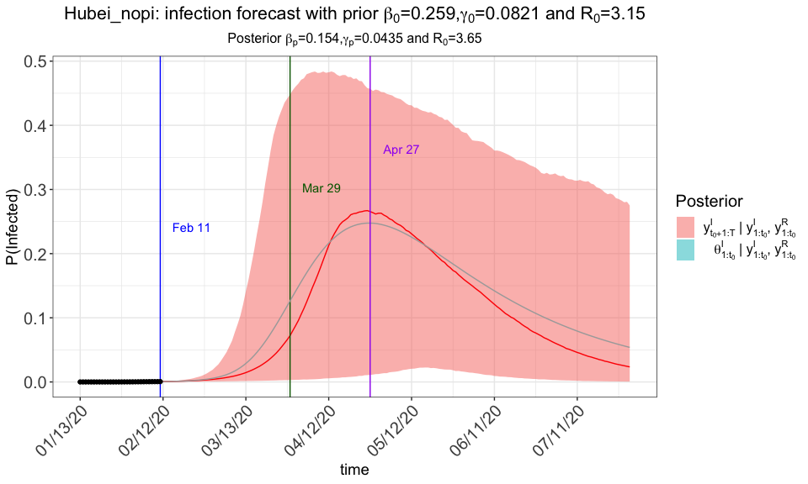
Without Intevention (Song et al. 2020)

Slide 27
SQIR model with time varying quarantine rate (Song et al. 2020)
Again, introduce $π(t)$ tramsmission parameter to SIR model, where $π(t)∈[0,1]$, but also introduce new Q compartment
$$\frac{θ_{t}^{S}}{dt}=−βπ(t)θ_{t}^{S}θ_{t}^{I}−ϕ(t)\frac{θ_{t}^{Q}}{dt}=π(t)θ_{t}^{S} θ_{t}^{S} \frac{dθ_{t}^{I}}{dt}=βπ(t)θ_{t}^{S}θ_{t}^{I}−γθ_{t}^{I} \frac{dθ_{t}^{R}}{dt}=γθ_{t}^{I}$$
where,
$$π(t)=\left\{\begin{matrix}0.1 & \text{if} t=\text{Jan 23 city blockade} \\ 0.4 & \text{if} t=\text{Feb 4 enhanced quarantine} \\ 0.4 & \text{if} t=\text{Feb 8 use of new hospitals} \\ 0 & \text{else},\end{matrix}\right.$$

Slide 28
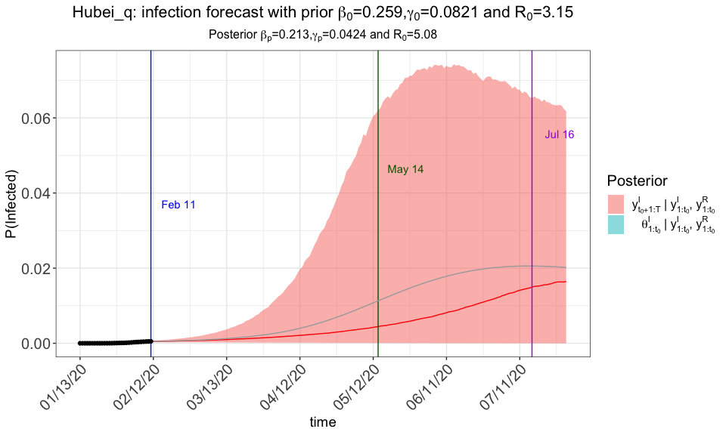
SAIR model with time varying quarantine rate (Song et al. 2020)

Slide 29
SIR with time-varying subset of population immunized with antibody positivity (Song et al. 2020)
Introduce $α$ “unreported infection” parameter to account for those who develop antibodies (either due to self-care following infection or asymptomatic cases) to SIR model, where $α∈[0,1]$, as well as new A compartment. Here we assume $20\%$ of cases go unreported.
$$\frac{θ_{t}^{S}}{dt}=−αθ_{t}^{S}θ_{t}^{I}−βθ_{t}^{S}θ_{t}^{I} \frac{θ_{t}^{A}}{dt}=αθ_{t}^{S}θ_{t}^{I} \frac{dθ_{t}^{I}}{dt}=βθ_{t}^{S}θ_{t}^{I}−γθ_{t}^{I} \frac{dθ_{t}^{R}}{dt}=γθ_{t}^{I}$$

Slide 30
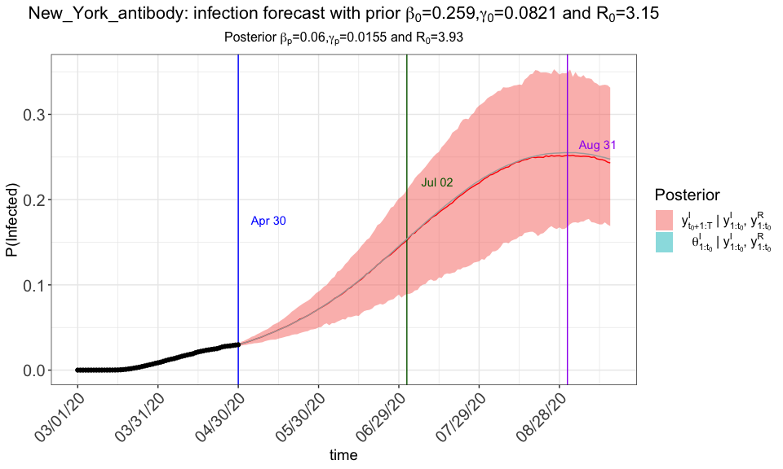
SIR with time-varying subset of population immunized with antibody positivity (Song et al. 2020)

Slide 31
References
Bjørnstad, Ottar N. 2018. “Epidemics.” Models and Data Using R: Springer International Publishing, 318.
Dukic, Vanja, Hedibert F Lopes, and Nicholas G Polson. 2012. “Tracking Epidemics with Google Flu Trends Data and a State-Space Seir Model.” Journal of the American Statistical Association 107 (500): 1410–26.
Kermack, William Ogilvy, and Anderson G McKendrick. 1927. “A Contribution to the Mathematical Theory of Epidemics.” Proceedings of the Royal Society of London. Series A, Containing Papers of a Mathematical and Physical Character 115 (772): 700–721.
Osthus, Dave, Kyle S Hickmann, Petruţa C Caragea, Dave Higdon, and Sara Y Del Valle. 2017. “Forecasting Seasonal Influenza with a State-Space Sir Model.” The Annals of Applied Statistics 11 (1): 202.
Prado, Raquel, and Mike West. 2010. Time Series: Modeling, Computation, and Inference. CRC Press.
Song, Peter X, Lili Wang, Yiwang Zhou, Jie He, Bin Zhu, Fei Wang, Lu Tang, and Marisa Eisenberg. 2020. “An Epidemiological Forecast Model and Software Assessing Interventions on Covid-19 Epidemic in China.” MedRxiv.

