Slide 1

Abaqus/CAE File
*.cae
Model
Part Level
Assembly Level
Part
Property
Assembly
Step
Interaction
Load
Mesh
Job
Visualization
Part
Material
Section
Section Assignment
Instance
Step
Field Output
History Output
Contact
Constraint
Tie
Rigid Body
Coupling
Embedded Region
…
Connector
Load
Boundary Condition
Predefined Field
Input File
*.inp
Solver
Output File
*.odb
Abaqus/Standard
Abaqus/Explicit

Slide 2
Abaqus/CAE File
*.cae
HyperMesh File
*.hm
Model
Contain only one model for each *.hw
Compute Console
HyperMesh
HyperView
HyperGraph
Part Level
Assembly Level
Part
Property
Assembly
Step
Interaction
Load
Mesh
Job
Visualization
Part
Material
Section
Section Assignment
Instance
Step
Field Output
History Output
Contact
Constraint
Tie
Rigid Body
Coupling
Embedded Region
…
Connector
Load
Boundary Condition
Predefined Field
Load Collector
Load (PLOAD4, FORCE, MOMENT, …)
Component
Part
Part Assembly
Load Collector
Property
Load Steps/SUBCASE
Constraint (SPC, …)
Cards/OUTPUT
Connector
Rigid Body Mesh
RBE2, RBE3, MPC
Attachment
…
Input File
*.inp
Output File
*.odb
PBEAM
Solver
*.fem
Abaqus/Standard
Abaqus/Explicit
Optistruct
Radioss
*.h3d

Slide 3
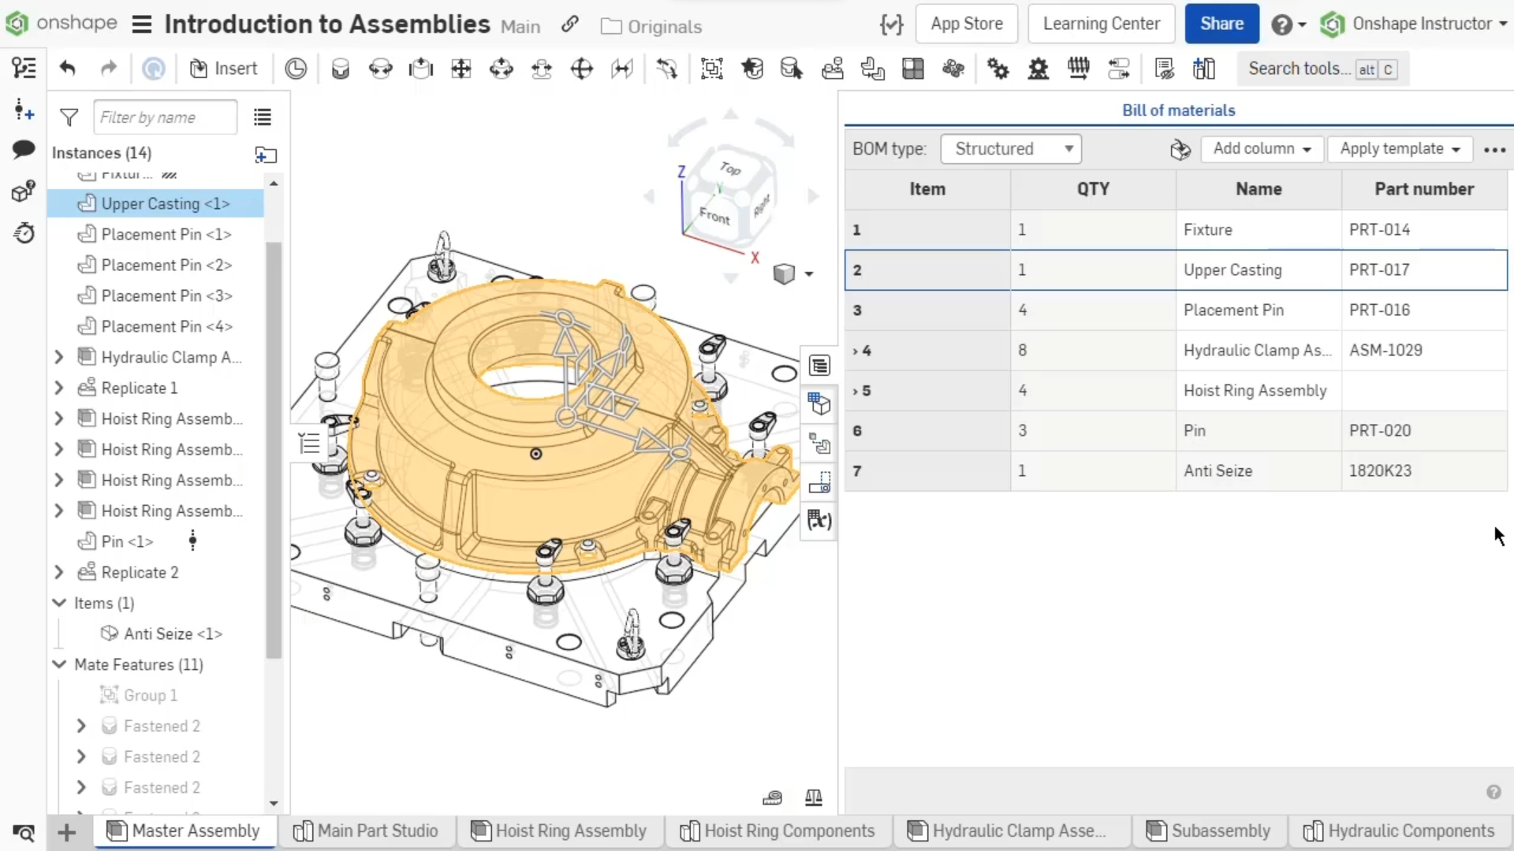

Slide 4
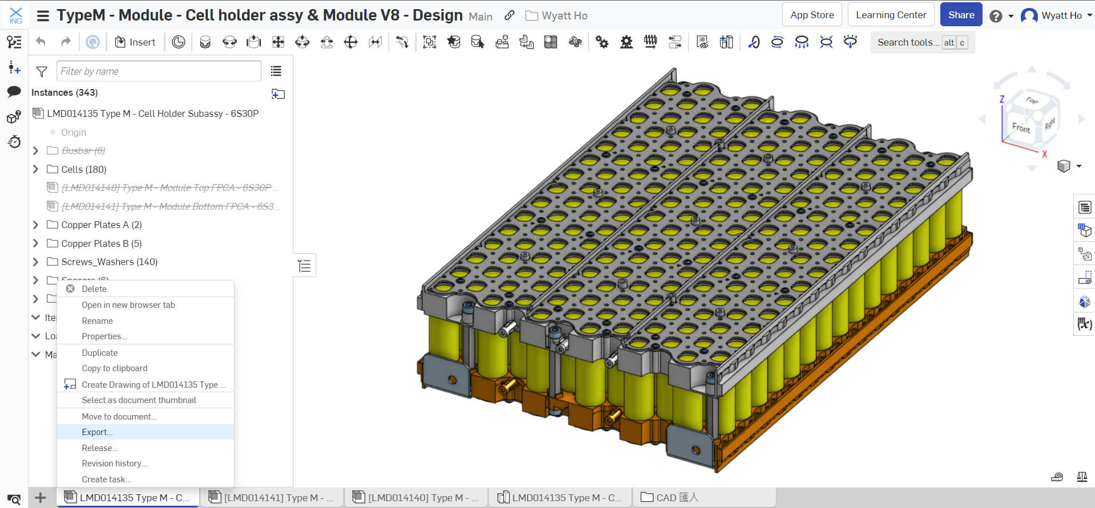
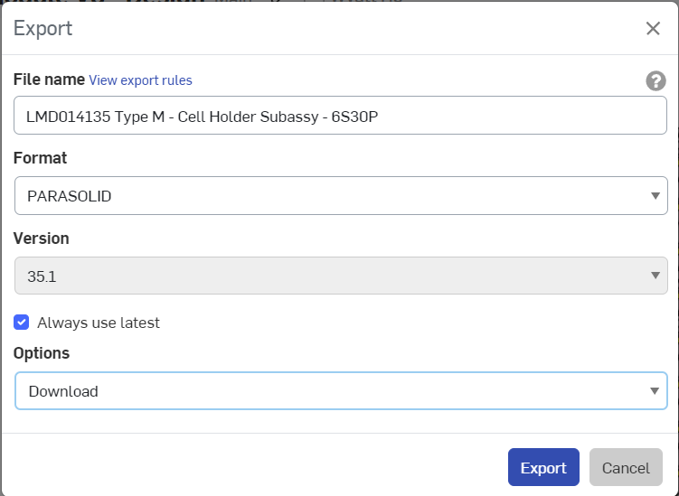
2
3
1

Slide 5
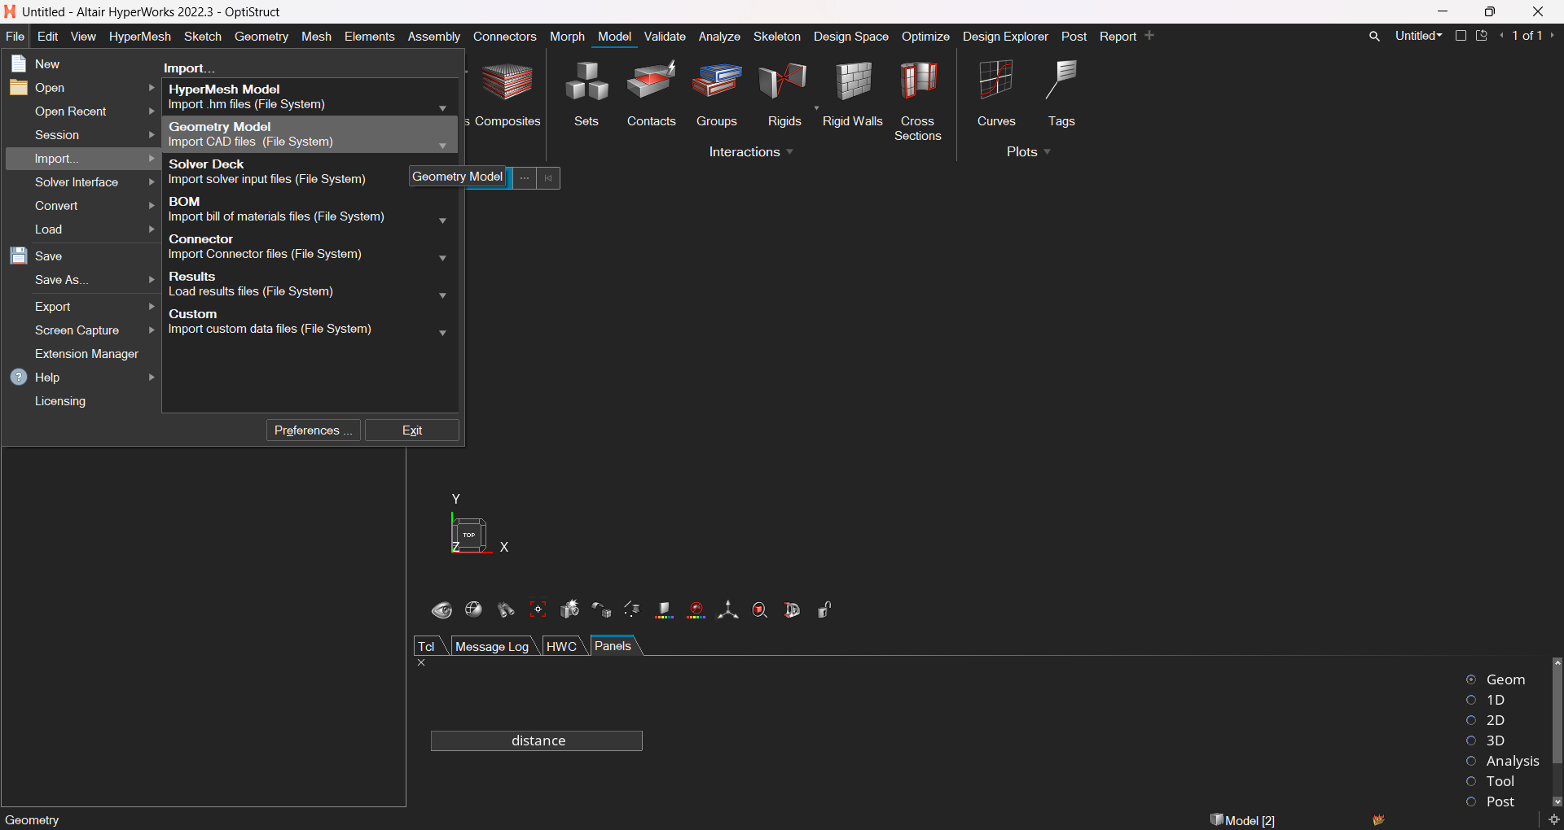
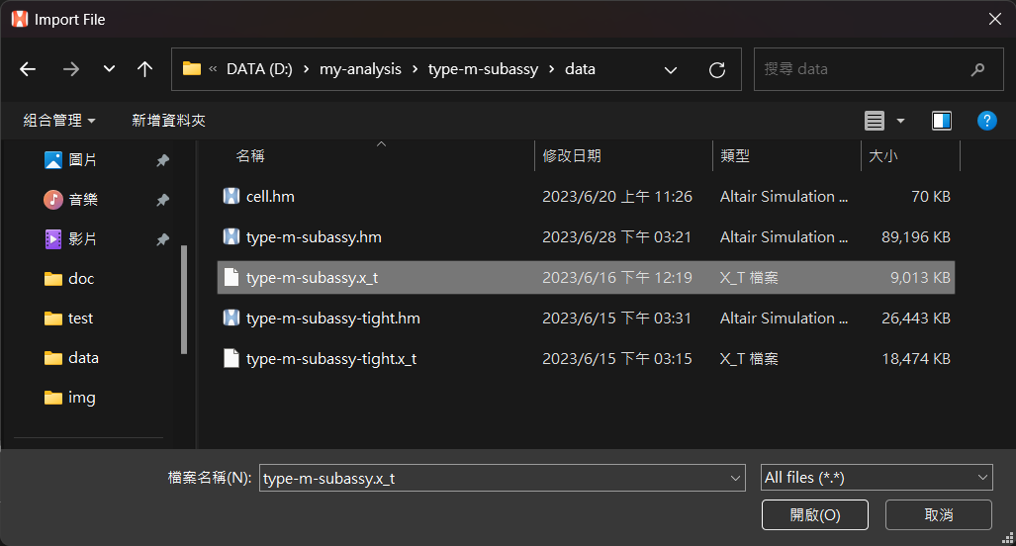
4
5

Slide 6
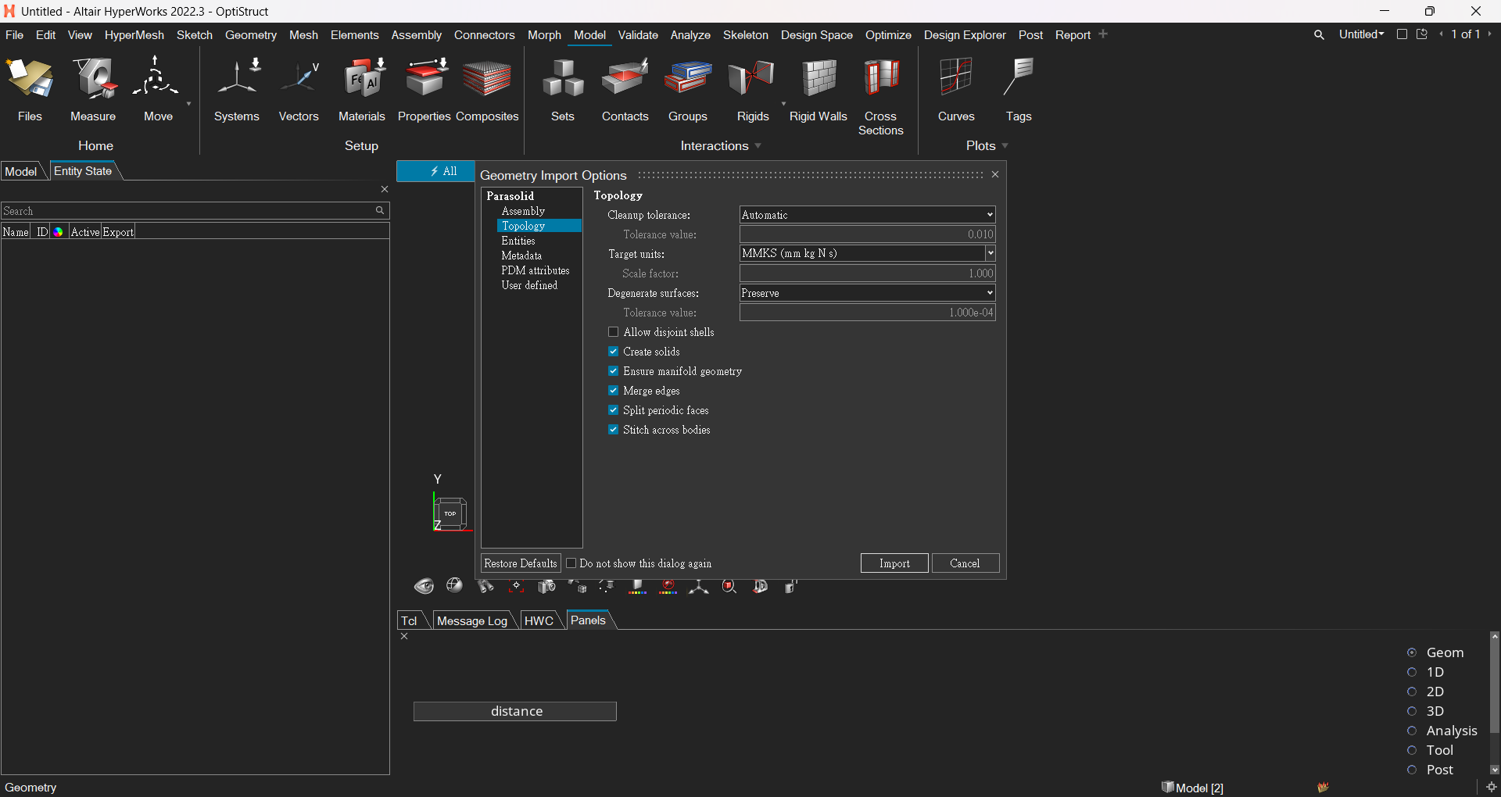
6
7

Slide 7
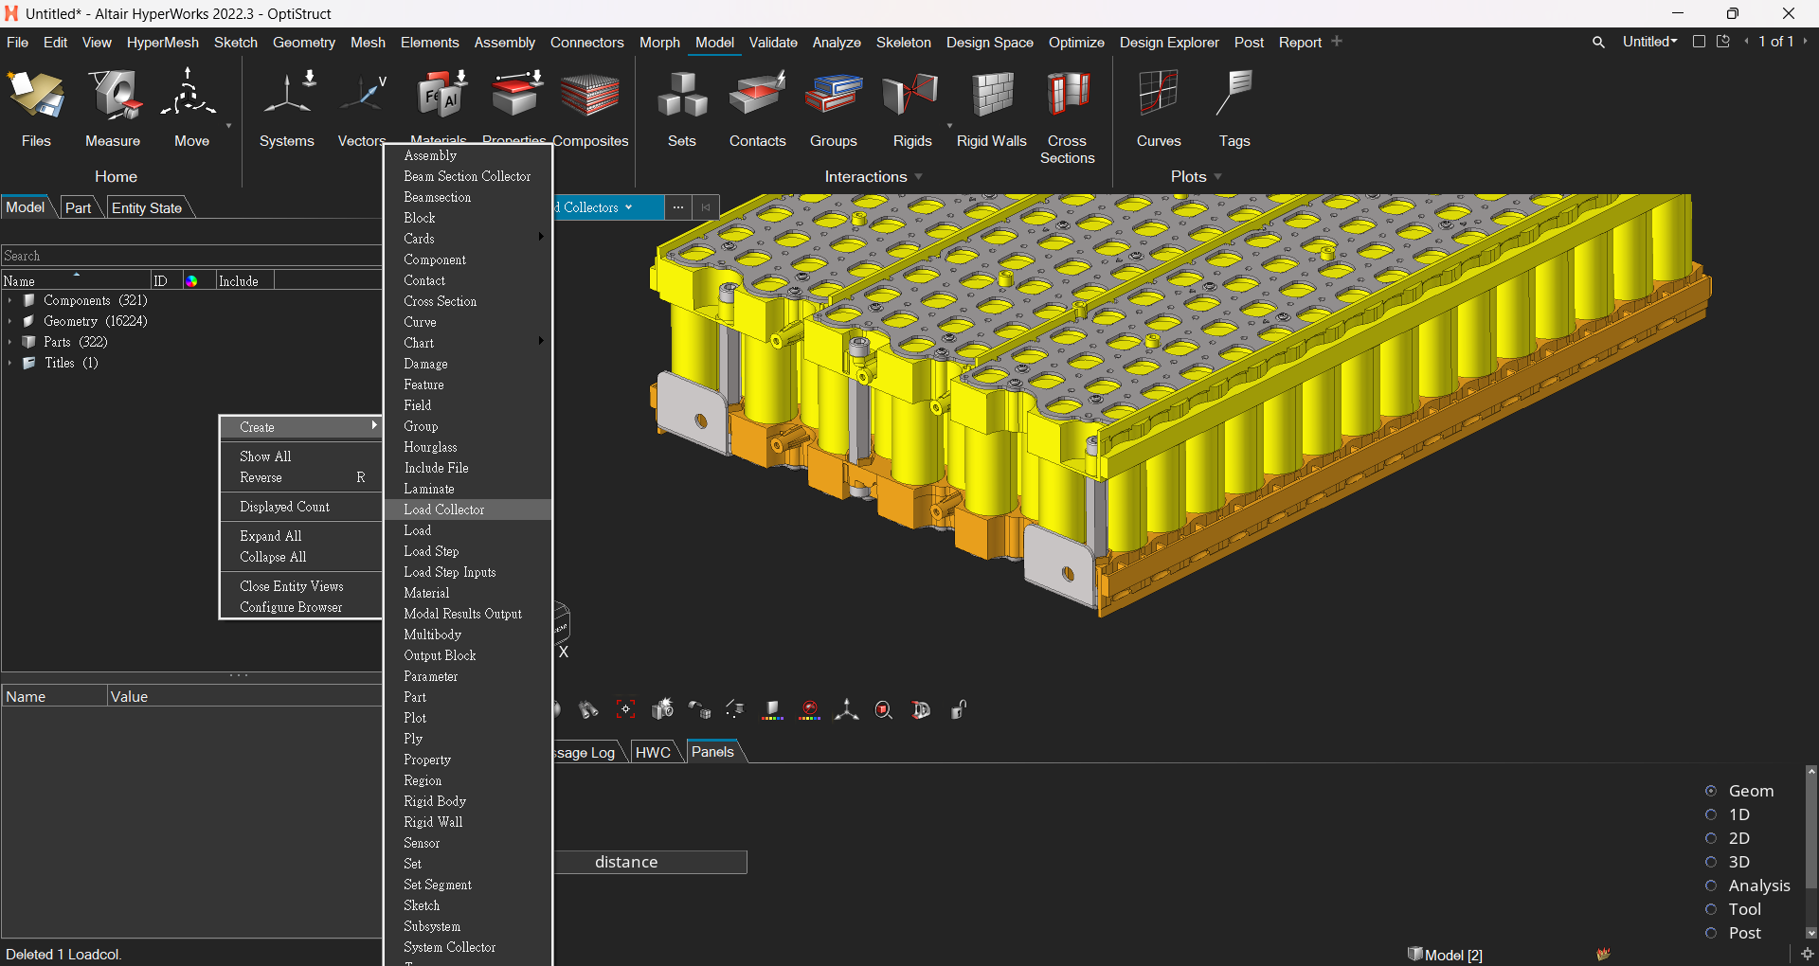
1

Slide 8
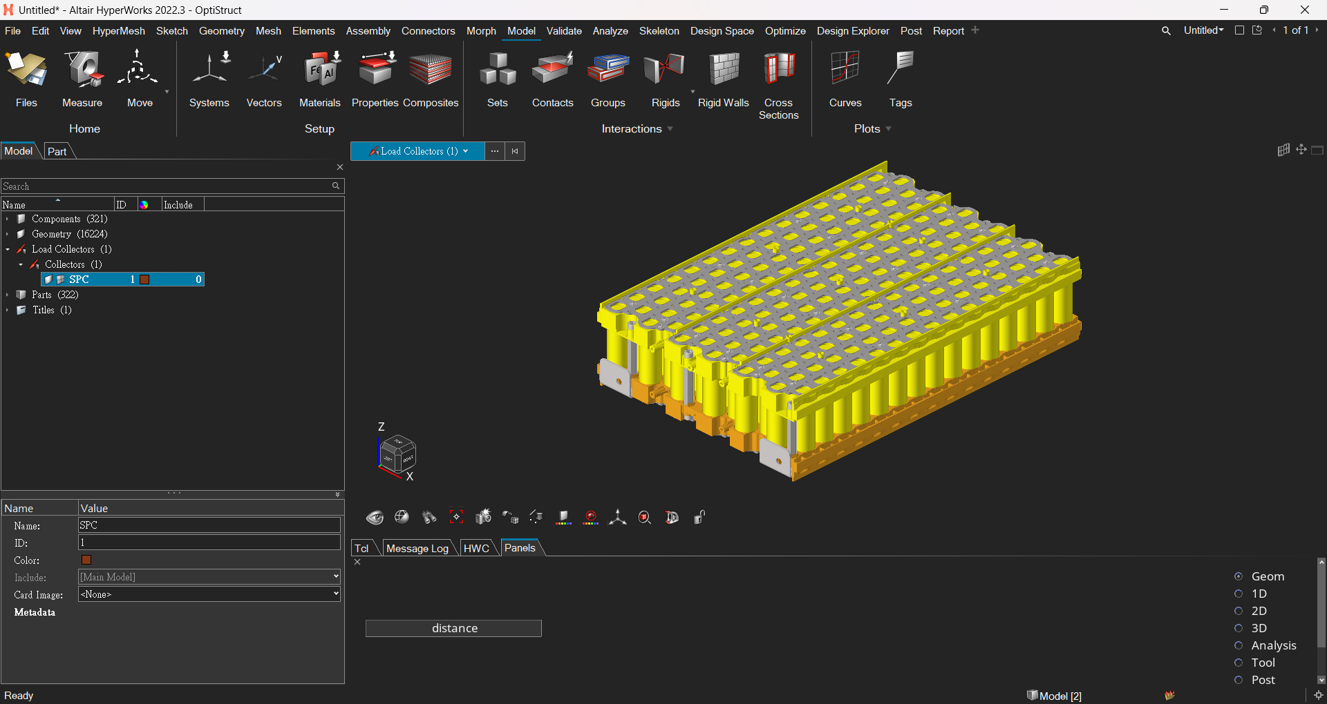
2

Slide 9
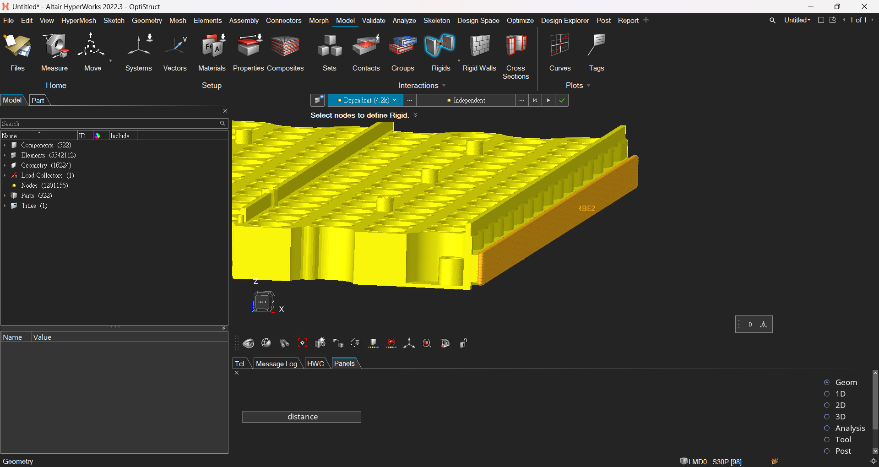
3

Slide 10
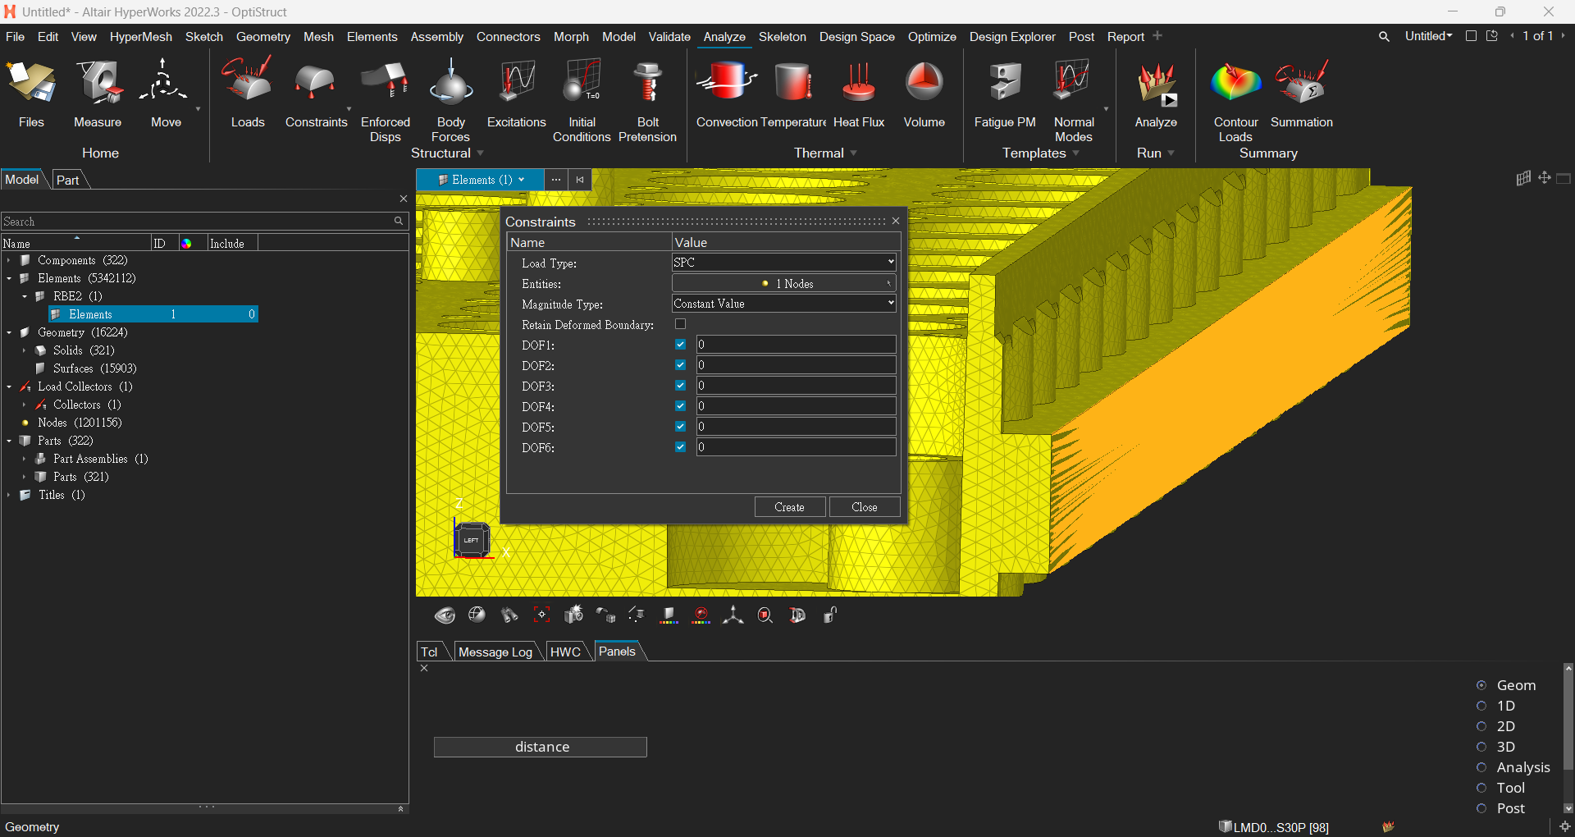
4
The independent node of the RBE2

