Slide 1
Group 1 Final Presentation
Balance
Devs: Wyatt Morgan, Owen Graham, Corey Unruh
Client: Dr. Voss
Notes:
Wyatt initiates, all introduce selves

Slide 2

Project Outline
Our project goal is to create an automated and AI assisted month-end close system. Things like Quickbooks online currently have a large following in the accounting and banking industry, but are very repetitive and inconvenient for things like month-end closing. We want to fix that issue where we can with and for our client, Dr. Voss.
Notes:
Wyatt

Slide 3
Introduction
Bookkeeping
  A financial diary - entries skipped means audit failure
Business reliance
  No books means blind work
  Repetitive work in small areas (payroll, sales, etc.) can lead to human error
  Accumulated errors = incorrect statements, tax return info, etc.
Despite having safeguards and duty segregations in place, CPA firms can and do experience audit failures
As a result…
  Significant financial loss
  Fines
  Federal/legal action if severe enough
Notes:
Wyatt

Slide 4

Problem Statement
Streamlined software (QuickBooks Online) makes bookkeeping easy
  But at a cost
  Repetitive
  Time-Consuming
  Manual Process
Lack of efficiency
Very little automation
Overall negative effects
  Increased risk of human error, snowball of errors
  Delays in reporting/reconciliation
  Time constraints are not met
  Overall failure of audits, incorrect tax data, loss of finances
Notes:
Wyatt

Slide 5
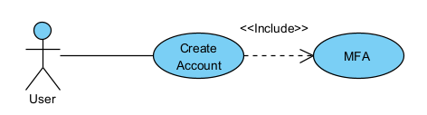
Use Cases 1/9
1. Account Creation
Goal: Creating an Account
Success Scenario Steps:
  On system startup, login prompt appears
  User clicks create account button on prompt
  User enters desired username and password
  User sets up Multi-Factor Authentication
  User confirms entered credentials and clicks create account button
  System creates the account
Notes:
Wyatt

Slide 6
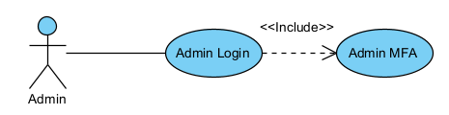
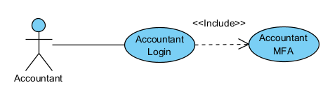
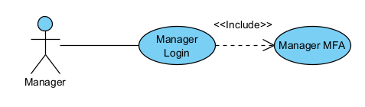
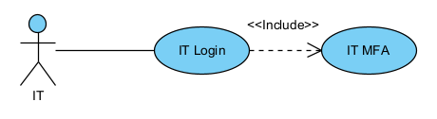
Use Cases 2/9
2. User Login
Goal: Log In
Success Scenario Steps:
  On system startup, login prompt appears
  After account creation, user is sent back to login prompt
  User enters login information and clicks login button
  User enter Multi-Factor Authentication credentials
  System confirms credentials and logs user in
Exceptions:
  System confirms credentials and sends error: No matching user account
  System confirms credentials and sends error: Incorrect credentials
Notes:
Wyatt

Slide 7
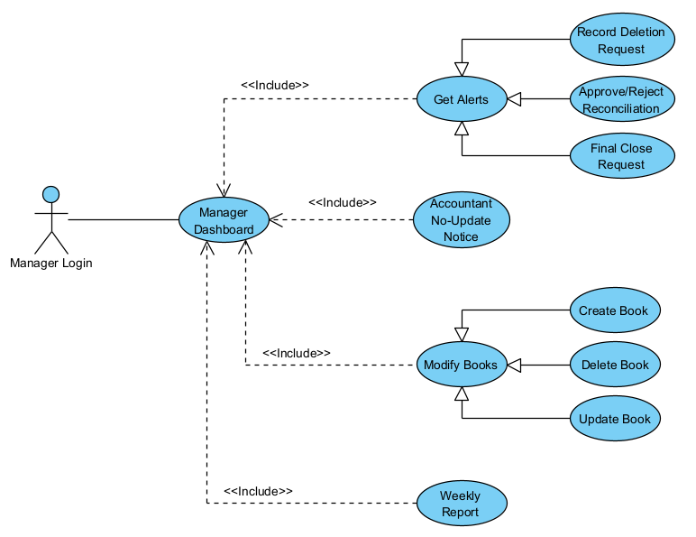
Use Cases 3/9
3. Manager Permissions
Goal: Give Manager accounts proper Managerial permissions
Success Scenario Steps:
  After logging in, Manager is sent to Managerial dashboard
  At the dashboard, Manager will:
    See alerts for record deletion requests and final month-end close confirmation request for all current assigned bookkeeping projects
    Get weekly report about updates to all current assigned bookkeeping projects
    Receive ability to create, delete, and update all current assigned bookkeeping projects
    See updates for accountants that have not updated books in two-day periods from assignments
    Get notifications to review and approve reconciliations prepared by accountants
Notes:
Owen

Slide 8
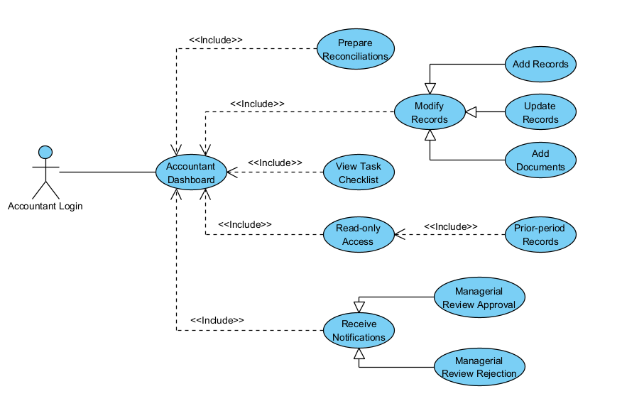
Use Cases 4/9
4. Accountant Permissions
Goal: Give Accountant accounts proper Account permissions
Success Scenario Steps:
  After logging in, Accountant is sent to Accountants dashboard
  At the dashboard, Accountant will:
    Be able to add and update records in assigned bookkeeping projects
    Have the ability to add supporting documents to assigned bookkeeping projects
    Be able to view given task lists for assigned bookkeeping projects
    Get the ability to prepare reconciliations
    Receive notifications for review approval or rejection status from managers
    Get read-only access to prior-period records for reference
Notes:
Owen

Slide 9
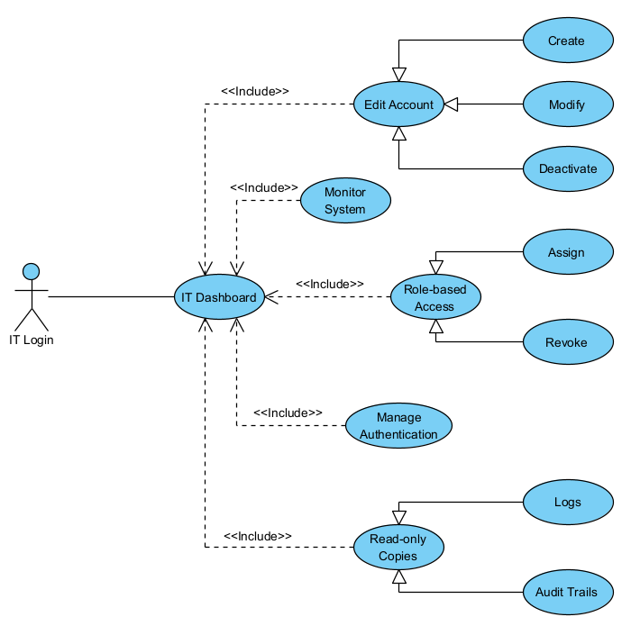
Use Cases 5/9
5. IT Permissions
Goal: Give IT accounts proper IT permissions
Success Scenario Steps:
  After logging in, IT is sent to IT dashboard
  At the dashboard, IT will:
    Have the ability to create, modify and deactivate accounts that don't have the admin role
    Be able to assign or revoke role-based access classes
    Have the ability to manage authentication methods for users
    Get the ability to see read-only copies of logs and audit trails
    Have permissions to monitor system well-being(troubleshooting, errors, integrated software/systems)
Notes:
Owen

Slide 10
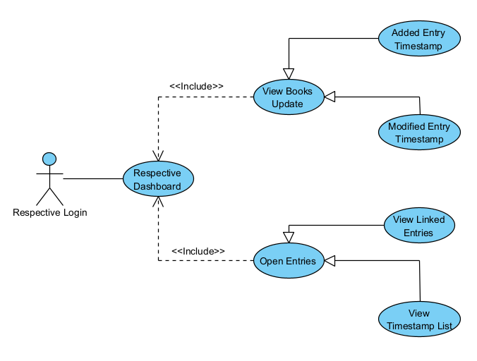
Use Cases 6/9
6. Audit Trail
Goal: Allow respective users to see the audit trail for all transactions
Success Scenario Steps:
  After logging in, the user is sent to their respective dashboard
  At the dashboard, the user will:
    View timestamps for when a transaction is added to the books
    View generated timestamps for when a transaction in the books is modified
    Be able to open transactions to view their context
    Click links to connected entries in opened transactions
    View all timestamps for the transaction as a list inside the opened entry
Notes:
Owen

Slide 11
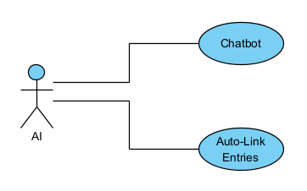
Use Cases 7/9
7. AI Integration
Goal: Add AI to the system
Success Scenario Steps:
  After logging in, the user is sent to their respective dashboard
  At dashboard, the user will be able to:
    Use a chatbot AI assistant that works like an on-screen assistant for month-end close operations
    View automatically-audited transaction links done by the built-in system AI
Notes:
Owen

Slide 12
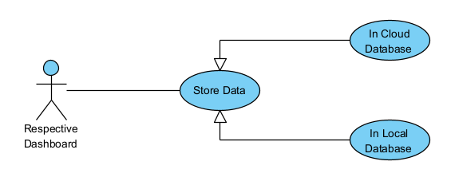
Use Cases 8/9
8. Data Management
Goal: Manage data as efficiently and logical as possible.
Success Steps:
  After logging in, the user will be sent to their respective dashboard
  To manage data, the user will have the following options:
    Store information within a database (cloud-based)
    Larger enterprises may need to use local storage for faster data access
    Receipt scanning could be done using mobile features
Notes:
Owen

Slide 13
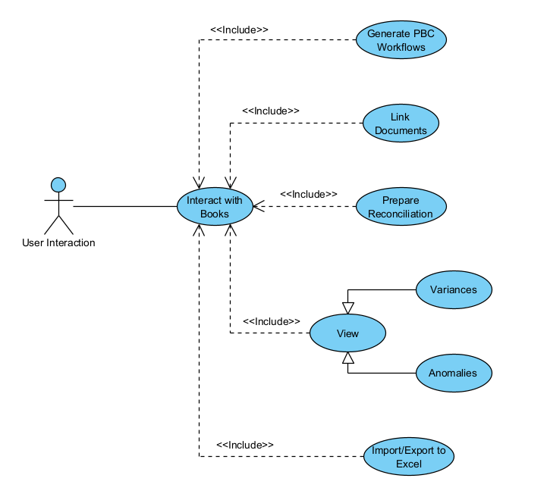
Use Cases 9/9
9. Bookkeeping Features
  Goal: Successfully prepare and generate records for bookkeeping and audit trails.
  Success Steps:
    After logging in, the user will be sent to their respective dashboard
    The user will generate data for audits based on the following options:
      Auto-prepare bank reconciliation as the final product
      Generate journal entries along with documents to support the entries
      Show and highlight variances and anomalies to show any conflicting information
      Generate Prepared By Client workflows for client interaction
      Excel integration for exports and reporting
      Supported input formats include .csv, .txt, and more common file types
      Bank statements are included in audit trails
Notes:
Owen

Slide 14
Functional Requirements
Structure
Businesses and Organizations can create simulations of their structures
Authentication & Security
Account based logins with multi-factor authentication
Audit Trail Managements
Information and receipts for the what, where, and why transactions are happening
AI Integration
An open source AI to help with things like auto auditing transaction links
Data Management
Cloud/Local storing of information that is cleanly organized and filtered
Bookkeeping Features
Integrated Excel, QBO, and Xero with month-end close features
Notes:
Corey
The system MUST allow businesses and organizations to build a simulation of how their company is structured.
NOTE: Organizations/Businesses, Departments, Teams, Employees, Roles, etc.
The system MUST have an account-based login system.
The system MUST have different logins for different account types.
The system MUST have Two-factor authentication (options: location-based, authenticator apps, etc.).
The system MUST have IT/admin-level access for installs and troubleshooting.
The system MUST log who or what added or modified a transaction.
The system MUST log timestamps for when a transaction is added to the books.
The system MUST log timestamps for when a transaction in the books is modified.
The system MUST allow transactions to be opened to view their context.
The system MUST have links to connected entries in opened transactions.
The system MUST store all timestamps for the transaction as a list inside the opened entry.
The system MUST have links to connected documents and explain where the transaction is mentioned in opened transactions.
NOTE: Documents can be Bank Statements, Journal Entries, etc.
The system MAY have a chatbot AI assistant that works like an on-screen assistant for month-end close operations.
If there is an AI, the AI MUST be open source so we don't have to worry about API calls and it can be run locally.
The system MAY have a built-in system AI that will go through and automatically audit transaction links.
The system MUST filter the database so only that business or organization can access their data from it.
The system MUST store information securely within a database.
The system MUST prefer cloud database storage.
The system SHOULD have local database storage for large enterprises.
The system MAY have mobile features for receipt scanning.
NOTE: Filter is just a figure of speech in this context. The database structure will create artificial divides in the data due to primary and foreign keys.
The system MUST auto-prepare reconciliations for inputted documents.
The system MUST highlight variances and anomalies between inputted documents.
The system MUST provide Prepared By Client (PBC) workflows for easier client communication.
The system MUST integrate with Excel, QBO, Xero for exports and reporting.
The system MUST have .csv, .txt, etc. input formats.
NOTE: Excel, QBO(QuickBooks Online) and Xero(read Zero) are some of the current tools used during month-end closes.

Slide 15
Non-Functional Requirements
The program should improve the efficiency of completing the problem. Month-end close operations should take no more than an hour.
The program should improve the profitability of businesses/accounting firms by reducing the time accountants are working on the problem by at least 20%.
The program should prioritize stability so that everything it can control is always accessible and online at least 95% of the time.
The program should prioritize performance so that loading times are consistent based on network speed. Web pages should take no more than 5 seconds to open.
The program should prioritize security for everything since it is dealing with monetary transactions for clients. Client data should be reliably safe and secure for those using our app.
The program should prioritize usability so that non-technical users can handle it just as easily as technical users. The UI should be readable and comprehensive for just about everyone.
The program should prioritize organization so that it remains uniform and appealing to look at for the average user.
Notes:
Corey

Slide 16
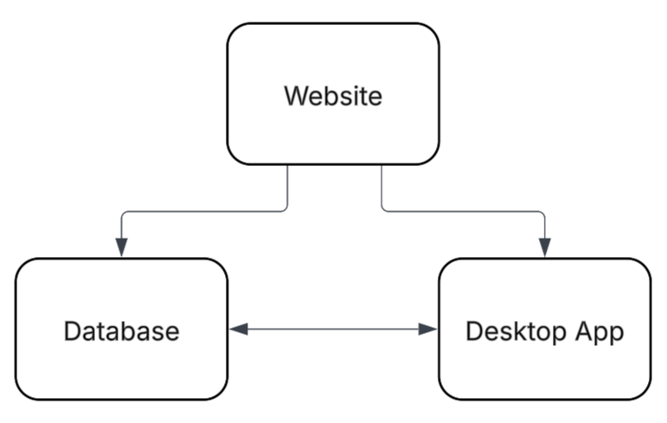
Architecture diagram/plan
Platforms & Technologies
  Visual Studio Code
  Frontend:
    REACT (Next.js)
      CSS
      HTML
  Backend:
    Node
Libraries:
  Hugging Face model and necessary libraries
Hosting strategies
  REACT or Node
Notes:
Corey

Slide 17
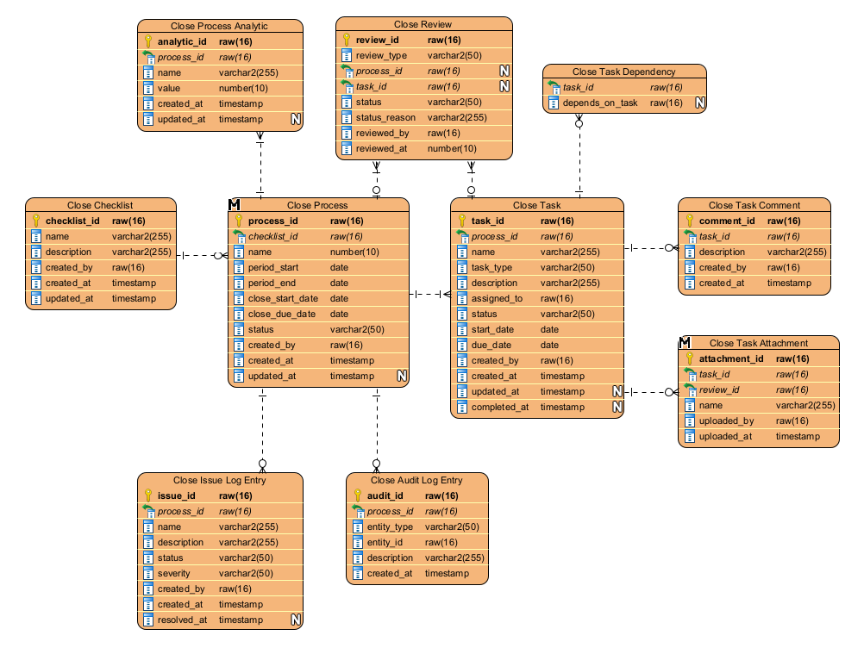
Data Management Plan
Important Data
Data priority lies in robust data retention and auditability
Names
Timestamps
Data Security
Data stored domestically
  Prevents complexity of storing overseas
Data deletion
  Prevent deletion to preserve audit trails
  Multi-factor deletion
  Robust data retention - prevent accidental or malicious deletion, etc.
Notes:
Corey

Slide 18
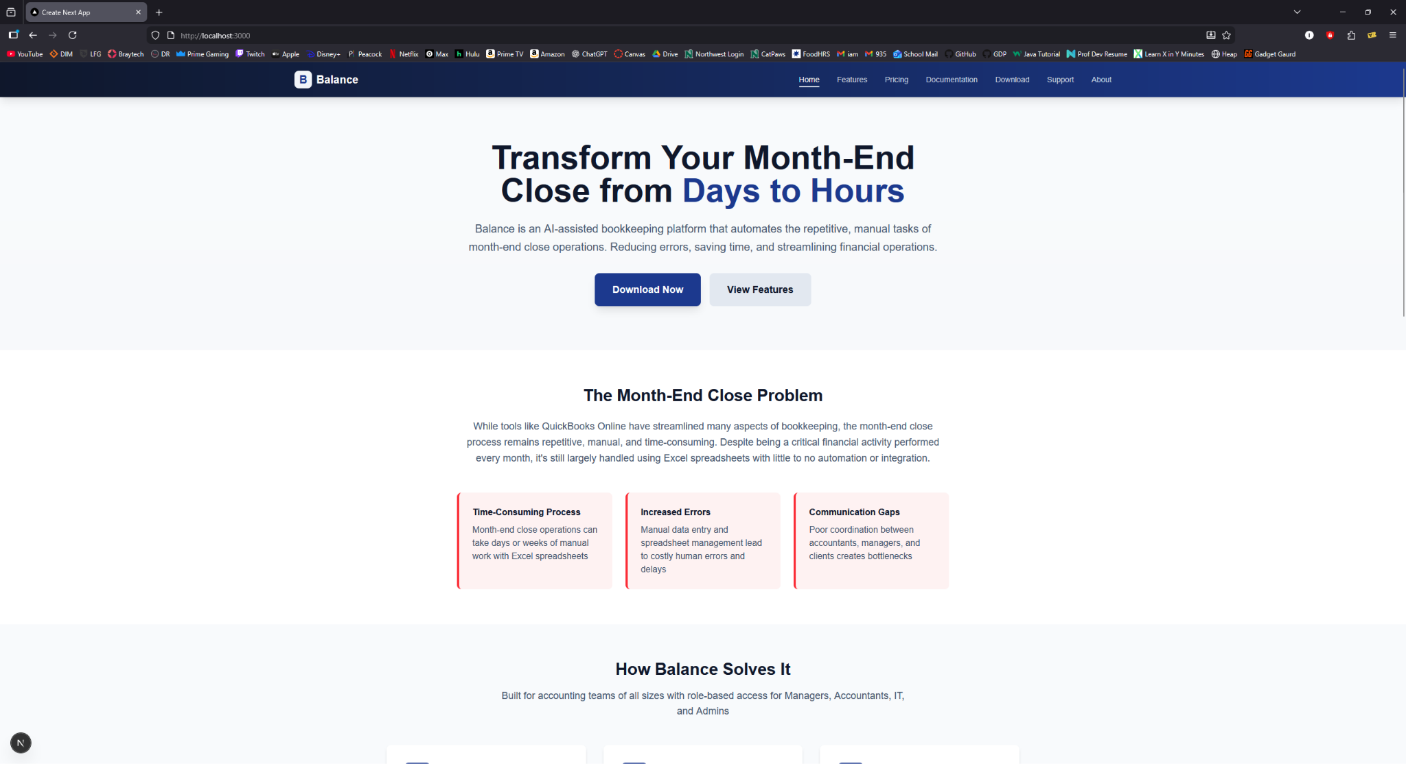
Prototype demos
Notes:
Corey and/or all as we go through it

Slide 19

What Has Been Accomplished?
Various forms of documentation
Many thorough meetings with Dr. Voss
Data management framework
General website layout for download/setup of application
Notes:
Corey

Slide 20

Spring 2026 Plan
Develop and realize Balance application
Finalize application website
Setup and organize database
Notes:
Corey

