Slide 1
AGGIE CODING CLUB
CUDA Vision
Learning GPU programming, one pixel at a time
Beginner-friendly · No GPU required · Basic C++ is plenty
Notes:
Welcome to CUDA Vision. This is a learning project: we will learn how GPUs work by writing code that processes images. The grid on the right is our whole first project in one picture: color pixels in, grayscale pixels out.

Slide 2



What is CUDA Vision?
A semester-long learning project for anyone curious about how GPUs work.
Learn how GPUs think
Parallel programming explained with pictures, not proofs.
If you have written a for-loop in C++ (or honestly any language), you are ready. We start from zero on GPUs and build up together, one small program at a time.
Build real image filters
Every exercise produces an image you can actually see.
No GPU? No problem
We use free cloud GPUs, so any laptop works.
Notes:
Set expectations: this is about learning, not competing. Low C++ knowledge is fine; we will review the C++ we need as it comes up.

Slide 3
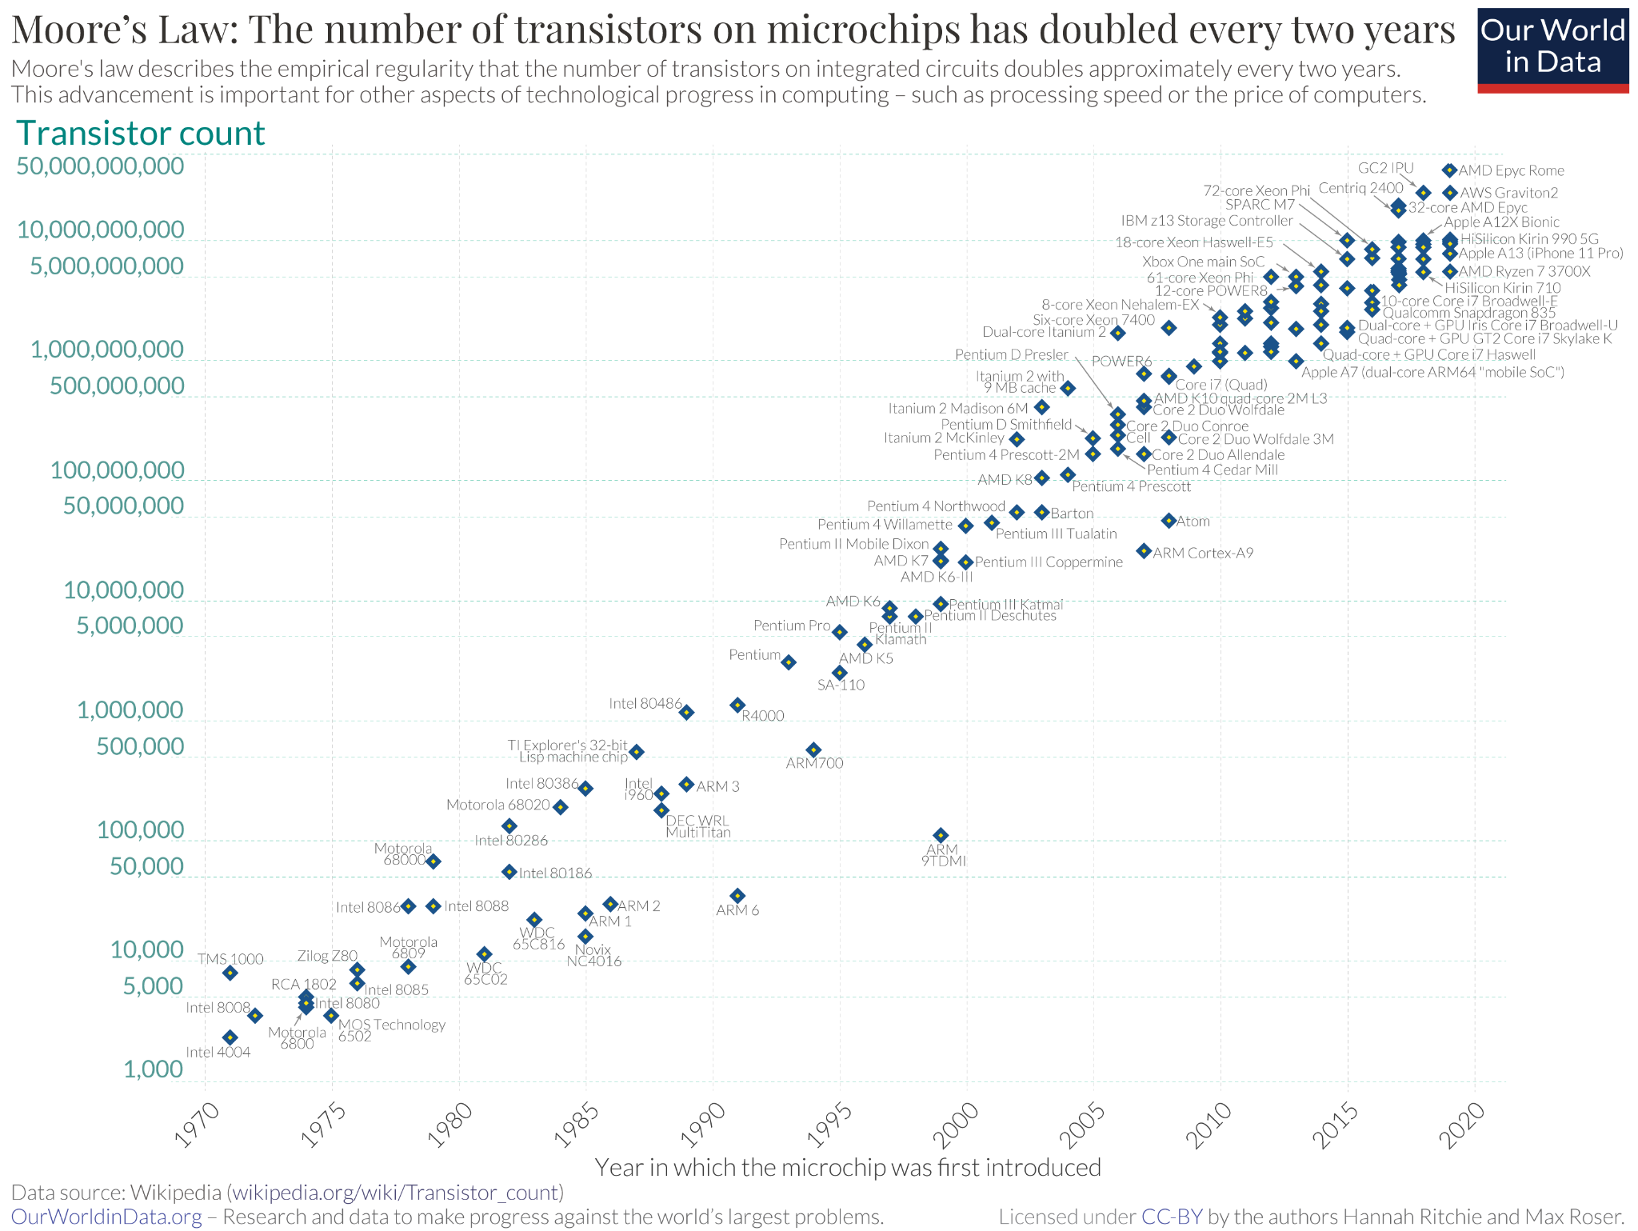
Background

Slide 4
Dennard Scaling & Growth
Dennard Scaling
Power requirements proportional to area.
Smaller transistors result in same power density.
More performance
Higher clock speeds (higher power consumption)
At very small scales, Dennard Scaling breaks down
How do we still get more performance?

Slide 5
Parallelization: CPU vs GPU
More processors can do more work.
CPU
GPU
A few very powerful and capable cores. Great at complex tasks done one after another.
Thousands of simpler cores. Great at doing the same simple job to lots of data at once.
Notes:
Key idea: GPUs are not "faster CPUs." They win when you have a huge number of small, independent jobs. Images are perfect for this: millions of pixels, each handled the same way.
gpus are the best and most common way to handle parallel computing right now. popularized for more general purpose compute with cryptomining, scientific compute, and now ML

Slide 6
So what is CUDA?
CUDA is NVIDIA's platform that lets you write C++ code that runs on the GPU.
2007
C++
1000s
Year NVIDIA released CUDA
Plus a few extra keywords
Threads running your code at once
CUDA only runs on NVIDIA GPUs, which is why will use Google Colab and other sites that can run it for free.
Notes:
CUDA stands for Compute Unified Device Architecture, but nobody calls it that. Main point: it is mostly normal C++. You mark some functions as GPU functions, and CUDA runs them across thousands of threads.

Slide 7




The big picture: where CUDA shows up
AI & deep learning
Science & simulation
PyTorch and TensorFlow use CUDA to train and run neural networks.
Weather models, molecular dynamics, physics simulations.
Graphics & video
Robotics & self-driving
Rendering, video editing, and image processing.
Turning camera feeds into decisions in real time.
Notes:
Every AI headline you read runs on GPUs, and most of them on CUDA. The skills in this project, thinking in parallel, are the same skills those systems are built on. Computer vision (bottom right) is where our project lives.

Slide 8
Why it matters for your career
NVIDIA
Skills you can put on a resume
Created CUDA. It is the core of their AI and graphics software.
C++ and working with memory directly
Parallel programming (thinking in threads)
Measuring and improving performance
Image processing / computer vision basics
A finished project you can show and explain
AMD
HIP / ROCm: code looks nearly identical to CUDA, so the skills transfer directly.
Intel, Apple & more
SYCL, Metal and others use the same parallel ideas. So do Google, Meta, Tesla and AI startups.
Example resume line: "Wrote CUDA C++ kernels for image filters (grayscale, blur) and measured speedup over a CPU version of X%."
Can be considered a “kernel” as you are compiling it uniquely with CUDA, nvcc.
Notes:
GPU programming is in demand at chip companies (NVIDIA, AMD, Intel) and anywhere that runs AI or graphics at scale. Roles include GPU software engineer, CUDA or performance engineer, and ML infrastructure. Even outside those roles, a project where you can explain why your code got faster stands out in interviews.

Slide 9
PART 2 · LEARNING
1
When is a GPU actually faster?
GPU code that looks like the C++ standard library
How C++ becomes GPU instructions
2
3
The CUDA library stack
4
Thrust: std::, GPU edition
We let a library do the hard part: Thrust.
5
Host vs device: policies & specifiers
6
3 hands-on exercises
Notes:
Part 2 is the hands-on learning section. We are going to use Thrust, NVIDIA's GPU version of the C++ standard library, so we can run real code on the GPU before we ever write a kernel by hand. Here is the plan for the next 30 minutes.

Slide 10
Faster at what? A car and a bus
CPU = the car
Optimized for latency
GPU = the bus
Optimized for throughput
Gets a few people there fast.
Takes many trips to move a crowd.
Few, powerful cores. Low overhead to get started.
Slower for a few people.
Moves a crowd in one trip.
Thousands of simple cores. Costs time to "load up".
"Which is faster?" is the wrong question. Ask: faster at moving how much?
Notes:
Ask the room: which is faster, a bus or a car? The honest answer is: it depends what you are doing. Moving 2 people across town, the car wins. Moving 60 people, the bus wins easily, even though each trip is slower. CPUs are cars, built for low latency on a few tasks. GPUs are buses, built for throughput on huge numbers of tasks.

Slide 11
Problem size picks the winner
SMALL JOB
MEDIUM JOB
HUGE JOB
512 elements
65,536 elements
268 million elements
Fastest: 1 CPU thread
Fastest: 64 CPU threads
Fastest: GPU
Starting extra threads, or waking up the GPU, costs more time than the work itself.
Now there is enough work to split across CPU cores, so multithreading pays off.
Multithreading breaks up processes into pieces to then be run at the same time.
The setup cost is tiny next to the work. Thousands of GPU threads win easily.
Takeaway: the GPU only wins when you give it enough work. Images (millions of pixels) are a perfect fit.
Notes:
In the lecture's benchmark, a simulation with only 512 objects ran fastest on a single CPU thread: about 150 times faster than 64 threads and 200 times faster than the GPU, because the setup overhead dominated. At 64 thousand elements, 64 CPU threads pulled ahead. At hundreds of millions of elements, the GPU wins. The lesson: parallel hardware has a start-up cost, and you need enough work to pay for it.

Slide 12
One line of C++, three different machines
your C++ expression
temp[i] + k * diff
g++ main.cpp
aarch64-g++ main.cpp
nvcc main.cpp
vfmadd132ss
vmla.f32
fma.rn.f32
runs on x86 CPU
Intel / AMD laptops
runs on ARM CPU
Phones, Apple silicon
runs on NVIDIA GPU
What we use
nvcc (NVIDIA CUDA Compiler) knows how to turn C++ into GPU instructions. Same source, new target.
Notes:
A CPU or GPU cannot run C++ directly; a compiler translates it into that chip's instructions. The same multiply-add line becomes a different instruction for an Intel chip, an ARM chip, or an NVIDIA GPU. All three are fused multiply-add instructions. nvcc is the compiler that can produce the GPU version, which is why every CUDA build in this club uses nvcc instead of g++.

Slide 13
The CUDA software stack
Your application
Why use libraries?
Simpler code: one call instead of a hand-written kernel.
Faster code: tuned by NVIDIA engineers for every GPU.
Today: we live at the Thrust layer.
Underneath it all, the CUDA Runtime moves data and launches work on the GPU.
Thrust
std-style algorithms & containers
cuBLAS
linear algebra
cuDNN
neural nets
CUB
fast GPU building blocks
libcu++
C++ standard library pieces for GPU
CUDA Runtime talks to the GPU
Notes:
Most real GPU programs are built on libraries, not raw kernels. At the bottom is the CUDA Runtime, which actually talks to the GPU. On top sit libraries: libcu++ (standard library pieces that work on the GPU), CUB (high-performance building blocks), and Thrust (the easy, std-like layer). Specialized libraries like cuBLAS for linear algebra and cuDNN for neural networks sit alongside. Today we stay at the Thrust layer.

Slide 14
Thrust: the standard library, GPU edition
If you know std::, you already know most of thrust::
C++ standard library
Thrust (runs on the GPU too)
Containers
std::vector
thrust::host_vector · device_vector · universal_vector
Algorithms
std::copy / sort / transform
thrust::copy / sort / transform
Extended
(no std:: version)
thrust::tabulate · sort_by_key · reduce_by_key
Function objects
std::plus / less / multiplies
thrust::plus / less / multiplies
Iterators
(no std:: version)
thrust::counting_iterator · transform_iterator
Full reference: nvidia.github.io/cccl/thrust
Notes:
Thrust deliberately mirrors the C++ standard library. Same algorithm names, same iterator style, similar containers. It adds a few extras the standard library does not have, like sort_by_key and counting_iterator. universal_vector is the container we use in the exercises: its memory can be read by both the CPU and the GPU, so we do not have to copy data by hand yet.

Slide 15
Execution policy: tell Thrust where to run
Standard C++
CUDA C++ with Thrust
std::transform(temp.begin(), temp.end(),
temp.begin(), op);
thrust::transform(thrust::device,
temp.begin(), temp.end(),
temp.begin(), op);
Only change: one extra first argument
thrust::host
→ CPU (host) Runs the algorithm on the CPU.
thrust::device
→ GPU (device) Runs the algorithm on the GPU.
Same interface on both sides, so the same code can run on the CPU or the GPU by swapping one word.
Notes:
Compare std::transform to thrust::transform. The only difference is the first argument: the execution policy. It answers one question: where should this algorithm run? thrust::host means the CPU, thrust::device means the GPU. Because the interface is the same, switching between CPU and GPU is a one-word change.

Slide 16
Policy vs specifier: two different jobs
Execution policy
thrust::host / thrust::device
Decided at run time
Picks WHERE the algorithm will run
Does not compile anything for that place
Function specifier
__host__ / __device__
Decided at compile time
Picks WHAT the function is compiled for
Both = a CPU version and a GPU version
Kitchen analogy
The Function Specifier is which kitchens the recipe is written for. The policy is which kitchen you send the order to.
Send an order to a kitchen that has no recipe for it, and it fails before you even start (a compile error).
Notes:
This is the most common source of confusion. The policy is a run-time choice of where the algorithm runs. The specifier on your function or lambda is a compile-time choice of which processors it gets compiled for. Writing thrust::device does not magically compile your lambda for the GPU; you need __device__ (or __host__ __device__) for that. Both have to agree.

Slide 17
Which combinations work?
lambda / function specifier
__host__
__device__
__host__ __device__
thrust::host
runs on CPU
compile error
runs on CPU
policy
thrust::device
compile error
runs on GPU
runs on GPU
Rule of thumb: mark lambdas __host__ __device__ and they work with either policy.
Notes:
Walk the grid. A host-only lambda cannot run on the GPU, and a device-only lambda cannot run on the CPU; both are compile errors, which is good, because you find out before running. __host__ __device__ produces both versions, so it works with either policy. That is why most Thrust code marks its lambdas __host__ __device__.

Slide 18
Exercise 1: where does each line run?
5 minutes · replace each "???" with CPU or GPU
1 cv::where_am_I("???");
2
3 thrust::universal_vector<int> vec{1};
4 thrust::for_each(thrust::device, vec.begin(), vec.end(),
5 [] __host__ __device__(int) { cv::where_am_I("???"); });
6
7 thrust::for_each(thrust::host, vec.begin(), vec.end(),
8 [] __host__ __device__(int) { cv::where_am_I("???"); });
9
10 cv::where_am_I("???");
How to check
Each where_am_I call prints [ OK ] or [MISS].
Run:
make ex1_annotate_problem
./ex1_annotate_problem
File: 01-execution-spaces/ex1_annotate_problem.cu
Notes:
Give everyone five minutes. Encourage them to guess on paper first, then run the program. The helper prints OK or MISS for each line, so they get instant feedback. Do not reveal the answers until most people have run it.

Slide 19
Exercise 1: solution
1 cv::where_am_I("CPU");
2
3 thrust::universal_vector<int> vec{3};
4 thrust::for_each(thrust::device, vec.begin(), vec.end(),
5 [] __host__ __device__(int) { cv::where_am_I("GPU"); });
6
7 thrust::for_each(thrust::host, vec.begin(), vec.end(),
8 [] __host__ __device__(int) { cv::where_am_I("CPU"); });
9
10 cv::where_am_I("CPU");
Line 1
main() always starts on the CPU.
Line 5
thrust::device + a lambda that has a GPU version → GPU.
Line 8
Same lambda, thrust::host → CPU.
Line 10
Back on the CPU. Device execution does not "leak" out of the algorithm.
Key idea: the policy only affects the algorithm it is passed to. Everything else stays on the CPU.
Notes:
Answers: CPU, GPU, CPU, CPU. The tricky one is the last line: some people expect that after running something on the GPU we stay there. We do not. Each Thrust call with thrust::device runs on the GPU and then control comes back to the CPU.

Slide 20
Exercise 2: move it to the GPU
5 minutes · this loop prints on the CPU. Make it run on the GPU.
thrust::for_each(thrust::host, vec.begin(), vec.end(), [] __host__ (int val) {
printf("printing %d on %s\n", val, cv::execution_space());
});
Hint
You need to change TWO words. One controls where it runs, the other controls what gets compiled.
Expected output
printing 1 on GPU
printing 2 on GPU
printing 3 on GPU
File: 01-execution-spaces/ex2_change_space_problem.cu
Notes:
Most people will change thrust::host to thrust::device and hit a compile error. That is the point of the exercise: let them see the error, then connect it back to the policy vs specifier grid.

Slide 21
Exercise 2: solution
Before: CPU
thrust::for_each(thrust::host, vec.begin(), vec.end(), [] __host__ (int val) {
printf("printing %d on %s\n", val, cv::execution_space());
});
After: GPU
thrust::for_each(thrust::device, vec.begin(), vec.end(), [] __device__ (int val) {
printf("printing %d on %s\n", val, cv::execution_space());
});
thrust::device
Policy: run this algorithm on the GPU.
__device__
Specifier: compile this lambda for the GPU. (__host__ __device__ also works.)
Notes:
Two changes: the policy becomes thrust::device and the lambda specifier becomes __device__. Changing only the policy gives a compile error, because there is no GPU version of a host-only lambda. Point out that the printed lines may come out in a different order on the GPU, because the threads run in parallel.

Slide 22
Exercise 3: port std:: code to the GPU
A cooling simulation: each cell moves halfway toward room temperature every step.
Problem (CPU, std::)
Solution (GPU, thrust::)
std::vector<float> temp{42, 24, 50};
auto op = [=](float t) {
return t + k * (room - t);
};
std::transform(temp.begin(), temp.end(),
temp.begin(), op);
thrust::universal_vector<float> temp{42, 24, 50};
auto op = [=] __host__ __device__(float t) {
return t + k * (room - t);
};
thrust::transform(thrust::device,
temp.begin(), temp.end(), temp.begin(), op);
std::vector → universal_vector (CPU and GPU can both read it)
Mark the lambda __host__ __device__
std::transform → thrust::transform + thrust::device
Notes:
This connects back to the compilation slide: temp[i] + k * diff is the same expression, now running on the GPU. Three changes: the container, the lambda specifier, and the algorithm plus policy. The output is identical to the CPU version, which is a good habit: always check your GPU result against a CPU result.

Slide 23

Potential Project 1: color to grayscale
gray = 0.299·R + 0.587·G + 0.114·B
Each thread reads one pixel's red, green and blue values.
It mixes them into one brightness value.
It writes that single gray pixel back out.
Input: RGB
Output: gray
~2 million threads for one 1080p photo (1920 × 1080 pixels), all running in parallel. Getting use of GPU performance vs the CPU.
Notes:
Why grayscale first: every pixel is independent, the math is one line, and you get a result you can see immediately. Notice it has the exact same shape as Exercise 3: one small function applied to every element, which is a single thrust::transform call. The weights favor green because human eyes are most sensitive to green light.

Slide 24

The road ahead
Setup
Thrust
Grayscale
Level up
Free cloud GPU and our first Thrust program.
Host vs device, std:: to thrust:: (today).
Project 1: thrust::transform over every pixel.
Write our own kernels: blur, edges, and beyond.
What you need to join
A laptop, a Google account, and curiosity.
Notes:
Close with the roadmap and a clear call to action: bring a laptop to the next meeting, and we will get everyone running their first kernel on a free cloud GPU (for example Google Colab).

