Slide 1
Demo Lesson
Mark 6:55-56

Slide 2
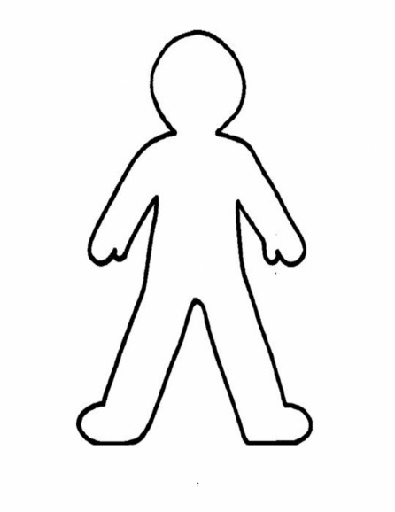
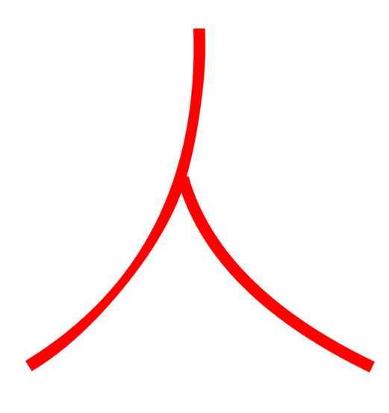
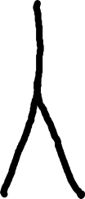
Person
Notes:
Person

Slide 3
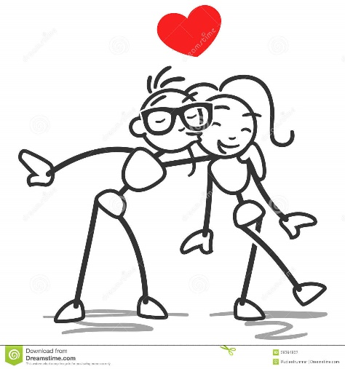

Love
Compassion
Notes:
Love/Compassion

Slide 4

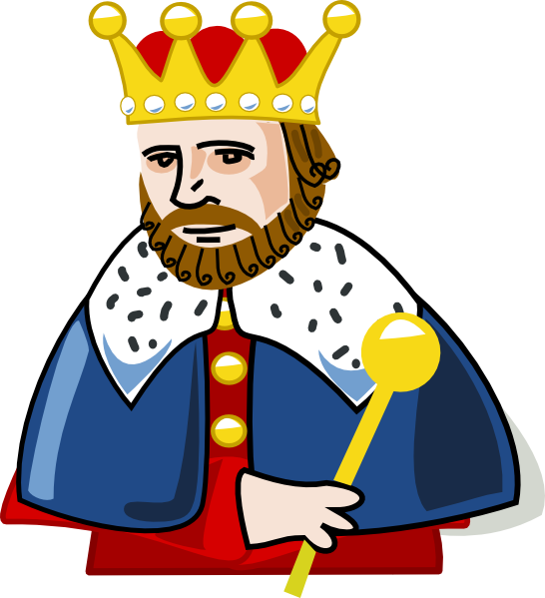

King
Lord
Crown
Ruler
Notes:
King
Lord
Ruler
Crown

Slide 5

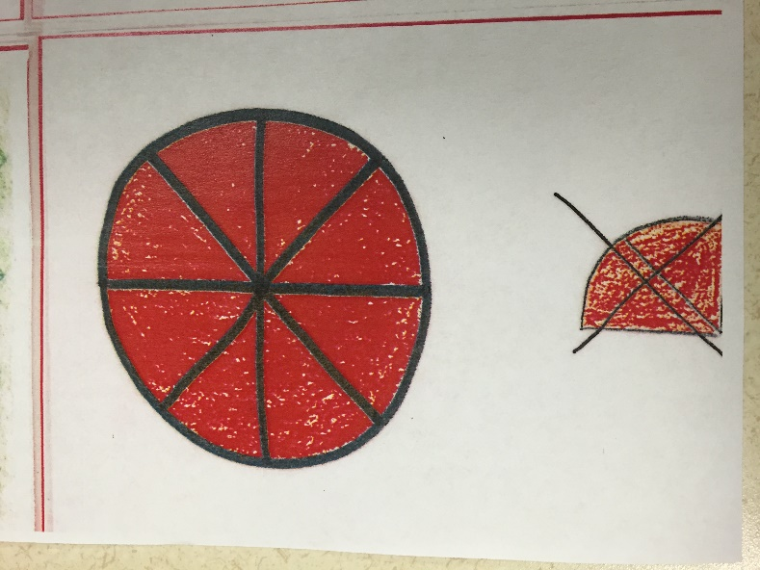
All
Whole
Every

Slide 6

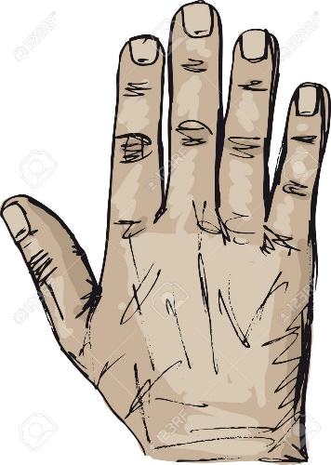

Hand

Slide 7
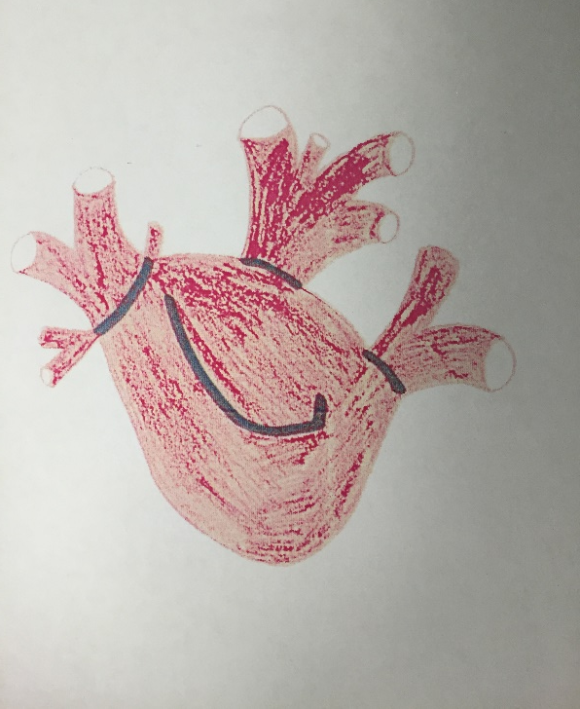

Heart

Slide 8
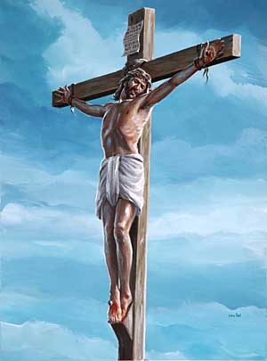

Cross

Slide 9
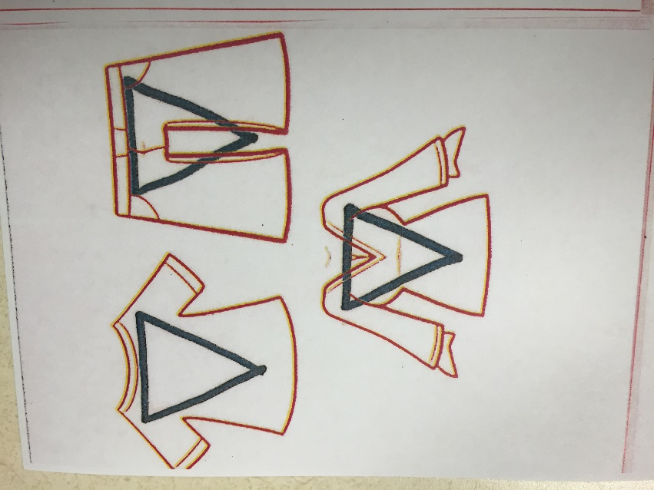

Clothing
Fabric

Slide 10
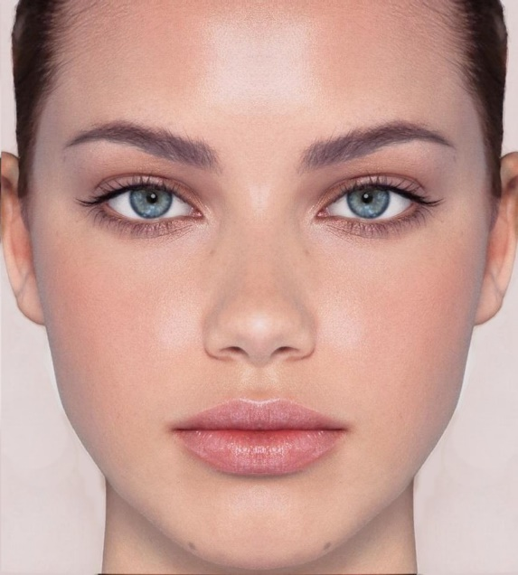


Face

Slide 11
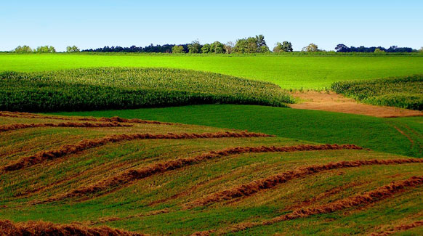

Land
Ground
Place
Space
Earth

Slide 12
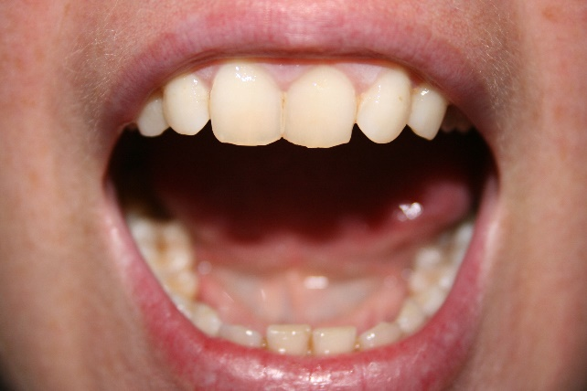

Mouth
Speak
Tell

Slide 13
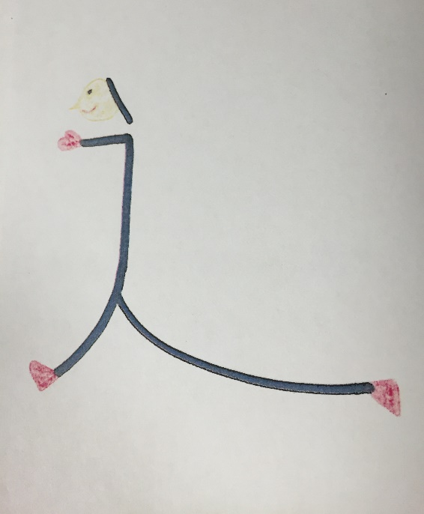
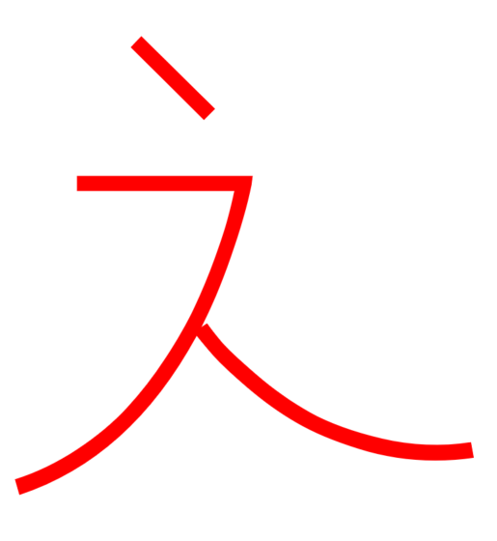
Walk

Slide 14
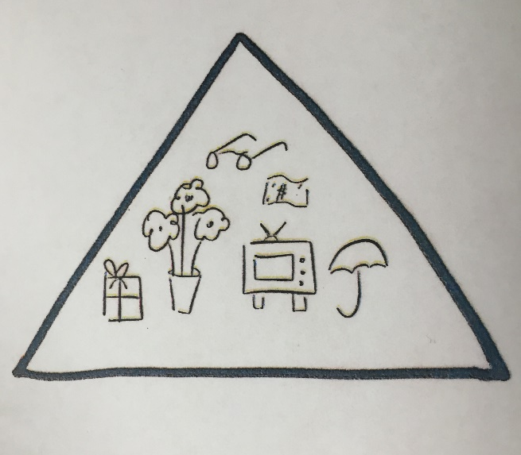

Thing

Slide 15
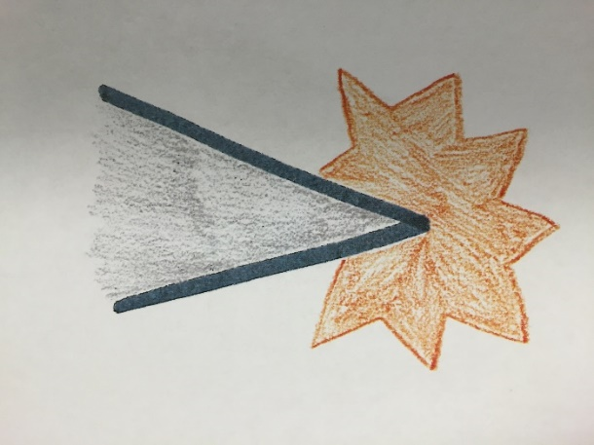

Very
(Showing Emphasis)

Slide 16

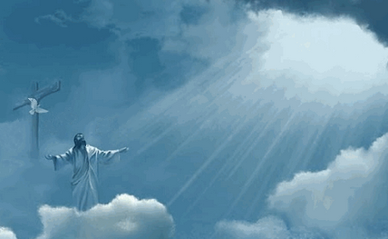
Jesus
King + Cross
Jesus is the King on the cross.

Slide 17
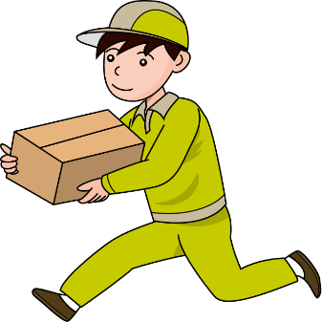

Take
Carry
Bring
Hand + Thing
When you have a thing in your hand, you are carrying, taking, or bringing it somewhere.

Slide 18

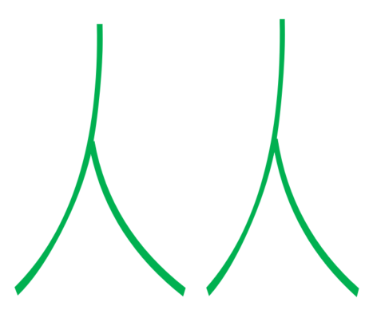
People
Two Persons
More than one person is people.

Slide 19


Lay Down
Sleep
Rest
Person on his side
When a person is laying on his side, hi is sleeping or resting.

Slide 20
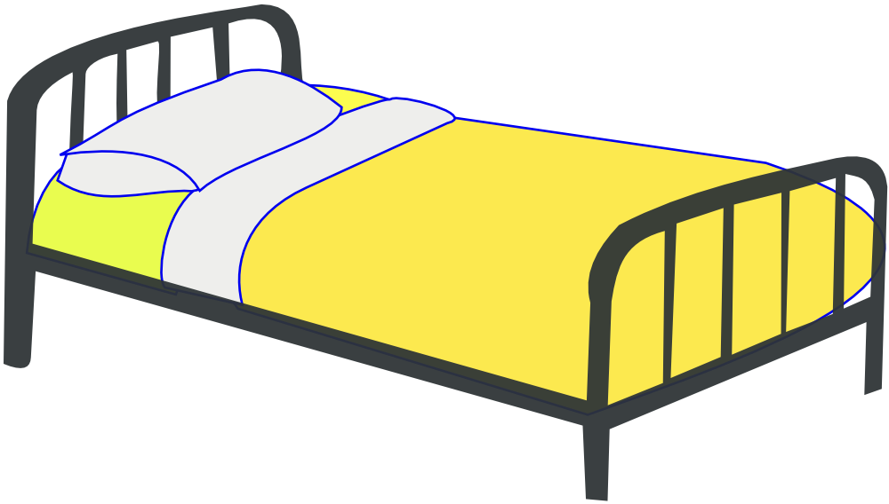

Bed
Lie down + (Line underneath)
The thing a person lies down on is a bed.

Slide 21
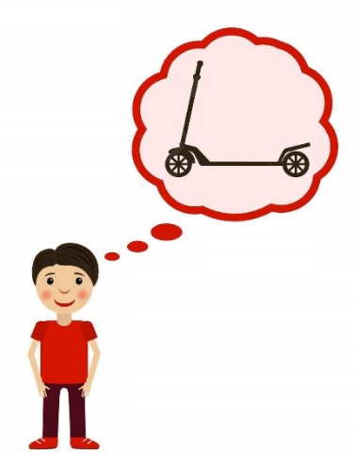

Desire
Will
Want
Love + Heart
When your heart loves something, you desire it.

Slide 22


Beg
Plead
Very + Mouth + Desire
When you are emphatically talking about something you desire, you are begging.

Slide 23


Happy
Joy
Smiling Face
A face that is smiling is happy.

Slide 24


Health
Healthy
Well
Happy + Heart
When you heart is happy, you are healthy.

Slide 25


Sad
Grieve
Sad Face

Slide 26

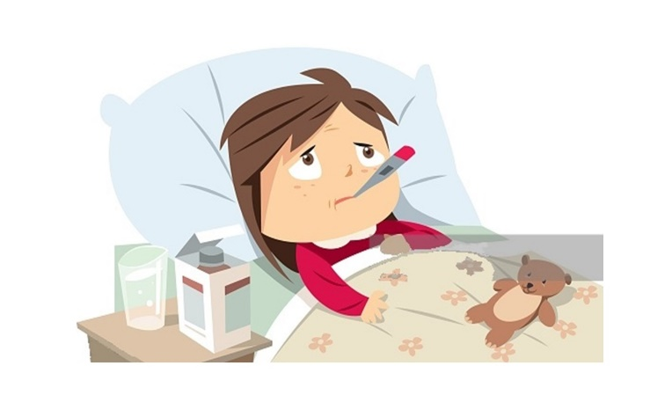
Sick
Disease
Sad + Heart
When your heart is sad, you are probably sick.

Slide 27
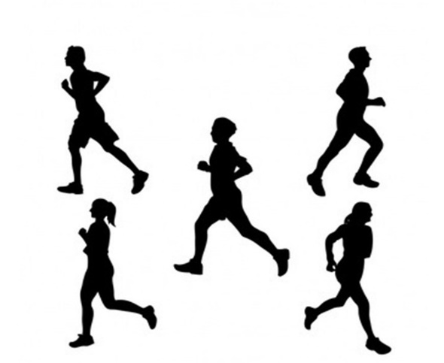

Run
Very + Walk
A run is a very fast walk.

Slide 28
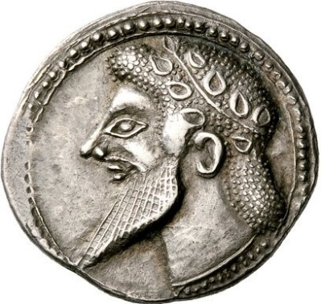

Money
Wealth
Wealthy
King on a (Coin)
Money is often in the form of a coin that has an inscription of a king or important person.

Slide 29
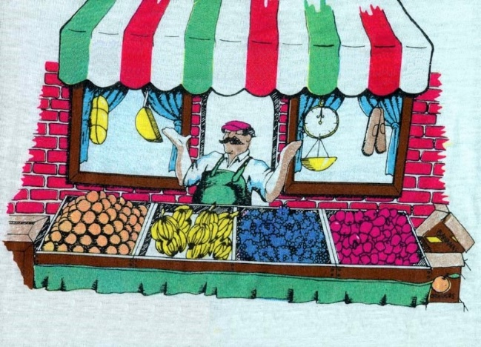

Market
Marketplace
Store
Money + Land
The land where money is exchanged is a marketplace.

Slide 30
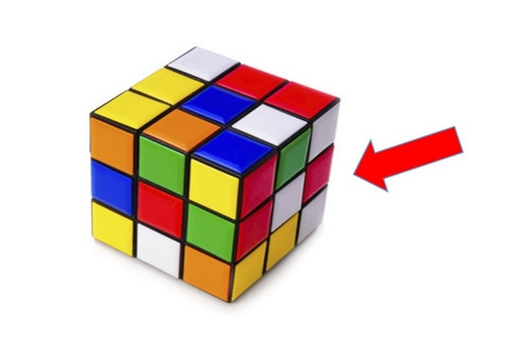

Side
Thing + Arrow
Pointing to the side of the thing.

Slide 31
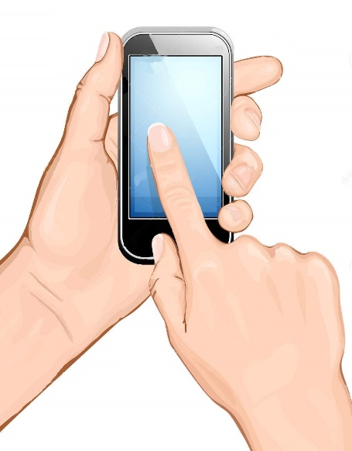

Touch
Hand touching a thing.

Slide 32

Notes:
People run throughout all the land.

Slide 33
 
Notes:
People bring sick people to Jesus.

Slide 34
 
Notes:
Sick people lie on mattresses.

Slide 35
 
Notes:
People lay the sick people in marketplaces.

Slide 36

Notes:
People want to touch the side of Jesus’ clothes.

Slide 37

Notes:
People beg Jesus.

Slide 38

Notes:
People who touched the side of Jesus’ clothese were made healthy.

