Slide 1
BTT Recorder v1.4
NEW USER SETUP

Slide 2
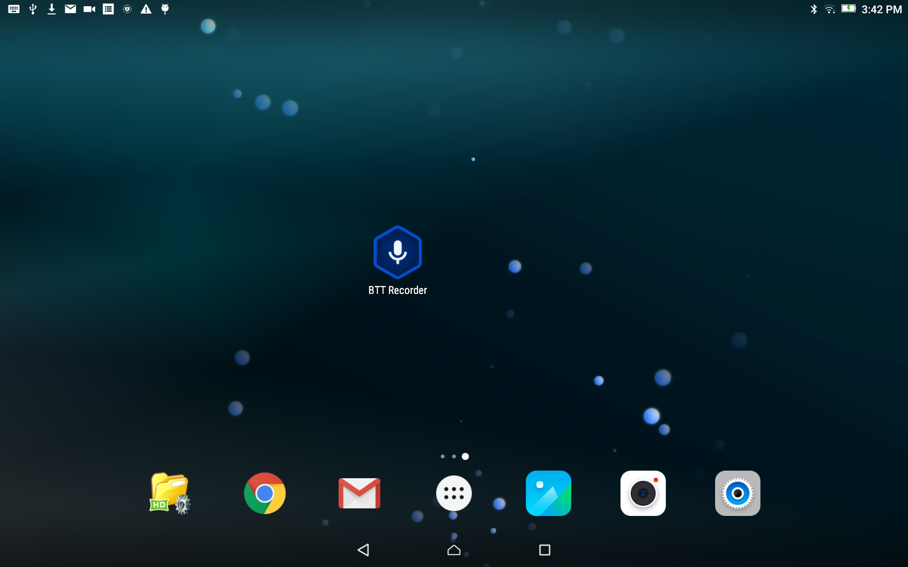
Open the Bible Translation Tools Recorder Program

Slide 3
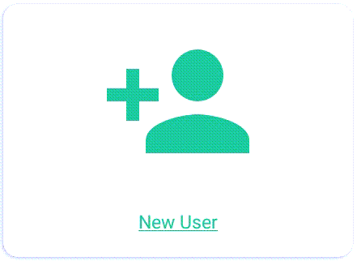
Create a new user profile
To create a new User profile, tap on the ‘New User’ card.

Slide 4
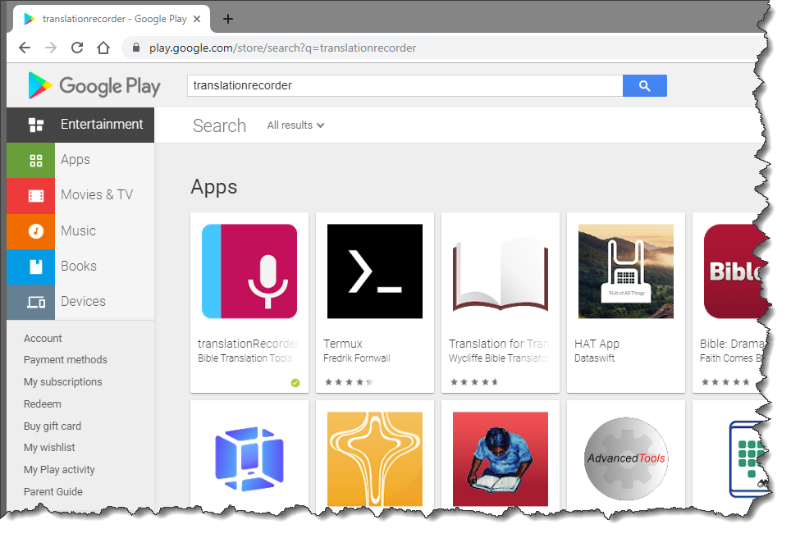
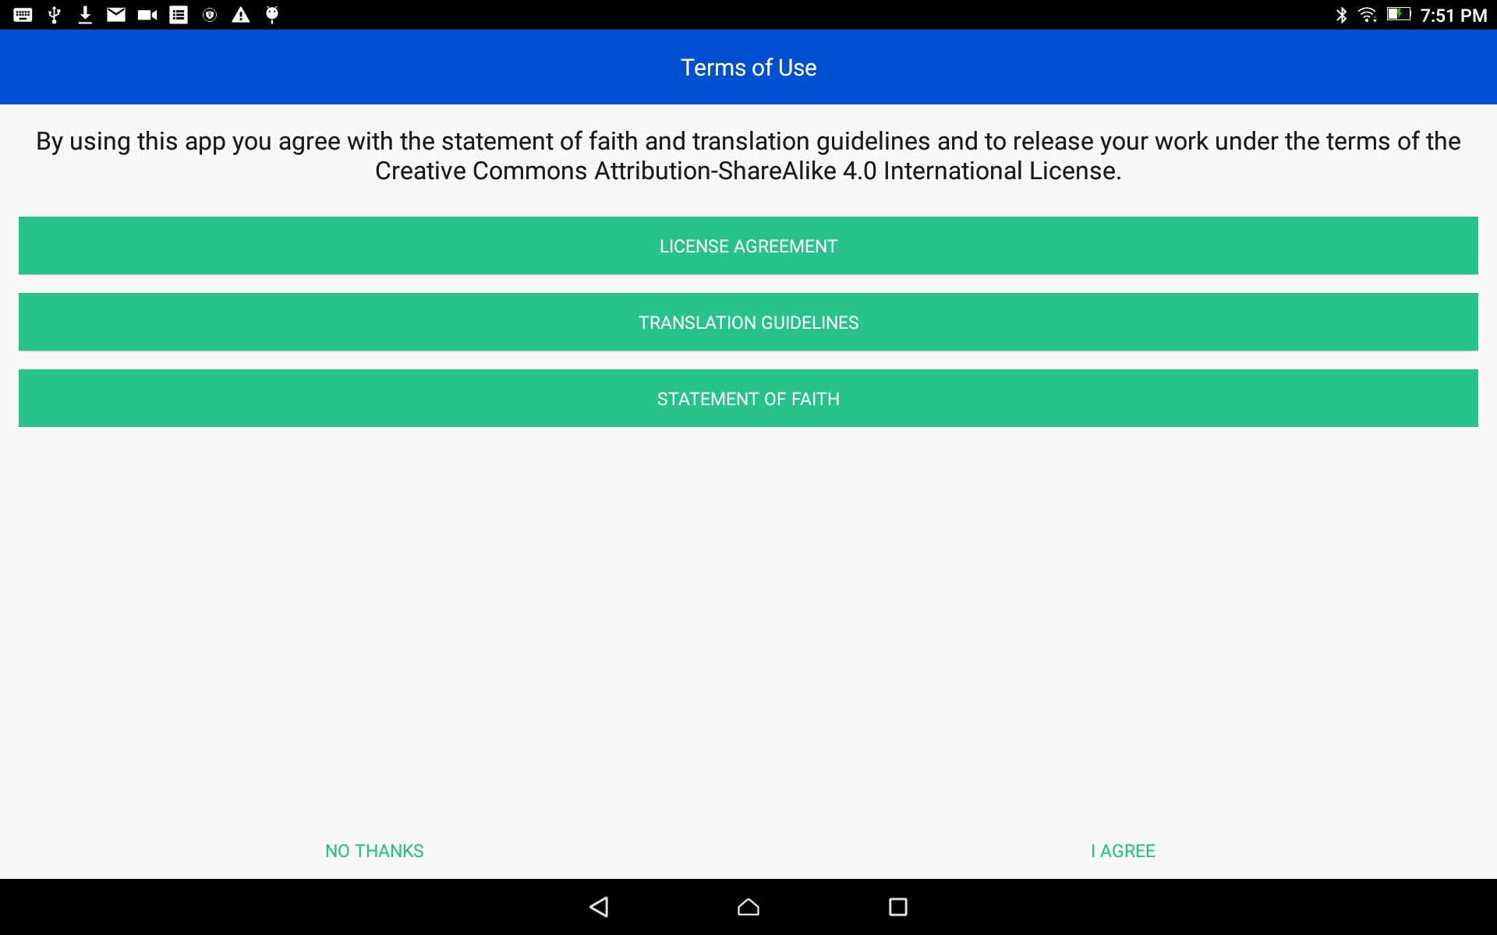

Terms of Use
Read, or have someone read to you, the three Terms of Use.
Tap on each of the green bars.
Read the content. You may need to scroll to see the entire contents of the ‘Translation Guidelines’ and the ‘Statement of Faith’.
Tap on ‘Close’ at the bottom of each of the windows.

Slide 5
Terms of Use
Tap the green I AGREE link at the bottom of the window if you agree with all three statements.

Slide 6
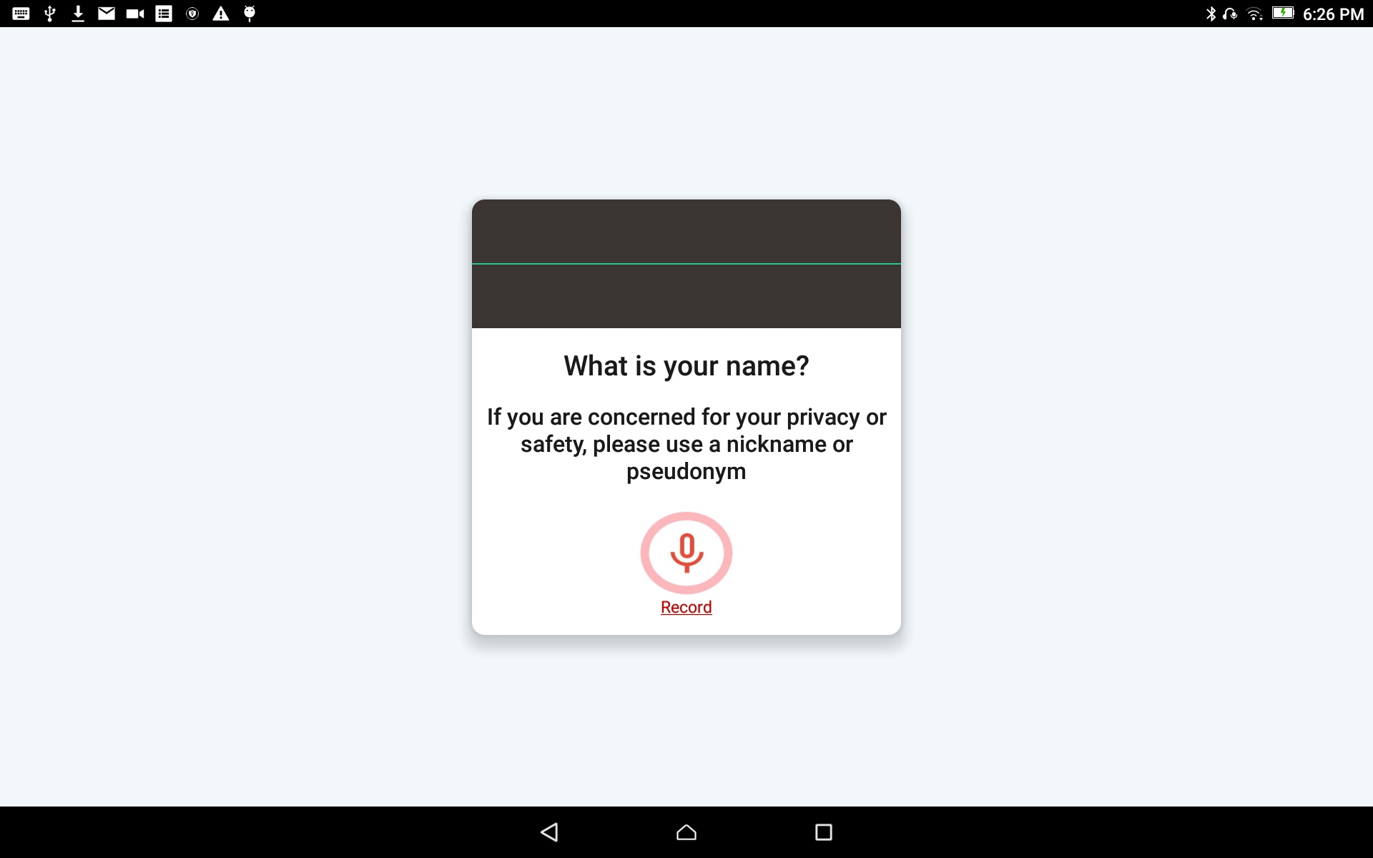
Create the New User
Tap the Record icon (microphone) and record your name.
You will need to record your name while the red circle is going around – 3 seconds.
A pseudonym is a false name that is used instead of the real name of the person doing the work.

Slide 7
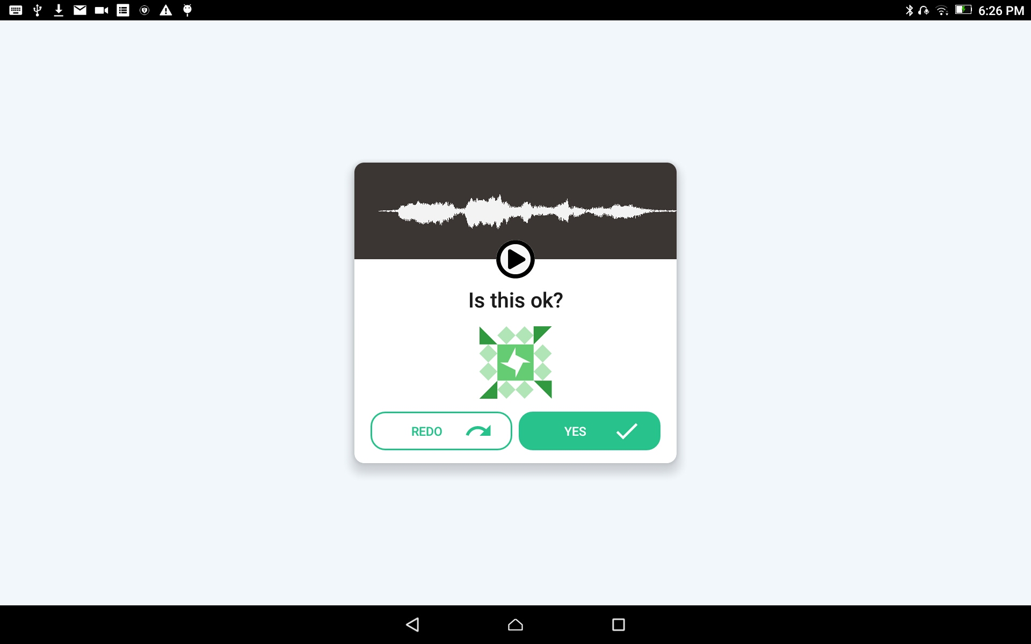
Create the New User
Press the play button to listen to the recording.

Slide 8
Create the New User
When you accept the recording - the opening recording screen opens, and you are ready to start a new project.

Slide 9
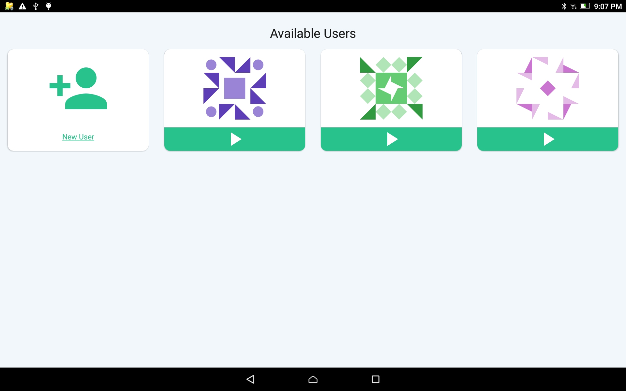
Several User Accounts
When you return to the program later, you will see the list of Users created on the device.
Tap on the User icon to open their work.

