Slide 1
BTT Recorder v1.4
Editing
Recordings
Menus
and
icons

Slide 2
Links to topics:
Project Management Home Screen 3-Dot Menu
Project Management Home Screen Information
Project Management Information Menu
Edit Screen Icons
Verse or Chunk Take Bar

Slide 3
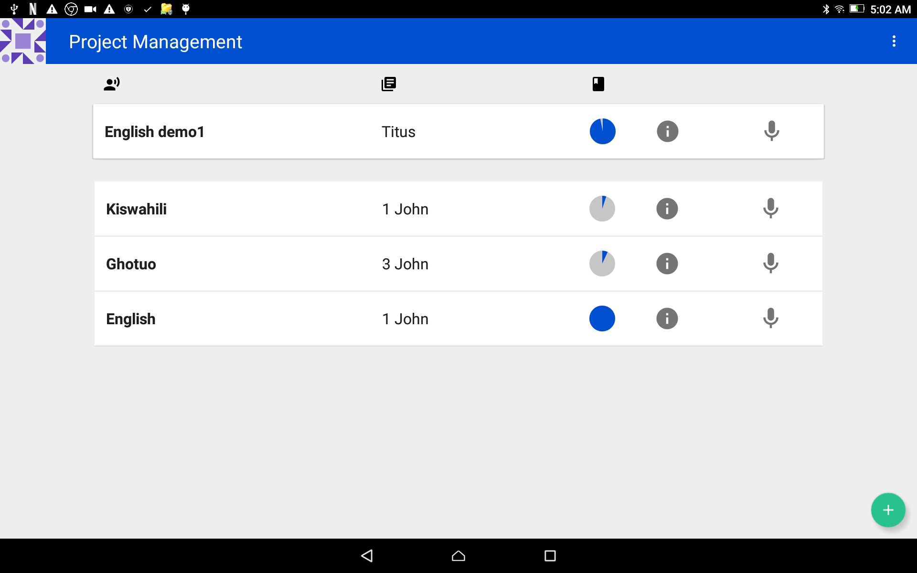
Project Management Home Screen 3-dot Menu
The 3-dot menu icon is found at the far right on the top blue bar.
Tap on the 3 dots to open the menu.

Slide 4
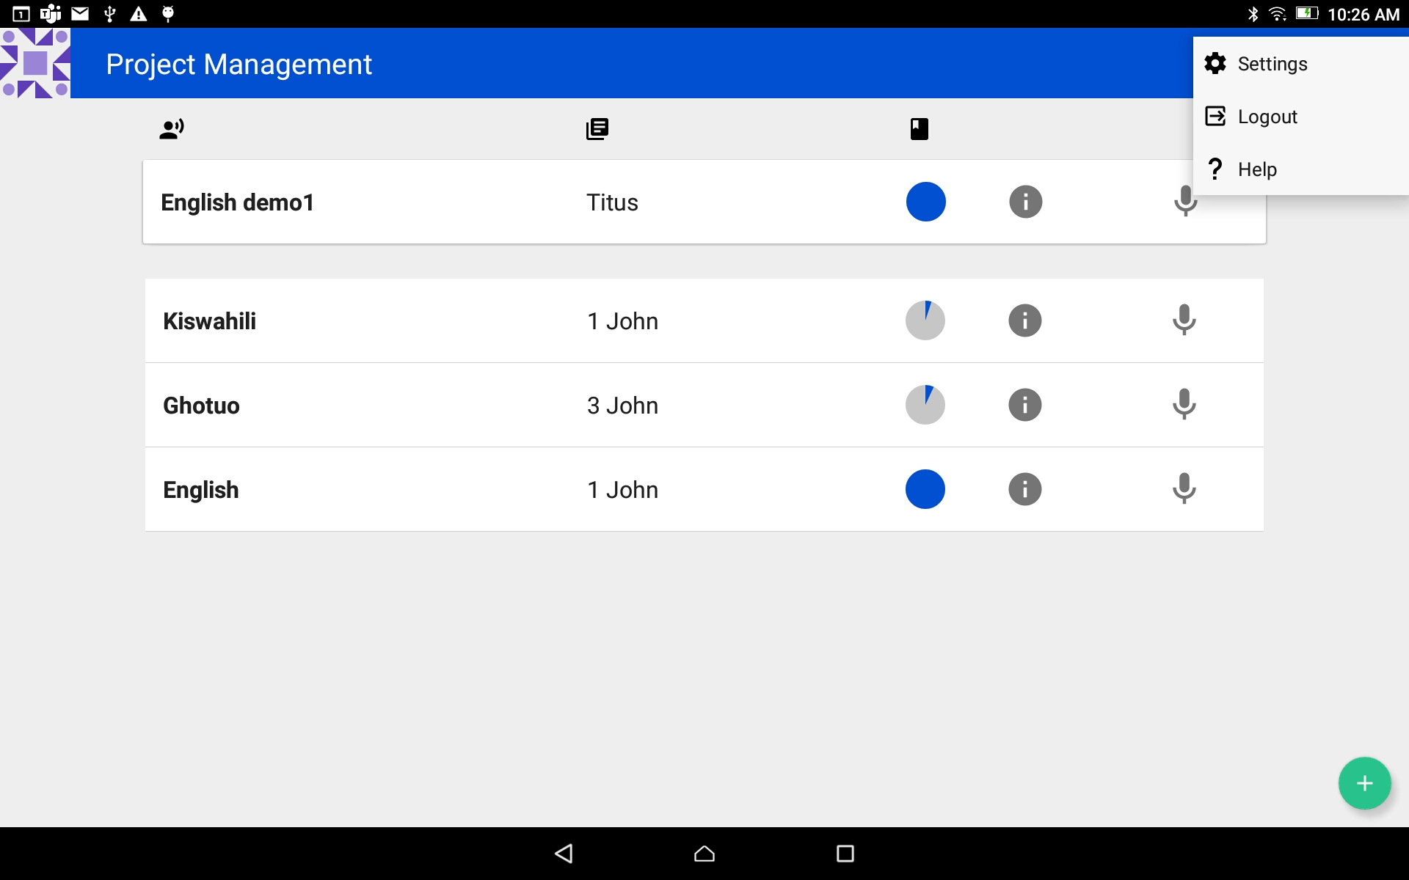
Project Management Home Screen 3-dot Menu
Menu choices:
Settings - Tap to view the settings of the program.
Logout – Tap to sign out of the program.
The program will restart at the User Account screen.
Help - Tap to view the documentation on how to use the BTT Recorder program.

Slide 5
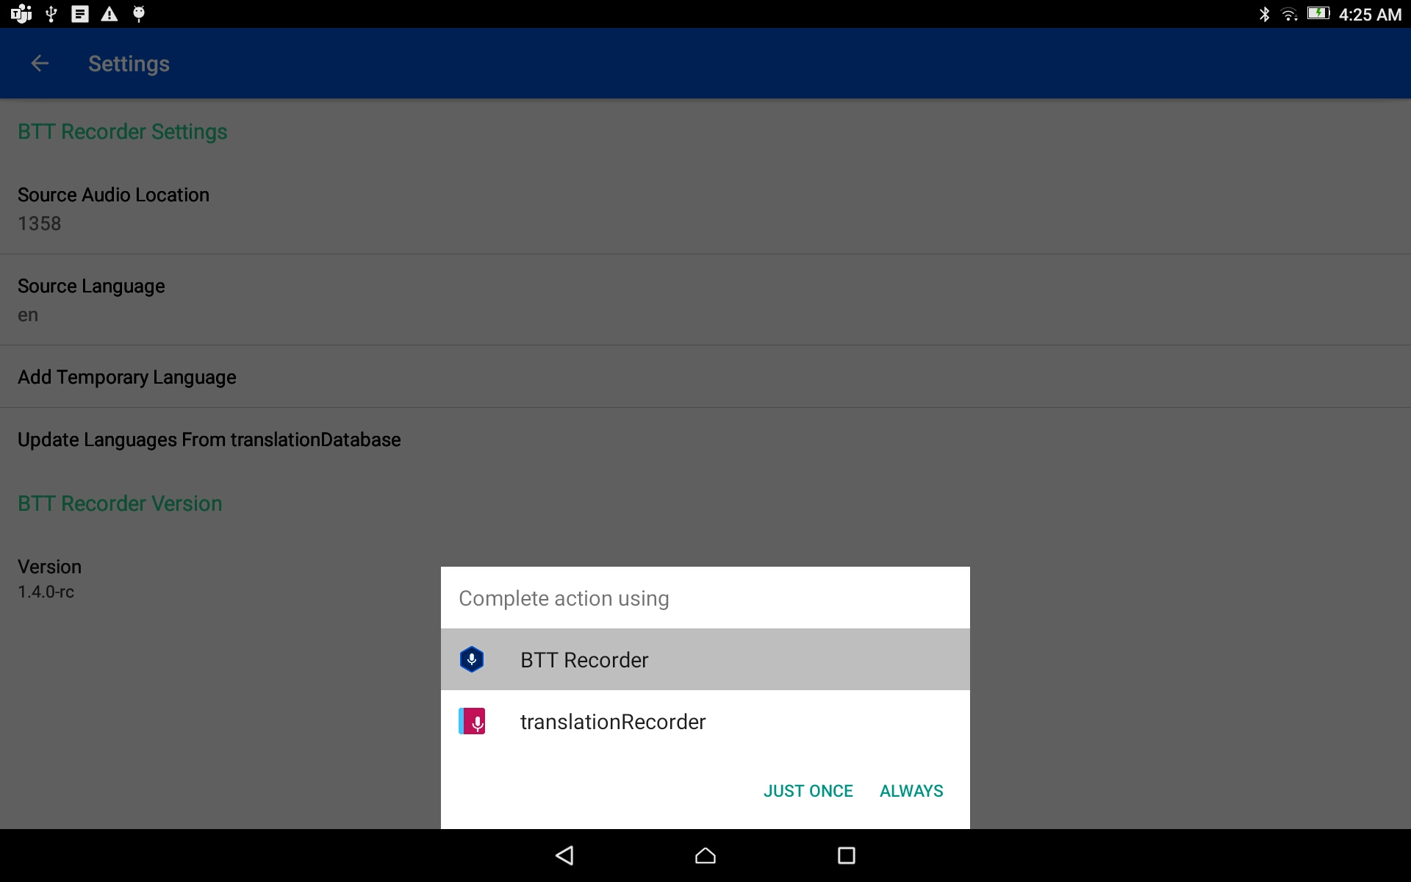
Project Management Home Screen 3-dot Menu - Settings
NOTE:
If translationRecorder is chosen, the audio files may need to go through the converter software to work in BTT Recorder.
Source Audio Location
Tap to open
Choose between
BTT Recorder
translationRecorder
Tap on either link – JUST ONCE or ALWAYS
The window closes.

Slide 6
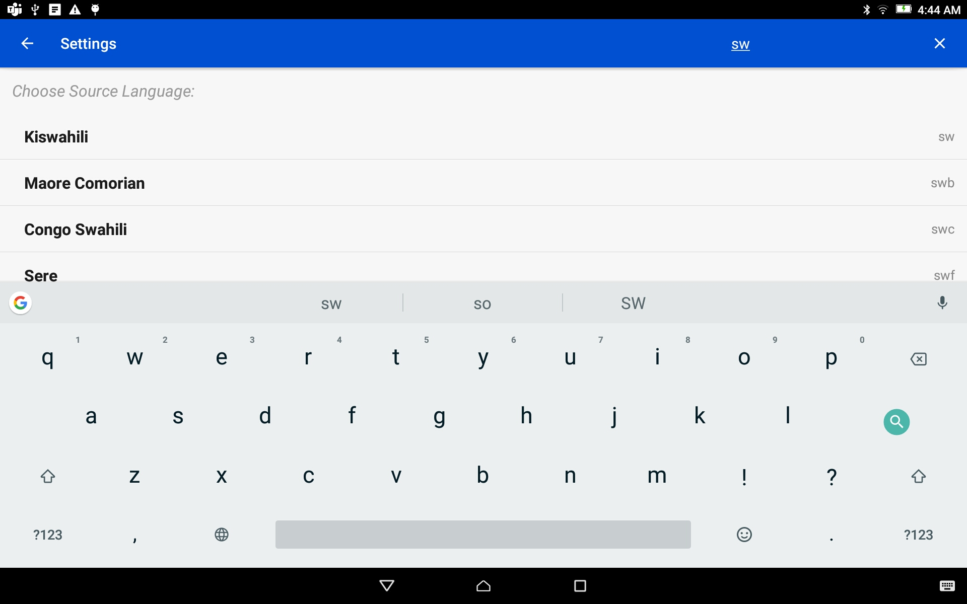
Project Management Home Screen 3-dot Menu - Settings
Source Language
Tap to open
Search for the language from the list of languages.
Tap on the language name.
The window closes.

Slide 7
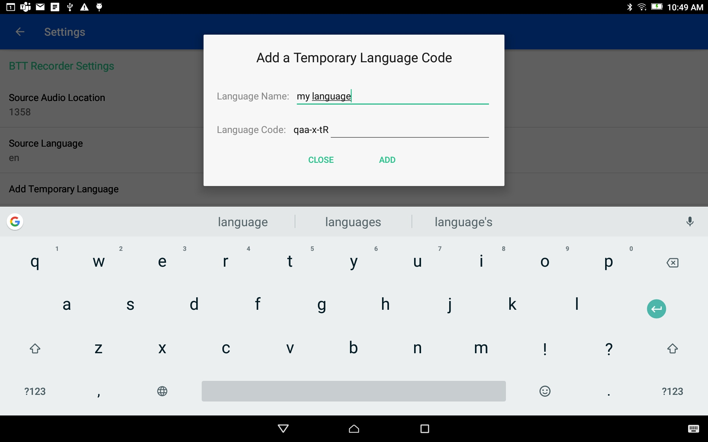
Project Management Home Screen 3-dot Menu - Settings
Add Temporary Language
Tap to open
Enter the language name
To close the window tap the CLOSE link at the bottom

Slide 8
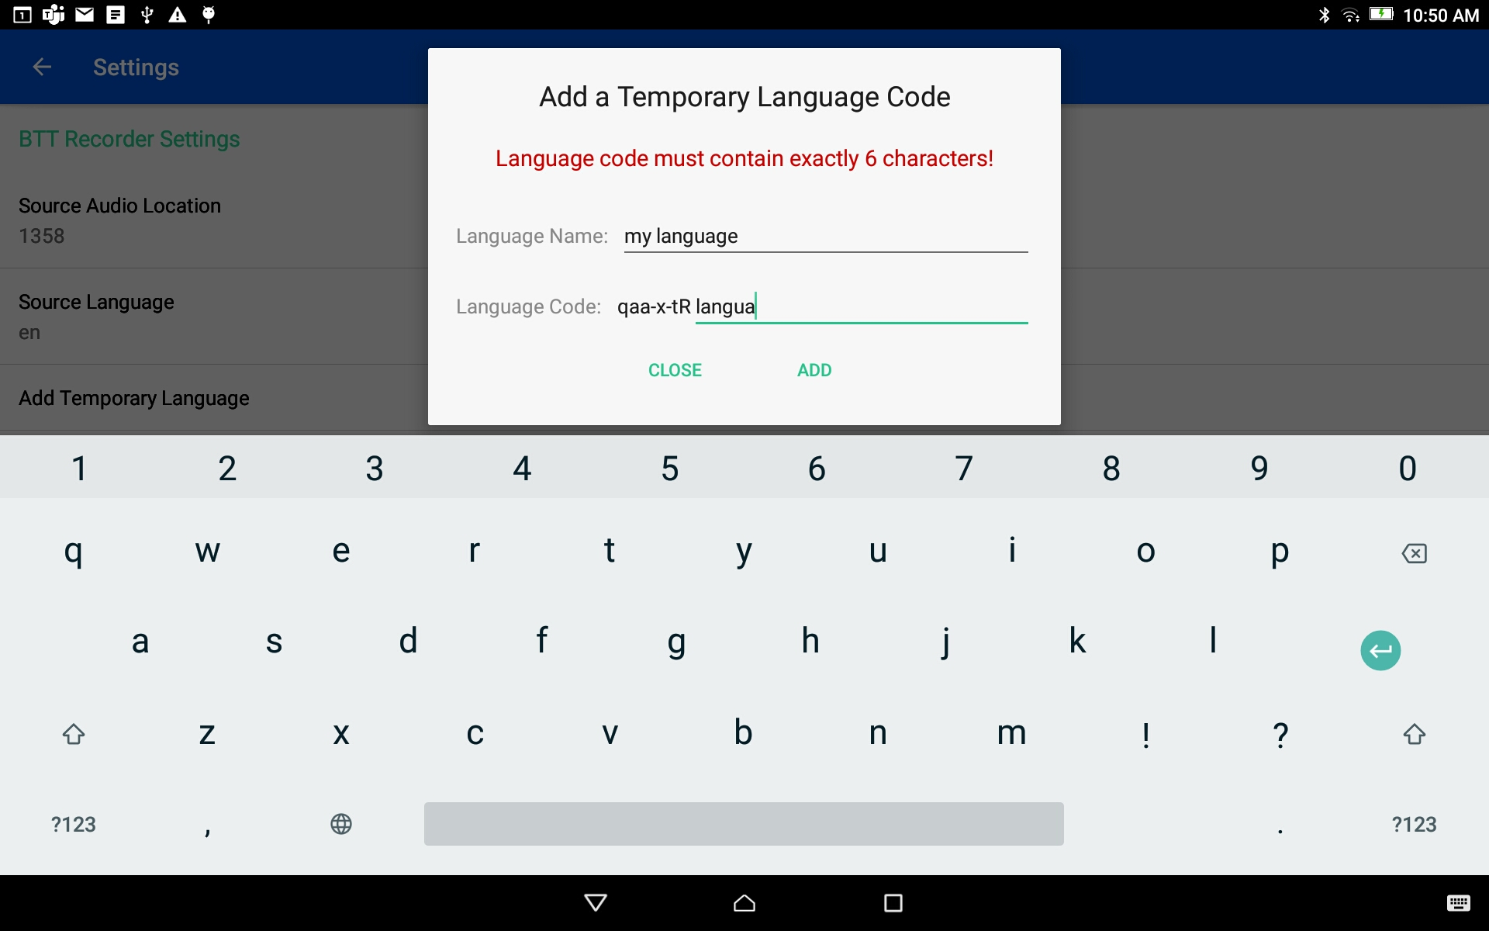
Project Management Home Screen 3-dot Menu - Settings
Add Temporary Language
Tap to open
Enter the language name
Enter a code of exactly 6 characters.
Tap the ADD link to add the language and close the window.

Slide 9
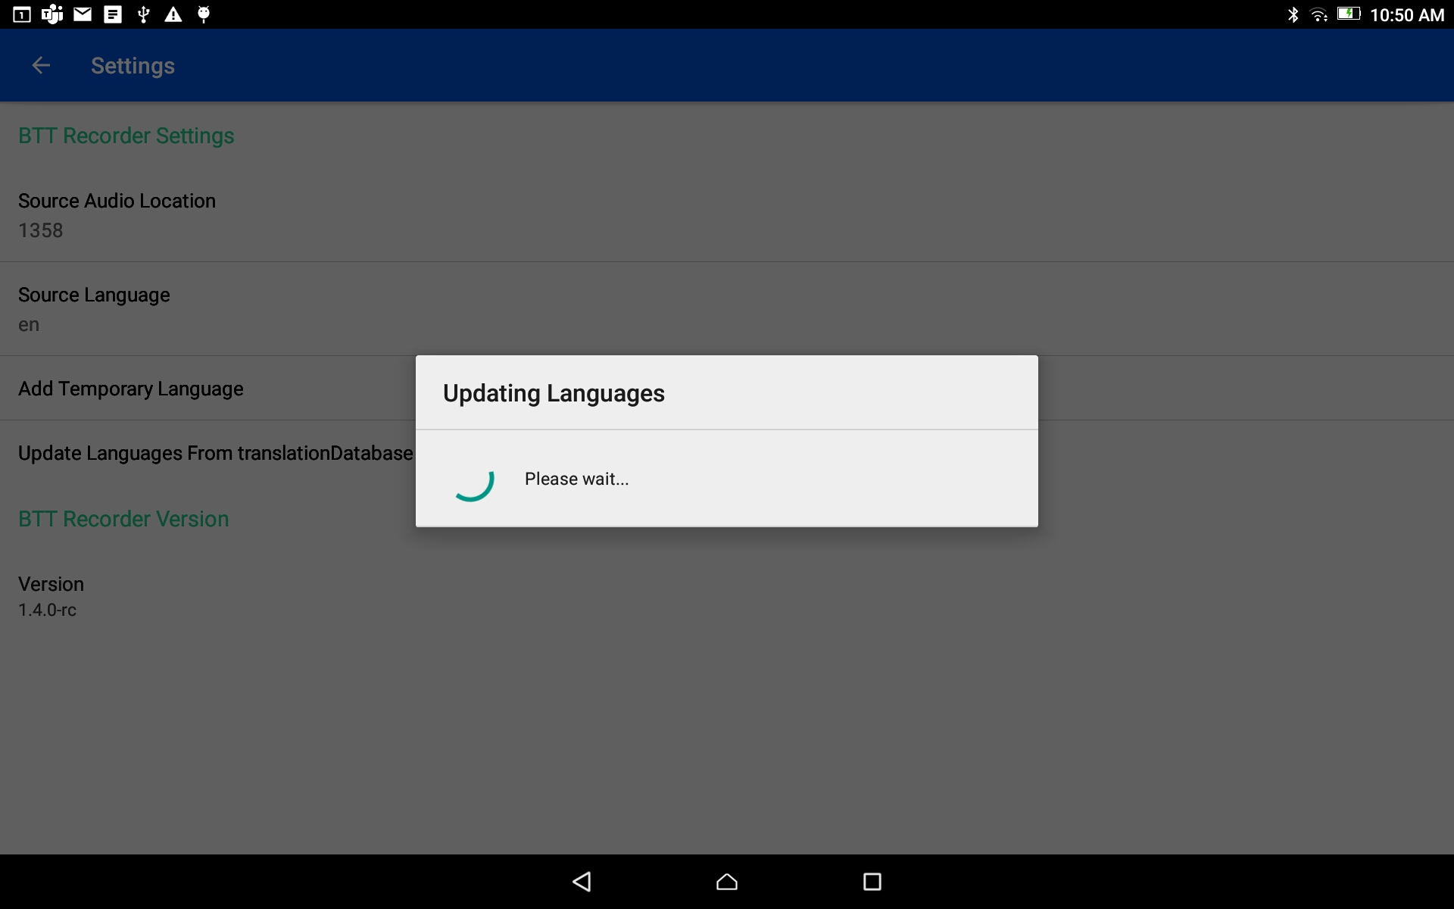
Project Management Home Screen 3-dot Menu - Settings
Update Language From translationDatabase
Tap to run the update
The update will process
The pop-up message window will close when the update is completed.

Slide 10
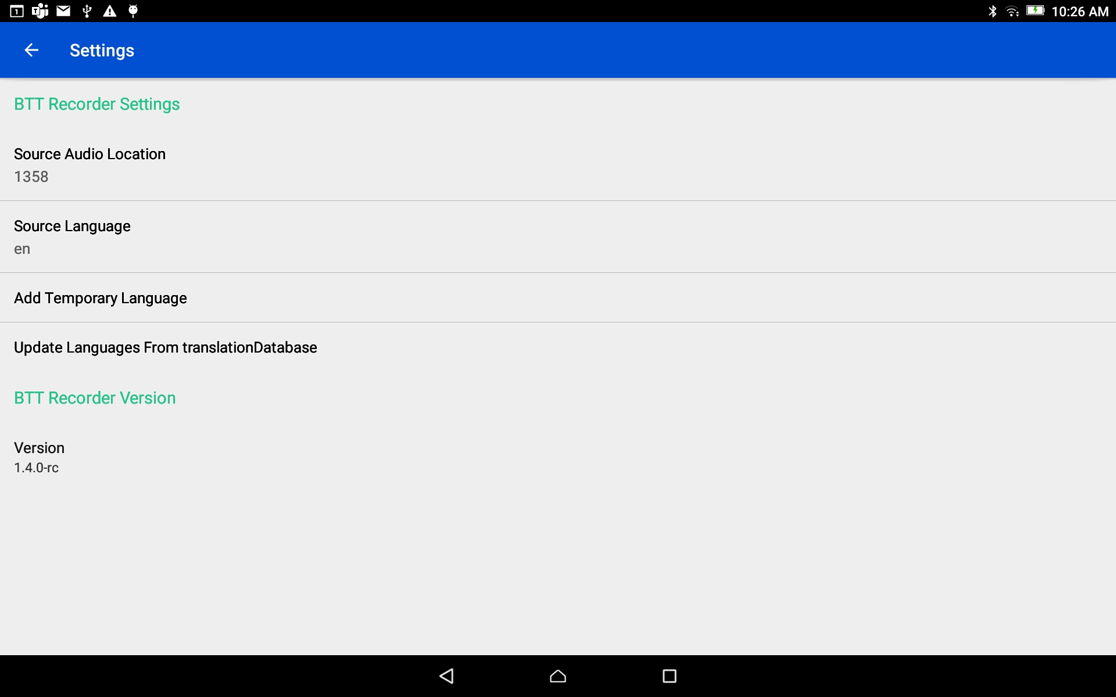
Project Management Home Screen 3-dot Menu - Settings
The BTT Recorder Version information cannot be changed.
Tap the back arrow at the top left to return to the Project Management home screen.

Slide 11
Project Management Home Screen Information
The Project Bars are listed according to most recent viewed.
Tap on any Project Bar to open the project.

Slide 12
Project Management Home Screen Information
The column headings show the order of information on the project bars:
Language - This will be the Target Language of the project.
Book - This is the book that is being translated or recorded.
Completeness - This circle will fill with blue as the project progresses.

Slide 13

Project Management Home Screen Information
There are two icons on each of the project bars:
Information icon
Microphone - Tap this icon to go directly to the recording screen

Slide 14
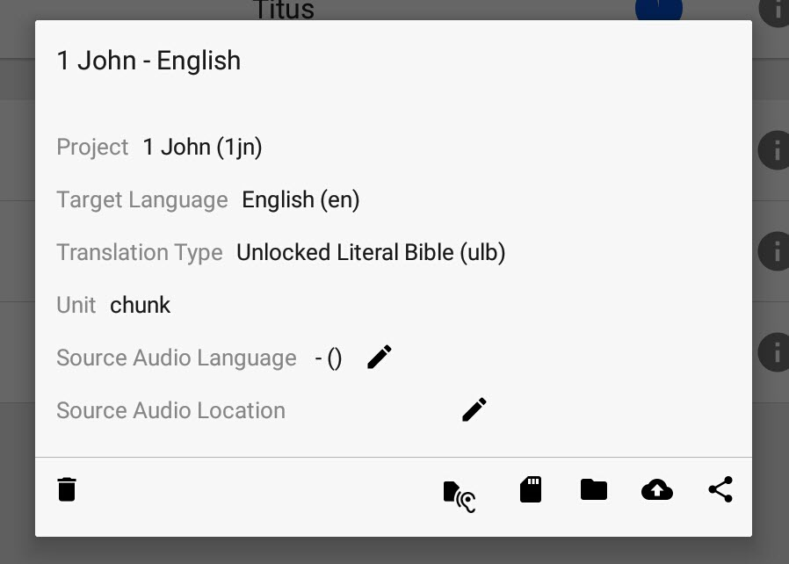
Project Management Home Screen Information Icon Menu
The Book and Target Language are in the title of the details with the rest of the details:
Project - This will have the name of the book.
Target Language - This is the common name followed by the language code in parenthesis.
Tap anywhere outside of the white area to close the Information Menu.

Slide 15
Project Management Home Screen Information Icon Menu
The Book and Target Language are in the title of the details with the rest of the details:
Translation Type - This provide the information on the choice made for the project. (Regular, UDB, or ULB)
Unit - This will be either ‘chunk’ or ‘verse.’
Tap anywhere outside of the white area to close the Information Menu.

Slide 16
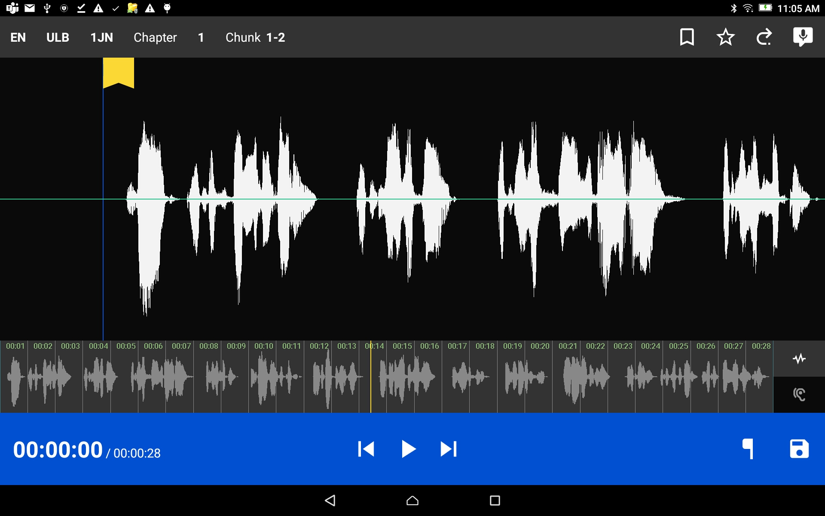
Icons on the Edit Screen Top Bar – Left Side
Language Code
Type of Project
Book ID (3-letter code)
Chapter number – tap + to increase number, tap – to decrease number.
Verse or chunk - tap + to increase number, tap – to decrease number.

Slide 17




Icons on the Edit Screen Top Bar – Right Side
Verse Marker
Star – Tap to rate the recording. Choose between 1, 2 or 3 stars.
Re-record – Tap to open a new recording screen.
Add a Recording – Tap to add a recording in a selected spot on the wave form.

Slide 18





Icons on the Edit Screen Bottom Blue Bar
Timer – the smaller numbers after the slash show the total length of the recording.
Rewind to beginning
Play
Fast Forward to end
Flag – tap to edit the recording
SD Card – tap to save

Slide 19


Icons on the Edit Screen Bottom Gray Bar
Recording Waves – Tap to listen to the Target Language recording.
Listen – Tap to listen to the Source Audio recording.

Slide 20
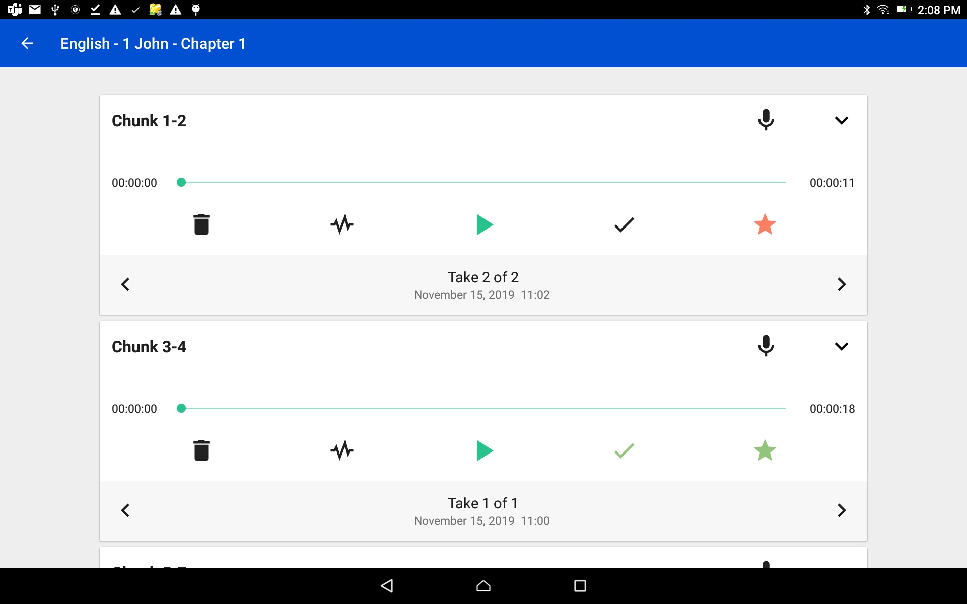

Verse or Chunk Take Bar Access by tapping on arrow at end of verse bar
Time Line – Shows the length and progression of the audio playback.
The line expand left to right as the audio take plays.

Slide 21



Verse or Chunk Take Bar Access by tapping on arrow at end of verse bar
Garbage icon - Tap on the garbage can icon to delete a selected take.
Wave form icon – Tap to enter the editing screen of BTT Recorder.
Play Icon – Tap to play the recording. Tap the pause icon to stop playback.
NOTE:
The number order of the takes will change after deleting, editing, or adding recordings.

Slide 22

Verse or Chunk Take Bar Access by tapping on arrow at end of verse bar
Check Mark – Tap to turn green.
A green check mark indicates:
Approved
Rated with 3 stars

Slide 23

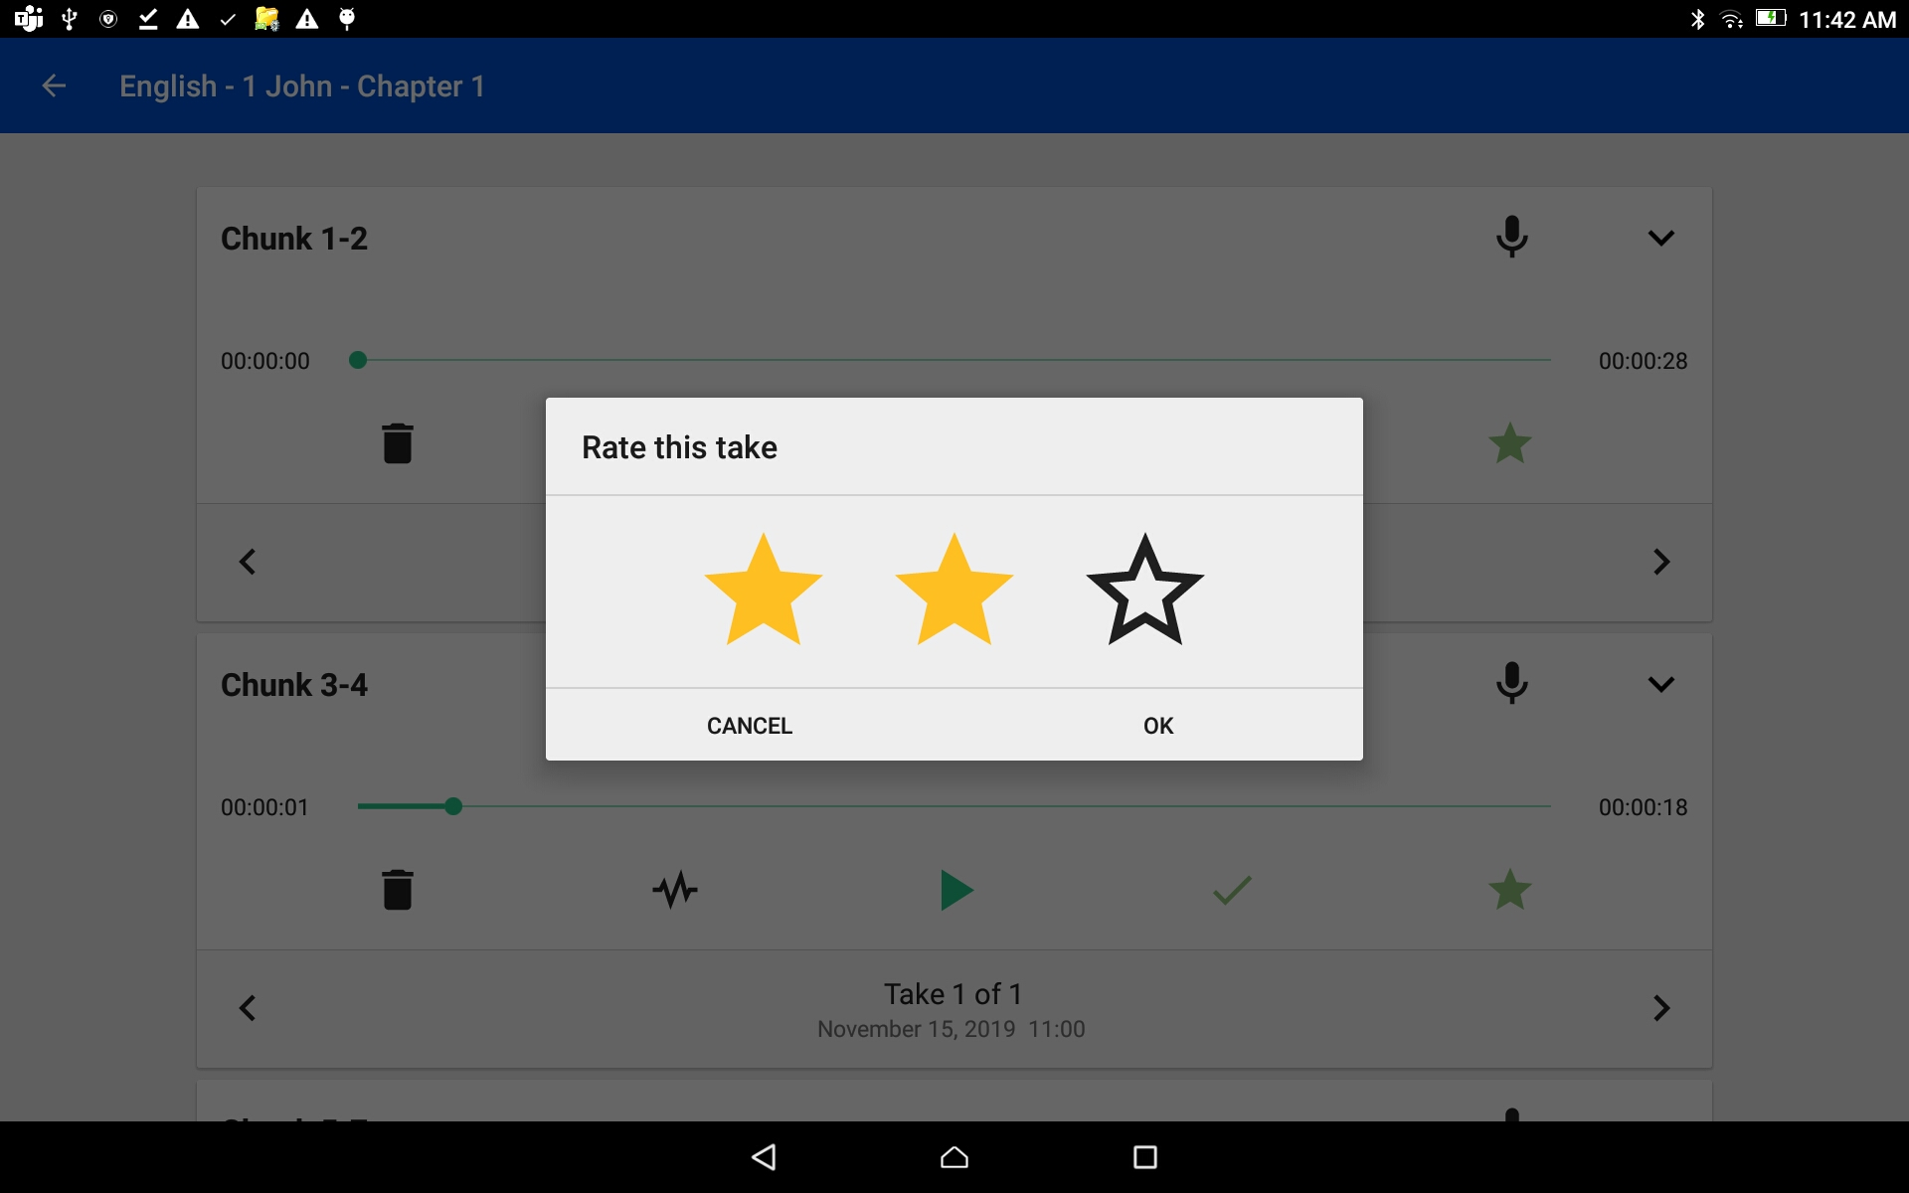
Verse or Chunk Take Bar Access by tapping on arrow at end of verse bar
Star – Tap on the star icon to rate the recording.
1 star = red
2 stars = yellow
3 stars = green

Slide 24

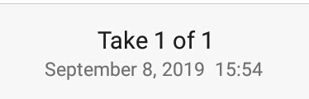
Verse or Chunk Take Bar Access by tapping on arrow at end of verse bar
Arrows on bar - Tap on the right or left arrow to go between the audio takes for a verse.
Notice the take number changes.
Take # of # – Display the take available. Has Date and time it was saved.

