Slide 1
BTT Recorder v1.4
Editing
Recordings
Finish
A book

Slide 2
Words to know:
Compile – to put into one piece, combine.
Stitch – to combine the different recordings into one recording.

Slide 3
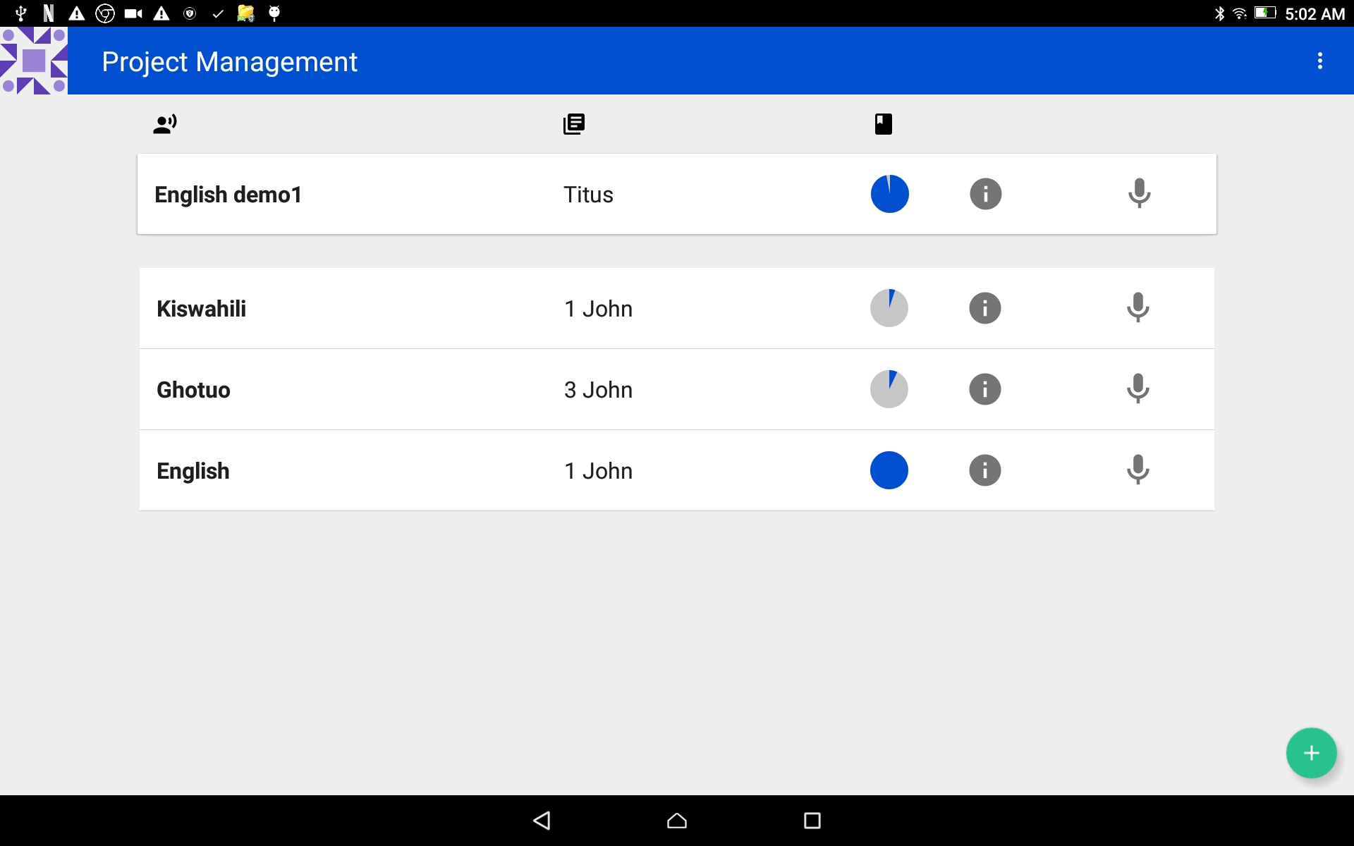
Complete the Recording of a Book
Start in the Project Management home screen and tap on the book to finish.
Notice that the circle should be full.

Slide 4
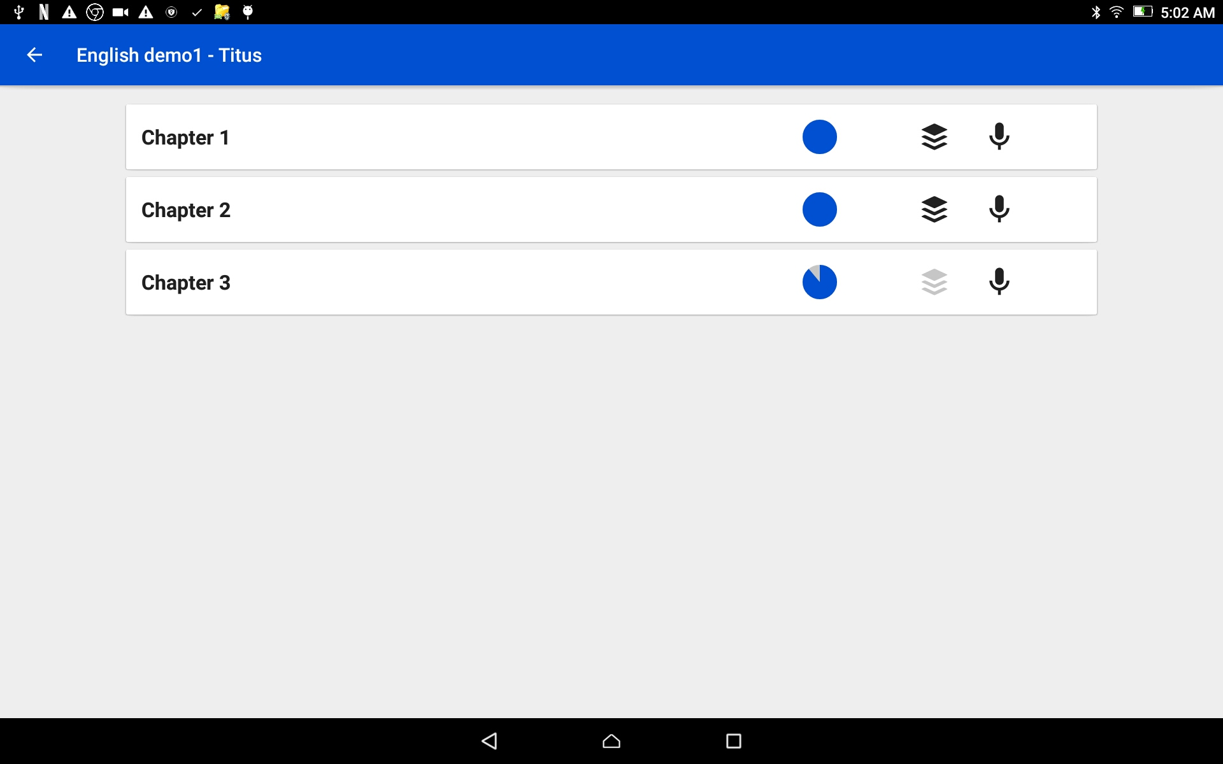
Complete the Recording of a Book
The chapters are listed – each one on a separate bar.
Note the color of the stack of paper icon.
Black - the chapter has all required recordings.
Gray – the chapter is missing some recordings.

Slide 5
Complete the Recording of a Book
Tap on a chapter bar to open a completed chapter.
Note the full blue circle.

Slide 6
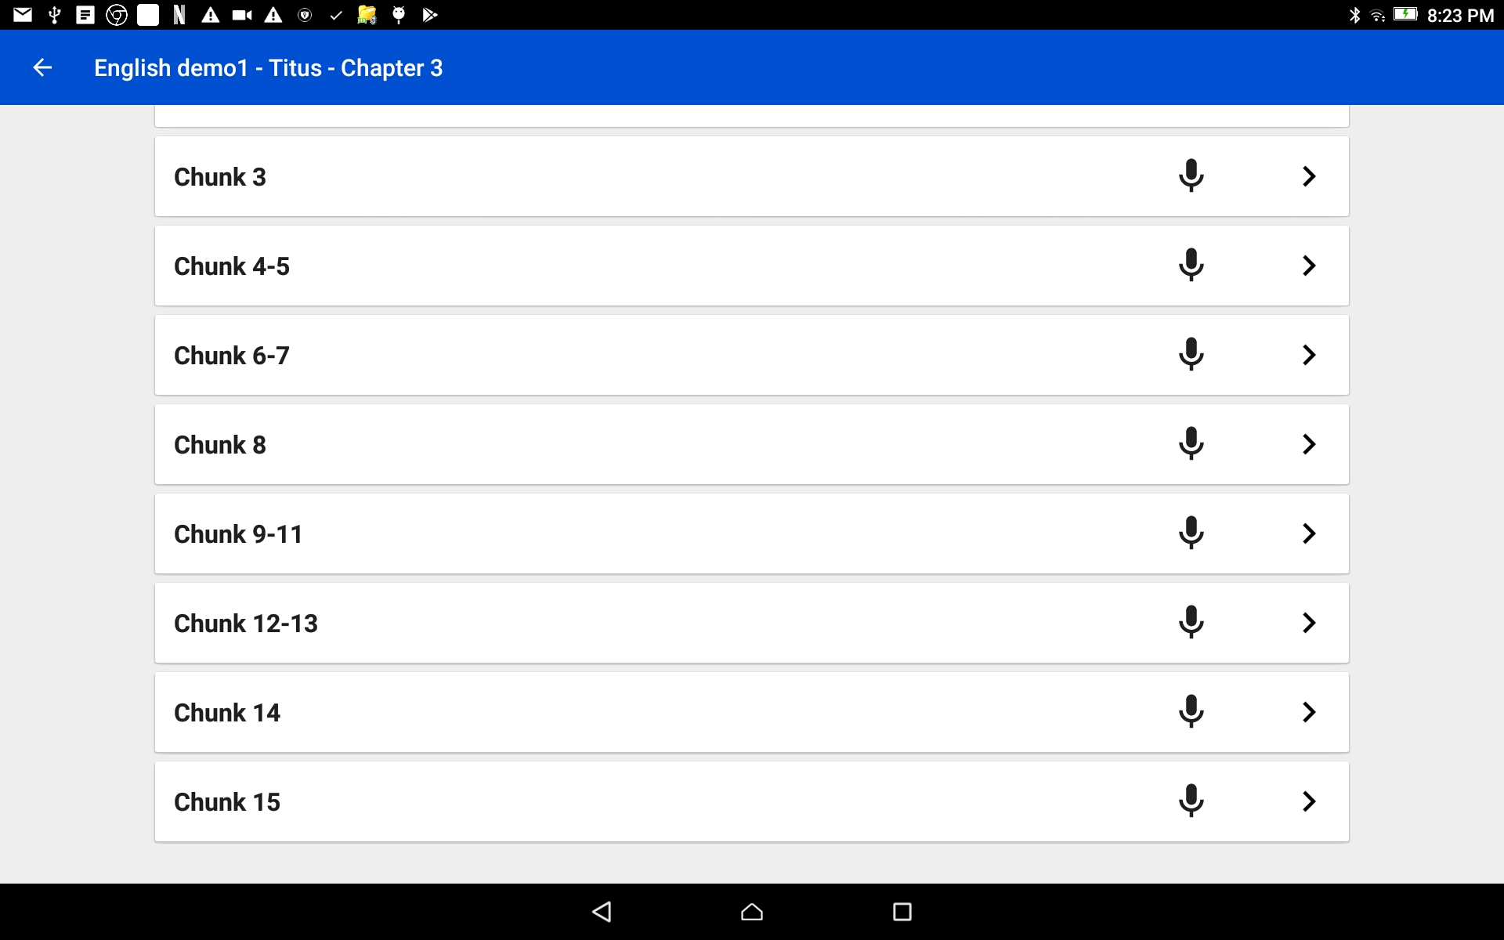
Complete the Recording of a Book
Check to make sure there is only one recording for each chunk or verse.
NOTE: if there is no number next to the microphone, there is only 1 take per verse/chunk.

Slide 7
Complete the Recording of a Book
When there are multiple takes per verse or chunk, there are rules for what take is included in the chapter recording.
These are the rules followed when combing a chapter into a single audio file:
If there is a recording with a star rating, they are included according to the number of stars.
3 green stars = first choice; 2 yellow stars = second choice; 1 red star = third choice
If there is not a star rating given, then a green check mark is used.
If there is not a star rating and the check is not green, then the most recent take is used.

Slide 8
Complete the Recording of a Book
Tap on the back arrow on the top blue bar to return to the chapter listing.
←

Slide 9


Complete the Recording of a Book
Tap on the black stack of paper icon to stitch the chapter into one file.

Slide 10
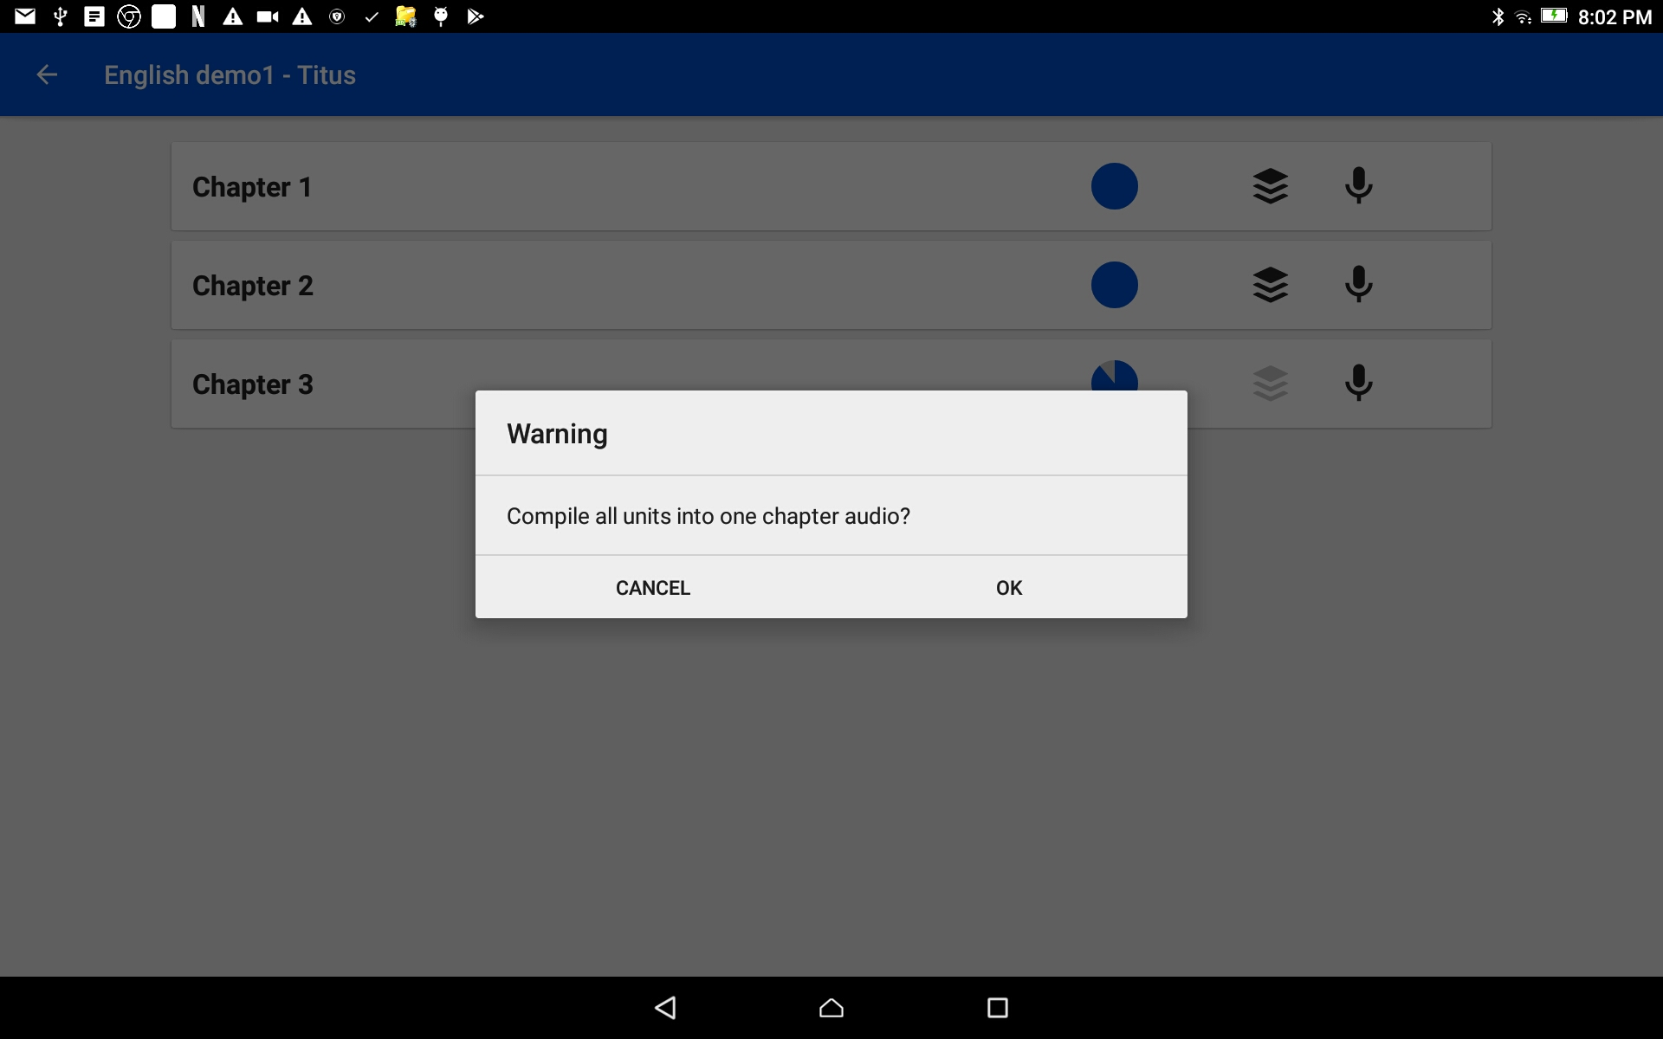
Complete the Recording of a Book
Tap on OK to accept the action of making the chapter into a single file.

Slide 11
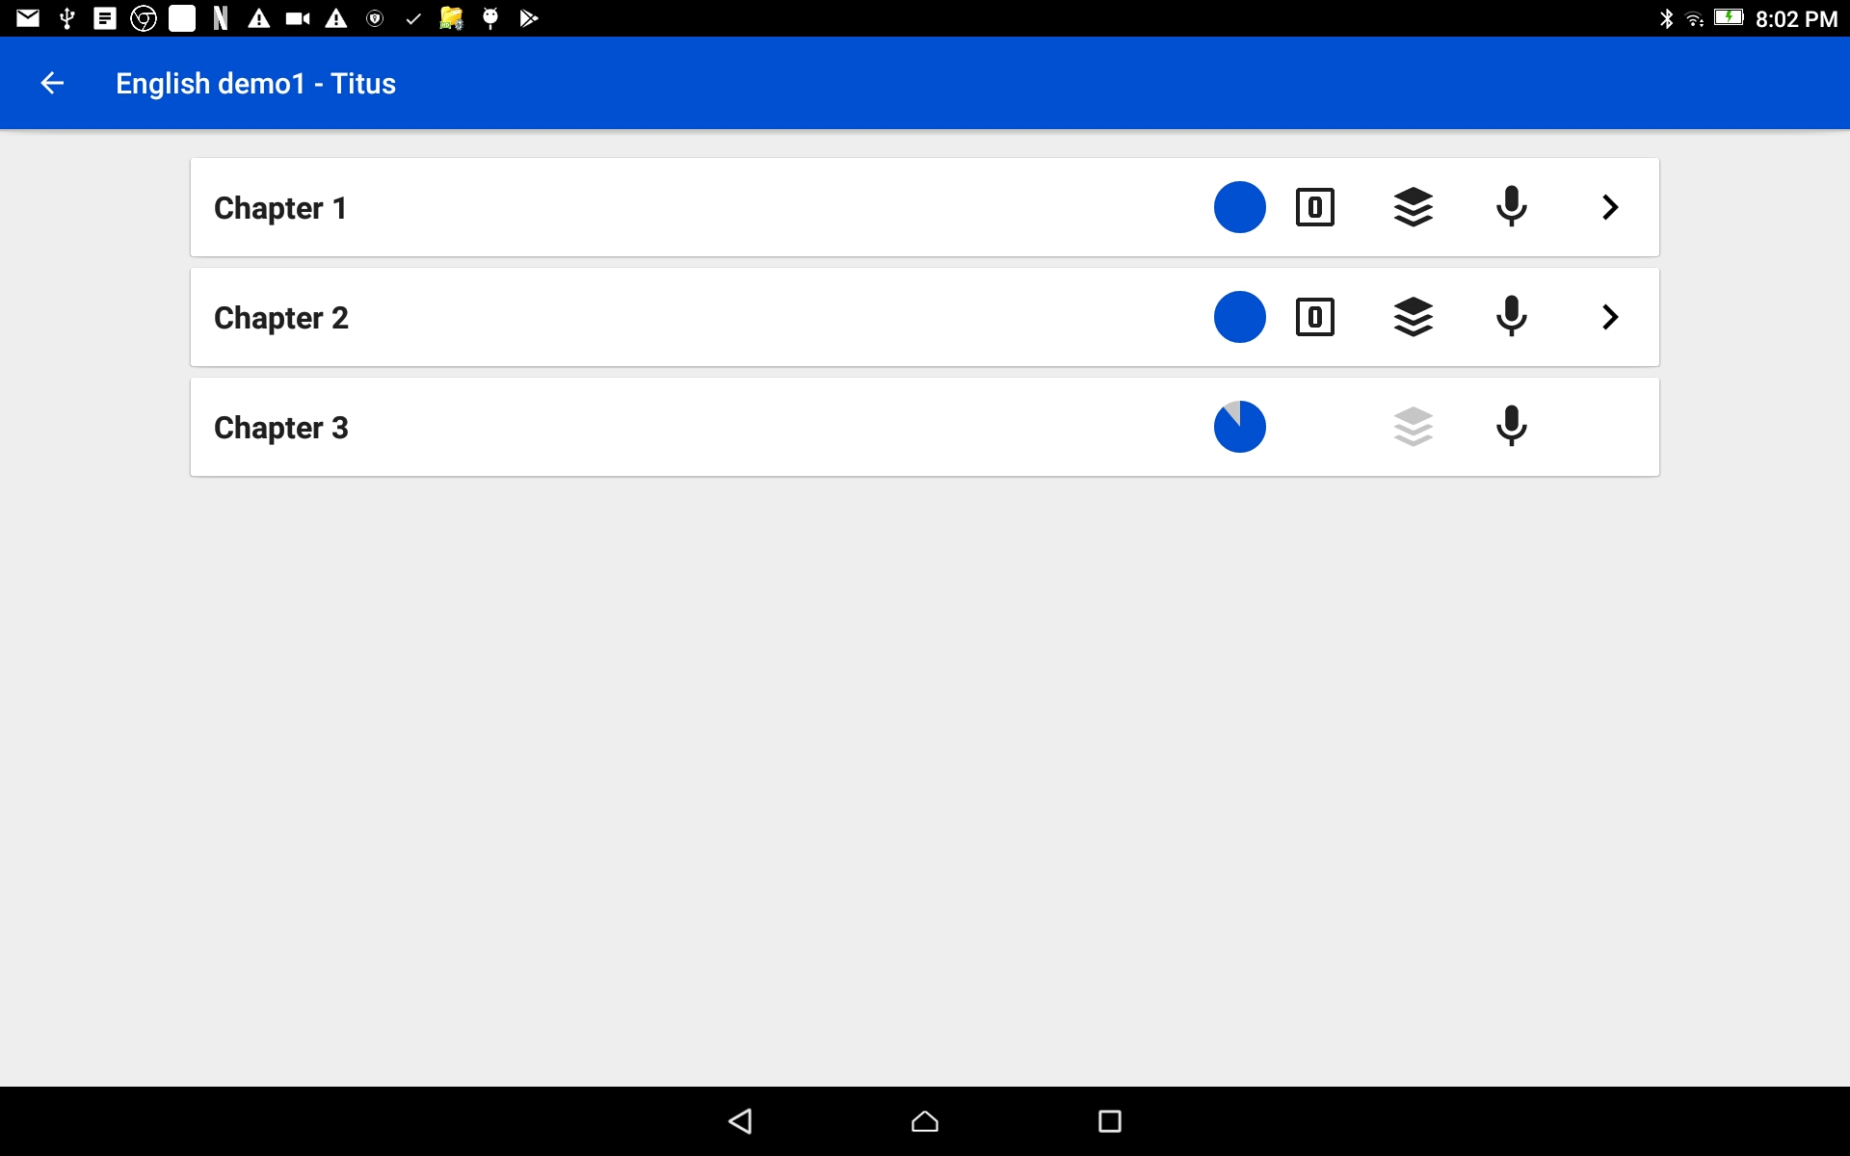
Complete the Recording of a Book
Listen to the chapter
Tap the > at the end of the chapter bar.

Slide 12
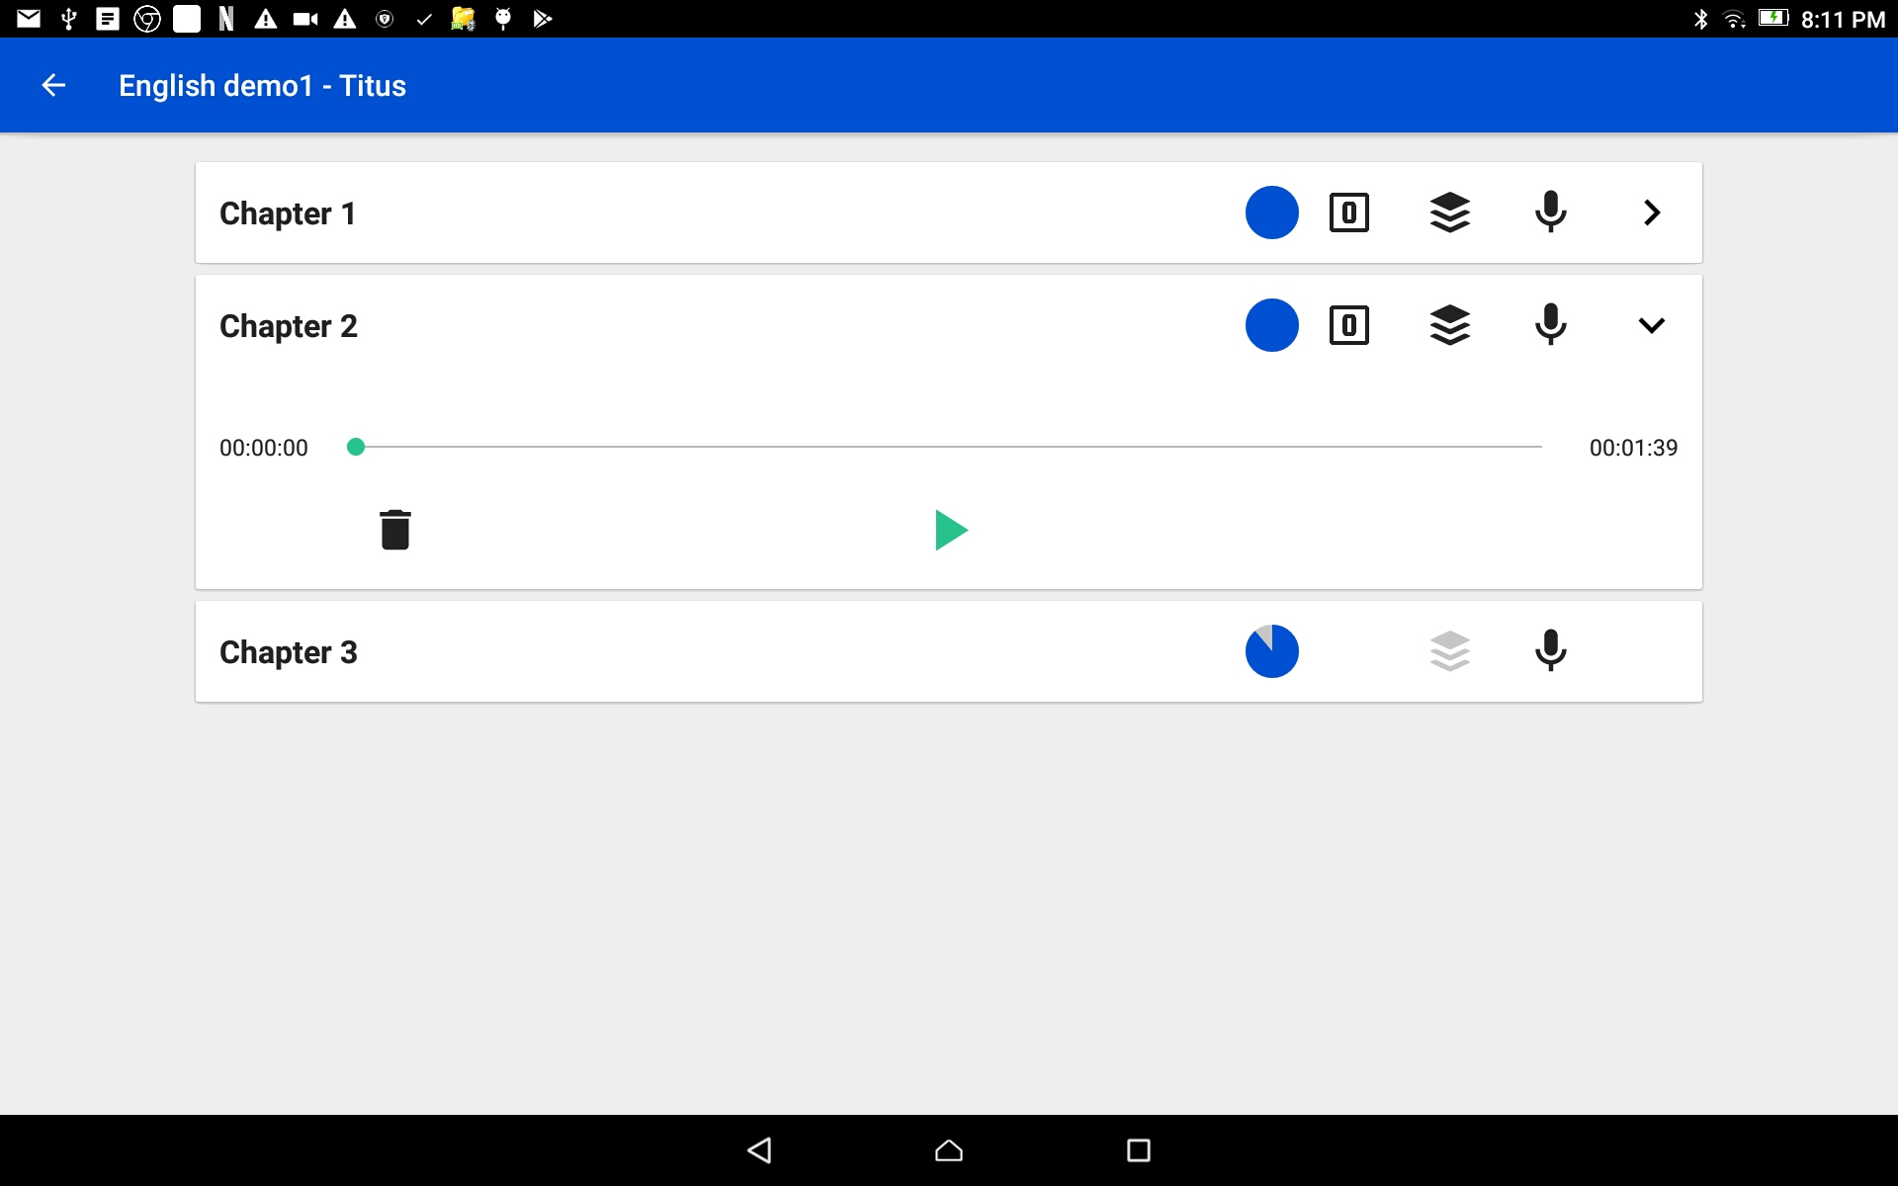
Complete the Recording of a Book
Listen to the chapter
Tap the > at the end of the chapter bar.
Press the play icon to listen to the chapter.

Slide 13
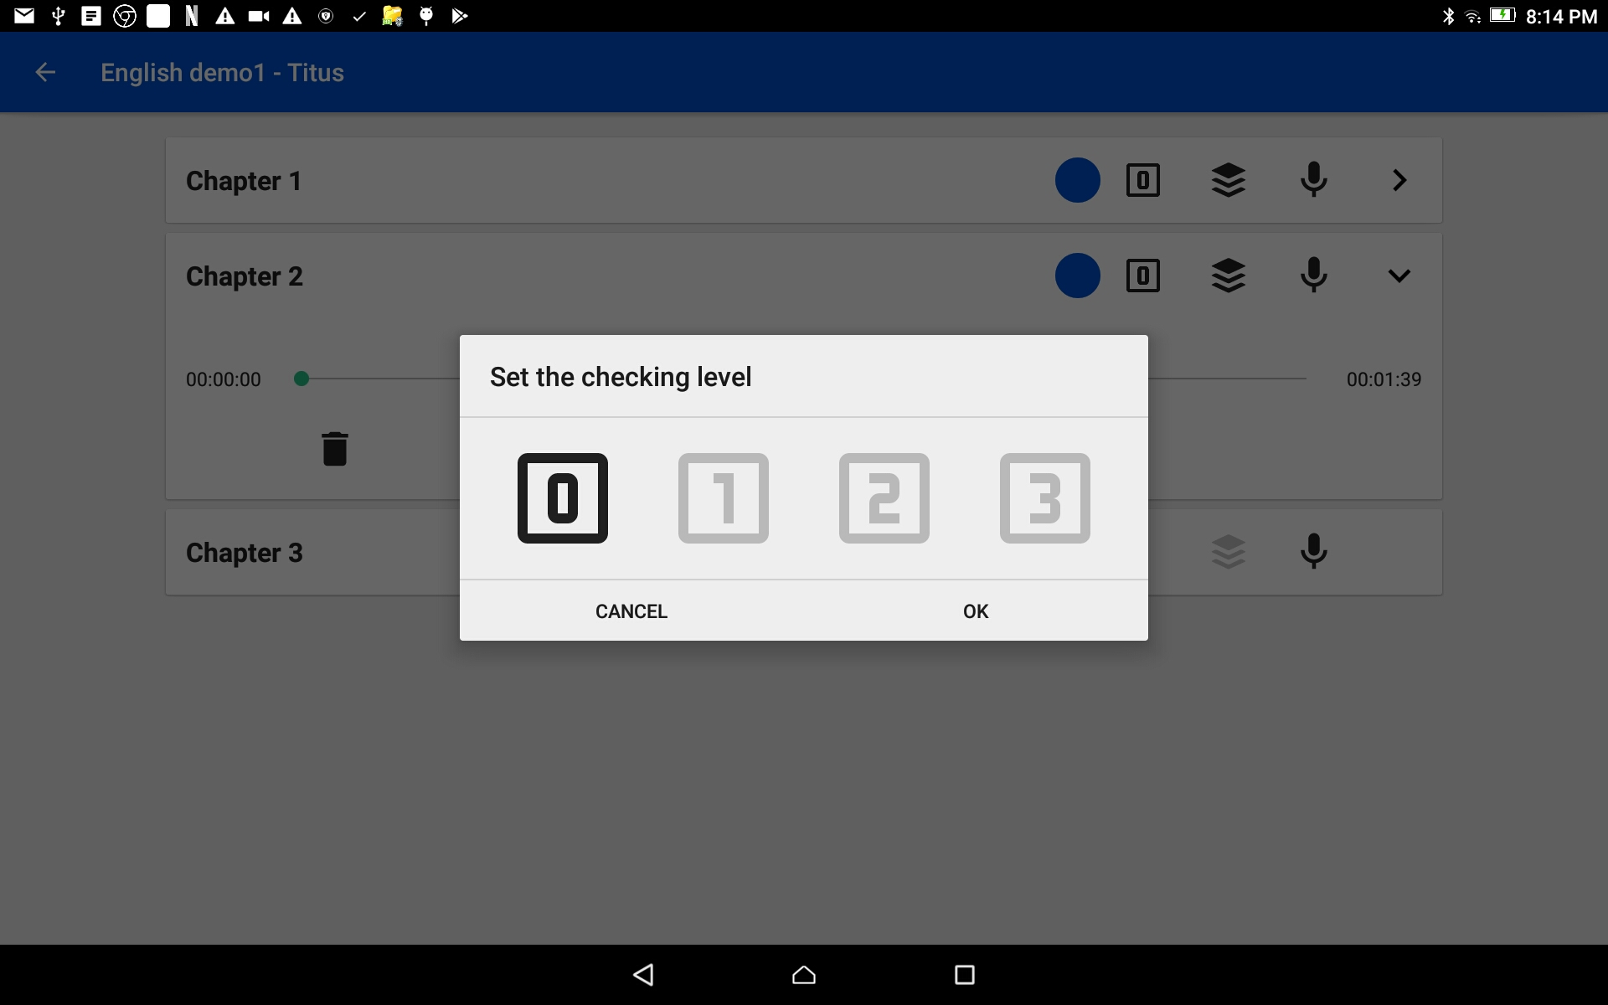
Complete the Recording of a Book
Rate the chapter
Tap on the number box.
Choose a rating by tapping on one of the numbers.
0 = no rating
3 = best rating
Tap on the OK link to save the rating and close the window.

Slide 14

Complete the Recording of a Book
Repeat these steps until each chapter has been stitched together into an audio file.
Chapters with a gray colored stack of paper is not ready to be stitched.

Slide 15
Complete the Recording of a Book
Did you notice the partial blue circle?
That indicates a partial chapter.
Tap on the chapter bar with the gray colored stack of paper.

Slide 16
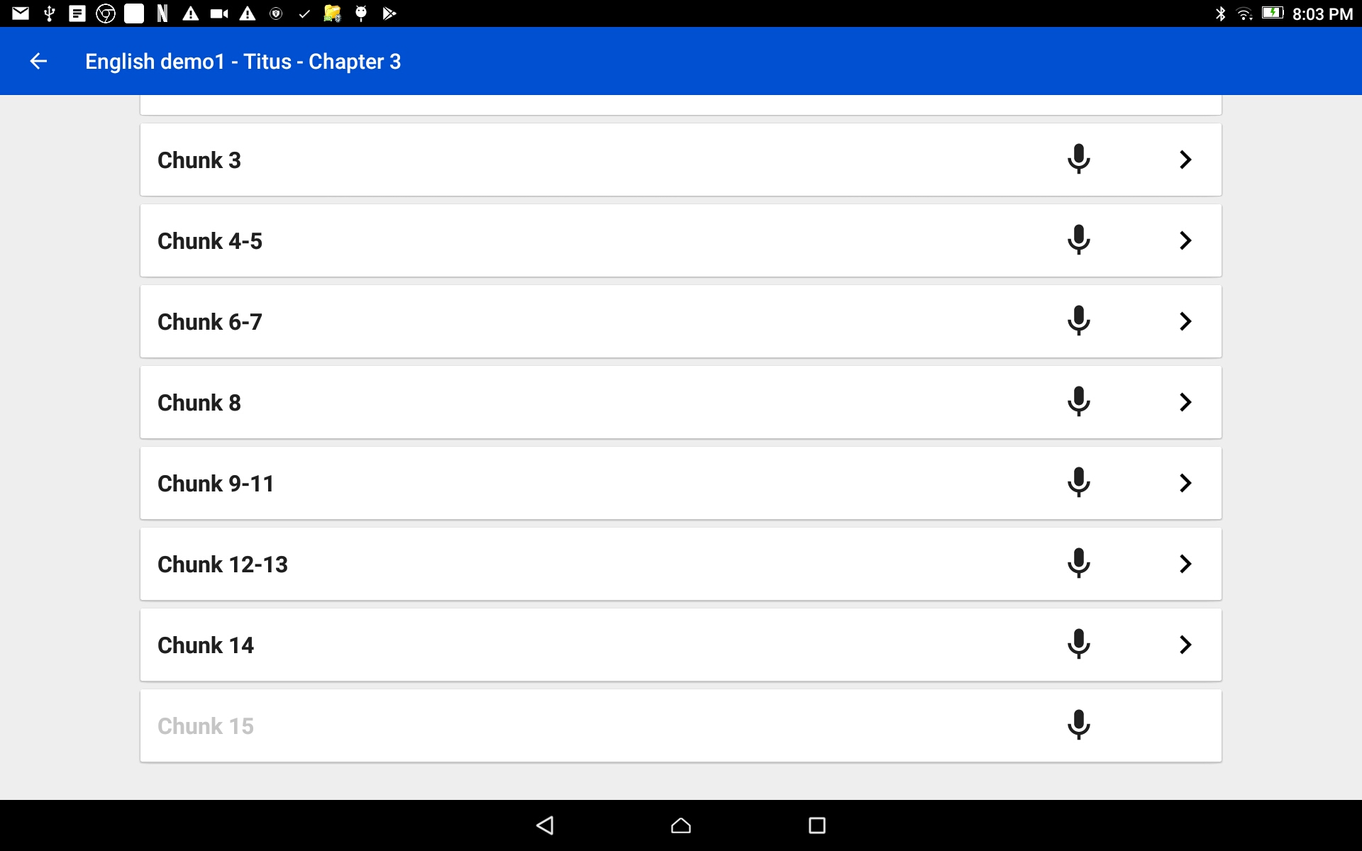
Complete the Recording of a Book
Find the verse or chunk that does not have a recording.
HINTS:
There is no arrow next to the microphone.
The verse/chunk number is in gray font.

Slide 17
Complete the Recording of a Book
Tap on the microphone icon and record the missing verse.
When done and all the verses/chunks have recordings; tap the back arrow to return to the chapter listing.

Slide 18
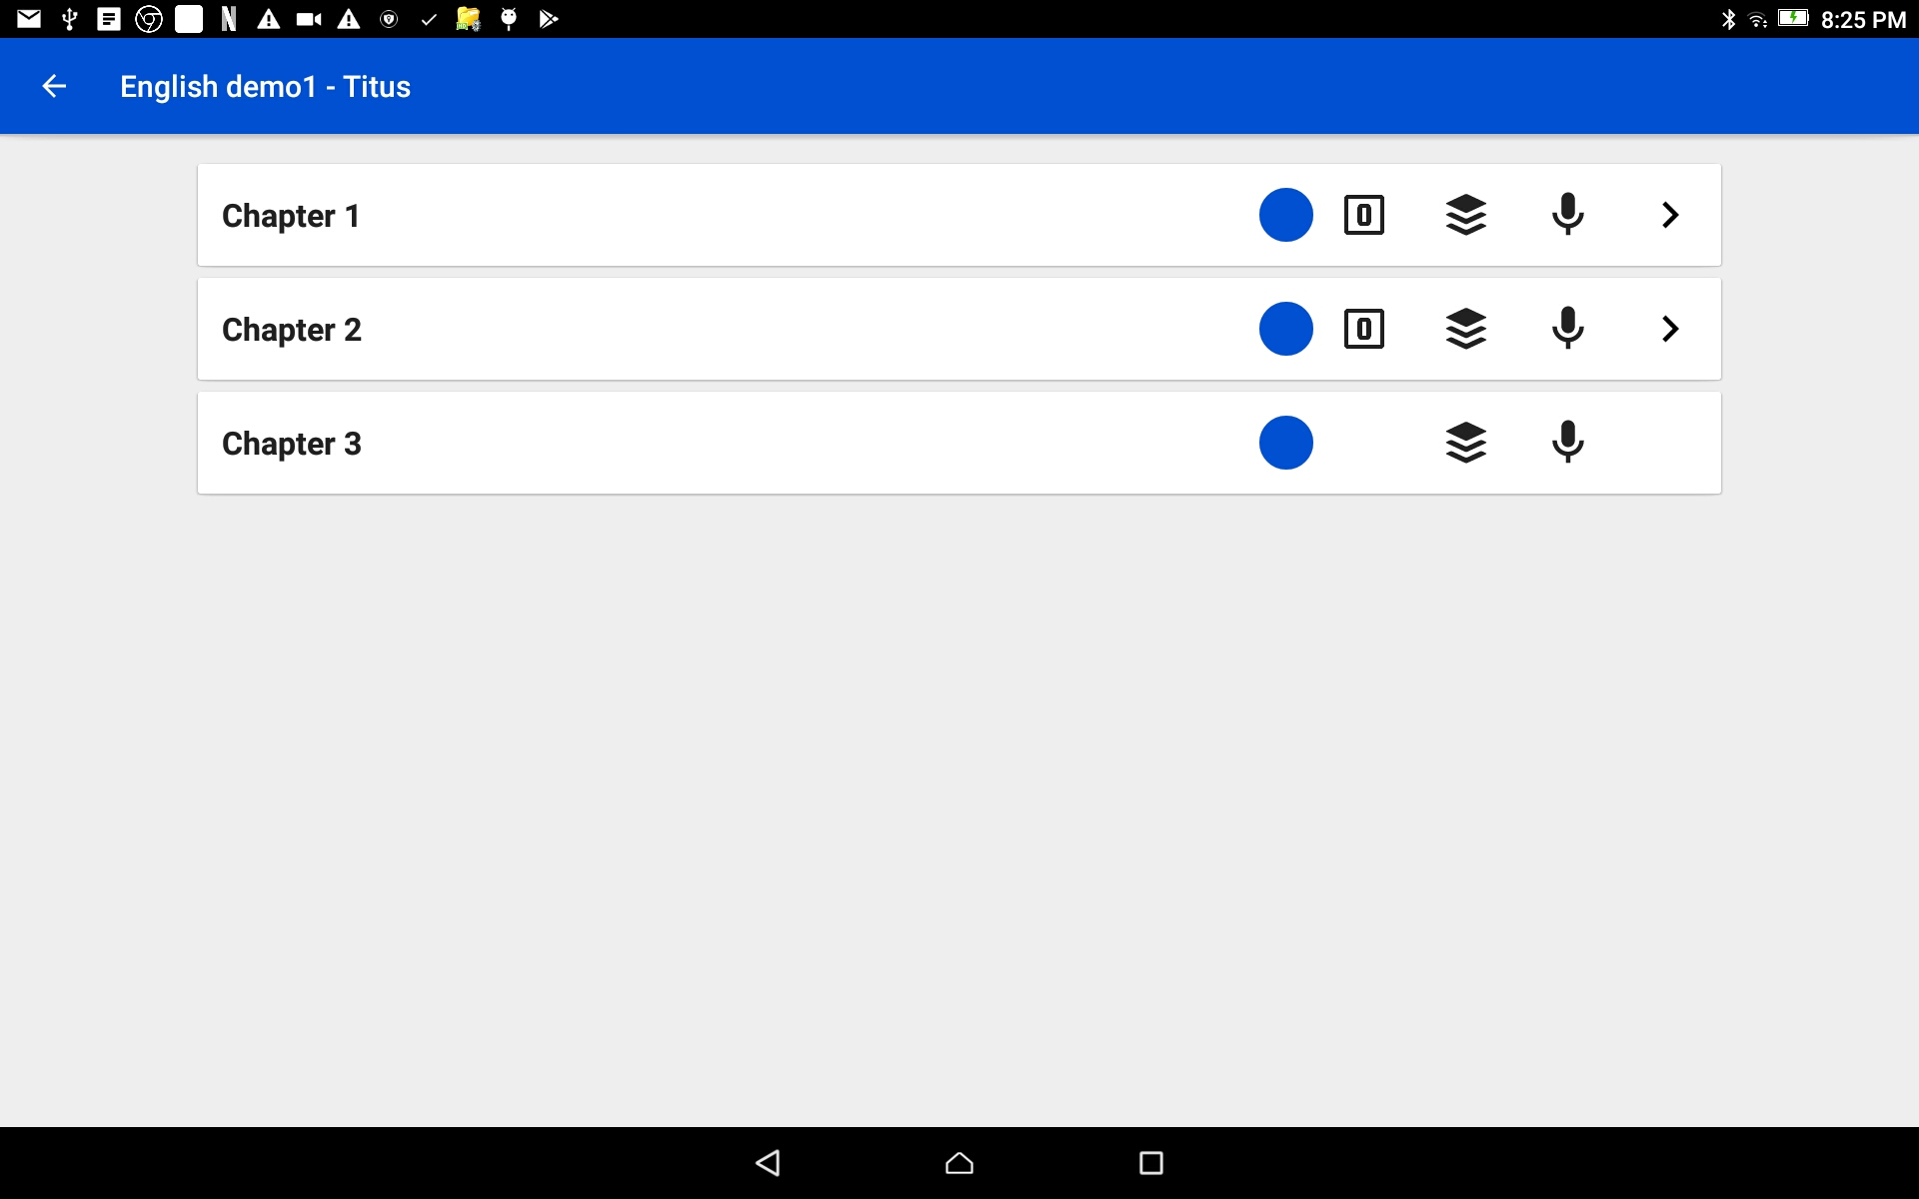
Complete the Recording of a Book
Tap the stack of black colored paper.
Remember: Chapters with the number in a box icon are the chapters that have been stitched.

Slide 19
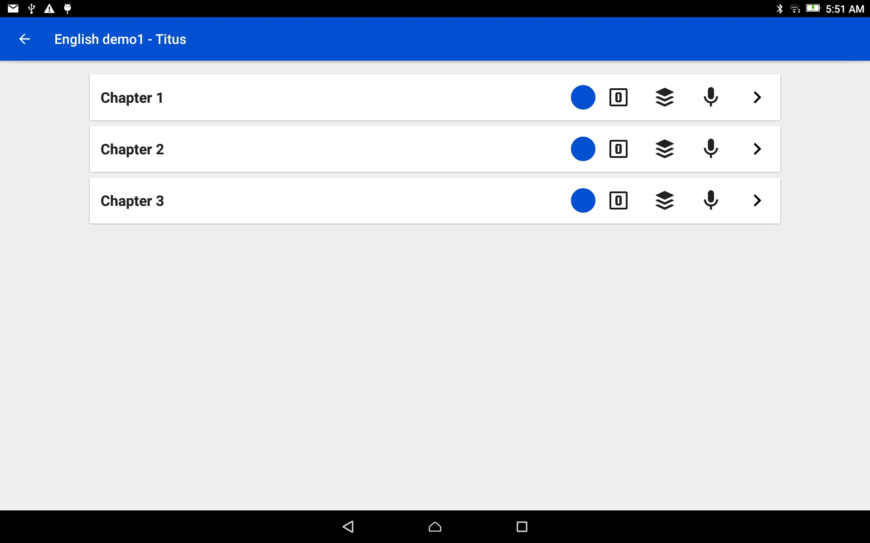
Complete the Recording of a Book
All of the chapters of this book have been stitched together.
The recordings are now available in complete chapters.
Tap the back arrow to go to the Project Management home screen.

Slide 20
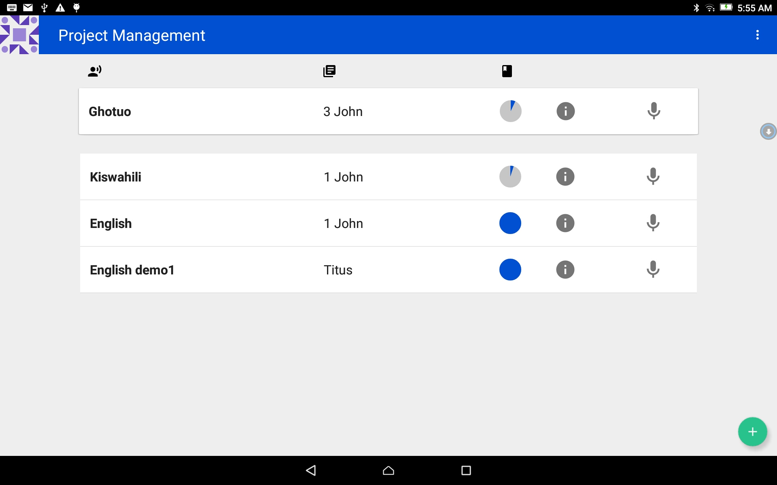
Complete the Recording of a Book Share the recordings
Tap on the information icon on the bar of the finished book.

Slide 21
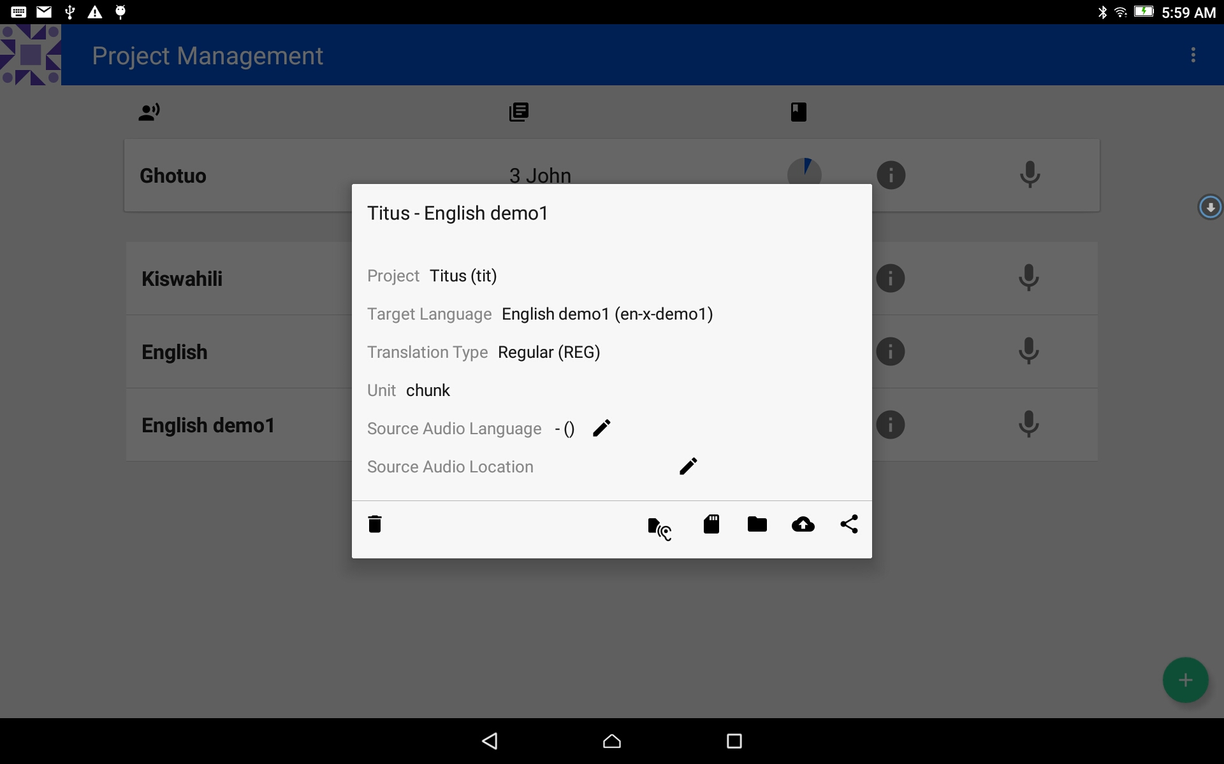
Complete the Recording of a Book Share the recordings
Tap on the information icon on the bar of the finished book.
The Project Information window opens.
Tap on the SD card icon.

Slide 22
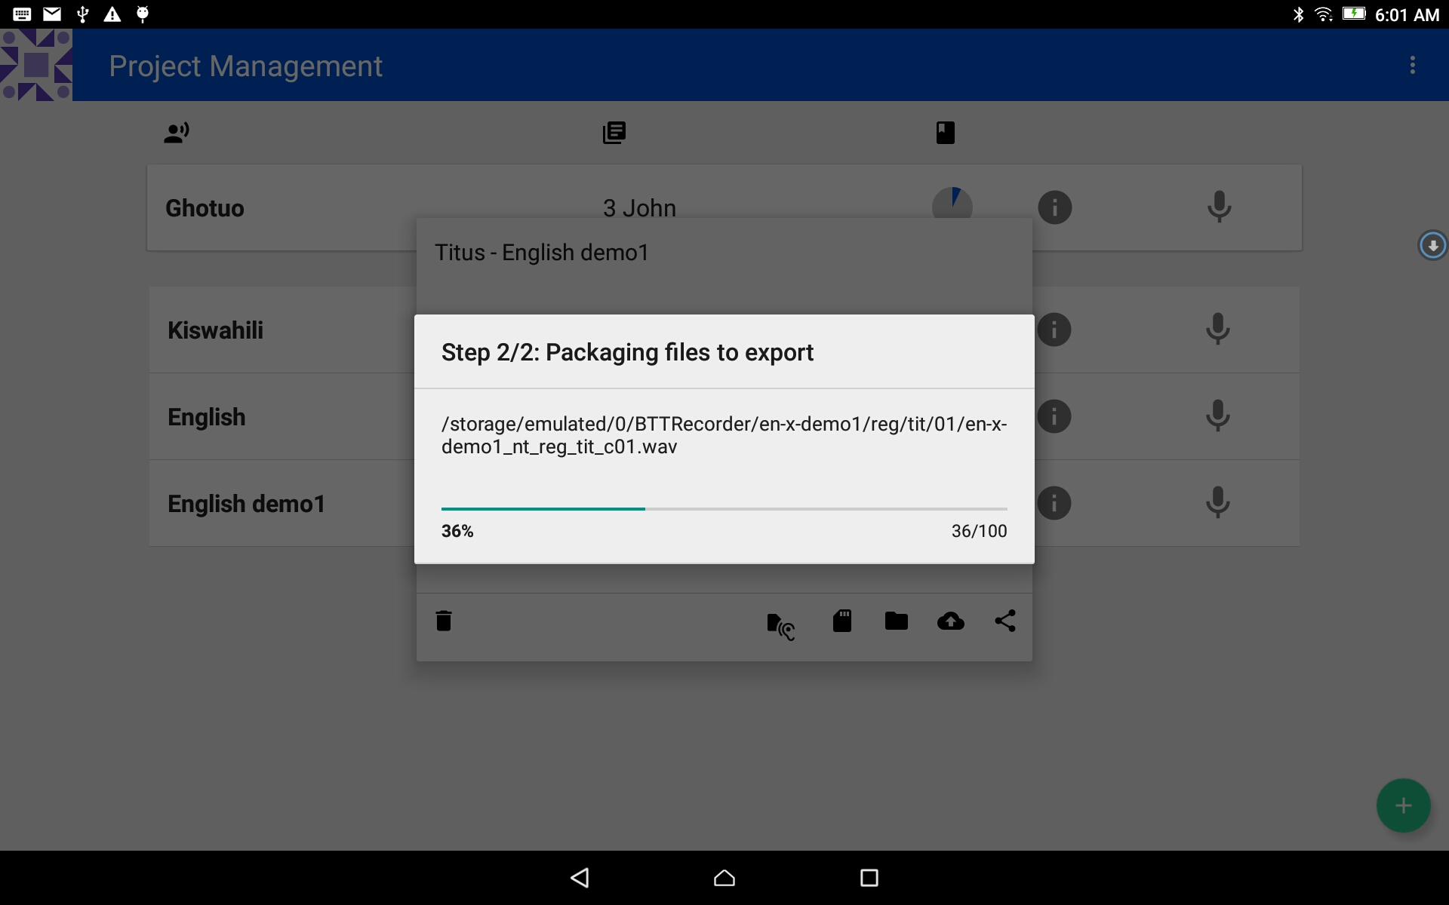
Complete the Recording of a Book Share the recordings
The Packaging process begins.
NOTE: that chapter files are included. (_c01.wav)
The process indicator window will close when the packaging is done.

Slide 23
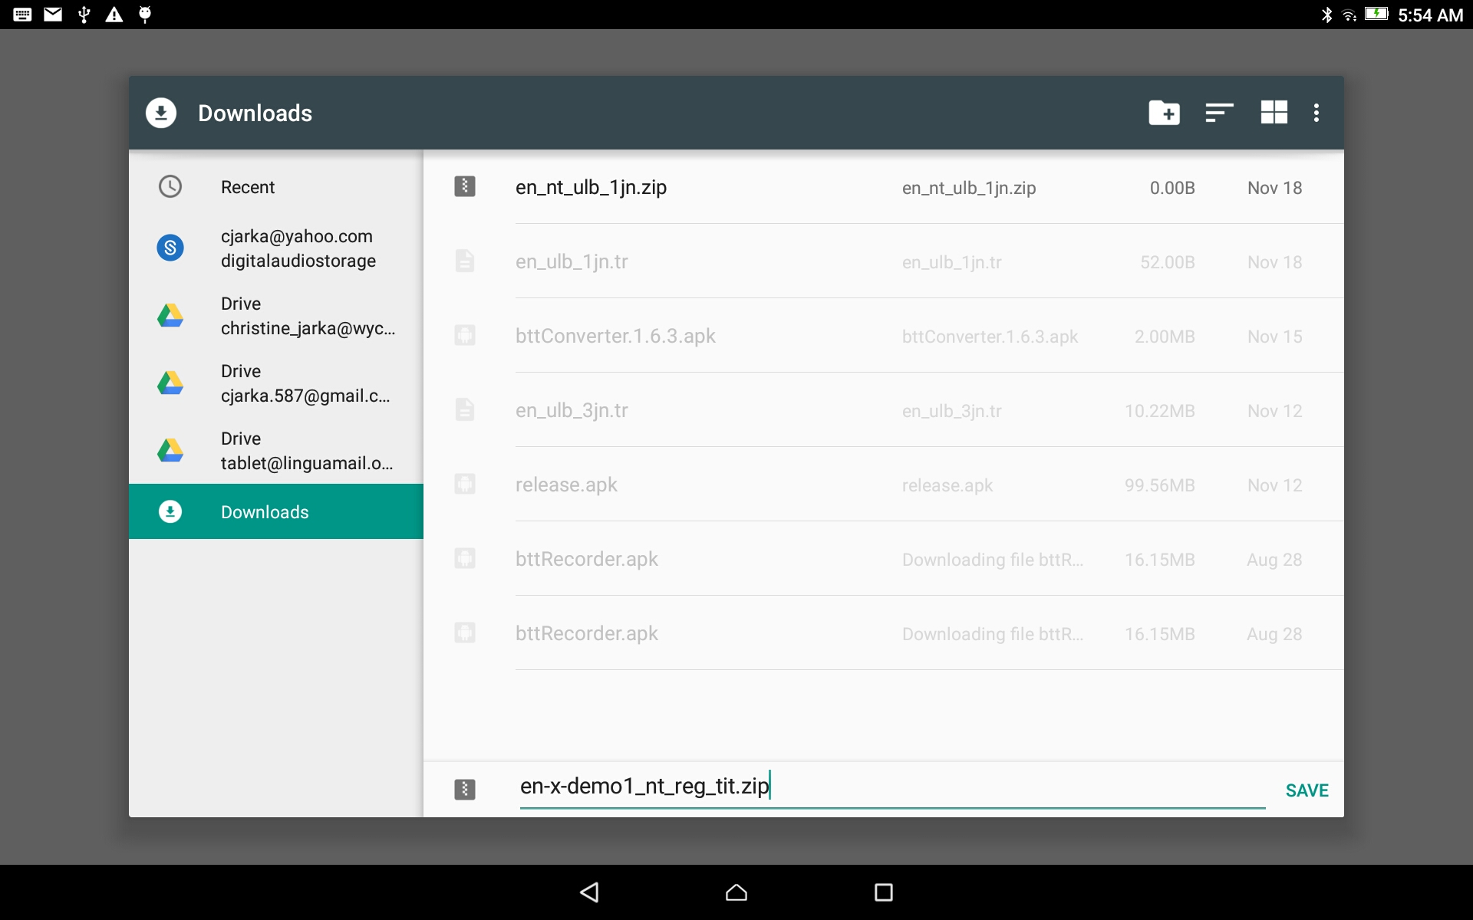
Complete the Recording of a Book Share the recordings
The file is saved to the Downloads folder.
Optional: change the name of the file.
Tap SAVE to complete the process.

Slide 24
Complete the Recording of a Book Share the recordings
BTT Recorder returns to the Project Management home screen.
The Project is now ready to share with others using the tablet’s file manager.

