Slide 1
BTT Recorder v1.4
Starting a new project
From
Record Section

Slide 2
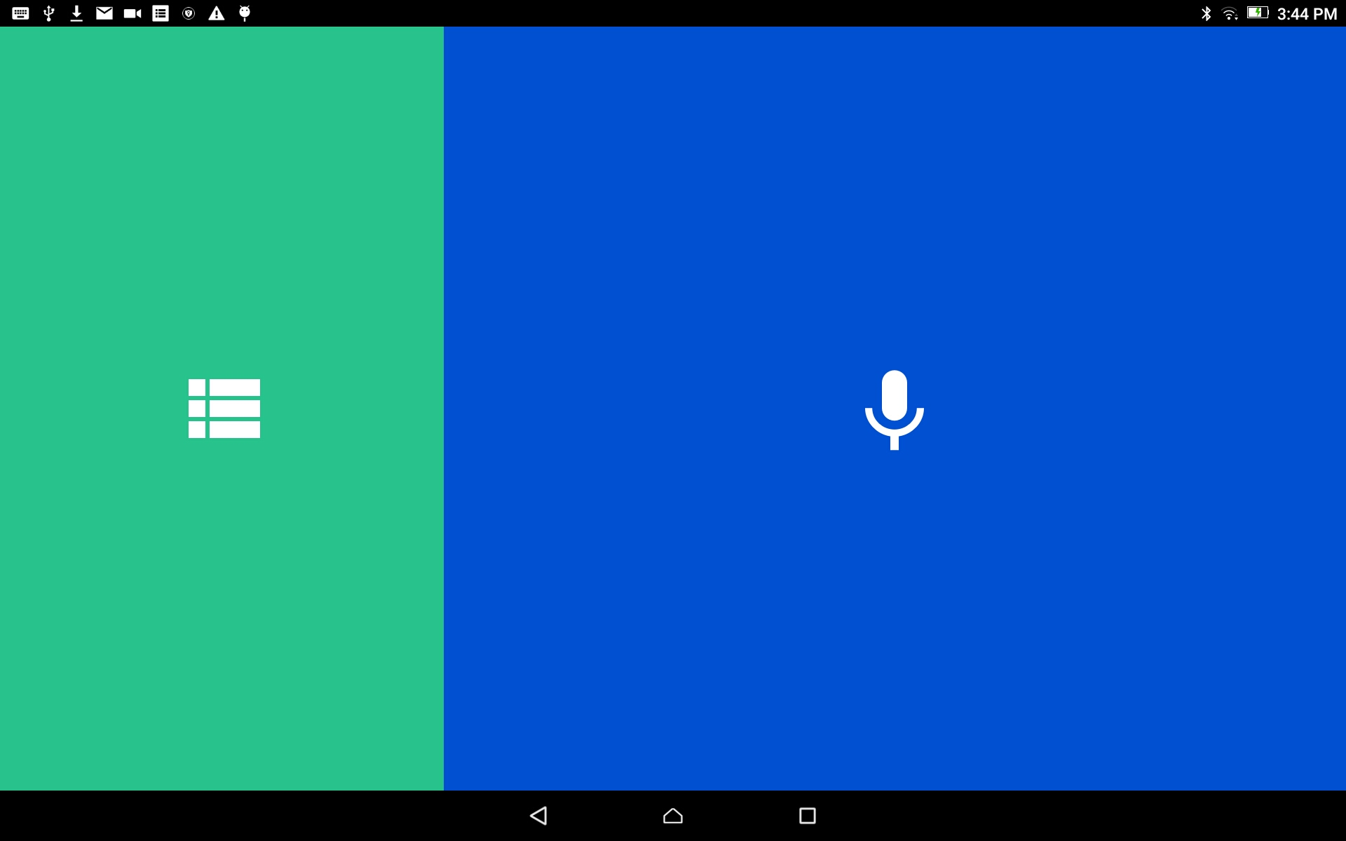
Start a Project:
NOTE: A new project can be started in the Recording Section ONLY when it is the first time BTT Recorder is used (a new install.)
From the home screen, tap in the blue area to open the Project Manager.

Slide 3
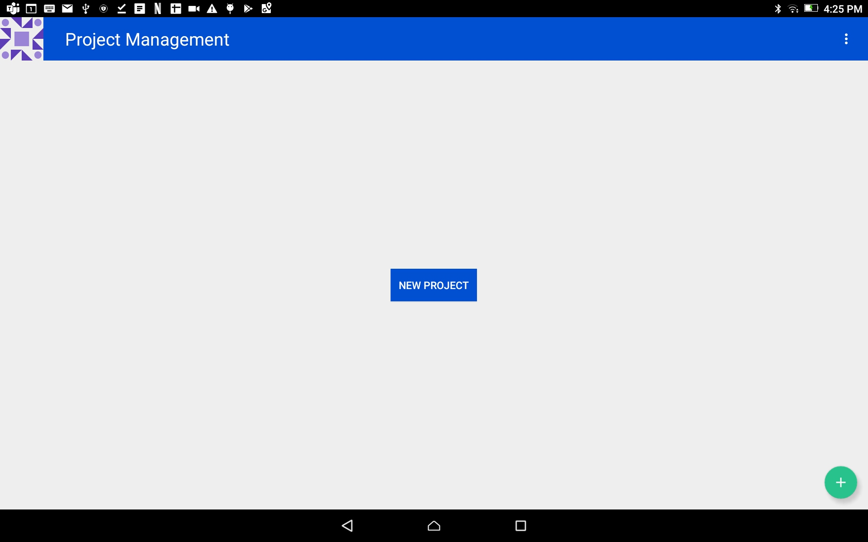
Start a Project:
Create a new project:
Tap on the ‘NEW PROJECT’ blue button.
NOTE: During these next steps, you may tap on the left arrow in the top blue bar to go back to the previous screen at any time.
You may want to go to the previous screen to make a different choice

Slide 4
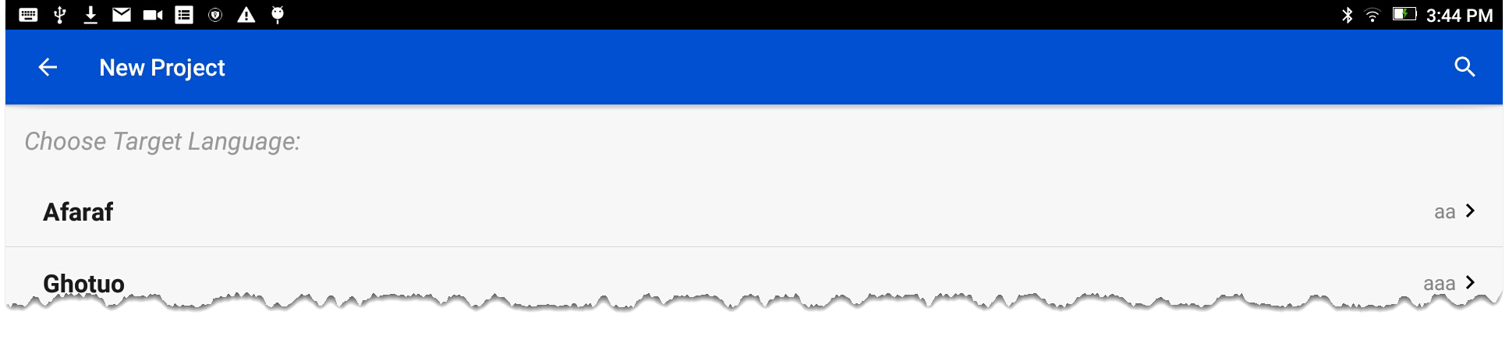
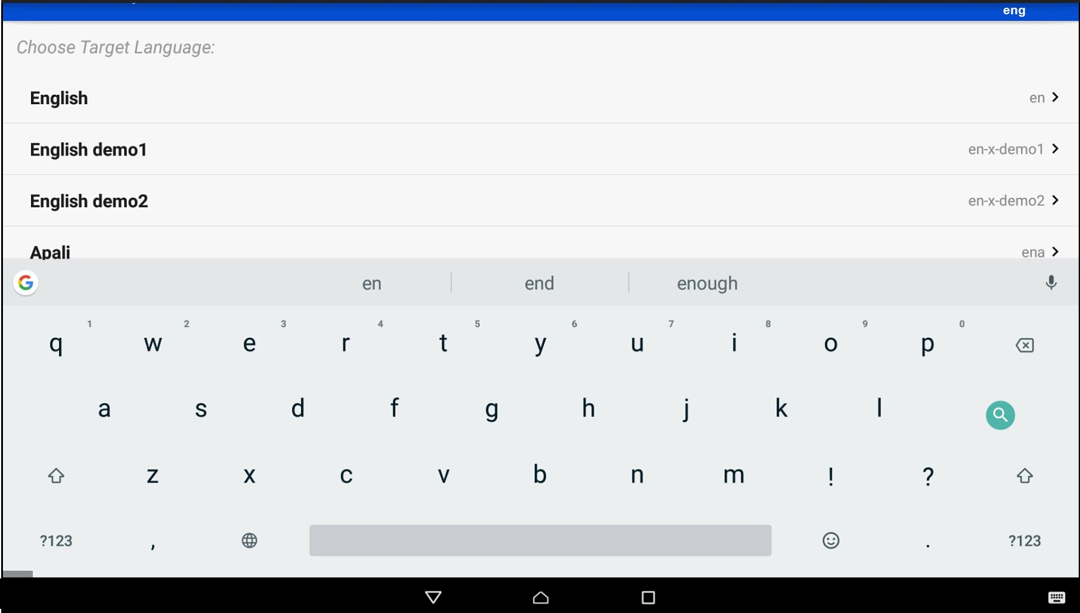


Start a Project
Select the Target Language:
The Target Language is the language into which you will translate.
Search for the desired language by either:
Scrolling to the language name.
OR
Clicking the magnifying glass and typing in the language name or language code.

Slide 5
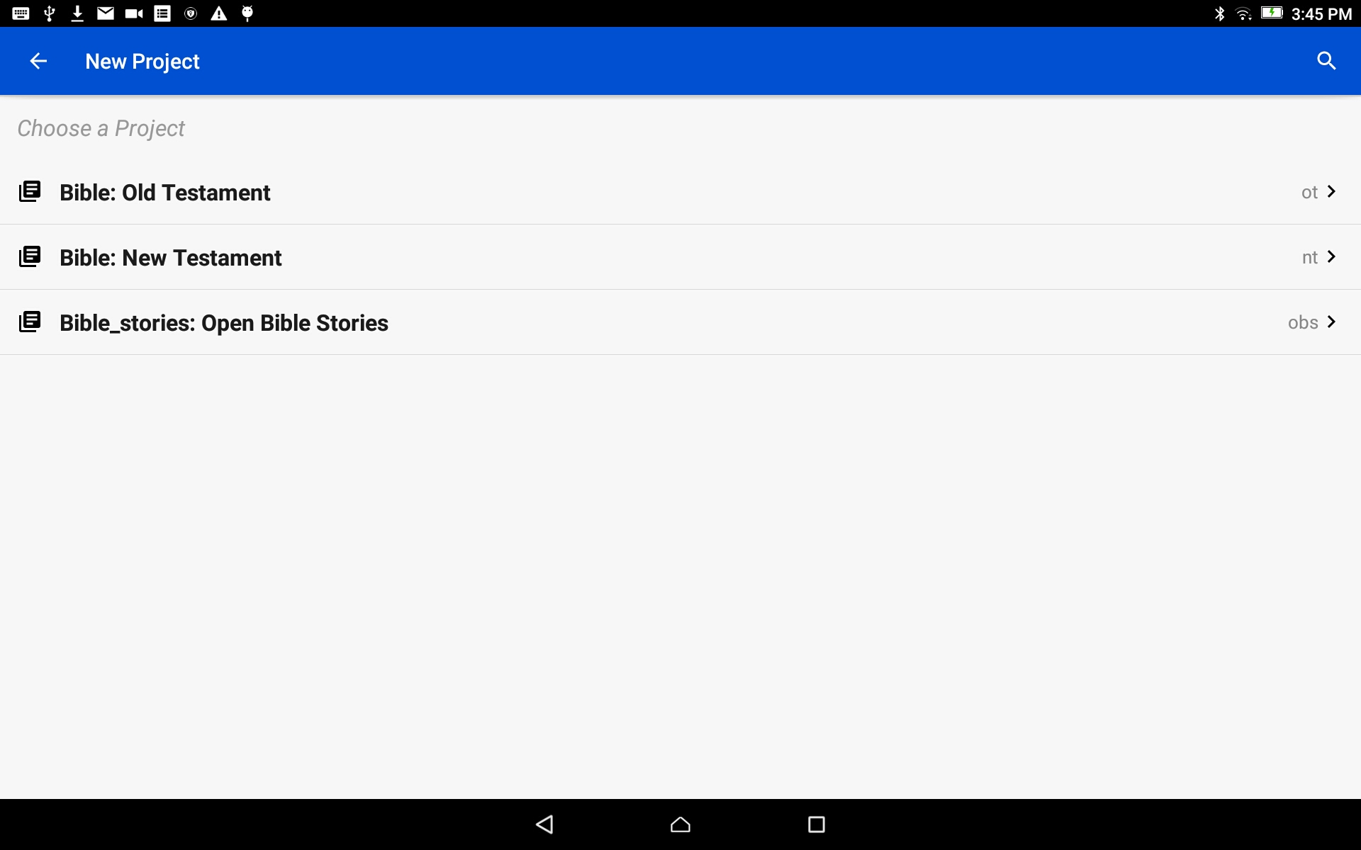
Start a Project
Choose a Project:
Tap on the words to choose to start an Old Testament, New Testament or Open Bible Stories project.

Slide 6
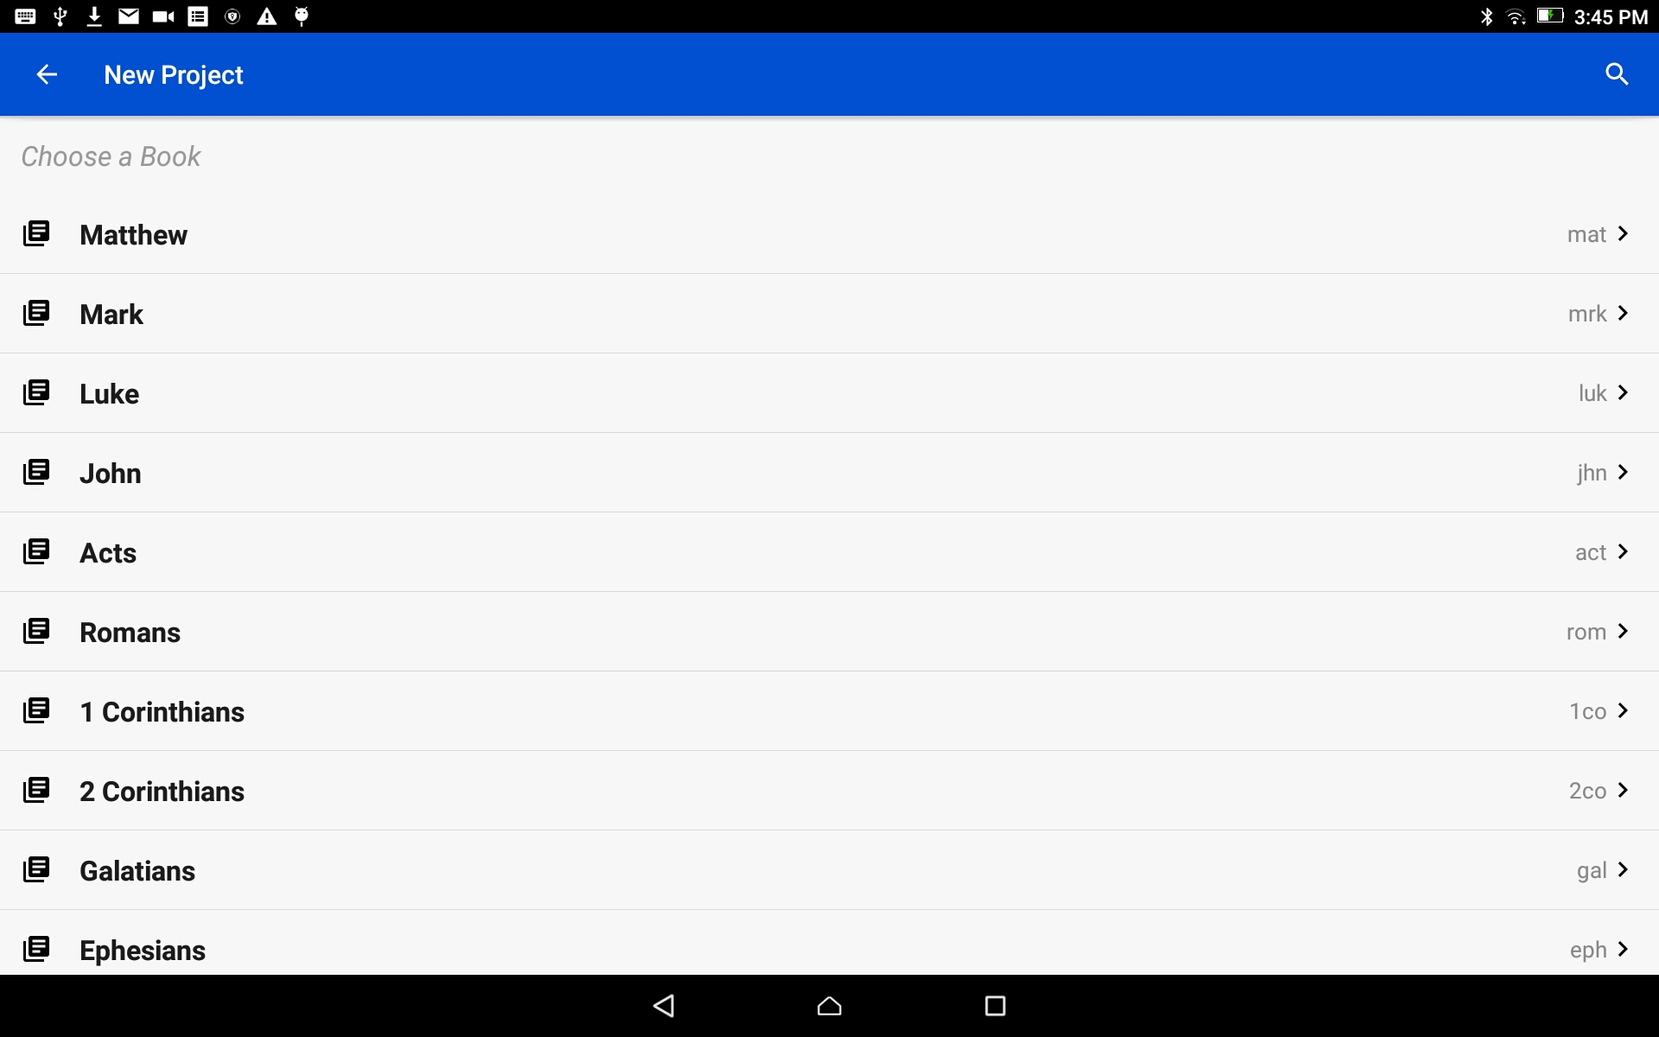
Start a Project
Choose a Book:
Tap on the book title to choose a book for the project.
Scroll down for more book names.

Slide 7
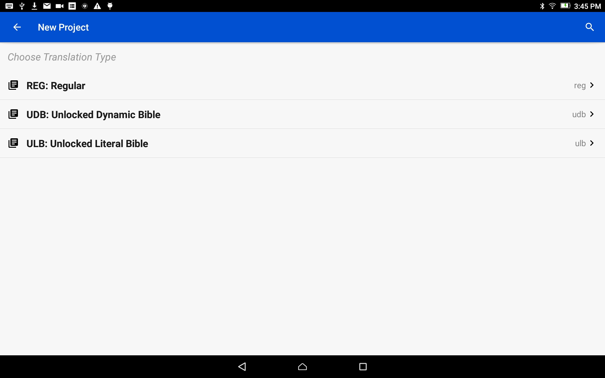
Start a Project
Choose a Translation Type:
The translation type is the type of translation of the final project work.
Tap on the words to choose a translation type.
Choose ULB if you will be importing English source audio.

Slide 8
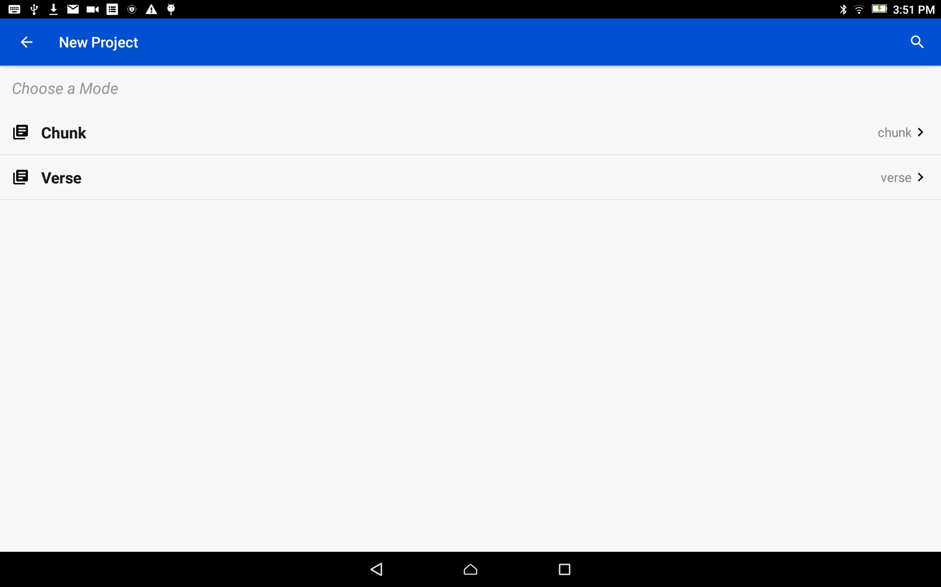
Start a Project
Choose a Mode:
Tap to choose either Verse or Chunk mode. This is how the information will be divided.
Choose Verse if you will be importing English source audio.

Slide 9
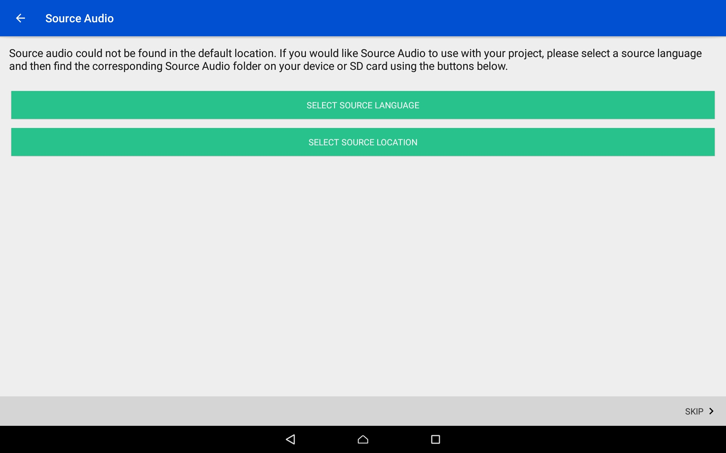
Start a Project
Skip this step if not using a source audio
Source Audio Selection:
The Source Language is the language from which you will translate.
Tap on the top green bar (Select Source Language).
Click here to skip the steps for source audio

Slide 10
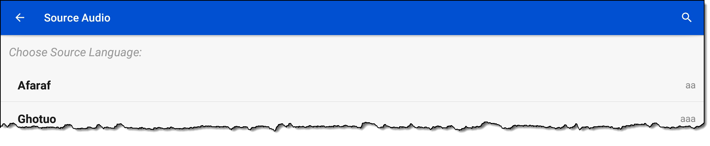
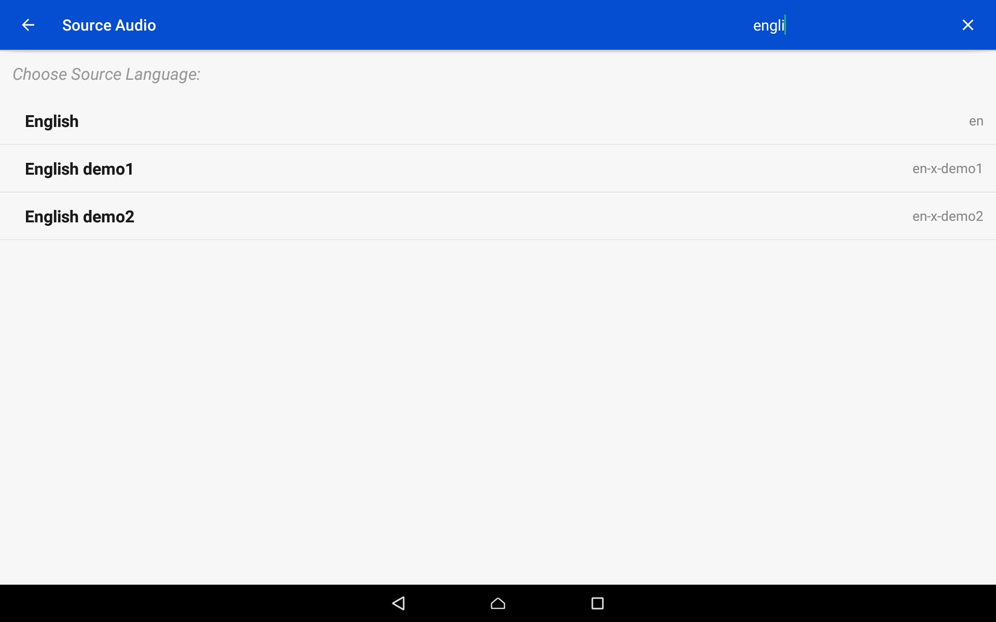
Start a Project
Skip this step if not using a source audio
Source Audio Selection:
Search for the desired language by either:
Scrolling to the language name.
Clicking the magnifying glass and typing in the language name or language code.

Slide 11
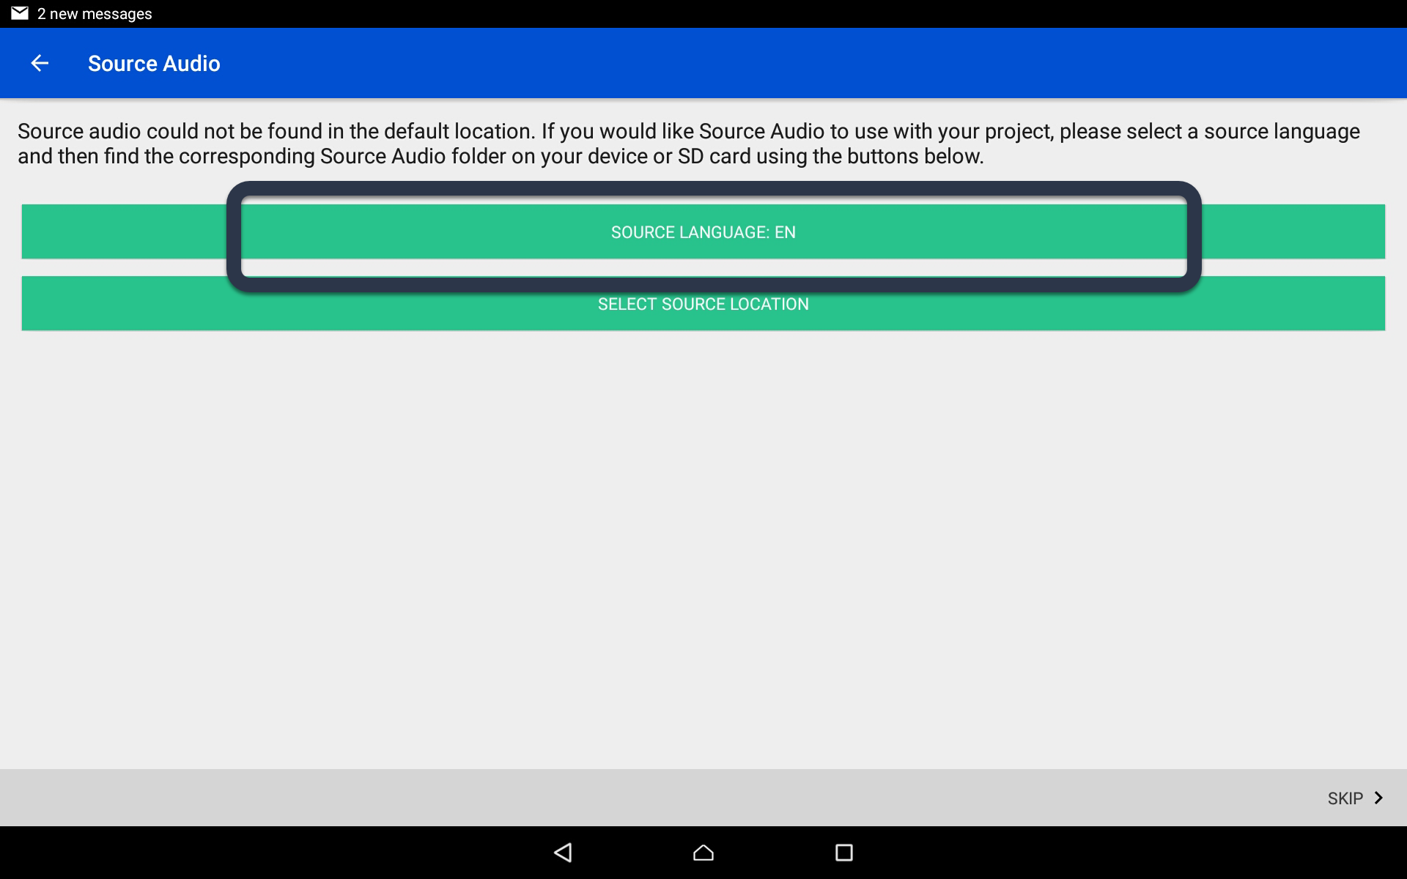
Start a Project
Skip this step if not using a source audio
Source Audio Selection:
The language code now shows on the Source Language green bar.
Tap on the bottom green bar (Select Source Location).

Slide 12
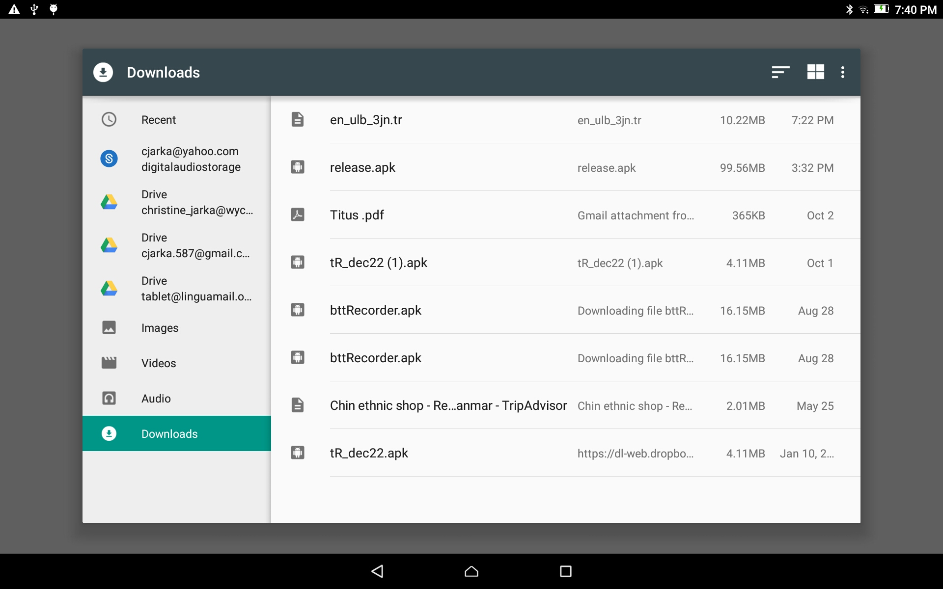
Start a Project
Skip this step if not using a source audio
Source Audio Selection:
Use the File Manager to find and select the appropriate source file.
(The facilitator will help with this.)

Slide 13
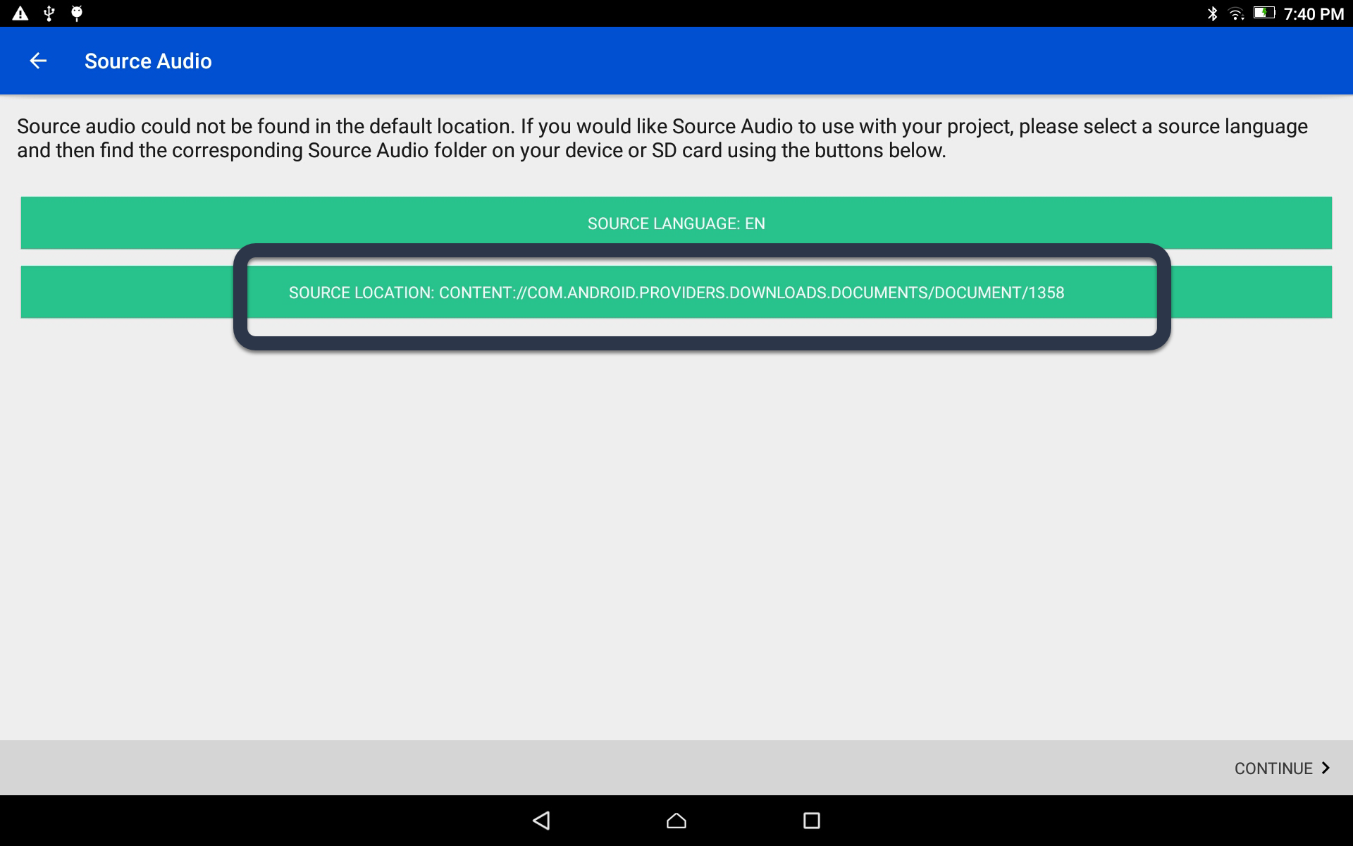
Start a Project
Skip this step if not using a source audio
Source Audio Selection:
The source language file name now shows on the Source Location green bar.
Close the keyboard.

Slide 14
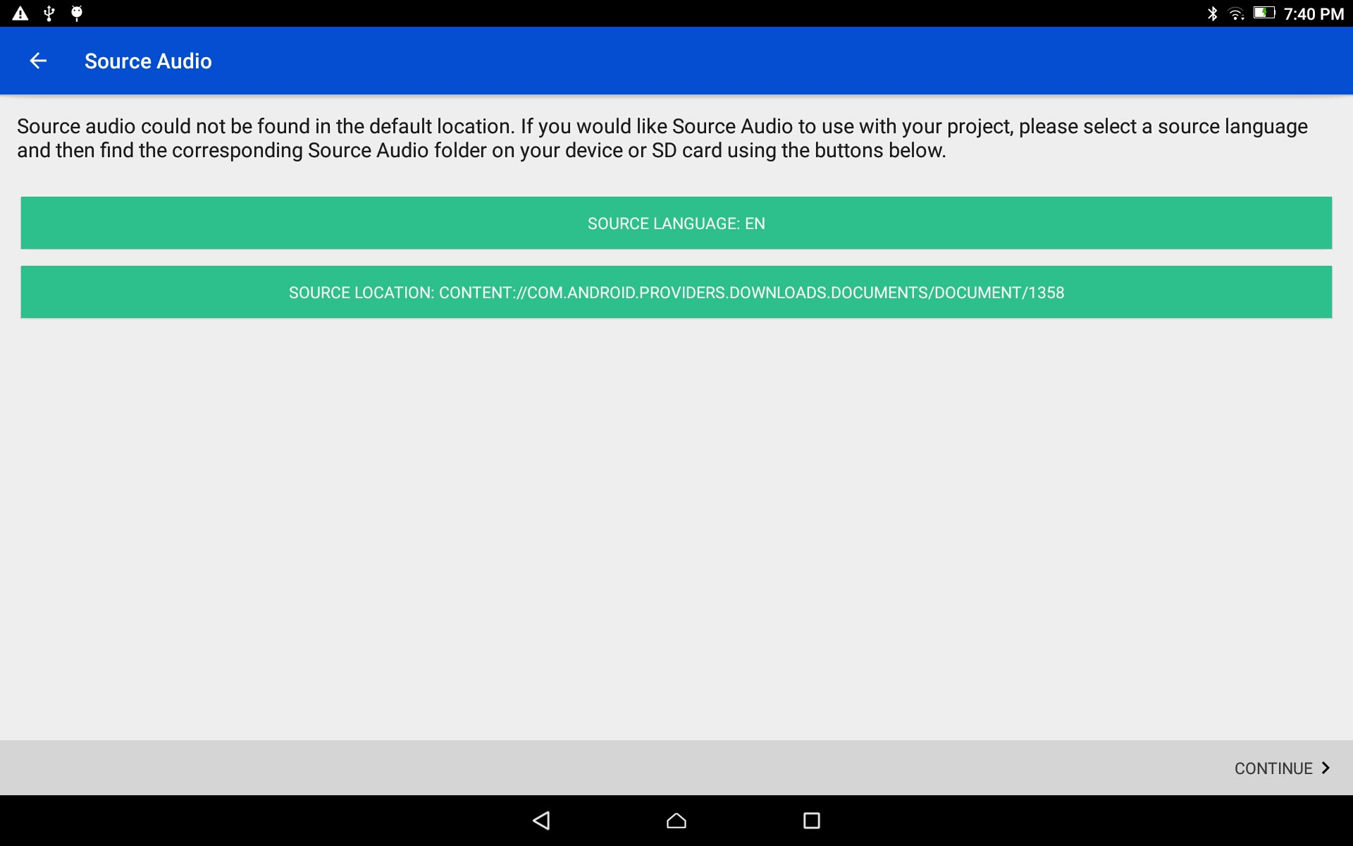
Start a Project
Skip this step if not using a source audio
Source Audio Selection:
Tap on the CONTINUE link at the bottom right.

Slide 15
Start a Project
Source Audio Selection:
Skip this step if there is no source audio.

Slide 16
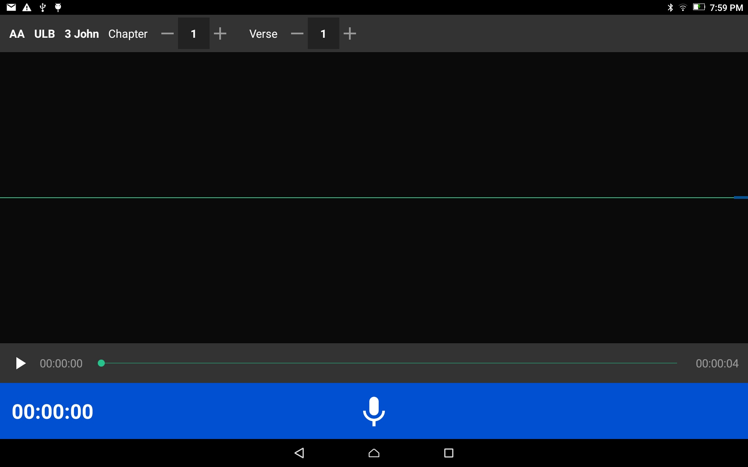
Start a Project
The new project starts

