Slide 1
BTT Recorder v1.4
Editing
Recordings
Create
Chapter
recording

Slide 2
Words to know:
Compile – to put into one piece, combine.
Stitch – to compile the different recordings into one recording.
Packaging – to prepare the recordings for compressing into a smaller file. This process is done automatically by the software.

Slide 3
Why make a chapter recording?
After the verse or chunk recordings have been created for a chapter it is then possible to compile the recording into a complete chapter.
The translator can listen to the entire chapter and make additional edits if necessary.

Slide 4
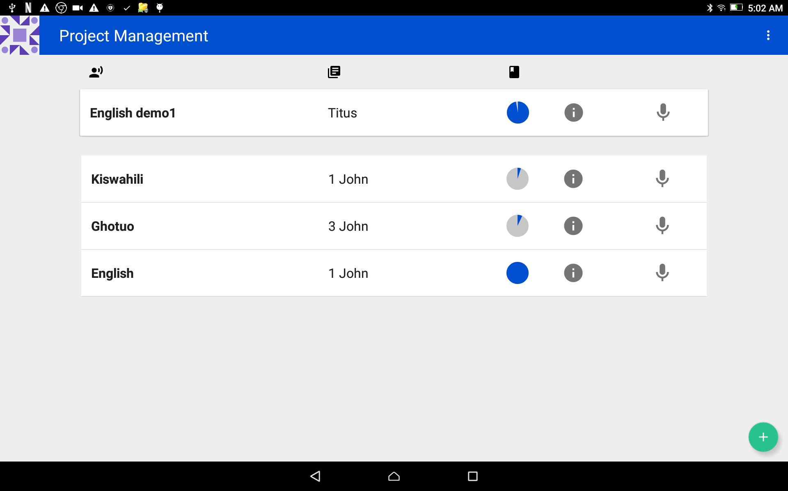
Complete Chapter Recording
Start in the Project Management home screen and tap on the book to finish.
Notice that the circle should be full or almost full.

Slide 5
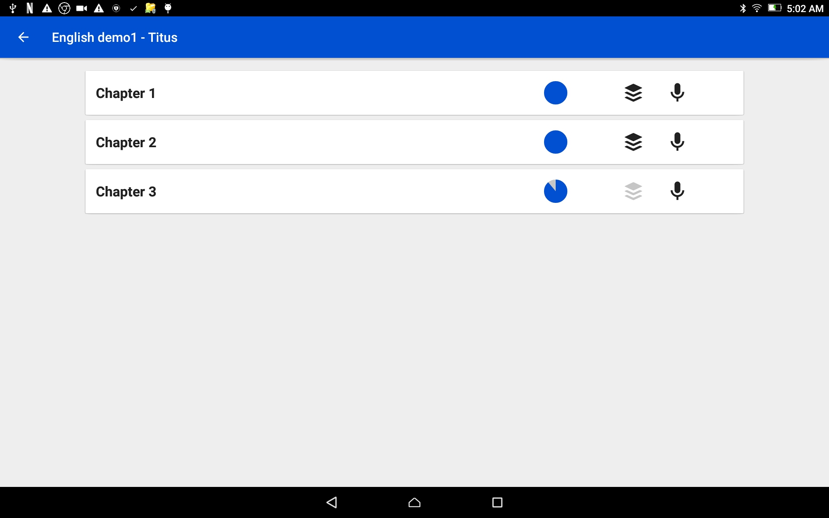
Complete Chapter Recording
The chapters are listed – each one on a separate bar.
Note the color of the stack of paper icon.
Black - the chapter has all required recordings.
Gray – the chapter is missing some recordings.

Slide 6
Complete Chapter Recording
Tap on a chapter bar to open a completed chapter.
Note the full blue circle.

Slide 7
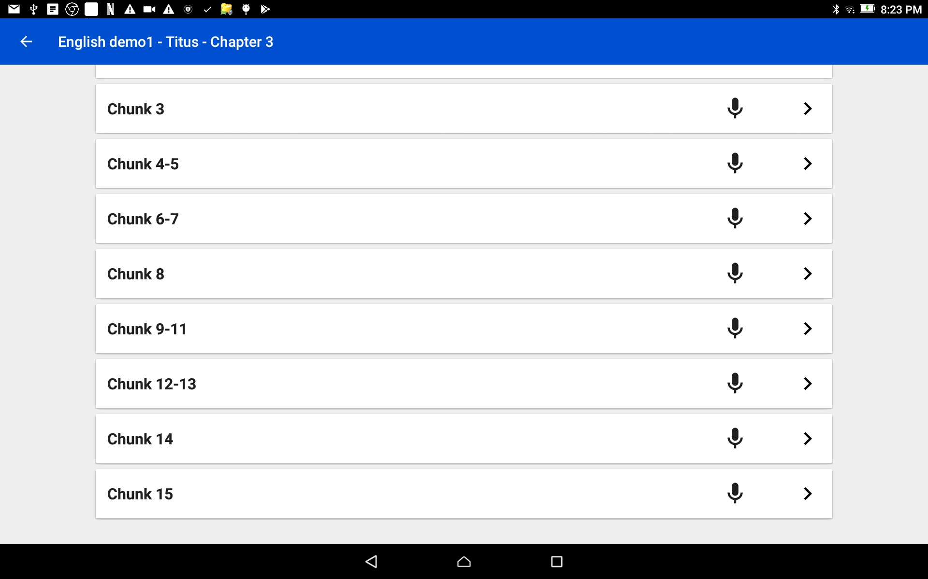
Complete Chapter Recording
Check to make sure there is only one recording for each chunk or verse.
NOTE: if there is no number next to the microphone, there is only 1 take per verse/chunk.

Slide 8
Complete Chapter Recording
When there are multiple takes per verse or chunk, there are rules for what take is included in the chapter recording.
These are the rules followed when combing a chapter into a single audio file:
If there is a recording with a star rating, they are included according to the number of stars.
3 green stars = first choice; 2 yellow stars = second choice; 1 red star = third choice
If there is not a star rating given, then a green check mark is used.
If there is not a star rating and the check is not green, then the most recent take is used.

Slide 9
Complete Chapter Recording
Tap on the back arrow on the top blue bar to return to the chapter listing.
←

Slide 10


Complete Chapter Recording
Tap on the black stack of paper icon to stitch the chapter into one file.

Slide 11
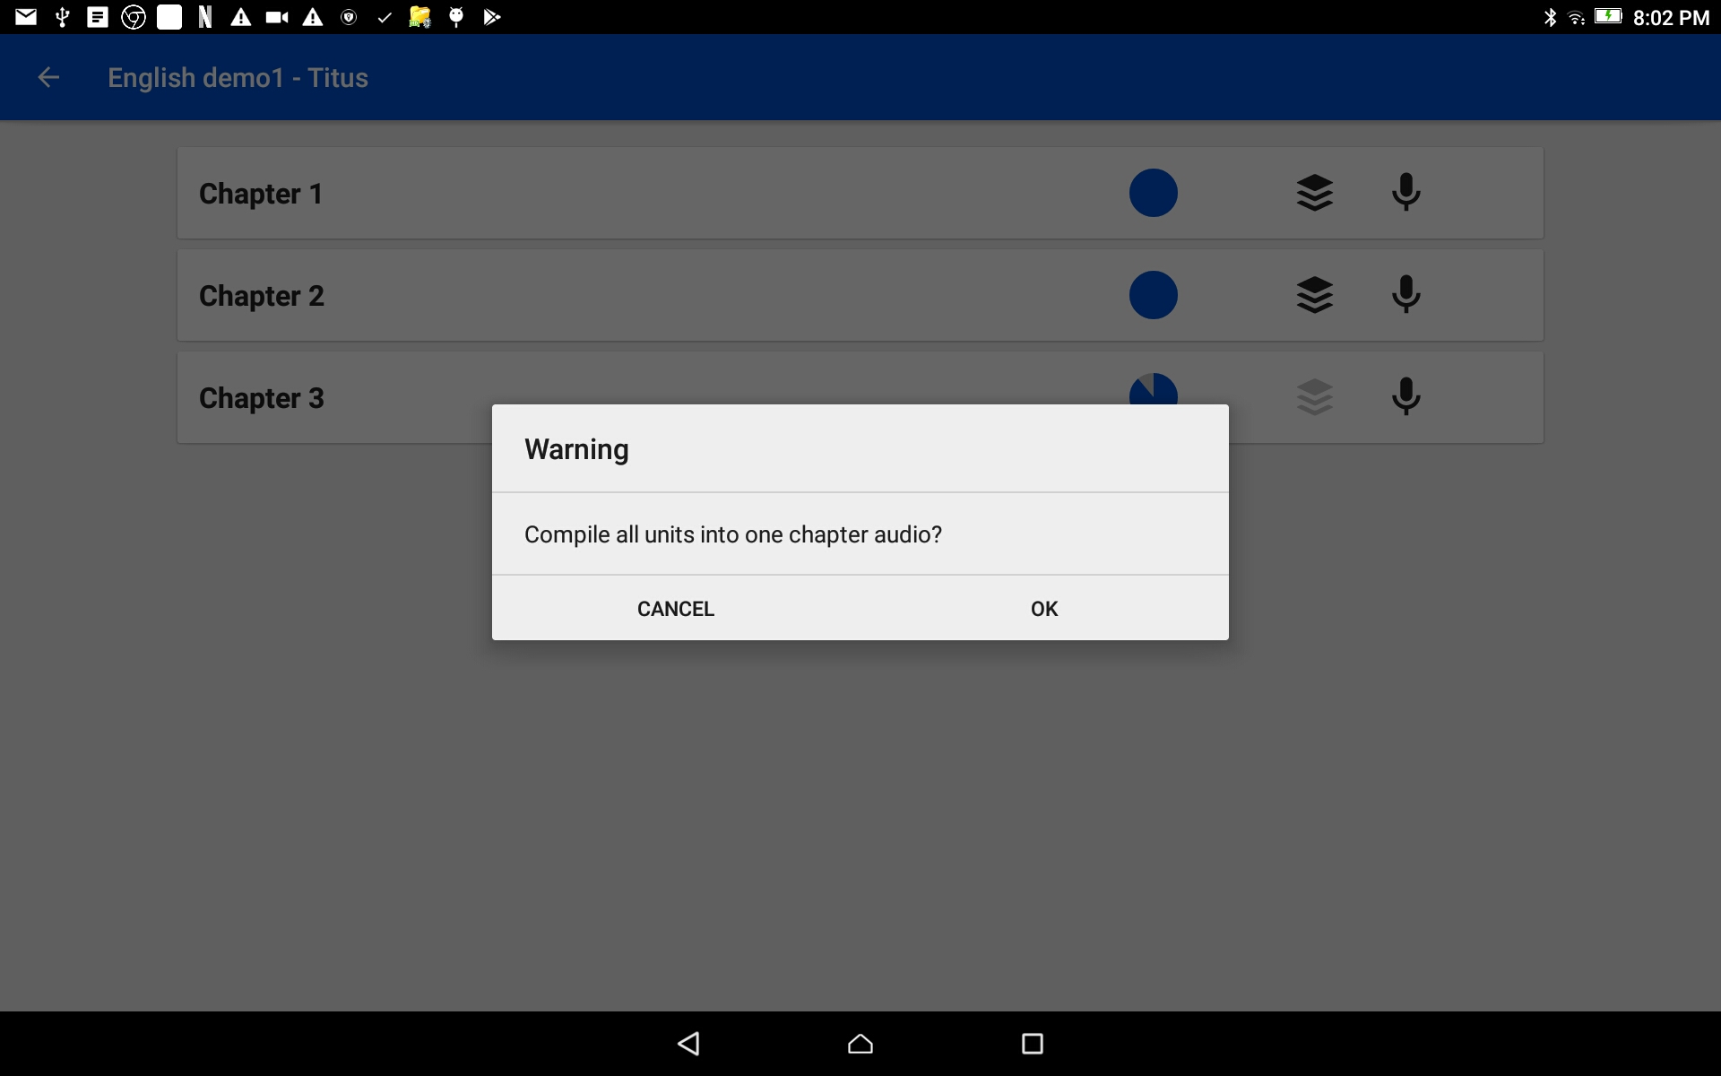
Complete Chapter Recording
Tap on OK to accept the action of making the chapter into a single file.

Slide 12
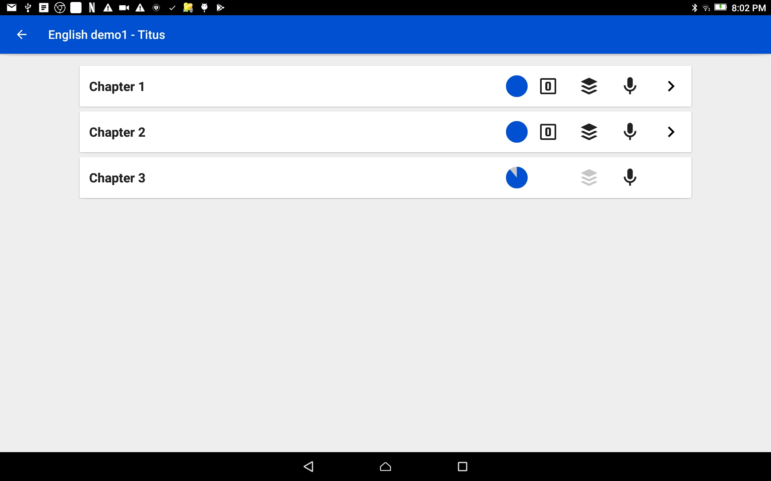

Complete Chapter Recording
Listen to the chapter
Tap the > at the end of the chapter bar.
NOTE: Compiled chapters have a number box and the > icon on the bar.

Slide 13
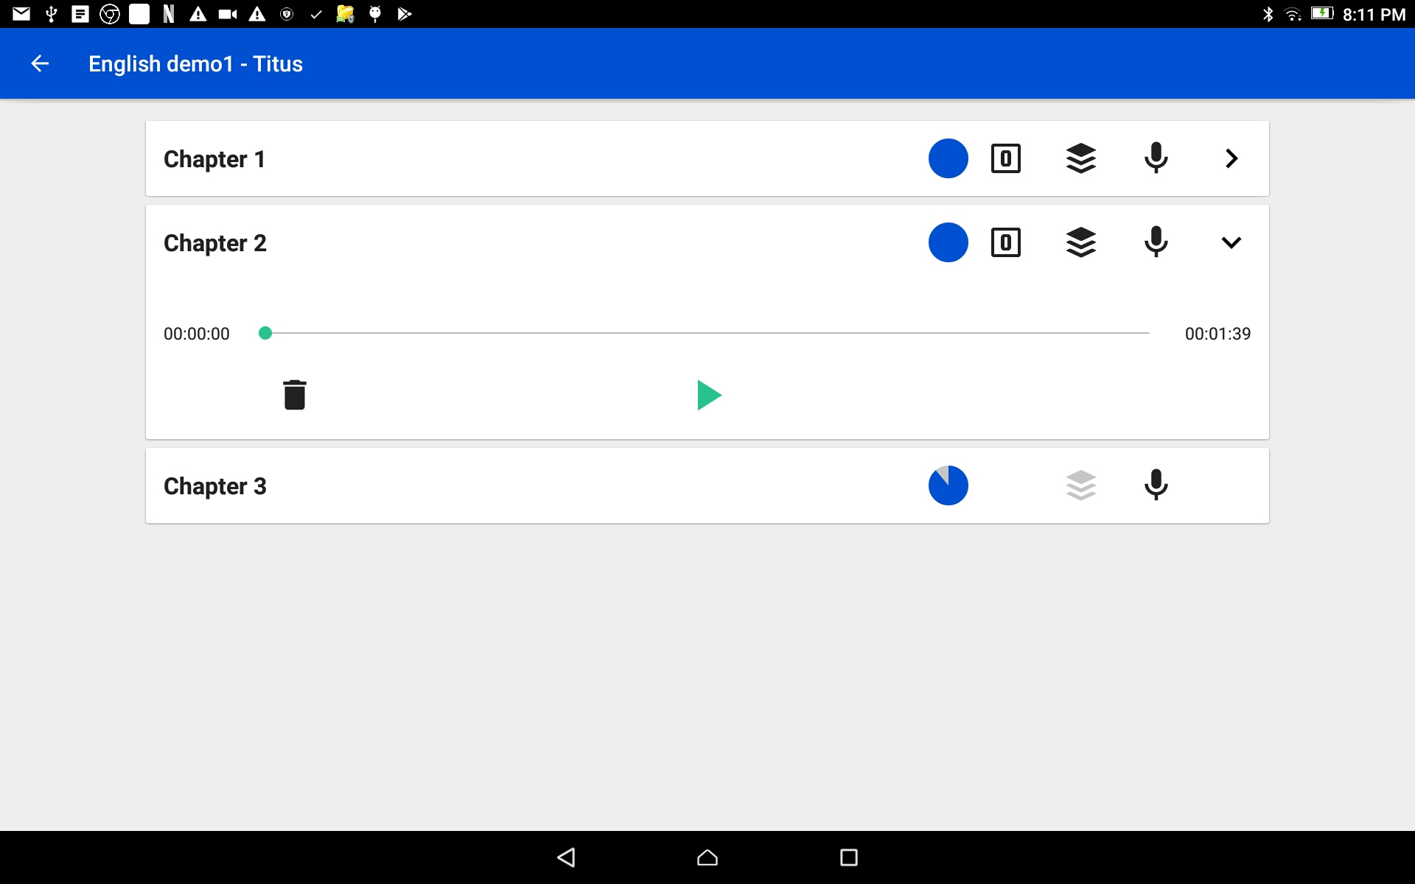
Complete Chapter Recording Listen to the Chapter Recording
Listen to the chapter
Tap the > at the end of the chapter bar.
Press the play icon to listen to the chapter.

Slide 14
Complete Chapter Recording Listen to the Chapter Recording
Does the recording need editing?
Are there long pauses?
Are there words that need to be corrected?
Are there missing words?
Tap on the chapter bar to go to the verse or chunk and make a new recording or edit the existing recording.

Slide 15
Complete Chapter Recording Listen to the Chapter Recording
Tap on the chapter bar.
Choose the verse or chunk that needs the new recording or editing.
Rate the best recording.
Use the back arrow to return to the Chapter list.

Slide 16
Complete Chapter Recording Listen to the Chapter Recording
Tap on the black stack of paper icon to stitch the chapter again.
NOTE: Each time a chapter is stitched – the new recording replaces the old chapter recording.

Slide 17
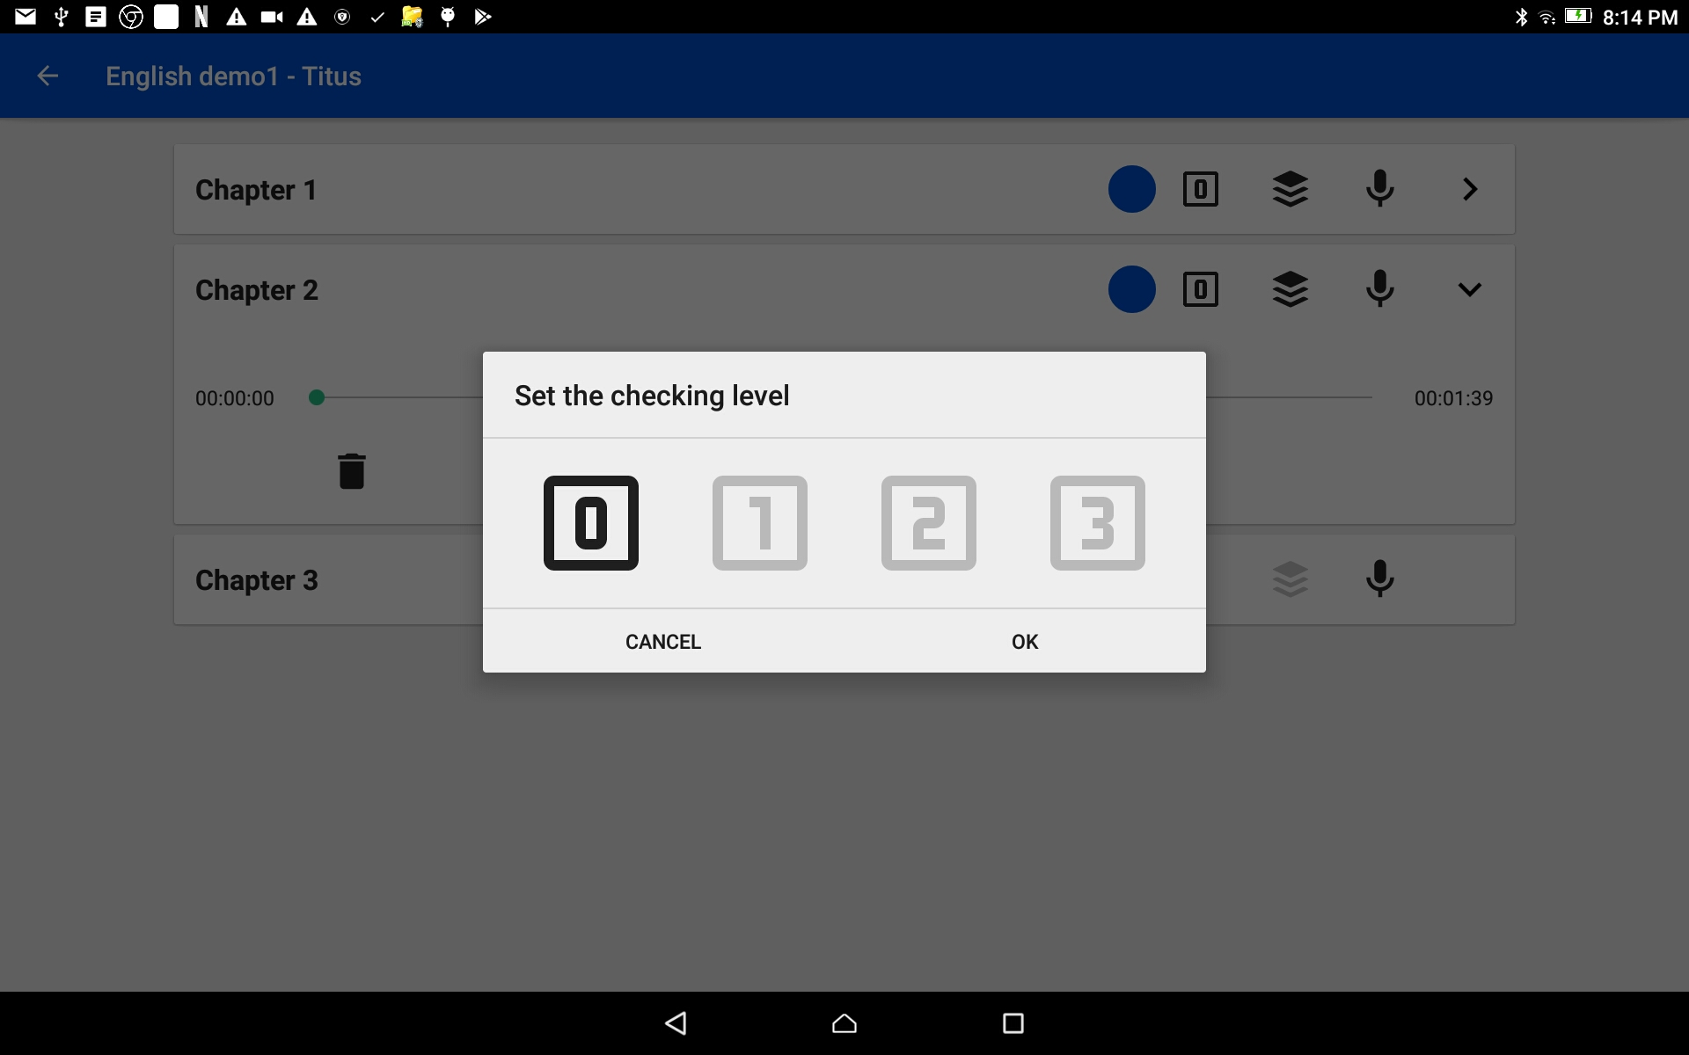
Complete Chapter Recording Rate the Chapter Recording
Tap on the number box.
Choose a rating by tapping on one of the numbers.
0 = no rating
3 = best rating
Tap on the OK link to save the rating and close the window.

Slide 18

Complete Chapter Recording
Repeat these steps until each chapter has been stitched together into an audio file.
Chapters with a gray colored stack of paper is not ready to be stitched.

Slide 19
Complete Chapter Recording
Did you notice the partial blue circle?
That indicates a partial chapter.
Tap on the chapter bar with the gray colored stack of paper.

Slide 20
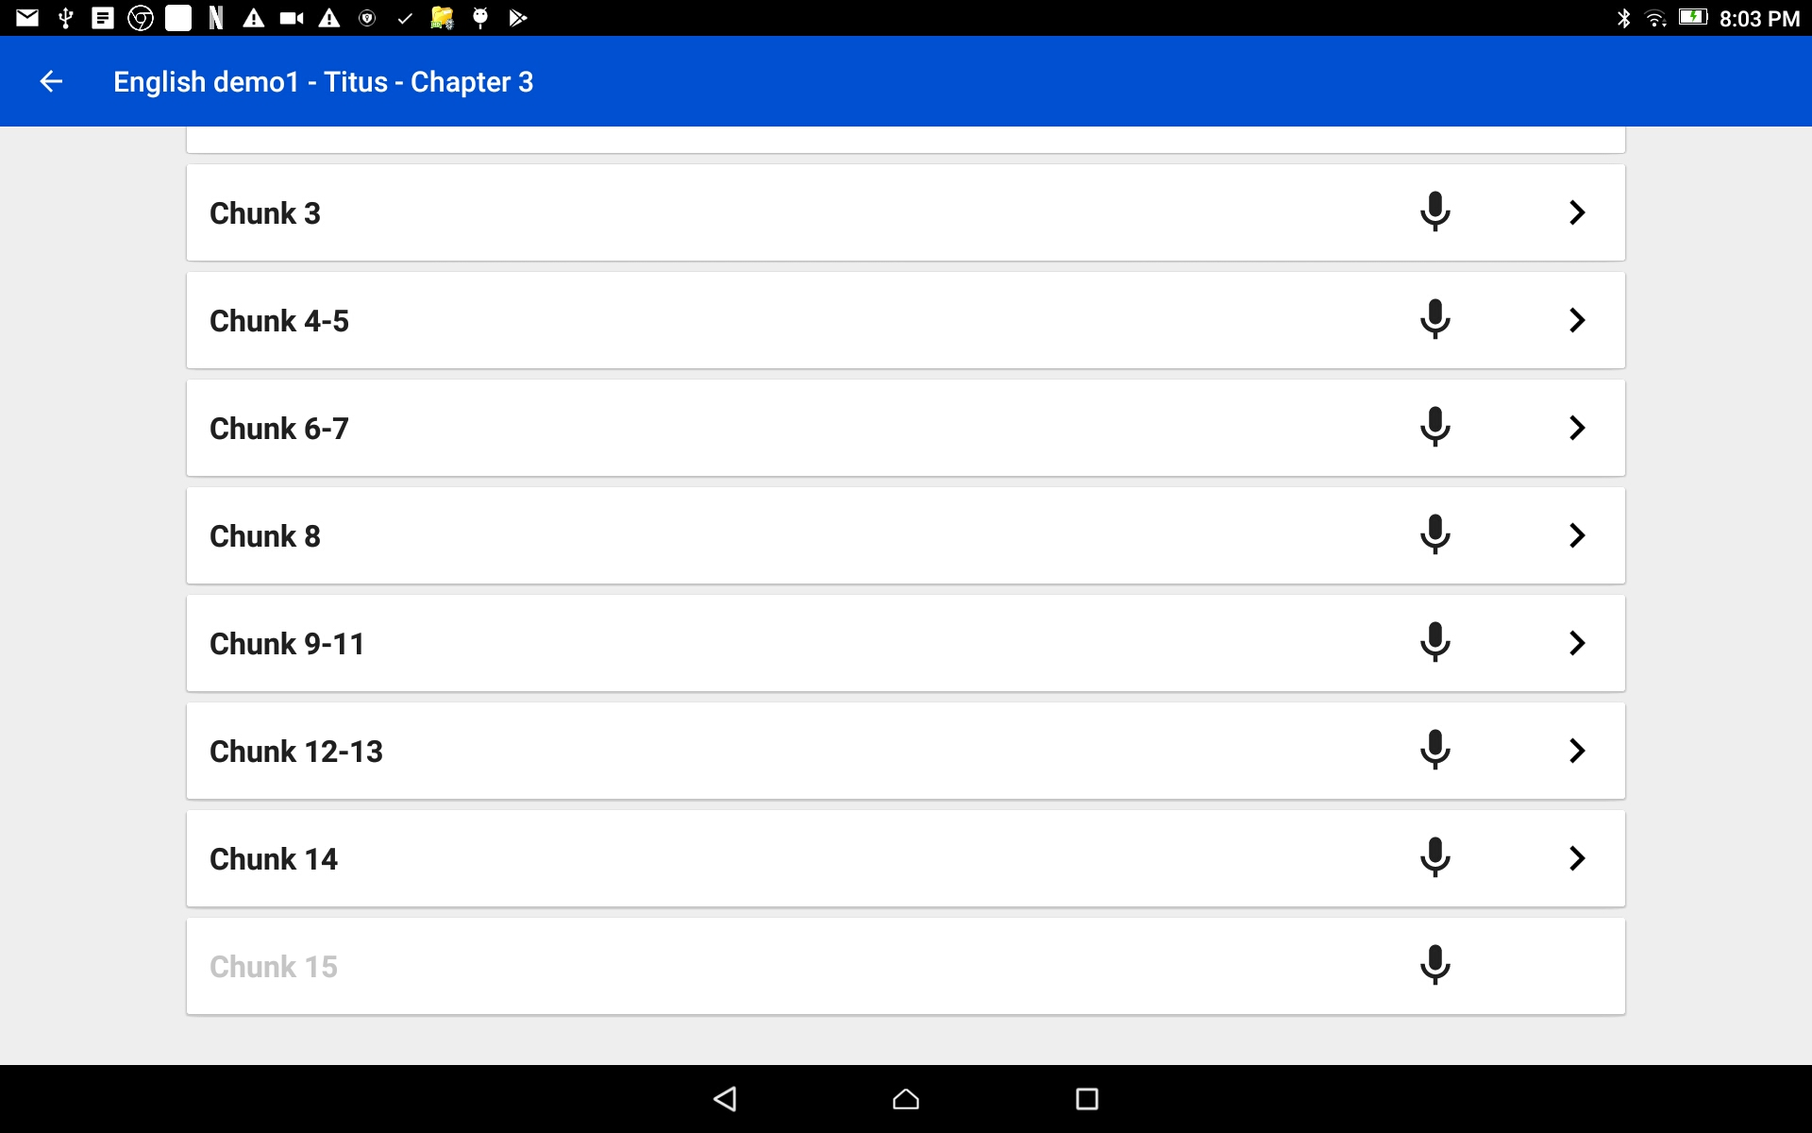
Complete Chapter Recording
Find the verse or chunk that does not have a recording.
HINTS:
There is no arrow next to the microphone.
The verse/chunk number is in gray font.

Slide 21
Complete Chapter Recording
Tap on the microphone icon and record the missing verse.
When done and all the verses/chunks have recordings; tap the back arrow to return to the chapter listing.

Slide 22
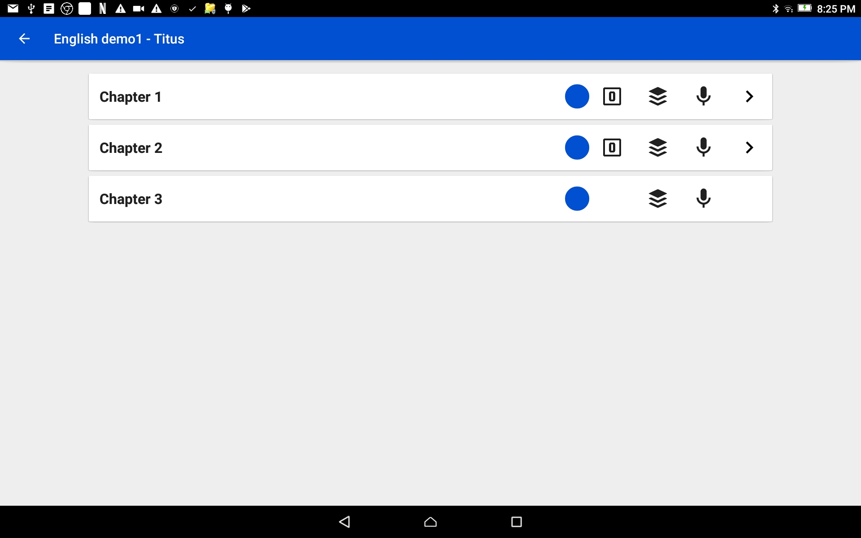
Complete Chapter Recording
Tap the stack of black colored paper.
Remember: Chapters with the number in a box icon are the chapters that have been stitched.

Slide 23
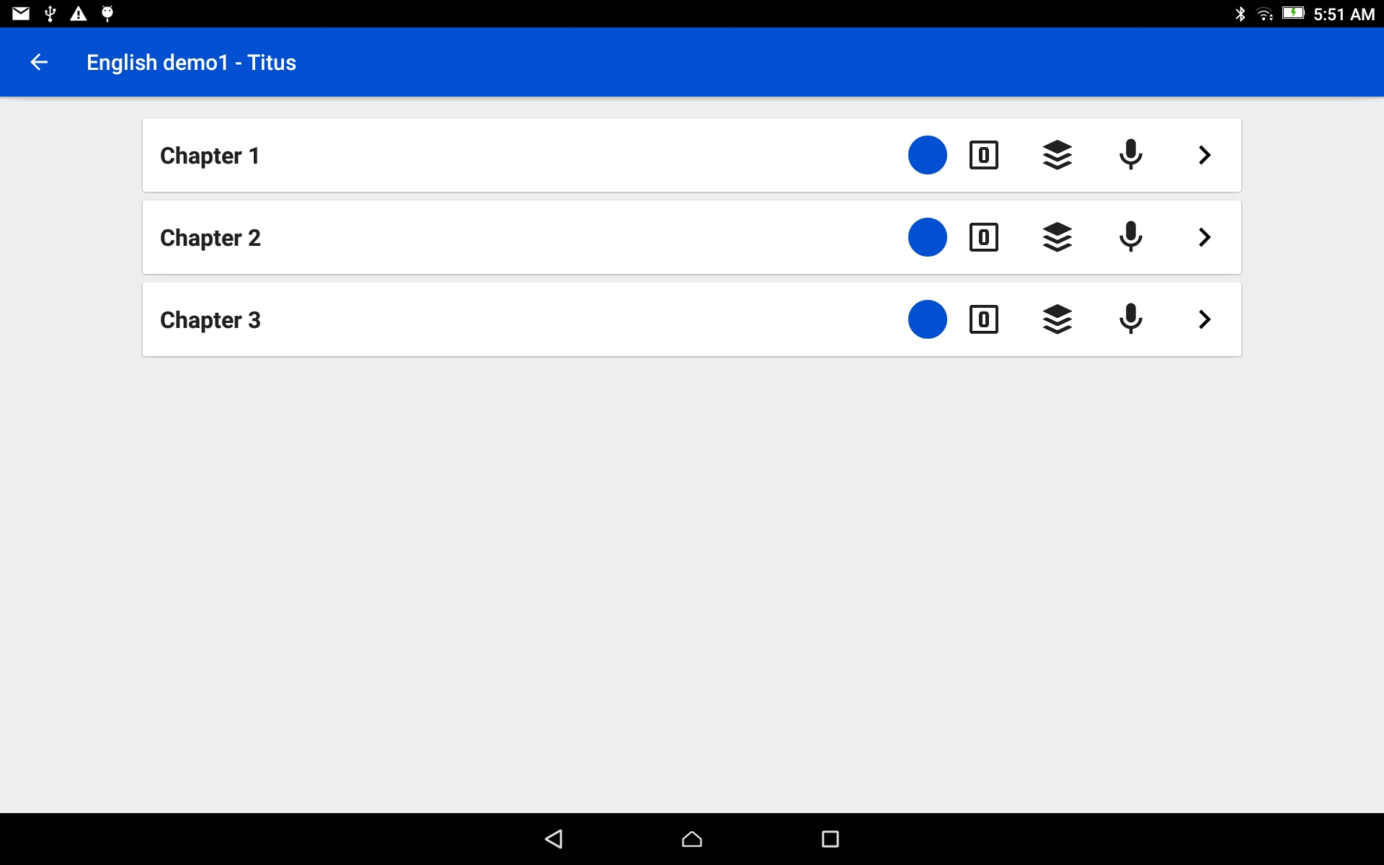
Complete Chapter Recording
All of the chapters of this book have been stitched together.
The recordings are now available in complete chapters.
Tap the back arrow to go to the Project Management home screen.

Slide 24
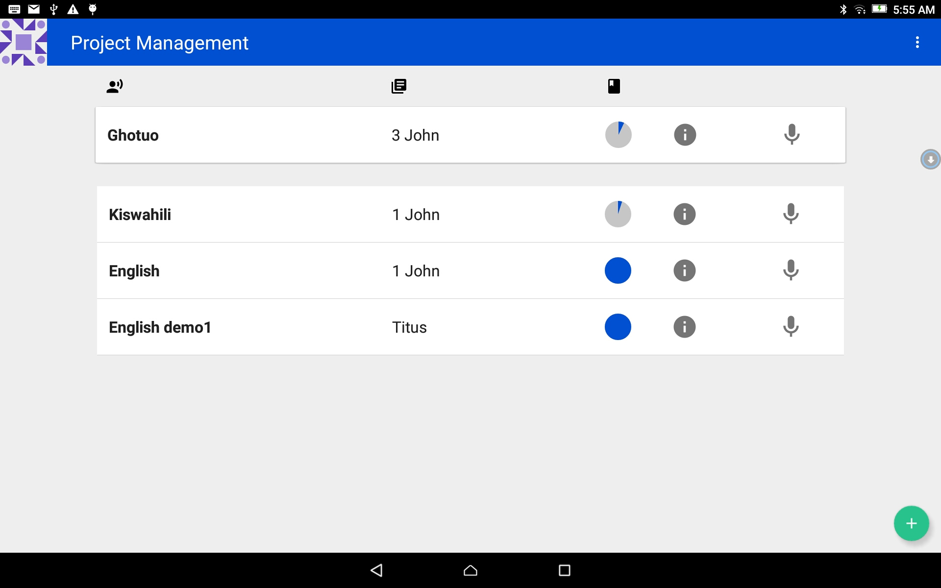
Complete Chapter Recording Share the Chapter Recording
Create a zipped file of *.wav files with single chapter files and folders for each chapter that contains the individual verse/chunk audio files.
Tap on the information icon on the bar of the finished book.

Slide 25
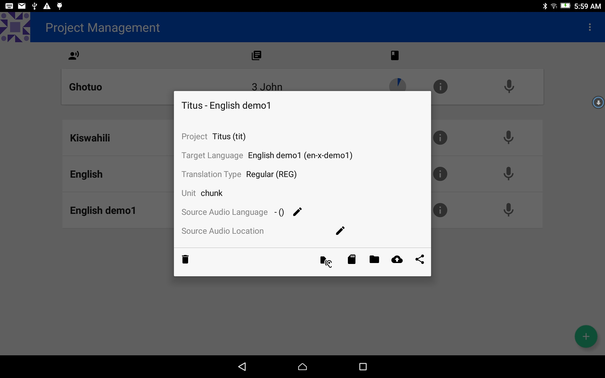
Complete Chapter Recording Share the Chapter Recording
The Project Information window opens.
Tap on the SD card icon.

Slide 26
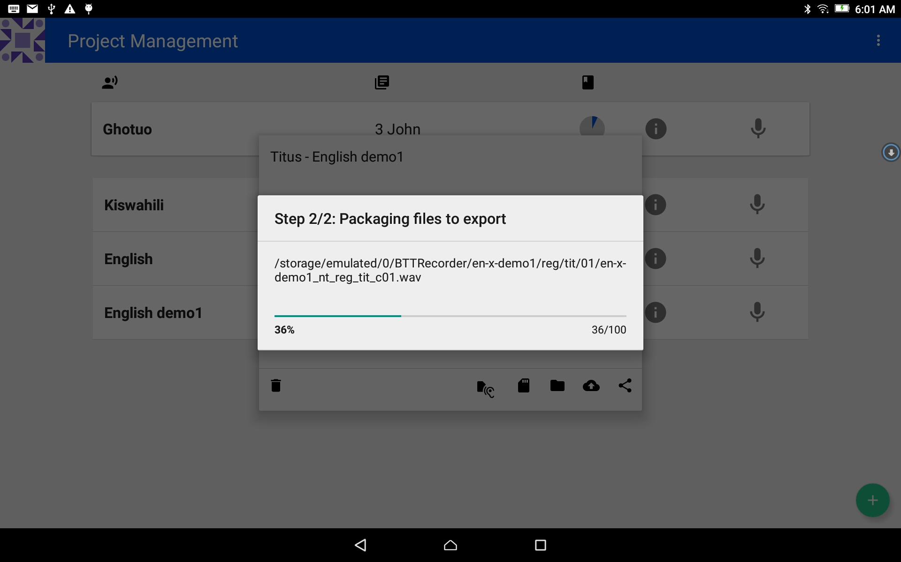
Complete Chapter Recording Share the Chapter Recording
The Packaging process begins.
NOTE: that chapter files are included. (_c01.wav)
The process indicator window will close when the packaging is done.

Slide 27
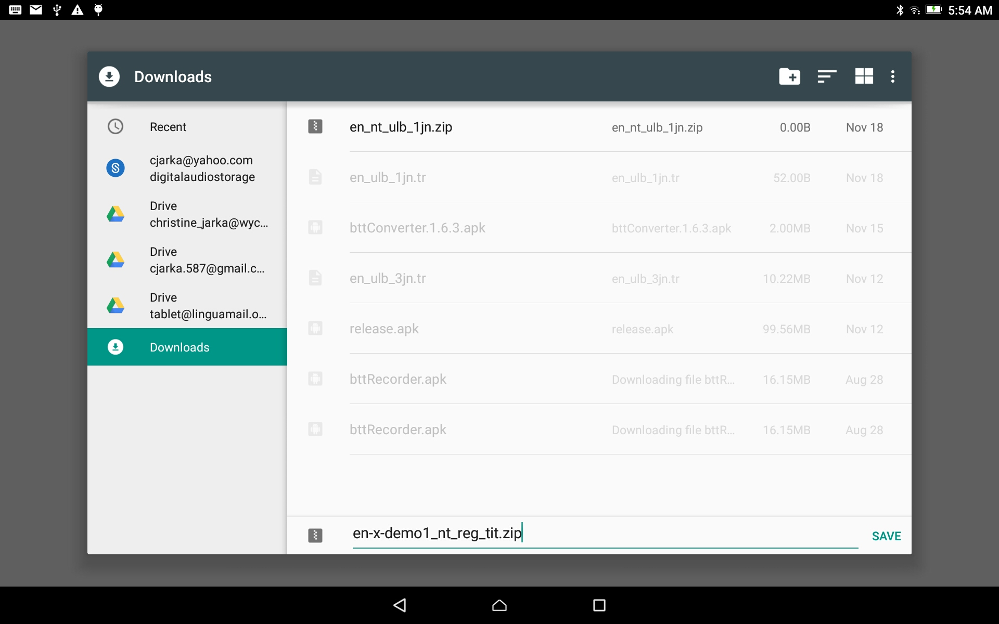
Complete Chapter Recording Share the Chapter Recording
The file is saved to the Downloads folder.
Optional: Change the name of the file.
Tap SAVE to complete the process.

Slide 28
Complete Chapter Recording Share the Chapter Recording
BTT Recorder returns to the Project Management home screen.
The Project is now ready to share with others using the tablet’s file manager.

