Slide 1
BTT Recorder v1.4
editing in
PROJECT management

Slide 2
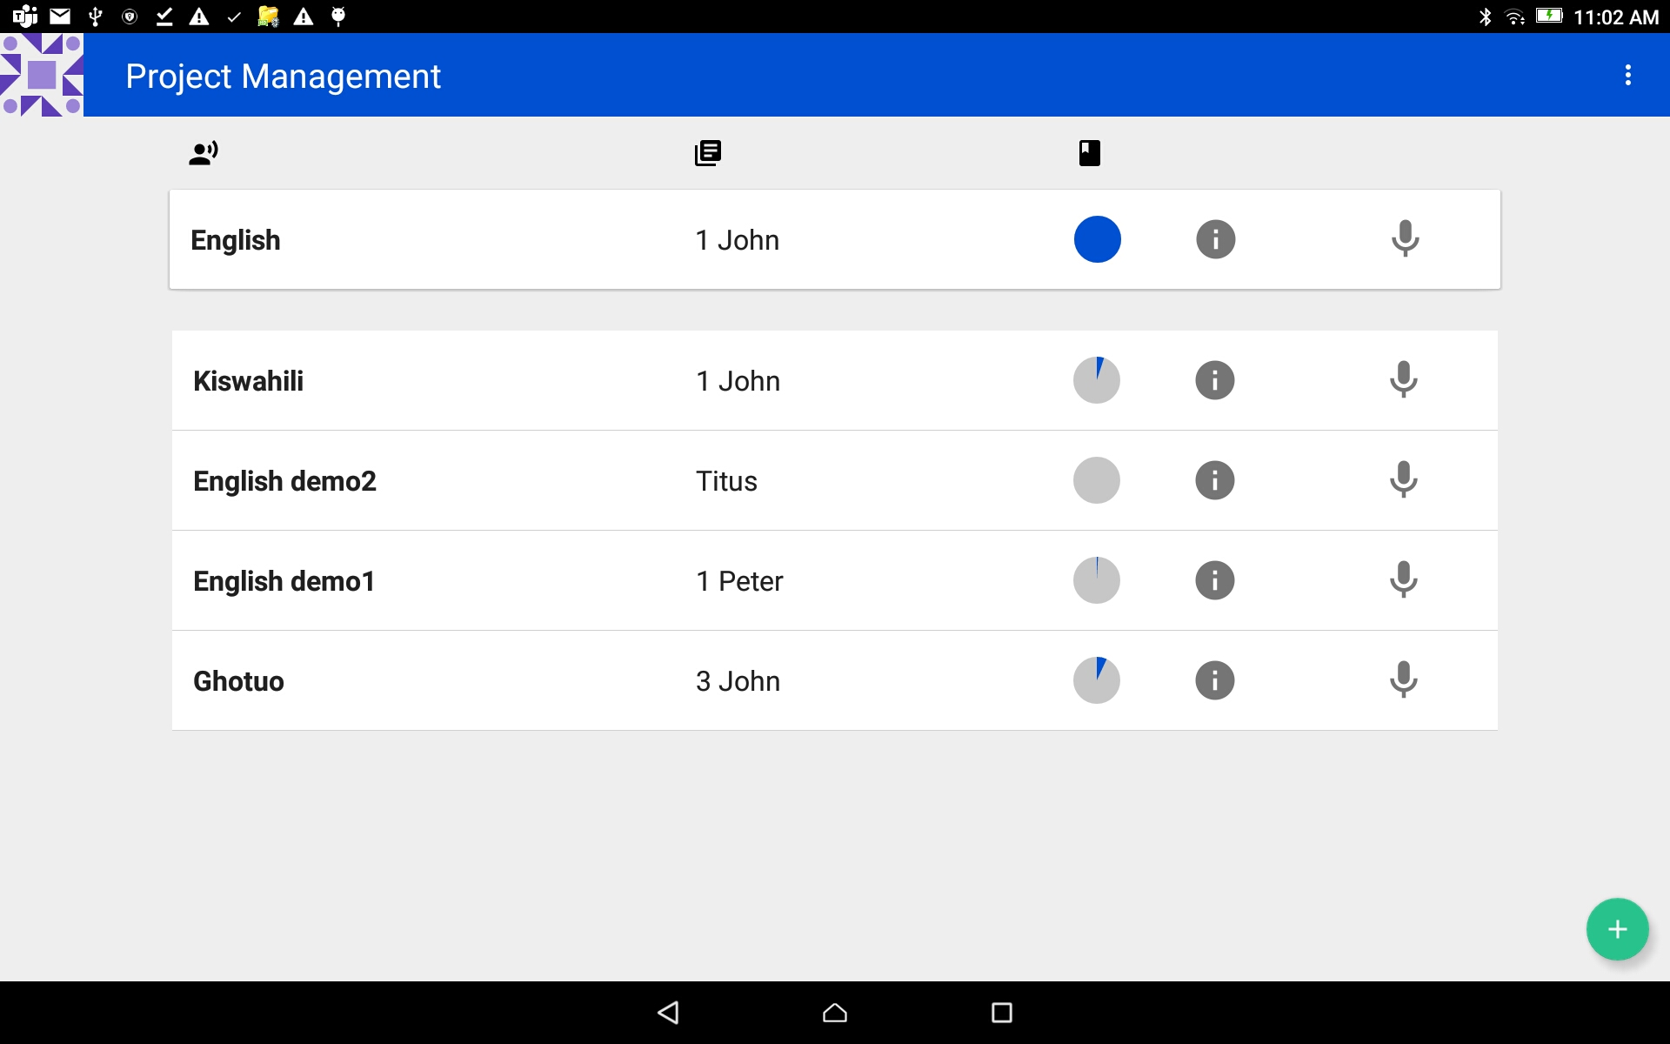
Find a Recording
Start at the Project Management screen.
Tap on a Project to edit.

Slide 3
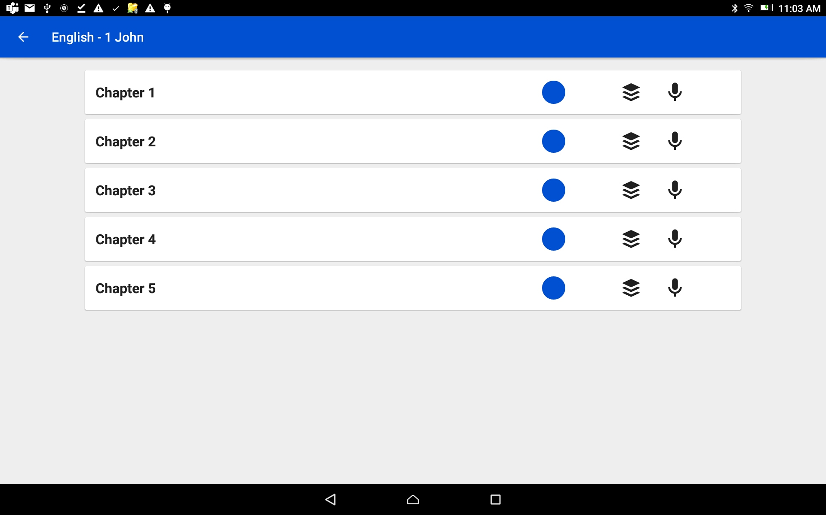
Find a Recording
Tap on the Chapter bar.

Slide 4
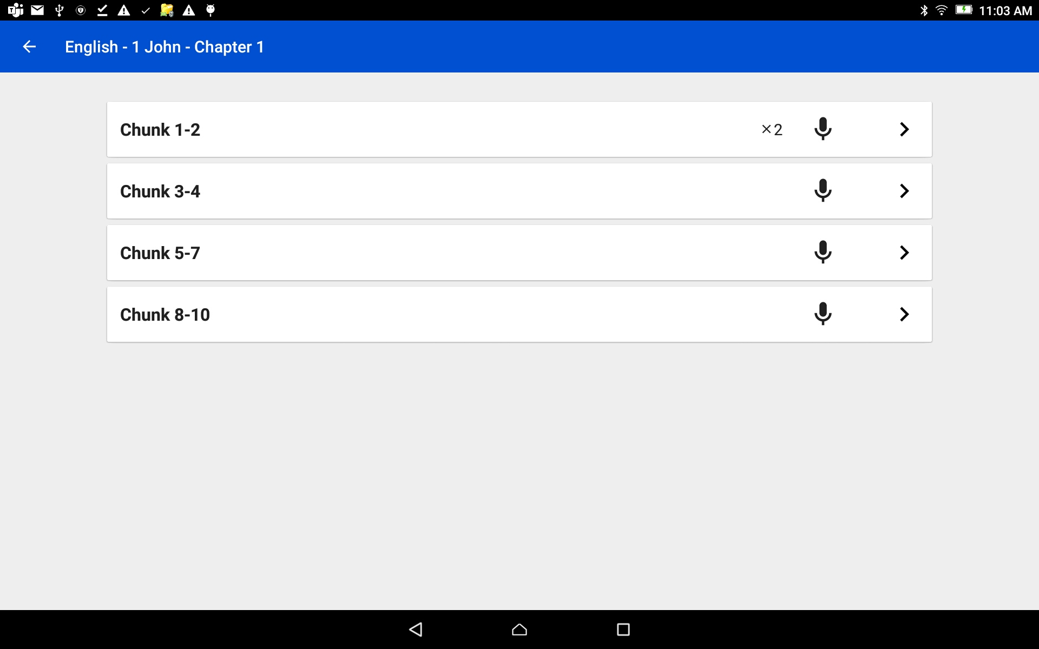
Find a Recording
Tap on the arrow at the end of the verse bar.
The Verse Take Bar opens.

Slide 5
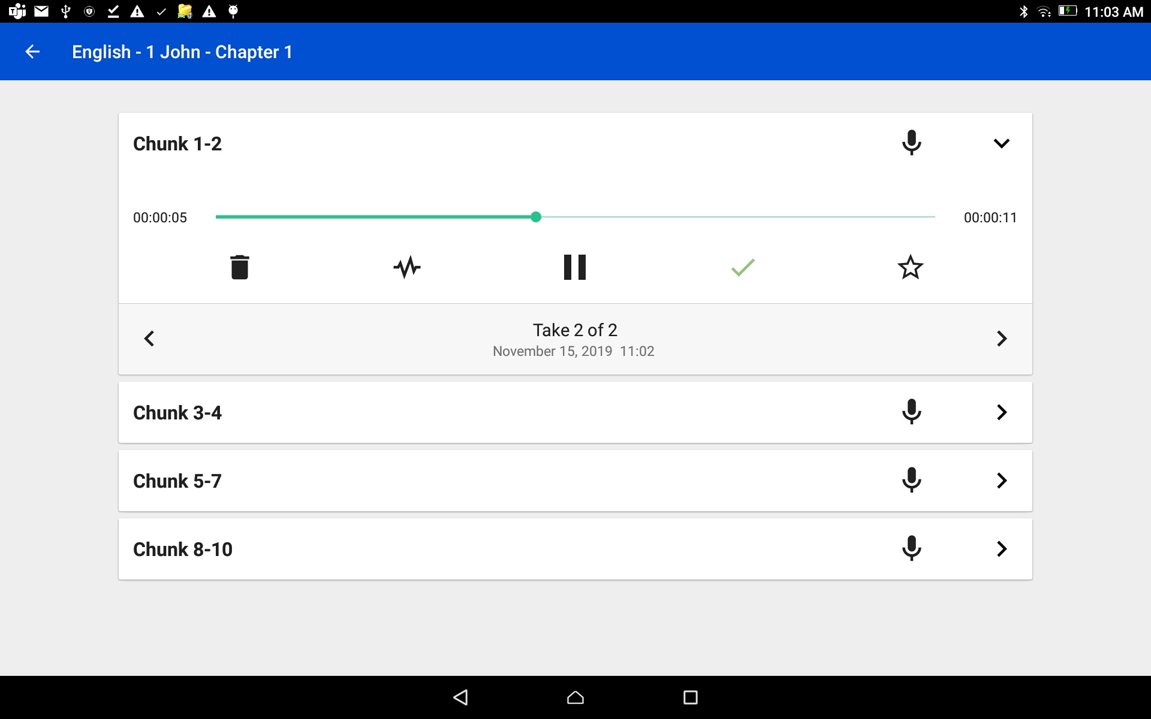
Verse/Chunk Take Bar Choose a recording
Tap on the right or left arrow to go between the audio takes for a verse.
A ‘take’ is a word that refers to a recording.

Slide 6
Verse/Chunk Take Bar Choose a recording
Tap on the right or left arrow to go between the audio takes for a verse.
Notice the take number changes.

Slide 7
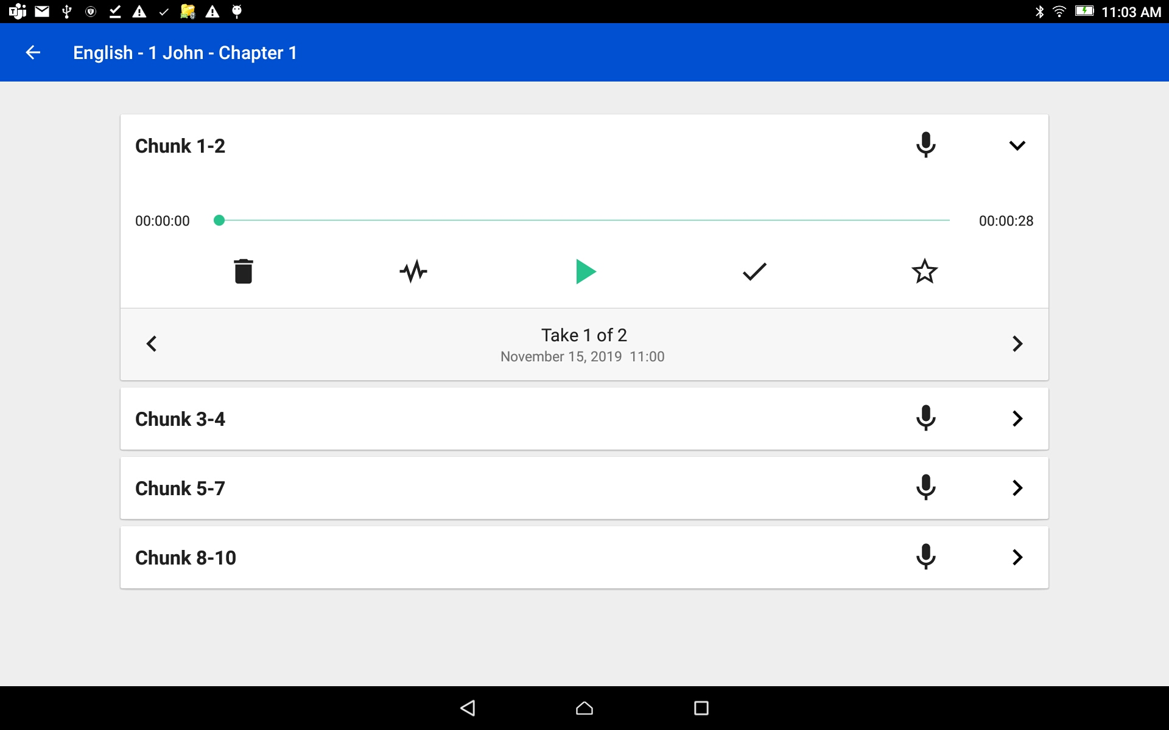
Verse/Chunk Take Bar Play a recording
Tap the play icon to play the recording.

Slide 8
Verse/Chunk Take Bar Play a recording
Tap the play icon to play the recording.
Tap the pause icon to stop the recording.

Slide 9
Verse/Chunk Take Bar Delete a Recording
Tap the trash can to delete the recording.
Note: this will delete the recording that was just heard.

Slide 10
Verse/Chunk Take Bar Rate a recording
Tap on the star icon.

Slide 11
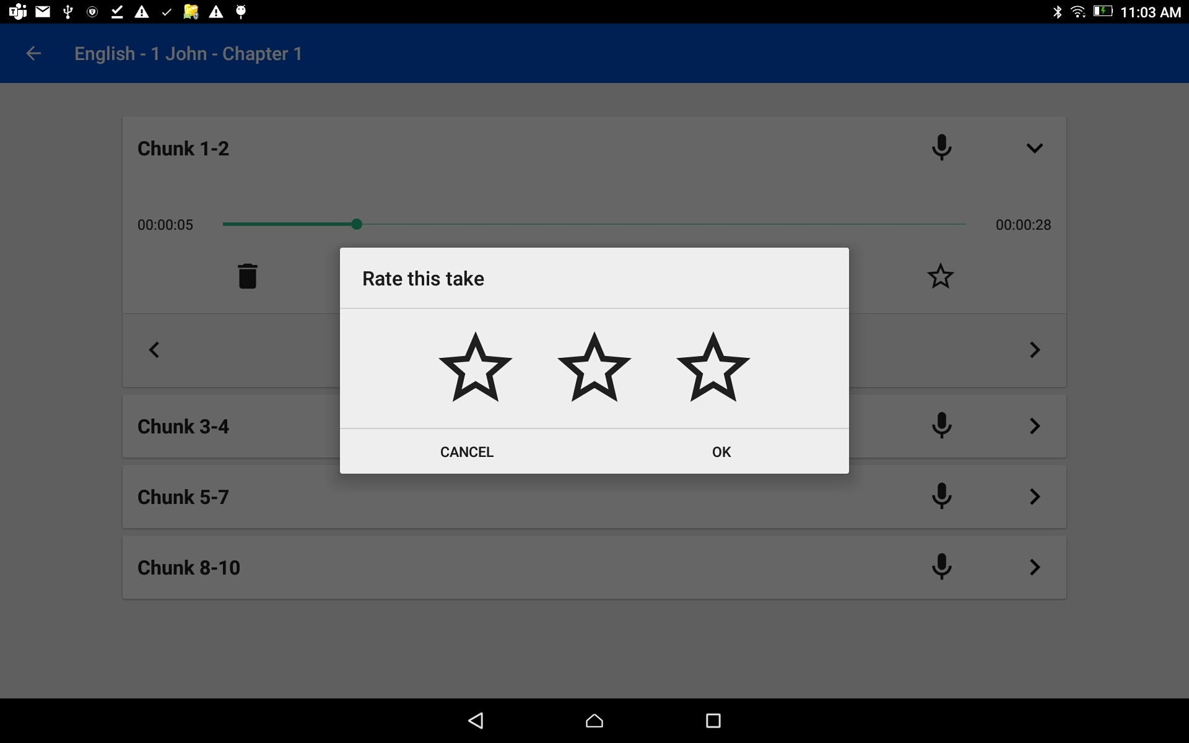
Verse/Chunk Take Bar Rate a recording
Tap on the star icon.
Rate the recording –

Slide 12
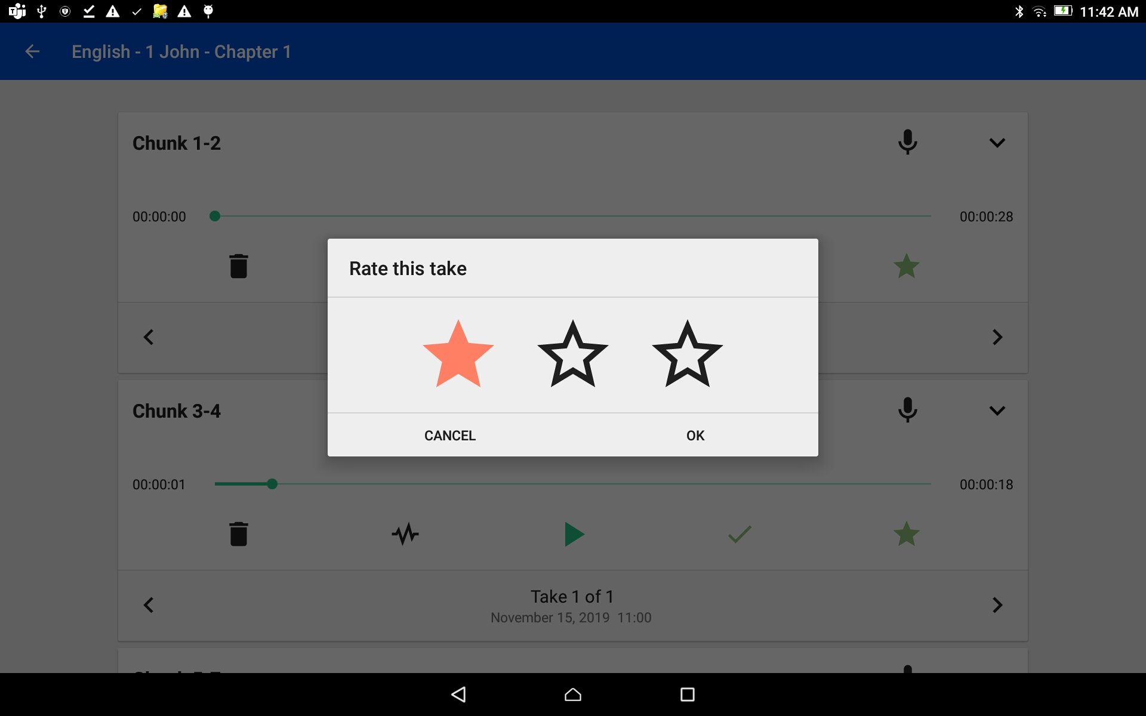
Verse/Chunk Take Bar Rate a recording
Tap on the star icon.
Rate the recording –
Tap on the left star if the recording is not the best – the star turns red.
Tap on OK to save.

Slide 13
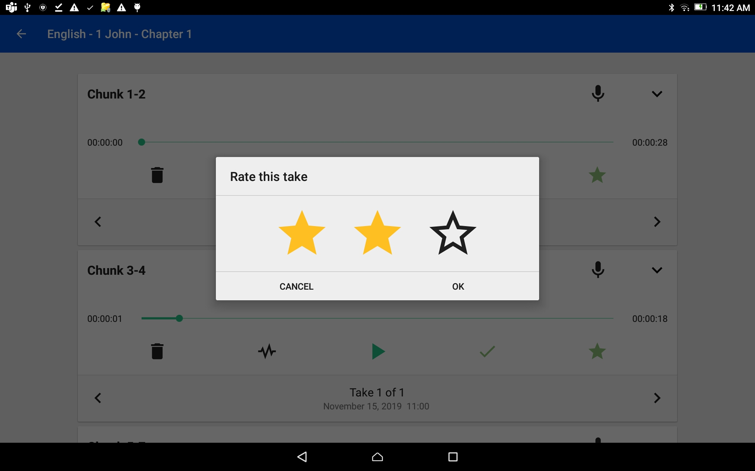
Verse/Chunk Take Bar Rate a recording
Tap on the star icon.
Rate the recording –
Tap on the left star if the recording is not the best – the star turns red.
Tap on the middle star if the recording is fine but could be better – the stars turn yellow.
Tap on OK to save.

Slide 14
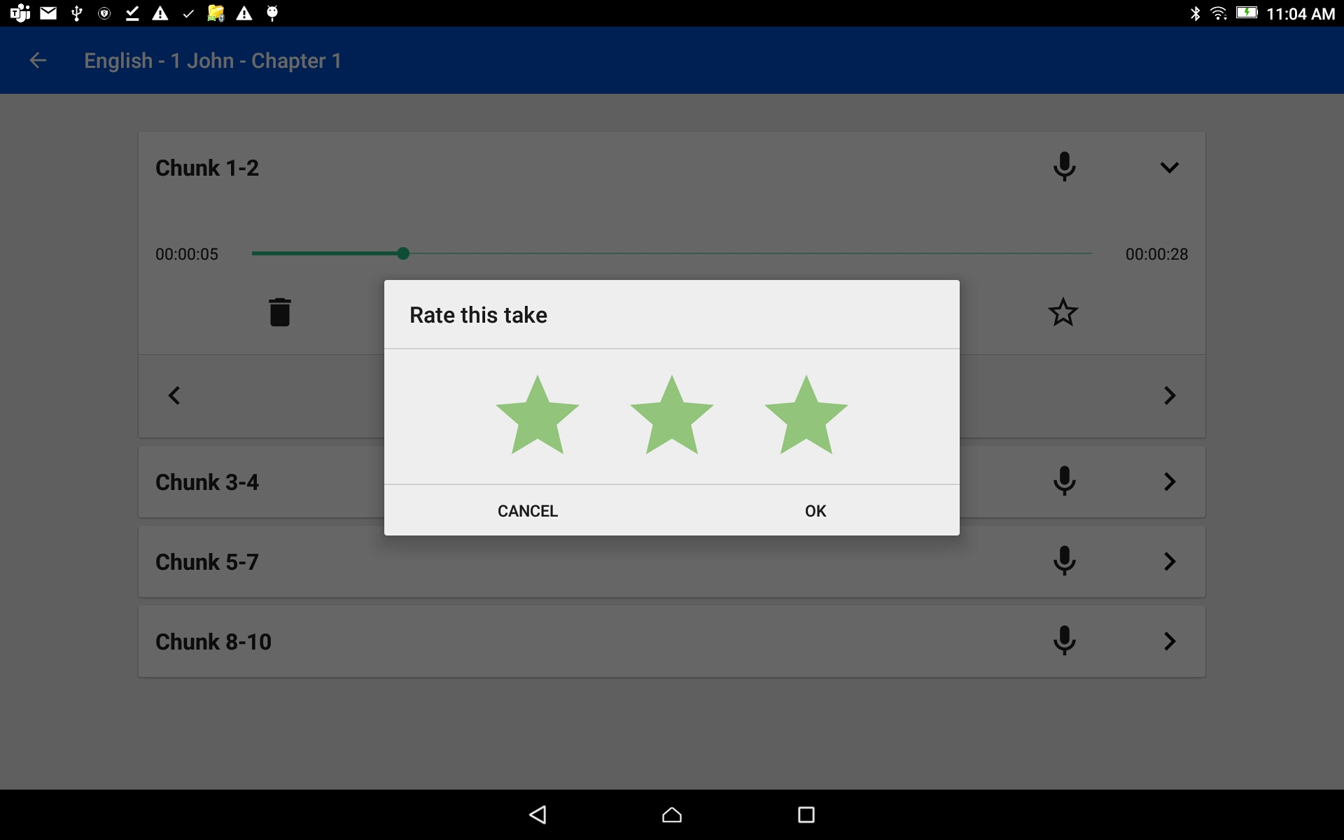
Verse/Chunk Take Bar Rate a recording
Tap on the star icon.
Rate the recording –
Tap on the left star if the recording is not the best – the star turns red.
Tap on the middle star if the recording is fine but could be better – the stars turn yellow.
Tap on the right star for a very good recording – the starts turn green.
Tap on OK to save.

Slide 15
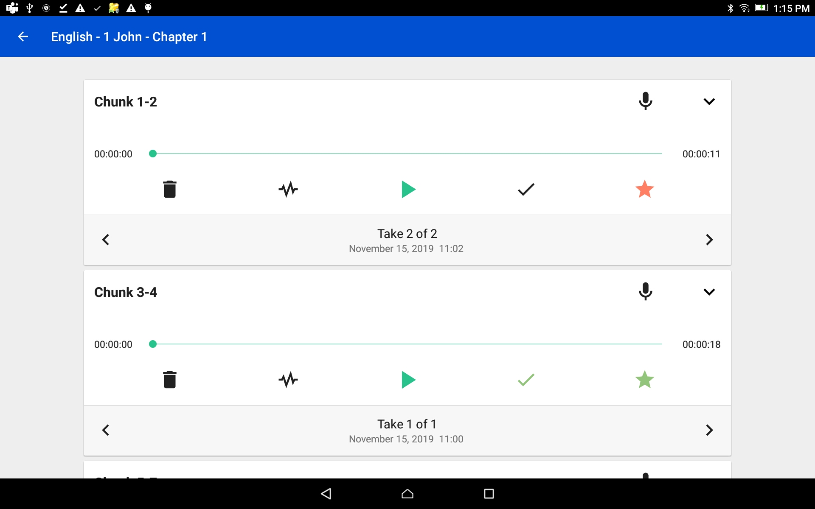
Verse/Chunk Take Bar Rate a recording
Note the different colored of stars on the Verse Take bar.

Slide 16
Verse/Chunk Take Bar Edit the Recording
Tap on the wave form icon to enter the Audio Editing screen.

Slide 17
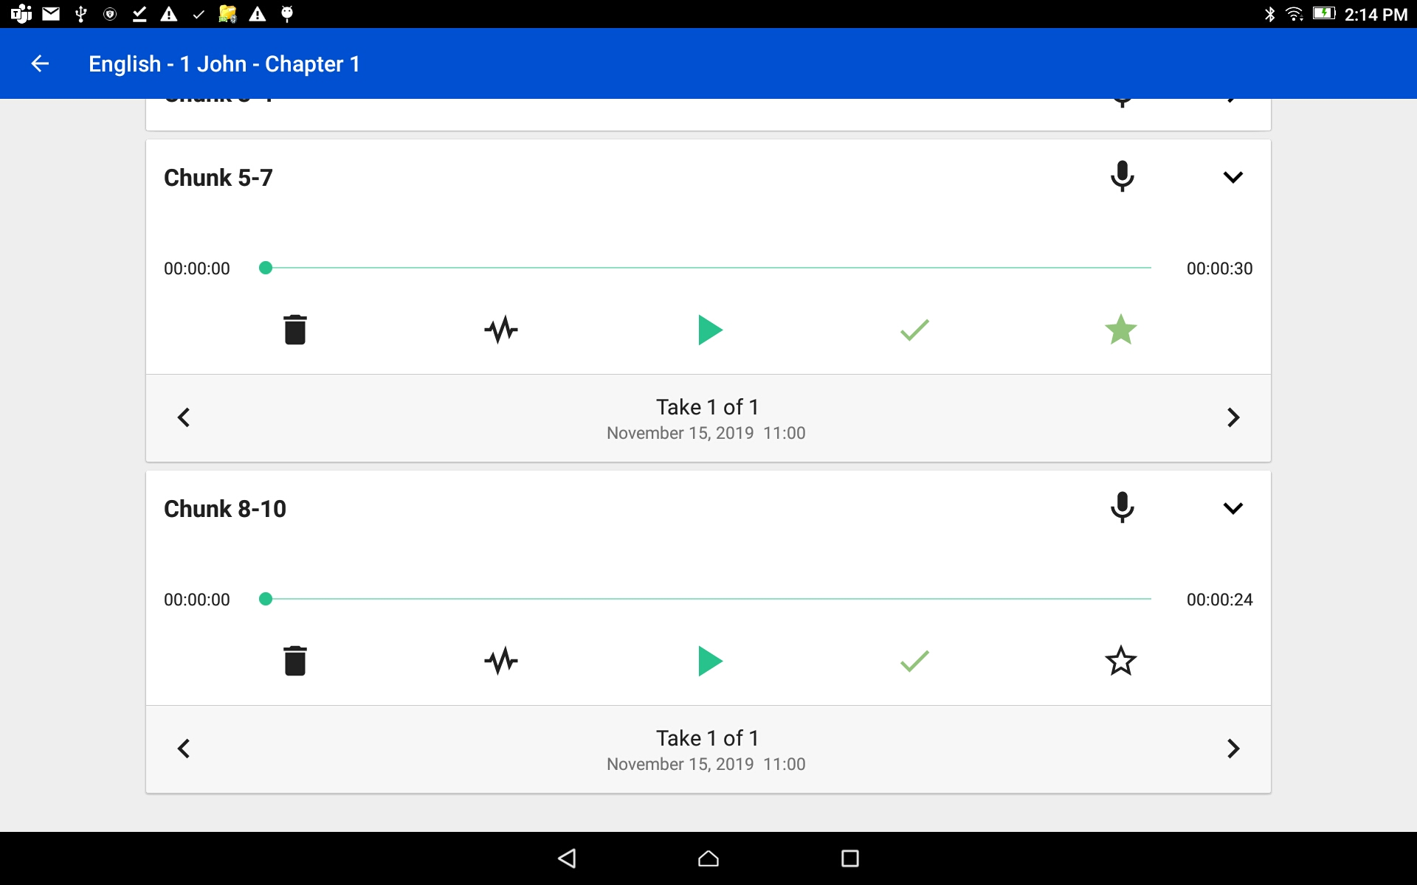
Verse/Chunk Take Bar Best Practice
Have only one take per verse/chunk.
This one take is the best available.
There is no need to do a rating if there is only one take on the verse/chunk.

