Slide 1
Cambiando la Configuración del Programa
Escritor BTT para androide

Slide 2
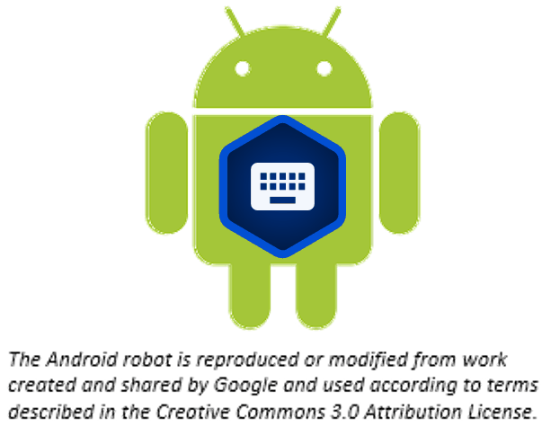
¿De qué trata esta presentación?
En esta presentación usted aprenderá a:
Abrir el menú de Opciones
Ver la configuración del programa
Utilizar las pestañas de los ajustes
Cambiar los ajustes del programa

Slide 3

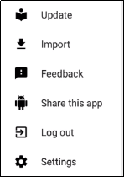
Accediendo a los Ajustes o la Configuración
Toque el ícono de 3 puntos para ceder al menú de Opciones.
Toque Ajustes (Settings)..

Slide 4
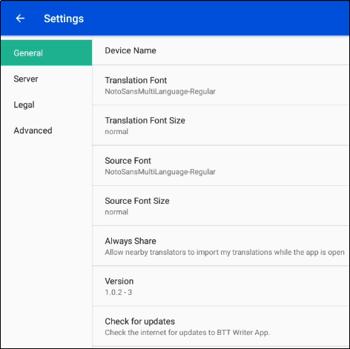
Menú de Ajustes – Generales
Nombre del dispositivo - Nombrar la tableta es útil al compartir con un amigo.
Tipo de Letra de la Traducción - Se muestra el nombre del tipo de letra seleccionado.
Tamaño de Letra de la Traducción - Se muestra el tamaño de la letra seleccionada.
Tipo de Letra del Texto Fuente - Se muestra el nombre del tipo de letra seleccionado.
Notes:
General
Device name - Tap on the words 'Device name' to name the tablet. Naming the tablet is helpful when sharing with a friend.
Translation Font - The name of the chosen font is displayed. Tap on the words 'Translation Font' to change the displayed font in the text.
Translation Font Size - The size of the chosen font is displayed. Tap on the words 'Translation Font size' to change the displayed font size in the text.
Source Font - The name of the chosen font is displayed. Tap on the words 'Source Font' to change the displayed font in the source.
Source Font Size -The size of the chosen font is displayed. Tap on the words 'Source Font Size' to change the displayed font size in the text.
Always Share – Choose whether you want the program to allow nearby translators to import my translations while the app is open.
Version - The version of the translationStudio program is displayed.
Check for updates - Tap to check for updates to translationStudio. This uses an internet connection.
Server - Keep all of the settings for the server as determined by the program. There is no need to edit any of the settings unless directed by an unfoldingWord technician.
Legal Settings - You can view important information about the program in this section of the Settings Menu.
License Agreement - read what you are able to do with the content in the program and the content that you create.
Statement of Faith - you, the user of the program, agreed to agree with this the first time the program was started. Read this to review what the Essentials Beliefs are.
Translation Guidelines - read this document to learn about the guidelines that can help the translator clearly, accurately and naturally translate the text.
Software Licenses - this file contains all the licenses for the various softwares that are used to create the translationStudio program.
Attribution - read this document to learn about the restrictions of using the derivative works and name branding.
Advanced
Backup Interval - The program sets the backup to occur every 5 minutes. This can be changed by the end user.
Logging Level and Developer Tools - The settings in this area are set by the program and should not be changed.

Slide 5
Menú de Ajustes – Generales (continuación)
Tamaño de Letra del Texto Fuente - Se muestra el tamaño de la letra seleccionada.
Compartir Siempre - Elija si usted desea que el programa permita a traductores que estén cerca importar Mis Traducciones mientras la aplicación esté abierta.
Versión - Se muestra la versión del programa Escritor BTT .
Revisar actualizaciones - Toque para buscar actualizaciones para Escritor BTT. Esto utiliza una conexión de internet.
Notes:
General
Device name - Tap on the words 'Device name' to name the tablet. Naming the tablet is helpful when sharing with a friend.
Translation Font - The name of the chosen font is displayed. Tap on the words 'Translation Font' to change the displayed font in the text.
Translation Font Size - The size of the chosen font is displayed. Tap on the words 'Translation Font size' to change the displayed font size in the text.
Source Font - The name of the chosen font is displayed. Tap on the words 'Source Font' to change the displayed font in the source.
Source Font Size -The size of the chosen font is displayed. Tap on the words 'Source Font Size' to change the displayed font size in the text.
Always Share – Choose whether you want the program to allow nearby translators to import my translations while the app is open.
Version - The version of the translationStudio program is displayed.
Check for updates - Tap to check for updates to translationStudio. This uses an internet connection.
Server - Keep all of the settings for the server as determined by the program. There is no need to edit any of the settings unless directed by an unfoldingWord technician.
Legal Settings - You can view important information about the program in this section of the Settings Menu.
License Agreement - read what you are able to do with the content in the program and the content that you create.
Statement of Faith - you, the user of the program, agreed to agree with this the first time the program was started. Read this to review what the Essentials Beliefs are.
Translation Guidelines - read this document to learn about the guidelines that can help the translator clearly, accurately and naturally translate the text.
Software Licenses - this file contains all the licenses for the various softwares that are used to create the translationStudio program.
Attribution - read this document to learn about the restrictions of using the derivative works and name branding.
Advanced
Backup Interval - The program sets the backup to occur every 5 minutes. This can be changed by the end user.
Logging Level and Developer Tools - The settings in this area are set by the program and should not be changed.

Slide 6
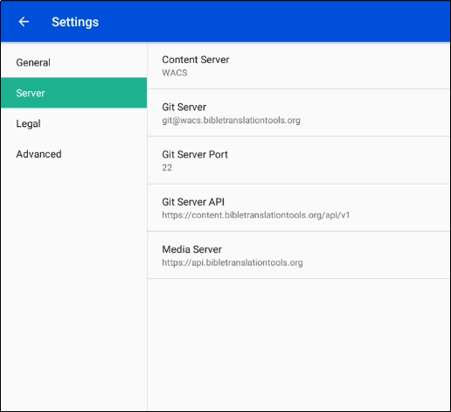
Menú de Ajustes – del Servidor
Servidor de Contenido: Por defecto es WACS (Wycliffe Associates Content Server). Usted puede cambiar esto a DCS (Door43 Content Server).
Notes:
General
Device name - Tap on the words 'Device name' to name the tablet. Naming the tablet is helpful when sharing with a friend.
Translation Font - The name of the chosen font is displayed. Tap on the words 'Translation Font' to change the displayed font in the text.
Translation Font Size - The size of the chosen font is displayed. Tap on the words 'Translation Font size' to change the displayed font size in the text.
Source Font - The name of the chosen font is displayed. Tap on the words 'Source Font' to change the displayed font in the source.
Source Font Size -The size of the chosen font is displayed. Tap on the words 'Source Font Size' to change the displayed font size in the text.
Always Share – Choose whether you want the program to allow nearby translators to import my translations while the app is open.
Version - The version of the translationStudio program is displayed.
Check for updates - Tap to check for updates to translationStudio. This uses an internet connection.
Server - Keep all of the settings for the server as determined by the program. There is no need to edit any of the settings unless directed by an unfoldingWord technician.
Legal Settings - You can view important information about the program in this section of the Settings Menu.
License Agreement - read what you are able to do with the content in the program and the content that you create.
Statement of Faith - you, the user of the program, agreed to agree with this the first time the program was started. Read this to review what the Essentials Beliefs are.
Translation Guidelines - read this document to learn about the guidelines that can help the translator clearly, accurately and naturally translate the text.
Software Licenses - this file contains all the licenses for the various softwares that are used to create the translationStudio program.
Attribution - read this document to learn about the restrictions of using the derivative works and name branding.
Advanced
Check Hardware Requirements – Tap the check box to have the app check for the required hardware each time it starts.
Backup Interval - The program sets the backup to occur every 5 minutes. This can be changed by the end user.
Logging Level and Developer Tools - The settings in this area are set by the program and should not be changed.

Slide 7
Menú de Ajustes – del Servidor
Cuando usted cambia el ajuste del Servidor de Contenido, los ajustes mostrados debajo cambian automáticamente a los valores apropiados para el servidor seleccionado.
Para WACS
Servidor Git: git@wacs.bibletranslationtools.org
Puerto del Servidor Git: Para WACS: 22
API del Servidor Git: https://content.bibletranslationtools.org/api/v1
Servidor de Medios: https://api.bibletranslationtools.org
Para DCS
Servidor Git: git@git.door43.org
Puerto del Servidor Git: Para DCS: 9299
API del Servidor Git: https://git.door43.org/api/v1
Servidor de Medios: https://api.unfoldingword.org
Notes:
General
Device name - Tap on the words 'Device name' to name the tablet. Naming the tablet is helpful when sharing with a friend.
Translation Font - The name of the chosen font is displayed. Tap on the words 'Translation Font' to change the displayed font in the text.
Translation Font Size - The size of the chosen font is displayed. Tap on the words 'Translation Font size' to change the displayed font size in the text.
Source Font - The name of the chosen font is displayed. Tap on the words 'Source Font' to change the displayed font in the source.
Source Font Size -The size of the chosen font is displayed. Tap on the words 'Source Font Size' to change the displayed font size in the text.
Always Share – Choose whether you want the program to allow nearby translators to import my translations while the app is open.
Version - The version of the translationStudio program is displayed.
Check for updates - Tap to check for updates to translationStudio. This uses an internet connection.
Server - Keep all of the settings for the server as determined by the program. There is no need to edit any of the settings unless directed by an unfoldingWord technician.
Legal Settings - You can view important information about the program in this section of the Settings Menu.
License Agreement - read what you are able to do with the content in the program and the content that you create.
Statement of Faith - you, the user of the program, agreed to agree with this the first time the program was started. Read this to review what the Essentials Beliefs are.
Translation Guidelines - read this document to learn about the guidelines that can help the translator clearly, accurately and naturally translate the text.
Software Licenses - this file contains all the licenses for the various softwares that are used to create the translationStudio program.
Attribution - read this document to learn about the restrictions of using the derivative works and name branding.
Advanced
Check Hardware Requirements – Tap the check box to have the app check for the required hardware each time it starts.
Backup Interval - The program sets the backup to occur every 5 minutes. This can be changed by the end user.
Logging Level and Developer Tools - The settings in this area are set by the program and should not be changed.

Slide 8
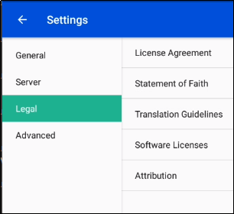
Menú de Ajustes – Legales
Usted puede ver información importante acerca del programa en esta sección del Menú de Ajustes.
Acuerdo de Licencia - lo que usted puede hacer con el contenido del programa y con el contenido que usted cree.
Declaración de Fe - usted, el usuario del programa, acordó estar de acuerdo con esto la primera vez que el programa fue iniciado. Lea esto para revisar lo que son las Creencias Esenciales.
Las pautas de traducción - aprenda acerca de las normas que pueden ayudar al traductor a traducir el texto en forma clara, correcta y natural.
Notes:
General
Device name - Tap on the words 'Device name' to name the tablet. Naming the tablet is helpful when sharing with a friend.
Translation Font - The name of the chosen font is displayed. Tap on the words 'Translation Font' to change the displayed font in the text.
Translation Font Size - The size of the chosen font is displayed. Tap on the words 'Translation Font size' to change the displayed font size in the text.
Source Font - The name of the chosen font is displayed. Tap on the words 'Source Font' to change the displayed font in the source.
Source Font Size -The size of the chosen font is displayed. Tap on the words 'Source Font Size' to change the displayed font size in the text.
Always Share – Choose whether you want the program to allow nearby translators to import my translations while the app is open.
Version - The version of the translationStudio program is displayed.
Check for updates - Tap to check for updates to translationStudio. This uses an internet connection.
Server - Keep all of the settings for the server as determined by the program. There is no need to edit any of the settings unless directed by an unfoldingWord technician.
Legal Settings - You can view important information about the program in this section of the Settings Menu.
License Agreement - read what you are able to do with the content in the program and the content that you create.
Statement of Faith - you, the user of the program, agreed to agree with this the first time the program was started. Read this to review what the Essentials Beliefs are.
Translation Guidelines - read this document to learn about the guidelines that can help the translator clearly, accurately and naturally translate the text.
Software Licenses - this file contains all the licenses for the various softwares that are used to create the translationStudio program.
Attribution - read this document to learn about the restrictions of using the derivative works and name branding.
Advanced
Check Hardware Requirements – Tap the check box to have the app check for the required hardware each time it starts.
Backup Interval - The program sets the backup to occur every 5 minutes. This can be changed by the end user.
Logging Level and Developer Tools - The settings in this area are set by the program and should not be changed.

Slide 9
Menú de Ajustes – Legales (continuación)
Usted puede ver información importante acerca del programa en esta sección del Menú de Ajustes.
Licencias del Software - muestra todas las licencias para los distintos softwares que son usados para crear el programa Escrito BTT.
Atribución - lea este documento para conocer acerca de las restricciones del uso de trabajos derivados y la mención de marcas.
Notes:
General
Device name - Tap on the words 'Device name' to name the tablet. Naming the tablet is helpful when sharing with a friend.
Translation Font - The name of the chosen font is displayed. Tap on the words 'Translation Font' to change the displayed font in the text.
Translation Font Size - The size of the chosen font is displayed. Tap on the words 'Translation Font size' to change the displayed font size in the text.
Source Font - The name of the chosen font is displayed. Tap on the words 'Source Font' to change the displayed font in the source.
Source Font Size -The size of the chosen font is displayed. Tap on the words 'Source Font Size' to change the displayed font size in the text.
Always Share – Choose whether you want the program to allow nearby translators to import my translations while the app is open.
Version - The version of the translationStudio program is displayed.
Check for updates - Tap to check for updates to translationStudio. This uses an internet connection.
Server - Keep all of the settings for the server as determined by the program. There is no need to edit any of the settings unless directed by an unfoldingWord technician.
Legal Settings - You can view important information about the program in this section of the Settings Menu.
License Agreement - read what you are able to do with the content in the program and the content that you create.
Statement of Faith - you, the user of the program, agreed to agree with this the first time the program was started. Read this to review what the Essentials Beliefs are.
Translation Guidelines - read this document to learn about the guidelines that can help the translator clearly, accurately and naturally translate the text.
Software Licenses - this file contains all the licenses for the various softwares that are used to create the translationStudio program.
Attribution - read this document to learn about the restrictions of using the derivative works and name branding.
Advanced
Check Hardware Requirements – Tap the check box to have the app check for the required hardware each time it starts.
Backup Interval - The program sets the backup to occur every 5 minutes. This can be changed by the end user.
Logging Level and Developer Tools - The settings in this area are set by the program and should not be changed.

Slide 10
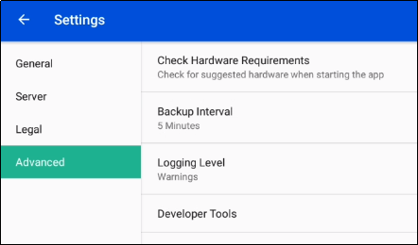
Menú de Ajustes - Avanzados
Revise los requisitos del hardware - Elija si revisar el hardware al iniciar la aplicación.
Intérvalo de la Copia de Seguridad - El programa establece que la copia de seguridad ocurrirá cada 5 minutos. Esto puede ser cambiado por el usuario final.
Nivel de Registro y Herramientas del Desarrollador - Los ajustes en esta área están establecidos por el programa y no deben ser cambiados.
Notes:
General
Device name - Tap on the words 'Device name' to name the tablet. Naming the tablet is helpful when sharing with a friend.
Translation Font - The name of the chosen font is displayed. Tap on the words 'Translation Font' to change the displayed font in the text.
Translation Font Size - The size of the chosen font is displayed. Tap on the words 'Translation Font size' to change the displayed font size in the text.
Source Font - The name of the chosen font is displayed. Tap on the words 'Source Font' to change the displayed font in the source.
Source Font Size -The size of the chosen font is displayed. Tap on the words 'Source Font Size' to change the displayed font size in the text.
Always Share – Choose whether you want the program to allow nearby translators to import my translations while the app is open.
Version - The version of the translationStudio program is displayed.
Check for updates - Tap to check for updates to translationStudio. This uses an internet connection.
Server - Keep all of the settings for the server as determined by the program. There is no need to edit any of the settings unless directed by an unfoldingWord technician.
Legal Settings - You can view important information about the program in this section of the Settings Menu.
License Agreement - read what you are able to do with the content in the program and the content that you create.
Statement of Faith - you, the user of the program, agreed to agree with this the first time the program was started. Read this to review what the Essentials Beliefs are.
Translation Guidelines - read this document to learn about the guidelines that can help the translator clearly, accurately and naturally translate the text.
Software Licenses - this file contains all the licenses for the various softwares that are used to create the translationStudio program.
Attribution - read this document to learn about the restrictions of using the derivative works and name branding.
Advanced
Check Hardware Requirements – Tap the check box to have the app check for the required hardware each time it starts.
Backup Interval - The program sets the backup to occur every 5 minutes. This can be changed by the end user.
Logging Level and Developer Tools - The settings in this area are set by the program and should not be changed.

Slide 11
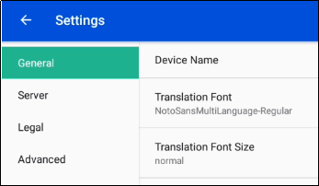
Cambiando el Nombre del Dispositivo
Es una buena práctica si se está compartiendo el proyecto con otras tabletas.
Para cambiar el nombre del dispositivo en Ajustes:
Toque la pestaña General.
Toque Nombre del Dispositivo.
1
2

Slide 12
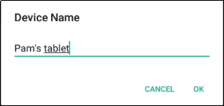
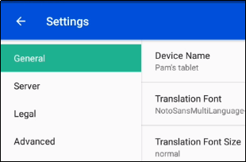
Cambiando el Nombre del Dispositivo (continuación)
Es una buena práctica si se está compartiendo el proyecto con otras tabletas.
Para cambiar el nombre del dispositivo en Ajustes:
Escriba el nombre deseado y toque OK.
Se muestra el nuevo nombre.
3
4

Slide 13
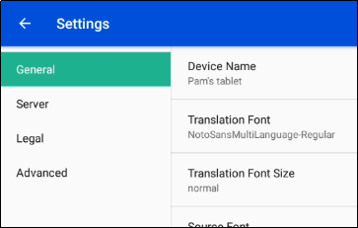
Cambiando el Tamaño de la Letra de Traducción
Es una buena práctica si se utiliza un lenguaje con caracteres no-romanos.
Para cambiar el tamaño de letra de la traducción en Ajustes:
Toque la pestaña General.
Toque el tamaño de la letra de traducción.
1
2

Slide 14
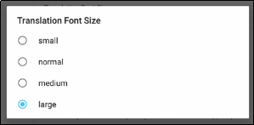
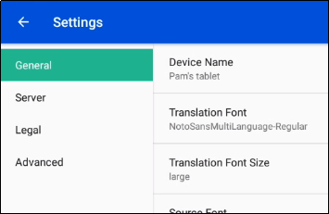
Cambiando el Tamaño de la Letra de Traducción (continuación)
Es una buena práctica si se utiliza un lenguaje con caracteres no-romanos.
Para cambiar el tamaño de letra de la traducción en Ajustes:
Toque el tamaño de la letra deseada.
Se muestra el nuevo tamaño de letra.
3
4

Slide 15
¿Qué aprendió usted?
En esta presentación usted aprendió a:
Abrir el menú de Opciones
Ver la configuración del programa
Utilizar las pestañas de ajustes
Cambiar los ajustes del programa

