Slide 1
Publishing a Project
BTT Writer for the Desktop

Slide 2
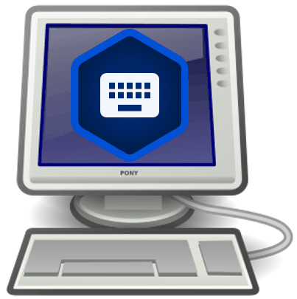
What Is This Presentation About?
In this presentation you learn to:
Describe the two types of publishing
List prerequisites for source text publishing
Explain the steps for source text publishing

Slide 3
What Is Publishing?
Publishing is a way to make your work available to others.
Two types:
Self-publishing
Source text publishing (only for Gateway Languages)

Slide 4
What Is Publishing?
Publishing is a way to make your work available to others.
Two types:
Self-publishing
Source text publishing (only for Gateway Languages)

Slide 5
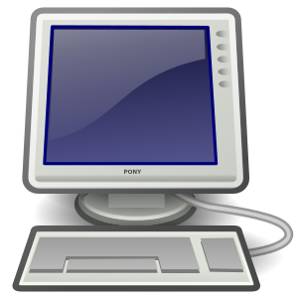
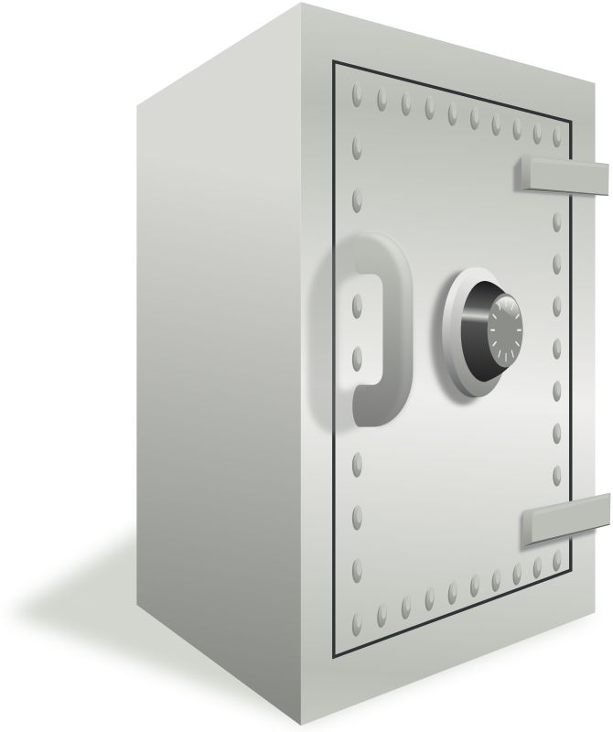
How Do I Self-Publish?
Upload your project to the content server as often as you want to create a backup of your work (see Uploading or Exporting Your Work).
Uploaded project is available online to anyone at the URL:
For WACS: https://wacs.bibletranslationtools.org/username/project_code.
For DCS: https://door43.org/u https://door43.org/u/username/project_code.
See Uploading, Exporting, and Importing a Project f

Slide 6
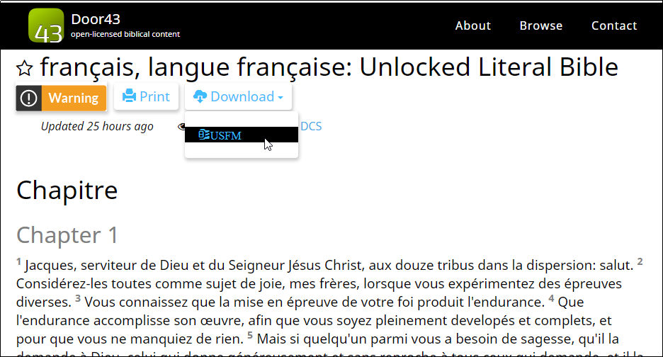
Viewing Self-Published Projects
From the content server, anyone can:
See the web version of your project with default formatting
Download documents of your project (like a PDF)
Get the link to the USFM file for your project
Interact with others about your project

Slide 7
What Is Publishing?
Publishing is a way to make your work available to others.
Two types:
Self-publishing
Source text publishing (only for Gateway Languages)

Slide 8
How Do I Publish Source Text?
To publish the source text for a Gateway Language you must:
Meet the prerequisites
Submit Source Text Request Form

Slide 9
Prerequisites for Publishing Source Text
The source text must meet all of the following:
Whole resource: Entire book or all of Open Bible Stories
Appropriate checking level: Level 3 for Bible translations
Uploaded to Door43: Merge content if done on multiple devices
All contributors listed by either name or pseudonym
Agreements: Document agreements by all contributors to License, Statement of Faith, and Translation Guidelines;
May be done by having them:
Create Door43 accounts
OR physically sign documents and digitize them (scan or photo)

Slide 10
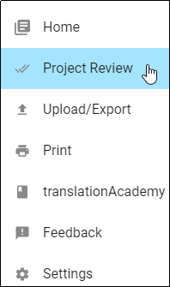
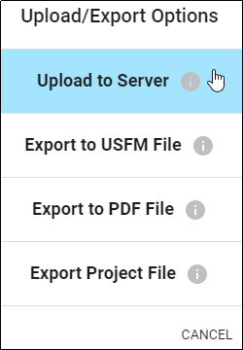
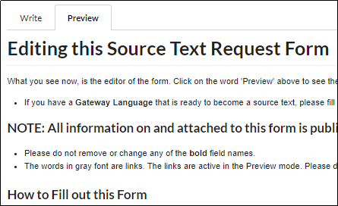
Submitting Source Text Request Form
To request that source text be published:
Perform project review to ensure that:
Translation is complete
All contributors are listed (include their server usernames OR attach signed license agreements for them.)
Upload completed project to content server.
Submit source text request form:i at http://ufw.io/pub/.
You will be contacted about any issues.
You will be notified when publishing is complete for your review.

Slide 11
What Did You Learn?
In this presentation you learned to:
Describe the two types of publishing
List prerequisites for source text publishing
Explain the steps for source text publishing

