Slide 1
Modification des paramètres du programme
BTT Writer pour Android

Slide 2
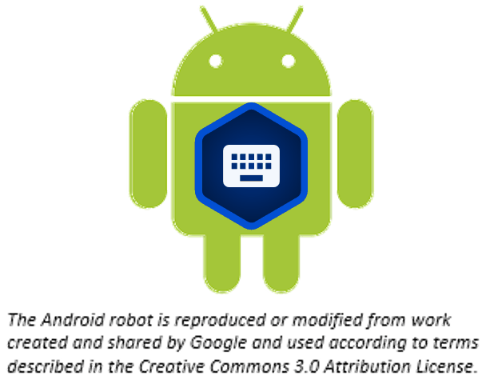
De quoi parle cette présentation ?
Dans cette présentation, vous apprenez à :
Ouvrir le menu des Options
Afficher les paramètres du programme
Utiliser les onglets de paramètres
Modifier les paramètres du programme

Slide 3

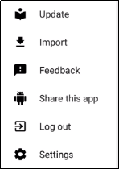
Accéder aux paramètres
Tapez sur l'icône à 3 points pour accéder au menu des options.
Tapez sur Paramètres.

Slide 4
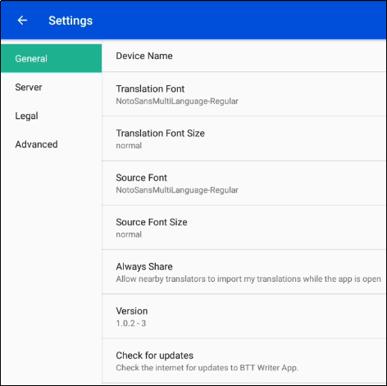
Menu des Paramètres
Paramètres généraux
Nom de l'appareil - Le nom de la tablette est utile lors du partage avec un ami.
Configuration de traduction - Le nom de la configuration choisie s'affiche.
Taille des caractères de traduction - la taille des caractères est affichée.
Police source - Le nom de la police choisie s'affiche.
Taille de la police source - La tailles des caractères est affichée.
Toujours partager - Choisissez si vous souhaitez que le programme autorise les traducteurs à proximité importent mes traductions pendant que l'application est ouverte.
Version - La version du programme translationStudio s'affiche.
Rechercher les mises à jour - Tapez pour rechercher les mises à jour de translation Studio. Cela utilise une connexion Internet.
Notes:
General
Device name - Tap on the words 'Device name' to name the tablet. Naming the tablet is helpful when sharing with a friend.
Translation Font - The name of the chosen font is displayed. Tap on the words 'Translation Font' to change the displayed font in the text.
Translation Font Size - The size of the chosen font is displayed. Tap on the words 'Translation Font size' to change the displayed font size in the text.
Source Font - The name of the chosen font is displayed. Tap on the words 'Source Font' to change the displayed font in the source.
Source Font Size -The size of the chosen font is displayed. Tap on the words 'Source Font Size' to change the displayed font size in the text.
Always Share – Choose whether you want the program to allow nearby translators to import my translations while the app is open.
Version - The version of the translationStudio program is displayed.
Check for updates - Tap to check for updates to translationStudio. This uses an internet connection.
Server - Keep all of the settings for the server as determined by the program. There is no need to edit any of the settings unless directed by an unfoldingWord technician.
Legal Settings - You can view important information about the program in this section of the Settings Menu.
License Agreement - read what you are able to do with the content in the program and the content that you create.
Statement of Faith - you, the user of the program, agreed to agree with this the first time the program was started. Read this to review what the Essentials Beliefs are.
Translation Guidelines - read this document to learn about the guidelines that can help the translator clearly, accurately and naturally translate the text.
Software Licenses - this file contains all the licenses for the various softwares that are used to create the translationStudio program.
Attribution - read this document to learn about the restrictions of using the derivative works and name branding.
Advanced
Backup Interval - The program sets the backup to occur every 5 minutes. This can be changed by the end user.
Logging Level and Developer Tools - The settings in this area are set by the program and should not be changed.

Slide 5
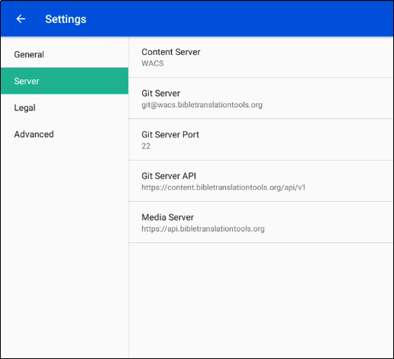
Menu des Paramètres
Paramètres du serveur
Serveur de contenu : La valeur par défaut est WACS (Wycliffe Associates Content Server). Vous pouvez changer cela en DCS (Door43 Content Server).
Lorsque vous modifiez le paramètre du serveur de contenu, les paramètres indiqués ci-dessous changent automatiquement aux valeurs appropriées pour le serveur sélectionné.
Serveur Git : pour WACS : git@wacs.bibletranslationtools.org
Pour DCS : git@git.door43.org
Port du serveur Git: pour WACS: 22
Pour DCS: 9299
API Git Serveur: Pour WACS: https://content.bibletranslationtools.org/api/v1
Pour DCS : https://git.door43.org/api/v1
Serveur multimédia : pour WACS : https://api.bibletranslationtools.org
Pour DCS : https://api.unfoldingword.org
Notes:
General
Device name - Tap on the words 'Device name' to name the tablet. Naming the tablet is helpful when sharing with a friend.
Translation Font - The name of the chosen font is displayed. Tap on the words 'Translation Font' to change the displayed font in the text.
Translation Font Size - The size of the chosen font is displayed. Tap on the words 'Translation Font size' to change the displayed font size in the text.
Source Font - The name of the chosen font is displayed. Tap on the words 'Source Font' to change the displayed font in the source.
Source Font Size -The size of the chosen font is displayed. Tap on the words 'Source Font Size' to change the displayed font size in the text.
Always Share – Choose whether you want the program to allow nearby translators to import my translations while the app is open.
Version - The version of the translationStudio program is displayed.
Check for updates - Tap to check for updates to translationStudio. This uses an internet connection.
Server - Keep all of the settings for the server as determined by the program. There is no need to edit any of the settings unless directed by an unfoldingWord technician.
Legal Settings - You can view important information about the program in this section of the Settings Menu.
License Agreement - read what you are able to do with the content in the program and the content that you create.
Statement of Faith - you, the user of the program, agreed to agree with this the first time the program was started. Read this to review what the Essentials Beliefs are.
Translation Guidelines - read this document to learn about the guidelines that can help the translator clearly, accurately and naturally translate the text.
Software Licenses - this file contains all the licenses for the various softwares that are used to create the translationStudio program.
Attribution - read this document to learn about the restrictions of using the derivative works and name branding.
Advanced
Check Hardware Requirements – Tap the check box to have the app check for the required hardware each time it starts.
Backup Interval - The program sets the backup to occur every 5 minutes. This can be changed by the end user.
Logging Level and Developer Tools - The settings in this area are set by the program and should not be changed.

Slide 6
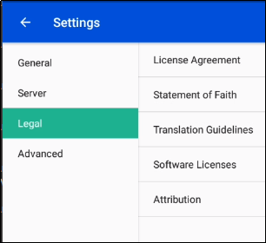
Menu Paramètres
Paramètres juridiques
Vous pouvez voir des informations importantes sur le programme dans cette section du menu des Paramètres
Contrat de licence - ce que vous pouvez faire avec le contenu du programme et le contenu que vous créez.
Déclaration de foi - vous, l'utilisateur du programme avez accepté de l'agréer la première fois que le programme a été lancé. Lisez ceci pour revoir ce que sont les croyances essentielles.
Directives de traduction - découvrez les directives qui peuvent aider le traducteur à traduire le texte de manière claire, précise et naturelle.
Licences logicielles - affichez toutes les licences des différents logiciels utilisés pour créer le programme BTT Writer.
Attribution - lisez ce document pour en savoir plus sur les restrictions d'utilisation des œuvres dérivées et de l'image de marque.
Notes:
General
Device name - Tap on the words 'Device name' to name the tablet. Naming the tablet is helpful when sharing with a friend.
Translation Font - The name of the chosen font is displayed. Tap on the words 'Translation Font' to change the displayed font in the text.
Translation Font Size - The size of the chosen font is displayed. Tap on the words 'Translation Font size' to change the displayed font size in the text.
Source Font - The name of the chosen font is displayed. Tap on the words 'Source Font' to change the displayed font in the source.
Source Font Size -The size of the chosen font is displayed. Tap on the words 'Source Font Size' to change the displayed font size in the text.
Always Share – Choose whether you want the program to allow nearby translators to import my translations while the app is open.
Version - The version of the translationStudio program is displayed.
Check for updates - Tap to check for updates to translationStudio. This uses an internet connection.
Server - Keep all of the settings for the server as determined by the program. There is no need to edit any of the settings unless directed by an unfoldingWord technician.
Legal Settings - You can view important information about the program in this section of the Settings Menu.
License Agreement - read what you are able to do with the content in the program and the content that you create.
Statement of Faith - you, the user of the program, agreed to agree with this the first time the program was started. Read this to review what the Essentials Beliefs are.
Translation Guidelines - read this document to learn about the guidelines that can help the translator clearly, accurately and naturally translate the text.
Software Licenses - this file contains all the licenses for the various softwares that are used to create the translationStudio program.
Attribution - read this document to learn about the restrictions of using the derivative works and name branding.
Advanced
Check Hardware Requirements – Tap the check box to have the app check for the required hardware each time it starts.
Backup Interval - The program sets the backup to occur every 5 minutes. This can be changed by the end user.
Logging Level and Developer Tools - The settings in this area are set by the program and should not be changed.

Slide 7
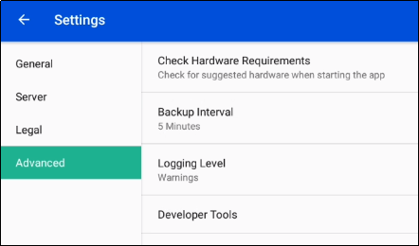
Menu des Paramètres
Réglages avancés
Vérifier les exigences matérielles - Choisissez de vérifier le matériel lors du démarrage de l'application
Intervalle de sauvegarde - Le programme définit la sauvegarde pour qu'elle se produise toutes les 5 minutes. Cela peut être modifié par l'utilisateur final.
Niveau de journalisation et outils de développement - Les paramètres de cette zone sont définis par le programme et ne doivent pas être modifiés
Notes:
General
Device name - Tap on the words 'Device name' to name the tablet. Naming the tablet is helpful when sharing with a friend.
Translation Font - The name of the chosen font is displayed. Tap on the words 'Translation Font' to change the displayed font in the text.
Translation Font Size - The size of the chosen font is displayed. Tap on the words 'Translation Font size' to change the displayed font size in the text.
Source Font - The name of the chosen font is displayed. Tap on the words 'Source Font' to change the displayed font in the source.
Source Font Size -The size of the chosen font is displayed. Tap on the words 'Source Font Size' to change the displayed font size in the text.
Always Share – Choose whether you want the program to allow nearby translators to import my translations while the app is open.
Version - The version of the translationStudio program is displayed.
Check for updates - Tap to check for updates to translationStudio. This uses an internet connection.
Server - Keep all of the settings for the server as determined by the program. There is no need to edit any of the settings unless directed by an unfoldingWord technician.
Legal Settings - You can view important information about the program in this section of the Settings Menu.
License Agreement - read what you are able to do with the content in the program and the content that you create.
Statement of Faith - you, the user of the program, agreed to agree with this the first time the program was started. Read this to review what the Essentials Beliefs are.
Translation Guidelines - read this document to learn about the guidelines that can help the translator clearly, accurately and naturally translate the text.
Software Licenses - this file contains all the licenses for the various softwares that are used to create the translationStudio program.
Attribution - read this document to learn about the restrictions of using the derivative works and name branding.
Advanced
Check Hardware Requirements – Tap the check box to have the app check for the required hardware each time it starts.
Backup Interval - The program sets the backup to occur every 5 minutes. This can be changed by the end user.
Logging Level and Developer Tools - The settings in this area are set by the program and should not be changed.

Slide 8
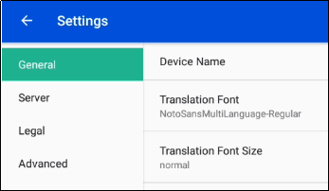
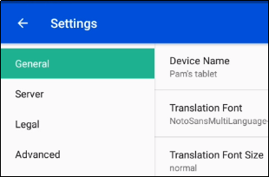
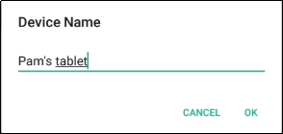
Changer le nom de l'appareil
C’est une bonne chose à faire si vous partagez un projet avec d’autres tablettes.
Pour modifier le nom de l'appareil dans les paramètres :
Tapez sur l'onglet général.
Tapez sur Nom de l'appareil.
Saisissez le nom souhaité et appuyez sur OK.
Le nouveau nom s'affiche.
1
2
3
4

Slide 9
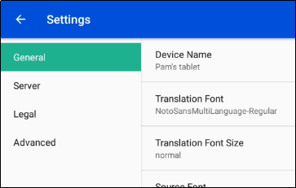
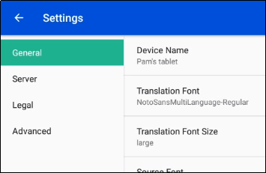
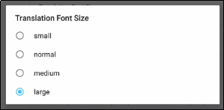
Modification de la taille de la police de traduction
C’est une bonne chose à faire si vous utilisez un langage avec des caractères non romains.
Pour modifier la taille de la police de traduction dans les paramètres :
Tapez sur l'onglet général.
Tapez sur Taille de la police de traduction.
Tapez sur la taille de police souhaitée.
La nouvelle taille de police s'affiche.
1
2
3
4

Slide 10
Qu'avez-vous appris ?
Dans cette présentation vous avez appris à :
Ouvrir le menu Options
Afficher les paramètres du programme
Utiliser les onglets de paramètres
Modifier les paramètres du programme

