Slide 1
Changing Program Settings
BTT Writer for the desktop

Slide 2
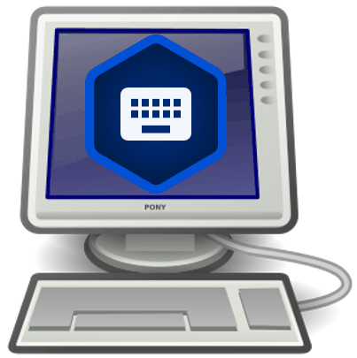
What Is This Presentation About?
In this presentation you learn to:
Open the Options menu
View program settings
Change program settings

Slide 3
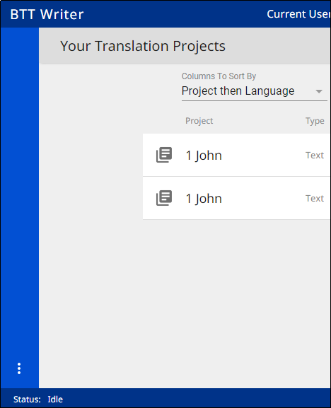
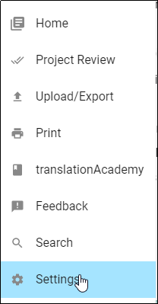
Accessing Settings
Click the 3-dot icon to access the Options menu, and then click Settings.

Slide 4
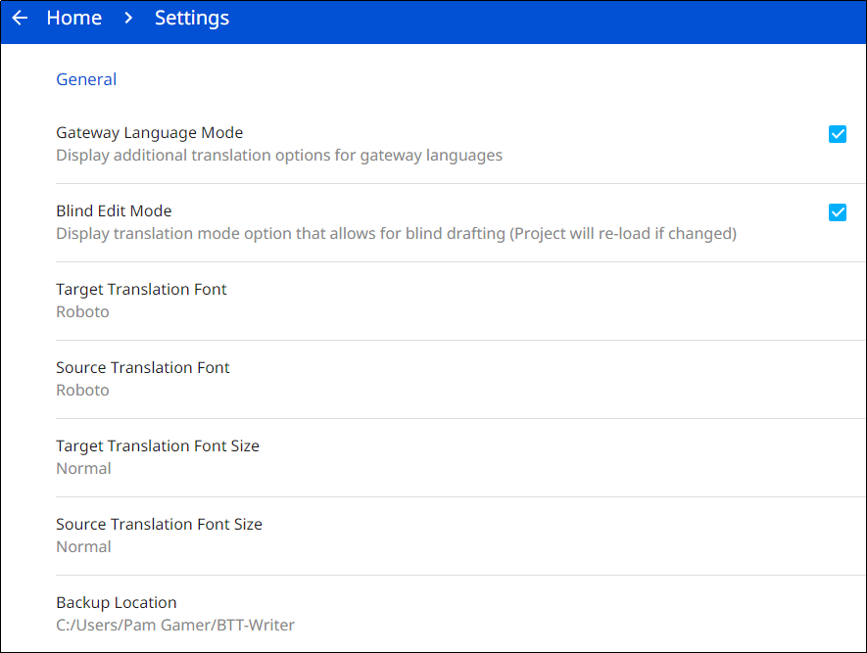
Settings Menu
General Settings
Gateway Language Mode– Check to provide GL options.
Blind Edit Mode– Check to provide options for blind drafting.
Target Translation Font – The name of the chosen font is displayed; click to change the font.
Source Translation Font – The name of the chosen font is displayed; click to change the font.
Target Translation Font Size – The size of the chosen font is displayed; click to change the font size.
Source Translation Font Size – The size of the chosen font is displayed ; click to change the font size.
Backup Location – The location on the file system where project files are stored (tS backs up to this location automatically every 5 minutes); click to change the location.

Slide 5
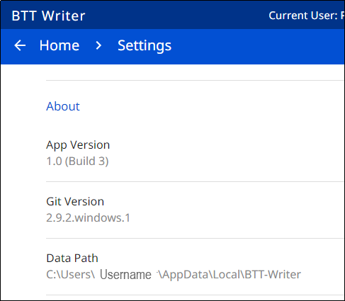
Settings Menu
Scroll down to see more settings:
About Settings (these settings are view-only and cannot be changed)
App Version – The installed version of the translationStudio program
Git Version – The installed version of Git, which is a version control system used by translationStudio
Data Path – Path to data used by the program

Slide 6
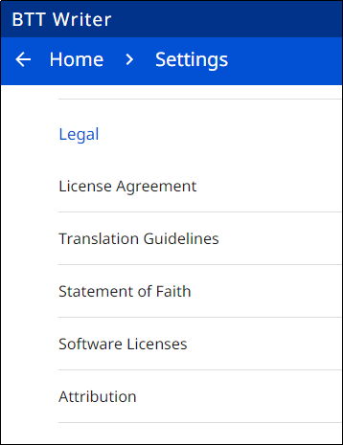
Settings Menu
Legal Settings (these settings are view-only and cannot be changed)
License Agreement - click to read what you agreed that you are permitted to do with the content in the program and the content that you create.
Statement of Faith - click to review the Essentials Beliefs that you agreed to.
Translation Guidelines - click to learn about the guidelines that can help the translator clearly, accurately and naturally translate the text.
Software Licenses - click to view all the licenses for the code packages and libraries that are used by the translationStudio program.
Attribution - click to learn about the restrictions of using the derivative works and name branding.

Slide 7
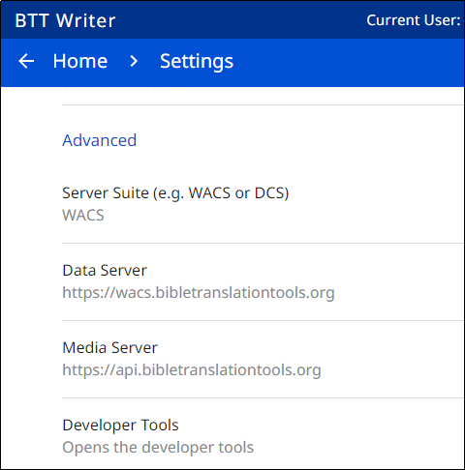
Settings Menu
Advanced
Server Suite (e.g. WACS or DCS): Specifies the content server where you can upload or import translations. Choose between the Wycliffe Associates Content Server (WACS) or the Door43 Content Server (DCS). Changing this setting also automatically changes the values for the next 2 settings shown below. Note: If you change this setting, you are prompted to close and reopen the BTT Writer program.
Data Server: The WACS or Door43 server, depending on what you choose for Server Suite. Don't change this value unless directed to do so by a support technician.
Media Server: The WACS or unfoldingWord media server, depending on what you choose for Server Suite. Don't change this value unless directed to do so by a support technician.
Developer Tools: You should not open developer tools unless directed to do so by a support technician.

Slide 8
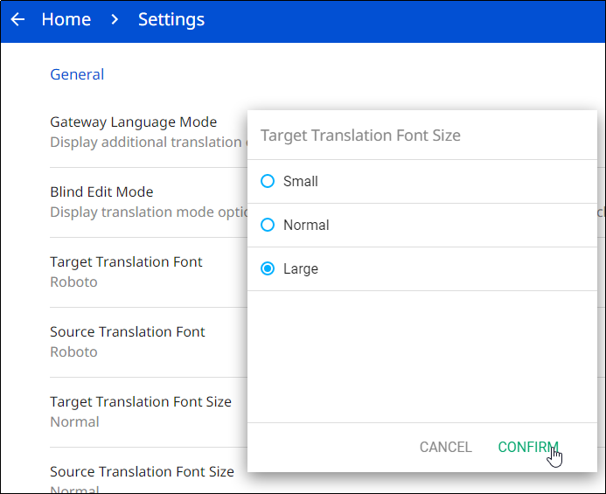

Changing the Translation Font Size
It’s a good thing to do if using language with non-Roman characters.
To change the translation font size in Settings:
Click Target Translation Font Size.
Select the desired font size and click CONFIRM.
The new font size is displayed.
2
1
3

Slide 9
What Did You Learn?
In this presentation you learned to:
Open the Options menu
View program settings
Change program settings

