Slide 1
Translating Footnotes
BTT Writer for android

Slide 2
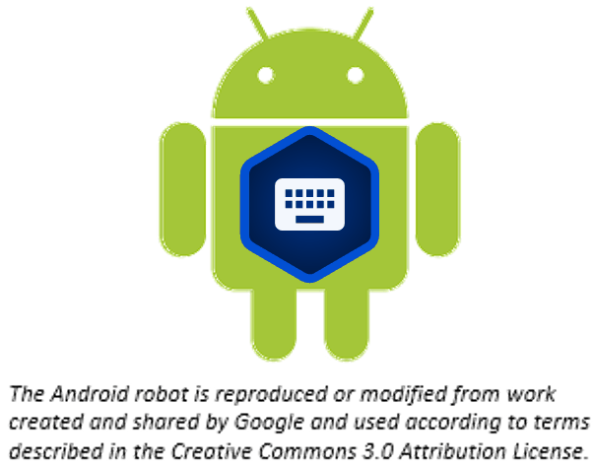
What Is This Presentation About?
In this presentation you learn to:
Explain how footnotes are used
Translate a footnote
Edit or delete a translated footnote

Slide 3
What Is a Footnote?
A footnote is additional text that usually appears at the bottom of a book’s page and is referenced within the page.
In BTT Writer, a footnote is shown as a black page icon that you click to display the footnote.
Footnotes can provide further explanation when:
There are proper names, words or terms that differ between various Bible versions
There are missing words or verses in the ULB. (There may be text in one Bible version that is not present in the ULB.)

Slide 4
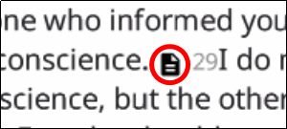



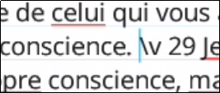
Adding a Footnote
To add a footnote to the translation:
Tap the English footnote to open it.
It’s not possible to copy/paste the footnote text.
You may need to write down the translation because you can’t have the original footnote open and type into the footnote translation at the same time.
Open the translated chunk for editing.
Tap at the place where you want to add the footnote.
1
2
3

Slide 5

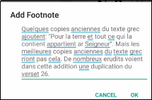
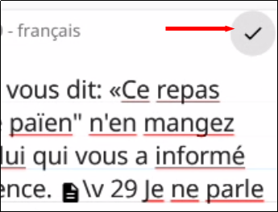
Adding a Footnote (continued)
Tap the Add Footnote icon.
Translate the footnote text into the “Add Footnote” pop-up and tap OK.
The footnote icon now appears inline. Tap the check mark to save the changes.
4
5
6

Slide 6

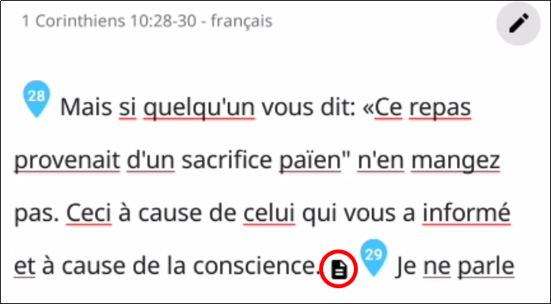
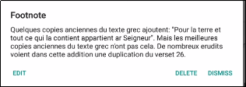

Editing a Footnote
To edit an existing translated footnote:
Ensure the chunk is not marked done and that you are not in Edit mode.
Tap the footnote.
Tap DELETE to delete it or EDIT to edit it.
When finished, mark chunk as done.
1
2
3
4

Slide 7
What Did You Learn?
In this presentation you learned to:
Explain how footnotes are used
Translate a footnote
Edit or delete a translated footnote

