Slide 1
Getting Started
BTT Writer for android

Slide 2
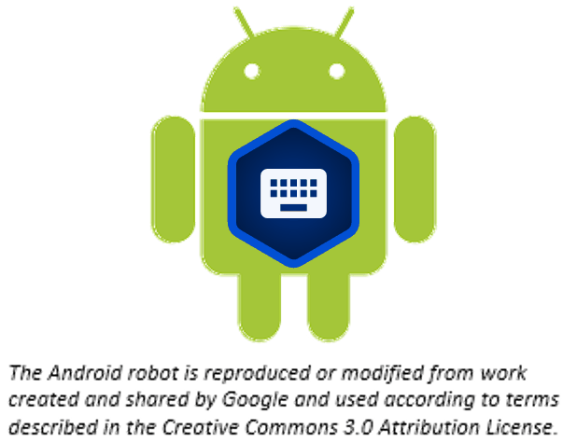
What Is This Presentation About?
In this presentation you learn to:
Install BTT Writer for Android
Open the program
Agree with terms of use
Create an account
Understand the home screen

Slide 3
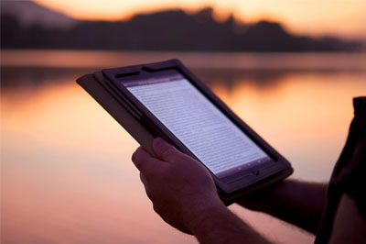
What Is BTT Writer for Android?
Mobile app for translating Bible & Open Bible Stories
Open source
Contains:
Content to be translated
Bible resources
Work can be shared and published
Notes:
BTT Writer for Android is a mobile app that can be downloaded for Android devices so that anyone with an Android tablet can translate the Bible into their heart language.
BTT Writer is open source (without cost) and copyright free (content is not copyrighted against translation)
Most Bibles and resources are copyrighted – can’t use as a translation source unless receiving permission from publisher, often involving paying royalties.
For example, if you translate out of a single source, it is considered plagiarism to publish. You must use at least 3 sources for it not to be plagiarism.
It contains the content that needs to be translated as well as Bible resources – notes, words, questions – that can improve the translation.
Information can be shared directly from device to device and finished content can be uploaded to a content server and digitally published.

Slide 4
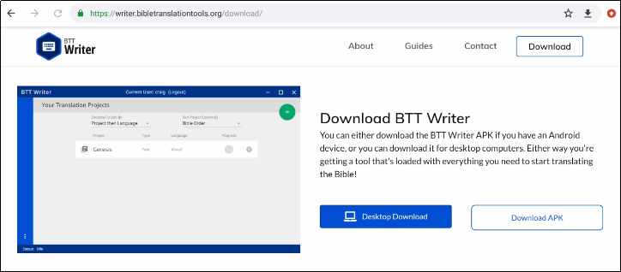


Installing BTT Writer for Android
In the browser on the Android device, go to this URL: https://writer.bibletranslationtools.org/download/
Tap on the white 'Download APK' button to download the install program to the tablet.

Slide 5
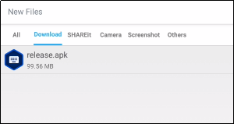
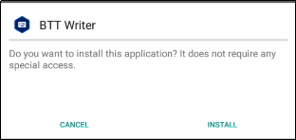
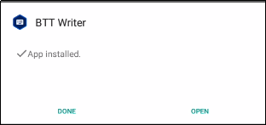

Installing BTT Writer for Android
Navigate to the Download folder on the tablet.
Tap on the release.apk file.
Agree to allow the program to be installed.
Tap to open the App when installed.
Tap ALLOW to enable BTT Writer to access photos, media, and files on your device.

Slide 6
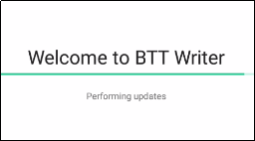

Opening BTT Writer
After installing, BTT Writer opens automatically (There may be automatic updates before the BTT Writer app opens.)
After closing, to reopen the app tap the BTT Writer icon on your tablet screen.

Slide 7
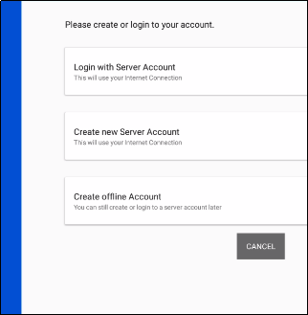
Choosing an Account Type
}
Server Account – user has full use of the program and can upload to and import from the content server (requires Internet connection.)
Offline Account – user has full use of the program except for uploading to or importing from the server.
CANCEL to exit the app.
Notes:
One of the first things you’ll need to do is to decide which type of account to use. There are two types:
Offline Account – user has full use of the program except for uploading to or importing from the content server. NO INTERNET CONNECTION REQUIRED.
Server Account – user has full use of the program and can upload to and import from the content server (requires Internet connection.)
You can switch between these at any time, so you can do your work in an offline account, and then log in to a Door43 account when you want to upload your work.
The work is attached to the device, not to the account.
NOTE: During a MAST event the translators may be directed to choose one of the types of accounts. As a facilitator - learn which the team lead is asking the translators to choose.

Slide 8
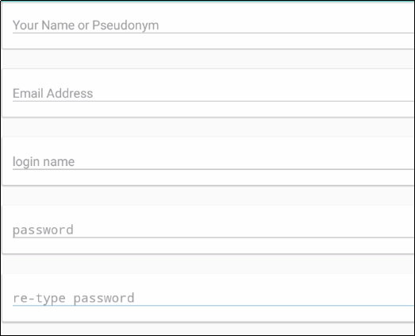
Creating a Server Account
Full name (or pseudonym if you don’t want your name associated publicly with Bible work)
Email – Used only if you forget your password
Login name – no spaces (same as pseudonym if using)
Password – something you can easily remember

Slide 9
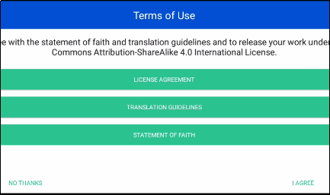
Agreeing to Terms of Use
Each translator or user of BTT Writer must agree to these terms of use. Tap each to read, scroll, and then tap Close.
License Agreement: Explains what you are able to do with the content in the program and the content that you create
Translation Guidelines: Describes qualities of a good translation to help the translator clearly, accurately, and naturally translate the text
Statement of Faith: Lists common elements of the Christian faith
Tap I AGREE (or tap NO THANKS to return to login screen).

Slide 10
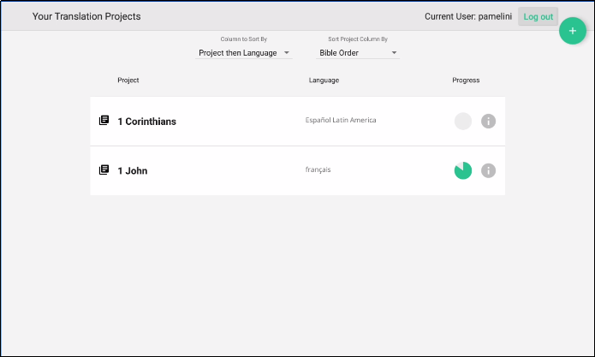
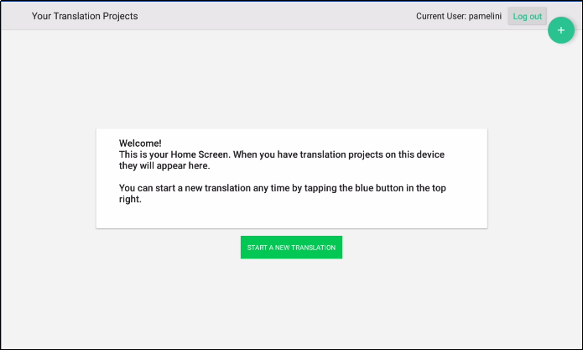
Viewing the Home Screen
, or welcomes you if you have no projects yet.
BTT Writer opens to display the Home screen:
Lists all of your projects
User name
User name
Logout button
Logout button

Slide 11
What Did You Learn?
In this presentation you learned to:
Install BTT Writer for Android
Open the program
Agree with terms of use
Create an account
Understand the home screen

