Slide 1
Performing Navigation
BTT Writer for android

Slide 2
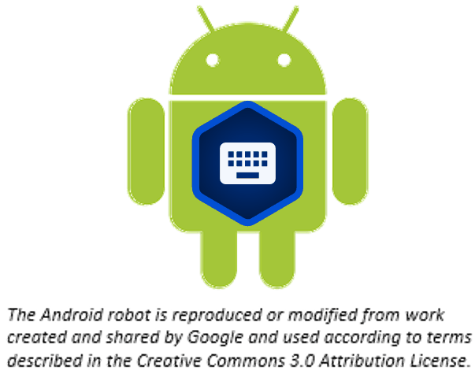
What Is This Presentation About?
In this presentation you learn to:
Explain the difference between the Home screen and a Project screen
Move between BTT Writer screens
Describe the three views of a project
Navigate within a project

Slide 3
Two Types of Screens
Home: Lists all of your projects
Project: Your working area for a single project

Slide 4
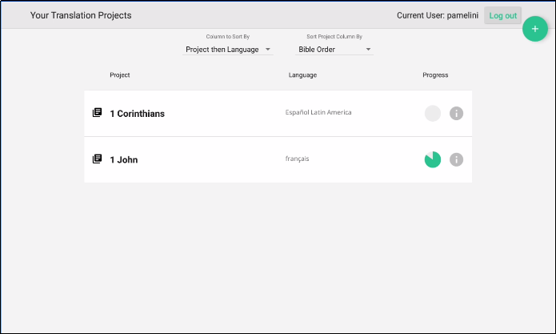
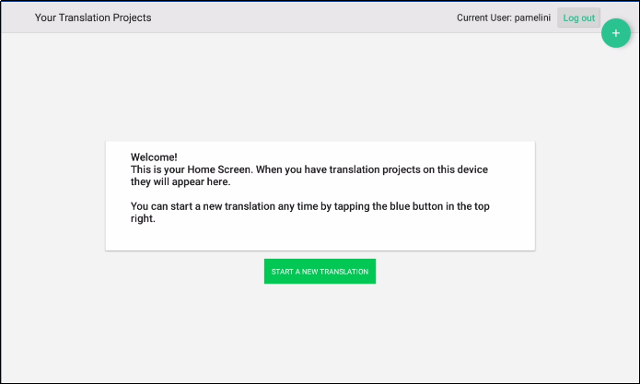
Two Types of Screens
, or welcomes you if you have no projects yet.
Home: Lists all of your projects
User name
User name
Logout button
Logout button

Slide 5
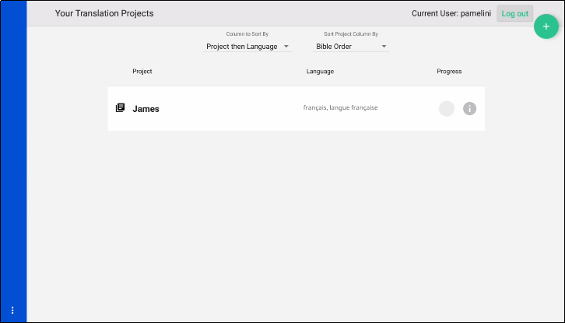


Navigating to the Project Screen
To navigate to the Project screen,
tap the project you want to open:

Slide 6
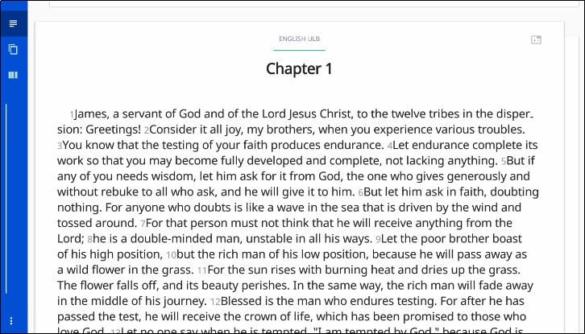
Two Types of Screens
Home: Lists all of your projects
Project: Your working area for a single project.
Has 3 different views:
Chapter
Slider moves through the text
Chapter view of the source text
Tap right to see translated text, if any

Slide 7
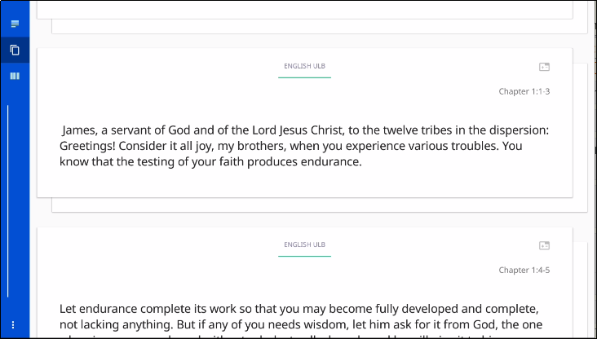
Two Types of Screens
Home: Lists all of your projects
Project: Your working area for a single project.
Has 3 different views:
Chapter
Chunk
Chunk view of the source text
Tap right to see translated text or to translate a chunk

Slide 8
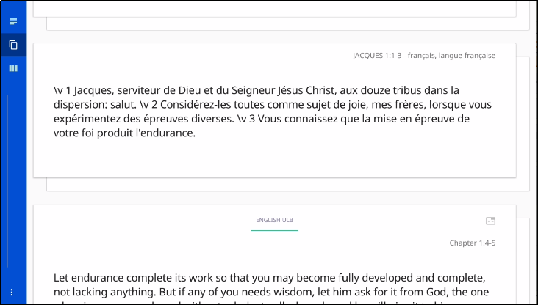
Two Types of Screens
Home: Lists all of your projects
Project: Your working area for a single project.
Has 3 different views:
Chapter
Chunk
Chunk view of the translated text
Tap right to return to source text chunk

Slide 9
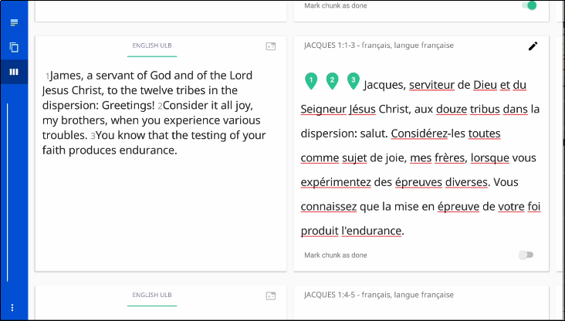
Two Types of Screens
Home: Lists all of your projects
Project: Your working area for a single project.
Has 3 different views:
Chapter
Chunk
Check
Check view with source and translation side by side
Check view with English ULB source text has helpful resources (swipe left to see)

Slide 10
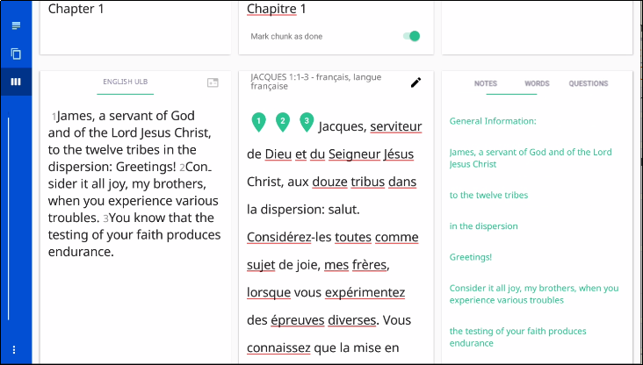
Two Types of Screens
Home: Lists all of your projects
Project: Your working area for a single project.
Has 3 different views:
Chapter
Chunk
Check
Check view with source, translation, and resources
Check view with English ULB source text has helpful resources (swipe left to see)

Slide 11
Two Types of Screens
Home: Lists all of your projects
Project: Your working area for a single project.
Has 3 different views:
Chapter
Chunk
Check
Check view with source, translation, and resources
Check view with English ULB source text has helpful resources (swipe left to see)
Edit by tapping the pencil.

Slide 12
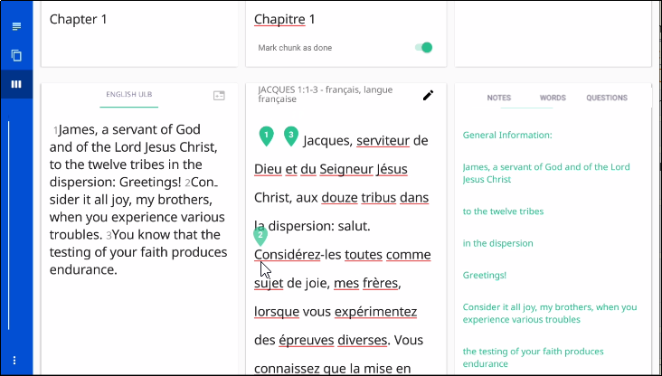
Two Types of Screens
Home: Lists all of your projects
Project: Your working area for a single project.
Has 3 different views:
Chapter
Chunk
Check
Check view with source, translation, and resources
Drag verse markers to correct locations.

Slide 13
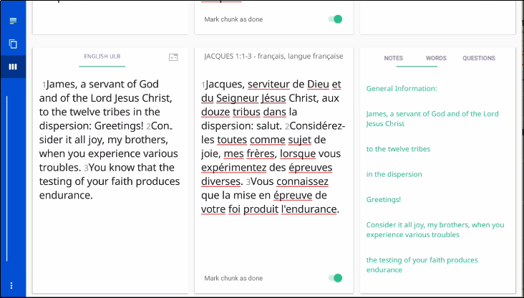
Two Types of Screens
Home: Lists all of your projects
Project: Your working area for a single project.
Has 3 different views:
Chapter
Chunk
Check
Check view with source, translation, and resources
Drag verse markers to correct locations.
Mark chunk as done

Slide 14

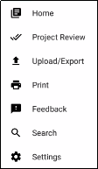
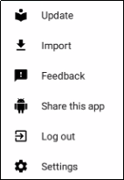
Options (3-dot) Menu
Tap 3 dots in lower left (or right if holding tablet vertically):
2 different menus from the 2 different screens:
On the Home screen:
On the Project screen:
Return to Home screen
Source/target language files, app
Prepare for publishing
Project or source text
Upload to server or export to a file
Report a bug
Print to PDF file
Share w another device or email
Log out (so you can log in as a different user)
Search source text
Modify program settings

Slide 15
Return to the Home Screen
Tap the 3 dots to open options menu.
Tap Home.

Slide 16
What Did You Learn?
In this presentation you learned to:
Explain the difference between the Home screen and a Project screen
Move between BTT Writer screens
Describe the three views of a project
Navigate within a project

