Slide 1
Starting a New Project
BTT Writer for android

Slide 2
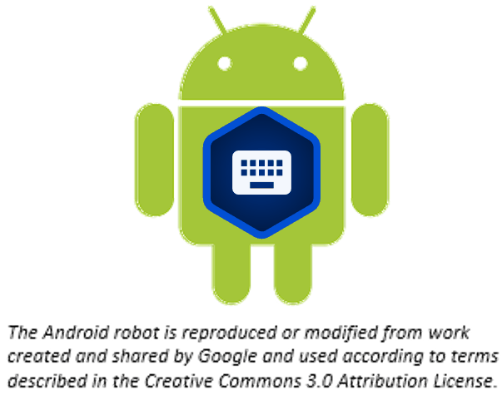
What Is This Presentation About?
In this presentation you learn to:
Explain what a BTT Writer project is
Create a new translation project

Slide 3
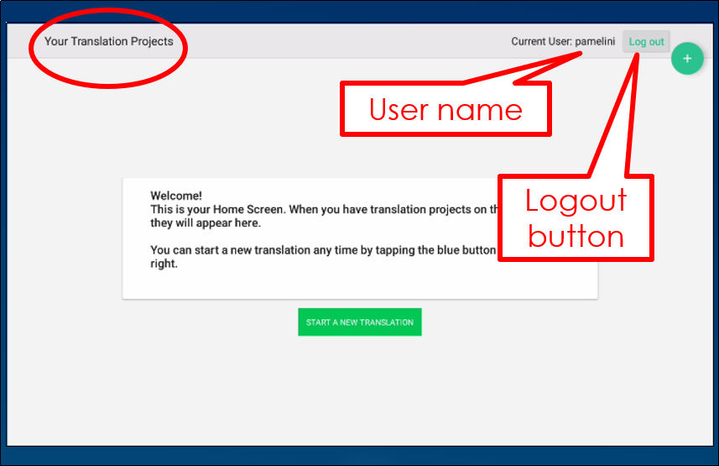
There Are Two Types of Screens
TranslationStudio opens to display the first type, the Home screen.

Slide 4
What Is a Project?
A project is a workspace to translate a specific portion of Scripture or Bible story into a target language
2 elements:
Target language: What language am I translating INTO?
Project category: What will I be translating?
Old or New Testament? Which book?
Open Bible Stories?
After creating a project, you must specify source text: What will I use to translate FROM?
Can be English or a gateway language, ULB or UDB
Can use multiple source texts
Can change source texts at any time

Slide 5
Steps to Create a New Project
Tap the icon to start a new project
Choose the target language (language you’re translating into) Suggestions: English Demo 1 or Demo 2
Choose the project category (what you will translate) Suggestion: Bible:NT → James
Specify a source text (language and text for the source translation) Suggestion: English (en) – Unlocked Literal Bible
These steps are shown in the next few slides.
Notes:
Demo this as you go through the next few slides and have them do the exercise on their tablet as you demo and guide them through it.

Slide 6


Starting a Project
Tap the plus icon or the START A NEW TRANSLATION button

Slide 7
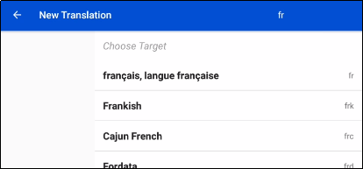

Starting a Project
Choose target language:
Tap in the search box.
Search for language, such as “fr”
Tap desired target language
Language you’re translating into

Slide 8
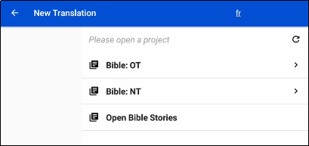
Starting a Project
Choose project category (what to translate):
Tap Bible:NT

Slide 9
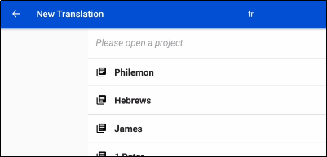
Starting a Project
Choose project category (what to translate):
Tap Bible:NT
Swipe up to scroll
Tap James

Slide 10
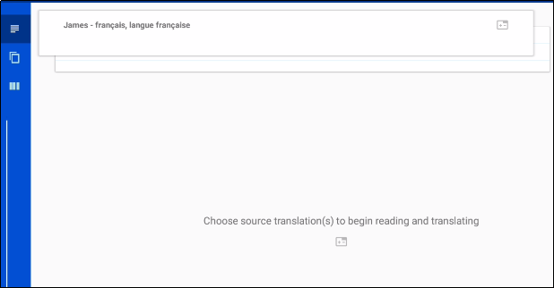
Starting a Project
Choose one or more source texts:
Project is created:
Can’t work until a source text is specified – tap anywhere in bottom part of screen.

Slide 11
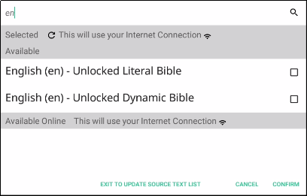
Starting a Project
Choose one or more source texts:
Project is created:
Can’t work until a source text is specified – tap anywhere in bottom part of screen.
Select one or more source texts – tap magnifying glass to search (tap English ULB)

Slide 12
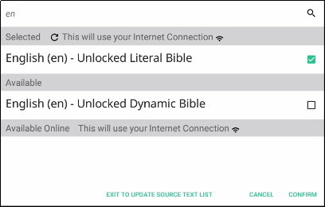
Starting a Project
Choose one or more source texts:
Project is created:
Can’t work until a source text is specified – tap anywhere in bottom part of screen.
Select one or more source texts – tap magnifying glass to search (tap English ULB)
Tap CONFIRM.

Slide 13
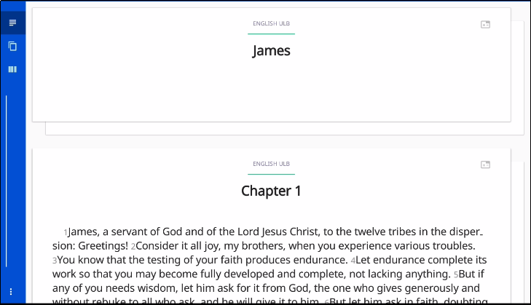
Second Type of Screen
The Project screen opens: Your working area for a single project. You are now ready to begin translating.

Slide 14
What Did You Learn?
In this presentation you learned to:
Explain what a BTT Writer project is
Create a new translation project

