Slide 1
Publishing a Project
BTT Writer for android

Slide 2
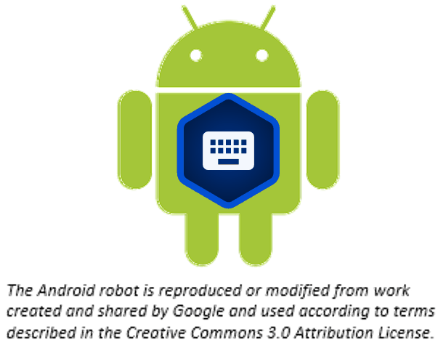
What Is This Presentation About?
In this presentation you learn to:
Describe the two types of publishing
List prerequisites for source text publishing
Explain the steps for source text publishing

Slide 3
What Is Publishing?
Publishing is a way to make your work available to others.
Two types:
Self-publishing
Source text publishing (only for Gateway Languages)

Slide 4
What Is Publishing?
Publishing is a way to make your work available to others.
Two types:
Self-publishing
Source text publishing (only for Gateway Languages)

Slide 5
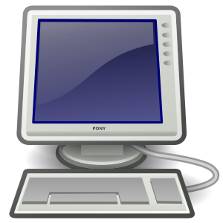

How Do I Self-Publish?
Upload your project to the server as often as you want to create a backup of your work (see Uploading or Exporting Your Work).
Uploaded project is available online to anyone:
DCS: https://door43.org/u/username/project_code WACS: https://wacs.bibletranslationtools.org/user_name/project_name

Slide 6
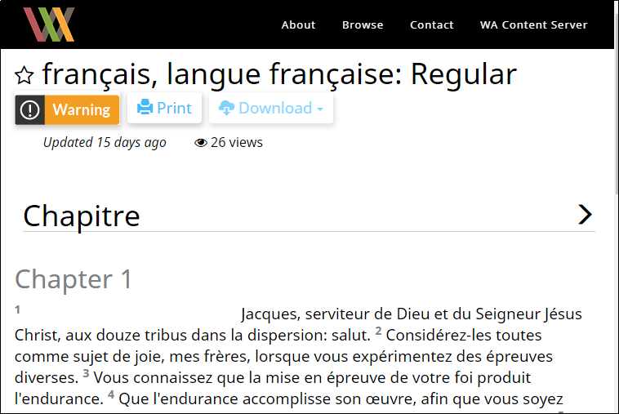
Viewing Self-Published Projects
From WACS or Door43, anyone can:
See the web version of your project with default formatting
Download documents of your project (like a PDF)
Get the link to the USFM file for your project
Interact with others about your project

Slide 7
What Is Publishing?
Publishing is a way to make your work available to others.
Two types:
Self-publishing
Source text publishing (only for Gateway Languages)

Slide 8
How Do I Publish Source Text?
Publishing source text is available only for Gateway Languages.
To publish the source text for a Gateway Language you must:
Meet the prerequisites
Submit Source Text Request Form

Slide 9
Prerequisites for Publishing Source Text
The source text must meet all of the following:
Whole resource: Entire book or all of Open Bible Stories
Appropriate checking level: Level 3 for Bible translations
Uploaded to the server: Merge content if done on multiple devices
All contributors listed by either name or pseudonym
Agreements: Document agreements by all contributors to License, Statement of Faith, and Translation Guidelines;
May be done by having them:
Create server accounts
OR physically sign documents and digitize them (scan or photo)

Slide 10
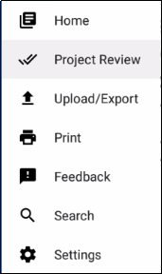
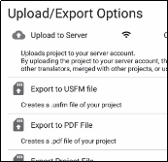
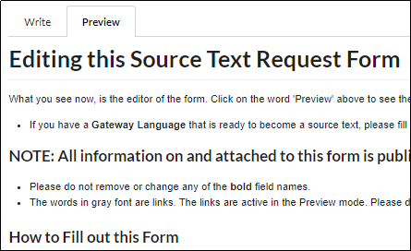
Submitting Source Text Request Form
To request that source text be published:
Perform project review to ensure that:
Translation is complete
All contributors are listed (include their server usernames OR attach signed license agreements for them.)
Upload the completed project to the server.
Fill out the source text request form at http://ufw.io/pub/.
You will be contacted about any issues.
You will be notified when publishing is complete for your review.

Slide 11
What Did You Learn?
In this presentation you learned to:
Describe the two types of publishing
List prerequisites for source text publishing
Explain the steps for source text publishing

