Slide 1
Uploading, Exporting, and Importing a Project
BTT Writer for android

Slide 2
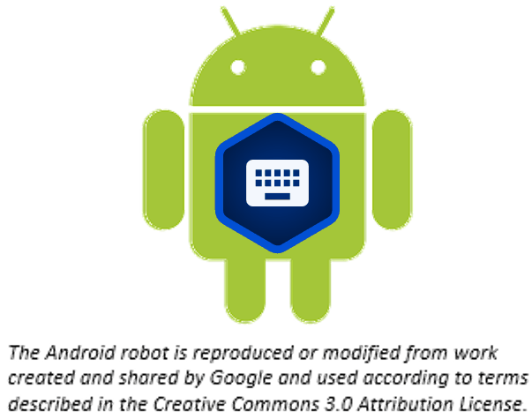
What Is This Presentation About?
In this presentation you learn to:
Explain why you should upload a project
Describe the upload options
Review a project
Upload a project to the server
Look at a project on the server
Delete a project from BTT Writer
Import a project from the server

Slide 3
Uploading/Exporting a Project
BTT Writer saves work to your device every 5 min. by default (can change in Settings)
Good idea to create an offline backup in case:
Your files get corrupted
Your device crashes
Enables you to:
Share your work with others
Work on a different device by importing to any device that has BTT Writer installed
BTT Writer provides several ways to back up and/or share your work

Slide 4
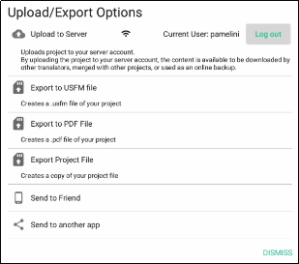
Options for Uploading/Exporting a Project
Options menu (3 dot icon) from Project Screen: Upload/Export
Upload to content server (requires internet connection and login to server account)
Save a USFM file on your device
Save a PDF file on your device
Save project on your device with tstudio extension
Allow another tablet to import
Send using Bluetooth, email, Google drive, or other app on your device
Notes:
USFM – Unified Standard Format Markers – markup language that is widely used for encoding the digital text of scripture translations.

Slide 5
Exporting/Importing a Project
Log in to the content server (either WACS or DCS, depending on setting).
Review your project and add another contributor.
Export your project to the server.
View the project on the server.
Delete your project from your device (to simulate loss of the file).
Import your project from the server.

Slide 6
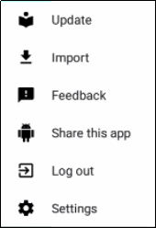

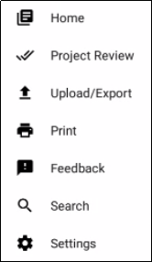
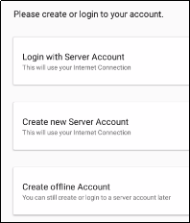
Step 1: Logging in to the Server
If you are using an offline account:
Log out of BTT Writer.
Create a server account, or log into an existing one.
OR
OR

Slide 7
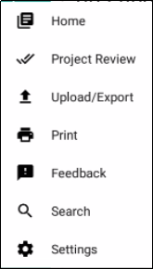
Step 2: Reviewing Your Project
Review your project and add another contributor.
Open your project
Tap Project Review on Options menu.

Slide 8
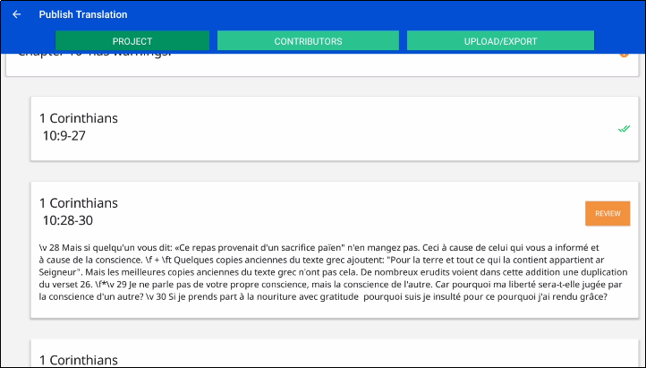
Step 2: Reviewing Your Project
Review your project.
Open your project
Tap Project Review on Options menu.
Tap Project.
Tap REVIEW buttons, if any
Good idea to review before sharing or exporting
Indication of incomplete
translation chunk
Indications of incomplete
translation chunks

Slide 9
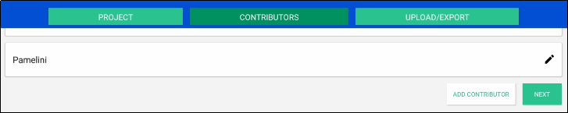
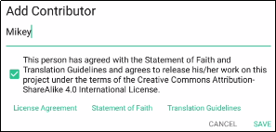
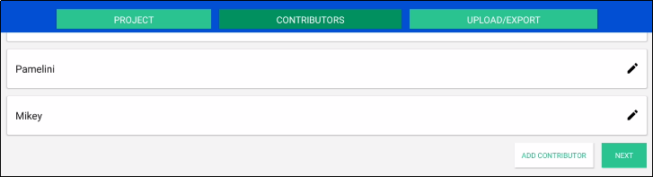
Step 2: Reviewing Your Project
Add another contributor.
Tap Contributors.
Tap Add Contributor.
Add contributor’s name and check the agreement box, then tap Save (you may have to tap the device’s back button to dismiss the keyboard so that you can see the Save button.)
Now the added contributor is shown.

Slide 10
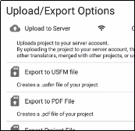
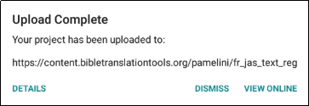
Step 3: Exporting the Project to the Server
Export your project to the server.
Tap Upload/Export from either the Project Review screen or from the Options menu.]
Tap Upload to Server.
On the Upload Complete message, note the upload location:
OR
File location:
File name: LanguageCode_BookCode_ProjectCategory

Slide 11
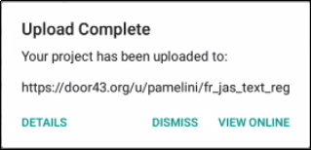
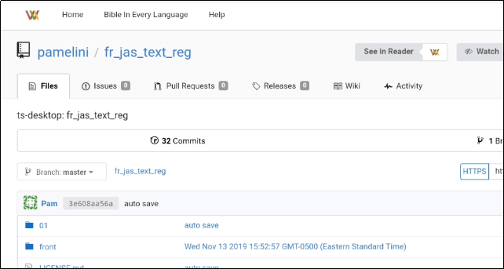
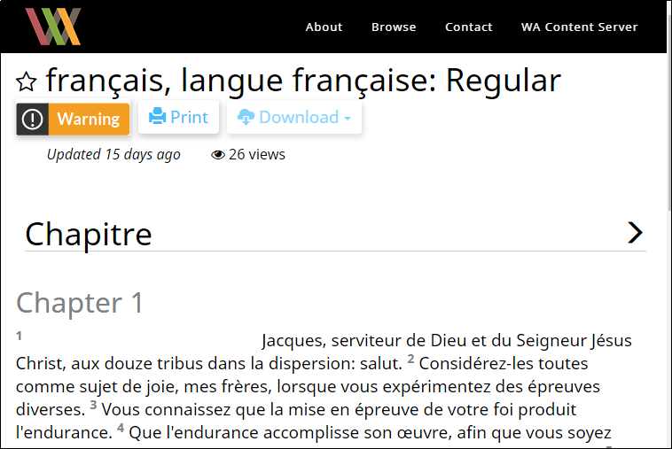
Step 4: Viewing the Project on the Server
Tap View Online.
A browser window displays your project on the server.
Tap See in Reader for read-friendly version.

Slide 12


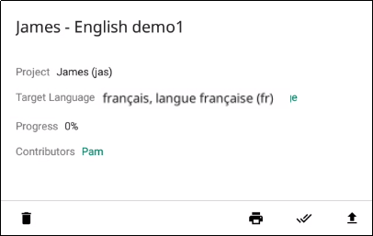
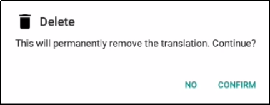
Step 5: Deleting Your Project from Your Device (to simulate loss of the file)
On the Home page, tap the “i” icon next to your project.
Tap the Delete icon (trash can), and then tap Confirm.
The project disappears from your home screen – it has been deleted from your device.
Other things you can do from this window:
Print
Project
Project Review
Upload
Export

Slide 13
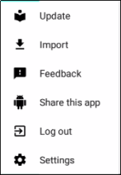
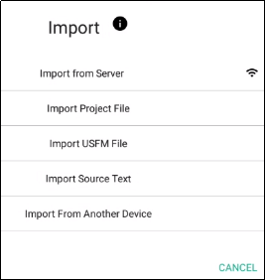
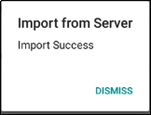
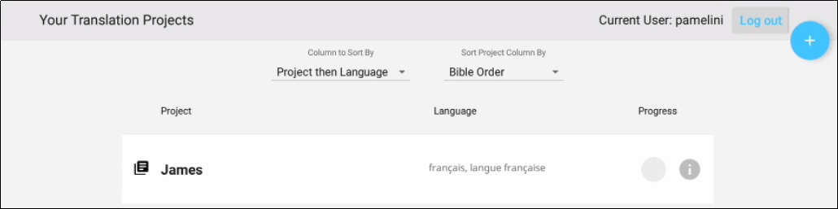

Step 6: ImportingYour Project from the Server
On the Options menu, tap Import.
Tap Import from Server.
Dismiss the Success message.
Your project has been imported to your device.

Slide 14
What Did You Learn?
In this presentation you learned to:
Explain why you should upload a project
Describe the upload options
Review a project
Upload a project to the server
Look at a project on the server
Delete a project from BTT Writer
Import a project from the server

