Slide 1
Uploading, Exporting, and Importing a Project
Btt writer for the desktop

Slide 2
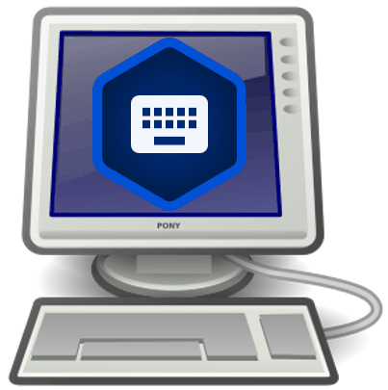
What Is This Presentation About?
In this presentation you learn to:
Explain why you should upload a project
Describe the upload options
Review a project
Upload a project to the content server
View a project on the content server
Delete a project from BTT Writer
Import a project from the content server
Resolve merge conflicts

Slide 3
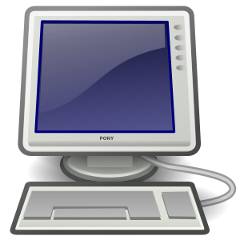

Uploading/Exporting a Project
BTT Writer saves work to your device every 5 min. by default (can change in Settings)
Good idea to create an offline backup in case:
Your files get corrupted
Your device crashes
Enables you to:
Share your work with others
Work on a different device by importing to any device that has BTT Writer installed
BTT Writer provides several ways to back up and/or share your work

Slide 4
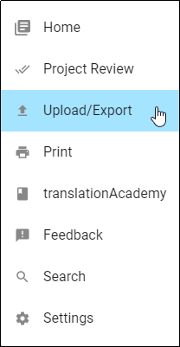
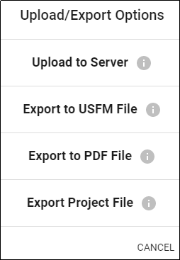
Options for Uploading/Exporting a Project
Options menu (3 dot icon) from Project Screen: Upload/Export
Several options:
Upload to content server (requires internet connection and login to server account)
Save a USFM file on your device
Save a PDF file on your device
Save project on your device with tstudio extension
Notes:
USFM – Unified Standard Format Markers – markup language that is widely used for encoding the digital text of scripture translations.

Slide 5
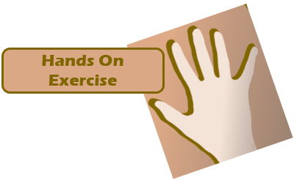
Reviewing/Uploading/Exporting a Project
Check your settings
Log in to the content server (either WACS or DCS, depending on settings – the following examples use WACS).
Review your project and add another contributor.
Export your project to the server.
View the project on the server.

Slide 6
Step 1: Checking Your Settings
Check your settings:
Open the Settings page (3-dot menu → Settings).
Scroll to the Advanced section.
Set Server Suite to the server of your choice (the following examples use WACS).
If you change the setting, you need to close and restart the BTT Writer.

Slide 7

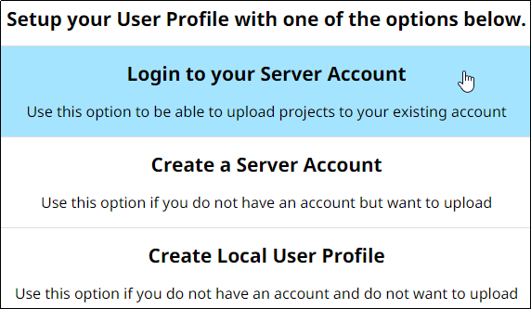
Step 2: Logging in to the Server
Log in to the server:
If you are using an offline account or an account that is not on the server you selected in Step 1:
Log out of BTT Writer.
Log in to your server account, or create an account if you don’t already have one on that server.
OR

Slide 8
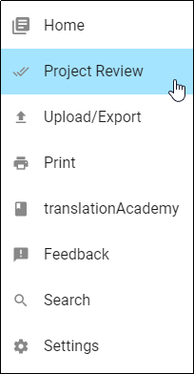
Step 3: Reviewing Your Project
Review your project and add another contributor.
Open your project
Click Project Review on Options menu (good idea to review before sharing or exporting).

Slide 9
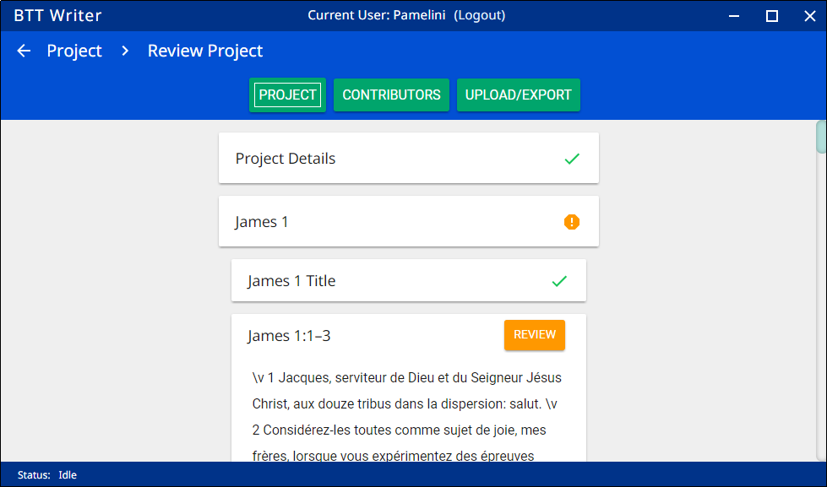
Step 3: Reviewing Your Project
Review your project and add another contributor.
Open your project
Click Project Review on Options menu (good idea to review before sharing or exporting).
Click Project.
Indication that translation of chunk is incomplete

Slide 10

Step 3: Reviewing Your Project
Review your project and add another contributor.
Open your project
Project Review on Options menu (good idea to review before sharing or exporting).
Click Project.
Click Contributors.

Slide 11
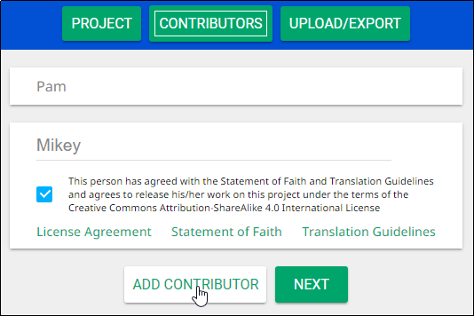
Step 3: Reviewing Your Project
Review your project and add another contributor.
Open your project
Project Review on Options menu (good idea to review before sharing or exporting).
Click Project.
Click Contributors.
Add contributor’s name and check the agreement box, then click Add Contributor.

Slide 12
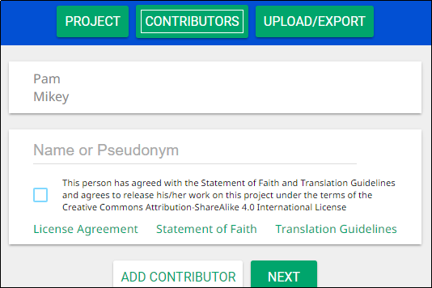
Step 3: Reviewing Your Project
Review your project and add another contributor.
Open your project
Click Project Review on Options menu (good idea to review before sharing or exporting).
Click Project.
Click Contributors.
Add contributor’s name and check the agreement box, then click Add Contributor.
The new contributor has been added.

Slide 13
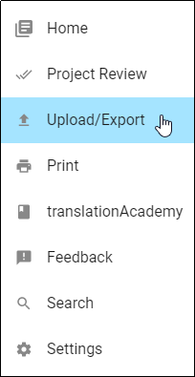

Step 4: Exporting the Project to the Server
Export your project to the server.
Click Upload/Export from either the Project Review screen or from the Options menu.
OR

Slide 14
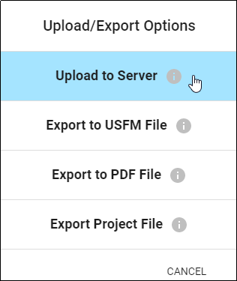
Step 4: Exporting the Project to the Server
Export your project to the server.
Click Upload/Export from either the Project Review screen or from the Options menu.
Click Upload to Server.

Slide 15
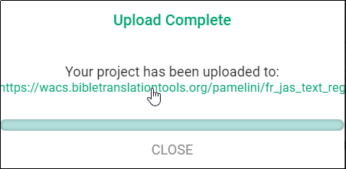
Step 4: Exporting the Project to the Server
Export your project to WACS.
Click Upload/Export from either the Project Review screen or from the Options menu.
Click Upload to the server.
On the Upload Complete message, note the upload location (DON’T CLICK CLOSE YET).
File location
0
File name: LanguageCode_BookCode_FileType_TranslationType

Slide 16
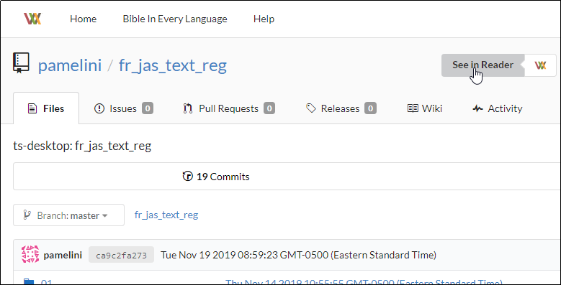
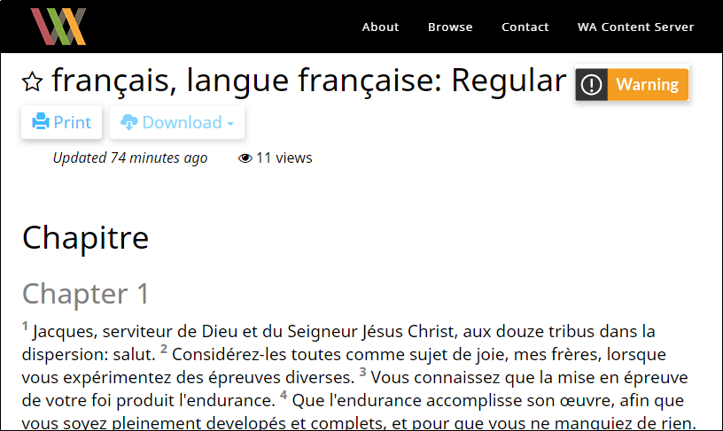
Step 5: Viewing the Project on the Server
Click the location link.
A browser window opens to display your project on the server.
Click See in Reader for a reader-friendly view.

Slide 17
Deleting and Importing a Project
Delete your project from your device (to simulate loss of the file).
Import your project from the server.

Slide 18


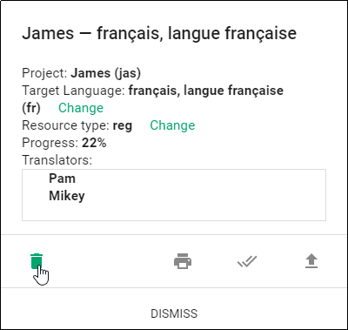
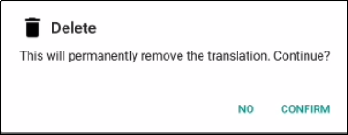
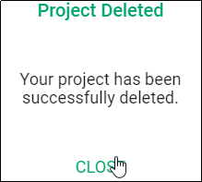
Step 1: Deleting Your Project from Your Device (to simulate loss of the file)
On the Home page, click the “i” icon next to your project.
Click the Delete icon (trash can), and then click Confirm.
Click Close to dismiss the Project Deleted message.
OTHER THINGS YOU CAN DO FROM THIS WINDOW:
Change target language
Print
Project
Project Review
Upload
Export

Slide 19

Step 1: Deleting Your Project from Your Device (to simulate loss of the file)
On the Home page, click the “i” icon next to your project.
Click the Delete icon (trash can), and then click Confirm.
Click Close to dismiss the Project Deleted message.
The project disappears from your home screen – it has been deleted from your device.

Slide 20
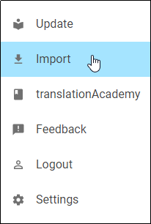
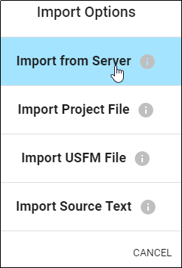
Step 2: Importing Your Project from the Server
On the Options menu, click Import.
Click Import from Server

Slide 21
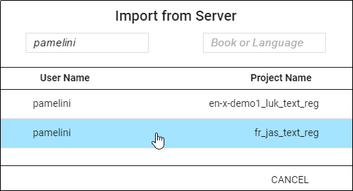
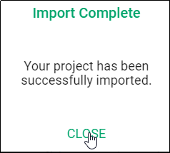
Step 2: Importing Your Project from the Server
On the Options menu, click Import.
Click Import from Server
Select the project to import.
Close the Success message.
The project has been imported to your device.

Slide 22
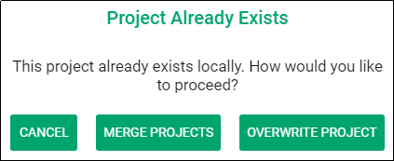
Merging Projects
If you try to import a project that already exists on your device, you have 2 import options:
Overwrite Project:
Removes all information on the computer related to the previous local project and substitutes it with the information from the imported project.
We recommend that you do not choose this option if you have previously uploaded the project to the server.
Problems? Email helpdesk@techadvancement.com or submit a ticket at https://www.techadvancement.com/submit-ticket/
Merge Projects:
The importing process continues.
When the message that the import is complete shows, click Close.
Open the project.
If the imported translation has recent changes, they now show in the text.

Slide 23
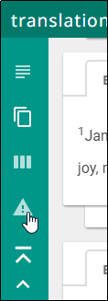
Resolving Merge Conflicts
When merging projects with differences between local and imported projects, BTT Writer tells you how many chunks have conflicts.
Click the triangle “Warning” icon in the left side of the screen to view only the chunks with a conflict.

Slide 24
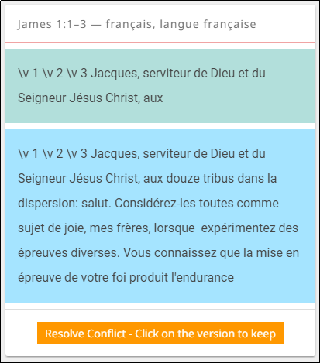
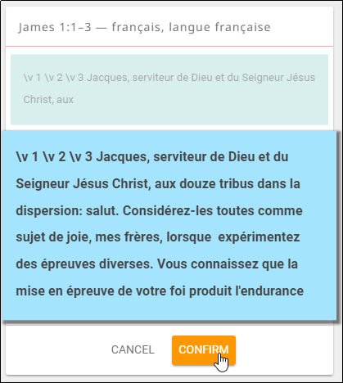
Resolving Merge Conflicts
When merging projects with differences between local and imported projects, BTT Writer tells you how many chunks have conflicts.
Click the triangle “Warning” icon in the left side of the screen to view only the chunks with a conflict.
For each chunk, select either:
The text prior to the import (green box)
OR
The text from the import (blue box)
Click Confirm; the other text disappears.

Slide 25
What Did You Learn?
In this presentation you learned to:
Explain why you should upload a project
Describe the upload options
Review a project
Upload a project to the content server
View a project on the content server
Delete a project from BTT Writer
Import a project from the content server
Resolve merge conflicts

